Slide 1
NFM-3841AO.10 (08/16))
Notes:
Welcome!
I’m glad to be here with you and talk about one of those major life events — retirement.
Retirement can be an exciting time, but also a bit unsettling. I think it’s safe to say that everyone talks about their hopes and dreams for retirement. The question is, are you doing enough now to make those dreams come true? Will your investments be able to support you comfortably in retirement, even though the market can be volatile?
As you know, investing involves risk — including the possible loss of principal. There’s also no guarantee of meeting your investment objectives. However, there are steps you can take to help meet your retirement goals. That’s what we’re going to talk about today.
So, how can this presentation help you? It’s simple: take the information you receive — then take action.

Slide 2
What we’ll cover.
• Not a deposit • Not FDIC or NCUSIF insured • Not guaranteed by the institution • Not insured by any federal government agency • May lose value
Notes:
Let’s take a look at what we’ll cover together.
First, we’ll discuss your retirement journey. Then we’ll talk about different risks that can potentially change the direction of your journey, including the market, income, inflation and longevity. Finally, I’ll summarize the presentation and then offer possible next steps in your journey of planning for and living in retirement.

Slide 3
About this presentation.
This presentation is for educational purposes only and is not intended to be a solicitation or sale of a specific product or service. The presentation is designed to provide accurate, authoritative information in regard to the subject matter covered. The general information in this presentation is not intended to be nor should it be treated as tax, legal, accounting or other professional advice. Additional issues could exist that would affect the tax treatment of a specific transaction. Therefore, taxpayers should seek advice from an independent tax advisor based on their particular circumstances before acting on any information presented. This information is not intended to be, nor can it be, used by any taxpayer for the purpose of avoiding tax penalties.
Notes:
Before we begin, let’s quickly discuss the parameters of this presentation.
[READ SLIDE]

Slide 4
About retirement.
Notes:
Let’s get started. In this section we’ll talk about your retirement journey and how you can prepare to deal with the risks that can derail it.

Slide 5
Where are you on the mountain?
Notes:
To help you better understand how retirement works, I like using an analogy about climbing a mountain.
Sir Edmund Hillary once said that, “There are two aspects to achievement — reaching your goal and getting safely back home again. One is incomplete without the other.” To be successful in mountain climbing, you can’t plan for just half the trip. Reaching the summit — getting to retirement — is only half the goal. Being successful during your return trip — living in retirement — is just as important.
So, where are you on the retirement mountain?

Slide 6
What you can’t control — and what you can.
Notes:
Let’s take this analogy a step further.
In mountain climbing, just like in life, there are things we can control and those we can’t. For example, you can seek guidance ahead of time about how to plan for the climb from someone with knowledge and experience, but you can’t control the weather. Similarly, here’s what you can control when it comes to planning for retirement:
Learning about the risks of retirement
Working with your financial advisor
Maintaining a balanced portfolio
Following your plan
Wherever you are on the mountain, you have to do more than just hope for the best. You have to take action by learning about the risks you may face in retirement. Feeling overwhelmed? Don’t worry. We’re here to help you face those risks and stay focused on achieving your goals — no matter where you are in your journey.

Slide 7
Understanding risks.
Notes:
As you prepare for this journey, you should understand the retirement risks you may face.

Slide 8
Did you know?
¹ 2014 Retirement Confidence Survey, Employee Benefit Research Institute (3/14).
² 2015 IRI Fact Book, Insured Retirement Institute (05/15).
Notes:
Investing involves risk, including the possible loss of the money you’ve invested.
There is no guarantee that you’ll achieve your objectives. Even if you use diversification as part of your overall investment strategy, you’re not assured a profit or guaranteed against loss in a declining market. Part of planning for retirement is finding the right balance between the amount of risk you’re comfortable with, and the amount of risk it will take to potentially keep your money from running out.
That’s where your financial advisor can help. Whether you’re building your retirement investments, using them for income or trying to protect them from loss, your financial advisor can help you find that balance — and reduce the key risks you may face.

Slide 9
The risks.
Notes:
Every journey has risks, but it helps if you have someone who understands them. And there are things you can also do to help offset the four main risks we’ll cover today: market, income, inflation and longevity.

Slide 10
Market risk.
Notes:
In this section we’ll discuss how market risk can affect your retirement plans — and how you can take action.

Slide 11
Did you know?
³ “Bad January a bad omen for stocks in 2016? - On Money", Chicago Tribune, January 2016.
Notes:
You want your money to grow. But you don’t want to risk losing what you already have.
That gets to the heart of market risk — the potential for the value of a portfolio to decrease because of changes in stock prices, interest rates, foreign exchange rates, commodity prices and other factors. Put simply, market risk is the potential for investments to lose value due to market fluctuation. This risk is a constant and can cause problems due to the unpredictable ups and downs of investing.
It’s vital to find the right balance between the amount of risk you’re comfortable with and the amount it takes to potentially keep your money from running out.

Slide 12
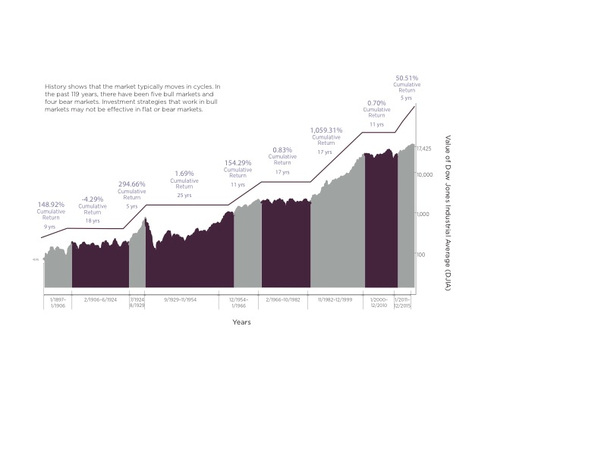
Market performance over 119 years.
Source: Graph created by Guggenheim Investments using data from dowjones.com. Cumulative returns are calculated by Guggenheim Investments. Logarithmic graph of the Dow Jones Industrial Average from 1.1897 through 12.2015.
Performance displayed represents past performance, which is no guarantee of future results. The “Dow Jones Industrial Average” is a product of S&P Dow Jones Indices LLC (“SPDJI”). Standard & Poor’s® and S&P® are registered trademarks of Standard & Poor’s Financial Services LLC (“S&P”); DJIA®, The Dow®, Dow Jones® and Dow Jones Industrial Average are trademarks of Dow Jones Trademark Holdings LLC (“Dow Jones”); and these trademarks have been licensed for use by SPDJI. Guggenheim Investments is not sponsored, endorsed, sold or promoted by SPDJI, Dow Jones, S&P, their respective affiliates do not sponsor, endorse, sell or promote investment products based on the Dow Jones Industrial Average, and none of such parties make any representation regarding the advisability of investing in such products nor do they have any liability for any errors, omissions, or interruptions of the Dow Jones Industrial Average.
Notes:
Where do you think we’re headed?
As you can tell from this chart, the market can be volatile and unpredictable. You can see how many times during the past 117 years the market has been down or flat (bear market) and how many times it has been up (bull market). Again, the use of diversification as part of an overall investment strategy does not assure a profit or guarantee against loss in a declining market.
The question is, will it be up, down or flat when you retire?
Now, you might be thinking:
Will I have enough to retire?
I can’t afford to lose any more money in the market
Don’t just wish. Take action. No one can predict the market. But you may be able to protect your investments and reduce their volatility by diversifying.

Slide 13
Did you know?
⁴ S&P 500 Index Performance, Bloomberg, (01/16).
⁵ Are retirement savings too exposed to market risk? Number 8-16, Center for Retirement Research at Boston College (10/08).
Notes:
It’s not just market conditions that affect your personal rate of return.
When you invest, timing may also have a big impact on your long-term investment results. If you look at the experience of different investors, the paths their investments take vary significantly depending on when they entered the market.

Slide 14
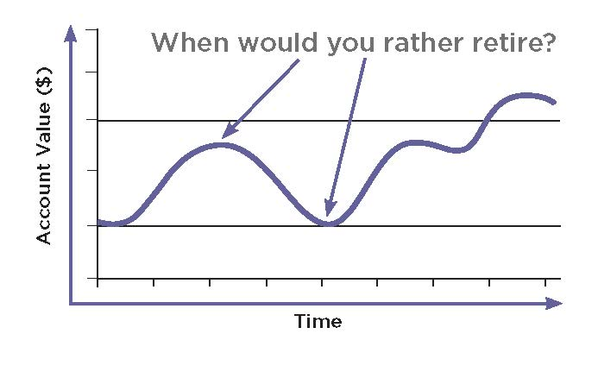
Effect of market fluctuation.
Notes:
Entering the market at different points can produce very different results.
We know that your investment value will rise and fall with the market. And we know you can’t predict or control equity values. So what happens to your money if the market is down when you invest or when you decide to retire? The graph in this slide illustrates how important timing is. The arrow to the right, when the market is up, shows the more appealing option for when you would want to retire.
Now, you might be thinking, “All of my friends invest, but I don’t seem to do as well as they do.”
Work with your financial advisor to create a plan that can help reduce your concerns about trying to time the market.

Slide 15
Income risk.
Notes:
In this section we’ll discuss how you can take action against income risk.

Slide 16
Did you know?
⁶ 2015 Retirement Confidence Survey, Employee Benefit Research Institute (4/15).
⁷ 2013/2014 Towers Watson Global Benefit Attitudes Survey, Towers Watson (03/14).
Notes:
Let’s shift our attention now to income risk.
Because the market fluctuates over time, so will the value of your investment portfolio. That means you also need to think about income risk — the times when your investment income will decrease from year to year after you retire and start taking withdrawals. Why is this a problem? If you don’t know what your income will be in a particular year, it’s hard to budget for your expenses. And if your income takes a hit, you may not be able to handle the rising cost of basic necessities.
Income risk is most obvious during years when your investments have a negative rate of return. But your income can decrease even during years with positive returns when they are lower than your withdrawal rate.

Slide 17
Let’s look at an example.
Notes:
Let’s look at a scenario where this could happen.
What if someone’s yearly income shrinks because the investment value drops? Let’s say that person retires and withdraws 4% of his or her investment every year. Would that investor rather take 4% of $75,000 — or $100,000?
Now, you might be thinking:
Can I afford to take a cut in my retirement income?
What would I have to do to make ends meet if I experienced a shortfall?
Don’t just wish. Take action. Work with your financial advisor to identify your retirement income needs and decide how best to meet them.

Slide 18
Inflation risk.
Notes:
In this section we’ll discuss how you can take action against inflation risk.

Slide 19
Did you know?
⁸ Society of Actuaries’ Risk Report Highlights Impact of Inflation on Retirement Planning, soa.org (2/11).
⁹ Trends in employment-based health insurance coverage: evidence from the National Compensation Survey, Bureau of Labor Statistics Monthly Labor Review (10/14).
¹⁰Retirement Health Care Costs and Income Replacement Ratios, HealthView Insights, (12/15).
Notes:
Inflation is the ever-increasing cost of goods and services.
It can impact your retirement significantly over the long term. If your investments aren’t beating the inflation rate, you’re actually losing buying power, and your retirement savings can fall behind.

Slide 20
Price increases from 1986 to 2015¹¹
¹¹ Bureau of Labor Statistics, Consumer Price Index (www.bls.gov) (12/15).
Notes:
Conventional wisdom says you should be more conservative with your money as you get older.
But if you want to stay ahead of inflation, finding the right balance between risk and return may be a better plan. What does $20 buy today, and what will it buy 30 years from now? Did your last car cost more than your first house? How much will it cost to see a doctor or get medicine?
Now, you might be thinking:
How will I afford the things I need?
What kinds of investments can help me stay ahead of inflation?
Don’t just wish. Take action. Work with your financial advisor to learn how you may be able to outpace inflation by staying invested.

Slide 21
Longevity risk.
Notes:
The final risk you may face is longevity. Let’s talk about how you can take action here.

Slide 22
Did you know?
¹¹ Older Americans 2012: Key Indicators of Well- Being, Federal Interagency Forum on Aging-Related Statistics, (6/12).
¹² Who Needs Care?, http://longtermcare.gov/the-basics/who-needs-care/ (10/14).
¹³ Genworth 2015 Cost of Care Survey, April 1, 2015. Costs vary by region and provider used for care.
Notes:
Longevity risk is the chance of running out of money before retirement is over.
You’ve heard that age is just a number. But with people living longer and retiring earlier, facing longevity risk means planning for lifetime income. How long is a lifetime? Based on the increased selection of birthday cards for 100-year-olds, the greeting card companies think you’re going to live a lot longer than previous generations. People retiring at 65 may have to fund 20 plus years of retirement with their savings.
For most people, this means staying somewhat aggressive right up to and into retirement with at least a portion of their portfolio if they hope to sustain a lengthy retirement.
Are you prepared?

Slide 23
Let’s look at the facts.
Calculations based on Society of Actuaries, 2012 Individual Annuity Mortality Tables, Basic.
Notes:
Now, let’s take a look at the facts on this slide:
For a 65-year-old couple, there is a 1-in-4 chance of at least one spouse living past 97 and a 1-in-10 chance of at least one spouse living to 100.
With people living longer and retiring early, the need for secure lifetime income is increasing. Preparing to make your income last to a specific age is risky because planning for life expectancy won’t be enough for at least some retirees. Which would you rather be? Prepared for the average with the risk of outliving your assets? Or prepared to live longer than average?
Now, you might be thinking:
I don’t want to be a burden to my kids
What will happen if we run out of money? Or I live longer than my spouse?
Don’t just wish. Take action. Work with your financial advisor to ensure you’re protected against the chance of outliving your assets or taking excess withdrawals.

Slide 24
Why Nationwide®?
Notes:
Now that we’ve talked about the risks of retirement, let’s discuss how Nationwide can help.

Slide 25
¹⁴ North American And Bermudian Insurers ERM Scores Are On A Stable Footing, RatingsDirect Report, Standard &
Poor’s (6/8/15).
Notes:
Nationwide was founded by a group of forward thinkers who joined forces to protect what matters most. That sense of working together for the common good has never left us.
Today we’re a Fortune 100 company, with a diversified corporate portfolio that allows us to navigate all manner of economic ups and downs. In fact, our prudent investment approach and long-term business vision earn us financial ratings that place us in the top 32% of insurance-based financial services companies for our risk management capabilities.
¹⁴ North American And Bermudian Insurers ERM Scores Are On A Stable Footing, RatingsDirect Report, Standard & Poor’s (6/8/15).

Slide 26
Why Nationwide?
These ratings and rankings reflect rating agency assessment of the financial strength and claims-paying ability of Nationwide Life Insurance Company and Nationwide Life and Annuity Insurance Company. They are not intended to reflect the investment experience or financial strength of any variable account, which is subject to market risk. Because the dates are only updated when there’s a change in the rating, the dates above reflect the most recent ratings we have received. They are subject to change at any time.
Notes:
At first glance, we probably look like every big company out there.
True, we’re a Fortune 100¹⁵ company with more than 30,000 associates. But spend some time with us and you’ll quickly see a difference. We pair a focus on financial strength with a commitment to protecting what’s most important to people. As a mutually-owned company, we exist to serve our customers, not shareholders, and we cultivate long-term capital strength so we can continue to honor every promise we make.
¹⁵ Based on revenue, Fortune magazine (6/16).

Slide 27
Next steps.
Notes:
Finally, let’s discuss the next steps you can make to take action.

Slide 28
Work with your financial advisor to learn how Nationwide can help you reduce the impact of these common retirement risks.
Don’t just wish. Take action.
Notes:
As I mentioned at the beginning, here’s what you can control when preparing for retirement:
Learning about the risks of retirement
Working with your financial advisor
Maintaining a balanced portfolio
Following your plan
Now that you have a better understanding of the risks, work with your financial advisor to learn how Nationwide can help you reduce the impact of these common retirement risks.

Slide 29
Nationwide Investment Services Corporation, member FINRA.
Nationwide, Nationwide is on your side and the Nationwide N and Eagle are service marks of Nationwide Mutual Insurance Company. © 2016 Nationwide
Notes:
Thank you for attending this presentation. What questions do you have?

