Slide 1
MAKING THE MOST
OF YOUR IRA
Navigating Common and Costly IRA Mistakes
[Presenter Name], [Presenter Title]
[When presenting in AR, CA, OK, TX or IL, use the phrase “Insurance Sales Presentation.” In CA and AR, add License Number]
Issued by The Prudential Insurance Company of America, Newark, NJ, and its affiliates.
Prudential Annuities is providing this workshop for informational or educational purposes only and does not provide investment advice or recommendations about managing or investing your retirement savings.
[Firm Logo(s)]
Notes:
Welcome. My name is _______________. Today we are going to discuss the “Making the Most of Your IRA” and some of the common and costly IRA mistakes.

Slide 2
Prudential Annuities®
Making the Most of Your IRA
[When presenting in AR, CA, OK, TX or IL, use the phrase “Insurance Sales Presentation.” In CA and AR, add License Number.]
[Presenter Name], [Presenter Title]
INVESTMENT AND INSURANCE PRODUCTS ARE:
NOT FDIC INSURED NOT INSURED BY ANY FEDERAL GOVERNMENT AGENCY NOT A DEPOSIT OR OTHER OBLIGATION OF, OR GUARANTEED BY, THE BANK OR ANY OF ITS AFFILIATES SUBJECT TO INVESTMENT RISKS INCLUDING POSSIBLE LOSS OF THE PRINCIPAL AMOUNT INVESTMENT
Issued by The Prudential Insurance Company of America, Newark, NJ, and its affiliates.
Prudential Annuities is providing this workshop for informational or educational purposes only and does not provide investment advice or recommendations about managing or investing your retirement savings.
1025337-00003-00 Ed. 01/2020
Notes:
[REQUIRED SLIDE FOR JP MORGAN CHASE ONLY. REMOVE WHEN USING FOR ALL OTHER FIRMS]
Welcome. My name is _______________. Today we are going to look at some strategies to help you make the most from your IRA.

Slide 3
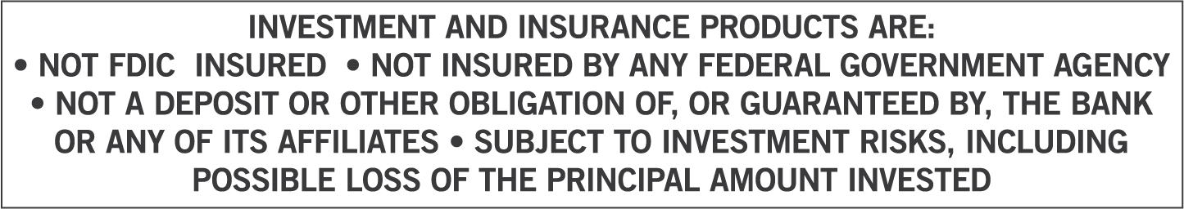
MAKING THE MOST
OF YOUR IRA
Navigating Common and Costly IRA Mistakes
[Presenter Name], [Presenter Title], [Designations]
[When presenting in AR, CA, OK, TX or IL, use the phrase “Insurance Sales Presentation.” In CA and AR, add License Number]
Issued by The Prudential Insurance Company of America, Newark, NJ, and its affiliates.
Prudential Annuities is providing this workshop for informational or educational purposes only and does not provide investment advice or recommendations about managing or investing your retirement savings.
[Firm Logo(s)]
Notes:
[REQUIRED SLIDE FOR BANK FIRMS ONLY. REMOVE WHEN USING FOR ALL OTHER FIRMS].
Welcome. My name is _______________. Today we are going to discuss the “Making the Most of Your IRA," and some of the common and costly IRA mistakes.

Slide 4
[Optional Disclosure Slide]
Investments are offered through [BROKER DEALER NAME], a registered broker dealer. [Insurance is offered through [AGENCY NAME- if applicable.]]
BROKER DEALER and AGENCY- if applicable], located at [ADDRESS], [is/are] not affiliated with Prudential Financial.
Notes:
[Optional Slide]

Slide 5
[For Allstate Financial Services only: This slide must be shown prior to the beginning of the customer presentation]
[Hosted/Presented by:]
[PFR Name]
Personal Financial Representative
[Allstate Financial Services, LLC or LSA Securities (in LA & PA)]
Securities offered by Personal Financial Representatives through Allstate Financial Services, LLC (LSA Securities in LA and PA). Registered Broker-Dealer. Member FINRA, SIPC. Main Office: 2920 South 84th Street, Lincoln, NE 68506. (877) 525-5727. Check the background of this firm on FINRA’s BrokerCheck website http://brokercheck.finra.org.
Notes:
[Optional Slide]

Slide 6
[Required For Merrill Lynch Events Only]
Bank of America Corporation (“Bank of America”) is a financial holding company that, through its subsidiaries and affiliated companies, provides banking and investment products and other financial services.
Merrill Lynch makes available products and services offered by Merrill Lynch, Pierce, Fenner & Smith Incorporated (“MLPF&S”), a registered broker-dealer and member SIPC, and other subsidiaries of Bank of America Corporation (BofA Corp). Merrill Lynch Life Agency is a licensed insurance agency and a wholly owned subsidiary of BofA Corp.
Investment products offered through MLPF&S and insurance and annuity products offered through Merrill Lynch Life Agency Inc.:
The views and opinions expressed in this presentation are not necessarily those of Bank of America Corporation; Merrill Lynch, Pierce, Fenner & Smith Incorporated; or any affiliates.
Nothing discussed or suggested in these materials should be construed as permission to supersede or circumvent any Bank of America, Merrill Lynch, Pierce, Fenner & Smith Incorporated policies, procedures, rules, and guidelines.
[This material should be regarded as educational information on health care and Social Security and is not intended to provide specific advice. If you have questions regarding your particular situation, you should contact your legal or tax advisors.]
[INCLUDE THE FOLLOWING DISCLOSURE AND READ ALOUD IF HEAVY TAX DISCUSSION OR ADDRESSING NEW TAX LAWS] [Merrill Lynch does not provide legal or tax advice. We recommend that you consult with your lawyer, accountant or other advisor about questions affecting your individual circumstances. The content was provided by a third party not affiliated with Merrill Lynch or any of its affiliates and is for information and educational purposes only. The opinions and views expressed do not necessarily reflect the opinions and views of Merrill Lynch or any of its affiliates. Any assumptions, opinions and estimates are as of the date of this material and are subject to change without notice. The information contained in this material does not constitute advice on the tax consequences of making any particular investment decision. This material does not take into account your particular investment objectives, financial situations or needs and is not intended as a recommendation, offer or solicitation for the purchase or sale of any security, financial instrument, or strategy. Before acting on any recommendation in this material, you should consider whether it is suitable for your particular circumstances and, if necessary, seek professional advice.]
Are Not FDIC Insured | May Lose Value | Are Not Bank Guaranteed
Are Not Insured by Any Federal Government Agency | Are Not Deposits | Are Not a Condition to Any Banking Service or Activity
Notes:
[For any presentations heavily discussing taxes or the new tax laws, the speaker must read aloud the paragraph in BOLD.]

Slide 7
[Required For Morgan Stanley Smith Barney Events Only]
Morgan Stanley Smith Barney is not affiliated with Prudential Annuities.
The views and opinions expressed in this presentation are not necessarily those of Prudential Annuities; or any affiliates. Nothing discussed or suggested in these materials should be construed as permission to supersede or circumvent any Morgan Stanley Smith Barney incorporated policies, procedures, rules, and guidelines. This material should be regarded as educational information on Health Care, Social Security, Taxes and is not intended to provide specific advice. If you have questions regarding your particular situation, you should contact your legal or tax advisors.
Notes:
By nature, humans are driven by self-interest, with the ultimate goal of self-preservation. Our survival instincts pre-date ethical standards, so there formed a need for unwritten “rules” so that all group members could coexist and benefit from each other. These rules established how everyone should treat each other within the group.
Thus, the primary purpose of ethical rules is to help society function smoothly. Society is a web of relationships, and a well-functioning society is based on healthy relationships. Hence, the purpose of morality and ethics is to help relationships that are healthy not only to survive, but also to flourish.
We talk about and attempt to reach agreement about what’s just or fair. Those agreed-upon beliefs comprise ethics or morality, which are the means for resolving disputes. If we never had disputes, we would not need ethics because we could all just do what we want.
Ethical rules are in place to enforce an agreed upon set of standards about practices, defining right or wrong, and allow for working relationships between group members.

Slide 8
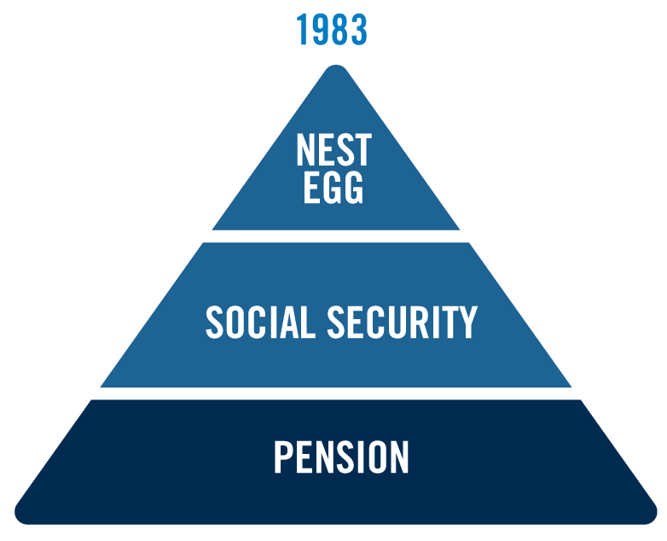
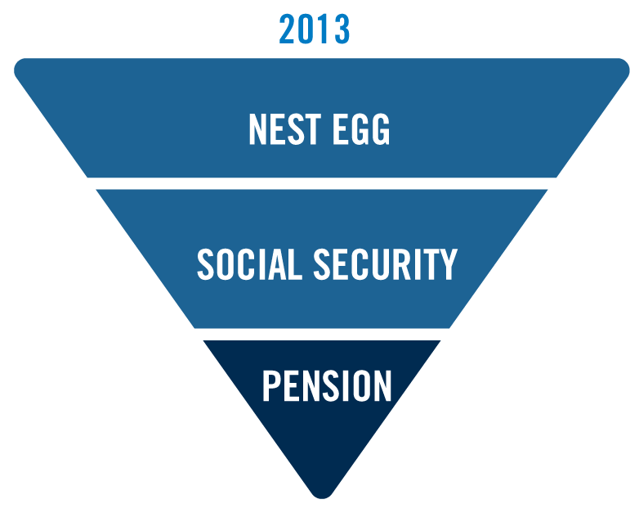
Retirement Income – Then and Now
Then
Now
Notes:
Retirement Income then and now- read slide

Slide 9
Common and Costly IRA Mistakes
  Contributions
  Rollovers
  Withdrawals/Distributions
  RMDs (Required Minimum Distributions)
  Naming Beneficiaries
  Roth IRAs
Notes:
Read slide- Here are the mistakes we will be covering.

Slide 10
Contribution Mistake – Not Contributing Enough
Failing to make Catch Up Contributions if age 50 or above
Failing to make Non-Deductible Contributions if income exceeds limit to contribute to a Deductible or Roth IRA
Failing to Contribute after age 70 ½- under the Secure Act, taxpayers with earned income can make contributions at any age, even after 70 ½
Failing to contribute to a Spousal IRA
  Up to $6,000 ($7,000 if age 50 or above)
  Married couple must:
      File joint tax return
      At least one spouse earns as much as the amount contributed to all IRAs
      Catch up contribution can only apply to spouse’s age 50 or above
Notes:
One mistake when it comes to making contributions to an IRA, is not contributing enough.
A catch-up contribution is a type of retirement savings contribution that allows people aged 50 or older to make additional contributions to their 401(k) accounts and/or individual retirement accounts (IRAs). Catch-up contributions will be larger than the standard contribution limit.
The amount you can contribute to your 401(k) or similar workplace retirement plan goes up from $18,500 in 2018 to $19,500 in 2020. Catch-up contribution limits if you're 50 or older in 2020 are $6,500 for workplace plans and $1,000 for IRAs.
Income limits-
Married filing jointly and you're covered by retirement plan at work $104,000 or less
Married filing jointly and your spouse is covered by a retirement plan at work $196,000 or less
Single or head of household and you are covered by a retirement plan at work $65,000 or less
Married filing separately and you or your spouse is covered by a retirement plan at work Not available

Slide 11
Contribution Mistake – Making Excess Contributions
2020 IRA Contribution Limits
How Excess Contributions Happen
$6,000
$1,000 Catch-Up for 50 and older Deadline: Tax filing date, excluding extensions
Exceeds annual limit More than earned income Ineligible rollover (RMD, SEPP, Annuitized Income) Roth IRA contribution made when MAGI (modified adjusted gross income) exceeds income limits
6% penalty for each year excess amount remains in the IRA
Notes:
Another potential pitfall is making excess contributions:
Ineligible rollover: RMD, Substantially Equal Periodic Payment (SEPP), Annuitized Income
Roth IRA contribution made when Modified Adjusted Gross Income (MAGI) exceeds income limits
A rollover occurs when you withdraw cash or other assets from one eligible retirement plan and contribute all or part of it, within 60 days, to another eligible retirement plan. This rollover transaction isn't taxable, unless the rollover is to a Roth IRA, but it is reportable on your federal tax return. You must include the taxable amount of a distribution that you don't roll over in income in the year of the distribution.
Ineligible Distributions
Certain distributions from an eligible retirement plan can't be rolled over, including:
Generally, the nontaxable part of a distribution, such as your after-tax contributions to a retirement plan, A distribution that's one of a series of payments made for your life (or life expectancy), or the joint lives (or joint life expectancies) of you and your beneficiary, or made for a specified period of 10 years or more, A required minimum distribution,
A hardship distribution, Dividends paid on employer securities, or The cost of life insurance coverage.
Roth IRA income limits for max contribution- Married filing jointly or qualifying widow(er)Less than $193,000, Single, head of household or married filling separately (if you did not live with spouse during year) Less than $122,000, Married filing separately (if you lived with spouse at any time during year) Less than $10,000

Slide 12
Rollover Mistakes
Failing to complete rollover in 60 days
Ineligible rollover (RMDs, SEPP, Annuitized Income)
Incorrect transfers of inherited IRA
More than one rollover within 365 days
Rolling over after-tax Contributions to a traditional IRA
  Indirect Rollover Rules
20% mandatory tax withholding on eligible rollover distributions
Within 60 days
Only one IRA-to-IRA rollover allowed in 365 days
Reported on Forms 1099-R & 5498
  Direct Transfer Rules
Institution to institution
No withholding
No 60 day requirement
Not limited to once per 365 days
Not reportable
Notes:
In some situations, making ethical or unethical decisions is crystal clear. In other situations, the water is muddy. Every day, otherwise ethical financial professionals make unethical decisions with the best intentions, and can jeopardize success, relationships and their employment. Why does this occur?
There are many reasons why this occurs. Let’s take a look at a few:
Pressure - Many people make succumb to pressure from colleagues, bosses, families even their own clients, to make unethical decisions and behave how they normally would not. Pressure from a client can be especially tricky, as one wants to do right by their client and maintain the relationship
(Speaker) Have you ever been pressured by a client to make an ethical decision?
Misunderstanding ethical guidelines- The phrase “ignorance is bliss” is not always true, especially where business ethics is involved. It may be possible that you are unaware of company guidelines on a particular topic, and would have made a different decision had you known.
(Speaker) Can you give me an example of someone you know who made an unethical decision because they were not aware of guidelines?
Short-term gratification – As a nation, Americans have become focused on immediate gratification. This can lend to a culture in which we take a short-term view on many things, largely because of the immediacy technology has brought to us. In addition, technology makes it possible to instantly make decisions, and leaves a permanent record of it, adding an additional layer of complexity when making decisions.
New situations - We also see otherwise ethical people makes unethical decisions when they are in unfamiliar territory. A good example of this is the use of technology. It is easier than ever to communicate with clients, advertise yourself, conduct business with other companies. With that ease comes new rules of conduct, and an improper understanding of those rules can lead to unethical behavior.
(Speaker) Are there any aspects of your business that are unfamiliar and make you question if you are doing the right thing?

Slide 13
Reasons to Roll to an IRA
  No plan-imposed restrictions
  Estate planning flexibility
  No mandatory 20% withholding on withdrawals
  Control and greater investment selection
  Access to products providing guaranteed retirement income
All guarantees, including optional benefits, are backed by the claims-paying ability of the issuing company.
Notes:
Why would you roll over retirement assets to an IRA? Read slide

Slide 14
Reasons to NOT Roll to an IRA
  Early access to retirement assets
  Retired at or after age 55
  Delayed distributions
  Working beyond normal beginning date*
  Net Unrealized Appreciation (NUA) tax treatment
  ERISA credit protection
* Under the SECURE Act, taxpayers who attain age 70½ on or before 12-31-2019 have a beginning date based on age 70½.
Taxpayers who attain age 70½ after 12-31-2019 have a beginning date based on age 72.
Notes:
What are some reasons why rolling over assets to an IRA might not be a good idea?
If you need to access your retirement assets prior to age 59 ½
If you plan working past age 70 ½
You could lose beneficial tax treatment on net unrealized appreciation on any company stock
Rolling to an IRA means you will lose your protection under the ERISA ( Employee Retirement Income Security Act) 1974.

Slide 15
Distribution Mistake – Taking an Early Distribution
10% penalty with these exceptions
  Age 59½
  Death or disability
  First-time home buyer (up to $10,000)
  Deductible medical expenses (in excess of 10% of AGI)
  Education expenses for investor’s family
  Health insurance premiums for the unemployed
  Substantially Equal Periodic Payments (SEPP)
Note: Early distribution after divorce is not an exception
Not all exceptions are listed
Not all of these exceptions apply to employer-sponsored qualified plans
Notes:
What are the consequences if you withdrawal money from your IRA too early? Are there any exceptions? Read slide.

Slide 16
Taking Distributions in a Down Market
What is a bear market?
– 20% loss from the most recent market peak*
– 10 bear markets since 1945*
1
What is the average bear market loss since 1945?
– 35%**
2
How many bear markets will a retiree face on average?
– 4 bear markets**
3
How long does the average bear market last?
– 17 months*
4
* JP Morgan “Guide to the Markets®, 1Q 2020; based on market activity post-WWII
** Assumes retiree age 65 with anticipated death at age 90, and an average 6.8 years between market peaks in the post-WWII era.
SL 00130d 02/2019
Notes:
What do I need to be aware of when withdrawing from my account when it is experiencing poor performance? Read slide.

Slide 17
Distribution Danger – Market Risk
Mathematics of loss in distribution
Long term investing success lies in avoiding large losses during the inevitable declines that all markets experience
169%
133%
150%
% of Gain Required
over 3 years
100%
63%
74%
42%
51%
43%
11%
26%
33%
25%
Withdrawal rate
0%
4%
6%
0%
4%
6%
0%
4%
6%
0%
4%
6%
% of Loss
10%
20%
30%
50%
Notes:
What does it take to recover? Explain that withdrawals coupled with a loss in the portfolio means you will need a greater return to get back to even. So for example if we look at the middle of the chart and if you experience a 20% loss in the value of your portfolio while at the same time you are withdrawing 4% every year, what return would you need over the next 3 years to recover? The answer is 42%! Now the next question is – How likely is that?

Slide 18
Distribution Mistake – Withdrawing Too Much
What is a Safe and Sustainable Withdrawal Rate?
The rate one can safely withdraw from their retirement portfolio without prematurely depleting the account
  Opinions on Safe Withdrawal Rates have varied over time
Bengen (1994)¹: | 4%
Guyton (2004)²: | 3.6% - 5.8%
Milevsky & Huang (2010)³: | 3%
Pfau (2020)⁴: | 2.1%
¹ “Determining Withdrawal Rates Using Historical Data”, William Bengen, Journal of Financial Planning, October 1994
² “Decision Rules and Portfolio Management for Retirees: Is the ‘Safe’ Initial Withdrawal Rate Too Safe?”, Jonathan Guyton; FPA Journal; October 2004
³ “Spending Retirement on Planet Vulcan: The Impact of Longevity Risk Aversion on Optimal Withdrawal Rates”; M.A. Milevsky & H. Huang; Retirement Income Journal, March 2010
4. “Retirement Income Dashboard For a Benchmark Couple Both Turning 65 in January 2020”; Conservative portfolio (25% stock allocation) with 2% spending COLA; Wade Pfau at https://retirementresearcher.com/dashboard/
Notes:
(Remove slide if presenting to Allstate financial) What is a safe withdrawal rate? Read slide.

Slide 19
RMDs and Sustainable Withdrawals
RMDs Increase Each Year*
Age
70½†
3.6%
72†
3.9%
75
4.4%
80
5.4%
85
6.8%
90
8.8%
*If the spouse is the sole beneficiary and is more than 10 years younger, the RMD distribution rate is lower.at each age
† IRA owners who attained age 70½ prior to 1/1/2020 have a Required Beginning Date of age 70½. IRA owners who attained age 70½ after 12/31/2019 have a Required Beginning Date of age 72
SL 00006 01/2020
Notes:
According to the IRS tables, at age 70 ½ clients with IRAs and 401(k)s will need to withdraw, at a minimum, 3.6% of the value of the IRA. As you can see, the withdrawal quickly increases. This could challenge the sustainable withdrawal rates for your clients.
*RMDs must begin by April 1 of the year after the person attains his or her required age and must continue annually thereafter. Individuals who attain age 70½ prior to 1/1/2020 have a required age of 70½; individuals attaining 70½ after 2/31/2019 have a required age of 72.

Slide 20
Required Minimum Distribution Mistakes
RMD =
Fair Market Value
Life Expectancy Factor
Fair Market Value aka Entire Interest =
Annuity cash value plus Actuarial Present Value of contract benefits
Required Beginning Date:
  For those attaining age 70 ½ after Jan 1, 2020- April 1 of the year following the year the individual attains age 72
  If deferred until the following April, two RMDs will have to be taken that year.
  For those who attained 70 ½ before Jan 1, 2020- April 1 of the year following the year the individual attains age 70½
    If deferred until the following April, two RMDs will have to be taken that year.
Penalty for missing RMD:
  50% of the required withdrawal amount
  Correctable with IRS Form 5329
Notes:
What are some of the common mistakes when it comes to taking RMDs? Read slide
Fair Market Value aka Entire Interest =
Annuity cash value plus Actuarial Present Value of contract benefits
The term “life expectancy factor” refers to the number of years a person can expect to live. By definition, life expectancy is based on an estimate of the average age that members of a particular population group will be when they die.

Slide 21
Beneficiary Mistake – Failure to Conduct Reviews
  Retirement assets account for 41% of the wealth for Americans with a net worth of $100,000 or more*
  Wills cover only probate assets
  Life-altering events may change circumstances
  Naming trusts as beneficiary of retirement accounts is dangerous
*United States Census Bureau, Net Worth and Asset Ownership of Households 2015; Rev. 6-10-2019
Weighted average households with net worth over $100,000; includes home equity; 73% when excluding home equity
Notes:
Are you reviewing your named beneficiaries? Read slide

Slide 22
Roth IRA Mistakes
Roth Contribution Rules
Roth Conversion Rules
  Must have enough earned income
  Must be under the MAGI limits*
  Joint: ($196K to $206K)
  Single: ($124K to $139K)
  Recharacterization allowed
Distributions will be tax-free if taken later than age 59 ½ and 5 years after first contribution
  Tax recognized in the year of conversion
  Aggregation Required
  Partial Conversions Permitted
  Recharacterization not allowed
Distributions of conversion amounts will be penalty-free if taken more than 5 years after conversion or if after age 59½†
Please note, $6,000/$7,000 contribution limit is a combined limit to contribute to a Traditional IRA and Roth IRA.
* AGI limits for 2020
† Other exceptions may apply
Notes:
Here are some common pitfalls when it comes to Roth IRAs. Now this gets technical- but don’t worry about remembering all the terms and rules. This is where your advisor can help you.
A Roth conversion is the moving of assets from a tax-deductible traditional individual retirement account, or IRA, to a non-deductible Roth IRA. Participants in Roth IRAs don't pay income tax when they withdraw those funds in retirement because money deposited into a Roth is from after-tax income.
The IRA aggregation rule was created to limit the ability of taxpayers to take advantage of 'abusive' IRA tax strategies, by requiring that all IRAs are aggregated together to determine the tax consequences of a distribution from any of them.
A recharacterization occurs when an investor changes how a certain contribution or investment is treated. This typically refers to how taxes apply to the investment. Most often, recharacterizations happen when you change your contribution type from a Traditional IRA to a Roth—or a Roth back to a Traditional.

Slide 23
Roth IRA Mistake – Conversions
Benefits
Increase Tax-free Savings Hedge Against Rising Taxes Estate Planning Benefits Tax Diversification No RMDs
Considerations
Time Horizon Current Tax Bracket Tax Rates when Retired Paying the Conversion Tax Liability
Conversions to a Roth IRA are generally fully taxable. Before you convert to a Roth IRA, consider how your tax bracket will affect the overall benefit of the rollover. Conversion income may push you into a higher tax bracket. It is, however, possible to convert only part of your traditional IRA. This could enable you to remain in the same tax bracket you would be in without the conversion.
It is generally advisable to pay the taxes on the conversion with funds other than those in your traditional IRA. If you are under age 59½ when you do a conversion, any funds not deposited in the Roth IRA will be subject to the 10% federal income tax penalty (unless an exception applies).
Notes:
Read slide.
Benefits:
Tax free savings Converting to a Roth IRA can help you increase the amount you have in tax-free savings
Hedge against higher taxes- Tax free income from a Roth can help hedge against the possibility of higher income taxes in the future.
Estate planning benefits- A Roth IRA, at the owner's death, is subject only to estate tax. The income tax paid on the conversion would reduce one's taxable estate.
Tax diversification- A Roth IRA can help you diversify how your assets and income are taxed in retirement
No RMDs- There are no RMDs required with a Roth IRA
Considerations:
Time horizon- Generally, the younger a person is, the longer he or she has to take advantage of the potential to benefit from tax-free growth. Also, younger people typically have less money in their IRAs, so taxes due upon a conversion could be less.
Current tax bracket- If your current tax bracket is higher than what you anticipate it will be in the future, then you may want to consider if converting to a Roth makes sense.
Paying the tax liability- If you owe taxes when you make the conversion, after determining the amount of the tax, you should consider where the money will come from to make that payment. It is generally better not to pay those taxes with funds withdrawn from the IRA or other retirement accounts since doing so could generate yet more tax liability and reduce the additional advantage of potential tax-free growth on the full amount of the conversion.

Slide 24
Conclusion
  Contributions
  Rollovers
  Withdrawals/Distributions
  RMDs
  (Required Minimum Distributions)
  Naming Beneficiaries
  Roth IRAs
Work with Your Advisor to Navigate These Common IRA Mistakes, and Make the Most of Your Retirement.
Notes:
Let’s expand upon that last point of unfamiliar territory. Technology has changed almost every aspect of your business. It has changed how you communicate with your clients, how you conduct business, the products and investments available in the marketplace, how you interact with your colleagues. No matter how long you have been in the business, it is essential to understand ethical behavior in the ever-changing world, and applying your personal and professional code of ethics to situations with which you are familiar, and situations that are brand new to you.
Social media - A good place to start is understanding your company’s policy on social media. Many financial professionals make unethical business decisions on social media, simply because they do not understand the proper rules of engagement and standard operating procedures.
Email policies – Becoming familiar with your company’s email policies is vital as well. Knowing what to put in an email, what information is sensitive, and what business can be conducted via email can help you make a good decision.
Texting – As with email, knowing how to conduct business via text is incredibly important. Check to see if your company has guidelines on texting and business, to help avoid a potentially unethical decision.

Slide 25
​In-service withdrawals can be appropriate for many individuals. There are, however, some factors to consider:
Exceptions to the 10% federal income tax penalty - The penalty exceptions for employer plan and IRA distributions are not identical. Two exceptions apply to an employer plan, but do not apply to an IRA: separation from service at or after age 55, and Qualified Domestic Relations Orders. On the other hand, IRAs provide penalty exceptions for first-time home purchase and higher education, but employer plans do not.
Net Unrealized Appreciation (NUA) tax treatment - Favorable NUA tax treatment is not available to IRAs. Therefore, if you have highly appreciated company stock in your employer-sponsored plan, rolling that stock to an IRA eliminates the ability to take advantage of NUA tax treatment.
Creditor protection - While IRAs now have federal bankruptcy protection, they are not protected from other judgments the way that federal law (specifically ERISA) protects qualified plans.
New contributions to the employer plan - Taking an in-service distribution may affect your ability to make future contributions to the employer plan.
Loans - In the event that a 401(k) is terminated, the loan may be subject to income taxes and a federal income tax penalty.
Availability and Fees - It is important to check with your employer to see if they offer in-service withdrawals. Sources of information include your Plan Administrator, Summary Plan Description, or Participant Statement. Please consult these sources for any possible restrictions, fees and expenses.
Required Minimum Distributions (RMDs) - RMDs are required to begin from IRAs when an individual reaches age 70½. The first distribution can be deferred to April 1 of the year following the year the individual reaches age 70½. For subsequent years, distributions must be taken by December 31st. If you defer the first payment to the year following the year you reach age 70½, you will be required to take two distributions within the same year. For a participant in an employer plan, other than a 5% or greater owner, RMDs must begin at the later of age 70½ or when you retire from that employer.
Because qualified retirement plans, IRAs and variable annuities offer a tax-deferral feature, you should carefully consider the other features, benefits, risks, and costs associated with a variable annuity before purchasing one in either a qualified plan or an IRA. Before purchasing a variable annuity, you should take full advantage of your 401(k) and other qualified plans
Notes:
Read slide.

Slide 26
This material is being provided for informational or educational purposes only and does not take into account the investment objectives or financial situation of any client or prospective clients. The information is not intended as investment advice and is not a recommendation about managing or investing your retirement savings. If you would like information about your particular investment needs, please contact a financial professional.
Prudential Annuities and its distributors and representatives do not provide tax, accounting, or legal advice. Please consult your own attorney or accountant.
© 2020 Prudential Financial, Inc. and its related entities. Prudential Annuities, Prudential, the Prudential logo, the Rock symbol, and Bring Your Challenges are service marks of Prudential Financial, Inc. and its related entities, registered in many jurisdictions worldwide.
[REF# 5847512]
Notes:
Read slide.

