Slide 1
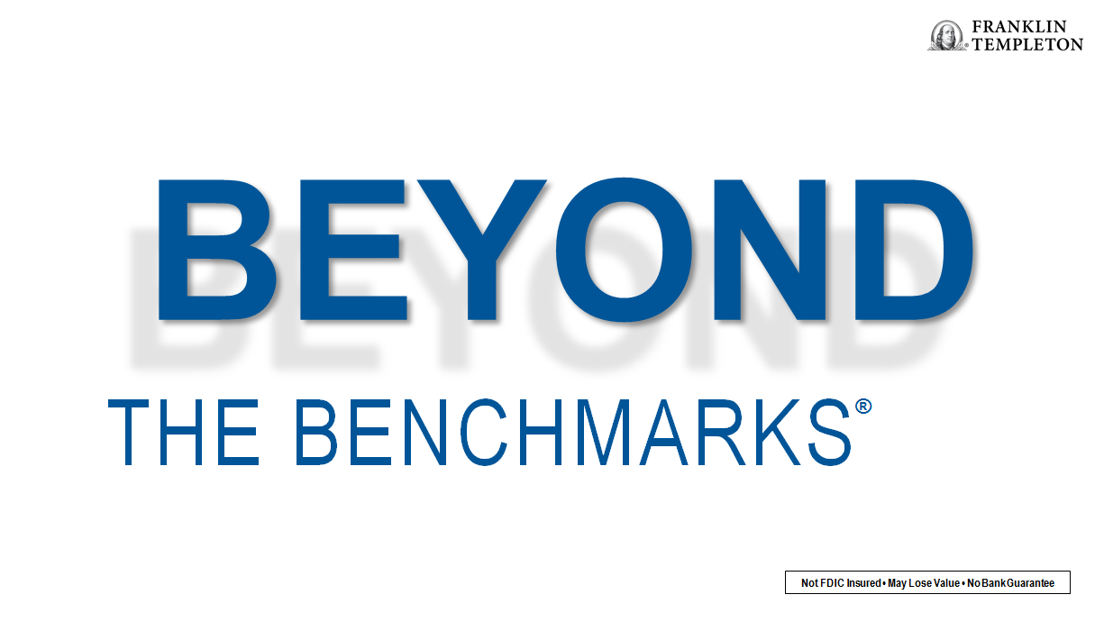
Not FDIC Insured • May Lose Value • No Bank Guarantee
Notes:
Presentation Description: Learn how to identify truly active mutual funds that have the potential to go beyond market benchmarks both in terms of performance and risk management.

Slide 2

Not FDIC Insured • May Lose Value • No Bank Guarantee
Notes:
Since our founding, Franklin Templeton has been dedicated to delivering exceptional asset management for our clients. We're one of the world's largest and most trusted asset management firms.
Focus on Investment Excellence
Our unique multi-manager structure brings world-class investment teams together in a single firm. Our specialized teams cover all major investment styles and asset classes, from traditional to alternative.
Global Perspective Shaped by Local Expertise
Our global perspective is a hallmark of our firm. We have over 600 investment professionals on the ground around the globe. Our in-depth understanding of local culture, companies, and economies makes us unique as a global partner.
Strength and Experience
The strength and experience of our firm is evident from our more than 70 years of navigating the world's financial markets, our globally diversified business and our long-standing commitment to our clients and customers.

Slide 3

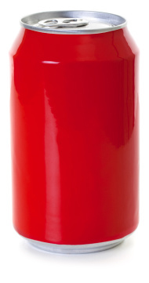


$3,500
credit card debt
lbs. overweight
23
480
cans of soda
$61,372
annual income
30
donuts
$12,000
minutes daily exercise
retirement savings
17
See the last slide of this presentation for sources.
Notes:
Synonyms for the word average include mediocre, ordinary or middling. In fact, let’s take a look at some of the characteristics of the average American.
The average American has an annual income of about $61,000.
That average American has accumulated [CLICK] $3,500 worth of credit card debt and has only saved [CLICK] $12,000 toward their retirement savings. Now that’s what they look like financially.
But life isn’t all about money.
The average American also eats [CLICK] 30 donuts each year.
And they must also get thirsty when eating 30 donuts because the average American consumes [CLICK] 480 cans of soda each year.
In an attempt to burn off those calories, the average American will exercise [CLICK] 17 minutes a day.
But apparently that’s not quite enough because the average American is also [CLICK] 23 pounds overweight.
Here’s a question—who in this room exactly fits this profile? Chances are, nobody does. It’s just an average.
But here’s the important question—as I read these statistics about the average American, how many of you started comparing yourself to these averages?
Perhaps you thought, “I don’t have that much credit card debt, but I wonder if I eat more than 30 donuts in a year.”

Slide 4
BEYOND
THE BENCHMARKS
®
Notes:
Today, I want to show you how you can look beyond the benchmarks.
Specifically, how when it comes to investing, “average” may not be good enough.

Slide 5
Today’s Discussion
When Average Comes Up Short
What It Means to Be a Truly Active Manager
Why Invest Differently Than the Crowd
Notes:
In today’s conversation I’d like to cover three important areas:
When Average Comes Up Short
Despite the fixation on products that track an average, many investors say they want something more.
What It Means to Be a Truly Active Manager
We’ll discuss a way to test whether your investments are different from the benchmark.
Why Invest Differently Than the Crowd
We’ll look at how investments in truly active funds may help you reach long-term goals.

Slide 6

When Average Comes Up Short
Notes:
First let’s talk about “When Average Comes Up Short.”

Slide 7
Survey Says—Average May Not Be Enough
35%
90%
it’s important to lose less than the market when it’s down
risk management is important
91%
it’s important to invest in products that can outperform the market
Source: 2018 Franklin Templeton Global Investor Sentiment Survey, conducted in partnership with Qualtrics©. The results reflect data collected from 500 US adult investors surveyed between February 12, 2018, and February 13, 2018.
Notes:
While it may seem that investors would be content with market-average returns, when we surveyed them, many told us something very different.
In fact, 35% said it’s important to lose less than the market when it’s down.
When it comes to performance, 91% said it’s important to invest in products that can outperform the market.
And, 90% said risk management is important when investing.
The source for this data is the Franklin Templeton Global Investor Sentiment Survey, conducted in partnership with Qualtrics©. The results here reflect 500 adult investors surveyed in the United States between February 12, 2018, and February 13, 2018.
When asked, many investors tell us they want attributes that are only found in active investments, and yet they’re still adding passive investments to their portfolio.

Slide 8
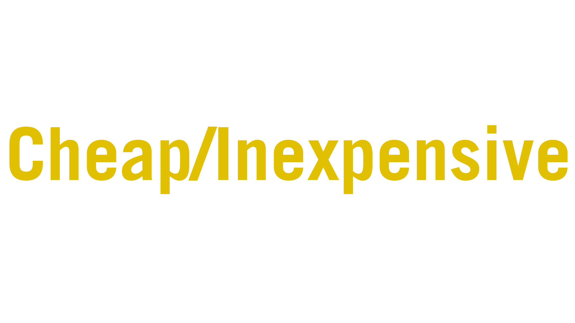
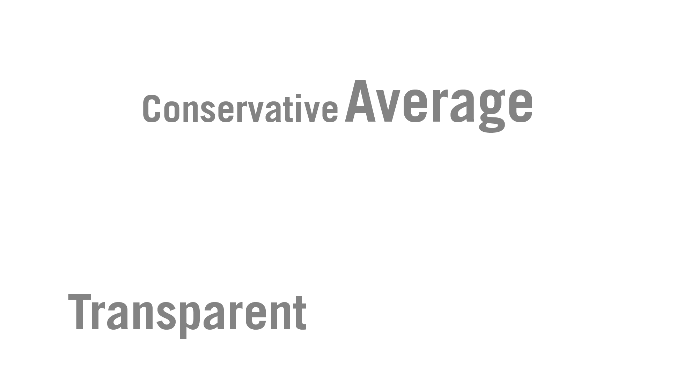
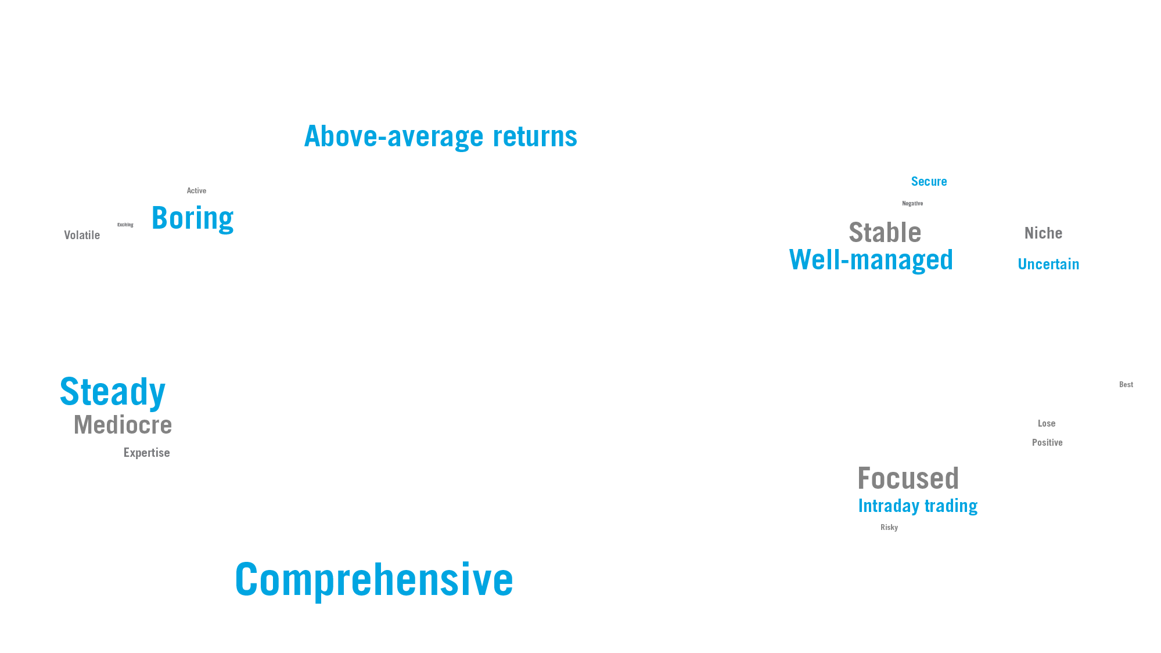
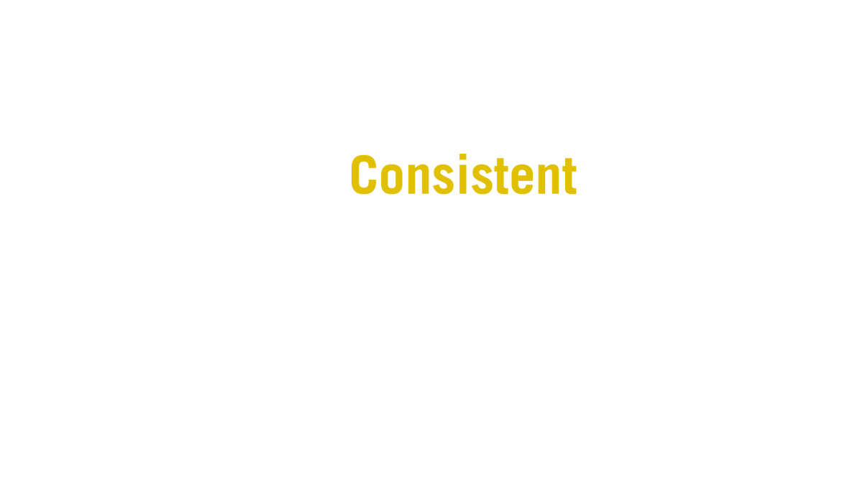
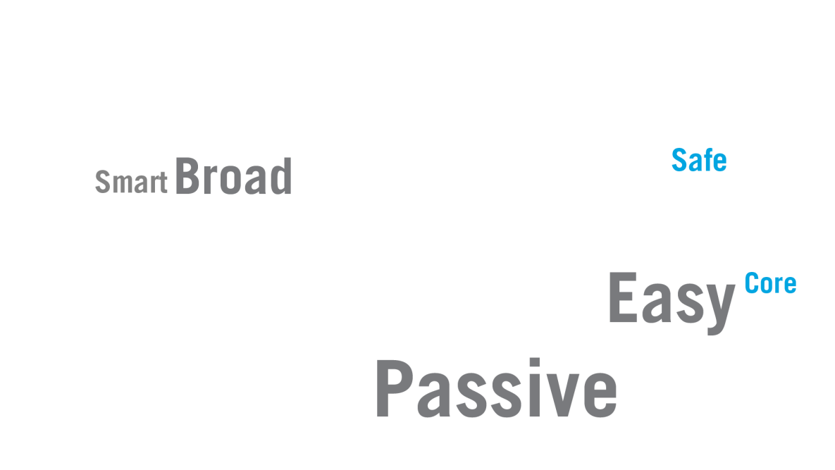
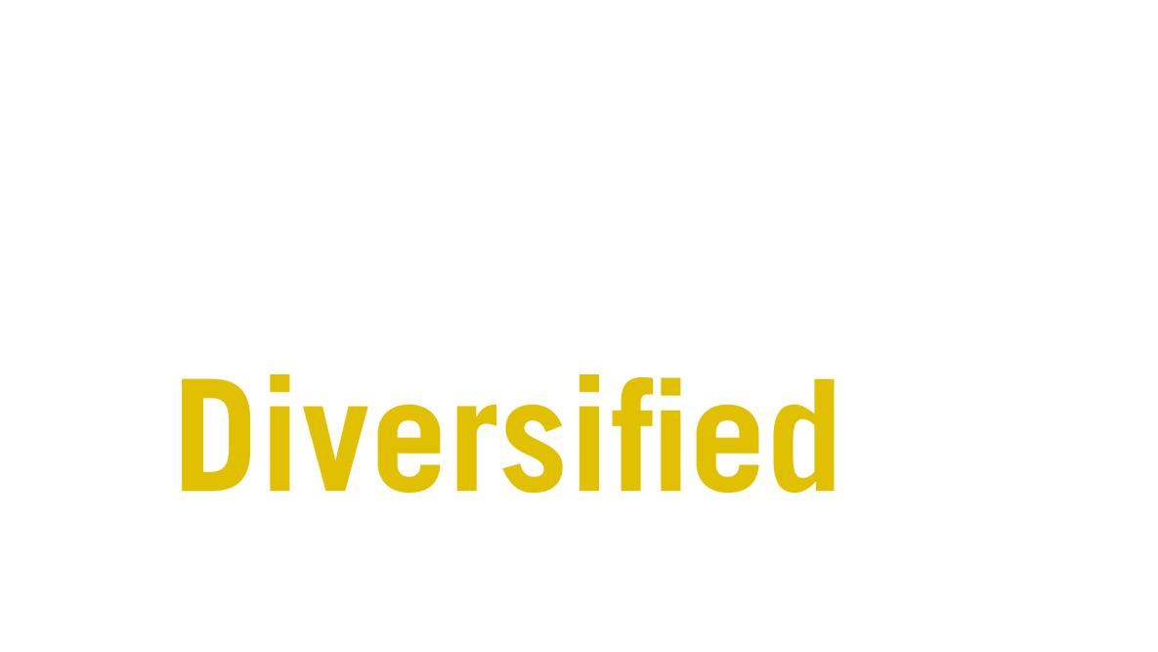
What Words Do You Associate with
Investing In an Index Fund?
Source: Franklin Templeton/The Wall Street Journal online survey conducted among 403 adult investors. The survey was conducted between 11/26/13 and 12/10/13.
Notes:
So what do investors think they’re getting when they buy an index fund? In another survey we conducted, we asked investors what words they associate with investing in index funds, and here are the results.
The words are sized proportionate to the number of respondents who identified that phrase as something they would associate with investing in an index fund.
Clearly, being cheap, or inexpensive, was the number one reason investors look at index funds.
Diversification also came up as a key reason investors use to describe index funds.
They also mentioned words like passive, average and easy.
Let's look at these in a little more detail.

Slide 9
Here’s What “Cheap/Inexpensive” Buys You
S&P 500 Index committee meets once a month to review index composition.
Key Selection Criteria
Accurate Representation of Market Sectors
Financially Viable
Liquid—Over 50% Public Shares
$8.2 Billion+ Market Capitalization
US Domiciled
Removal Criteria
Delisted
Substantially Violates Selection Criteria
Sources: Morningstar; S&P.
Notes:
So what does “cheap,” or “inexpensive” buy you when it comes to an index fund?
Let’s look at some of the basics of how the S&P 500 Index manages its holdings.
The investment committee for the S&P 500 Index typically meets once a month to discuss portfolio holdings.
You can see the key criteria they use to select companies.
Using these criteria, it’s clear the goal of the index is not to achieve any targets related to risk or returns, but just to accurately represent the US market.
On the other side, getting removed from the index is more difficult.
The majority of the companies that are removed from the S&P 500 Index are removed because they have been delisted due to financial troubles or a merger.
Fewer of them are removed because they’ve failed to meet one of the five selection criteria.
Let’s look at another reason investors give as their reason for purchasing index funds: diversification.

Slide 10

Diversification Is Skewed
Notes:
It might be easy to think that when you invest in a S&P 500 Index fund, you’re extremely diversified because you own 500 securities.
Unfortunately, it’s not that simple.
Many investors are under the impression that the index is composed of 500 equally weighted holdings.

Slide 11
Diversification Is Skewed
S&P 500 Index Holdings by Weighting (as of December 31, 2019)
Top 12 Holdings
= 25% of Index
Bottom 362 Holdings
= 25% of Index
Sources: Morningstar; S&P.
Indexes are unmanaged and one cannot invest directly in an index.
Notes:
The reality is that the index is skewed towards a few large holdings.
[CLICK] As of December 31, 2019, the top 12 holdings in the S&P 500 Index represented 25% of the entire index.
[CLICK] At the same time, you’d have to take 362 of the index’s smallest holdings to add up to 25%.
To put this in a little different perspective…

Slide 12


A Little Perspective on a Big Disparity
Notes:
If you took the smallest holding in the S&P 500 Index as of December 31, 2019, it would represent roughly .01% of the index.
Let’s imagine this company (News Corporation Class B) as a little prairie dog.
If you compared it to the largest holding in the index (Apple at 4.58%), [CLICK] it would be like comparing it to an 800-pound gorilla.

Slide 13
Two Noteworthy Sector Bubbles
S&P 500 Index Sector Weightings
Sources: Morningstar; FactSet.; S&P.
Indexes are unmanaged and one cannot invest directly in an index. Index returns do not reflect any fees, expenses or sales charges.
Notes:
Indexes—and the passive investments that track them—are dispassionate followers of market behavior.
If a sector or region becomes the darling of the day, there is no oversight to counterbalance that sentiment.
These charts show two historical stock “bubbles” and their aftermaths, which resulted from the rapid price appreciation of certain segments of the market.
As the stock prices in those segments ran up, they became an even greater portion of the index.
In periods of rising markets, a market capitalization weighting process that allocates more to potentially overvalued stocks can work to an index return’s benefit.
For example, in 2000, 24% of the S&P 500 Index was represented by tech stocks, and at the end of 2006, 22% of the index was represented by financials.
[CLICK] However, as a result of the decline in the value of the stocks in those sectors during the following downturn, and without a way to divest, the index’s weightings for tech and financials readjusted downward along with the value.

Slide 14
One Famous Geographic Bubble
MSCI World Index Japan Weighting
17%
41%
12%
1982
1989
1997
This chart is for illustrative purposes only.
Sources: FactSet, MSCI.
Indexes are unmanaged and one cannot invest directly in an index. Index returns do not reflect any fees, expenses or sales charges.
Notes:
Similarly, Japan’s massive run-up in the late 1980s led to a subsequent spectacular collapse.
As you can see here, at its height, Japanese stocks composed well over a third of the MSCI World Index.
Lastly, many investors told us they think of index funds as consistent.

Slide 15
Does Average Really Mean Consistent?
What was the S&P 500 Index average annual return for the 20-year period ended December 31, 2019?
6.1%
Past performance does not guarantee future results.
Sources: Morningstar; S&P.
Indexes are unmanaged and one cannot invest directly in an index. Index returns do not reflect any fees, expenses or sales charges.
Notes:
But does investing in a market average really mean consistent?
If I ask you what was the S&P 500 Index average annual return for the twenty year period ended December 31, 2019, what would you guess?
[CLICK] The correct answer is 6.1%.

Slide 16
A Closer Look at “Consistency”
S&P 500 Index Average Annual Total Returns (1998–2019)
6.1%
2000
2001
2002
2003
2004
2005
2006
2007
2008
2009
2010
2011
2012
2013
2014
2015
2016
2017
2018
2019
This chart is for illustrative purposes only and does not reflect the performance of any Franklin Templeton fund.
Past performance does not guarantee future results.
Sources: Morningstar; S&P.
Indexes are unmanaged and one cannot invest directly in an index. Index returns do not reflect any fees, expenses or sales charges.
Notes:
The problem is that when you say that to a client, they may think that they’re going to earn roughly 6.1% each year. What’s the reality?
[CLICK] The closest 1-year return to the long-term average over the past 20 years was in 2007 when the index returned 5.49%.
[CLICK] Most of the remaining 19 years saw returns that were significantly higher or lower than 6.1%.

Slide 17
The 6.1% Journey—Expectation vs. Reality
Value of a $10,000 Investment
S&P 500 Index Performance vs. a Compounded Hypothetical 6.1% Return
20-Year Period Ended December 31, 2019
$32,421
1999 2002 2004 2007 2009 2012 2014 2017 2019
This chart is for illustrative purposes only and does not reflect the performance of any Franklin Templeton fund.
Past performance does not guarantee future results.
Sources: Morningstar; S&P.
Indexes are unmanaged and one cannot invest directly in an index. Index returns do not reflect any fees, expenses or sales charges.
Notes:
So, while an investor may expect a 20-year investment journey to look something like this [CLICK], the reality is that the returns for the S&P 500 Index looked like this [CLICK].
This gap between expectation and reality may cause investors to act in ways that don’t help them reach long-term goals.

Slide 18
A Bumpy Road Can Lead to Bad Decisions
S&P 500 Index Performance vs. Equity Fund Net New Flows
1996–2002
2004–2010
Equity Fund Flows
BUYING HIGH
S&P 500 Index
SELLING LOW
This chart is for illustrative purposes only and does not reflect the performance of any Franklin Templeton fund.
Past performance does not guarantee future results.
Sources: S&P 500 Index: Morningstar; Equity Fund Flows: ICI. Flows are represented by monthly rolling 12-month net new cash flows. Indexes are unmanaged and one cannot invest directly in an index.
Notes:
In fact, it can lead to buying high and selling low.
The green line represents performance of the S&P 500 Index and the blue shading represents equity fund flows.
[CLICK] As you can see, when the S&P 500 Index performed well during the Internet boom, there was an influx of money into equity funds (buying high).
Conversely, when the market pulled back after the housing crash, investors withdrew their money from equities (selling low).

Slide 19
Investor Returns Have Been Lower Than Market Returns
20-Year Period Ended December 31, 2018
Average Equity Investor’s Annualized Return
S&P 500 Index
This chart is for illustrative purposes only and does not reflect the performance of any Franklin Templeton fund.
Past performance does not guarantee future results.
Sources: Morningstar; S&P; DALBAR.
Indexes are unmanaged and one cannot invest directly in an index. Index returns do not reflect any fees, expenses or sales charges.
Notes:
These bad timing decisions can have a big impact on an investor’s returns.
Each year a company called DALBAR conducts a study investigating this. For the 20-years ended in 2018, the most recent data published by DALBAR, the S&P 500 Index returned an average of 5.6%.
[CLICK] But, the average equity investor only achieved a 3.9% average annual return over the same period.

Slide 20
The Importance of Reducing Downside Capture
Hypothetical Growth of a $10,000 Investment in the S&P 500 Index
20-Year Period Ended December 31, 2019
Difference
$13,237
$6,065
S&P 500 Index
95% Downside Capture Ratio
90% Downside Capture Ratio
This chart is for illustrative purposes only and does not reflect the performance of any Franklin Templeton fund.
Past performance does not guarantee future results.
Source: Morningstar. S&P. Downside Capture Ratio totals were calculated by including 95% and 90% of the S&P 500 Index’s return for the months when the Index’s return was negative.
Indexes are unmanaged and one cannot invest directly in an index. Index returns do not reflect any fees, expenses or sales charges.
Notes:
While investors may be more focused on what risk does to their anxiety level, it’s probably more important to look at what volatility can do to their bottom line.
Downside capture is a statistic that indicates how correlated a fund is to a market when the market declines.
The lower the downside capture, the better the fund has preserved wealth during market downturns.
Over time, a lower downside capture can make a significant difference to an investor’s portfolio.
For example, for the 20-year period ended December 31, 2019, a $10,000 hypothetical investment in the S&P 500 Index would have grown to more than $32,000.
[CLICK] However, if an investment had captured 5% less of the index’s downside, it would have grown to more than $38,000.
[CLICK] And if that investment avoided 10% of the index’s downside, it would have grown to more than $45,000.
[CLICK] Avoiding some of the index’s downside can potentially make a difference to investors over time.

Slide 21
Avoiding the Worst Performing Stocks
Can Make a Big Difference
S&P 500 Index Average Annual Total Returns
20-Year Period Ended December 31, 2019
Entire Index
Excluding the 5 Worst
Performing Stocks
Excluding the 25 Worst
Performing Stocks
This chart is for illustrative purposes only and does not reflect the performance of any Franklin Templeton fund.
Past performance does not guarantee future results.
Sources: Morningstar; S&P; FactSet. Analysis excludes the 5 and 25 worst contributors (by factoring in a stock’s index weighting) to the S&P 500 Index total return on an annual basis.
Indexes are unmanaged and one cannot invest directly in an index. Index returns do not reflect any fees, expenses or sales charges.
Notes:
With 500 stocks included in the index, it would be easy to think that performance wouldn’t improve that much just by excluding the five worst or even the 25 worst performing stocks in any given year.
However, the long-term numbers tell a different story.
Here we see how much the S&P 500 Index average annual returns would have increased if they excluded the [CLICK] 5 and [CLICK] 25 worst performing stocks for the 20-year period ended December 31, 2019.

Slide 22
Volatility Matters—Especially in Retirement
 | Returns Required to Recover Initial Loss
10% Loss | +11%
20% Loss | +25%
30% Loss | +43%
40% Loss | +67%
Returns Required to Recover Initial Loss—with a 5% Annual Withdrawal (Over 5 Years)
+44%
+62%
+85%
+115%
30% Loss | +43%
30% Loss
+85%
This chart is for illustrative purposes only and does not reflect the performance of any Franklin Templeton fund.
Past performance does not guarantee future results.
Notes:
The importance of managing risk is heightened even more today by the wave of investors currently nearing or entering retirement.
Equal percentage returns on the downside and the upside won’t get an investor back to square one.
[CLICK] For example, to recover from a 30% loss, an investment would need to be followed by a total return of 43%.
Many will be looking for more than just market accumulation from their investments; they will also be looking for income.
[CLICK] As you can see here, when combined with consistent withdrawals (such as “retirement income withdrawals”), market losses are significantly harder to recover from.
[CLICK] Let’s take another look at the investment that lost 30%.
If an investor wanted to take a 5% annual withdrawal over five years, then over that period, an 85% total return would be needed to recover the initial loss.

Slide 23

What It Means to Be a Truly Active Manager
Notes:
If investors are ready to go beyond the benchmarks, they should look at finding a truly active manager for their investments.
I’d like to show you a way to measure how active their investment managers really are.

Slide 24
Why You Need to Know About Active Share
$$\text{Active} \text{Share}=\sum{(\frac{1}{2}×\left|\text{Fund} \text{Weight}\text{ – }\text{Benchmark} \text{Weight}\right|\text{)}}$$
The portion of stock holdings in an actively managed fund that differs from its benchmark index¹
Helps to identify “closet indexers”
Helps prove an investment manager is truly active
Identify potential for relative outperformance
There is no guarantee that a fund with a higher active share will outperform a benchmark index.
1. Source: K. J. Martijn Cremers and Antti Petajisto, How Active Is Your Fund Manager? A New Measure That Predicts Performance, The Review of Financial Studies (2009), Vol. 22 (9), Table 4 (adapted) and pp. 3335, 3341, 3342 & 3350 (adapted), by permission of Oxford University Press.
Notes:
Two professors from Yale University (Cremers and Petajisto) did an extensive amount of research and created a new metric called active share.
While the formula may look a little daunting, the concept is pretty simple.
[CLICK] Active share is the portion of stock holdings in an actively managed fund that differs from its benchmark index.
What can you do with active share?
[CLICK] First off, you can help identify “closet indexers”—funds that claim to be actively managed but hew close to the holdings found in an index.
[CLICK] Second, it helps prove an investment manager is truly active.
Actively managed funds typically have higher expenses than index funds due to the economic, market and company research and management of the fund’s holdings.
If a manager is just mimicking an index, the higher expense ratio may not be justified.
[CLICK] Third, active share can be used to identify the potential for relative outperformance. The more active a fund, the more potential for exhibiting performance that doesn’t move in lockstep with its index. Past performance does not guarantee future results.
Let’s look at a simplified example of how active share is calculated.

Slide 25




Active Share in Action
1. Hold a Stock Not Found in the Index
NOT
FOUND
Albemarle
Fund
Index
For illustrative purposes only. Securities referenced here are not necessarily included in a Franklin Templeton fund.
Notes:
Let’s look at an example of how active share is calculated. There are three ways a fund can add to its active share percentage.
The first is to hold a stock not found in the index.
For example, a hypothetical fund has a holding in the company Albemarle.
However, that company is not found in the S&P 500 Index.
That means it will add to the fund’s active share figure.

Slide 26

Active Share in Action
2. Not Hold a Stock Found in the Index
NOT
FOUND
Nike
Fund
Index
For illustrative purposes only. Securities referenced here are not necessarily included in a Franklin Templeton fund.
Notes:
The second example is a company that’s found in the index, but not in the hypothetical fund.
This means a company such as Nike may represent a sizeable portion of the index. However, Nike is not a holding in the fund.

Slide 27
Active Share in Action
3. Hold More Or Less of a stock in the index
Johnson & Johnson
3.90%
Johnson & Johnson
1.72%
Fund
Index
For illustrative purposes only. Securities referenced here are not necessarily included in a Franklin Templeton fund.
Notes:
The third way to add active share is to hold more or less of a stock that’s found in the index.
For example, a fund could have a substantial holding in Johnson & Johnson, while the index may have a considerably smaller holding, or vice versa.
If you add up all the differences between every holding in the hypothetical fund and index, you come up with an active share figure for the entire fund.

Slide 28
The Active Share Spectrum
Index Funds
Closet Index Funds
Active Funds
0%
20%
40%
60%
80%
100%
Source: Franklin Templeton. Reference: K.J. Martijn Cremers and Antti Petajisto, How Active Is Your Fund Manager? A New Measure That Predicts Performance, The Review of Financial Studies (2009), Vol. 22 (9), pp. 3341–3342.
Notes:
When the professors calculated active share for hundreds of funds, they noticed some common groupings.
It’s no surprise that most funds with 0% to 20% active share are in fact index funds.
However, the professors classified funds with active share from 20% to roughly 60% as closet index funds. These funds may purport to be actively managed, but a large portion of their holdings are identical to the index.
Once you get above 60% you are in the range of what Cremers and Petajisto called active funds.
And, many people look at an 80% threshold as the bar for many US stock fund categories to be considered truly active.

Slide 29

Why Invest Differently Than the Crowd
Notes:
I hope what we’ve discussed so far has helped you understand how and why investors may want to invest differently than the crowd.
In fact, a world-famous investor said it best…

Slide 30
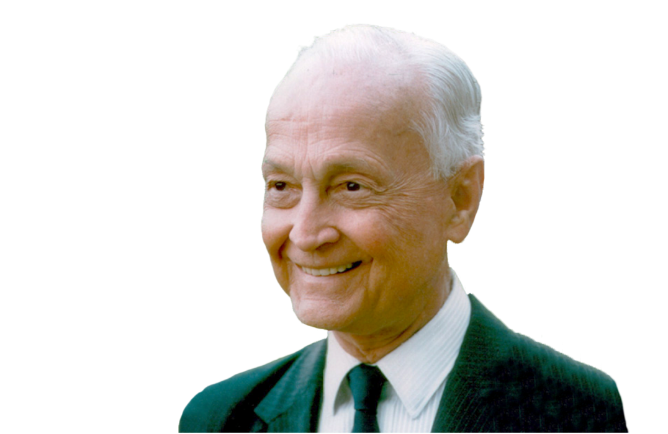
If you want to have a better performance than the crowd, you must do things differently from the crowd.”
–Sir John Templeton
Notes:
Sir John Templeton said, “If you want to have a better performance than the crowd, you must do things differently from the crowd.”
This is a philosophy that we believe is important in shaping how many Franklin Templeton mutual funds are managed.

Slide 31
Franklin Templeton Funds’ Active Share Scorecard
Top 10 Equity Funds by Assets¹ As of December 31, 2019 | Active Share
Franklin Rising Dividends Fund | 78%
Franklin Growth Fund | 64%
Franklin Mutual Global Discovery Fund | 91%
Templeton Growth Fund, Inc. | 93%
Franklin Mutual Shares Fund | 88%
Franklin DynaTech Fund | 64%
Templeton Foreign Fund | 90%
Franklin Mutual Quest Fund | 97%
Franklin Growth Opportunities Fund | 66%
Franklin Mutual Beacon Fund | 95%
82% average active share for our 10 largest equity funds
84% average active share for our 25 largest equity funds
80% or higher active share for 23 of 35 equity funds¹
1. Franklin Templeton US registered, non-sector specific equity funds. Fund active share scores were calculated by Franklin Templeton according to the formula: Active Share = sum (½ *| weight sec – weight benchmark sec |) as outlined by K.J. Martijn Cremers and Antti Petajisto, How Active is Your Fund Manager? A New Measure That Predicts Performance, The Review of Financial Studies (2009), Vol 22 (9). Active share scores range from 0% to 100%. An active share score of 0% indicates a portfolio that is identical to its primary benchmark index, while an active share score of 100% represents a portfolio composition that holds no overlapping positions. Different position allocation amounts contribute to active share score and are subject to change.
Notes:
In fact, if you look at our top 10 non-sector specific equity funds (by assets as of December 31, 2019) you’ll see that six have active share of at least 80%.
On average, they have active share of 82%.
If we broaden the group out to our 25 largest equity funds, the average active share moves up to 84%.
And, 23 of the 35 non-sector equity funds we manage have an active share of at least 80%.
We are truly looking to invest differently than the crowd.
We are truly active managers.
Today, I’d like to focus on one of these funds…

Slide 32

Franklin Rising Dividends Fund
Notes:
Franklin Rising Dividends Fund’s unique screening process, along with the research done by its managers, mean many of the stocks it chooses aren’t found in its benchmark index.

Slide 33

A Distinct Stock Selection Process
Five Screens
Consistent
Dividend Increases
Substantial
Dividend Increases
Reinvested Earnings for Future Growth
Strong
Balance Sheet
Attractive Price
Notes:
The fund has a distinct stock selection process it uses comprising five screens:
Consistent dividend increases
Our fund managers believe that companies with consistently increasing dividends should eventually realize an increase in their share prices.
Substantial dividend increases
Our fund managers look for companies that have increased their dividends in at least 8 of the previous 10 years with no year showing a decrease. Companies must also have at least doubled their dividend in the last 10 years.
Reinvested earnings for future growth
A company’s payment of dividends must be less than 65% of earnings, with at least 35% of its earnings being reinvested. This is consistent with fund management’s philosophy that companies reinvesting a significant portion of their earnings in their businesses tend to have better future growth prospects.
Strong balance sheet
Fund managers seek companies that have either long-term debt that is no more than 50% of their capitalization (except for utility companies) or senior debt that has been rated investment grade by at least one of the major bond rating organizations.
Attractive price
Our fund managers like to purchase companies when they are out of favor. This means they prefer to buy shares when they are at the lower half of their range over the past 10 years, or when their P/E ratio at the time of purchase is less than the average P/E ratio of stocks composing the S&P 500 Index.

Slide 34
Franklin Rising Dividends Fund
Top 10 Holdings Comparison as of December 31, 2019
Franklin Rising Dividends Fund¹ |  | S&P 500 Index²
Microsoft Corp |  | Apple Inc.
Roper Technologies Inc. |  | Microsoft Corp
Stryker Corp |  | Alphabet Inc.
Accenture Plc |  | Amazon.com Inc.
Linde Plc |  | Facebook Inc.
Honeywell International Inc. |  | Berkshire Hathaway Inc.
Becton Dickinson And Co |  | JPMorgan Chase & Co
Air Products & Chemicals Inc. |  | Johnson & Johnson
Texas Instruments Inc. |  | Visa Inc.
Medtronic Plc |  | Procter & Gamble Co
78%
Active
Share
(As of 12/31/19)
1. Holdings are subject to change. For updated information, please call Franklin Templeton at (800) DIAL BEN/342-5236 or visit franklintempleton.com. The portfolio manager for the fund reserves the right to withhold release of information with respect to holdings that would otherwise be included in the top 10 holdings list.
2. Sources: FactSet; S&P.
Indexes are unmanaged and one cannot invest directly in an index. Index returns do not reflect any fees, expenses or sales charges.
Notes:
The result of this screening process is a portfolio that is very different from its benchmark, the S&P 500 Index.
Not only does the fund have an overall active share of 78% as of December 31, 2019, only one of the fund’s top 10 holdings was also found in the top 10 holdings for the S&P 500 Index (Microsoft Corporation).

Slide 35
Franklin Rising Dividends Fund Portfolio Analysis
Sector Weighting Differential
Franklin Rising Dividends Fund¹ vs. S&P 500 Index²
As of December 31, 2019
78%
Active
Share
(As of 12/31/19)
1. Holdings are subject to change. For updated information, please call Franklin Templeton at (800) DIAL BEN/342-5236 or visit franklintempleton.com.
2. Sources: FactSet; S&P.
Indexes are unmanaged and one cannot invest directly in an index. Index returns do not reflect any fees, expenses or sales charges.
Notes:
If you look at the impact this had on sector weightings, you see how the fund was clearly different than its benchmark.
Specifically, the fund was overweight in sectors like industrials and materials, but underweight in sectors like financials and communication services.

Slide 36
Taking Another Look at the “Lost Decade”
Franklin Rising Dividends Fund–Advisor Class
Growth of a $10,000 Investment
10-Year Period Ended December 31, 2009
Performance data represents past performance, which does not guarantee future results. Current performance may differ from figures shown. The fund’s investment return and principal value will change with market conditions, and investors may have a gain or a loss when they sell their shares. Please call Franklin Templeton at (800) DIAL BEN/342-5236 or visit franklintempleton.com for the fund’s most recent month-end performance.
Advisor Class shares do not have sales charges or Rule 12b-1 fees and are offered only to certain eligible investors as stated in the prospectus
1. Effective 10/3/05, the fund began offering Advisor Class Shares. For periods prior to the fund’s Advisor Class inception date, restated figures are used based on the fund’s oldest share class, Class A performance, excluding the effect of Class A’s initial sales charge but reflecting the effect of the Class A Rule12b-1 fees; and for periods after the fund’s Advisor Class inception date, actual Advisor Class performance is used, reflecting all charges and fees applicable to that class. 2. Source: Morningstar. S&P, LLC. All rights reserved. Indexes are unmanaged and one cannot invest directly in an index. Index returns do not reflect any fees, expenses or sales charges.
Notes:
Let’s look back at a period where investors needed all the help they could get.
The 10-year period ended December 31, 2009 is often referred to as the “lost decade” because it’s one of the few 10-year periods where the S&P 500 Index had a negative return.
You can see that $10,000 in the S&P 500 Index would have ended up worth only $9,090 at the end of the period.
Had an investor put their $10,000 in Franklin Rising Dividends Fund—Advisor Class, it would have been worth $17,905 at the end of the period.
Clearly investing differently than the index had a significant impact on returns for this period.
As always, this data represents past performance, which does not guarantee future results.

Slide 37
Franklin Rising Dividends Fund–Advisor Class Performance and Risk
Monthly Rolling 10-Year Periods Over the 20-Year Period Ended December 31, 2019
OUTPERFORMANCE
LOWER RISK
54%
100%
Percentage of 10-year rolling periods the fund’s Advisor Class shares¹ outperformed the S&P 500 Index
Percentage of 10-year rolling periods the fund had a lower beta
than the S&P 500 Index²
Performance data represents past performance, which does not guarantee future results.
Advisor Class shares do not have sales charges or Rule 12b-1 fees and are offered only to certain eligible investors as stated in the prospectus.
1. Effective 10/3/05, the fund began offering Advisor Class Shares. For periods prior to the fund’s Advisor Class inception date, restated figures are used based on the fund’s oldest share class, Class A performance, excluding the effect of Class A’s initial sales charge but reflecting the effect of the Class A Rule12b-1 fees; and for periods after the fund’s Advisor Class inception date, actual Advisor Class performance is used, reflecting all charges and fees applicable to that class.
2. Source: Morningstar. S&P, LLC. All rights reserved. Indexes are unmanaged and one cannot invest directly in an index. Index returns do not reflect any fees, expenses or sales charges.
Notes:
Let’s look at every monthly rolling 10-year period over the 20 years ended December 31, 2019.
Over the 240 10-year rolling periods this includes, Franklin Rising Dividends Fund–Advisor Class outperformed the S&P 500 Index 54% of the time.
During 100% of those same periods, Franklin Rising Dividends Fund had a lower beta than the S&P 500 Index.
So, the fund outperformed over half the time with less risk 100% of the time.

Slide 38
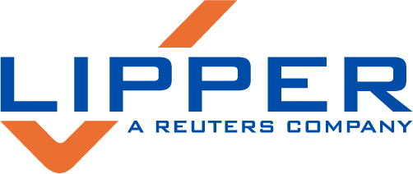

Performance Highlights
Franklin Rising Dividends Fund–Advisor Class
As of December 31, 2019
Large-Cap Core Funds Asset Group
NUMBER OF FUNDS:
12,253
Performance data represents past performance, which does not guarantee future results.
Advisor Class shares do not have sales charges or Rule 12b-1 fees and are offered only to certain eligible investors as stated in the prospectus.
Source: Lipper. These awards are subject to change every month and are based on an equal-weighted average of percentile rankings over the last 3-, 5- and 10-year periods. Lipper Leader status is calculated monthly using data available at time of calculation; Lipper undertakes no responsibility for updating the calculations more frequently than monthly to incorporate more current data. Twenty percent of funds in the classification are named Lipper Leaders; the next 20% receive a score of 4; the next 20% are scored 3, the next 20% are scored 2, and the next 20% are scored 1. Under no circumstances does information about Lipper Leader funds constitute a recommendation to buy or sell funds, nor does it necessarily imply that a fund named as a Lipper Leader had the best performance within its category. Lipper Leader ratings are based on past fund performance, and past performance does not guarantee future results. Lipper ratings for Preservation reflect a fund’s historical loss avoidance relative to other funds within the same asset class. Preservation ratings are relative, rather than absolute measures, and funds named Lipper Leaders for Preservation may still experience losses periodically; those losses may be larger for equity and mixed equity funds than for fixed income funds.
Notes:
Franklin Rising Dividends Fund has been recognized for its performance.
As of December 31, 2019, the fund was named a Lipper Leader for Preservation in the Lipper Large-Cap Core Funds Asset Group.

Slide 39
Performance Data
Franklin Rising Dividends Fund
Average Annual Total Returns for Periods Ended December 31, 2019 |  | 1-Year | 3-Year | 5-Year | 10-Year | Since Inception January 14, 1987
Advisor Class (FRDAX)^{1,2} |  | 30.19% | 14.23% | 10.57% | 12.83% | 9.72%
Class A (FRDPX)^{1,3}
Without Sales Charge |  | 29.85% | 13.94% | 10.30% | 12.55% | 9.60%
With 5.50% Initial Sales Charge⁴ |  | 22.71% | 11.81% | 9.06% | 11.91% | 9.41%
Expense Ratio
Advisor Class | 0.63%
Class A | 0.88%
Performance data represents past performance, which does not guarantee future results. Current performance may differ from figures shown. The fund’s investment return and principal value will change with market conditions, and investors may have a gain or a loss when they sell their shares. Please call Franklin Templeton at (800) DIAL BEN/342-5236 or visit franklintempleton.com for the fund’s most recent month-end performance.
Advisor Class shares do not have sales charges or Rule 12b-1 fees and are offered only to certain eligible investors as stated in the prospectus.
1. The fund offers other share classes subject to different fees and expenses, that will affect their performance.
2. Effective 10/3/05, the fund began offering Advisor Class Shares. For periods prior to the fund’s Advisor Class inception date, restated figures used are based on the fund’s oldest share class, Class A performance, excluding the effect of Class A’s initial sales charge but reflecting the effect of the Class A Rule12b-1 fees; and for periods after the fund’s Advisor Class inception date, actual Advisor Class performance is used, reflecting all charges and fees applicable to that class.
3. Effective 5/1/94, the fund implemented a Rule 12b-1 plan, which affects subsequent performance.
4. Prior to 9/10/18, these shares were offered at a higher initial sales charge of 5.75%; thus actual returns would have differed. Total returns with sales charges have been restated to reflect the current maximum initial sales charge of 5.50%.
Notes:
Here are the fund’s average annual total returns, expense ratios.

Slide 40
Risk Discussion
Franklin Rising Dividends Fund
All investments involve risks, including possible loss of principal. Value securities may not increase in price as anticipated or may decline further in value. For stocks paying dividends, dividends are not guaranteed, and can increase, decrease or be totally eliminated without notice. While smaller and midsize companies may offer substantial opportunities for capital growth, they also involve heightened risks and should be considered speculative. Historically, smaller- and midsize-company securities have been more volatile in price than larger-company securities, especially over the short term. These and other risks are detailed in the fund’s prospectus.
Notes:
Here is important risk information regarding the fund.

Slide 41

Franklin Mutual Global Discovery Fund
Notes:
Franklin Mutual Global Discovery Fund focuses on undervalued mid- and large-cap equity securities, with a significant portion of its assets in foreign securities and, to a lesser extent, distressed securities and merger arbitrage.

Slide 42
A Distinct Strategy
Opportunistic Value Investors
Think and Act Like Company Owners
Strive to Reduce Risk
Notes:
The fund has a distinct strategy it uses that comprises of:
Being opportunistic value investors
Search for undervalued stocks: Our core investments are in undervalued stocks, with viable catalysts that we believe could change the way the market views their true worth, thus unlocking value potential for our shareholders.
Seek to find value wherever it hides: We are bottom-up investors, looking across sectors, industries, and countries for the best opportunities the market has missed.
Invest in all stages of the business cycle: Whether the economy is doing well, holding steady or slowing, we find opportunities among overlooked/unloved and undervalued stocks.
Thinking and acting like company owners
Perform our own proprietary research: Our portfolio managers consider themselves analysts first. This is a key differentiator, as they are intimately involved in the companies they are buying. They roll up their sleeves and do their own proprietary research rather than relying on third-party reports. This philosophy has been deeply ingrained in the culture at Franklin Mutual Series since 1949.
Determine what the business is worth today: We ask ourselves, “If we were a competitor, what would we be willing to pay for this company?” Or, “If this company were to be broken into pieces for several buyers, what would the sum of the parts be worth in today’s market?”
Striving to reduce risk
Focus on value investments: We seek to find investment opportunities trading for less than what we believe they are worth.
Invest (to a lesser extent) in non-correlating assets: For our investments in distressed securities and merger arbitrage, we take a conservative approach backed by diligent research. Moreover, these investments have historically shown low correlation with the overall market. Their risk tends to be issue-specific, which has helped make our funds less sensitive to broad market movements. While investing in undervalued stocks is the core of what we do, we feel that selective investments in these merger arbitrage and distressed situations are natural extensions of our value strategy.

Slide 43
Franklin Mutual Global Discovery Fund Portfolio Analysis
Top 10 Holdings Comparison as of December 31, 2019
Franklin Mutual Global Discovery Fund¹ |  | MSCI World Index²
Novartis AG Sponsored ADR |  | Apple Inc.
Medtronic Plc |  | Microsoft Corporation
GlaxoSmithKline plc |  | Amazon.com, Inc.
Samsung Electronics Co., Ltd. |  | Facebook, Inc. Class A
Walt Disney Company |  | JPMorgan Chase & Co.
Volkswagen AG Pref |  | Alphabet Inc. Class C
Kinder Morgan Inc Class P |  | Alphabet Inc. Class A
Hartford Financial Services Group, Inc. |  | Johnson & Johnson
Wells Fargo & Company |  | Visa Inc. Class A
Citigroup Inc. |  | Nestle S.A.
91%
Active
Share
(As of 12/31/19)
1. Holdings are subject to change. For updated information, please call Franklin Templeton at (800) DIAL BEN/342-5236 or visit franklintempleton.com. The portfolio manager for the fund reserves the right to withhold release of information with respect to holdings that would otherwise be included in the top 10 holdings list.
2. Source: FactSet, MSCI.
Indexes are unmanaged and one cannot invest directly in an index. Index returns do not reflect any fees, expenses or sales charges.
Notes:
The result of this strategy is a portfolio that is very different from its primary benchmark, the MSCI World Index.
Not only does the fund have an overall active share of 91% as of December 31, 2019, none of the fund’s top ten holdings was among the top 10 holdings for the MSCI World Index.

Slide 44
Franklin Mutual Global Discovery Fund Portfolio Analysis
Geographic Weighting Differential
Franklin Mutual Global Discovery Fund¹ vs. MSCI World Index²
As of December 31, 2019
91%
Active
Share
(As of 12/31/19)
1. Holdings are subject to change. For updated information, please call Franklin Templeton at (800) DIAL BEN/342-5236 or visit franklintempleton.com.
2. Source: MSCI.
Indexes are unmanaged and one cannot invest directly in an index. Index returns do not reflect any fees, expenses or sales charges.
Notes:
If you look at the impact this had on geographic weightings, you see how the fund was clearly different than its benchmark, the MSCI World Index.
Specifically, the fund was overweight in regions like Europe and Mid-East/Africa, but underweight in regions like North America and Asia.

Slide 45
Taking Another Look at the “Lost Decade”
Franklin Mutual Global Discovery Fund–Class Z
Growth of a $10,000 Investment
10-Year Period Ended December 31, 2009
Performance data represents past performance, which does not guarantee future results. Current performance may differ from figures shown. The fund’s investment return and principal value will change with market conditions, and investors may have a gain or a loss when they sell their shares. Please call Franklin Templeton at (800) DIAL BEN/342-5236 or visit franklintempleton.com for the fund’s most recent month-end performance.
Class Z shares do not have sales charges or Rule 12b-1 fees and are offered only to certain eligible investors as stated in the prospectus.
Sources: Morningstar, MSCI.
Indexes are unmanaged and one cannot invest directly in an index. Index returns do not reflect any fees, expenses or sales charges
Notes:
Let’s look back at a period where investors needed all the help they could get.
The 10-year period ended December 31, 2009 is often referred to as the “lost decade” because it’s one of the few 10-year periods where the MSCI World Index had a nearly flat return.
You can see that $10,000 in the MSCI World Index would have ended up worth only $10,234 at the end of the period.
Had an investor put their $10,000 in Franklin Mutual Global Discovery Fund–Class Z, it would have been worth $22,315 at the end of the period.
Clearly investing differently than the index had a significant impact on returns for this period.
As always, this data represents past performance, which does not guarantee future results.

Slide 46
Franklin Mutual Global Discovery Fund–Class Z Performance and Risk
Monthly Rolling 10-Year Periods
Since Inception Through December 31, 2019
OUTPERFORMANCE
LOWER RISK
89%
100%
Percentage of 10-year rolling periods the fund’s Class Z shares outperformed the MSCI World Index
Percentage of 10-year rolling periods the fund had a lower beta
than the MSCI World Index
Performance data represents past performance, which does not guarantee future results.
Class Z shares do not have sales charges or Rule 12b-1 fees and are offered only to certain eligible investors as stated in the prospectus.
Sources: Morningstar, MSCI. Indexes are unmanaged and one cannot invest directly in an index. Index returns do not reflect any fees, expenses or sales charges.
The fund’s inception date is 12/31/92.
Notes:
Let’s look at every monthly rolling 10-year period since the fund’s inception through September 30, 2019.
Over the 205 10-year rolling periods this includes, Franklin Mutual Global Discovery Fund–Class Z outperformed the MSCI World Index nearly 90% of the time.
During 100% of the times, Franklin Mutual Global Discovery Fund had a lower beta than the MSCI World Index.
So, the fund not only outperformed most of the time, it did so with less risk 100% of the time.

Slide 47
Performance Data
Franklin Mutual Global Discovery Fund
Average Annual Total Returns for Periods Ended December 31, 2019 |  | 1-Year | 3-Year | 5-Year | 10-Year | Since Inception December 31, 1992
Class Z (MDISX)¹ |  | 24.70% | 6.91% | 5.91% | 8.07% | 11.14%
Class A (TEDIX)^{1,2}
Without Sales Charge |  | 24.37% | 6.64% | 5.64% | 7.77% | 10.78%
With 5.50% Initial Sales Charge³ |  | 17.54% | 4.65% | 4.45% | 7.16% | 10.55%
Expense Ratio
Class Z | 0.98%
Class A | 1.23%
Performance data represents past performance, which does not guarantee future results. Current performance may differ from figures shown. The fund’s investment return and principal value will change with market conditions, and investors may have a gain or a loss when they sell their shares. Please call Franklin Templeton at (800) DIAL BEN/342-5236 or visit franklintempleton.com for the fund’s most recent month-end performance.
Class Z shares do not have sales charges or Rule 12b-1 fees and are offered only to certain eligible investors as stated in the prospectus.
1. This fund offers other share classes, subject to different fees and expenses that will affect their performance.
2. Prior to 11/1/96, the fund offered only a single class of shares without a sales charge and Rule 12b-1 expenses, Class Z shares. Figures reflect a restatement of the original class to include both the Rule 12b-1 expenses and maximum initial sales charges (when quoting figures with sales charges) applicable to each share class as though in effect from the fund's inception. For periods after 11/1/96, actual performance is used reflecting all charges and fees applicable to that class. Please see the fund’s prospectus for more information about fees and expenses.
3. Prior to 9/10/18, these shares were offered at a higher initial sales charge of 5.75%; thus actual returns would have differed. Total returns with sales charges have been restated to reflect the current maximum initial sales charge of 5.50%.
Notes:
Here are the fund’s average annual total returns and expense ratios.

Slide 48
Risk Discussion
Franklin Mutual Global Discovery Fund
All investments involve risks, including possible loss of principal. Value securities may not increase in price as anticipated or may decline further in value. Special risks are associated with foreign investing, including currency fluctuations, economic instability and political developments. Smaller-company stocks have exhibited greater price volatility than larger-company stocks, particularly over the short term. The fund’s investments in companies engaged in mergers, reorganizations or liquidations also involve special risks as pending deals may not be completed on time or on favorable terms. The fund may invest in lower-rated bonds, which entail higher credit risk. Please consult the prospectus for a more detailed description of the fund’s risks.
Notes:
Here is important risk information regarding the fund.

Slide 49
In Summary
When Average Comes Up Short
What It Means to Be a Truly Active Manager
Why Invest Differently Than the Crowd
Notes:
So what did we talk about today? We talked about:
When Average Comes Up Short
We discussed what investors think they’re getting when buying index funds and why there may be a disconnect between expectations and reality.
What It Means to Be a Truly Active Manager
We showed how active share is calculated and how it can be a valuable tool when determining what funds to include in a portfolio.
Why Invest Differently Than the Crowd
We showed how many Franklin Templeton equity funds have high active share and specifically how Franklin Rising Dividends Fund and Franklin Mutual Global Discovery Fund’s distinct stock selection process helps them stand out as actively managed funds.
All in all, I hope I’ve encouraged you to look beyond the benchmarks when it comes to their investment portfolios.

Slide 50
Investors should carefully consider a fund’s investment goals, risks, charges and expenses before investing. To obtain a summary prospectus and/or prospectus, which contains this and other information, talk to your financial advisor, call us at (800) DIAL BEN/342-5236 or visit franklintempleton.com. Please carefully read the prospectus before you invest or send money.
Important data provider notices and terms available at www.franklintempletondatasources.com.
Slide #2 Sources: Annual Income: US Census Bureau, Income and Poverty in the United States:; Credit Card Debt: Vornovytskyy, Marina, Alfred Gottschalck, and Adam Smith, US Census Bureau, Household Debt in the US: 2000 to 2011 (March 2013); Retirement Savings: National Institute on Retirement Security, “The Retirement Savings Crisis: Is it Worse Than We Think?” (June 2013); Donuts: RawFoodExplained.com; Cans of Soda: American Society for Nutrition; Daily Exercise: US Bureau of Labor Statistics, American Time Use Survey 2017; Weight: Centers for Disease Control and Prevention, CDC Weight of the Nation Press Briefing (July 27, 2009).
Franklin Templeton Distributors, Inc.
One Franklin Parkway
San Mateo, CA 94403-1906
(800) DIAL BEN®/342-5236
franklintempleton.com
BTB PPT 02/20
Notes:
Thank you.

