Slide 1
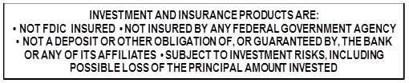
[When presenting in AR, CA, OK, TX or IL,
use the phrase “Insurance Sales Presentation.”]
[In CA and AR, add License Number]
Issued by Pruco Life Insurance Company and by Pruco Life Insurance Company of New Jersey.
Prudential Annuities is providing this workshop for informational or educational purposes only and does not provide investment advice or recommendations about managing or investing your retirement savings.
1003783-00002-00 ORD209747 Ed. 12/2018
Notes:
Welcome. My name is _______________. Today we are going to discuss two issues that are critical to most people’s success in retirement: maximizing your Social Security benefit and managing healthcare costs.

Slide 2
INVESTMENT AND INSURANCE PRODUCTS ARE:
NOT FDIC INSURED NOT INSURED BY ANY FEDERAL GOVERNMENT AGENCY NOT A DEPOSIT OR OTHER OBLIGATION OF, OR GUARANTEED BY, THE BANK OR ANY OF ITS AFFILIATES SUBJECT TO INVESTMENT RISKS INCLUDING POSSIBLE LOSS OF THE PRINCIPAL AMOUNT INVESTED
Prudential Annuities®
Meeting Today’s Retirement Income Challenges
[Presenter Name], [Presenter Title]
Issued by Pruco Life Insurance Company and by Pruco Life Insurance Company of New Jersey.
1003783-00002-00 ORD209747 Ed. 12/2018
Notes:
[REQUIRED SLIDE FOR JP MORGAN CHASE AND CITIBANK. REMOVE WHEN USING FOR ALL OTHER FIRMS]
Welcome. My name is _______________. Today we are going to talk about some of the income challenges you might face in retirement. Just know that you are not alone in facing them. Every one of us will face any number of these challenges.

Slide 3


[When presenting in AR, CA, OK, TX or IL, use the phrase “Insurance Sales Presentation.” In CA and AR, add License Number]
Issued by Pruco Life Insurance Company and by Pruco Life Insurance Company of New Jersey.
Prudential Annuities is providing this workshop for informational or educational purposes only and does not provide investment advice or recommendations about managing or investing your retirement savings.
1003783-00002-00 ORD209747 Ed. 12/2018
Notes:
[REQUIRED SLIDE FOR BANK FIRMS ONLY ONLY. REMOVE WHEN USING FOR ALL OTHER FIRMS].
Welcome. My name is _______________. Today we are going to talk about some of the income challenges you might face in retirement. Just know that you are not alone in facing them. Every one of us will face any number of these challenges.

Slide 4
Important Information to Consider
Prudential Annuities, its distributors and representatives do not provide tax, investment, accounting, or legal advice. Please consult your own attorney or accountant.
This guide presents a general overview of certain rules related to Social Security and Healthcare. The ideas presented are not individualized for your particular situation. This information is based on current law which can be changed at any time.

Slide 5
[Required For Merrill Lynch Events Only]
Investing involves risk including possible loss of principal. Information is current as of the date of this material and subject to change.
Any opinions expressed herein are from a third party and are given in good faith, are subject to change without notice, and are considered correct as of the stated date of their issue.
Merrill Lynch, Pierce, Fenner & Smith Incorporated is not a tax or legal advisor. Clients should consult a personal tax or legal advisor prior to making any tax or legal related investment decisions.
Bank of America Corporation (“Bank of America”) is a financial holding company that, through its subsidiaries and affiliated companies, provides banking and investment products and other financial services .
Merrill Lynch makes available products and services offered by Merrill Lynch, Pierce, Fenner & Smith Incorporated (“MLPF&S”), a registered broker-dealer and member SIPC, and other subsidiaries of Bank of America Corporation (BofA Corp). Merrill Lynch Life Agency is a licensed insurance agency and a wholly owned subsidiary of BofA Corp.
Merrill Lynch offers a broad range of brokerage, investment advisory and other services. There are important differences between brokerage and investment advisory services, including the type of advice and assistance provided, the fees charged, and the rights and obligations of the parties. It is important to understand the differences, particularly when determining which service or services to select. The views and opinions expressed in this presentation are not necessarily those of Bank of America Corporation; Merrill Lynch, Pierce, Fenner & Smith Incorporated; or any affiliates. [For more information about these services and their differences, speak with your Financial Advisor.]
Nothing discussed or suggested in these materials should be construed as permission to supersede or circumvent any Bank of America, Merrill Lynch, Pierce, Fenner & Smith Incorporated policies, procedures, rules, and guidelines.
Investment products offered through MLPF&S and insurance and annuity products offered through Merrill Lynch Life Agency Inc.:
[material should be regarded as educational information on [health care] [and] [Social Security] and is not intended to provide specific advice. If you have questions regarding your particular situation, you should contact your legal or tax advisors.]
Are Not FDIC Insured | May Lose Value | Are Not Bank Guaranteed
Are Not Insured by Any Federal Government Agency | Are Not Deposits | Are Not a Condition to Any Banking Service or Activity

Slide 6
[Required For Morgan Stanley Smith Barney Events Only]
Morgan Stanley Smith Barney is not affiliated with Prudential Annuities.
The views and opinions expressed in this presentation are not necessarily those of Prudential Annuities; or any affiliates. Nothing discussed or suggested in these materials should be construed as permission to supersede or circumvent any Morgan Stanley Smith Barney incorporated policies, procedures, rules, and guidelines. This material should be regarded as educational information on [Health Care, Social Security, Taxes] and is not intended to provide specific advice. If you have questions regarding your particular situation, you should contact your legal or tax advisors.

Slide 7
[For Allstate Financial Services only: This slide must be shown prior to the beginning of the customer presentation]
[Hosted/Presented by:]
[PFR Name]
Personal Financial Representative
[Allstate Financial Services, LLC or LSA Securities (in LA & PA)]
Securities offered by Personal Financial Representatives through Allstate Financial Services, LLC (LSA Securities in LA and PA). Registered Broker-Dealer. Member FINRA, SIPC. Main Office: 2920 South 84th Street, Lincoln, NE 68506. (877) 525-5727.
Notes:
[OPTIONAL SLIDE]

Slide 8
[Optional Disclosure Slide]
[Investments are offered through [BROKER DEALER NAME], a registered broker dealer. [Insurance is offered through [AGENCY NAME- if applicable.]]
[BROKER DEALER and AGENCY- if applicable], located at [ADDRESS], [is/are] not affiliated with Prudential Financial.]]
Notes:
[OPTIONAL SLIDE: please hide if not using]

Slide 9
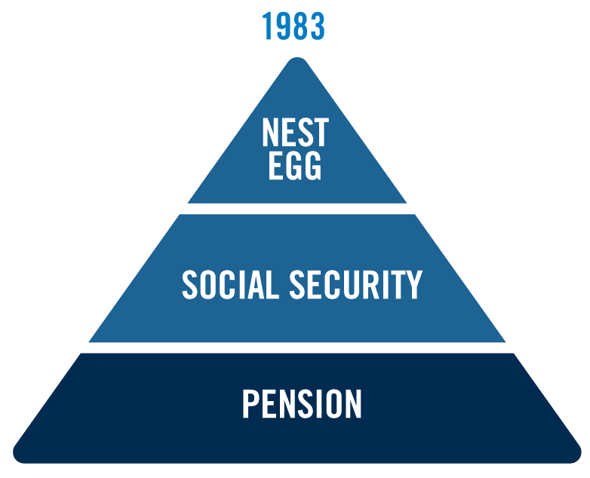
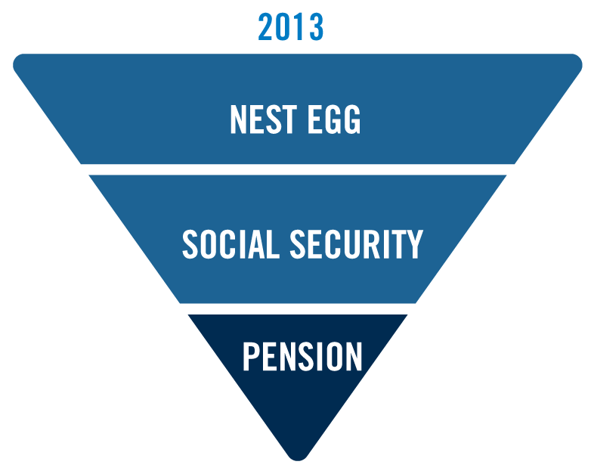
Retirement: Yesterday and Today
Yesterday
Today
Notes:
Before we dive into today’s topics, I’d like to set up our discussion with a look at how the way retirement is funded has changed from the past.
Decades ago, funding retirement was a far different proposition than it is now. Today, traditional pensions are becoming a luxury of the past, Social Security faces an uncertain future, and more of the burden of funding retirement is falling on individuals. Defined contribution plans, such as 401(k)s and 403(b)s, have become default vehicles to help fund retirement, but that approach can often leave investors exposed to market volatility without any protection.
As a result, there is a greater emphasis on the need for increased personal savings and investing wisely. A few things to consider are:
What strategies are available to help increase your Social Security benefits?
Other than Social Security, what other guaranteed income sources do you have?
How important is it to you to have a source of guaranteed income?

Slide 10
Agenda
Strategies to Maximize Social Security
  Understanding the basics of Social Security
  The impact of starting early & benefit of waiting
  Two filing strategies to maximize benefits
  Estimating healthcare costs
  Understanding the ABCs of Medicare
  Funding healthcare costs
Managing Healthcare Costs in Retirement
Notes:
The agenda will cover two topics. The first is: How do you maximize the benefits you and your spouse (or just you if you are single) get from Social Security? And the second critical issue is: How do you manage healthcare costs in retirement? We will end with a discussion on creating guaranteed lifetime income and how this can help you supplement what you get from Social Security and pay for healthcare costs in retirement.

Slide 11
Social Security
Proposed Changes
“Social Security benefits are not intended to be your only source of income when you retire. On average, Social Security will replace about 40 percent of your annual pre-retirement earnings. You will need other savings, investments, pensions, or retirement accounts to live comfortably when you retire.”*
Higher Payroll Tax
Higher Taxable Wage Base
Higher Retirement Age
Means Testing
Recalculating COLA
Raise Earliest Eligibility Age
Base Benefits on Highest 40 years of Earnings
The law governing benefits may change because, by 2034, the payroll taxes collected will be enough to pay only about 77 percent of scheduled benefits.
Source: Form SSA-7005-SSM-SI.
SL 0014-2 01/2018
Notes:
Note:
You are all used to seeing the "OASDI tax" on your paychecks. OASDI stands for old age, survivors, and disability insurance, and the money that your employer collects goes to the federal government in order to fund the Social Security program. If nothing changes, in 2034 the combined OASDI Trust Funds will deplete, and from that point the estimated payments rate is 77%.
In 2035, if nothing changes, the OASI Trust Fund that funds Social Security will deplete. After that payments rate will be 75%.
When considering how Social Security can be part of your retirement income plan, remember what the Social Security Administration says about their own program on their statements:
[CLICK] “Social Security benefits are not intended to be your only source of income when you retire.”
[CLICK] “On average, Social Security will replace about 40 percent of your annual pre-retirement earnings. You will need other savings, investments, pensions or retirement accounts to live comfortably when you retire.”

Slide 12
How Are Benefits Determined?
Becoming eligible:
  40 quarters (10 years) of wages that were subject to Social Security payroll taxes
  Quarters do not need to be consecutive
  Quarters do not expire and will remain on Social Security record
Benefits calculated based on:
Average of the 35 highest years of earnings
  If you have less than 35 years of work history:
  $0 is used in calculation for any year (up to 35 years) where you have no earnings
  Your benefit will be lower
Source: “How You Earn Credits”, SSA Publication No. 05-10072, ICN 467510; June 2016
Source: “Your Retirement Benefit: How It’s Figured”, SSA Publication No. 05-10070, ICN 467100; January 2016
Notes:
Let’s begin by taking a look at how eligibility is determined and how your benefits are calculated.
Paying taxes into Social Security does not automatically make someone eligible to receive benefits. To be eligible to receive Social Security benefits, individuals must work and pay Social Security taxes for 40 quarters.
The quarters do not need to be consecutive nor do they expire.
Once a taxpayer has worked and paid Social Security taxes for the 40 quarters, he or she is eligible to receive benefits.
[CLICK] The benefit amount is determined by the taxpayer’s work history. Benefits are calculated by averaging the 35 highest years of income. If a taxpayer does not have 35 years of earnings history, those years will count as $0 in the calculation. As a result, this will lower the benefits the taxpayer will receive as it will have the effect of lowering the average.

Slide 13
When is Full Retirement Age (FRA)?
Date of Birth
Full Retirement Age
1943-1954
66
1955
66 and 2 months
1956
66 and 4 months
1957
66 and 6 months
1958
66 and 8 months
1959
66 and 10 months
1960 and later
67
Source: www.ssa.gov/planners/retire/agereduction.html, Retirement Planner: Benefits By Year of Birth, accessed August 2017
Notes:
Full retirement age is based on the year in which a person was born. At full retirement age, he or she is eligible for full Social Security retirement benefits. [Read Slide]

Slide 14
Taking Benefits Early
Age
FRA 66
Age
FRA 67
62
25% reduction
20% reduction
13.3% reduction
6.7% reduction
Full benefits
62
30% reduction
25% reduction
20% reduction
13.3% reduction
6.7% reduction
Full benefits
63
63
64
64
65
65
66
66
67
Source: Social Security Administration - Retirement Planner: Benefits by Year of Birth (https://www.ssa.gov/planners/retire/agereduction.html), accessed January 2018
Notes:
You have the option to begin receiving Social Security benefits early, but if they do, their benefits will be reduced, potentially as much as 30%.
It is important to remember that the reduced benefit would generally be permanent for the rest of their life.

Slide 15
The Benefit of Delaying Payments
Increase in Benefits: Full Retirement Age (FRA) of 66 & 67
Age
FRA 66
Age
FRA 67
67
68
8% increase
16% increase
24% increase
32% increase
8% increase
16% increase
24% increase
68
69
69
70
70
Source: www.ssa.gov/planners/retire/delayret.html, Retirement Planner: Delayed Retirement Credits, accessed August 2017.
Notes:
Waiting to claim until after full retirement age may increase Social Security benefits.
From full retirement age until age 70, for every year Social Security benefits are delayed, benefits will increase by 8%. After age 70, while it is possible to delay taking benefits, the 8% increase does not continue. This means there is no incentive to delay taking benefits after age 70.

Slide 16
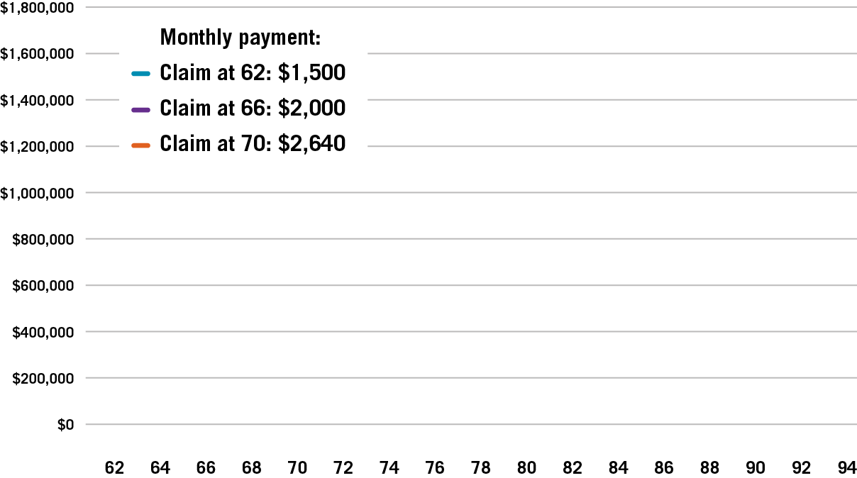

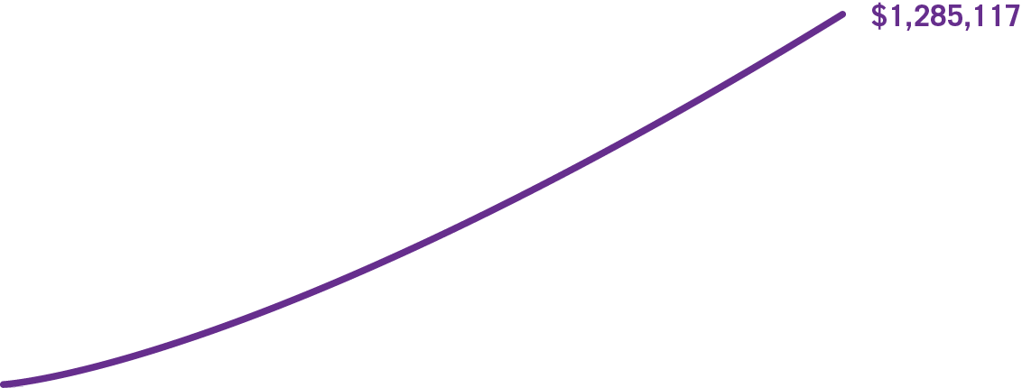
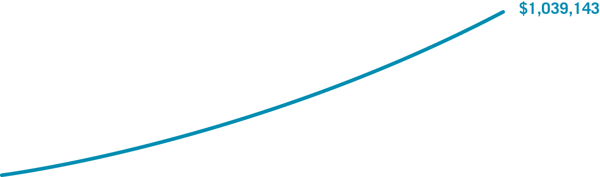
The Benefit of Delaying Payments
Breakeven Points:
Age 70 vs. 66: Age 81
Age 66 vs. 62: Age 76
Age 70 vs. 62: Age 79
This is a hypothetical example for illustrative purposes only. This assumes a full retirement age benefit of $24,000 a year, an annual cost of living adjust of 3%, and the client living to age 95. As the specifics for your situation may be different, please go to ssa.gov for more information.
Notes:
When should you take Social Security? Let’s look at some examples of breakeven points based on the age you decide to take your Social Security benefits.
None of us know for sure how long we’ll actually live, but let’s make some assumptions for the purposes of our examples.
For those who expect to live to or beyond their life expectancy, it may make sense to delay taking Social Security benefits. Let’s assume that you will receive a 3% cost-of-living adjustment every year:
take distributions at age 62 (assuming a monthly payment of $1,500), the total Social Security benefit at age 95 is $1,039,143
take distributions at age 66 (assuming a monthly payment of $2,000), the total Social Security benefit at age 95 is $1,285,117
take distributions at age 70 (assuming a monthly payment of $2,640), the total Social Security benefit at age 95 is $1,531,112
Even if you don’t live to 95 it may make sense to delay benefits.
If you delay taking distributions until:[CLICK]
66 instead of 62, and you live past age 76, you will receive more Social Security benefits.[CLICK]
70 instead of 62, and you live past age 79, you will receive more Social Security benefits.[CLICK]
70 instead of 66 and live past age 81, you will receive more Social Security benefits.
The longer you live past those “breakeven points,” the more benefits you will receive.

Slide 17
Taking Benefits and Working
Full Retirement Age (FRA)
No penalty
In the Year Full Retirement Age (FRA) is Reached
Give up $1 in benefits for every $3 earned
above a $45,360 limit
Under Full
Retirement Age (FRA)
Give up $1 in benefits for every $2 earned
above a $17,040 limit
Source: Social Security Administration, How Work Affects Your Benefits (https://www.ssa.gov/pubs/EN-05-10069.pdf), January 2018
Notes:
[OPTIONAL SLIDE. Please hide if not using.]
Besides age, there are other factors to consider when determining when to begin Social Security payments.
Depending on their age, if still working and collecting Social Security benefits, their benefits could be reduced. [Read Slide]

Slide 18

Taxation of Social Security Benefits
Taxation of benefits
depends on your
provisional income*:
Provisional income includes**:
  ½ Social Security benefits
  Income from municipal bonds
  Wages
  Business income
  Interest
  Capital gains
  Dividends
  Traditional IRA distributions
  Rental income
Provisional income does not include:
  Tax-deferred build-up inside IRAs,
  401(k)s and annuities
  Income from Roth IRAs
  Non-taxable income from life insurance
Single or Head of Household
  $25,000 = SS not taxable
  $25,000 - $34,000 = up to 50% taxable
  Above $34,000 = up to 85% taxable
Married Filing Jointly
  $32,000 = SS not taxable
  $32,000 - $44,000 = up to 50% taxable
  Above $44,000 = up to 85% taxable
* www.ssa.gov/planners/taxes.html, Benefits Planner: Income Taxes and Your Social Security Benefits, accessed August 2017
** IRS Form 1040 Instructions 2015
Prudential Annuities, its distributors and representatives do not provide tax, accounting, or legal advice. Please consult your own attorney or accountant.
Notes:
[OPTIONAL SLIDE: please hide if not using]
Social Security benefits may be taxable depending on the amount of provisional income. Provisional income equals ½ of Social Security benefits plus other income received during the year, even tax-free savings bond interest.
Provisional income includes [Read right-hand column of what’s included and not included]
Once the amount of provisional income is determined, how much Social Security income will be taxable is based on these thresholds:
Single persons: $25,000
Married couples filing a joint return: $32,000
These thresholds were put into place (in 1983) with the idea that only wealthy individuals would be paying these taxes. The thresholds are not indexed for inflation which means that the number of people paying taxes is growing. As time passes, the benefit and the amount of taxes paid will be increasing.

Slide 19

Spousal Benefits
Married individuals can claim Social Security benefits based on
  Personal earnings record, or
  Spouse’s earnings record
If electing based on spouse’s earnings record
  Spousal benefit is up to 50% of their spouse’s Social Security benefit
  Cannot claim spousal benefit until the spouse files for benefits
Source: “Retirement Benefits”; SSA Publication No. 05-10035, ICN 457500; June 2017
Notes:
It should be noted that it is possible to receive benefits even if the taxpayer never worked or did not have enough credits to be eligible for benefits. Someone who is married can receive Social Security benefits based on their spouse’s earnings history. In addition, if a married taxpayer has met the 40 quarter requirement, he or she can elect to receive benefits based on their own personal earnings record or their spouse’s.
[CLICK] If benefits are based on the spouse’s earnings history, the spousal benefit is up to 50% of the working spouse’s Social Security benefit. However, the spouse cannot claim spousal benefits until the working spouse files for benefits.

Slide 20

Survivor Benefits
A surviving spouse can receive or step up to the benefit of the deceased spouse
  If survivor is full retirement age,
  100% of spouse’s benefit
Survivor benefits generally begin at age 60
  Survivor benefits are reduced if received before full retirement age – up to 28.5%
  Exceptions for widowers with children who
  are under 16
Survivor can switch to his or her own benefits
  Advantageous if greater when full retirement age is reached
Source: “Survivor Benefits”; SSA Publication No. 05-10084, ICN 468540; June 2017
Notes:
Another way a spouse can receive Social Security benefits is when his/her spouse passes away. This type of benefit is known as survivor benefits. If the surviving spouse is at full retirement age, the benefit will step up to 100% of the deceased spouse’s benefit.
Survivor benefits can start as early as age 60, but if they begin this early the benefit will be reduced.
A surviving spouse who is collecting survivor benefits can also switch to his or her own benefits at a later point. We’ll talk about this strategy in a few minutes.

Slide 21
Spousal Benefits - Examples
    Gary & Amy – married; both age 62
    Gary’s full retirement age benefit: $2,000/month
    Amy has no earnings history
    A spouse is entitled to the greater of his/her own benefit, or up to 50% of his/her spouse’s full retirement age benefit depending on the age the claim is made
This is a hypothetical example of the Social Security benefits that could be received from the government and is for illustrative purposes only. As the specifics for your situation may be different, please go to ssa.gov for more information.
Notes:
Let’s look at some examples.

Slide 22
Spousal Benefits - Example # 1
Both file early at age 62
    Gary’s reduced benefit: $1,500/month
    Amy’s spousal benefit at 62: $700/month
    Survivor benefit: $1,650/month*
This is a hypothetical example of the Social Security benefits that could be received from the government and is for illustrative purposes only.
As the specifics for your situation may be different, please go to ssa.gov for more information.
* If decedent made an early claim for benefits, survivor benefits claimed at or after survivor’s FRA will not be less than 82.5% of decedent’s PIA
Notes:
Here both Gary and Amy decide to take their benefits at age 62.
If Gary takes benefits at 62, they will be reduced 25% to $1,500/month because of early payment reductions. If Amy takes benefits at age 62, assuming her full retirement age is 66, her spousal benefit will be reduced to 35% of Gary’s FRA benefit ($2,000), leaving her with a Social Security benefit of $700.
If Gary passes away after claiming his benefit before FRA, and Amy makes her survivor’s claim after her FRA, her survivor’s benefit will not be lower than 82.5% of Gary’s Primary Insurance Amount, so she will receive $1,650 instead of the $1,500 Gary was receiving.

Slide 23
Spousal Benefits - Example # 2
Both file at age 66 (Full Retirement Age)
    Gary’s FRA benefit: $2,000/month
    Amy’s spousal benefit: $1,000/month
    Survivor benefit: $2,000/month
This is a hypothetical example of the Social Security benefits that could be received from the government and is for illustrative purposes only. As the specifics for your situation may be different, please go to ssa.gov for more information.
Notes:
Under example #2, both Gary and Amy make their claim for benefits at FRA.
Gary receives his PIA of $2,000, and Amy receives the full 50% spousal benefit as age reductions no longer apply
When Gary passes away, Amy will collect 100% of Gary’s benefit and drop the spousal benefit.

Slide 24
Spousal Benefits - Example # 3
Both file at age 70
    Gary’s benefit at age 70: $2,640/month
    Amy’s spousal benefit: $1,000/month
    Survivor benefit: $2,640/month
This is a hypothetical example of the Social Security benefits that could be received from the government and is for illustrative purposes only. As the specifics for your situation may be different, please go to ssa.gov for more information.
Notes:
In example 3, Gary waits to age 70 to make his claim for benefits.
At age 70, Gary gets the benefit of 4 years of Delayed Retirement Credits, which have raised his benefit to $2,640, or 132% of his PIA.
Amy can now make a claim for spousal benefits. She was not able to do so prior to this time because Gary had not filed a claim for benefits.
Since Amy has attained FRA, she will receive the full 50% spousal benefit. Notice that the spousal benefit has not been increased due to Gary’s delayed retirement credits. DRCs do not increase the spousal benefit above the maximum of 50% of the FRA benefit.
When Gary passes away, Amy will drop the spousal benefit and step up to the benefit Gary was receiving at the time of his death.

Slide 25
Spousal Benefits
Assume Gary Passes Away at 85; Amy at 92
Total Payout:
$876,960
  Claim at 70
$475,200 Gary’s benefit
$180,000 Amy’s spousal
$221,760 Amy’s survivor
$852,000
  Claim at FRA
$456,000 Gary’s benefit
$228,000 Amy’s spousal
$168,000 Amy’s survivor
$745,800
  Claim at 62
$414,000 Gary’s benefit
$193,200 Amy’s spousal
$138,600 Amy’s survivor
This is a hypothetical example of the Social Security benefits that could be received from the government and is for illustrative purposes only.
Assumes death at age 92. As the specifics for your situation may be different, please go to ssa.gov for more information.
Notes:
This shows the hypothetical payouts for each filing age.

Slide 26
Collecting Benefits from a Divorced Spouse
Spousal benefits:
  Marriage lasted at least 10 years
  Cannot be remarried
  Ex-spouse is entitled to
  Social Security
Spousal benefits
Survivor benefits
Survivor benefits:
  Marriage lasted at least 10 years
  At least age 60 or older
  Cannot remarry until over age 60
Source: “What Every Woman Should Know”, SSA Publication No. 05-10127 ICN 480067; June 2017
Notes:
Divorced individuals can still collect benefits from an ex-spouse’s Social Security record as long as the marriage lasted at least 10 years. In other words, when determining benefits, calculate them assuming the claimant has not remarried.
If a divorced ex-spouse has passed away, an individual can collect survivor benefits so long as the marriage lasted for at least 10 years, are age 60 or older and don’t remarry until over age 60 (unless the latter marriage ends, whether by death, divorce, or annulment).

Slide 27
Changes to Strategies
  The Bipartisan Budget Act, signed into law in late 2015, has dramatically changed the landscape of Social Security planning
  The new law directly impacts two powerful claiming strategies:
    Restricted Application
    File and Suspend
  The Restricted Application remains available to anyone who has attained the age of 62 before December 31, 2015
  The File and Suspend strategy is no longer available. However, those who have already filed and suspended their benefits prior to April 30, 2016 will not be impacted
Source: The Bipartisan Budget Act of 2015, Pub. L. 114-74
Notes:
[Optional Slide- hide if not presenting] , I want to point out recent changes made to Social Security; specifically, Restricted Application and File and Suspend. [Read Slide]
How does the Restricted Application strategy work?
The Restricted Application strategy could allow your spouse to claim a spousal benefit while letting his or her own benefit grow. If your spouse is still working and you decide to retire, you may want to consider using this strategy if:
• Both you and your spouse are eligible for a Social Security benefit based on your own work histories, and the spouse who does not wish to restrict the application has filed for his or her Social Security benefits.
• At least one spouse has reached full retirement age, and that spouse wants to delay his or her own Social Security benefits to take advantage of the 8% delayed retirement credit.
Note: You cannot file a restricted application until you have reached full retirement age.

Slide 28


Social Security Maximization Strategies
Options for widows and widowers
Age
60
66
92
Wendy,
age 60
Wendy lives to age 92
Wendy’s own Social Security benefit:
  At age 62: $1,500
  At age 66: $2,000
  At age 70: $2,640
Husband passed away this year when he was age 66 with $2,400 benefit
Wendy’s survivor Social Security benefit:
  At age 60: $1,716
  At age 66: $2,400
  At age 70: $2,400
This is a hypothetical example of the Social Security benefits that could be received from the government and is for illustrative purposes only.
Assumes death at age 92. As the specifics for your situation may be different, please go to ssa.gov for more information.
Notes:
We talked earlier about survivor benefits, where a spouse can receive Social Security benefits when his/her spouse passes away.
Another strategy to be aware of is that a spouse can collect survivor benefits, and at some later point switch over to his/her own benefits. In other words, collecting survivor benefits will not have an effect on a surviving spouse’s own benefits.
Let’s run through some examples of this strategy using Wendy, who is 60 when her husband passes away at 66.

Slide 29
Social Security Maximization Strategies
Options for widows and widowers
Strategy
#1
Begin Survivor Benefits Immediately
Receive $1,716 per month beginning at
age 60
This is a hypothetical example of the Social Security benefits that could be received from the government and is for illustrative purposes only.
Assumes death at age 92. As the specifics for your situation may be different, please go to ssa.gov for more information.
Notes:
Strategy 1 would be for Wendy to begin her reduced survivor benefit right away.

Slide 30
Social Security Maximization Strategies
Options for widows and widowers
Strategy
#2
Begin Her Own Benefits At Age 62
Receive $1,500 per month beginning at
age 62
At age 66 switch to her survivor benefit
At age 66 her benefit becomes $2,400 per month
Taking her own benefit at 62 did not affect her ability to receive a full survivor benefit at age 66
This is a hypothetical example of the Social Security benefits that could be received from the government and is for illustrative purposes only.
Assumes death at age 92. As the specifics for your situation may be different, please go to ssa.gov for more information.
.
Notes:
Strategy 2 shows how Wendy could benefit from collecting her own reduced individual benefit of $1,500 per month at age 62, and then switching to the survivor benefit of $2,400 per month at age 66.
Receiving the reduced individual benefit from age 62 to age 66 will not reduce the survivor benefits available at age 66. In this case the full survivor benefits available at age 66 grow to a larger amount than the individual benefits available, even at age 70.

Slide 31
Social Security Maximization Strategies
Options for widows and widowers
Strategy
#3
Begin Survivor Benefits Immediately
Receive $1,716 per month beginning at
age 60
At age 70 switch to her own benefit
At age 70 her benefit becomes $2,640 per month
Taking a reduced survivor benefit did not affect her ability to take her own benefit at a later age
This is a hypothetical example of the Social Security benefits that could be received from the government and is for illustrative purposes only.
Assumes death at age 92. As the specifics for your situation may be different, please go to ssa.gov for more information.
.
Notes:
This third example shows how Wendy could benefit from choosing to begin collecting the reduced survivor benefit of $1,716 per month at age 60, and then switching to her own individual benefit of $2,640 per month at age 70.
Receiving the reduced survivor benefit from age 60 to age 70 will not reduce the individual benefits available at age 70. In fact, the individual benefits available at age 70 grow to a larger amount than the full survivor benefits available at Full Retirement Age.

Slide 32
Social Security Maximization Strategies
Options for widows and widowers
Total Payout:
  Survivor benefit at age 60 then her benefit at age 70
$205,920 of survivor benefits
$696,960 of her own benefits
$902,880
  Her benefit at 62 then survivor benefit at age 66
$820,800
$72,000 of her own benefits
$748,800 of survivor benefits
$658,944
  Survivor benefits only
$658,944 of survivor benefits
This is a hypothetical example of the Social Security benefits that could be received from the government and is for illustrative purposes only. As the specifics for your situation may be different, please go to ssa.gov for more information. Assumes death at age 92.
Notes:
[OPTIONAL SLIDE. Please hide if not using.]
This shows the hypothetical payouts for each strategy:
[CLICK for survivor benefits only]
[CLICK for her benefit at 62 then survivor benefit at age 66]
[CLICK for survivor benefit at age 60 then her benefit at age 70]

Slide 33
Key Points on Social Security Strategies
  Changes to Social Security under §831 of the Bipartisan Budget Act of 2015 have added urgency to all discussions of Social Security maximization.
  Monitor your Social Security statements
    Statements are now available online. Go to socialsecurity.gov to create a secure user account and view your statement
  Evaluate the impact of commencement dates on your retirement plan
  Be aware of the Restricted Application and survivor strategies
  Work with a Financial Professional to review your income sources and evaluate if a variable annuity can help fill any income gaps in retirement
Notes:
[Read Slide.]
Now let’s get into our second topic which is also of great interest to many, which is how to manage healthcare costs in retirement.

Slide 34
Managing Healthcare Costs in Retirement

Slide 35
Understanding Healthcare Costs is Essential to Retirement Planning
Increasing Medical Costs
Longer Life Expectancies
Elimination of Corporate Retiree Health Plans
Uncertainty of Medicare
The Challenge:
Estimating healthcare costs and incorporating them into a retirement income plan
Notes:
One of the biggest challenges to retirement income is creating enough income to cover expenses. Interestingly, one of the largest expenses in retirement that people often overlook is the cost of healthcare. Many people aren't aware that rising medical costs are not all covered through Medicare. And with longer life expectancies, they will mostly likely need to cover healthcare costs for a longer period of time.

Slide 36
Healthcare and Long-term Care Costs
HEALTHCARE
can take a healthy bite out
of retirement savings.
It is estimated that an average, healthy 65-year-old couple will need
$275,000
to pay for medical expenses for
the remainder of their lives.*
Second largest
expense in retirement†
30% are “very confident” that they will have enough money to take care of medical expenses in retirement‡
Does not include long-term care costs*
* Fidelity Investments retiree health costs estimate, 2017. Healthcare and nursing home costs may vary by state.
† Bureau of Labor Statistics, Consumer Expenditure Survey 2016; Table 1300 Mean annual expenditures by age; Age 75+
‡ Employee Benefits Research Institute (EBRI), 2017 Retirement Confidence Survey, Issue Brief No. 431; 3/21/2017
SL 0029-3 10/2017
Notes:
There’s a good reason that healthcare is the single biggest financial concern: it’s the second largest expense in retirement. And one of the biggest misconceptions is that Medicare covers all your healthcare expenses.
An average 65-year-old couple can expect to have $275,000 of healthcare costs not covered by Medicare. This figure does not include any long-term care costs they may incur.
Furthermore, the $275,000 figure is just an average. It could be more depending on how long you live, and what pat of the country you live in.
Out-of-Pocket Healthcare Costs
Part B and D Medicare premiums
Deductibles, co-insurance, co-pays
Medicare does not cover:
Acupuncture
Routine dental or eye care
Dentures
Routine foot care
Cosmetic Surgery
Hearing aides and exams for fitting
Long-term care
Source: Fidelity Investments retiree health costs estimate, 2017. Healthcare and nursing home costs may vary by state.

Slide 37
Challenges to Covering Healthcare Costs
  Long-Term Care Needs & Costs:
  Basic home care averages $49,190 per year¹
  Nursing home care averages $97,450 per year¹
  40% will require some nursing home care²
  Women are 67% of the nursing home population³
  Men require long-term care for 2.2 years⁴
  Women require long-term care for 3.7 years⁴
¹ Genworth 2017 Cost of Care Survey, Home Health Aide Services Median Annual Cost, Nursing Home (Private Room) Median Annual Cost.
² Prudential's Four Pillars of Retirement Series. "Planning for Retirement: The Distribution of Lifetime Healthcare Costs.
³ CDC, Long Term Care Providers and Services Users In The United States, February 2016.
⁴ https://longtermcare.acl.gov/the-basics/how-much-care-will-you-need.html, US Dept of Health and Human Services, Administration on Aging, accessed January 2018.
Notes:
As I mentioned, that $275,000 out-of-pocket average healthcare cost figure does not include any long-term care costs the retiree may incur - and 70% of those turning 65 will need some type of long-term care services.
Let's take a look at how nursing home costs alone might affect retirement savings.
[Read slide]

Slide 38
The ABCs of Medicare
A
- Hospital Insurance
Medicare Part
B
- Medical Insurance
C
- Medicare Advantage
D
- Prescription Drug Coverage
Notes:
There are four different parts of Medicare: A, B, C, and D.
[Speaker: Read Slide, then continue with notes below]
A common misconception is that Medicare is free.
However, there are premiums, deductibles, limitations, and a number of items, such as those we discussed previously, which simply are not covered.
While Part A is typically free, Medicare premiums for other parts will be deducted from your Social Security benefits – which means your benefits may be lower than you expected.
Investing time to learn about Medicare and the options available to you can help you choose the healthcare coverage that is right for you, and equally important, help you begin to make a plan for healthcare expenses you will need to pay for.

Slide 39
Types of Medicare Coverage
Unbundled
Unbundled
Traditional Coverage
Part A: Hospital Insurance
Part B: Medical Insurance
Part D: Prescription Drug Coverage
Medigap: (optional)
Bundled
Bundled
Medicare Advantage
Part C: Medicare Advantage
An “all in one” plan
    Includes Parts A and B
    Often includes Part D
Notes:
There are two overall approaches you can take with Medicare:
The unbundled approach , also referred to as “Original Medicare,” is where an individual purchases the different parts of Medicare separately.
The optional Medigap coverage in the unbundled approach helps fill coverage gaps for Parts A, B and D, such as deductibles, co-pays and co-insurance.
[Speaker: Give these definitions if you think they are necessary:]
Deductible: The amount you pay before your insurance coverage starts.
Co-insurance: The percentage of care you pay for after you meet your deductible.
Co-pay: A flat fee for services or drugs, usually paid in addition to co-insurance.
[Read if you are using optional slides on Medicare] Let’s go through the Medicare options to get an idea of some of the coverages and costs.

Slide 40
Medicare Part A
A
- Hospital Insurance
Provides hospital coverage
No out-of-pocket premiums
BUT once in the hospital:
  Days 1-60: $1,340 per hospital stay deductible
  Days 61-90: $335 per day coinsurance
  Days 91-150: $670 per “lifetime reserve day”
  Days 150+: All costs paid by patient
  90-day hospital stay could cost $11,390
Source: U.S. Dept. of Health and Human Services, Notice CMS-8065-N, Nov. 17, 2017
Notes:
[OPTIONAL SLIDE: please hide if not using.]
Let's take a look at part A, which is for hospital coverage.
Original Medicare covers up to 90 days in a hospital per benefit period, and offers an additional 60 days of coverage with a high co-pay (in 2018, $335/day) that are called "Lifetime Reserve Days." These 60 reserve days can be used only once during your lifetime but do not have to be applied towards the same hospital stay. For example, if you need to stay in the hospital twice for 100 days each time (during different benefit periods), you can use 10 of your lifetime reserve days each time. You would then have 70 lifetime reserve days left to use at a later time.
https://www.medicareinteractive.org/get-answers/medicare-covered-services/hospital-services-inpatient-part-a/how-do-hospital-lifetime-reserve-days-work
[Read Slide]
[Speaker: Click to bring up costs.]

Slide 41
Medicare Part B
B
- Medical Insurance
  Provides non-hospital
  medical coverage
    Except routine vision, dental,
    foot care, and hearing aids
  Annual deductible $183
  20% coinsurance on doctor’s services and outpatient care
  Monthly premium based
  on Adjusted Gross Income (AGI)
If your Yearly Income in 2016 was |  | Monthly Medicare Part B Premium
File Individual Tax Return | File Joint Tax Return
$85,000 or less | $170,000 or less | $134.00*
$85,001 up to $107,000 | $170,001 up to $214,000 | $187.50
$107,001 up to $160,000 | $214,001 up to $320,000 | $267.90
$160,001 up to $214,000 | $320,001 up to $428,000 | $348.30
above $214,000 | above $428,000 | $428.60
Source: U.S. Dept. of Health and Human Services, Notice CMS-8067-N, Nov. 17, 2017
Notes:
[OPTIONAL SLIDE: please hide if not using.]
Medicare Part B covers doctors visits. Let's take a look at some costs and coverage information.
[Read Slide]

Slide 42
Medicare Part D
D
- Prescription Drug Coverage
Average Medicare Part D monthly premium is $43.48*
First $3,750 of
Drug Costs
  Annual $405 deductible
  Beneficiary pays 25% of the rest or $836.25
Coverage Gap
“Donut Hole”
Next $3,758.75 of
Drug Costs
  Beneficiary pays 100% of out-of-pocket expenses
  ACA drug discounts:
    Name brand 65%
    Generic 56%
After $7,508.75 of Drug Costs
($4,950 total out-of-pocket)
  Beneficiary pays greater of 5% of costs, or
    $3.35/generic
    $8.35/brand name
  Medicare pays the balance of costs
Source: CMS Announcement of CY 2018 Medicare Advantage Capitation Rates and Medicare Advantage and Part D Payment Policies and Final Call Letter, April 3, 2017
* Source: Kaiser Family Foundation, “Medicare Part D: A First Look at Prescription Drug Plans in 2018”, October 2017; Average cost weighted by 2017 PDP enrollment
† Participants qualifying for Low Income Subsidies (LIS) attain out-of-pocket threshold at $7,508.75 of drug spending; participants who do not qualify for the LIS $8,417.60
Notes:
[OPTIONAL SLIDE: please hide if not using.]
[Read Slide]
You'll need to pay your deductible each year for your prescriptions before your Medicare drug plan begins to pay its share of your covered drugs. Deductibles vary between Medicare drug plans, but no Medicare drug plan may have a deductible of more than $405 in 2018. Once you've paid your deductible, for the first $3,750 of your drug costs you'll pay 25% of the rest of the cost. If you're paying the maximum allowable deductible, your costs would be $836.25.
If you enroll in other parts of Medicare, the premiums may be automatically deducted from Social Security payments, further reducing the amount of net spendable Social Security income.

Slide 43
Medicare Supplement Insurance (Medigap)
Medigap Insurance
  Private insurance to “fill in the gaps” of Parts A & B
  Plans vary depending on state and coverage
  10 standard plans offering different coverage
  Flexibility to see any doctor that accepts Medicare
  Generally no coverage for prescription drugs, long-term care, hearing aids, eyeglasses, or vision and dental care
Source: “Choosing a Medigap Policy: A Guide to Health Insurance for People with Medicare, 2017”; Centers for Medicare & Medicaid Services; CMS Product No. 02110, Rev. May 2017
Notes:
[OPTIONAL SLIDE: please hide if not using]
In addition to traditional Medicare Parts A, B, & D, a supplemental or Medigap policy should be considered. A Medigap policy is:
-- health insurance sold by private insurance companies and regulated by Medicare.
-- designed to pay some of the costs that original Medicare doesn't cover, such as copayments, coinsurance, and yearly deductibles.
[Read Slide, followed by notes below:]
A couple of other things to know about Medigap:
You must have Medicare Parts A & B to get Medigap insurance.
You pay a private insurance company a monthly premium in addition to the monthly Part B premium that you pay Medicare. The average monthly premium across all plan types is $173 per month. (Source: Kaiser Family Foundation)
Any standardized Medigap policy is guaranteed renewable even if you have health problems. This means the insurance company can’t cancel your policy as long as you pay the premium. (Source: Medicare.gov, February 2017)

Slide 44
Total Medicare Costs Example
Coverage | Average Annual Cost*
Part A | $0
Part B | $1,608
Part D¹ | $522
Medigap² | $2,076
Out-of-pocket (prescriptions, vision, dental)³ | $1,783
Total – Per Person | $5,989
1. Kaiser Family Foundation, “Medicare Part D: A First Look at Prescription Drug Plans in 2018”, October 2017
2. Kaiser Family Foundation, Medicare Part D: A First Look at Prescription Drug Plans in 2018, October 2017, The Henry J. Kaiser Family Foundation
3. Healthview Services “2017 Retirement Health Care Costs Data Report”, June 2017 (for a couple age 65)
* Costs may vary by state
Notes:
[OPTIONAL SLIDE: please hide if not using]
Let's take an estimate of what Medicare costs could be when purchasing the traditional, unbundled policy.
Medicare Part A – Is generally free, but if you paid less than 10 years of FICA Medicare taxes, the premium can be up to $422 each month. (Medicare.gov, accessed February 2017)
Medicare Part B – Most people pay the Part B premium of $134* each month. However, if your Modified Adjusted Gross Income (MAGI) from 2 years ago is above certain limits, you may pay more. (Medicare.gov)
*The average 2017 premium paid by Part B enrollees who are “held harmless” will be about $109
Medicare Part D – The projected average monthly premium for 2017 will be $43.48, based on Kaiser Family Foundation study.
(Kaiser Family Foundation, Medicare Part D: A First Look at Prescription Drug Plans in 2017, October 2017)
Medigap – People with Medigap paid an average of $173 per month in premiums for their policy, with wide variations across states and by plan type, according to “eHealth MedSup Price Index” October 2016
Additional out-of-pocket costs – based on data from Healthview Services “2017 Retirement Health Care Costs Data Report”, June 2017 (for a couple age 65)

Slide 45



Medicare Part C
C
- Medicare Advantage
Combines parts of Medicare A, B & D
Offered through private insurers (HMOs, PPOs, and non-managed care)
Hearing, dental and vision may be covered
Costs may increase for out-of-network doctors
Annual out-of-pocket expenses cannot exceed $6,700*
A
B
C
D
Source: “Medicare & You: 2018”; Centers for Medicare & Medicaid Services; CMS Product No. 10050; September 2017
* CMS, “Announcement of Calendar Year (CY) 2018 Medicare Advantage Capitation Rates and Medicare Advantage and Part D Payment policies and Final Call letter”; Table 14; April 3, 2017
Notes:
[OPTIONAL SLIDE: please hide if not using]
[Read Slide followed by:]
We've just covered the traditional, "unbundled" type of Medicare coverage. Now let's talk briefly about Medicare Advantage, the bundled "all in one" plan that includes Parts A & B, and often includes Part D.
Part C monthly premiums vary by plan. And the amount you pay for deductibles, co-pays and co-insurance also varies by plan.
Not all Medicare Advantage plans work the same way, so before you join, take the time to find and compare the health plans in your area.

Slide 46

Enrolling in Part A & B
  7-month enrollment period: 3 months before to 3 months after the month in which you turn age 65
  Working past age 65
    Part A: Usually free
    Part B: Must enroll 8 months from last month of work, otherwise:
        Coverage may be delayed for 3 to 15 months
          until next General Enrollment Period (Jan 1- Mar 31)
        10% premium penalty for every 12 months
        of delay
Source: Medicare & You 2018; Centers for Medicare & Medicaid Services; CMS Product No. 10050, September 2017
Notes:
[OPTIONAL SLIDE: please hide if not using]
Transitioning to Medicare from an employer's health insurance presents some complex challenges - and missteps can result in costly premium penalties and coverage gaps.
Signing up for Medicare has become a little more tricky now that enrollment no longer comes at the same time people start collecting Social Security. At 65, you can enroll in Medicare benefits. But what if you are still working? Many workers covered by company health plans may still benefit from enrolling in Medicare, especially when you consider that you can take Parts A and B at different times.
Part A covers hospitals and is usually free.
Part B covers doctor visits, and the standard Part B premium in 2017 is $134 (or higher depending on your income). So you may want to wait until after you retire to take advantage of Part B. You must enroll in Part B eight months from your last month of work, even if you have retiree health benefits or COBRA. Otherwise your coverage won’t kick in for 3 to 15 months and you will also face a 10% premium penalty for every 12-month delay. This premium is for life. That can add up: If you failed to enroll for five years, you'd ultimately face a 50 percent lifetime Part B penalty - 10 percent for each year.

Slide 47
Health Savings Accounts
Tax Deductible* up to:
$3,450 Self-Only coverage
$6,900 Family coverage
$1,000 catch-up age 55 and over
Tax-Free:
Withdrawals for qualified medical expenses including co-pays, vision and dental are tax-free
Tax-Deferred:
Earnings accumulate tax-deferred
Portable:
You can take it with you
Health Savings Account Plan
High
Deductible
Insurance
Plan
Savings Account
Source: SHRM: IRS Sets 2018 HSA Contribution Limits, May 5, 2017 (https://www.shrm.org/ResourcesAndTools/hr-topics/benefits/Pages/IRS-Sets-2018-HSA-
Contribution-Limits.aspx)
* 2018 limits; www.irs.gov
Notes:
Health Savings Accounts, or HSAs, are a type of savings account that lets you set aside money on a pre-tax basis to pay for qualified medical expenses if you have a high deductible health insurance plan.
[1st Bullet Point:]
Contributions to an HSA are 100% deductible up to the legal limit. [Speaker: review limits.]
[2nd Bullet Point:]
Withdrawals to pay qualified medical expenses, including dental care and vision care, are not taxed.
[3rd Bullet Point:]
Interest earnings accumulate tax-deferred. If you use those interest earnings to pay for qualified medical expenses, they are also tax-free.
[4th Bullet Point:]
HSAs are portable - you can take the funds with you if you change jobs or leave the workforce. And unlike a Flexible Spending Account (FSA), unused money in your HSA isn't forfeited at the end of the year. It continues to grow, tax-deferred.
However, once you are enrolled in Medicare, you can't make any contributions to an HSA. Also, you can't use your HSA to pay Medigap premiums.

Slide 48
In Closing
  Social Security will not cover your expenses in retirement
  It’s important to know how to maximize your Social Security benefit
  Healthcare will be a major expense in retirement
  Understanding healthcare costs and coverage will be an important part of your retirement planning
  Consider identifying streams of income to cover healthcare costs
Notes:
[Read Slide]

Slide 49
Explore the Advantages of a Variable Annuity
  Guaranteed income from a variable annuity can help you:
    Bridge income gaps enabling you to get the most from your Social Security benefits
    Cover healthcare costs in retirement
  Variable Annuities also provide:
    Tax-deferred growth (with more control over the timing of taxes)
    Professionally managed investment options with
    tax-free rebalancing
    Basic death benefit protection
All references to guarantees, including the benefit payment obligations arising under the annuity contract guarantees, rider guarantees, optional benefits, any fixed account crediting rates or annuity payout rates are backed by the claims-paying ability of Pruco Life Insurance Company and Pruco Life Insurance Company of New Jersey. Those payments and the responsibility to make them are not the obligations of the third party broker/dealer from which this annuity is purchased or any of its affiliates. All guarantees, including optional benefits, do not apply to the underlying investment options.
Prudential Annuities and its distributors and representatives do not provide tax, accounting, or legal advice. Please consult your own attorney or accountant.
Notes:
[OPTIONAL SLIDE. Please hide if not using.]
That being said, variable annuities offer all of these benefits.

Slide 50
Considerations Include:
  Fees & Charges - May apply and will vary depending on the annuity product chosen and any optional features selected.
  Access to Money - Generally allows up to 10% of purchase payments without incurring any charges.
  Withdrawals - Taxable amounts are subject to ordinary income tax and, if made prior to age 59½, may result in an additional 10% federal income tax penalty.
  Suitability - Investors should consider all aspects of a variable annuity including investment objectives, risks, charges and expenses carefully before investing.

Slide 51

Thank You

Slide 52
Disclosures
Investors should consider the features of the contract and the underlying portfolios' investment objectives, policies, management, risks, charges and expenses carefully before investing. This and other important information is contained in the prospectus, which can be obtained from your financial professional. Please read the prospectus carefully before investing.
Issuing companies are located in Newark, NJ (main office). Variable annuities are distributed by Prudential Annuities Distributors, Inc., Shelton, CT. All are Prudential Financial companies and each is solely responsible for its own financial condition and contractual obligations. Prudential Annuities is a business of Prudential Financial, Inc.
This material is being provided for informational or educational purposes only and does not take into account the investment objectives or financial situation of any client or prospective clients. The information is not intended as investment advice and is not a recommendation about managing or investing your retirement savings. Clients seeking information regarding their particular investment needs should contact a financial professional.

Slide 53
Disclosures
Annuity contracts contain exclusions, limitations, reductions of benefits, and terms for keeping them in force. Your licensed financial professional can provide you with complete details.
A variable annuity is a long-term investment designed for retirement purposes. Investment returns and the principal value of an investment will fluctuate so that an investor’s units, when redeemed, may be worth more or less than the original investment. Withdrawals or surrenders may be subject to contingent deferred sales charges.
Because qualified retirement plans, IRAs and variable annuities offer a tax-deferral feature, you should carefully consider the other features, benefits, risks, and costs associated with a variable annuity before purchasing one in either a qualified plan or an IRA. Before purchasing a variable annuity, you should take full advantage of your 401(k) and other qualified plans.
© 2018 Prudential Financial, Inc. and its related entities. Prudential Annuities, Prudential, the Prudential logo, the Rock symbol, and Bring Your Challenges are service marks of Prudential Financial, Inc. and its related entities, registered in many jurisdictions worldwide.
[REF# 3951782]
Notes:
[Read Slide]

