Slide 1
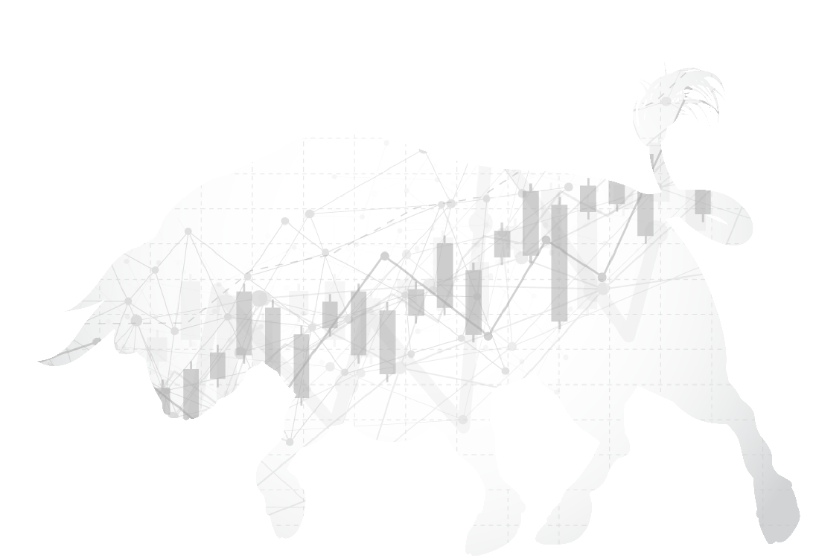
Reasons to be
Bullish on Equities
Not FDIC Insured | Not Bank Guaranteed | May Lose Value
This presentation was prepared by First Trust Portfolios L.P., and reflects the current opinion of the authors. Opinions and forward looking statements expressed are subject to change without notice. This information does not constitute a solicitation or an offer to buy or sell any security.
The information presented is not intended to constitute an investment recommendation for, or advice to, any specific person. By providing this information, First Trust is not undertaking to give advice in any fiduciary capacity within the meaning of ERISA and the Internal Revenue Code. First Trust has no knowledge of and has not been provided any information regarding any investor. Financial advisors must determine whether particular investments are appropriate for their clients. First Trust believes the financial advisor is a fiduciary, is capable of evaluating investment risks independently and is responsible for exercising independent judgment with respect to its retirement plan clients.

Slide 2
Bull markets don’t die of old age
Current bull market in stocks is the second-longest ever at 9 years, 3 months and 21 days (3/9/09-6/30/18).
Longest bull market in stocks lasted 12 years, 3 months and 20 days (12/4/87-3/24/00).
Current bull market lags the longest by 3 years.
Source: Bespoke Investment Group. S&P 500 Index used to measure bull markets.

Slide 3
Bull markets usually end when the Fed raises rates excessively – currently, not a problem
Federal funds rate
Source: Federal Reserve Board/Haver Analytics, 1990 – 2Q18.
Notes:
The Federal Funds rate remains well below the pace of nominal GDP growth (4.4% annual growth rate over the past two years), signaling that monetary policy remains loose
Even with four rate hikes in 2018 and four more in 2019 (First Trust’s forecast), rates would still not be tight (https://www.ftportfolios.com/Commentary/EconomicResearch/2018/6/11/is-2020-the-year-for-recession)
The markets currently place a low probability that there will be four rate hikes in 2019, despite the unemployment rate below the Fed’s long-run target and inflation standing above the Fed’s 2% inflation target.
As markets adjust to expectations for higher rates, there will likely be short-term volatility. As the markets overreact, remain focused on the fundamentals

Slide 4
The U.S. economic expansion has been relatively modest and that is why we believe it has legs
Current U.S. economic expansion is the second-longest ever at 9 years (July 2009-June 2018).
Longest U.S. economic expansion lasted 10 years (March 1991-March 2001).
Current economic expansion lags the longest by 1 year.
Source: Bespoke Investment Group

Slide 5
Real GDP growth has averaged just 2.2% in the current recovery (Q3’09-Q1’18)
Real gross domestic product (gdp)
Trillions of 2009 Dollars
Source: Bureau of Economic Analysis. Data from 1Q06 – 1Q18, seasonally adjusted annual rate.
Notes:
GDP is one of the primary indicators used to gauge the health of a country's economy. It represents the total dollar value of all goods and services produced over a specific time period. GDP figures are often considered the benchmark for the size of the economy.

Slide 6
U.S. trade is expanding despite rumors to the contrary
value of total trade (imports + exports)
USD, billions
Source: Federal Reserve Board/Haver Analytics, 1995 – 2Q18, seasonally adjusted.
Notes:
The value of total trade (imports plus exports) stands at/near all-time highs (https://www.ftportfolios.com/Commentary/EconomicResearch/2018/7/6/the-trade-deficit-in-goods-and-services-at-43.1-billion-in-may)
Tariff talk and trade wars are short-term distractions from the trend in increased global trade that has been in progress for decades
Companies and politicians love to discuss potential impacts from policy, we prefer to look at the data to see what is actually occurring

Slide 7
We do not see a recession looming, given the robust labor market
Job openings
Millions
Source: Bureau of Labor Statistics. Data from 12/06 – 5/18, total nonfarm, seasonally adjusted.
Update:
Economic Research FRED

Slide 8
Corporate profits have a significant influence on the direction of stock prices over time
Corporate profits after tax
USD, billions
Source: Federal Reserve Board/Haver Analytics, 1995 – 1Q18 (latest data available), seasonally adjusted.
Notes:
We believe after-tax corporate profits are the key driver for stocks.
After-tax corporate profits stand at an all-time high, and economic growth suggests the coming quarters should see this trend continue.

Slide 9
The expected decline in speculative-grade bond defaults is a sign of strength
If the level of risk in the markets were truly rising it would be validated by a rise in corporate bond defaults, specifically with respect to the riskiest issuers.
Since 1983, Moody’s puts the historical average default rate on global speculative-grade (high yield) corporate bonds at 4.2%. That default rate stood at 2.9% at the end of Q2’18.
Moody’s sees the default rate falling to 2.0% by Q2’19.
Source: Moody’s Investor Services, 6/30/18. Past performance is no guarantee of future results. There can be no assurance projections will be achieved.

Slide 10
Volatility in the stock market remains well below its historical average
CBOE SPX Volatility Index® (VIX)
Average: 20.26
Source: Bloomberg, weekly data from 6/26/98-6/29/18. Past performance is no guarantee of future results. There can be no assurance projections will be achieved.
VIX - Chicago Board Options Exchange SPX Volatility Index. The Chicago Board Options Exchange Volatility Index reflects a market estimate of future volatility, based on the weighted average of the implied volatilities for a wide range of strike prices.
Notes:
If the level of risk in the markets were markedly rising, then the VIX Index would not likely remain below its 20-year average of 20.26 for such lengthy sustained periods.

Slide 11
A snapshot of where interest rate and yield levels stood at the end of past bull markets
Day Bull Market Ended (S&P 500 Index) | Fed Funds Target Rate | 10-Year T-Note Yield
6/30/18 (Ongoing) | 2.00% | 2.86%
10/9/07 | 4.75% | 4.65%
3/24/00 | 6.00% | 6.19%
8/25/87 | 6.75% | 8.72%
11/28/80 | 18.00% | 12.72%
1/11/73 | 5.75% | 6.43%
Source: Bespoke Investment Group, Bloomberg.
Notes:
Economic expansions and bull markets in stocks in the U.S. tend to fizzle out when the Federal Reserve tightens monetary policy (raises lending rates) too much. This chart lends some perspective on rate levels.

Slide 12
These are numbers investors should embrace, not run from
S&P 500 and Sector Indices
 | 2018 Earnings Est. | 2019 Earnings Est. | 2018 Revenue Est. | 2019 Revenue Est.
S&P 500 Index | 23.1% | 11.1% | 7.8% | 5.1%
Consumer Discretionary | 12.9% | 14.6% | 8.5% | 6.5%
Consumer Staples | 9.1% | 6.2% | 4.6% | 3.5%
Energy | 95.9% | 17.3% | 17.1% | 4.5%
Financials | 25.4% | 10.6% | 3.8% | 5.2%
Health Care | 14.8% | 8.9% | 6.9% | 5.4%
Industrials | 18.4% | 12.5% | 7.6% | 5.2%
Info. Tech | 33.3% | 13.6% | 12.6% | 7.3%
Materials | 27.3% | 7.9% | 10.3% | 2.8%
Real Estate | 8.3% | 6.0% | 9.6% | 5.0%
Telecommunication Services | 16.0% | 2.3% | 2.8% | 1.3%
Utilities | 10.3% | 5.4% | 0.7% | 2.1%
Source: Bloomberg. Estimated Y-O-Y Earnings & Revenue Growth Rates as of 6/29/18. Consensus estimates using fiscal year revenue from each company. There can be no assurance projections will be achieved.
Notes:
Bull markets in stocks do not tend to roll over and die when earnings and revenue growth estimates project the kind of strength that is reflected in this table.

Slide 13
The recent spike in growth stocks is another sign of strength
Growth vs. Value total returns
Source: Bloomberg. Past performance is no guarantee of future results. YTD, 1-Year and Average Annualized Total Returns through 6/29/18. This chart is for illustrative purposes only and not indicative of any actual investment. The illustration excludes the effects of taxes and brokerage commissions or other expenses incurred when investing. Investors cannot invest directly in an index. The S&P 500 Pure Growth Index is a style-concentrated index designed to track the performance of stocks that exhibit the strongest growth characteristics based on three factors: sales growth, the ratio of earnings change to price, and momentum. It includes only those components of the parent index that exhibit strong growth characteristics, and weights them by growth score. Constituents are drawn from the S&P 500 Index. The S&P 500 Pure Value Index is a style-concentrated index designed to track the performance of stocks that exhibit the strongest value characteristics based on three factors: the ratios of book value, earnings, and sales to price. It includes only those components of the parent index that exhibit strong value characteristics, and weights them by value score. Constituents are drawn from the S&P 500 Index. The S&P 500 Index is a capitalization-weighted index comprised of 500 stocks (currently 505) used to measure large-cap U.S. stock market performance.
Notes:
The stock market is a forward-looking mechanism. That is why the forecasting of corporate earnings and revenue streams are so important. The significant outperformance of growth stocks relative to value stocks over the past year indicates that investors may be responding to the upbeat estimates on previous slide.

Slide 14
Corporate America is rewarding shareholders via dividends and buybacks
S&P 500 Index (Stock Dividends + Stock Buybacks)
USD, billions
Source: S&P Dow Jones Indices. *Q1’18 is a preliminary figure.
Notes:
Corporate America is flourishing in the current expansion and the companies that comprise the S&P 500 Index are sharing their good fortune with shareholders.

Slide 15
Corporate America’s coffers are growing despite higher spending on dividends and buybacks
S&P 500 Industrials (Old) Cash & Equivalents
USD, billions
Source: S&P Dow Jones Indices. S&P 500 Industrials (Old) is defined as the S&P 500 minus Financials, Transportation, Real Estate and Utilities.
Notes:
Corporate America remains cash rich despite returning trillions of dollars to shareholders via stock dividends and buybacks since the start of the current bull in March 2009.

Slide 16
A snapshot showing why stocks are not currently overvalued
S&P 500 Index Average Annual Total Returns
Source: Bloomberg & Ibbotson Associates/Morningstar. Past performance is no guarantee of future results. This chart is for illustrative purposes only and not indicative of any actual investment. The illustration excludes the effects of taxes and brokerage commissions or other expenses incurred when investing. Investors cannot invest directly in an index. The S&P 500 is a capitalization-weighted index comprised of 500 stocks (currently 505) used to measure large-cap U.S. stock market performance.
Notes:
Are U.S. stocks overvalued? While there are many metrics that can be used to argue one side or the other, we believe there is room for an eyeball test using historical returns.
The last bar in the chart represents the average annual total return for the S&P 500 Index since 1926. Since it covers such a long period, it tends to change modestly with each passing year.
The orange bar indicates that while the gap is narrowing, the 9.8% average annual total return still falls short of the 10.2% historical norm from 1926-2017.

