Slide 1

This presentation must be preceded or accompanied by a current Franklin Rising Dividends Fund, Franklin Adjustable U.S. Government Securities Fund, Franklin Income Fund, Franklin Mutual Global Discovery Fund and Templeton Global Bond Fund summary prospectus and/or prospectuses. Please carefully read a prospectus before you invest or send money. Investors should carefully consider a fund’s investment goals, risks, charges and expenses before investing.
Not FDIC Insured • May Lose Value • No Bank Guarantee
Notes:
Generating Income for Living
RTSI CUPPT 07/18

Slide 2
Retirement Realities
What percentage said they were concerned about managing their retirement income to meet their retirement expenses?¹
1. The Franklin Templeton Retirement Income Strategies and Expectations (RISE) survey was conducted online among a sample of 2,002 adults comprising 1,002 men and 1,000 women 18 years of age or older. The survey was administered between January 17 and 25, 2018, by ORC International’s Online CARAVAN®, which is not affiliated with Franklin Templeton Investments. Data is weighted to gender, age, geographic region, education and race. The custom-designed weighting program assigns a weighting factor to the data based on current population statistics from the U.S. Census Bureau.
Notes:
Main Point: People are concerned.
By a show of hands, who is concerned about generating income in retirement to meet your expenses? Well, you are not alone. According to our recent RISE Survey, 45% are concerned about managing their retirement income to meet their retirement expenses.¹
1. The Franklin Templeton Retirement Income Strategies and Expectations (RISE) survey was conducted online among a sample of 2,002 adults comprising 1,002 men and 1,000 women 18 years of age or older. The survey was administered between January 17 and 25, 2018, by ORC International’s Online CARAVAN®, which is not affiliated with Franklin Templeton Investments. Data is weighted to gender, age, geographic region, education and race. The custom-designed weighting program assigns a weighting factor to the data based on current population statistics from the U.S. Census Bureau.
Generating Income for Living
RTSI CUPPT 07/18

Slide 3
Retirement Realities
45%
are concerned about managing their retirement income to meet their retirement expenses.¹
1. The Franklin Templeton Retirement Income Strategies and Expectations (RISE) survey, 2018.
Notes:
Main Point: People are concerned.
By a show of hands, who is concerned about generating income in retirement to meet your expenses? Well, you are not alone. According to our recent RISE Survey, 45% are concerned about managing their retirement income to meet their retirement expenses.¹
1. The Franklin Templeton Retirement Income Strategies and Expectations (RISE) survey, 2018.
Generating Income for Living
RTSI CUPPT 07/18

Slide 4
Retirement Realities
What percentage of retirees under
age 65 retired due to circumstances beyond their control?¹
1. The Franklin Templeton Retirement Income Strategies and Expectations (RISE) survey, 2018.
Notes:
Main Point: People aren’t always in control.
According to our recent RISE Survey, 22% of retirees under age 65 retired due to circumstances beyond their control.¹ Perhaps it was due to a layoff or a health issue. Things don’t always go as planned, so being prepared for the unexpected is always a good idea.
1. The Franklin Templeton Retirement Income Strategies and Expectations (RISE) survey, 2018.
Generating Income for Living
RTSI CUPPT 07/18

Slide 5
Retirement Realities
22%
of retirees under age 65 retired due to circumstances beyond their control.¹
1. The Franklin Templeton Retirement Income Strategies and Expectations (RISE) survey, 2018.
Notes:
Main Point: People aren’t always in control.
According to our recent RISE Survey, 22% of retirees under age 65 retired due to circumstances beyond their control.¹ Perhaps it was due to a layoff or a health issue. Things don’t always go as planned, so being prepared for the unexpected is always a good idea.
1. The Franklin Templeton Retirement Income Strategies and Expectations (RISE) survey, 2018.
Generating Income for Living
RTSI CUPPT 07/18

Slide 6
Retirement Realities
What percentage of those who developed
a written retirement income plan know with
a high degree of confidence how much
of their current earned income may be
replaced by Social Security in retirement?¹
1. The Franklin Templeton Retirement Income Strategies and Expectations (RISE) survey, 2018.
Notes:
Main Point: People can prepare.
Our recent RISE Survey found that 72% of those who developed a written retirement income plan know with a high degree of confidence how much of their current earned income may be replaced by Social Security in retirement.¹ Do you know how much of your income will be replaced? If not, you are in the right place.
1. The Franklin Templeton Retirement Income Strategies and Expectations (RISE) survey, 2018.
Generating Income for Living
RTSI CUPPT 07/18

Slide 7
Retirement Realities
72%
of those who developed a written retirement income plan know with a high degree of confidence how much of their current earned income may be replaced by Social Security
in retirement.¹
1. The Franklin Templeton Retirement Income Strategies and Expectations (RISE) survey, 2018.
Notes:
Main Point: People can prepare.
Our recent RISE Survey found that 72% of those who developed a written retirement income plan know with a high degree of confidence how much of their current earned income may be replaced by Social Security in retirement.¹ Do you know how much of your income will be replaced? If not, you are in the right place.
1. The Franklin Templeton Retirement Income Strategies and Expectations (RISE) survey, 2018.
Generating Income for Living
RTSI CUPPT 07/18

Slide 8

INCOME FOR WHAT’S NEXT®
Generating Income
for Living
Month XX, 201X (Arial 12pt.)
Notes:
Generating Income for Living
RTSI CUPPT 07/18

Slide 9
Presented by
  Presenter Name, CFA
    Presenter Title
    Presenter other info
Notes:
Generating Income for Living
RTSI CUPPT 07/18

Slide 10
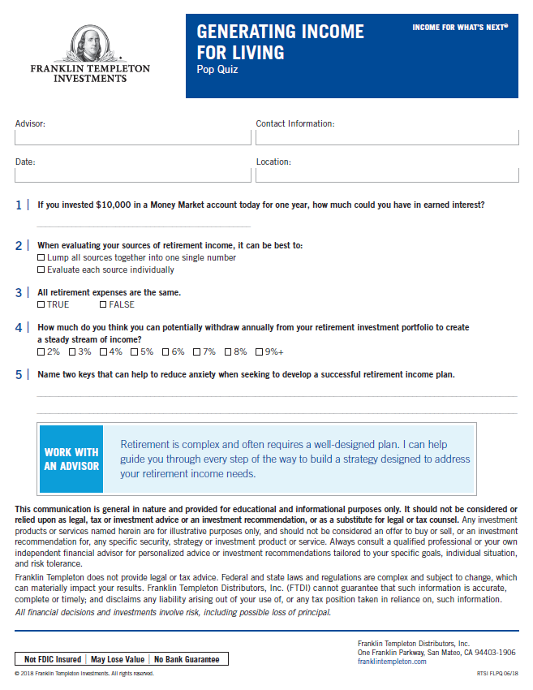
Retirement Income Pop Quiz
Notes:
Main Point: Retirement Income Pop Quiz
[Hand out quiz]
Everybody loves a quiz. Luckily, this one is open book...or open seminar.
(Read questions aloud)
If you invested $10,000 in a Money Market Account today for one year, how much could you have in earned interest?
When evaluating your sources of retirement income, it can be best to:
Lump all sources together into one single number
Evaluate each source individually
True or False? All retirement expenses are the same.
How much do you think you can potentially withdraw annually from your retirement investment portfolio to create a steady stream of income?
Name two keys that can help to reduce anxiety when seeking to develop a successful retirement income plan.
How many of you can answer these off the top of your head? Don’t worry, we will not grade them and you will learn the answers throughout the presentation, so be sure to take some notes.
Generating Income for Living
RTSI CUPPT 07/18

Slide 11
Today’s Discussion
Retirement Is Changing
The Three Building Blocks of a Retirement Income Plan
Developing Your Retirement Income Plan
Final Thoughts
Notes:
Main Point: Today’s Agenda
Here is the agenda for today’s presentation:
Retirement is Changing…what retirement was is not what it is today, or what it will be in the future.
The Three Building Blocks of a Retirement Income Plan…we will walk through the information needed to get started in building a Retirement Income Plan.
Developing Your Retirement Income Plan… we will show you a case study which will give you ideas for developing your own personal strategy.
Final Thoughts.
Generating Income for Living
RTSI CUPPT 07/18

Slide 12
Income for What’s Next
The Three
Building Blocks
of a Retirement
Income Plan
The Three
Building Blocks
of a Retirement
Income Plan
Developing
Your Retirement Income Plan
Retirement
Is Changing
Developing
Your Retirement Income Plan
Final Thoughts
Final Thoughts
Notes:
Main Point: Transition slide.
Generating Income for Living
RTSI CUPPT 07/18

Slide 13





Retirement Is Changing
You Are Not Rich Enough to Retire on CDs Alone
Notes:
Main Point: Retirement Is Changing.
Let’s talk briefly about the history of retirement.
Retirement is a fairly new concept. Consider that in the early 1900s, life expectancy was still in the 40s in the United States. It wasn’t until the 1940s that life expectancy first exceeded 60 years.
Social Security was started in the 1930s. The Social Security Act was signed by FDR on 8/14/35. Taxes were collected for the first time in January 1937 and the first one-time, lump-sum payments were made that same month. Regular ongoing monthly benefits started in January 1940. It was developed while life expectancy was still quite low. (Source: http://www.ssa.gov/history/hfaq.html)
Here are some examples of how retirement has changed over the years:
[Click] In the past, interest rates were on a declining trend. Will they continue rising in the future?
[Click] Historically, investors saw fewer investment choices for retirement. Today there are more options, but will they be more targeted in the future?
[Click] The responsibility of retirement saving was traditionally shared between the individual and the employer. Over the years, we’ve seen a shift making individuals responsible for their future in retirement.
[Click] Lifespans have changed, too. People are living longer than ever and need to plan for a longer retirement.
[Click] We have seen significant inflation in the past, and we can’t be certain what will happen in the future.
Transition: Let’s take a look at the first question on your quiz…if you invested $10,000 in a Money Market Account today for one year, what could you buy with the interest earned?
Generating Income for Living
RTSI CUPPT 07/18

Slide 14





Retirement Is Changing
You Are Not Rich Enough to Retire on CDs Alone
Notes:
Main Point: Retirement Is Changing.
Let’s talk briefly about the history of retirement.
Retirement is a fairly new concept. Consider that in the early 1900s, life expectancy was still in the 40s in the United States. It wasn’t until the 1940s that life expectancy first exceeded 60 years.
Social Security was started in the 1930s. The Social Security Act was signed by FDR on 8/14/35. Taxes were collected for the first time in January 1937 and the first one-time, lump-sum payments were made that same month. Regular ongoing monthly benefits started in January 1940. It was developed while life expectancy was still quite low. (Source: http://www.ssa.gov/history/hfaq.html)
Here are some examples of how retirement has changed over the years:
[Click] In the past, interest rates were on a declining trend. Will they continue rising in the future?
[Click] Historically, investors saw fewer investment choices for retirement. Today there are more options, but will they be more targeted in the future?
[Click] The responsibility of retirement saving was traditionally shared between the individual and the employer. Over the years, we’ve seen a shift making individuals responsible for their future in retirement.
[Click] Lifespans have changed, too. People are living longer than ever and need to plan for a longer retirement.
[Click] We have seen significant inflation in the past, and we can’t be certain what will happen in the future.
Transition: Let’s take a look at the first question on your quiz…if you invested $10,000 in a Money Market Account today for one year, what could you buy with the interest earned?
Generating Income for Living
RTSI CUPPT 07/18

Slide 15





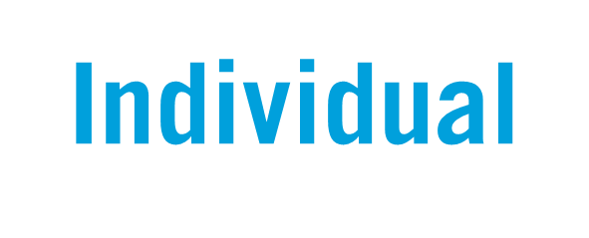
Retirement Is Changing
You Are Not Rich Enough to Retire on CDs Alone
Notes:
Main Point: Retirement Is Changing.
Let’s talk briefly about the history of retirement.
Retirement is a fairly new concept. Consider that in the early 1900s, life expectancy was still in the 40s in the United States. It wasn’t until the 1940s that life expectancy first exceeded 60 years.
Social Security was started in the 1930s. The Social Security Act was signed by FDR on 8/14/35. Taxes were collected for the first time in January 1937 and the first one-time, lump-sum payments were made that same month. Regular ongoing monthly benefits started in January 1940. It was developed while life expectancy was still quite low. (Source: http://www.ssa.gov/history/hfaq.html)
Here are some examples of how retirement has changed over the years:
[Click] In the past, interest rates were on a declining trend. Will they continue rising in the future?
[Click] Historically, investors saw fewer investment choices for retirement. Today there are more options, but will they be more targeted in the future?
[Click] The responsibility of retirement saving was traditionally shared between the individual and the employer. Over the years, we’ve seen a shift making individuals responsible for their future in retirement.
[Click] Lifespans have changed, too. People are living longer than ever and need to plan for a longer retirement.
[Click] We have seen significant inflation in the past, and we can’t be certain what will happen in the future.
Transition: Let’s take a look at the first question on your quiz…if you invested $10,000 in a Money Market Account today for one year, what could you buy with the interest earned?
Generating Income for Living
RTSI CUPPT 07/18

Slide 16




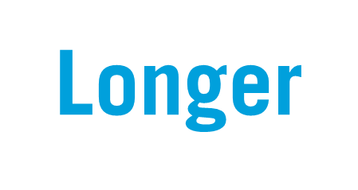
Retirement Is Changing
You Are Not Rich Enough to Retire on CDs Alone
Notes:
Main Point: Retirement Is Changing.
Let’s talk briefly about the history of retirement.
Retirement is a fairly new concept. Consider that in the early 1900s, life expectancy was still in the 40s in the United States. It wasn’t until the 1940s that life expectancy first exceeded 60 years.
Social Security was started in the 1930s. The Social Security Act was signed by FDR on 8/14/35. Taxes were collected for the first time in January 1937 and the first one-time, lump-sum payments were made that same month. Regular ongoing monthly benefits started in January 1940. It was developed while life expectancy was still quite low. (Source: http://www.ssa.gov/history/hfaq.html)
Here are some examples of how retirement has changed over the years:
[Click] In the past, interest rates were on a declining trend. Will they continue rising in the future?
[Click] Historically, investors saw fewer investment choices for retirement. Today there are more options, but will they be more targeted in the future?
[Click] The responsibility of retirement saving was traditionally shared between the individual and the employer. Over the years, we’ve seen a shift making individuals responsible for their future in retirement.
[Click] Lifespans have changed, too. People are living longer than ever and need to plan for a longer retirement.
[Click] We have seen significant inflation in the past, and we can’t be certain what will happen in the future.
Transition: Let’s take a look at the first question on your quiz…if you invested $10,000 in a Money Market Account today for one year, what could you buy with the interest earned?
Generating Income for Living
RTSI CUPPT 07/18

Slide 17


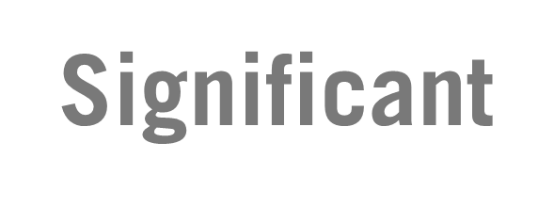


Retirement Is Changing
You Are Not Rich Enough to Retire on CDs Alone
Notes:
Main Point: Retirement Is Changing.
Let’s talk briefly about the history of retirement.
Retirement is a fairly new concept. Consider that in the early 1900s, life expectancy was still in the 40s in the United States. It wasn’t until the 1940s that life expectancy first exceeded 60 years.
Social Security was started in the 1930s. The Social Security Act was signed by FDR on 8/14/35. Taxes were collected for the first time in January 1937 and the first one-time, lump-sum payments were made that same month. Regular ongoing monthly benefits started in January 1940. It was developed while life expectancy was still quite low. (Source: http://www.ssa.gov/history/hfaq.html)
Here are some examples of how retirement has changed over the years:
[Click] In the past, interest rates were on a declining trend. Will they continue rising in the future?
[Click] Historically, investors saw fewer investment choices for retirement. Today there are more options, but will they be more targeted in the future?
[Click] The responsibility of retirement saving was traditionally shared between the individual and the employer. Over the years, we’ve seen a shift making individuals responsible for their future in retirement.
[Click] Lifespans have changed, too. People are living longer than ever and need to plan for a longer retirement.
[Click] We have seen significant inflation in the past, and we can’t be certain what will happen in the future.
Transition: Let’s take a look at the first question on your quiz…if you invested $10,000 in a Money Market Account today for one year, what could you buy with the interest earned?
Generating Income for Living
RTSI CUPPT 07/18

Slide 18
Retirement Is Changing
You Are Not Rich Enough to Retire on CDs Alone
After one year, a $10,000 investment would earn:
Yields as of December 31, 2018
Money Market Accounts
1-Year CDs
10-Year Treasuries
This chart is for illustrative purposes only and does not reflect the performance of any Franklin Templeton fund.
Past performance does not guarantee future results.
It’s important to note that money market accounts and CDs are insured by the Federal Deposit Insurance Corporation (FDIC) for up to $250,000 and CDs offer a fixed rate of return. Treasuries, if held to maturity, offer a fixed rate of return and fixed principal value; their interest payments and principal are guaranteed. Fund investment returns and share prices will fluctuate with market conditions, and investors may have a gain or a loss when they sell their shares.
Sources: FRED; Federal Reserve. Money Market Accounts yield data is from FRED: https://fred.stlouisfed.org/series/MMNRNJ#0. 1-Year CDs yield data is from FRED: https://fred.stlouisfed.org/series/CD12NRNJ#0. 10-Year Treasury Yield is from the Federal Reserve’s H.15 Report. Amount earned on a 1-Year $10,000 investment assumes
the investment is made on the as of date above. Internal sources: Federal Reserve’s website.
Notes:
As you know, we are in a situation with historically low interest rates. Just walk into your local bank and ask them about their current rate on a savings account. Because of these low rates, people who thought that they could simply put money into very conservative accounts are facing the harsh reality that they will likely have to look elsewhere for needed income. Let me show you what I mean.
[Click] As of December 31, 2018, if you invested $10,000 in a money market account for one year, you would earn about $16—or enough for a small latte at your favorite coffee shop. A one-year CD would earn you around $61—enough for three movie tickets...
And if you’re thinking a 10-year Treasury is much better, guess again. Earning approximately $280, you might only have enough for a trip to the grocery store. And if you factor in inflation and taxes, these meager yields look even worse.
Sources: FRED; Federal Reserve. Money Market Accounts yield data is from FRED: https://fred.stlouisfed.org/series/MMNRNJ#0. 1-Year CDs yield data is from FRED: https://fred.stlouisfed.org/series/CD12NRNJ#0. 10-Year Treasury Yield is from the Federal Reserve’s H.15 Report. Amount earned on a 1-Year $10,000 investment assumes the investment is made on the as of date above. Internal sources: Federal Reserve’s website.
Generating Income for Living
RTSI CUPPT 07/18

Slide 19
Income for What’s Next
The Three
Building Blocks
of a Retirement Income Plan
Developing
Your Retirement Income Plan
Retirement
Is Changing
Developing
Your Retirement Income Plan
Retirement
Is Changing
Final Thoughts
Final Thoughts
Notes:
Main Point: Transition slide.
Generating Income for Living
RTSI CUPPT 07/18

Slide 20


1. Prioritize Goals & Concerns
Goals
Concerns
Travel
Taxes
Go to School
Retire Early
Outliving Assets
Leave a Legacy
Hobbies
Risk Tolerance
Longevity
Volunteer
Market Declines
Inflation
Notes:
Main Point: Prioritize your goals and concerns.
The first and perhaps the most important building block of a retirement income plan is to prioritize your goals and concerns. A good retirement strategy should balance both. A plan that focuses on goals and does not address your concerns may keep you up at night as you worry about unaddressed issues and risks. Similarly, a plan that only addresses concerns and does not consider your goals runs the risk of implementing a strategy that is not personally rewarding.
Everyone is different. For you, going to school might be an important goal. For someone else, travel may be at the top of their list. It is the same with concerns; some may be worried about taxes. Others may be worried about outliving their savings.
Transition: The next step is to translate these goals and concerns into expenses. Many of you may already think this way, and in fact, 82% of all retirement-income calculations are based on an estimate of monthly expenses.¹
1. Cogent Research®: In-Retirement Income™ 2011.
Generating Income for Living
RTSI CUPPT 07/18

Slide 21



2. Translate Goals & Concerns into Expenses
Basic vs. Discretionary
What are they used for?
Greater Impact
from Income Volatility
Limited Impact
from Income Volatility
BASIC
Mortgage
Life Insurance
Fixed Loans
Discretionary
Health Care
Food
Utilities
Travel
Hobbies
Legacy
Notes:
Main Point: Not all retirement expenses are the same.
In general, there are two ways to look at your expenses.
The first way is to look at your expenses based on what they are used for, such as basic needs and discretionary “nice to haves.”
Basic: These are expenses for your basic needs such as food, shelter, transportation, health and medical.
Discretionary: As the name indicates, these expenses are not necessary. However, they can be essential for enjoying your retirement. They may include traveling, memberships and hobbies, for example.
Generating Income for Living
RTSI CUPPT 07/18

Slide 22
2. Translate Goals & Concerns into Expenses
Fixed vs. Rising
Do they rise over time?
Limited Impact
from Inflation
Greater Impact
from Inflation
FIXED
Mortgage
Life Insurance
Fixed Loans
RISING
Health Care
Food
Utilities
Travel
Hobbies
Legacy
Notes:
The first way we looked at expenses was what they were used for. The second way to look at them is how they change over time. Do they rise with inflation? Are they impacted by changes in the economy?
We can look at how they change over time:
Fixed: These are expenses that usually remain fairly consistent, like a fixed mortgage, other fixed loans or insurance payments.
Rising: These are the expenses such as food, utilities, health/medical care, and hobbies that tend to rise over time due to the impact of inflation.
Generating Income for Living
RTSI CUPPT 07/18

Slide 23
2. Translate Goals & Concerns into Expenses
There are three fundamental expense categories
FIXED
Mortgage
Life Insurance
Fixed Loans
RISING
Discretionary
Health Care
Food
Utilities
Travel
Hobbies
Legacy
Notes:
So, as we just discussed in the previous two slides, there are different types of retirement expenses…
First we looked at what they are used for, then we looked at how they change over time, and finally, we will combine those two ideas to come up with three easy distinct expense categories:
Fixed and Rising, which consist primarily of basic expenses, and Discretionary
As we have been talking about, not all expenses are the same. Let’s take a moment to think about how these expenses are different from one another and how that impacts your retirement.
For example…
What would happen if your income fell by 20%? For your Fixed expenses, would you simply not pay your mortgage? In many cases, that would be difficult. With Fixed and Rising expenses, income stability is important.
However, if we looked at your Discretionary expenses, you have more flexibility if your income falls. For example, you might opt for a stay-caution instead of going to Europe.
What would happen if inflation jumped to 8% per year?
Your Fixed expenses would likely not change, while your Rising and Discretionary expenses would be affected by the increase in inflation.
Transition: This is why we classify expenses into categories. By doing so, we can now look at identifying potential sources of income that also fit into these categories, and seek to match expenses and income sources.
Generating Income for Living
RTSI CUPPT 07/18

Slide 24


3. Understand Potential Retirement Income Sources
There is more than one source.
Your Retirement Income
= $??,??? per year
Notes:
Main Point: There is more than one source.
There are a variety of online retirement calculators that try to help you estimate how to save for retirement. In most cases, after you enter all of your information as assumptions, they show that you may have $X per year of projected income.
Many are tempted to think about their projected retirement income as just a single block of money. Just one number. In reality, your retirement income is likely more than a single block. In many cases, there are multiple sources that can contribute to your projected annual income, including “cashing out” of investments.
Generating Income for Living
RTSI CUPPT 07/18

Slide 25
3. Understand Potential Retirement Income Sources
Each one has a unique set of characteristics and risks.
Your Retirement Income
= $??,??? per year
Equity
Mutual Funds/
Stocks
Social Security/ Pension
Balanced Mutual Funds
Bonds/Fixed Income Mutual Funds
Work/ Employment
Variable Annuities
CDs/Fixed Annuities
Real Estate
Notes:
Main Point: Potential retirement income sources.
Think about your future retirement income. It will likely include more income sources than you had during your employment years.
Here is an example of the types of potential income sources that may contribute to retirement income. Each one of these has a unique set of characteristics and risks. Some, like Equity Mutual Funds or Stocks, have the potential to grow or decline over time. Others, like Variable Annuities, may be more protected from losing value. And some, like Social Security, are government-sponsored.
Transition: Just like expenses, there are different categories for potential sources of income. Let’s look at matching income sources to address the different types of expenses.
Generating Income for Living
RTSI CUPPT 07/18

Slide 26
Match Expenses with Potential Income Sources
Equity
Mutual
Funds
Social
Security/
Pension
Balanced
Mutual
Funds
Variable
Annuities
CDs/
Fixed
Annuities
Real
Estate
How do I do this?
Mortgage
Travel
Legacy
Food
Utilities
Life
Insurance
Fixed
Loans
Hobbies
Health Care
Notes:
Main Point: Match expenses with potential income sources.
Ok, you might be thinking…
“I thought this was supposed to be easy and simple. However, now I have to think about all of the types of income and expenses. It is very confusing.”
Transition: It’s actually not as confusing as it appears.
Generating Income for Living
RTSI CUPPT 07/18

Slide 27
Match Expenses with Potential Income Sources
Mortgage
Balanced
Mutual
Funds
Travel
Legacy
FIXED EXPENSES
Mortgage
Life
Insurance
Fixed Loans
RISING EXPENSES
Health Care
Food
Utilities
DISCRETIONARY
EXPENSES
Travel
Hobbies
Legacy
Food
Equity
Mutual
Funds
Life
Utilities
Insurance
Hobbies
Social
Security/
Pension
Fixed
Loans
Real
Estate
Variable
Annuities
CDs/
Fixed
Annuities
Health Care
Notes:
Main Point: Find common characteristics between expenses and income sources.
As we talked about earlier, your retirement income and retirement expenses each have unique characteristics. How can they best be associated?
Remember our Fixed basic expenses? They are less impacted by inflation but do need to be funded by a relatively stable source of income. Well, there are potential sources of income that may be suited to address them…Social Security, Pension, CDs and fixed annuities.
How about Rising basic expenses? They are more impacted by inflation. They too need to be funded by a relatively stable source, but one that has the potential to grow over time. Potential sources may include investments in equity mutual funds or stocks, and receiving dividends or the proceeds from the sale of shares. However, the potential for growth also increases the risk. If we choose too conservatively, they may not offer the necessary growth potential to meet rising costs. But, if we choose too aggressively, the source is at greater risk of loss, including possible total loss. A financial advisor can help you match the appropriate investment strategies with the right expense needs to suit your investment risk and comfort level.
How about Discretionary expenses? These are also impacted by inflation, but we have more flexibility in terms of the risk to stability. As mentioned earlier, if this source falls, you can adjust your spending more easily than you can with your basic expenses. You can downgrade your hobbies, travel, etc. However, if you are prepared to assume the risk of more growth-oriented investments, you have the potential of additional cash flow to fund your discretionary spending.
Transition: Now that we have learned about the building blocks of a retirement income plan, let’s look at how you and your financial advisor might develop your plan.
Generating Income for Living
RTSI CUPPT 07/18

Slide 28
Income for What’s Next
The Three
Building Blocks
of a Retirement Income Plan
Retirement
Is Changing
The Three
Building Blocks
of a Retirement Income Plan
Developing
Your Retirement Income Plan
Retirement
Is Changing
Final Thoughts
Final Thoughts
Notes:
Main Point: Transition slide.
Generating Income for Living
RTSI CUPPT 07/18

Slide 29

Hypothetical Case Study
Age | 65
Goal | Make his income last as long as he does
Annual Expenses | $50,000
Savings | $750,000
Unexpected | $50,000
Annual Non-Investment Income | $13,000
Benjamin Templeton
This example is intended only to illustrate one way in which the strategy may be used. All values used in the example are hypothetical and will differ from each client’s individual needs. There is no assurance that the strategy will achieve its intended objective.
Notes:
Main Point: Case study for Income for What’s Next.
Meet Benjamin Templeton.
He is 65 years old and wants to make sure that his income lasts as long as he does. Although he and his spouse have Social Security income, he still needs a majority of retirement income to come from his investments by receiving dividends or the proceeds from the sale of shares.
Here are the specifics:
Ben estimates his annual expenses in retirement to be about $50,000. Like many, he is not 100% sure about the amount of his expenses or what type of expenses they are.
Ben has done a good job of saving for retirement and has $800,000 in savings; $750,000 to build his retirement portfolio and $50,000 to set aside for unexpected expenses/purchases. In addition to his savings, Ben will receive Social Security, which will generate $13,000 per year.
The question is, how does he use that $750,000 of retirement savings to build his portfolio?
Transition: Let’s start with looking at Ben’s goals and concerns for retirement.
Generating Income for Living
RTSI CUPPT 07/18

Slide 30
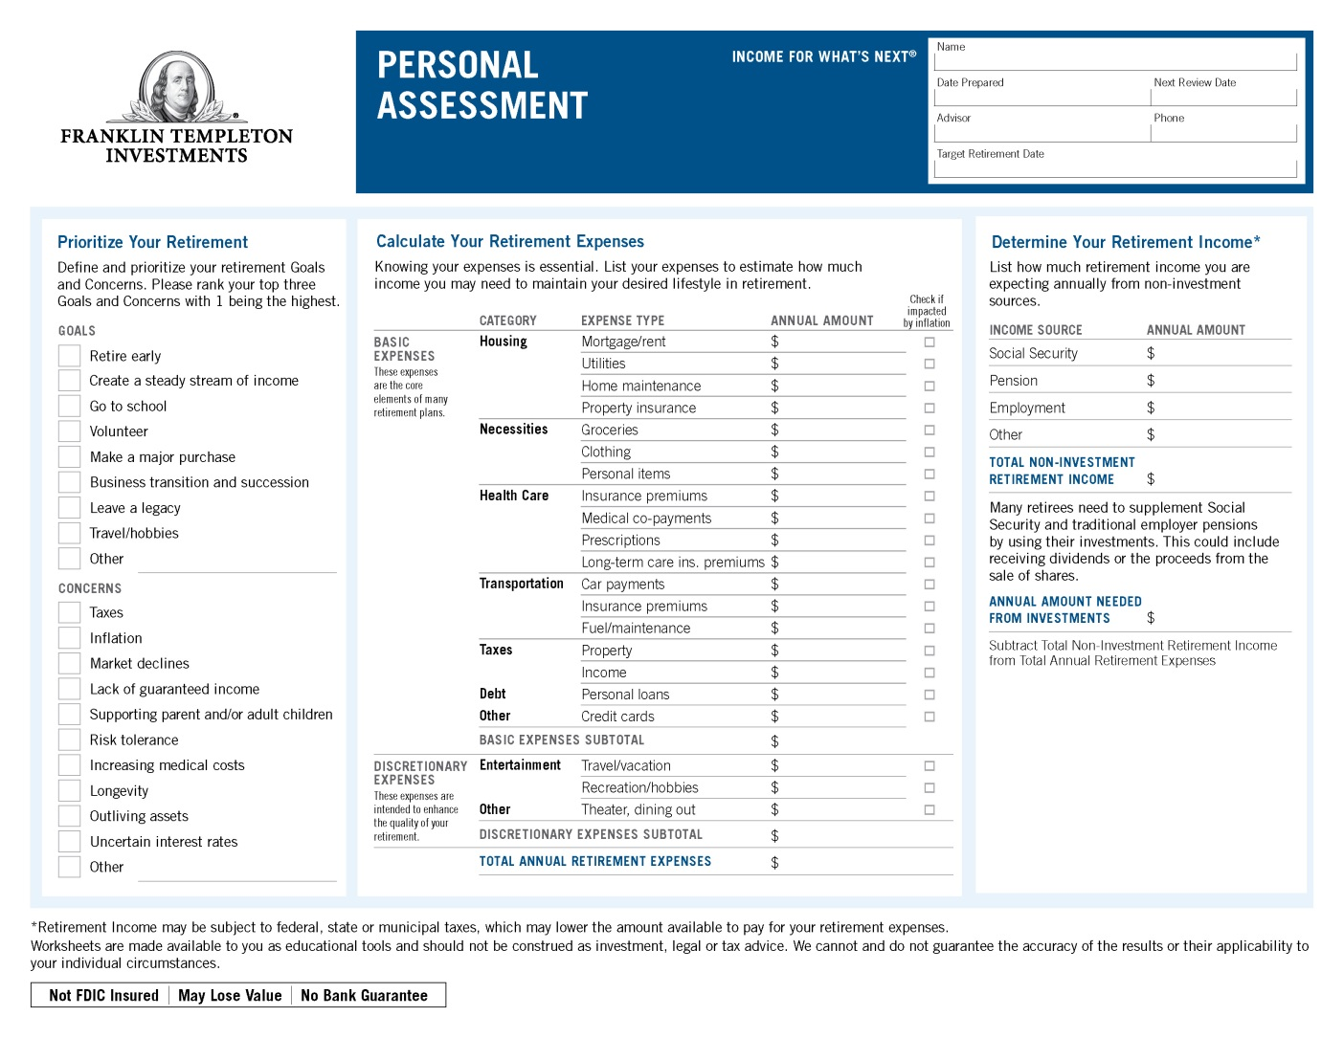
Hypothetical Case Study
Personal Assessment
Ben Templeton
10/23/18
10/23/19
Joe Smith
(123) 456-7890
1/1/20
Benjamin Templeton
Notes:
Main Point: Introduce the Income for What’s Next Personal Assessment Sheet
[Hand out Personal Assessment]
Let me introduce you to our Personal Assessment sheet. This tool will help you organize everything we have just discussed. There are sections to address both your goals and concerns, calculate your retirement expenses and determine your potential income sources in retirement. This is the first part of developing your retirement income plan, and you may want to fill it out before meeting with your financial advisor.
Let’s take a look at the Personal Assessment sheet and fill it out for Ben.
Generating Income for Living
RTSI CUPPT 07/18

Slide 31
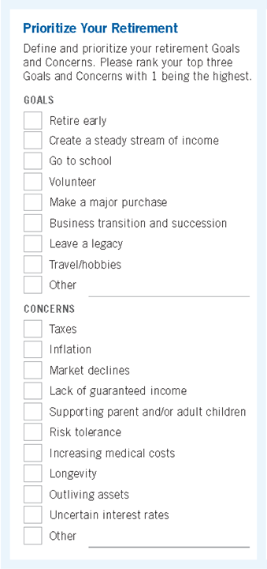
Hypothetical Case Study
Personal Assessment
Ben Templeton
10/23/18
10/23/19
Joe Smith
(123) 456-7890
1/1/20
1
Benjamin Templeton
2
3
3
2
1
Notes:
Main Point: Identify goals and concerns.
On the left side, there is a place for addressing both your goals and concerns.
[Click] to display the handwritten text in the ‘Prioritize Your Retirement’ section.
When it comes to his goals, we know that Ben’s goals include:
Primary goal: to create a steady stream of income.
Though he spent most of his career in the information technology field, he loves to write and has always dreamed of going back to school to study English or Journalism.
Ben and his wife Martha would like to take one significant trip out of the country each year, and hope to visit their grandchildren who are a three-hour drive away at least once a month.
When it comes to concerns, Ben is worried about:
Outliving assets
Market declines
Inflation
It is important to identify both your goals and concerns. A good retirement strategy should balance both. A plan that focuses on goals and does not address your concerns, may keep you up at night as you worry about unaddressed issues and risks. Similarly, a plan that only addresses concerns and does not consider your goals runs the risk of implementing
a strategy that is not personally rewarding.
Generating Income for Living
RTSI CUPPT 07/18

Slide 32
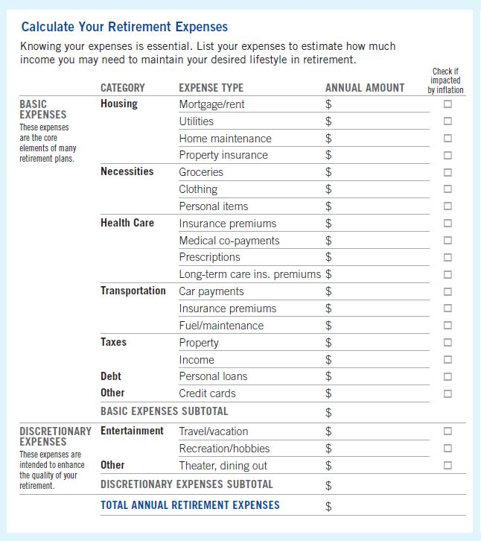
Hypothetical Case Study
Personal Assessment
Ben Templeton
10/23/17
10/23/19
Joe Smith
(123) 456-7890
1/1/19
12,000
12,000
12,000
x
x
Benjamin Templeton
1,200
x
1,200
1,200
x
x
1,000
x
1,000
1,000
x
x
1,000
x
1,000
1,000
x
x
1
7,600
x
7,600
7,600
x
x
2
500
x
500
500
x
x
500
x
500
500
x
x
3,000
x
3,000
3,000
x
x
500
x
500
500
x
x
3
500
x
500
500
x
x
1,200
x
1,200
3
1,200
x
x
2
3,000
x
3,000
3,000
1,500
1,500
1,500
1,500
1,500
1,500
1
35,000
35,000
35,000
x
x
5,000
x
5,000
5,000
x
x
5,000
x
5,000
5,000
x
x
5,000
x
5,000
5,000
15,000
15,000
15,000
50,000
50,000
50,000
Notes:
Main Point: Calculate retirement expenses.
[Click] to display the handwritten text in the ‘Calculate Your Retirement Expenses’ section.
Let’s take a look at Ben’s retirement expenses. This sheet makes it easy by listing common expenses and dividing them into Basic and Discretionary categories. From housing and health care to travel and taxes, Ben lists both the amount and, by checking the box to the right of the amount, if the expense is impacted by inflation.
Taking time to write this out is beneficial for two reasons:
By looking at your overall retirement income needs and examining them expense by expense, you will have greater insight into how you will live in retirement and where your income will need to go.
By checking the box that notes if it is impacted by inflation, it allows us to easily determine which category these expenses fall into.
It is important to note that you need to account for your taxes. Those will be an important consideration in your retirement.
Transition: Let me show you…
Generating Income for Living
RTSI CUPPT 07/18

Slide 33
Hypothetical Case Study
Personal Assessment
Fixed Expenses
Ben Templeton
10/23/17
10/23/19
Joe Smith
(123) 456-7890
1/1/19
Benjamin Templeton
12,000
x
1,200
x
1,000
x
1
1,000
x
2
7,600
x
500
x
500
x
3,000
x
3
500
x
500
3
1,200
x
2
3,000
x
1,500
1,500
1
35,000
5,000
x
5,000
x
5,000
x
15,000
50,000
Notes:
Main Point: Identify Fixed expenses.
[Click] to highlight Ben’s Fixed expenses.
Ben only has three Fixed expenses in the Basic category – his mortgage, his income and property taxes. Together, they total $15,000 per year.
Generating Income for Living
RTSI CUPPT 07/18

Slide 34
Hypothetical Case Study
Personal Assessment
Rising Expenses
Ben Templeton
10/23/17
10/23/19
Joe Smith
(123) 456-7890
1/1/19
Benjamin Templeton
12,000
x
1,200
x
1,000
x
1
1,000
x
2
7,600
x
500
x
500
x
3,000
x
3
500
x
500
3
1,200
x
2
3,000
x
1,500
1,500
1
35,000
5,000
x
5,000
x
5,000
x
15,000
50,000
Notes:
Main Point: Identify Rising expenses.
[Click] to highlight Ben’s Rising expenses.
Now, let’s look at Ben’s Rising expenses in the Basic category. In this case, Ben has a few more Rising expenses. These are the expenses that are in the Basic category and have the inflation box checked.
In total, Ben has $20,000 in Basic Rising expenses.
Generating Income for Living
RTSI CUPPT 07/18

Slide 35
Hypothetical Case Study
Personal Assessment
Discretionary Expenses
Ben Templeton
10/23/17
10/23/19
Joe Smith
(123) 456-7890
1/1/19
Benjamin Templeton
12,000
x
1,200
x
1,000
x
1
1,000
x
2
7,600
x
500
x
500
x
3,000
x
3
500
x
500
3
1,200
x
2
3,000
x
1,500
1,500
1
35,000
5,000
x
5,000
x
5,000
x
15,000
50,000
Notes:
Main Point: Identify Discretionary expenses.
[Click] to highlight Ben’s Discretionary expenses.
Finally, let’s look at Ben’s Discretionary expenses. In this case, Ben has allocated about $15,000 for these expenses.
Generating Income for Living
RTSI CUPPT 07/18

Slide 36
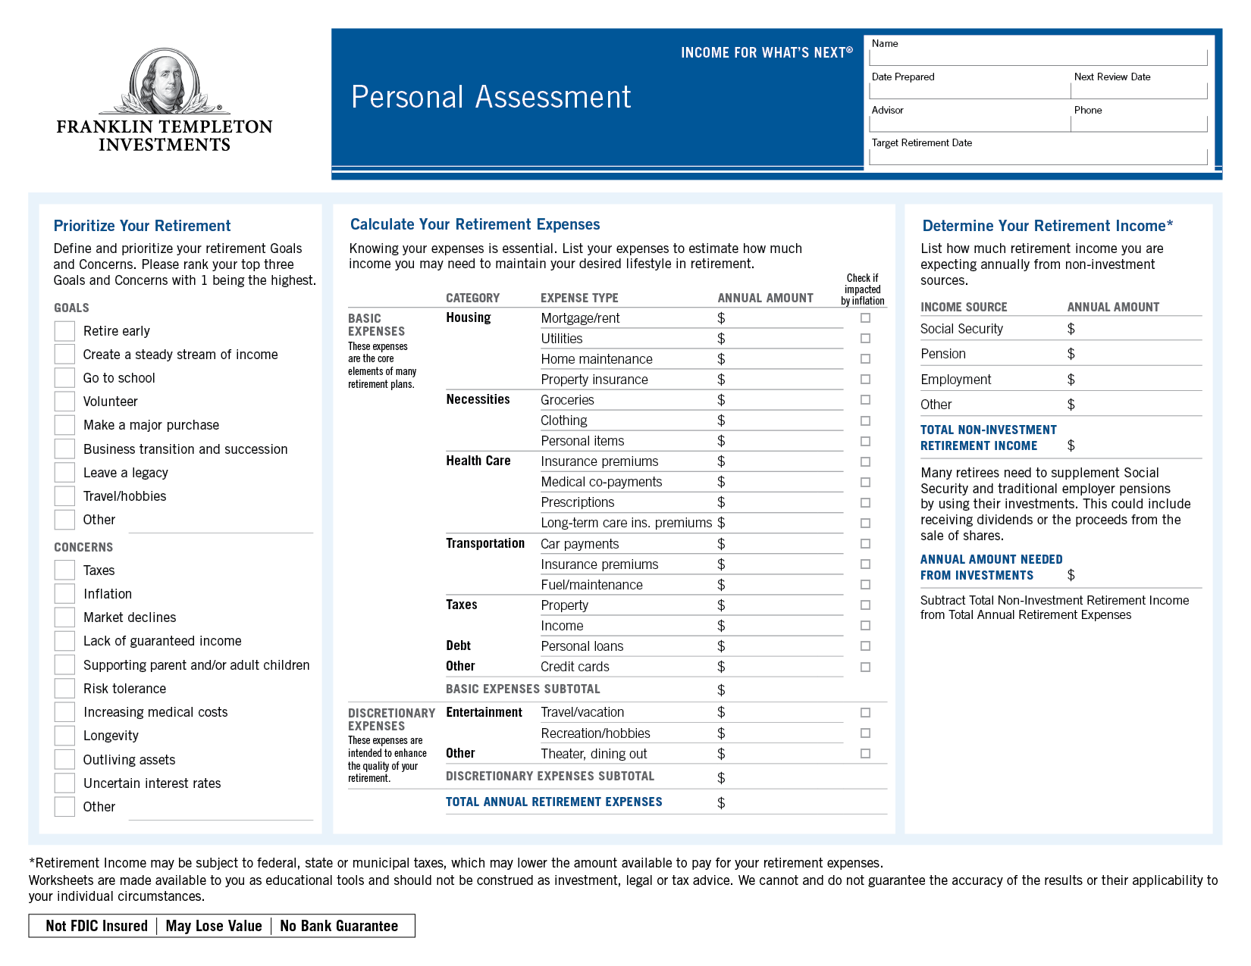
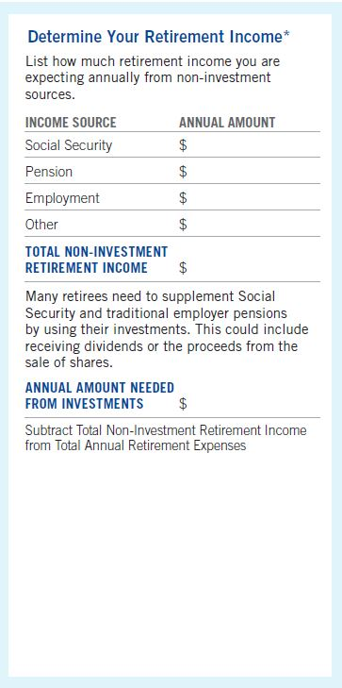
Hypothetical Case Study
Personal Assessment
Ben Templeton
10/23/18
10/23/19
Joe Smith
(123) 456-7890
1/1/20
Benjamin Templeton
13,000
13,000
37,000
Notes:
Main Point: Determine retirement income sources.
[Click] to highlight ‘Income Source and Annual Amount’ section.
Now let’s take a look at Ben’s retirement income. Ben will earn $13,000 per year in Social
Security benefits.
Generating Income for Living
RTSI CUPPT 07/18

Slide 37
Hypothetical Case Study
Personal Assessment
Ben Templeton
10/23/18
10/23/19
Joe Smith
(123) 456-7890
1/1/20
Benjamin Templeton
13,000
13,000
37,000
Notes:
Main Point: Calculate the total annual amount needed from investments.
[Click] to highlight the Annual Amount Needed from Investments section.
To calculate Ben’s Annual Amount Needed from Investments, we simply subtract his $13,000 of income from his $50,000 of Total Annual Retirement Expenses for a total of $37,000.
Transition: Now let’s take a look at the next step…
Generating Income for Living
RTSI CUPPT 07/18

Slide 38
Hypothetical Case Study
Three Types of Expenses
Benjamin Templeton
Rising
Discretionary
Fixed
$ 15,000
$ 20,000
$ 15,000
Notes:
Main Point: Three types of expenses.
Here is how Ben’s expenses turned out.
In the Basic category, Ben has $15,000 in Fixed expenses and $20,000 in Rising expenses.
In the Discretionary category, he has a total of $15,000 in expenses.
So, what is next? Because we have sliced and diced Ben’s retirement expenses into three distinct categories, now is the time to associate those expenses with potential income sources.
Transition: Luckily, we have an easy way to do this…with our Income for What’s Next Worksheet.
Generating Income for Living
RTSI CUPPT 07/18

Slide 39
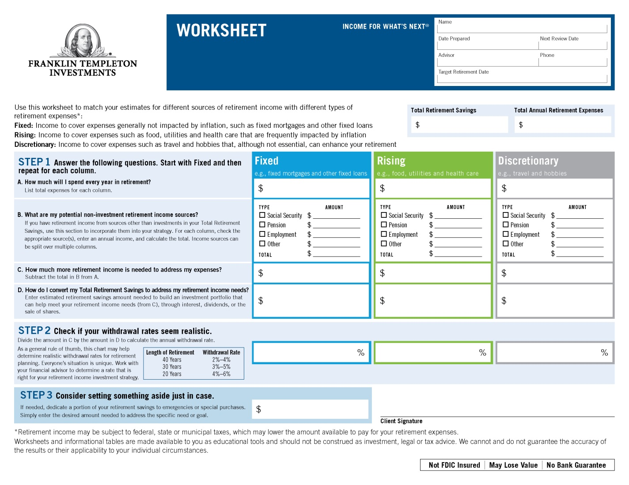
Hypothetical Case Study
Worksheet
Ben Templeton
10/23/18
10/23/19
Joe Smith
(123) 456-7890
1/1/20
Benjamin Templeton
800,000
50,000
Fixed
Rising
Discretionary
$ 15,000
$ 20,000
$ 15,000
15,000
20,000
15,000
x
13,000
13,000
2,000
20,000
15,000
50,000
450,000
250,000
4
4.5
6
50,000
Notes:
Let me now introduce you to our Worksheet. This is something you should fill out with your financial advisor, as he or she should be able to provide you personalized advice that is tailored to your specific goals, individual situation and risk tolerance.
• First, put the expenses into the correct columns. $15,000 goes into the Fixed column, $20,000 goes into the Rising column, and $15,000 goes into the Discretionary column. Once the expenses are entered, then it is time to work through each column and start to match income sources with the expenses.
[Click] to display the handwritten text in the Fixed section.
In the second box, we determine the sources of income that will be used for the Fixed expenses. In this case, Ben has decided to use his Social Security income to pay these expenses. As you can see, he has checked the Social Security box and entered the estimated amount of income. Social Security provides almost enough money to meet his estimated expenses; however, he needs an additional $2,000 to come from investments by receiving dividends or the proceeds from the sale of shares. Ben and his financial advisor decide to allocate $50,000 from Ben’s $800,000 savings and withdraw 4% of the initial investment, so $2,000 annually to meet his $2,000 Fixed expenses. We’ll talk more about withdrawal rates in a moment.
[Click] to display the handwritten text in the Rising section.
For the Rising expenses, we do the same thing. Ben has entered $20,000 of expenses. Next, let’s look at his income sources. Does he have any additional income sources? No, he used Social Security for his Fixed expenses. As a result, he needs that $20,000 to come from investments by receiving dividends or the proceeds from the sale of shares. The next step is to decide how much of his investments he should assign to his Rising expenses. In this case, Ben and his financial advisor decide to take $450,000 from savings. By withdrawing 4.5% of the initial investment, so $20,250 annually, he will have more than enough to meet his $20,000 Rising expenses. Since these expenses are Rising, Ben will work with his financial advisor to increase this amount by an additional 3% per year.
[Click] to display the handwritten text in the Discretionary section.
For the Discretionary expenses, it is very similar to Ben’s Rising expenses. Ben has entered $15,000 of expenses. Again, does he have any additional income sources? No. As a result, he needs $15,000 to come from investments by receiving dividends or the proceeds from the sale of shares. The next step is to decide how much of his investments he should assign to his Discretionary expenses. In this case, Ben and his financial advisor decide to use $250,000 from savings and withdraw 6% of the initial investment, so $15,000 annually, to meet the $15,000 Discretionary expenses.
[Click] to display the handwritten text in the Step 3 section.
So, we have finished matching Ben’s expenses with his income. Ben has allocated $750,000 of his $800,000 in retirement savings. Ben and his financial advisor have a plan for the remaining $50,000. In Step 3, we encourage everyone to set aside some money for special needs – unexpected expenses or a large expenditure that is not part of your typical spending pattern. In Ben’s case, he is setting aside $50,000 for these expenses.
Transition: I’ve thrown a lot of math at you, but there is something very important that I want to cover – withdrawal rates.
Generating Income for Living
RTSI CUPPT 07/18

Slide 40
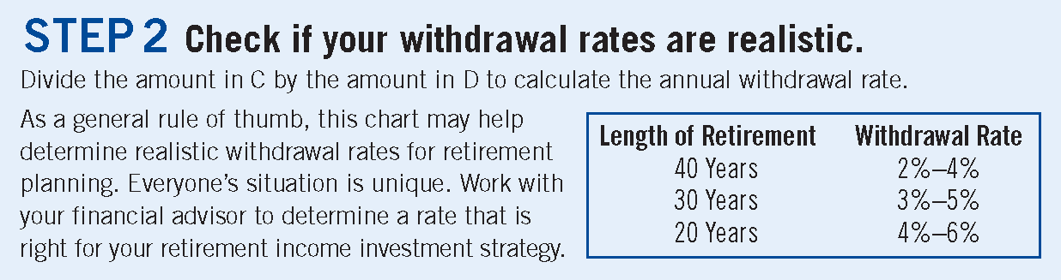
What Are Withdrawal Rates and Why Are They Important?
Ben Templeton
10/23/18
10/23/19
Joe Smith
(123) 456-7890
1/1/20
800,000
50,000
15,000
20,000
15,000
x
13,000
13,000
2,000
20,000
15,000
50,000
450,000
250,000
4
4.5
6
50,000
Notes:
Main Point: What are withdrawal rates and why are they important?
Withdrawal rates are the percentage of your investments that will provide desired cash flow from the sale of shares in retirement. The most important thing about withdrawal rates is making sure they are realistic and sustainable throughout your retirement. Everyone’s situation is unique, though, so you will need to work with your financial advisor to determine the appropriate withdrawal rate based on your specific circumstances and investment strategy, which can change over time.
Transition: Let’s talk a little bit more about realistic withdrawal rates.
Generating Income for Living
RTSI CUPPT 07/18

Slide 41
Realistic Withdrawal Rates
If your withdrawal rate is too high…
    It increases the risk of negative long-term impact from market losses
    It increases the likelihood of depleting your investments as a potential source of income and running out of money
If your withdrawal rate is too low…
    You could not meet your expenses, creating unnecessary stress
    You might not enjoy retirement as much as you should
Notes:
Main Point: Finding the right withdrawal rate is essential.
What happens if your withdrawal rates are not right?
If your withdrawal rate is too high…
It increases the risk of negative long-term impact from market losses
It increases the likelihood of depleting your investments as a potential source of income
If your withdrawal rate is too low…
You may not meet your expenses, creating unnecessary stress
You might not enjoy retirement as much as you could
[Click]
Despite the importance of withdrawal rates, many people are not sure how much they can withdraw.
According to our RISE survey, 37% of employed pre-retirees don’t know how much of their retirement savings they expect to spend/withdraw annually in retirement.¹ So, if you don’t know, you are not alone. That’s why it is important for you to work with a financial advisor.
Transition: Let’s talk a bit more about withdrawal rates in combination with investments.
1. The Franklin Templeton Retirement Income Strategies and Expectations (RISE) survey, 2017.
Generating Income for Living
RTSI CUPPT 07/18

Slide 42
Realistic Withdrawal Rates
37%
of employed pre-retirees don’t know how much of their retirement savings they expect to spend/withdraw annually in retirement.¹
1. The Franklin Templeton Retirement Income Strategies and Expectations (RISE) survey, 2017.
Notes:
Main Point: Finding the right withdrawal rate is essential.
What happens if your withdrawal rates are not right?
If your withdrawal rate is too high…
It increases the risk of negative long-term impact from market losses
It increases the likelihood of depleting your investments as a potential source of income and running out of money
If your withdrawal rate is too low…
You may not meet your expenses, creating unnecessary stress
You might not enjoy retirement as much as you should
[Click]
Despite the importance of withdrawal rates, many people are not sure how much they can withdraw.
According to our RISE survey, 37% of employed pre-retirees don’t know how much of their retirement savings they expect to spend/withdraw annually in retirement.¹ So, if you don’t know, you are not alone. That’s why it is important for you to work with a financial advisor.
Transition: Let’s talk a bit more about withdrawal rates in combination with investments.
1. The Franklin Templeton Retirement Income Strategies and Expectations (RISE) survey, 2017.
Generating Income for Living
RTSI CUPPT 07/18

Slide 43
Will You Outlive Your Savings?
Probability of Supporting Withdrawals over the 30-Year Period Beginning December 31, 2017 with the Annual Withdrawal Amount Increased by 3% Each Year¹
Asset Allocation | INITIAL WITHDRAWAL RATE
 | 3% | 4% | 5% | 6%
 | Probability to Sustain Withdrawals over the 30-Year Period Beginning 12/31/17
U.S. Bonds……….……... 100% | >95% | 94% | 56% | 14%
U.S. Stocks…………....... 100% | >95% | 90% | 78% | 62%
U.S. Stocks…………....... 60% U.S. Bonds..…………….. 40% | >95% | 95% | 81% | 56%
U.S. Stocks….................. 40% Global Stocks.................. 20% U.S. Bonds………........... 20% Global Bonds...……........ 20% | >95% | 95% | 77% | 50%
Cash……….…………..... 100% | >95% | <5% | <5% | <5%
IMPORTANT: The Monte Carlo projections or other information regarding the likelihood of various investment outcomes are generated by Franklin Templeton Investments, are hypothetical in nature and should not be considered investment advice. They do not reflect actual investment results and are not guarantees of future results. The simulations are based on a number of assumptions, including certain forward-looking capital market expectations (CMEs) of each asset class developed by Franklin Templeton Solutions. There can be no assurance that results shown will be achieved or sustained. The results present only a range of possible outcomes. Actual results will vary with each use and over time, as such results may be better or worse than the simulated scenarios, and the potential for loss (or gain) may be greater than demonstrated in the simulations.
ASSET CLASS ASSUMPTIONS: Based on our assumptions, including the application of CMEs, U.S. Bonds have an expected return of 6.04% and a standard deviation of 5.53%; U.S. Stocks have an expected return of 9.34% and a standard deviation of 14.69%; Global Bonds have an expected return of 4.53% and a standard deviation of 3.73%; Global Stocks have an expected return of 8.79% and a standard deviation of 14.79%; and Cash has an expected return of 3.42% and a standard deviation of 0.83%.
Please see “Important Information About Monte Carlo Simulations” on next slides for more information.
Notes:
Main Point: It’s important to diversify.
This chart looks at the probability of various asset allocation portfolios supporting withdrawals for
30 years based on different withdrawal rates, with a 3% annual inflation adjustment.
Let me translate…This chart helps us determine the likelihood that an asset allocation portfolio will last.
As you might expect, portfolios consisting of only one asset class often have a lower chance of supporting withdrawal rates. The ones that have a mix of different investments often stand a better chance of supporting withdrawal rates.
[Read the results from the chart]
But in the end, by doing this type of analysis, you and your financial advisor can gain more insight into how a portfolio can address your expectations for sustaining a withdrawal strategy for providing income throughout retirement.
Transition: As you can see, choosing appropriate withdrawal rates and investments is key to developing your retirement income plan. Let’s dive into helping our friend Ben with possible investment strategies.
IMPORTANT: The Monte Carlo projections or other information regarding the likelihood of various investment outcomes are generated by Franklin Templeton Investments, are hypothetical in nature and should not be considered investment advice. They do not reflect actual investment results and are not guarantees of future results. The simulations are based on a number of assumptions, including certain forward-looking capital market expectations (CMEs) of each asset class developed by Franklin Templeton Solutions. There can be no assurance that results shown will be achieved or sustained. The results present only a range of possible outcomes. Actual results will vary with each use and over time, as such results may be better or worse than the simulated scenarios, and the potential for loss (or gain) may be greater than demonstrated in the simulations.
ASSET CLASS ASSUMPTIONS: Based on our assumptions, including the application of CMEs, U.S. Bonds have an expected return of 6.04% and
a standard deviation of 5.53%; U.S. Stocks have an expected return of 9.34% and a standard deviation of 14.69%; Global Bonds have an expected return of 4.53% and a standard deviation of 3.73%; Global Stocks have an expected return of 8.79% and a standard deviation of 14.79%; and Cash has an expected return of 3.42% and a standard deviation of 0.83%.
Please see “Important Information About Monte Carlo Simulations” on next slides for more information.
Generating Income for Living
RTSI CUPPT 07/18

Slide 44
Monte Carlo Analysis
IMPORTANT INFORMATION ABOUT MONTE CARLO SIMULATIONS
Monte Carlo Simulations
Monte Carlo simulations model future uncertainty. In contrast to tools generating average outcomes, Monte Carlo analyses produce outcomes based on probability—thus incorporating future uncertainty. Each Monte Carlo simulation generates a randomized scenario consistent with the projected characteristics of the asset classes using our assumptions. The projections can be used to help an investor to understand the probability of various allocation strategies and withdrawal rates sustaining assets throughout the specified time period (simulation survival rates).
Material Assumptions
    Underlying long-term rates of return for each asset class are not directly based on historical returns. Rather, they represent assumptions that take into account, among other things, historical total returns, which may include our estimates for reinvested dividends and capital gains.
    These assumptions, as well as an assumed degree of fluctuation of returns around these long term rates, are used to generate random monthly returns for each asset class over the specified time period.
    The monthly returns are then used to generate 100,000 simulations, representing a spectrum of possible return outcomes for the modeled asset classes. The projections are directly based on these simulations.
Modeling Assumptions
    The projections are generated by Franklin Templeton Investments using a number of assumptions, including capital market expectations (CMEs) of arithmetic mean (return), standard deviation (risk) and correlation between asset classes (correlation is a measure of the degree in which returns are related or dependent upon each other). These CMEs are forward-looking and are developed by Franklin Templeton Solutions, a global investment management group within Franklin Templeton Investments that is dedicated to multi-strategy solutions, using informed forward estimates of fundamentals and economic regimes. In building asset return expectations for different asset classes, Franklin Templeton Solutions reviews data and themes it believes are drivers of capital markets. The long-term forecasts are based on an assessment of current valuation measures, economic growth and inflation prospects, as well as historical risk premiums. A complete summary of the CME methodology can be found in the 2016 Long-Term Capital Market Expectations: Perspective from Franklin Templeton Solutions.
    The initial withdrawal amount is the percentage of the initial value of the investments withdrawn in the first year where the entire amount is withdrawn on the last day of the year; in each subsequent year, the amount withdrawn is increased by 3% to reflect the annual rate of inflation.
    The indexes used for the asset classes are as follows: for U.S. Bonds, BofA Merrill Lynch U.S. Corporate Master Index (12/31/74–1/31/80), Citi Broad Investment Grade Credit Index (1/31/80–1/31/90) and Bloomberg Barclay’s U.S. Corporate – Investment Grade Index (1/31/90–Present); for U.S. Stocks, S&P 500 Index; for Global Bonds, Average IMF Euro Long Term Government Index (12/31/74–1/31/85), IMF Japan Long Term Government Index (12/31/74–1/31/85) and Citi World Government Bond Index (1/31/85–Present); Global Stocks, MSCI World Index; and for Cash, U.S. 30‐Day TBill TR (12/31/1925–12/31/1974), Encorr 90‐Day Tbill (12/31/1974–1/31/1997) and JPM 3M Tbill (1/31/1997–Present). Indexes do not reflect the deduction of fees or sales charges. Indexes are unmanaged and one cannot invest directly in an index. Past performance does not guarantee future results.
Notes:
Main Point: Mandatory disclosure slide if Monte Carlo results are discussed.
Read aloud.
Generating Income for Living
RTSI CUPPT 07/18

Slide 45
Monte Carlo Analysis
Key Limitations
    It is important to note that these projections are estimates only, are not predictions, and should be viewed as approximations, and they do not guarantee or predict any particular investment result. There can be no assurance that the assumptions and the return model will accurately estimate asset class return ranges going forward or that the simulation survival rates will be achieved or sustained. Actual results will vary and may be better or worse than the probabilities indicated, which only present a range of possible outcomes based on the simulations and assumptions. Consequently, investors should allow a margin for error and not place undue reliance on the apparent precision of the projections. It may also be prudent for an investor to be more conservative with the withdrawal rates, especially early in retirement, given the unpredictable nature of market performance.
    This type of Monte Carlo simulations also assumes that the distribution of returns is normal. A normal distribution means that returns are concentrated near the average (arithmetic mean) and decrease in frequency as the distance from the average increases. Should actual returns not follow this pattern, results may vary significantly.
    The simulations do not take into account taxes on withdrawals, nor early withdrawal penalties or required minimum distributions.
    The projections are based on a limited collection of asset classes. Other investments or asset classes not considered may have characteristics similar or superior
    to those being analyzed, may provide different returns or outcomes, and may be more appropriate for one’s individual situation.
    Some asset classes may have relatively short histories. Actual long term results for each asset class going forward may differ from our assumptions—with those
    for asset classes with limited histories potentially diverging more.
    Market crises can cause asset classes to perform similarly, lowering the accuracy of our return assumptions and diminishing the benefits of diversification (that is,
    of using many different asset classes) in ways not captured by the simulations. As a result, returns actually experienced by investors may be more volatile than those assumed in the simulations.
    Results also may significantly vary over time and each time the simulations are run. Periods of significant market volatility, which may occur more often than assumed in the simulations, may increase the chances that actual results will differ, possibly significantly, from the examples provided.
    The simulations do not take into consideration fluctuations in correlations among asset class returns over the short term.
    Inflation is assumed constant, so variations are not reflected in the simulations.
    The simulations model asset classes, not investment product. As a result, the actual experience of an investor in a given investment product (e.g., a mutual fund) may differ from the range generated by the simulations, even if the broad asset allocation of the investment product is similar to the one being modeled. Possible reasons for divergence include, but are not limited to, active management by the manager of the investment product, or the costs, fees, and other expenses associated with the investment product. Active management for any particular investment product – the selection of a portfolio of individual securities that differs from the broad asset classes modeled in the simulations – can lead to the investment product having higher or lower returns than the range in the simulations.
    Indexes are unmanaged, include reinvestment of dividends and, as they are unmanaged, do not include any fees and expenses. A mutual fund, or other managed account, will include investment management fees and other expenses, which will reduce returns. One cannot invest directly in an index.
Notes:
Main Point: Mandatory disclosure slide if Monte Carlo results are discussed.
Read aloud.
Generating Income for Living
RTSI CUPPT 07/18

Slide 46
Developing an Investment Strategy
Ben and his advisor can select investments based on:
Portfolios
OR
Individual Funds
Notes:
Main Point: Select investments. Choose a portfolio or individual funds approach.
Ben and his financial advisor can select investments based on portfolios or individual funds, that are selected as part of a well-diversified retirement portfolio that is personalized and tailored to his specific goals, individual situation and risk tolerance.
[Click on the desired approach to present.]
Let’s walk through a ___________ approach.
Generating Income for Living
RTSI CUPPT 07/18

Slide 47
Developing an Investment Strategy
Portfolio Approach – Hypothetical case study
Annual Expense
Income Sources
Investments
Fixed Expenses
Rising Expenses
Discretionary
Expenses
$15,000
$20,000
$15,000
Investment:
$50,000
Investment:
$450,000
Investment:
$250,000
Annual Withdrawal:
4%
Annual Withdrawal:
4.5%
Annual Withdrawal:
6%
Conservative Investment
Strategy
Inflation-Smart
Strategy
Growth-Oriented Investment
Strategy
BACK to Select Investments
This example is intended only to illustrate one way in which the strategy may be used. All values used in the example are hypothetical and will differ from each client’s individual needs. There is no assurance that the strategy will achieve its intended objective.
Notes:
Main Point: Select investments.
Ben and his financial advisor have selected a more conservative investment strategy to address his Fixed expenses, a more moderate investment strategy to address his Rising expenses, and a higher-risk, more growth-oriented investment strategy to address his Discretionary expenses.
Generating Income for Living
RTSI CUPPT 07/18

Slide 48
Income for What’s Next:
Inflation-Smart Strategy
Asset Allocation
Franklin Rising Dividends Fund (Advisor Class) | 20%
Franklin Adjustable U.S. Government Securities Fund (Advisor Class) | 20%
Franklin Income Fund (Advisor Class) | 20%
Franklin Mutual Global Discovery Fund (Class Z) | 20%
Templeton Global Bond Fund (Advisor Class) | 20%
How can we use withdrawals from the Inflation-Smart Strategy to help Ben meet his Rising expenses?
Past performance is not an indicator or a guarantee of future performance and diversification does not assure a profit or protect against a loss.
This sample portfolio is intended for illustrative purposes only and will differ from each client’s individual needs and risk tolerances. There is no assurance that the strategy will achieve its intended objective.
This presentation must be preceded or accompanied by a current Franklin Rising Dividends Fund, Franklin Adjustable U.S. Government Securities Fund, Franklin Income Fund, Franklin Mutual Global Discovery Fund and Templeton Global Bond Fund summary prospectus and/or prospectuses.
Please carefully read a prospectus before you invest or send money. Investors should carefully consider a fund’s investment goals, risks, charges and expenses before investing.
Notes:
Main Point: Discuss Inflation-Smart Strategy.
The Inflation-Smart Strategy has a relatively moderate level of risk in seeking to support an annual withdrawal strategy to address anticipated, inflation-sensitive income needs. It uses a portfolio of five funds that is diversified across multiple asset classes.
Here is the key question… How can we use withdrawals from the Inflation-Smart Strategy to help Ben meet his Rising expenses?
Transition: Let’s take a look…
Generating Income for Living
RTSI CUPPT 07/18

Slide 49
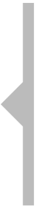
Income for What’s Next:
Inflation-Smart Strategy
Hypothetical Illustration:
19 Years of Systematic and Increasing Withdrawals¹
January 1, 2000–December 31, 2018
$450,000 Initial Investment (Advisor Class/Class Z)
$20,250 First Year Withdrawal Amount (4.5% of Initial Investment), 3% Annual Increase
in Withdrawal Amount, Rebalanced Annually, Reinvest Dividends and Capital Gains
$508,618
TOTAL WITHDRAWALS
Based on 19 years
of systematic and increasing withdrawals
Withdrawals
Year
The results of such a withdrawal strategy could vary substantially depending on investment performance during the period the program is in effect. The rate or amount chosen for withdrawal determines the value remaining at the end of the period. In a period of declining market values, continued withdrawals could eventually exhaust the principal. This hypothetical performance includes reinvestment of dividends and capital gains, and assumes rebalancing to an equal allocation of each of the five funds on an annual basis. The figures represent performance of a hypothetical combined investment, are for illustrative purposes only, and assume the current initial sales charges.
Advisor Class/Class Z shares are only offered to certain eligible investors as stated in the prospectus. They are offered without sales charges or Rule 12b-1 fees. The fund offers multiple share classes, which are subject to different fees and expenses that will affect their performance. Please see the prospectus for details.
1. It’s important to note that the amounts withdrawn do not represent dividends or income, but, rather, the proceeds from the sale of shares. This illustration assumes sufficient shares are sold from the shareholder’s account at the time of each withdrawal to provide for the annual withdrawal amount. Investors participating in a systematic withdrawal plan should annually review with their financial advisor the results being obtained and the value of remaining shares. Based on this annual review, individuals can increase or decrease the amount of withdrawals, as appropriate.
Notes:
Main Point: 19 years of systematic and increasing withdrawals.
Although the last 19 years have seen challenging times with many financial peaks and valleys, it has been a good time period to see how the Inflation-Smart Strategy would have performed, keeping in mind that past performance cannot guarantee future performance, and that retirement can extend more than 20–30 years.
In this example, we have invested Ben’s $450,000 in the five funds that comprise the Inflation-Smart Strategy. We have taken systematic annual withdrawals based on a 4.5% initial withdrawal rate equal to $20,250. That gives Ben more than enough to meet his $20,000 annual Rising Expenses.
Because this income is going to pay for the expenses that are impacted by inflation, we have increased the withdrawals by 3% annually.
As you can see, Ben took $508,618 in withdrawals over the 19-year period.
Transition: What happened to the account value during that period?
It’s important to note that the amounts withdrawn do not represent dividends or income, but, rather, the proceeds from the sale of shares. This illustration assumes sufficient shares are sold from the shareholder’s account at the time of each withdrawal to provide for the annual withdrawal amount. Investors participating in a systematic withdrawal plan should annually review with their financial advisor the results being obtained and the value of remaining shares. Based on this annual review, individuals can increase or decrease the amount of withdrawals, as appropriate. Of course, there is no assurance that any withdrawal strategy will provide sufficient income.
Generating Income for Living
RTSI CUPPT 07/18

Slide 50
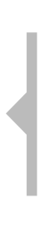
Income for What’s Next:
Inflation-Smart Strategy
The Inflation-Smart Strategy has a relatively moderate level of risk in seeking to support
an annual withdrawal strategy to address anticipated, inflation-sensitive income needs.
It uses a portfolio of five funds that is diversified across multiple asset classes.
Hypothetical Illustration: Account Value after $508,618 of Withdrawals¹
(Advisor Class/Class Z)
$756,574
ENDING PORTFOLIO VALUE–ADVISOR CLASS/CLASS Z
Account Value
Year
Please note that this hypothetical investment does not take into account federal, state or municipal taxes. If taxes were taken into account, the hypothetical values shown would have been lower. Although this hypothetical illustration represents a 19-year period, a retirement period could last more than 20–30 years. Investing in a Franklin Templeton fund does not guarantee one’s retirement income needs will be met.
Performance data represents past performance, which does not guarantee future results. Current performance may differ from figures shown. The funds’ investment returns and principal values will change with market conditions, and investors may have a gain or a loss when they sell their shares. Please call Franklin Templeton Investments at (800) DIAL BEN/ 342-5236 or visit franklintempleton.com for each fund’s most recent month-end performance.
1. This hypothetical performance includes reinvestment of dividends and capital gains, and assumes rebalancing to an equal allocation of each of the five funds on an annual basis. The figures represent performance of a hypothetical combined investment, and are for illustrative purposes only.
Notes:
Main Point: Account value after withdrawals.
While the amount of Ben’s annual withdrawals grew to keep up with inflation, his investment account’s value also ended this 19-year period higher than where it had started. Even after taking $508,618 in total withdrawals, the value of Ben’s initial $450,000 investment grew to $756,574.
Summary: In this example, in the end, by dividing up his expenses and income sources, it became very easy for Ben and his financial advisor to build his plan. More conservative investment strategies were associated with his Fixed expenses and higher risk, more growth-oriented investment strategies were associated with his Rising and Discretionary expenses.
It’s important to note that the amounts withdrawn do not represent dividends or income, but, rather, the proceeds from the sale of shares. This illustration assumes sufficient shares are sold from the shareholder’s account at the time of each withdrawal to provide for the annual withdrawal amount. Investors participating in a systematic withdrawal plan should annually review with their financial advisor the results being obtained and the value of remaining shares. Based on this annual review, individuals can increase or decrease the amount of withdrawals, as appropriate. Of course, there is no assurance that any withdrawal strategy will provide sufficient income.
Generating Income for Living
RTSI CUPPT 07/18

Slide 51
Fund Performance¹
Periods ended December 31, 2018
 | Franklin Rising Dividends Fund
Inception Date | 1/14/1987
 | Advisor Class (FRDAX)² | Class A (FRDPX)³
 |  | With Max 5.50% Initial Sales Charge | Without Sales Charge
1-Year | -5.07% | -10.51% | -5.30%
3-Year | 9.49% | 7.19% | 9.23%
5-Year | 6.91% | 5.44% | 6.64%
10-Year | 11.66% | 10.76% | 11.38%
Since Inception | 9.13% | 8.83% | 9.02%
Expense ratio | 0.65% | 0.90%
30-Day Standardized Yield⁴ As of 12/31/18 | N/A
Franklin Adjustable U.S. Government Securities Fund
10/20/1987
Advisor Class (FAUZX)⁵ | Class A (FISAX)
 | With Max 2.25% Initial Sales Charge | Without Sales Charge
1.02% | -1.51% | 0.77%
0.54% | -0.49% | 0.29%
0.42% | -0.29% | 0.16%
1.19% | 0.71% | 0.94%
3.67% | 3.51% | 3.58%
Without Waiver⁶ 0.69% With Waiver 0.68% | Without Waiver⁶ 0.94% With Waiver 0.93%
Without Waiver 1.71% With Waiver 1.72% | Without Waiver 1.40% With Waiver 1.42%
Franklin Income Fund
8/31/1948
Advisor Class (FRIAX)⁷ | Class A (FKIQX)⁸
 | With Max 4.25% Initial Sales Charge | Without Sales Charge
-5.22% | -9.77% | -5.77%
6.28% | 4.38% | 5.90%
2.84% | 1.77% | 2.65%
9.00% | 8.30% | 8.78%
10.03% | 9.87% | 9.94%
Without Waiver⁹ 0.48% With Waiver 0.47% | Without Waiver⁹ 0.73% With Waiver 0.72%
Without Waiver 4.84% With Waiver 4.84% | Without Waiver 4.39% With Waiver 4.39%
Performance data represents past performance, which does not guarantee future results.
Current performance may differ from figures shown. The funds’ investment returns and principal values will change with market conditions, and investors may have a gain or a loss when they sell their shares. Please call Franklin Templeton Investments at (800) DIAL BEN/
342-5236 or visit franklintempleton.com for each fund’s most recent month-end performance.
1. These funds offer other share classes, subject to different fees and expenses that will affect their performance.
2. Effective 10/3/05, the fund began offering Advisor Class Shares. For periods prior to the fund’s Advisor Class inception date, a restated figure is used based on the fund’s oldest share class, Class A performance, excluding the effect of Class A’s maximum initial sales charge but reflecting the effect of the Class A Rule 12b-1 fees; and for periods after the fund’s Advisor Class inception date, actual Advisor Class performance is used, reflecting all charges and fees applicable to that class.
3. Prior to 9/10/18, these shares were offered at a higher initial sales charge of 5.75%; thus actual returns would have differed. Total returns with sales charges have been restated to reflect the current maximum initial sales charge of 5.50%. Prior to 8/3/98, fund shares were offered at a lower initial sales charge; thus, actual returns may have differed.
4. The fund’s 30-day standardized yield is calculated over a trailing 30-day period using the yield to maturity on bonds and/or the dividends accrued on stocks. It may not equal the fund’s actual income distribution rate, which reflects the fund’s past dividends paid to shareholders.
5. Effective 5/15/08, the fund began offering Advisor Class Shares. For periods prior to the fund’s Advisor Class inception date, a restated figure is used based on the fund’s oldest share class, Class A performance, excluding the effect of Class A’s maximum initial sales charge but reflecting the effect of the Class A Rule 12b-1 fees; and for periods after the fund’s Advisor Class inception date, actual Advisor Class performance is used, reflecting all charges and fees applicable to that class.
6. The fund has a fee waiver associated with any investment it makes in a Franklin Templeton money fund and/or other Franklin Templeton fund, contractually guaranteed through February 28, 2019. Fund investment results reflect the fee waiver; without this waiver, the results would have been lower.
7. Effective 12/31/96, the fund began offering Advisor Class shares. For periods prior to the fund’s Advisor Class inception date, a restated figure is used based on the fund’s oldest share class, Class A1 performance, excluding the effect of Class A1’s maximum initial sales charge but reflecting the effect of the Class A1 Rule 12b-1 fees; and for periods after the fund’s Advisor Class inception date, actual Advisor Class performance is used, reflecting all charges and fees applicable to that class.
8. Effective 9/10/18 Class A shares closed to new investors, were renamed Class A1 shares, and a new Class A share with a different expense structure became available. Class A performance shown has been calculated as follows: (a) for periods prior to 9/10/18, a restated figure is used based on the fund's Class A1 performance and including any Rule 12b-1 rate differential as exists between Class A1 and Class A; and (b) for periods after 9/10/18, actual Class A performance is used, reflecting all charges and fees applicable to that class. Effective 5/1/94, the fund implemented a Rule 12b-1 plan, which affects subsequent performance.
9. The fund has a fee waiver associated with any investment it makes in a Franklin Templeton money fund and/or other Franklin Templeton fund, contractually guaranteed through January 31, 2019. Fund investment results reflect the fee waiver; without this waiver, the results would have been lower.
Notes:
Main Point: Review standardized average annual total returns.
Generating Income for Living
RTSI CUPPT 07/18

Slide 52
Fund Performance¹
Periods ended December 31, 2018
 | Franklin Mutual Global Discovery Fund
Inception Date | 12/31/1992
 | Class Z (MDISX) | Class A (TEDIX)²
 |  | With Max 5.50% Initial Sales Charge | Without Sales Charge
1-Year | -10.78% | -15.89% | -10.99%
3-Year | 3.42% | 1.23% | 3.16%
5-Year | 2.40% | 0.98% | 2.12%
10-Year | 7.77% | 6.86% | 7.47%
Since Inception | 10.65% | 10.05% | 10.29%
Expense ratio | 0.96% | 1.21%
30-Day Standardized Yield³ As of 12/31/18 | N/A
Templeton Global Bond Fund
9/18/1986
Advisor Class (TGBAX)⁴ | Class A (TPINX)⁵
 | With Max 4.25% Initial Sales Charge | Without Sales Charge
1.44% | -3.05% | 1.27%
3.53% | 1.79% | 3.26%
1.64% | 0.51% | 1.38%
5.45% | 4.72% | 5.18%
7.35% | 7.00% | 7.15%
Without Waiver⁶ 0.78% With Waiver 0.71% | Without Waiver⁶ 1.03% With Waiver 0.96%
Without Waiver 5.90% With Waiver 5.98% | Without Waiver 5.38% With Waiver 5.47%
Performance data represents past performance, which does not guarantee future results.
Current performance may differ from figures shown. The funds’ investment returns and principal values will change with market conditions, and investors may have a gain or a loss when they sell their shares. Please call Franklin Templeton Investments at (800) DIAL BEN/
342-5236 or visit franklintempleton.com for each fund’s most recent month-end performance.
1. These funds offer other share classes, subject to different fees and expenses that will affect their performance.
2. Prior to 9/10/18, these shares were offered at a higher initial sales charge of 5.75%; thus actual returns would have differed. Total returns with sales charges have been restated to reflect the current maximum initial sales charge of 5.50%. Prior to 11/1/96, the fund offered only a single class of shares without a sales charge and Rule 12b-1 expenses, Class Z shares. Figures reflect a restatement of the original share class to include both the Rule 12b-1 fees and maximum initial sales charges (when quoting figures with sales charges) applicable to each share class as though in effect from the fund’s inception. For periods after 11/1/96, actual performance is used, reflecting all charges and fees applicable to that class..
3. The fund's 30-day standardized yield is calculated over a trailing 30-day period using the yield to maturity on bonds and/or the dividends accrued on stocks. It may not equal the fund's actual income distribution rate, which reflects the fund's past dividends paid to shareholders.
4. Effective 1/1/97, the fund began offering Advisor Class Shares. For periods prior to the fund’s Advisor Class inception date, a restated figure is used based on the fund’s oldest share class, Class A performance, excluding the effect of Class A’s maximum initial sales charge but reflecting the effect of the Class A Rule 12b-1 fees; and for periods after the fund’s Advisor Class inception date, actual Advisor Class performance is used, reflecting all charges and fees applicable to that class.
5. On 1/1/93, a plan of distribution was implemented for these shares under Rule 12b-1, which affects subsequent performance.
6. The fund has a fee waiver associated with any investment it makes in a Franklin Templeton money fund and/or other Franklin Templeton fund, contractually guaranteed through April 30, 2019. Fund investment results reflect the fee waiver; without this waiver, the results would have been lower.
Notes:
Main Point: Review 30-Day Standardized Yields and Distribution Rates.
Generating Income for Living
RTSI CUPPT 07/18

Slide 53
Fund Descriptions and Risks
Franklin Rising Dividends Fund
The fund seeks long-term capital appreciation by investing at least 80% of its net assets in companies of any size that have paid consistently rising dividends.
All investments involve risks, including possible loss of principal. Value securities may not increase in price as anticipated or may decline further in value. For stocks paying dividends, dividends are not guaranteed, and can increase, decrease or be totally eliminated without notice. While smaller and midsize companies may offer substantial opportunities for capital growth, they also involve heightened risks and should be considered speculative. Historically, smaller- and midsize-company securities have been more volatile in price than larger company securities, especially over the short term. These and other risks are detailed in the fund’s prospectus.
Franklin Adjustable U.S. Government Securities Fund
The fund seeks a high level of current income, while providing lower volatility of principal than a fund that invests in fixed-rate securities. The fund invests predominantly in adjustable-rate mortgage securities (ARMS) that are issued or guaranteed by the U.S. government, its agencies or instrumentalities. The fund’s investments may include securities issued by government-sponsored entities, such as Fannie Mae and Freddie Mac.¹
All investments involve risks, including possible loss of principal. Interest rate movements, unscheduled mortgage prepayments and other risk factors will affect the fund’s share price and yield. Bond prices generally move in the opposite direction of interest rates. As the prices of bonds in the fund adjust to a rise in interest rates, the fund’s share price may decline. Changes in the financial strength of a bond issuer or in a bond’s credit rating may affect its value. These and other risk considerations are discussed in the fund’s prospectus.
1. Although U.S. government-sponsored entities may be chartered or sponsored by Acts of Congress, their securities are neither issued nor guaranteed by the U.S. government. Please see the fund’s prospectus for a detailed discussion regarding the various levels of credit support for government agency or instrumentality securities. The fund’s yield and share price are not guaranteed and will vary with market conditions. Securities owned by the fund, but not shares of the fund, are guaranteed by the U.S. government, its agencies or instrumentalities as to timely payment of principal and interest.
Notes:
Main Point: Fund Descriptions and Risks
[Read slide]
Generating Income for Living
RTSI CUPPT 07/18

Slide 54
Fund Descriptions and Risks (cont’d.)
Franklin Income Fund
The fund seeks to maximize income, while maintaining prospects for capital appreciation, by investing in a diversified portfolio of stocks and bonds.
All investments involve risks, including possible loss of principal. The fund’s share price and yield will be affected by interest rate movements. Bond prices generally move in the opposite direction of interest rates. Thus, as the prices of bonds in the fund adjust to a rise in interest rates, the fund’s share price may decline. Changes in the financial strength of a bond issuer or in
a bond’s credit rating may affect its value. The fund’s portfolio includes a substantial portion of higher-yielding, lower-rated corporate bonds because of the relatively higher yields they offer. Floating-rate loans are lower-rated, higher-yielding instruments, which are subject to increased risk of default and can potentially result in loss of principal. These securities
carry a greater degree of credit risk relative to investment-grade securities. Stock prices fluctuate, sometimes rapidly and dramatically, due to factors affecting individual companies, particular industries or sectors, or general market conditions. These and other risk considerations are discussed in the fund’s prospectus.
Franklin Mutual Global Discovery Fund
The fund seeks capital appreciation. Its strategy is focused on undervalued mid- and large-cap equity securities, with
a significant portion of its assets in foreign securities and, to a lesser extent, distressed securities and merger arbitrage.
All investments involve risks, including possible loss of principal. Value securities may not increase in price as anticipated or may decline further in value. Special risks are associated with foreign investing, including currency fluctuations, economic instability and political developments. Because the Fund may invest its assets in companies in a specific region, including Europe, it is subject to greater risks of adverse developments in that region and/or the surrounding regions than a fund that is more broadly diversified geographically. Current political and financial uncertainty surrounding the European Union may increase market volatility and the economic risk of investing in companies in Europe. Smaller-company stocks have exhibited greater price volatility than larger-company stocks, particularly over the short term. The fund's investments in companies engaged in mergers, reorganizations or liquidations also involve special risks as pending deals may not be completed on time or on favorable terms. The fund may invest in lower-rated bonds, which entail higher credit risk. Please consult the prospectus for a more detailed description of the fund's risks.
Notes:
Main Point: Fund Descriptions and Risks
[Read slide]
Generating Income for Living
RTSI CUPPT 07/18

Slide 55
Fund Descriptions and Risks (cont’d.)
Templeton Global Bond Fund
The fund seeks current income with capital appreciation and growth of income, by investing at least 80% of its net assets in bonds of governments, government related entities and government agencies located around the world. The fund regularly enters into various currency-related and other transactions involving derivative instruments.
All investments involve risks, including possible loss of principal. Derivatives, including currency management strategies, involve costs and can create economic leverage in the portfolio which may result in significant volatility and cause the fund to participate in losses on an amount that exceeds the fund’s initial investment. The fund may not achieve the anticipated benefits, and may realize losses when a counterparty fails to perform as promised.
The markets for particular securities or types of securities are or may become relatively illiquid. Reduced liquidity will have an adverse impact on the security’s value and on the fund’s ability to sell such securities when necessary to meet the fund’s liquidity needs or in response to a specific market event. Foreign securities involve special risks, including currency fluctuations (which may be significant over the short term) and economic and political uncertainties; investments in developing markets involve heightened risks related to the same factors. Sovereign debt securities are subject to various risks in addition to those relating to debt securities and foreign securities generally, including, but not limited to, the risk that a government entity may be unwilling or unable to pay interest and repay principal on its sovereign debt, or otherwise meet its obligations when due. Investments in lower-rated bonds include higher risk of default and loss of principal. Bond prices generally move in the opposite direction of interest rates. As the prices of bonds in the fund adjust to a rise in interest rates, the fund’s share price may decline. Changes in the financial strength of a bond issuer or in a bond’s credit rating may affect its value. These and other risks are discussed in the fund’s prospectus.
Notes:
Main Point: Fund Descriptions and Risks
[Read slide]
Generating Income for Living
RTSI CUPPT 07/18

Slide 56
Developing an Investment Strategy
Individual Fund Approach – Hypothetical case study
Annual Expense
Income Sources
Investments
Fixed Expenses
Rising Expenses
Discretionary
Expenses
$15,000
$20,000
$15,000
Investment:
$50,000
Investment:
$450,000
Investment:
$250,000
Annual Withdrawal:
4%
Annual Withdrawal:
4.5%
Annual Withdrawal:
6%
Franklin U.S. Government Securities Fund
Franklin
Income Fund
Franklin
Mutual Shares Fund
This presentation must be preceded or accompanied by a current Franklin U.S. Government Securities Fund, Franklin Income Fund and Franklin Mutual Shares Fund summary prospectus and/or prospectuses.
Please carefully read a prospectus before you invest or send money. Investors should carefully consider a fund’s investment goals, risks, charges and expenses before investing.
BACK to Select Investments
This example is intended only to illustrate one way in which the strategy may be used. All values used in the example are hypothetical and will differ from each client’s individual needs. There is no assurance that the strategy will achieve its intended objective.
Notes:
Main Point: Select investments.
To align with Ben’s goals and risk tolerances, Ben and his financial advisor have diversified his retirement income sources by selecting Franklin U.S. Government Securities Fund to address his Fixed expenses, Franklin Income Fund to address his Rising expenses, and Franklin Mutual Shares Fund to address his Discretionary expenses.
Let’s see how Ben can use withdrawals from Franklin Income Fund to help him meet his Rising expenses.
Generating Income for Living
RTSI CUPPT 07/18

Slide 57
Franklin Income Fund
Hypothetical Illustration: 30 Years of Systematic and Increasing Withdrawals¹
January 1, 1989–December 31, 2018
$450,000 Initial Investment (Advisor Class)
$20,250 First Year Withdrawal Amount (4.5% of Initial Investment), 3% Annual Increase in
Withdrawal Amount, Rebalanced Annually, Reinvest Dividends and Capital Gains
$963,403
TOTAL WITHDRAWALS
Based on 30 years
of systematic and increasing withdrawals
Withdrawals
Year
The results of such a withdrawal strategy could vary substantially depending on investment performance during the period the program is in effect. The rate or amount chosen for withdrawal determines the value remaining at the end of the period. In a period of declining market values, continued withdrawals could eventually exhaust the principal. This hypothetical performance includes reinvestment of dividends and capital gains, and assumes rebalancing to an equal allocation of each of the five funds on an annual basis. The figures represent performance of a hypothetical combined investment, are for illustrative purposes only, and assume the current initial sales charges.
Advisor Class shares are only offered to certain eligible investors as stated in the prospectus. They are offered without sales charges or Rule 12b-1 fees. The fund offers multiple share classes, which are subject to different fees and expenses that will affect their performance. Please see the prospectus for details.
1. It’s important to note that the amounts withdrawn do not represent dividends or income, but, rather, the proceeds from the sale of shares. This illustration assumes sufficient shares are sold from the shareholder’s account at the time of each withdrawal to provide for the annual withdrawal amount. Investors participating in a systematic withdrawal plan should annually review with their financial advisor the results being obtained and the value of remaining shares. Based on this annual review, individuals can increase or decrease the amount of withdrawals, as appropriate.
Notes:
Main Point: 30 years of systematic and increasing withdrawals.
Although the last 30 years have seen challenging times with many financial peaks and valleys, it has been a good time period to see how Franklin Income Fund would have performed, keeping in mind that past performance cannot guarantee future performance.
In this example, we have invested Ben’s $450,000 in Franklin Income Fund. We have taken systematic annual withdrawals based on a 4.5% initial withdrawal rate equal to $20,250. This gives Ben enough to meet his $20,000 annual Rising Expenses.
Because this income is going to pay for the expenses that are impacted by inflation, we have increased the withdrawals by 3% annually.
As you can see, Ben took $963,403 in withdrawals over the 30-year period.
Transition: What happened to the account value during that period?
It’s important to note that the amounts withdrawn do not represent dividends or income, but, rather, the proceeds from the sale of shares. This illustration assumes sufficient shares are sold from the shareholder’s account at the time of each withdrawal to provide for the annual withdrawal amount. Investors participating in a systematic withdrawal plan should annually review with their financial advisor the results being obtained and the value of remaining shares. Based on this annual review, individuals can increase or decrease the amount of withdrawals, as appropriate. Of course, there is no assurance that any withdrawal strategy will provide sufficient income.
Generating Income for Living
RTSI CUPPT 07/18

Slide 58
Franklin Income Fund
The fund seeks to maximize income, while maintaining prospects for capital appreciation, by investing in a diversified portfolio of stocks and bonds.
Hypothetical Illustration: Account Value after $963,403 of Withdrawals¹
(Advisor Class)
$2,328,318
ENDING PORTFOLIO
VALUE–ADVISOR CLASS
Account Value
Year
Please note that this hypothetical investment does not take into account federal, state or municipal taxes. If taxes were taken into account, the hypothetical values shown would have been lower. Investing in a Franklin Templeton fund does not guarantee one’s retirement income needs will be met.
Performance data represents past performance, which does not guarantee future results. Current performance may differ from figures shown. The fund’s investment returns and principal values will change with market conditions, and investors may have a gain or a loss when they sell their shares. Please call Franklin Templeton Investments at (800) DIAL BEN/ 342-5236 or visit franklintempleton.com for each fund’s most recent month-end performance.
1. Franklin Income Fund’s performance includes reinvestment of dividends and capital gains, and assumes rebalancing on an annual basis. The figures represent performance of a hypothetical investment, and are for illustrative purposes only.
Notes:
Main Point: Account value after withdrawals.
While the amount of Ben’s annual withdrawals grew to keep up with inflation, his investment account’s value also ended this 30-year period higher than where it had started. Even after taking $963,403 in total withdrawals, the value of Ben’s initial $450,000 investment grew to $2,328,318.
Summary: In the end, by dividing up his expenses and income sources, it became very easy for Ben and his financial advisor to build his strategy. More conservative investment strategies were associated with his Fixed expenses and higher risk, more growth-oriented investment strategies were associated with his Rising and Discretionary expenses.
It’s important to note that the amounts withdrawn do not represent dividends or income, but, rather, the proceeds from the sale of shares. This illustration assumes sufficient shares are sold from the shareholder’s account at the time of each withdrawal to provide for the annual withdrawal amount. Investors participating in a systematic withdrawal plan should annually review with their financial advisor the results being obtained and the value of remaining shares. Based on this annual review, individuals can increase or decrease the amount of withdrawals, as appropriate. Of course, there is no assurance that any withdrawal strategy will provide sufficient income.
Generating Income for Living
RTSI CUPPT 07/18

Slide 59
Fund Performance¹
Franklin Income Fund
Average Annual Total Returns
(Periods ended December 31, 2018)
 | 1-Year | 3-Year | 5-Year | 10-Year | Since Inception (8/31/48)
Advisor Class (FRIAX)² | -5.22% | 6.28% | 2.84% | 9.00% | 10.03%
Class A (FKIQX) with Maximum 4.25% Initial Sales Charge³ | -9.77% | 4.38% | 1.77% | 8.30% | 9.87%
Class A (FKIQX) without Sales Charge | -5.77% | 5.90% | 2.65% | 8.78% | 9.94%
 | 30-Day Standardized Yield⁴ (As of 12/31/18) |  | Expense Ratio⁵ | Beta (3-Year)⁶ (As of 12/31/18)
Advisor Class | Without Waiver | 4.84% | 0.48% | 0.54
 | With Waiver |  | 0.47%
 |  | 4.84%
Class A | Without Waiver | 4.39% | 0.73% | 0.54
 | With Waiver | 4.39% | 0.72%
Performance data represents past performance, which does not guarantee future results.
Current performance may differ from figures shown. The fund’s investment returns and principal values will change with market conditions, and investors may have a gain or a loss when they sell their shares. Please call Franklin Templeton Investments at (800) DIAL BEN/342-5236 or visit franklintempleton.com for the most recent month-end performance.
This fund offers other share classes, subject to different fees and expenses that will affect their performance.
Effective 12/31/96, the fund began offering Advisor Class shares. For periods prior to the fund’s Advisor Class inception date, a restated figure is used based on the fund’s oldest share class, Class A1 performance, excluding the effect of Class A1’s maximum initial sales charge but reflecting the effect of the Class A1 Rule 12b-1 fees; and for periods after the fund’s Advisor Class inception date, actual Advisor Class performance is used, reflecting all charges and fees applicable to that class.
Effective 9/10/18 Class A shares closed to new investors, were renamed Class A1 shares, and a new Class A share with a different expense structure became available. Class A performance shown has been calculated as follows: (a) for periods prior to 9/10/18, a restated figure is used based on the fund's Class A1 performance and including any Rule 12b-1 rate differential as exists between Class A1 and Class A; and (b) for periods after 9/10/18, actual Class A performance is used, reflecting all charges and fees applicable to that class. Effective 5/1/94, the fund implemented a Rule 12b-1 plan, which affects subsequent performance..
4. The fund’s 30-day standardized yield is calculated over a trailing 30-day period using the yield to maturity on bonds and/or the dividends accrued on stocks. It may not equal the fund’s actual income distribution rate, which reflects the fund’s past dividends paid to shareholders.
5. The fund has a fee waiver associated with any investment it makes in a Franklin Templeton money fund and/or other Franklin Templeton fund, contractually guaranteed through January 31, 2019. Fund investment results reflect the fee waiver; without this waiver, the results would have been lower.
6. Beta is a measure of the fund’s volatility relative to the market, as represented by the S&P 500 Index. A beta greater than 1.00 indicates volatility greater than the market. Based on the 3-year period ended as of the date of the calculation.
Notes:
Main Point: Review fund performance.
Let’s take a look at the fund performance for Franklin Income Fund.
Generating Income for Living
RTSI CUPPT 07/18

Slide 60
Fund Descriptions and Risks
Franklin Income Fund
The fund seeks to maximize income, while maintaining prospects for capital appreciation, by investing in a diversified portfolio of stocks and bonds.
All investments involve risks, including possible loss of principal. The fund’s share price and yield will be affected by interest rate movements. Bond prices generally move in the opposite direction of interest rates. Thus, as the prices of bonds in the fund adjust to a rise in interest rates, the fund’s share price may decline. Changes in the financial strength of a bond issuer or in
a bond’s credit rating may affect its value. The fund’s portfolio includes a substantial portion of higher-yielding, lower-rated corporate bonds because of the relatively higher yields they offer. Floating-rate loans are lower-rated, higher-yielding instruments, which are subject to increased risk of default and can potentially result in loss of principal. These securities carry
a greater degree of credit risk relative to investment-grade securities. Stock prices fluctuate, sometimes rapidly and dramatically, due to factors affecting individual companies, particular industries or sectors, or general market conditions. These and other risk considerations are discussed in the fund’s prospectus.
Notes:
Main Point: Fund Descriptions and Risks
[Read slide]
Generating Income for Living
RTSI CUPPT 07/18

Slide 61
A Wide Range of Investment Options
Investment Leadership Through the Decades¹
Templeton Global Balanced
Fund
Franklin Total Return
Fund
Franklin Strategic Income
Fund
Franklin
Equity Income
Fund
Franklin Adjustable U.S. Government Fund
Franklin High Yield Tax-Free Income
Fund
Franklin Federal Tax-Free Income Fund
Franklin
New York
Tax-Free Income
Fund
Franklin California
Tax-Free Income
Fund
Franklin U.S. Government Securities
Fund
Franklin
High
Income
Fund
Templeton Growth Fund
Mutual
Shares Fund
Franklin Income Fund
2005
1998
1994
1989
1987
1986
1983
1982
1981
1970
1969
1954
1949
1948
1982
1981
1970
1969
1954
1949
1948
Franklin
New York
Tax-Free Income
Fund
Franklin California
Tax-Free Income
Fund
Franklin U.S. Government Securities
Fund
Franklin
High
Income
Fund
Templeton Growth Fund
Franklin Mutual
Shares Fund
Franklin Income Fund
1. Investments involve risks, including possible loss of principal. Generally, investments offering potential for higher return are accompanied by a higher degree of risk.
Notes:
Main Point: A wide range of investment options.
We have shown you one example, but in working with your financial advisor, you may find that your specific needs require different strategies. Franklin Templeton Investments has a wide range of investment options to choose from. Talk to your financial advisor about funds that may be appropriate for your individual situation.
Investors should carefully consider a fund’s investment goals, risks, charges and expenses before investing. To obtain a summary prospectus and/or prospectus, which contains this and other information, talk to your financial advisor, call us at (800) DIAL BEN/342-5236 or visit franklintempleton.com. Please carefully read a prospectus before you invest or send money.
Generating Income for Living
RTSI CUPPT 07/18

Slide 62
Income for What’s Next
The Three
Building Blocks
of a Retirement Income Plan
Developing
Your Retirement Income Plan
Retirement
Is Changing
The Three
Building Blocks
of a Retirement Income Plan
Developing
Your Retirement Income Plan
Retirement
Is Changing
Final Thoughts
Notes:
Main Point: Transition slide.
Generating Income for Living
RTSI CUPPT 07/18

Slide 63
Start Developing Your Retirement Income Plan
✓
Attend the Income for What’s Next presentation
Complete the Personal Assessment
Set up time with your financial advisor
Develop a written retirement income plan with your financial advisor starting with the Worksheet
Review and update your plan annually
Notes:
Main Point: Start developing your Retirement Income Plan.
Now that you have attended this presentation, you should complete the Personal Assessment sheet and set up time to meet with your financial advisor.
Transition: Let’s see how you all did on the quiz.
Generating Income for Living
RTSI CUPPT 07/18

Slide 64
Retirement Income Pop Quiz
1
If you invested $10,000 in a Money Market Account today for one year, how much could you have in earned interest?
  ANSWER
  $16¹
1. Money Market Account yield as 12/31/18 was 0.16%. Source: FRED; Federal Reserve. Money Market Accounts yield data is from FRED: https://fred.stlouisfed.org/series/MMNRNJ#0.
Notes:
Main Point: Review Quiz.
Let’s run through the questions:
If you invested $10,000 in a Money Market Account for one year, how much could you have in earned interest?¹
ANSWER: $16¹
1. Money Market Account yield as of 12/31/18 was 0.16%. Source: FRED; Federal Reserve. Money Market Accounts yield data is from FRED: https://fred.stlouisfed.org/series/MMNRNJ#0.
Generating Income for Living
RTSI CUPPT 07/18

Slide 65
Retirement Income Pop Quiz
2
When evaluating your sources of retirement income, it can be best to:
  ANSWER
  Evaluate each source individually
Notes:
Main Point: Review Quiz.
When evaluating your sources of retirement income, it can be best to:
ANSWER: Evaluate each source individually
Generating Income for Living
RTSI CUPPT 07/18

Slide 66
Retirement Income Pop Quiz
3
All retirement expenses are the same.
  ANSWER
  False
Notes:
Main Point: Review Quiz.
All retirement expenses are the same.
ANSWER: False
Generating Income for Living
RTSI CUPPT 07/18

Slide 67
Retirement Income Pop Quiz
4
How much do you think you can potentially withdraw annually from your retirement investment portfolio to create a steady stream of income?
  ANSWER
  Generally between 2%–6% annually based on length of retirement and other factors.
Notes:
Main Point: Review Quiz.
How much do you think you can potentially withdraw annually from your retirement investment portfolio to create a steady stream of income?
ANSWER: Generally between 2%–6% annually based on length of retirement and other factors.
Generating Income for Living
RTSI CUPPT 07/18

Slide 68
Retirement Income Pop Quiz
5
Name two keys that can help to reduce anxiety when seeking to develop a successful retirement income plan.
  ANSWER
  Use a financial advisor and develop a written retirement income plan.
Notes:
Main Point: Review Quiz.
Name two keys that can help to reduce anxiety when seeking to develop a successful retirement income plan.
ANSWER: Use a financial advisor and develop a written retirement income plan.
Generating Income for Living
RTSI CUPPT 07/18

Slide 69



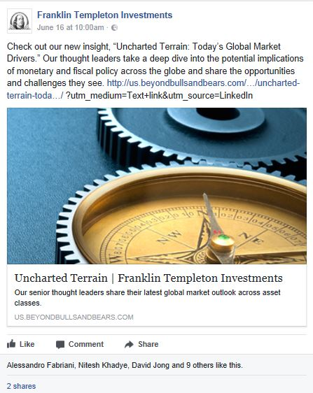


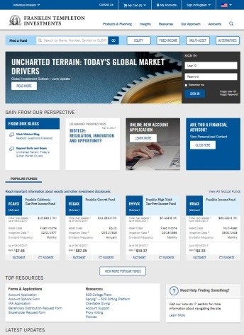



Join the Retirement Conversation
Notes:
Main Point: Join the retirement conversation.
Finally, how many of you have a Facebook account? LinkedIn? Twitter?
If you are connected with Franklin Templeton’s social media pages, you will receive regular updates when we post new information about retirement and other topics. Feel free to respond to posts and comment on topics that interest you. We would love to get your feedback.
Generating Income for Living
RTSI CUPPT 07/18

Slide 70
This communication is general in nature, and should not be considered or relied upon as legal, tax or investment advice or an investment recommendation, or as a substitute for legal or tax counsel and provided for educational and informational purposes only. Any investment products or services named herein are for illustrative purposes only, and should not be considered an offer to buy or sell, or an investment recommendation for, any specific security, strategy or investment product or service. Always consult a qualified professional or your own independent financial advisor for personalized advice and investment recommendations tailored to your specific goals, individual situation, and risk tolerance.
Franklin Templeton Investments does not provide legal or tax advice. Federal and state laws and regulations are complex and subject to change, which can materially impact your results. Franklin Templeton Distributors, Inc. (FTDI) cannot guarantee that such information is accurate, complete or timely; and disclaims any liability arising out of your use of, or any tax position taken in reliance on, such information.
All financial decisions, strategies, and investments involve risks, including possible loss of principal.
Fluctuations in the financial markets and other factors may cause declines in one’s account. Diversification and asset allocation strategies do not ensure a profit or protect against a loss. There is no guarantee that any particular asset allocation will meet one’s investment goal, provide one with a given level of income, or provide sufficient funds to meet future retirement needs. Investors are strongly advised to consult with appropriate financial, legal or tax advisors about one’s specific circumstances and individual goals.
This presentation must be preceded or accompanied by a current Franklin U.S. Government Securities Fund, Franklin Rising Dividends Fund, Franklin Adjustable U.S. Government Securities Fund, Franklin Income Fund, Franklin Mutual Shares Fund, Franklin Mutual Global Discovery Fund and Templeton Global Bond Fund summary prospectus and/or prospectuses. Please carefully read
a prospectus before you invest or send money. Investors should carefully consider a fund’s investment goals, risks, charges and expenses before investing.
Franklin Templeton Distributors, Inc.
One Franklin Parkway
San Mateo, California 94403-1906
(800) DIAL BEN®/342-5236
franklintempleton.com
RTSI CUPPT 01/19
Notes:
Generating Income for Living
RTSI CUPPT 07/18

