Slide 1

B1016SS
Notes:
READ SLIDE

Slide 2

Notes:
READ SLIDE

Slide 3
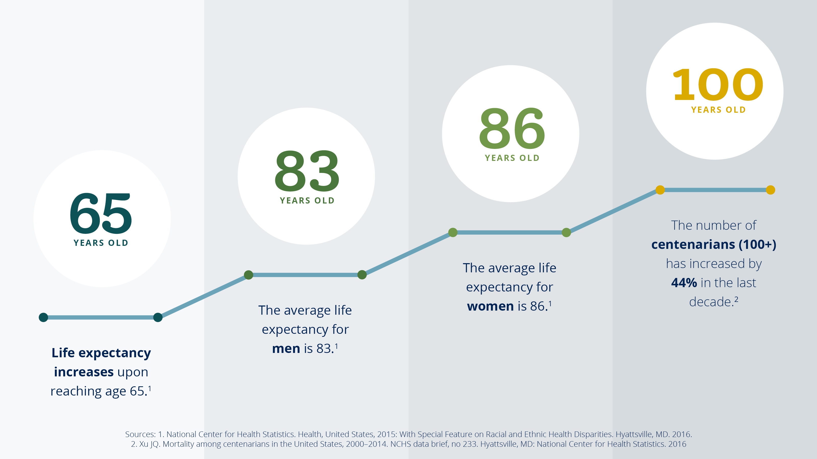
Notes:
READ SLIDE

Slide 4
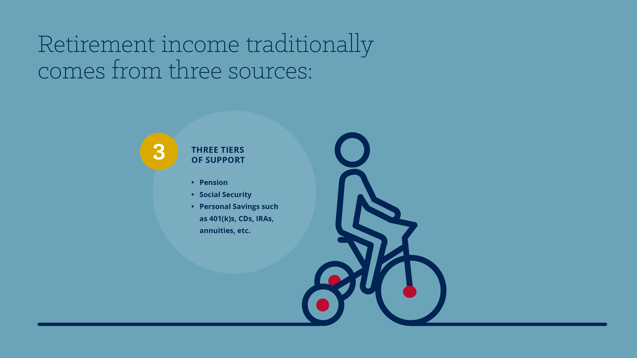
Notes:
Because of our increasing life expectancies, how we fund retirement is becoming increasingly important. Typically, people draw retirement income from three sources: pensions, social security, and personal savings such as 401(k)s, CDs, IRAs, and annuities. In today’s presentation, we are going to focus on Social Security and what you need to know about it.

Slide 5
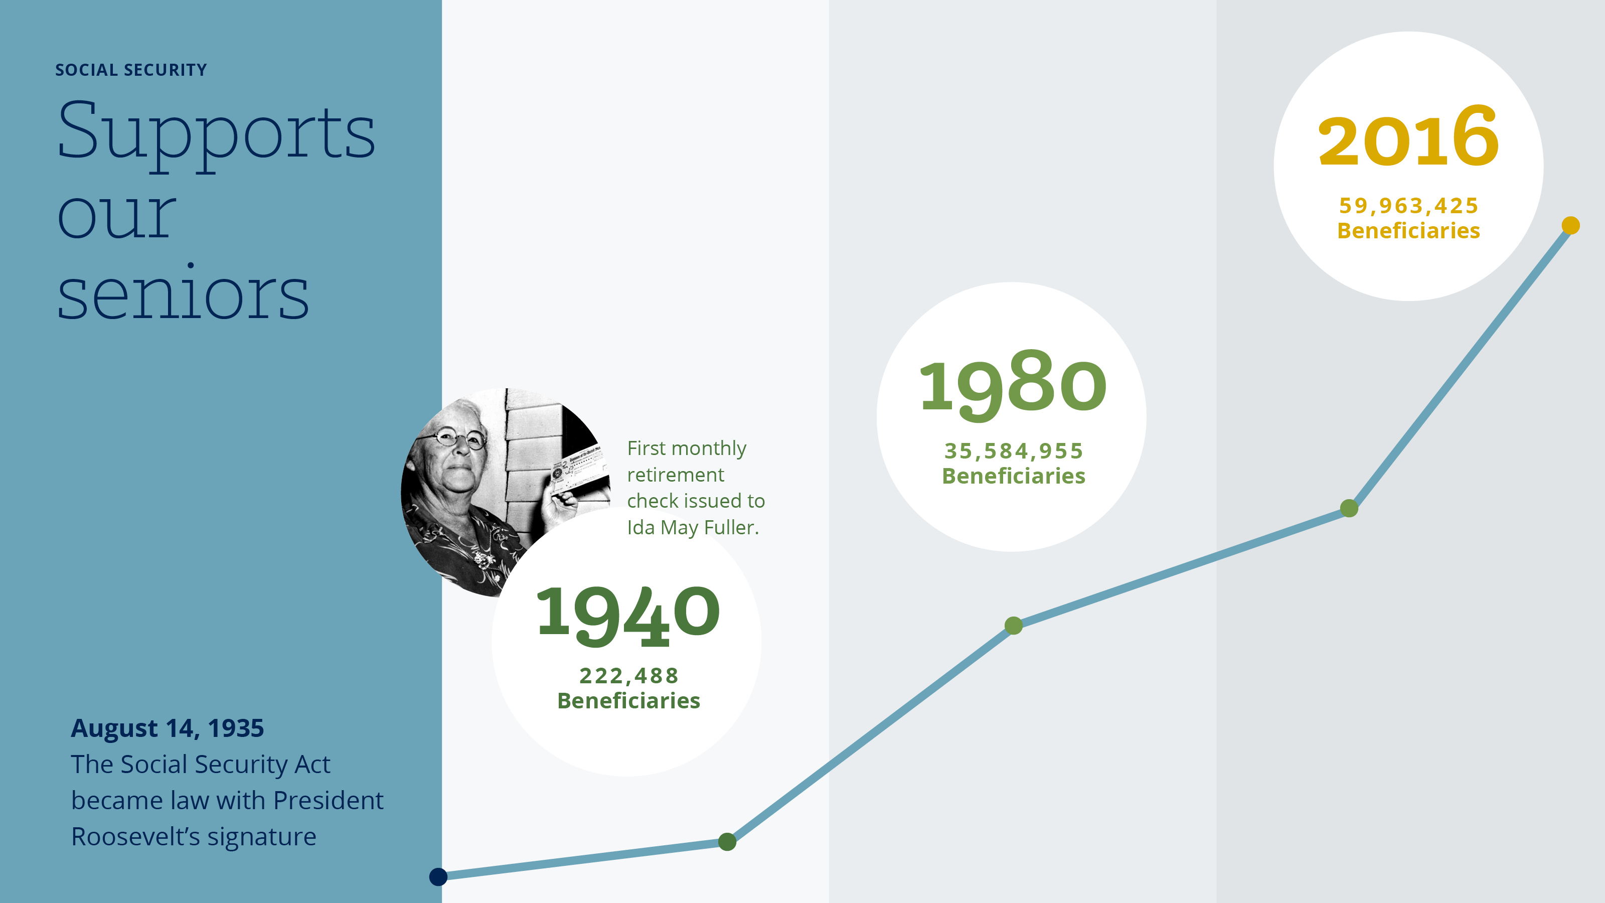
Notes:
Now for a short history of social security benefits. Payment of monthly benefits began in January 1940. On January 31, 1940, the first monthly retirement check was issued to a retired legal secretary, Ida May Fuller, of Ludlow, Vt., in the amount of $22.54. Miss Fuller died in January 1975 at the age of 100. During her 35 years as a beneficiary, she received over $22,000 in benefits.
When Ida first began receiving her benefits, there where 222,488 beneficiaries. This grew to over 35 million in 40 years. And has almost doubled again since then.

Slide 6

Notes:
In the last slide we learned that nearly 60 million Americans depend on Social Security for a portion of their income. And of those planning for retirement, on average, they except social security to account for 35% of their retirement income. This is the largest single source of retirement income.

Slide 7

Notes:
READ SLIDE

Slide 8
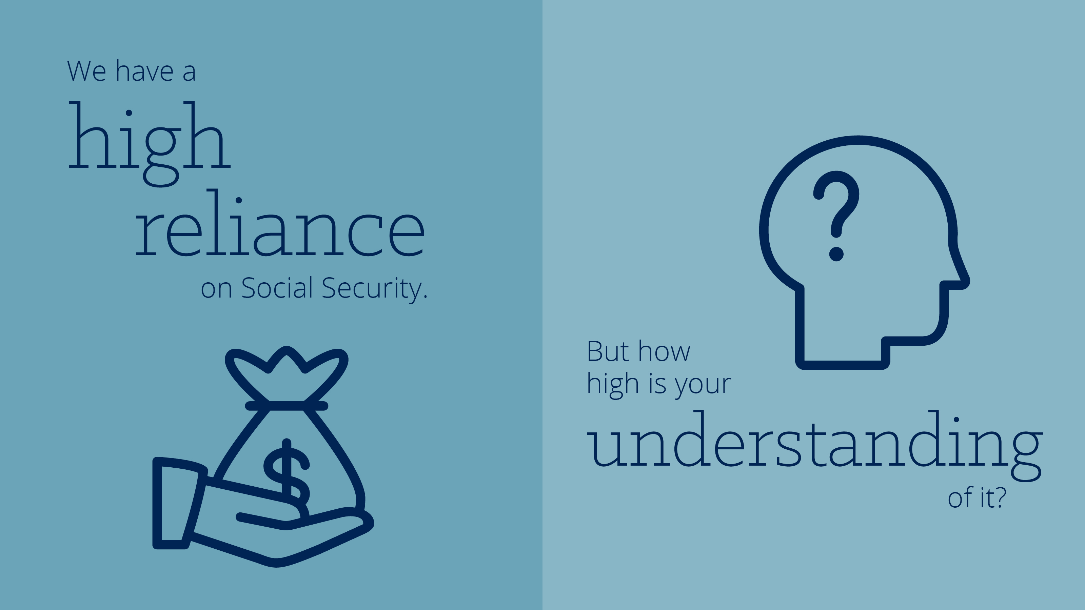
Notes:
But how high is your understanding of it? For the next portion of the presentation, I am going to ask for a little audience participation. We will do a little Q&A, and please remember to jot do how these different topics apply to you in the worksheet.

Slide 9

Notes:
READ SLIDE

Slide 10
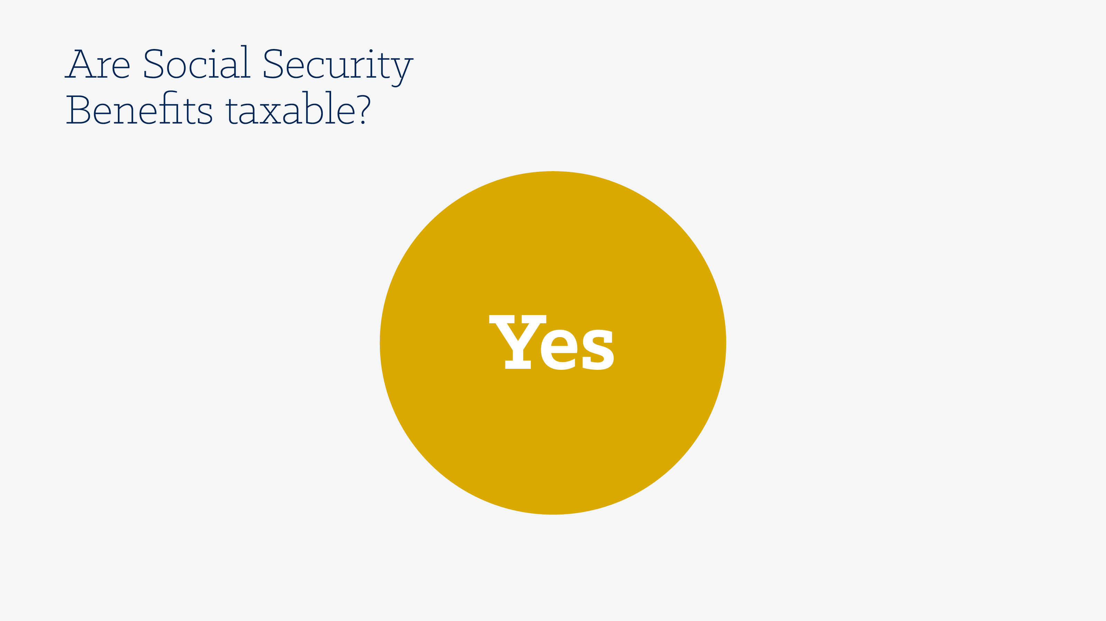
Notes:
YES

Slide 11
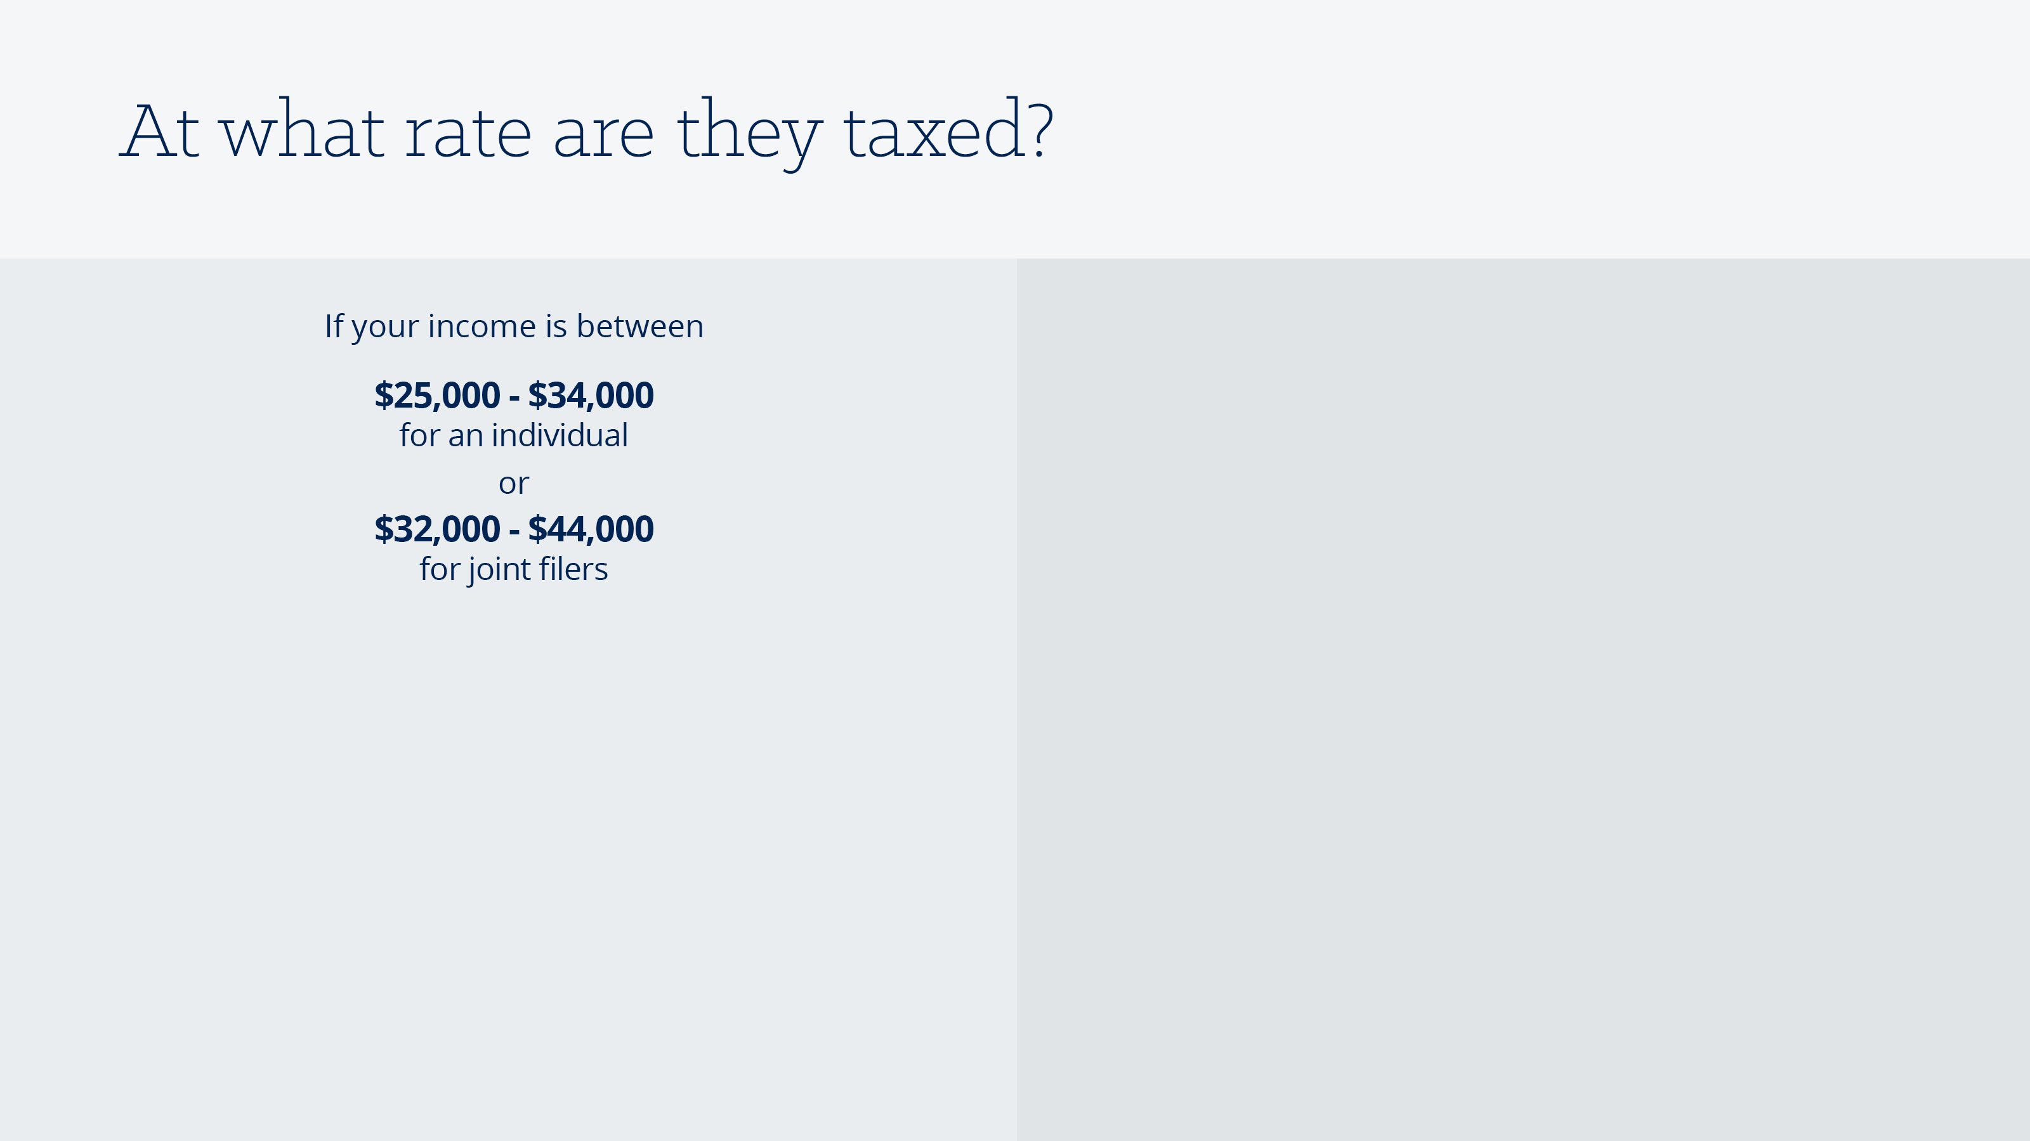
Notes:
READ SLIDE

Slide 12
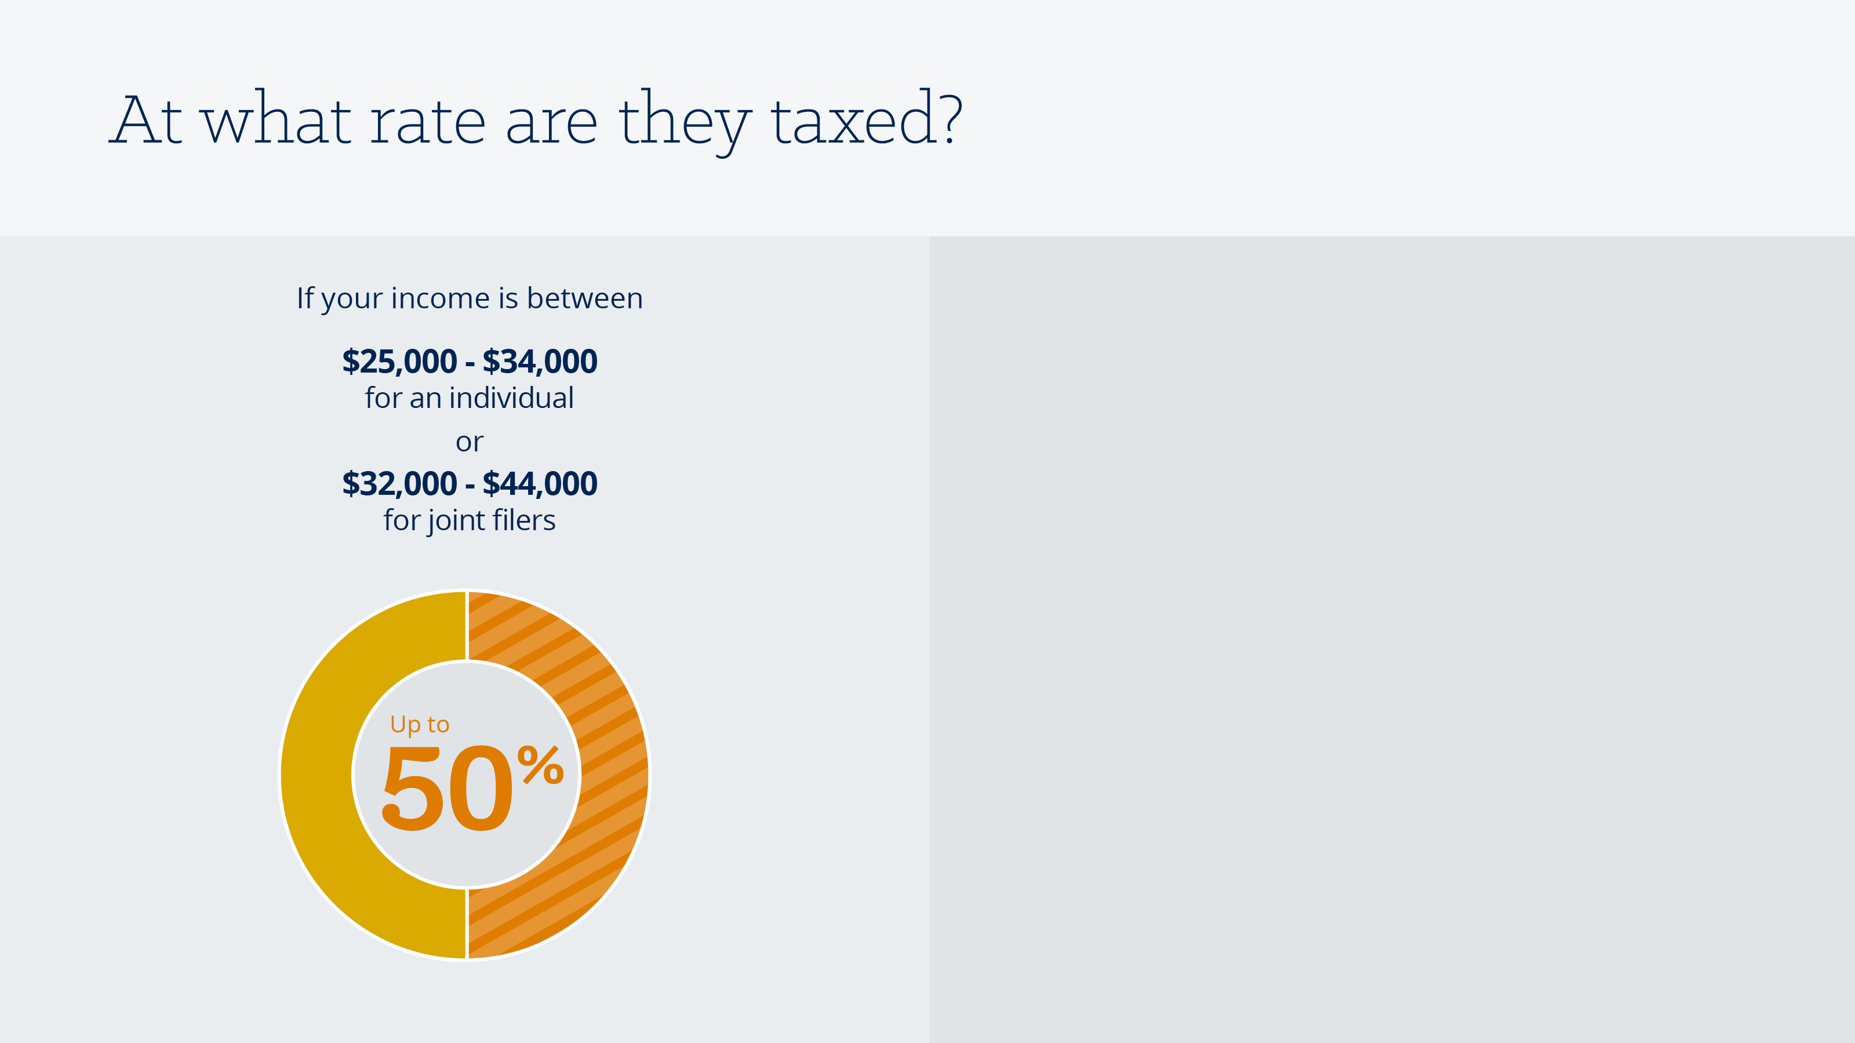
Notes:
Up to 50% of you benefit is taxed.

Slide 13
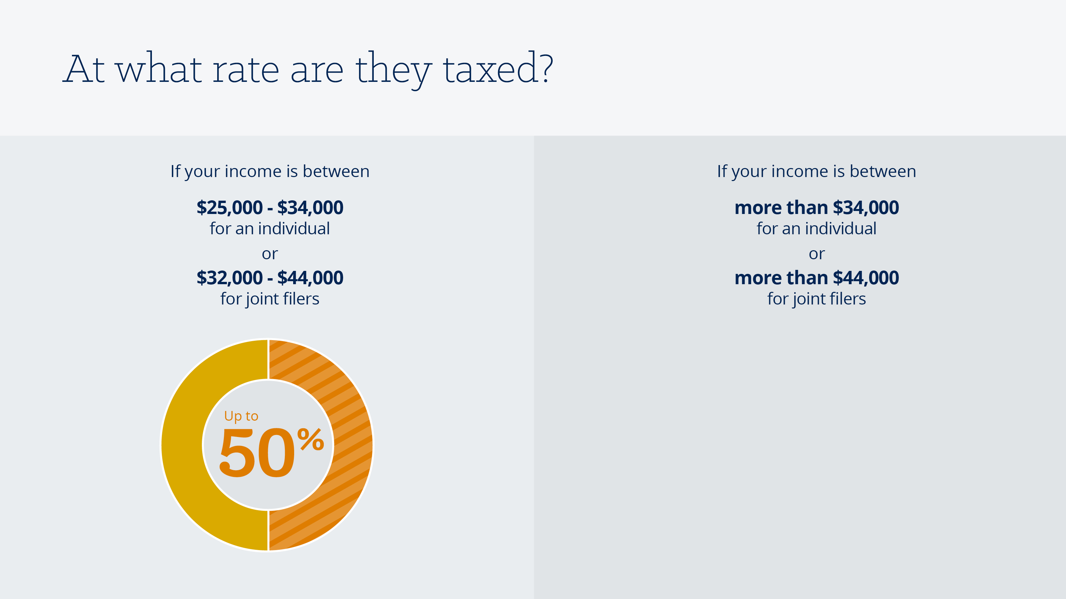
Notes:
But if your income is higher – over $34,000 if filing taxes individually and $44,000 if filing taxes jointly, then

Slide 14
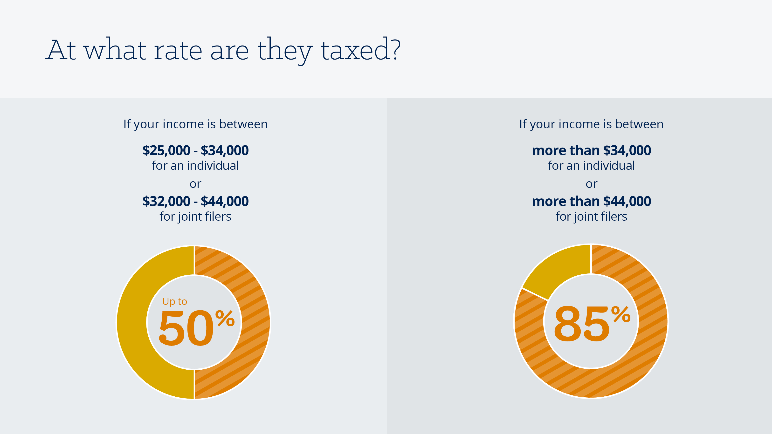
Notes:
85% percent of your benefit is taxable.

Slide 15
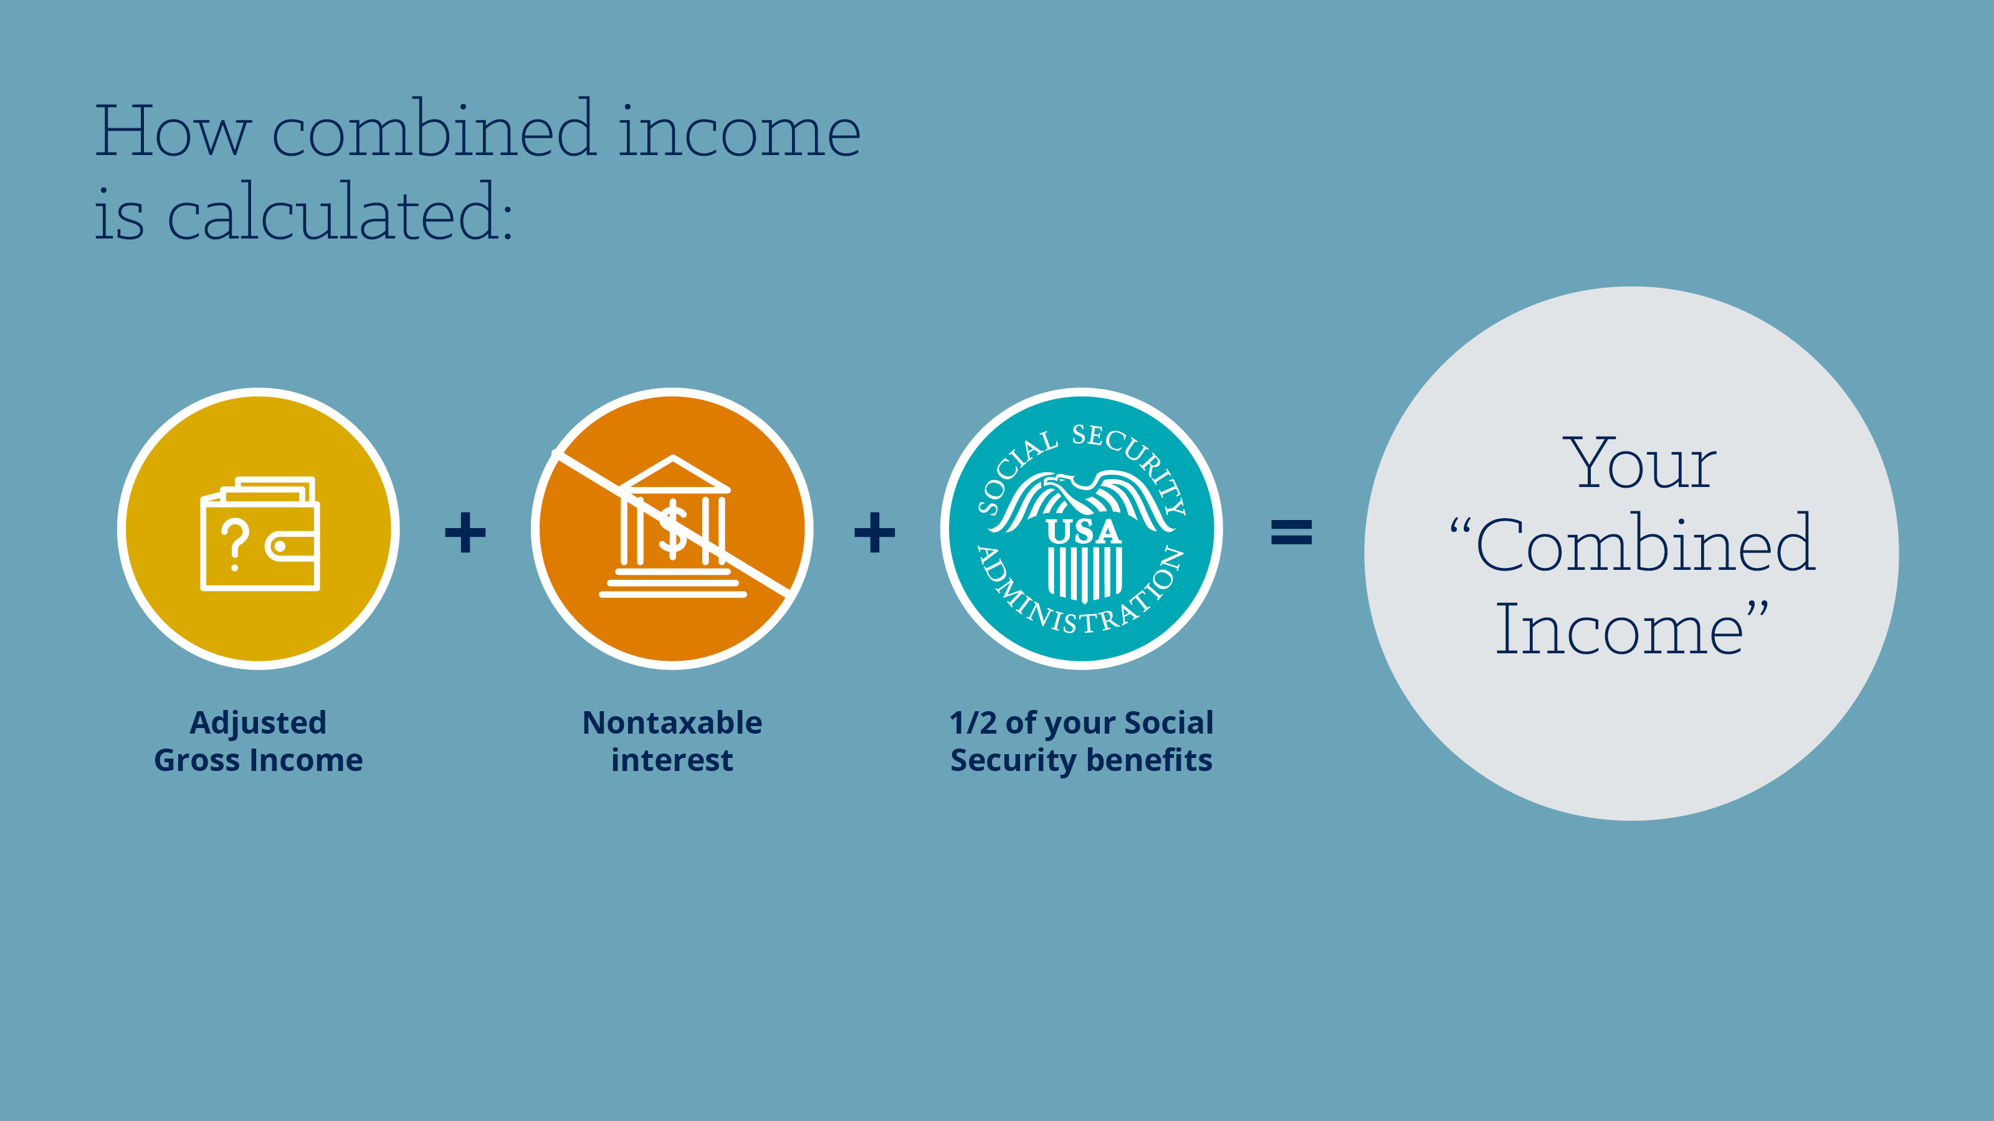
Notes:
Income is not just your adjusted gross income. It is your adjusted gross income, plus nontaxable interest, plus ½ of your social security benefit. This is the number that has to be over $44,000 if filing jointly to have 85% of your benefit taxable.

Slide 16

Notes:
READ SLIDE

Slide 17
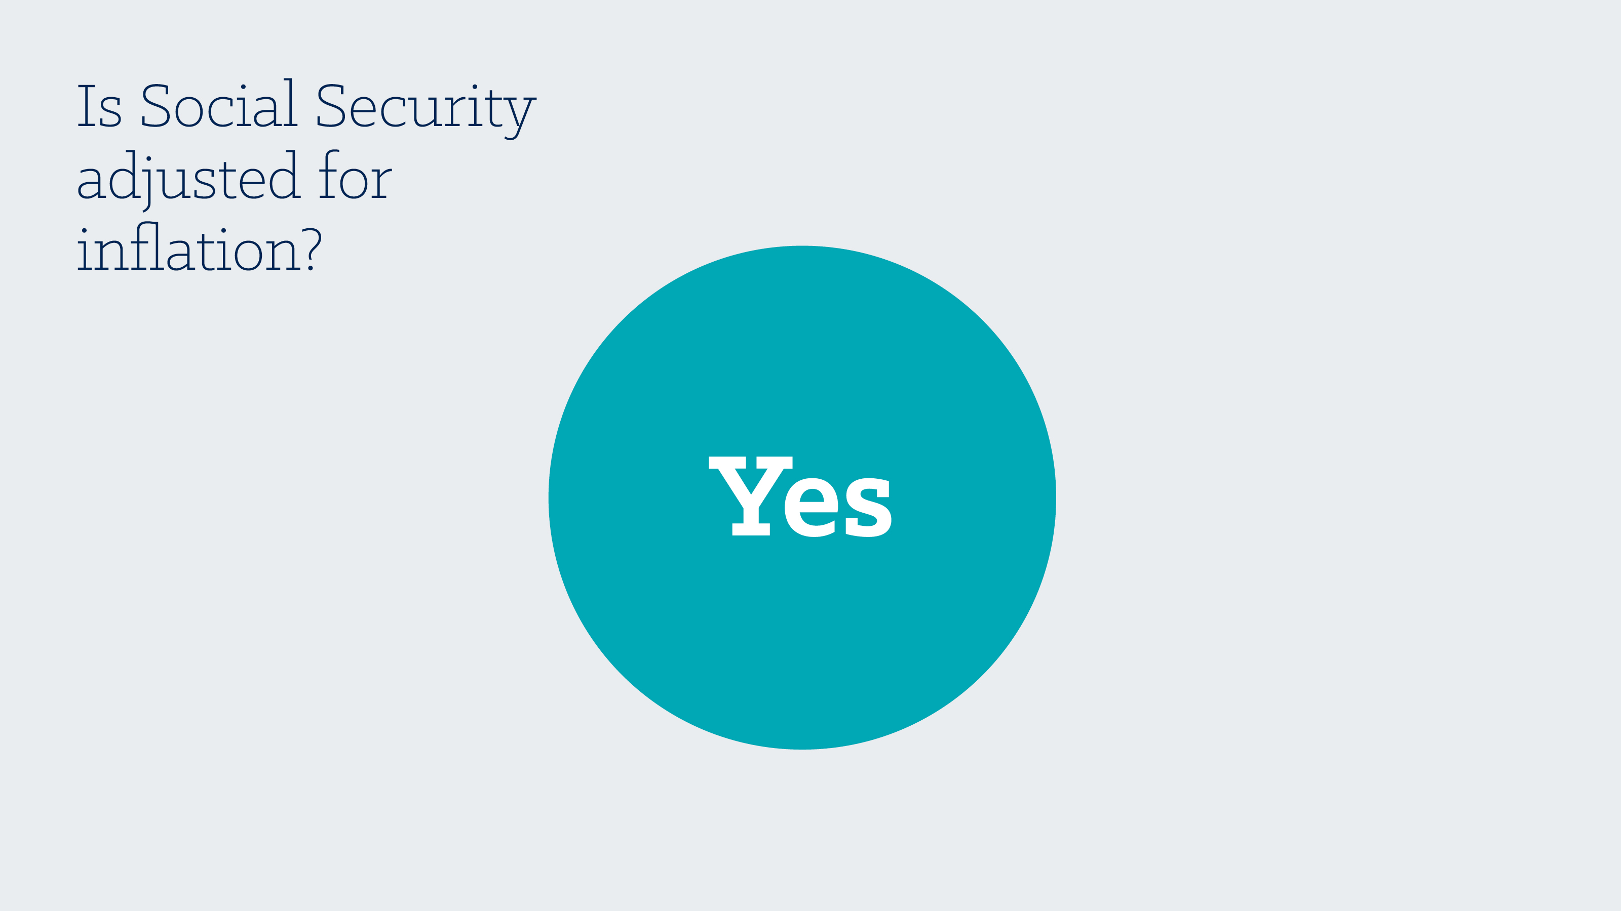
Notes:
Yes

Slide 18
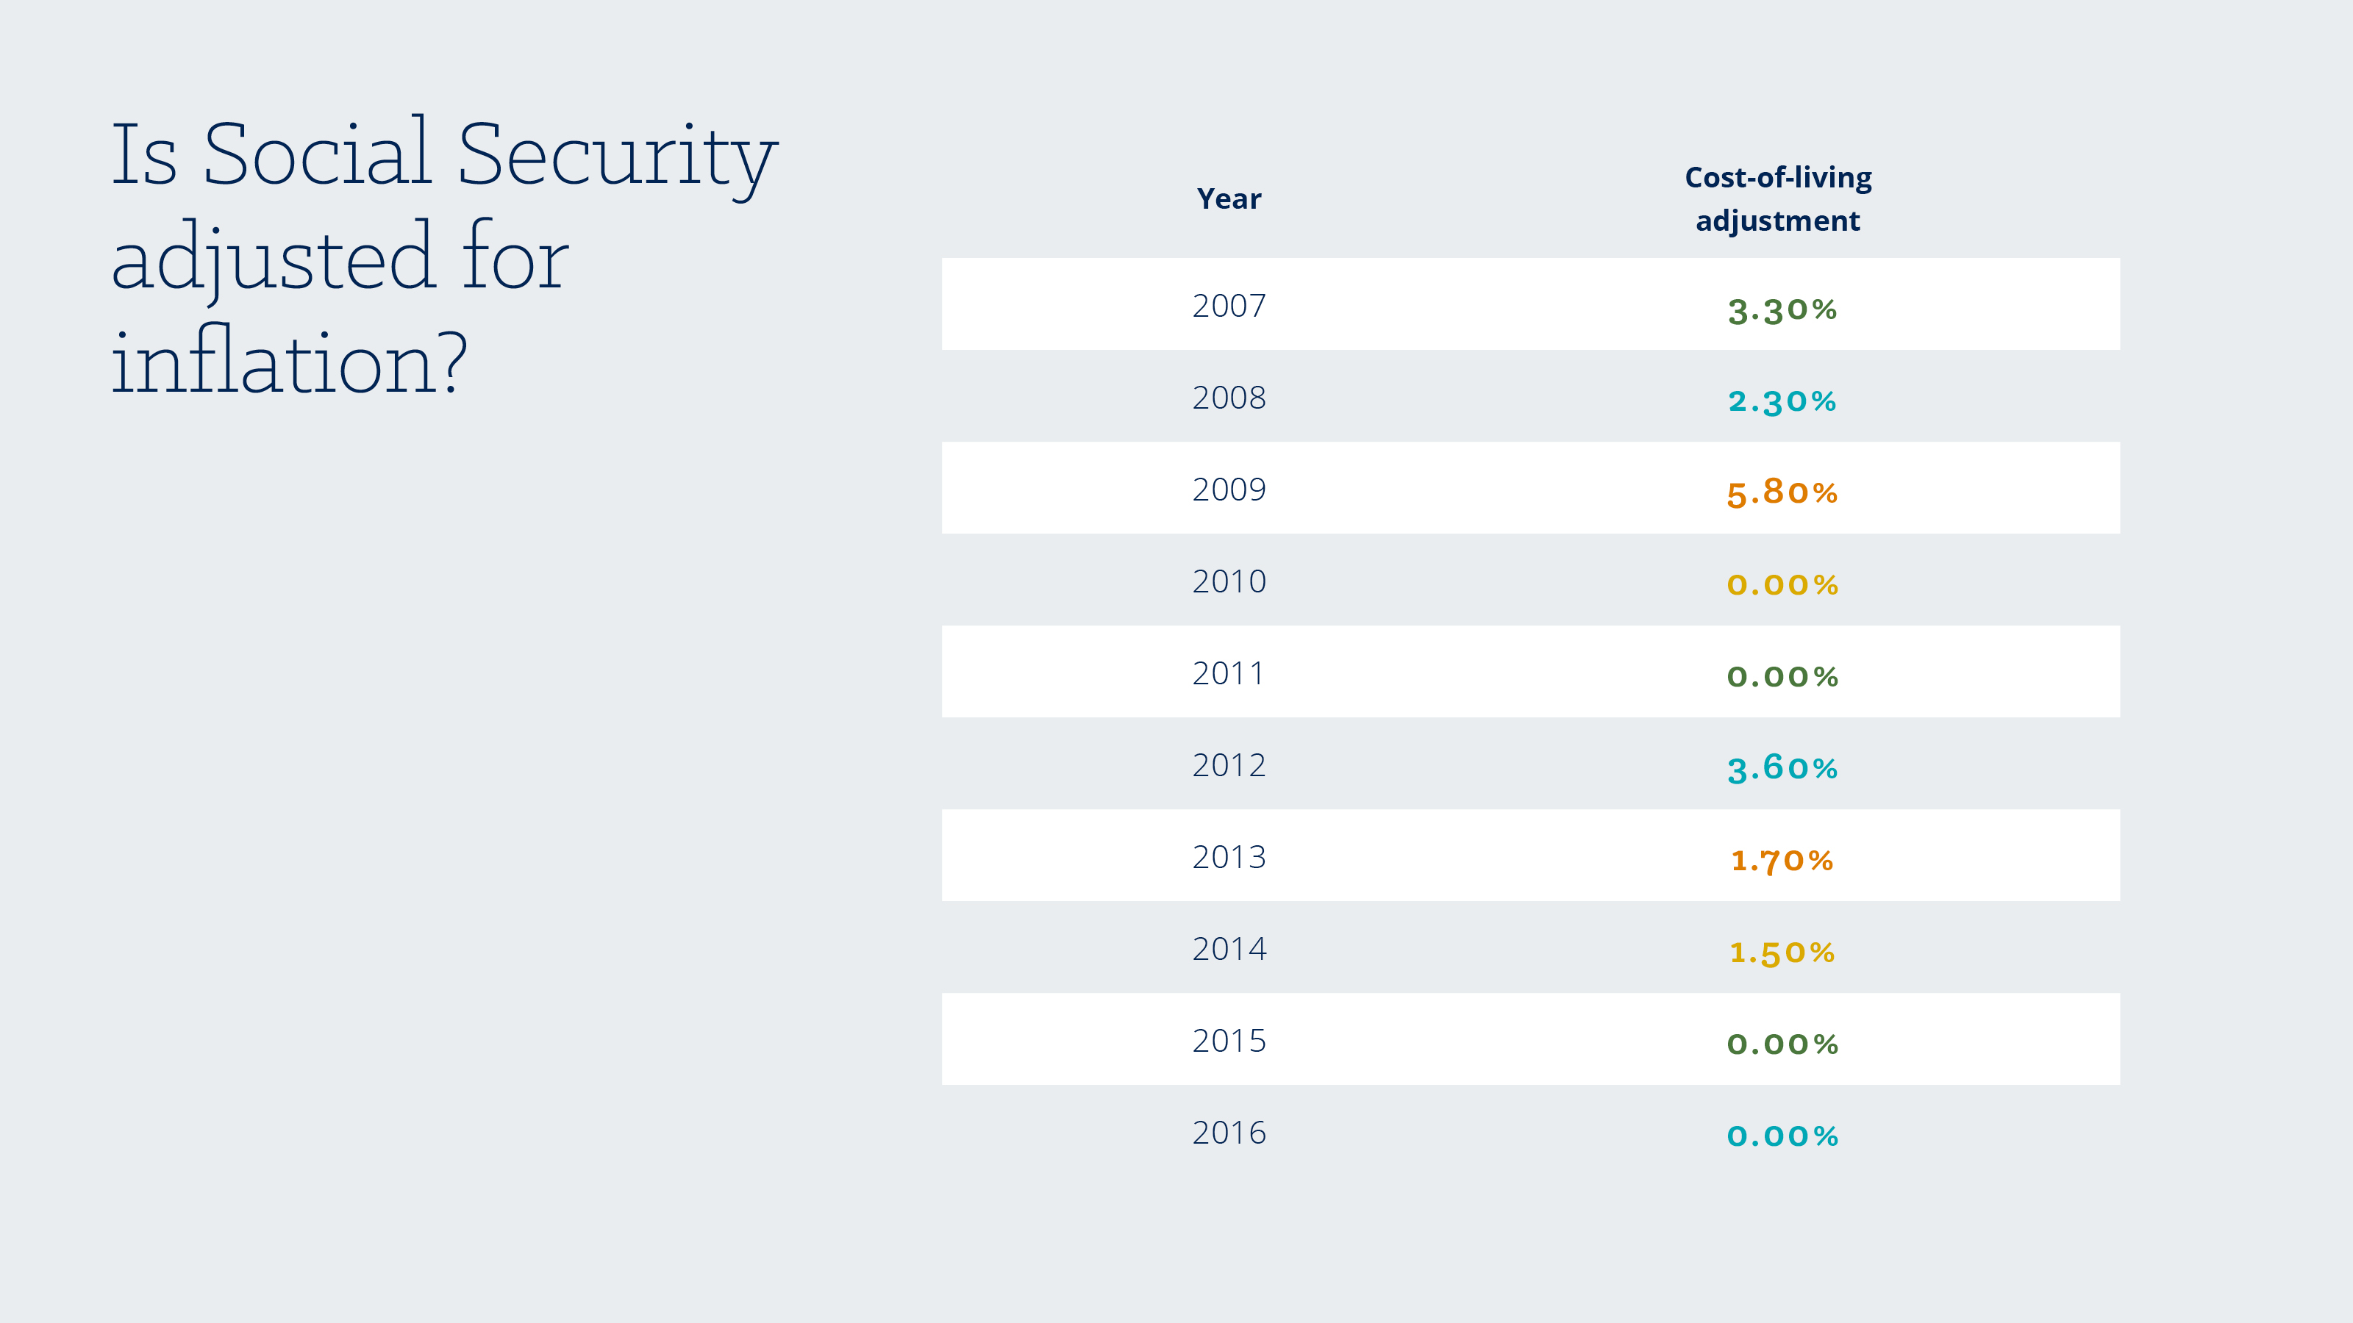
Notes:
You may be surprised to find out that Social Security is adjusted for inflation. The cost-of-living adjustment is known as COLA and is based off of the CPI-W or the Consumer Price Index for Urban Wage Earners. There is a lot of research out there when it comes to COLA and the buying power of retirees. Most research shows that COLA does not keep pace with the increase in spending that retirees face because retirees tend to spend less on items such as transportation and disproportionately more on items such as housing.*
From this table, you can see that on average, COLA increased social security benefits by 1.8% per year, but it has not increased at all the last two years.
*Arthur Delaney and Daniel Marans, Huffington Post, “Social Security Beneficiaries Stiffed Amid Benefits Debate,” October 2015.

Slide 19

Notes:
READ SLIDE

Slide 20

Notes:
Yes, but they must meet specific conditions

Slide 21

Notes:
READ SLIDE
Now, there is a loophole that allows those born in 1954 or earlier to file a restricted applicatoin that allows them to claim spousal benefits first while allowing their own to grow until they reach age 70. Consult your financial advisor for more information.

Slide 22

Notes:
READ SLIDE

Slide 23

Notes:
They are if they too meet certain conditions.

Slide 24

Notes:
READ SLIDE
And the good news is that your ex-spouse will not know that you filed for ex-spouse benefits unless you tell them.

Slide 25


Slide 26

Notes:
Yes, but they must meet specific conditions.

Slide 27

Notes:
READ SLIDE

Slide 28

Notes:
READ SLIDE

Slide 29
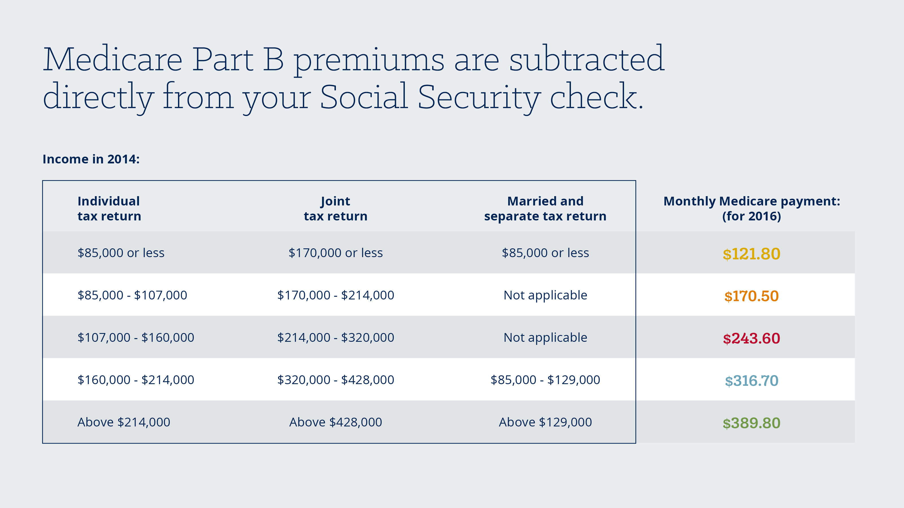
Notes:
Take a look at this table to determine how much your social security check may be reduced due to Medicare premiums. For example, if your retirement income, married filing jointly, is $200,000, your monthly benefit will be reduced by $170.50 each month to pay for Medicare Part B. And this is only part of the story. You may choose additional Medicare, such as the drug coverage- Medicare part D, that will cost even more. Make sure you consult with your financial advisor and plan for medical expenses in retirement.

Slide 30
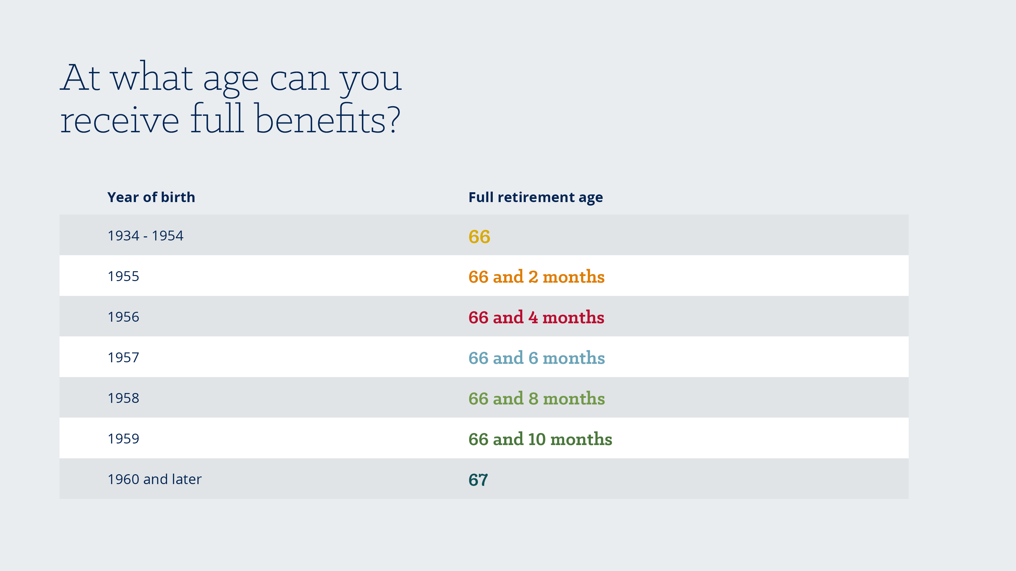
Notes:
To be eligible to receive 100% of your monthly social security benefit, you must wait until your full retirement age to claim social security benefits. Your full retirement age is based on your birth year. Take a look at this table to determine when you will be eligible for full benefits. For example, if you were born in 1956, you will be eligible for full benefits when you are 66 years and 4 months old.

Slide 31
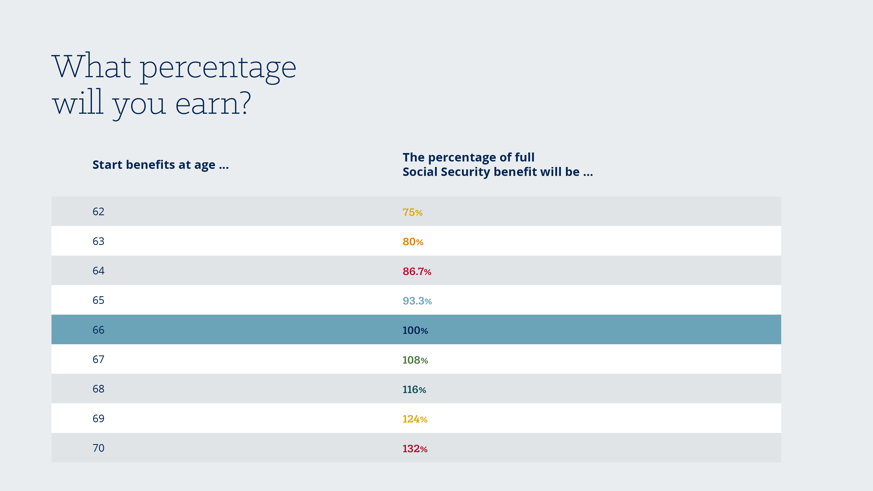
Notes:
You do not have to start taking benefits at your full retirement age. You may choose to take your benefits as early as age 62 or as late as age 70. Each year between ages 62 and 70, you will get a percent of your full retirement benefit. But once you file, your benefit amount is set for the rest of your life. For example, if you file for social security benefits at age 63, then you would receive 80% of your full benefit monthly for the rest of your life. However, if you wait to file until age 68, you will receive 116% of your benefit monthly for the rest of your life.

Slide 32

Notes:
READ SLIDE

Slide 33
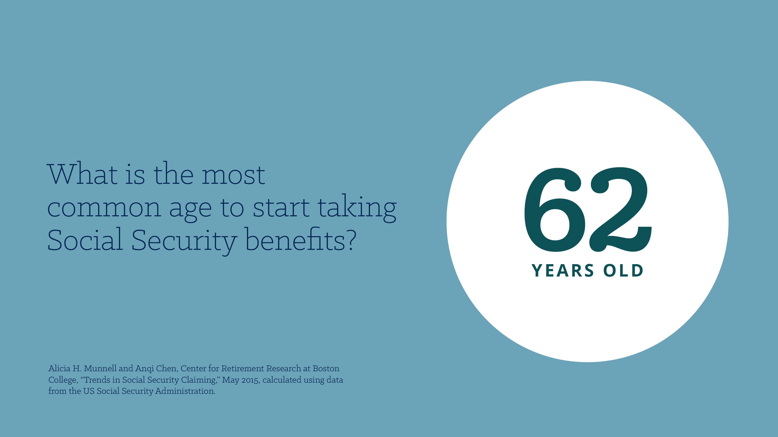
Notes:
62 is the most popular age to begin taking social security benefits.* This the earliest possible age to do so. But taking Social Security benefits before your full retirement age does affect the amount of the benefit.
*Emily Brandon, US News and World Report, “The Most Popular Ages to Sign Up for Social Security,” June 2015.

Slide 34
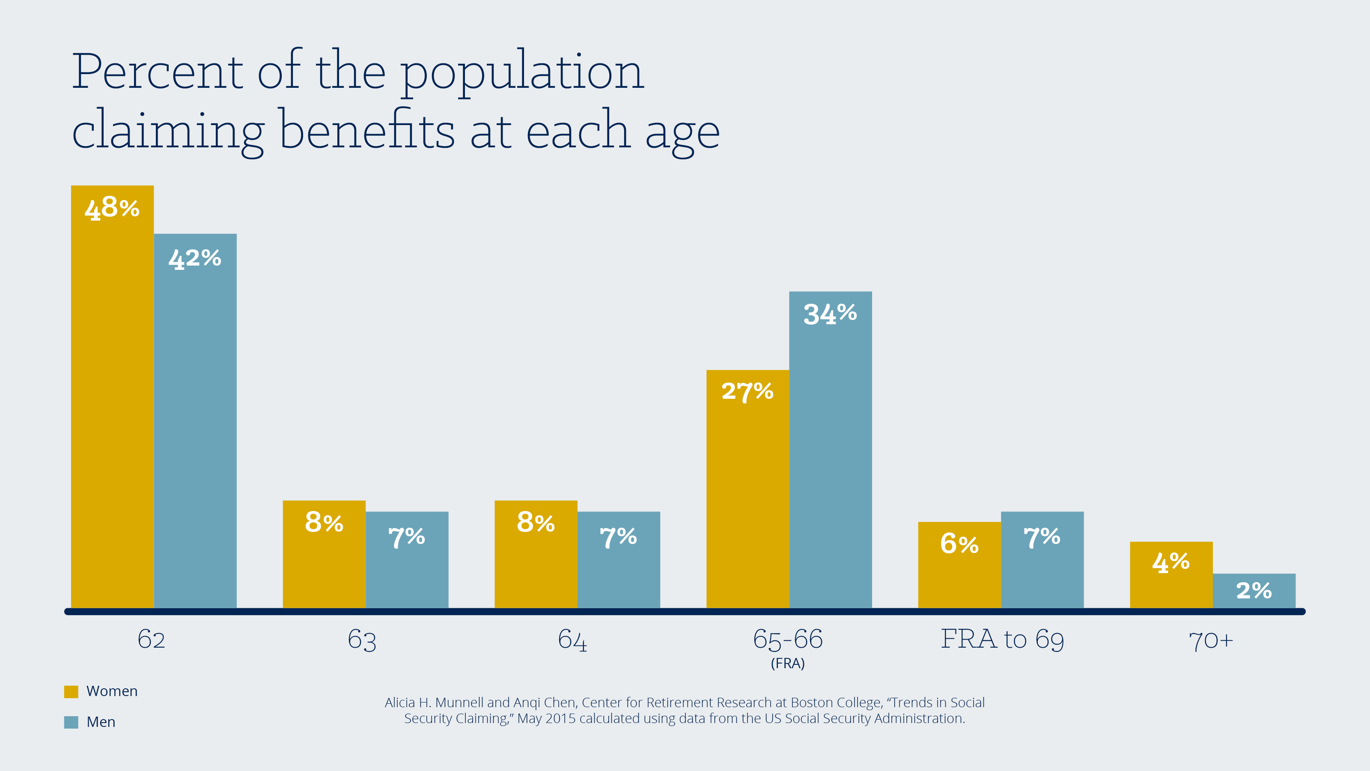
Notes:
Let’s take a quick look at the claiming patterns of retirees across ages. After age 62, the most popular age to claim social security benefits is full retirement age. A very small percentage wait until after full retirement age.

Slide 35
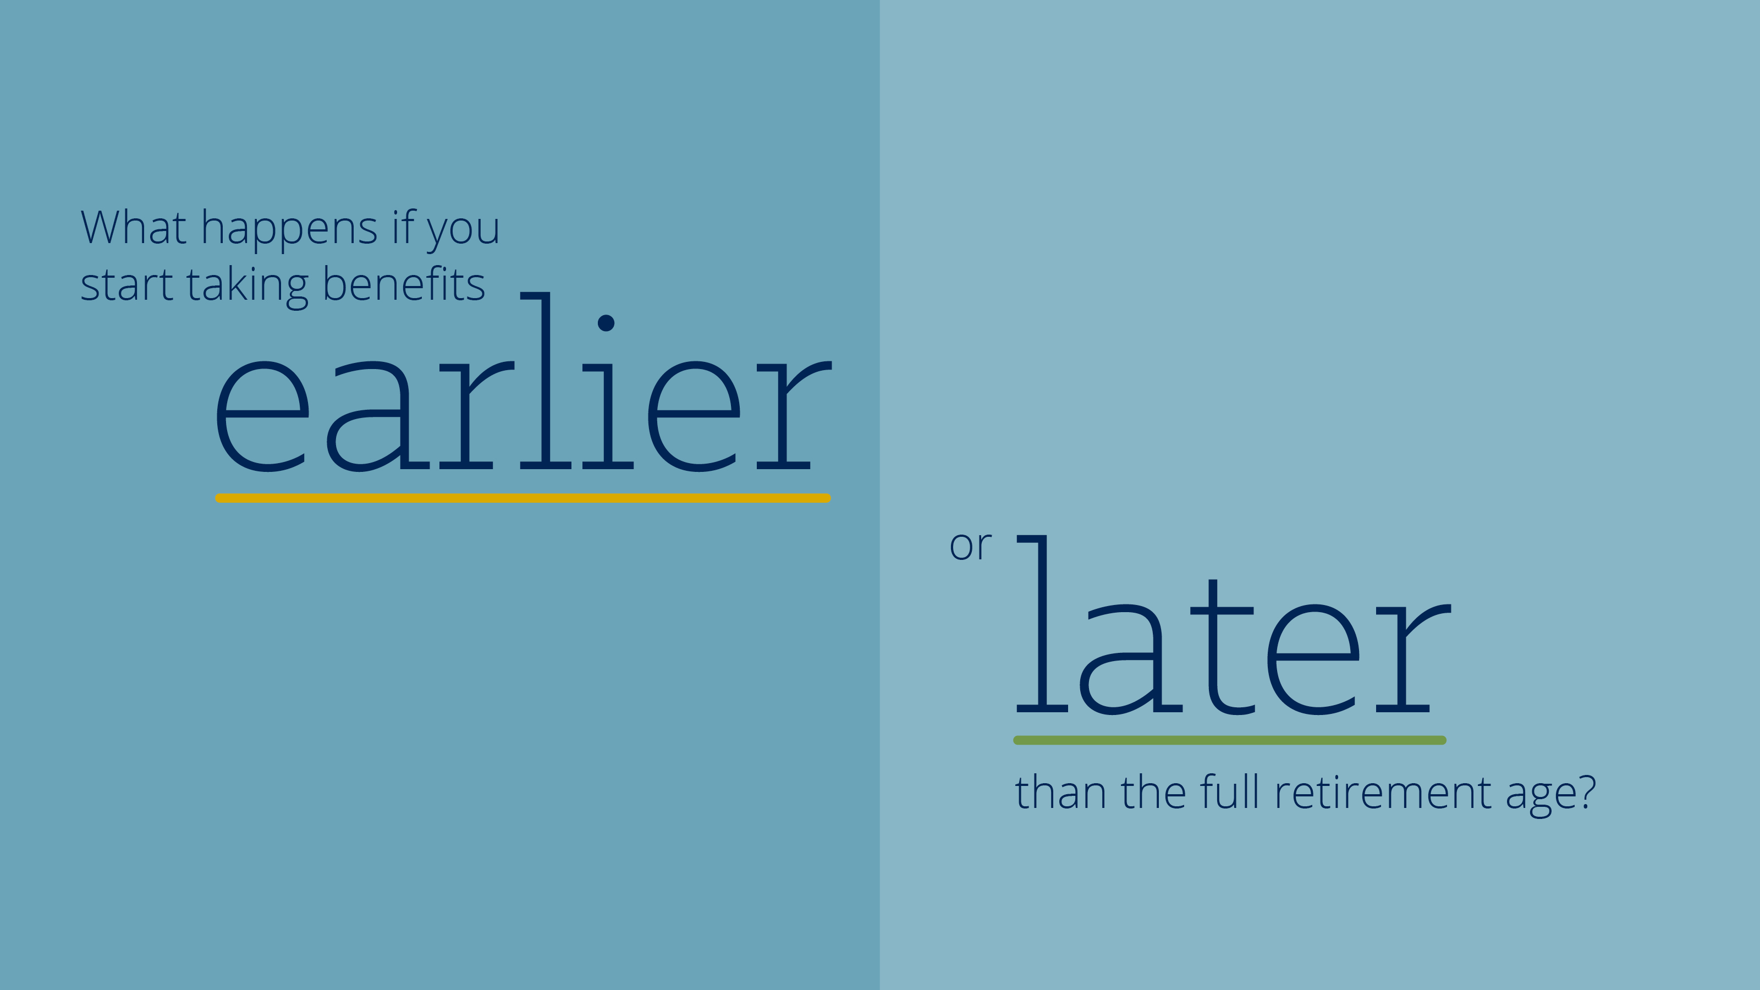
Notes:
I know, you may all be thinking, well this is great but when should I start taking social security benefits. Well lets take a look to see what happens if you start taking benefits earlier or later than full retirement age.

Slide 36

Notes:
Meet Jack and Diane. Jack is 64 years old and Diane is 60. Jack and Diane have been married for 40 years, have 2 grown children and are both accountants. They have saved since they started working and they are looking forward to living the retirement lifestyle they have imagined which includes traveling often to visit their children and grandchildren.

Slide 37
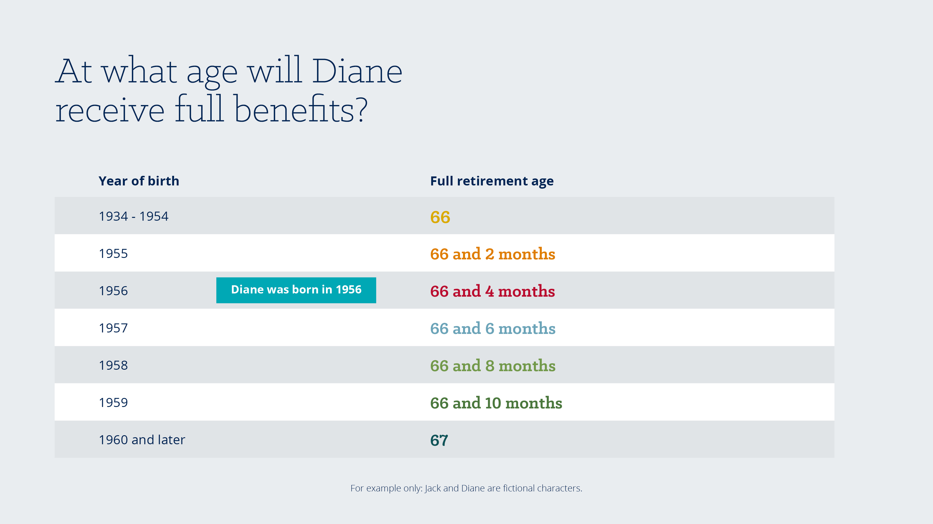
Notes:
Let’s focus in on Diane’s unique situation. Diane is only 60 years old and was born in 1956. Her full retirement age is 66 and 4 months.

Slide 38
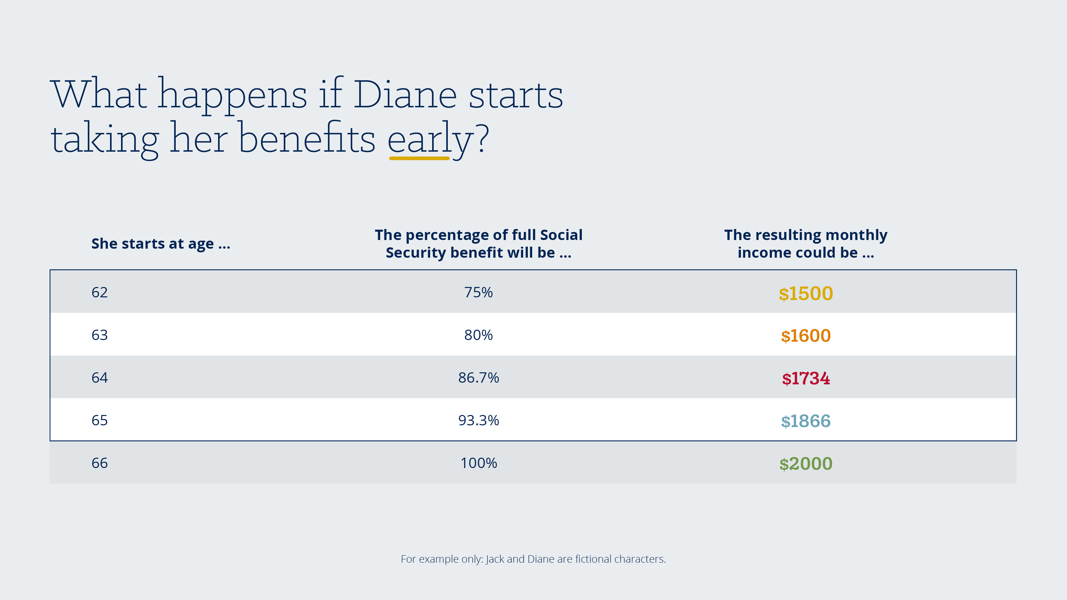
Notes:
Diane can start taking benefits in two short years. But she will face a 25% permanent reduction in her monthly benefit if she chooses to do so. In this example, if Diane waits until her full retirement age she will receive $2,000 per month in benefits for the rest of her life, but if she files at age 62 she will receive $1,500 per month for the rest of her life.

Slide 39
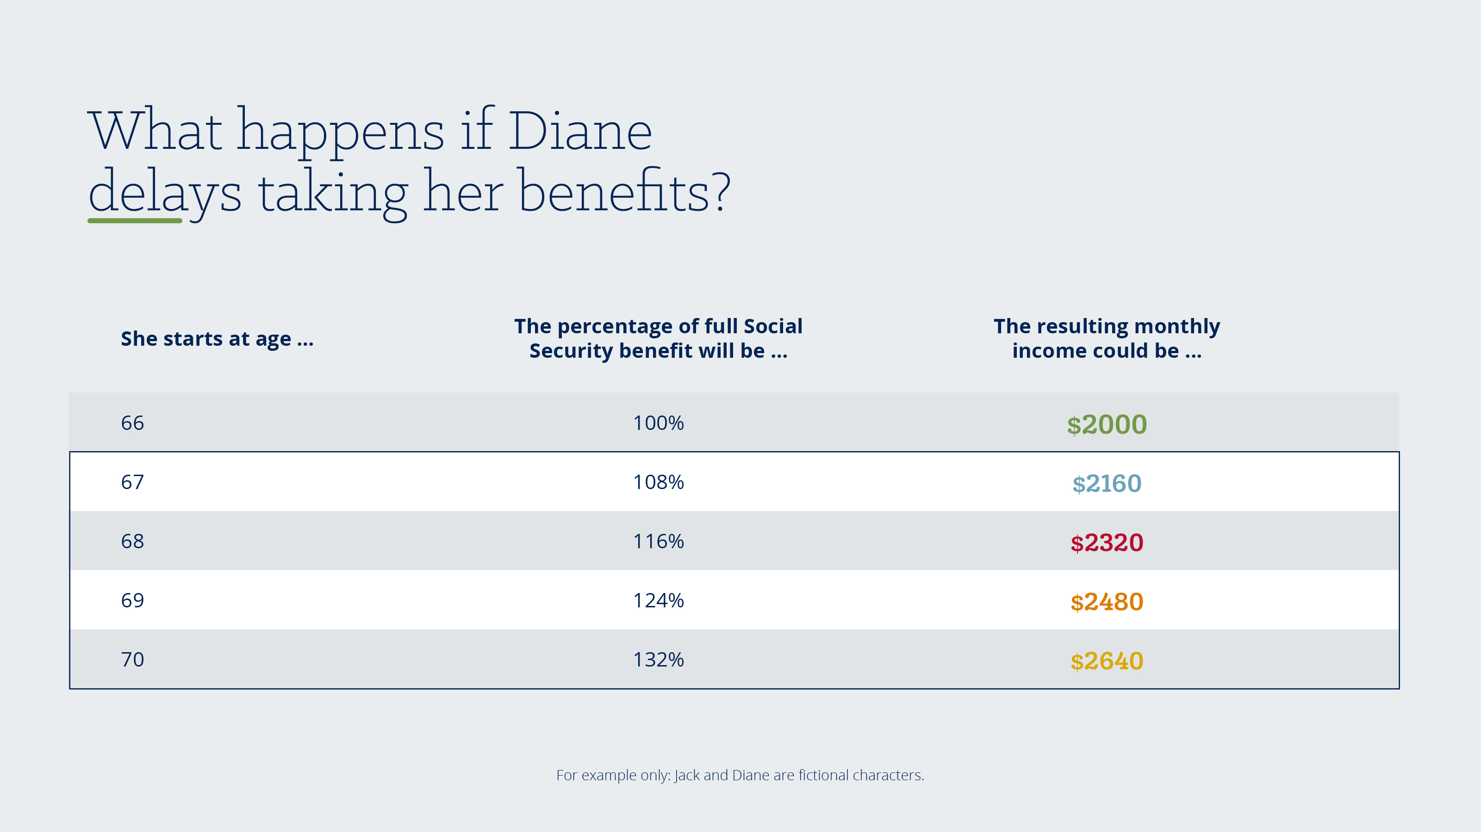
Notes:
Diane can certainly delay taking benefits. Again, for this example, if she delays taking social security until age 70, her monthly benefit will be permanently increased. In this scenario, her benefit would be $2,640 per month.

Slide 40
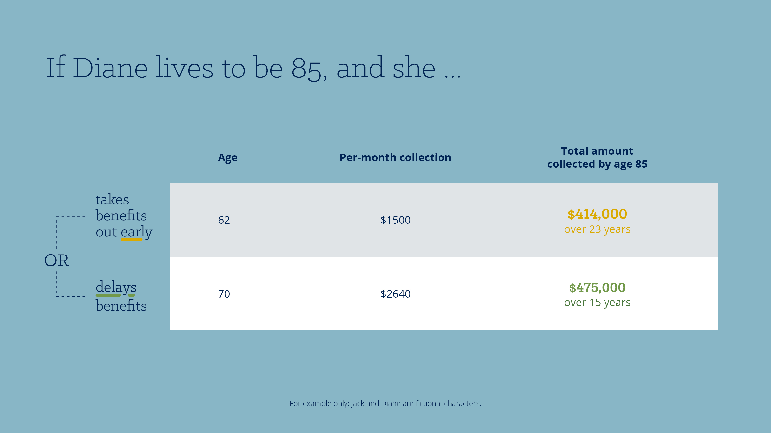
Notes:
In a direct comparison, if Diane lives to 85 years old, she will collect $1,500 per month for 276 months or 23 years. The amount collected at age 85 will be $414,000. But, if Diane delays taking social security she will collect $2,640 for 180 months or 15 years. The amount collected will be $475,000 at age 85. The result will be that she will receive $60,000 more in benefits by age 85 if she delays and lives to age 85. And this difference will continue to grow the longer she lives.
The problem is that we do not know how long we will live. And everyone has their own unique set of circumstances. Consult your financial professional for advice.

Slide 41

Notes:
The first step you will want to take when putting together a social security strategy will be to see how much monthly income you can expect in retirement. Did you notice that the social security administration no longer mails out annual statements? They used to send statements annually, but now they only mail them out once every five years. So you will receive a statement at age 30, 35, 40, 45, etc. But that’s not a problem because checking your expected social security income is super simple on the social security website.

Slide 42


Notes:
[Play video]

Slide 43
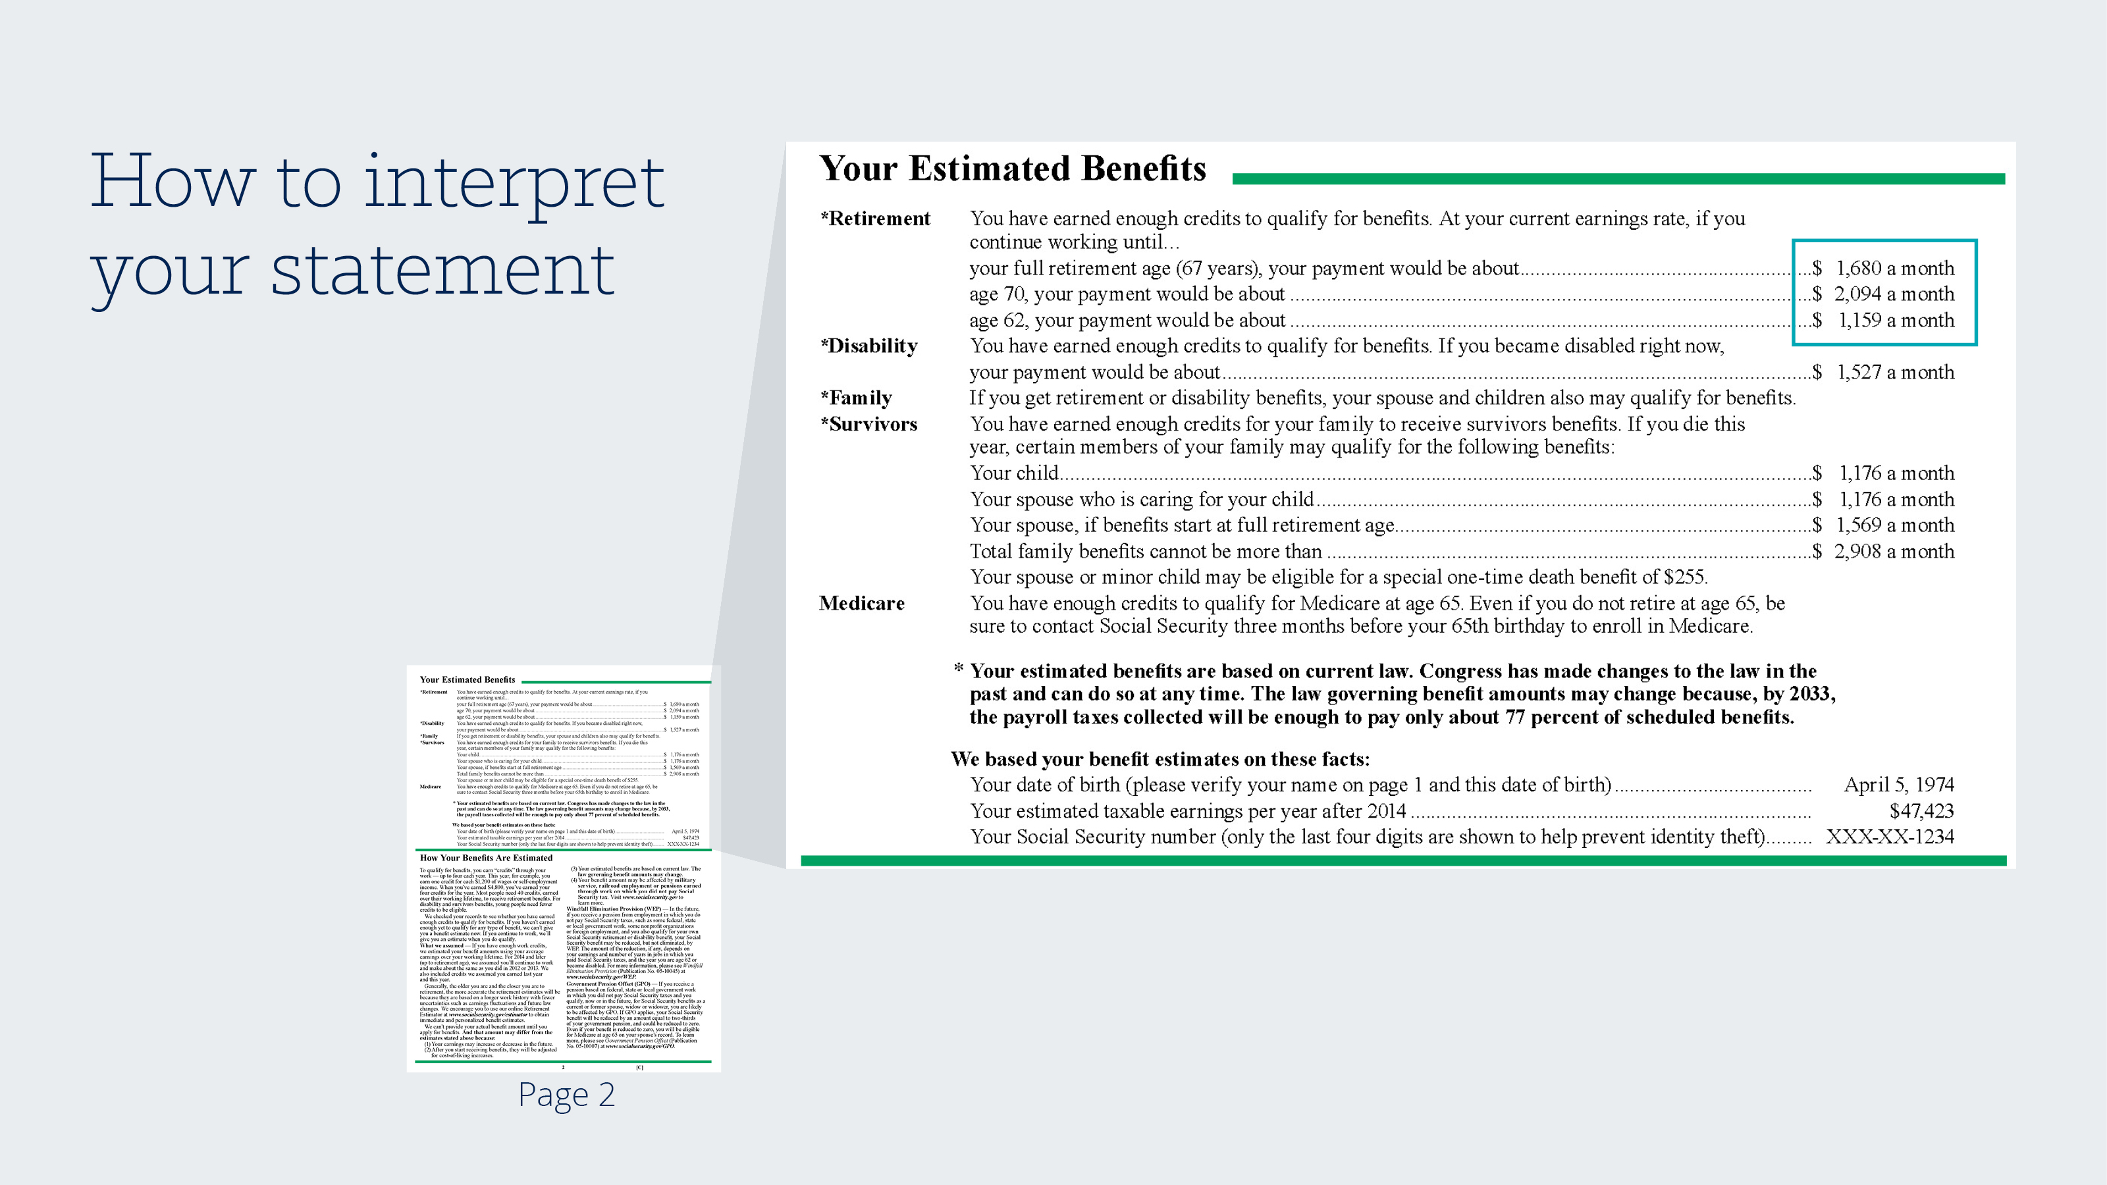
Notes:
Once you have accessed your statement, pages 2 and 3 are where your personal information resides.
In the top half of the page, you will find all of your social security income permutations including retirement, disability, and survivors benefits.
The portion I’ve outlined in blue shows your monthly check at full retirement age, at age 62, and at age 70.

Slide 44
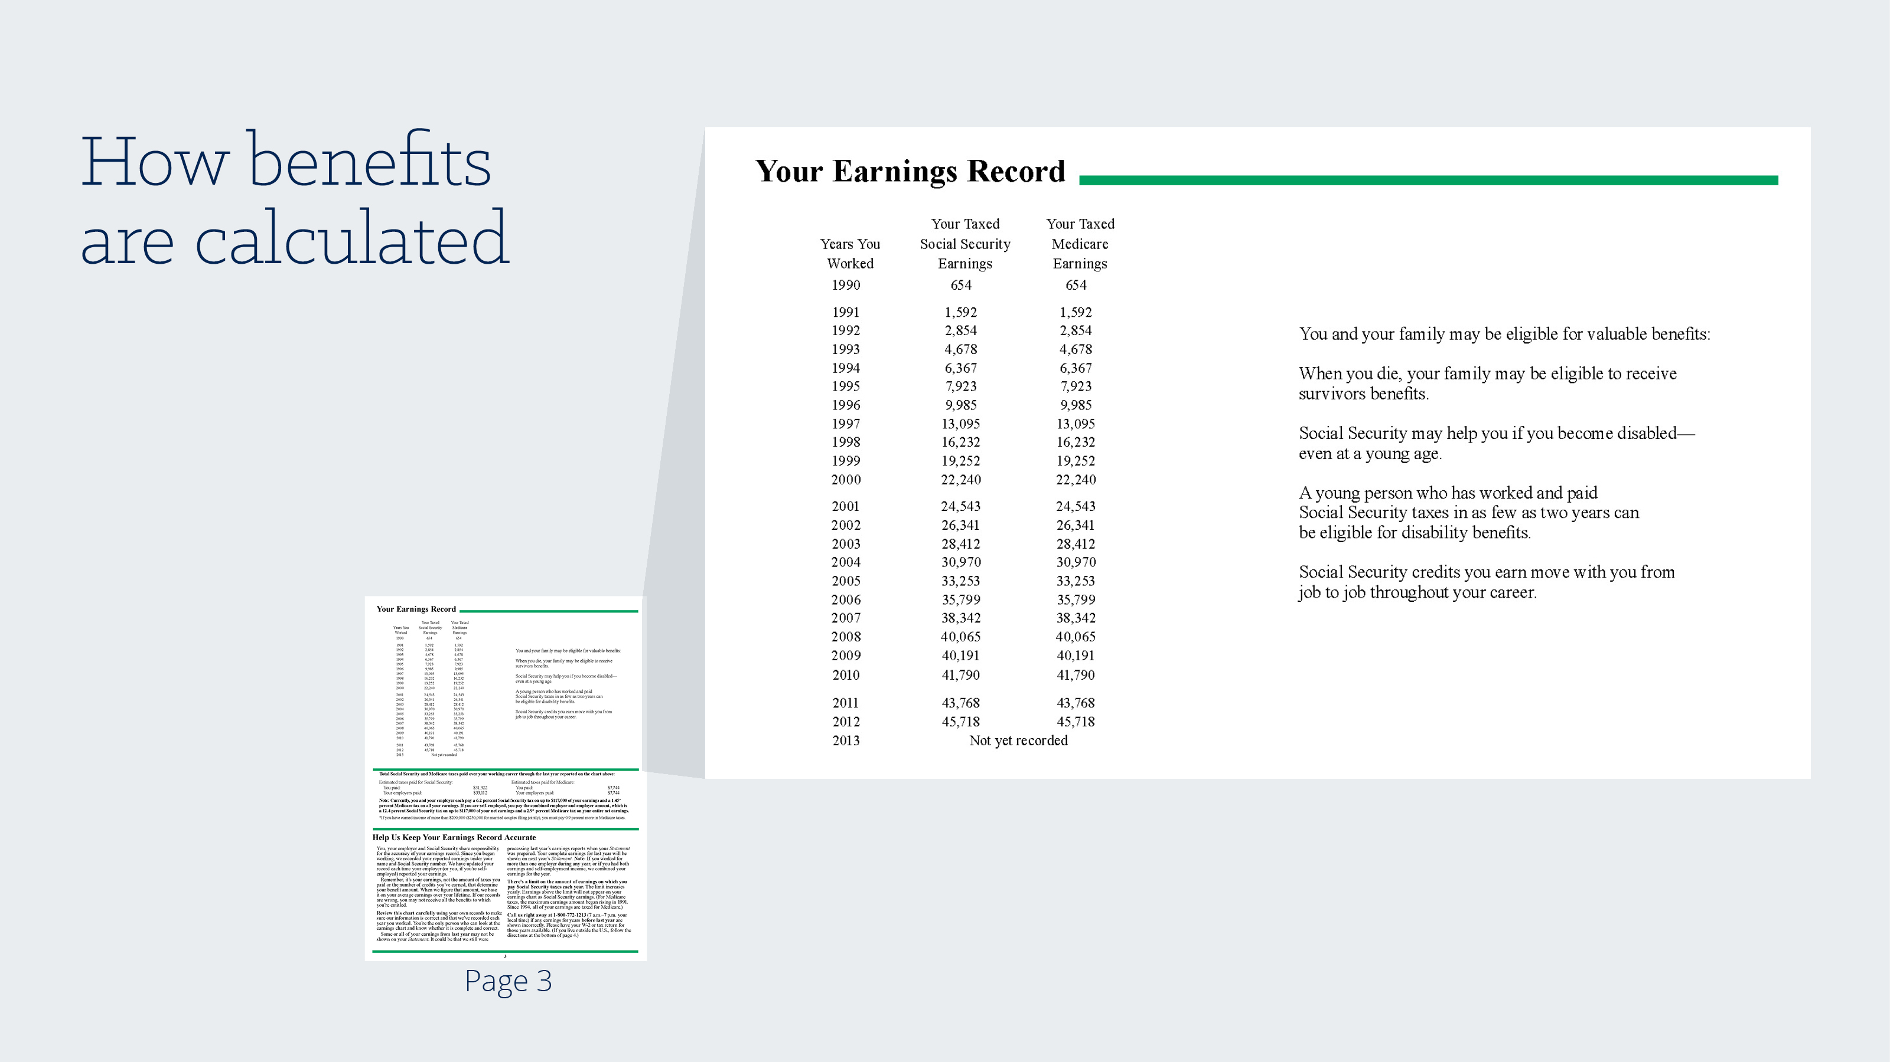
Notes:
You may be wondering what these monthly benefit calculations are based on, well they are based on your 35 highest earning years, which can be found on page 3 of your statement. Here you will find a list of the years that you worked and the income received those years. If you have not worked for 35 years, a zero is factored into the average for those years. Your advisor or the Social Security Administration can provide more details on the exact calculation if you want them.

Slide 45
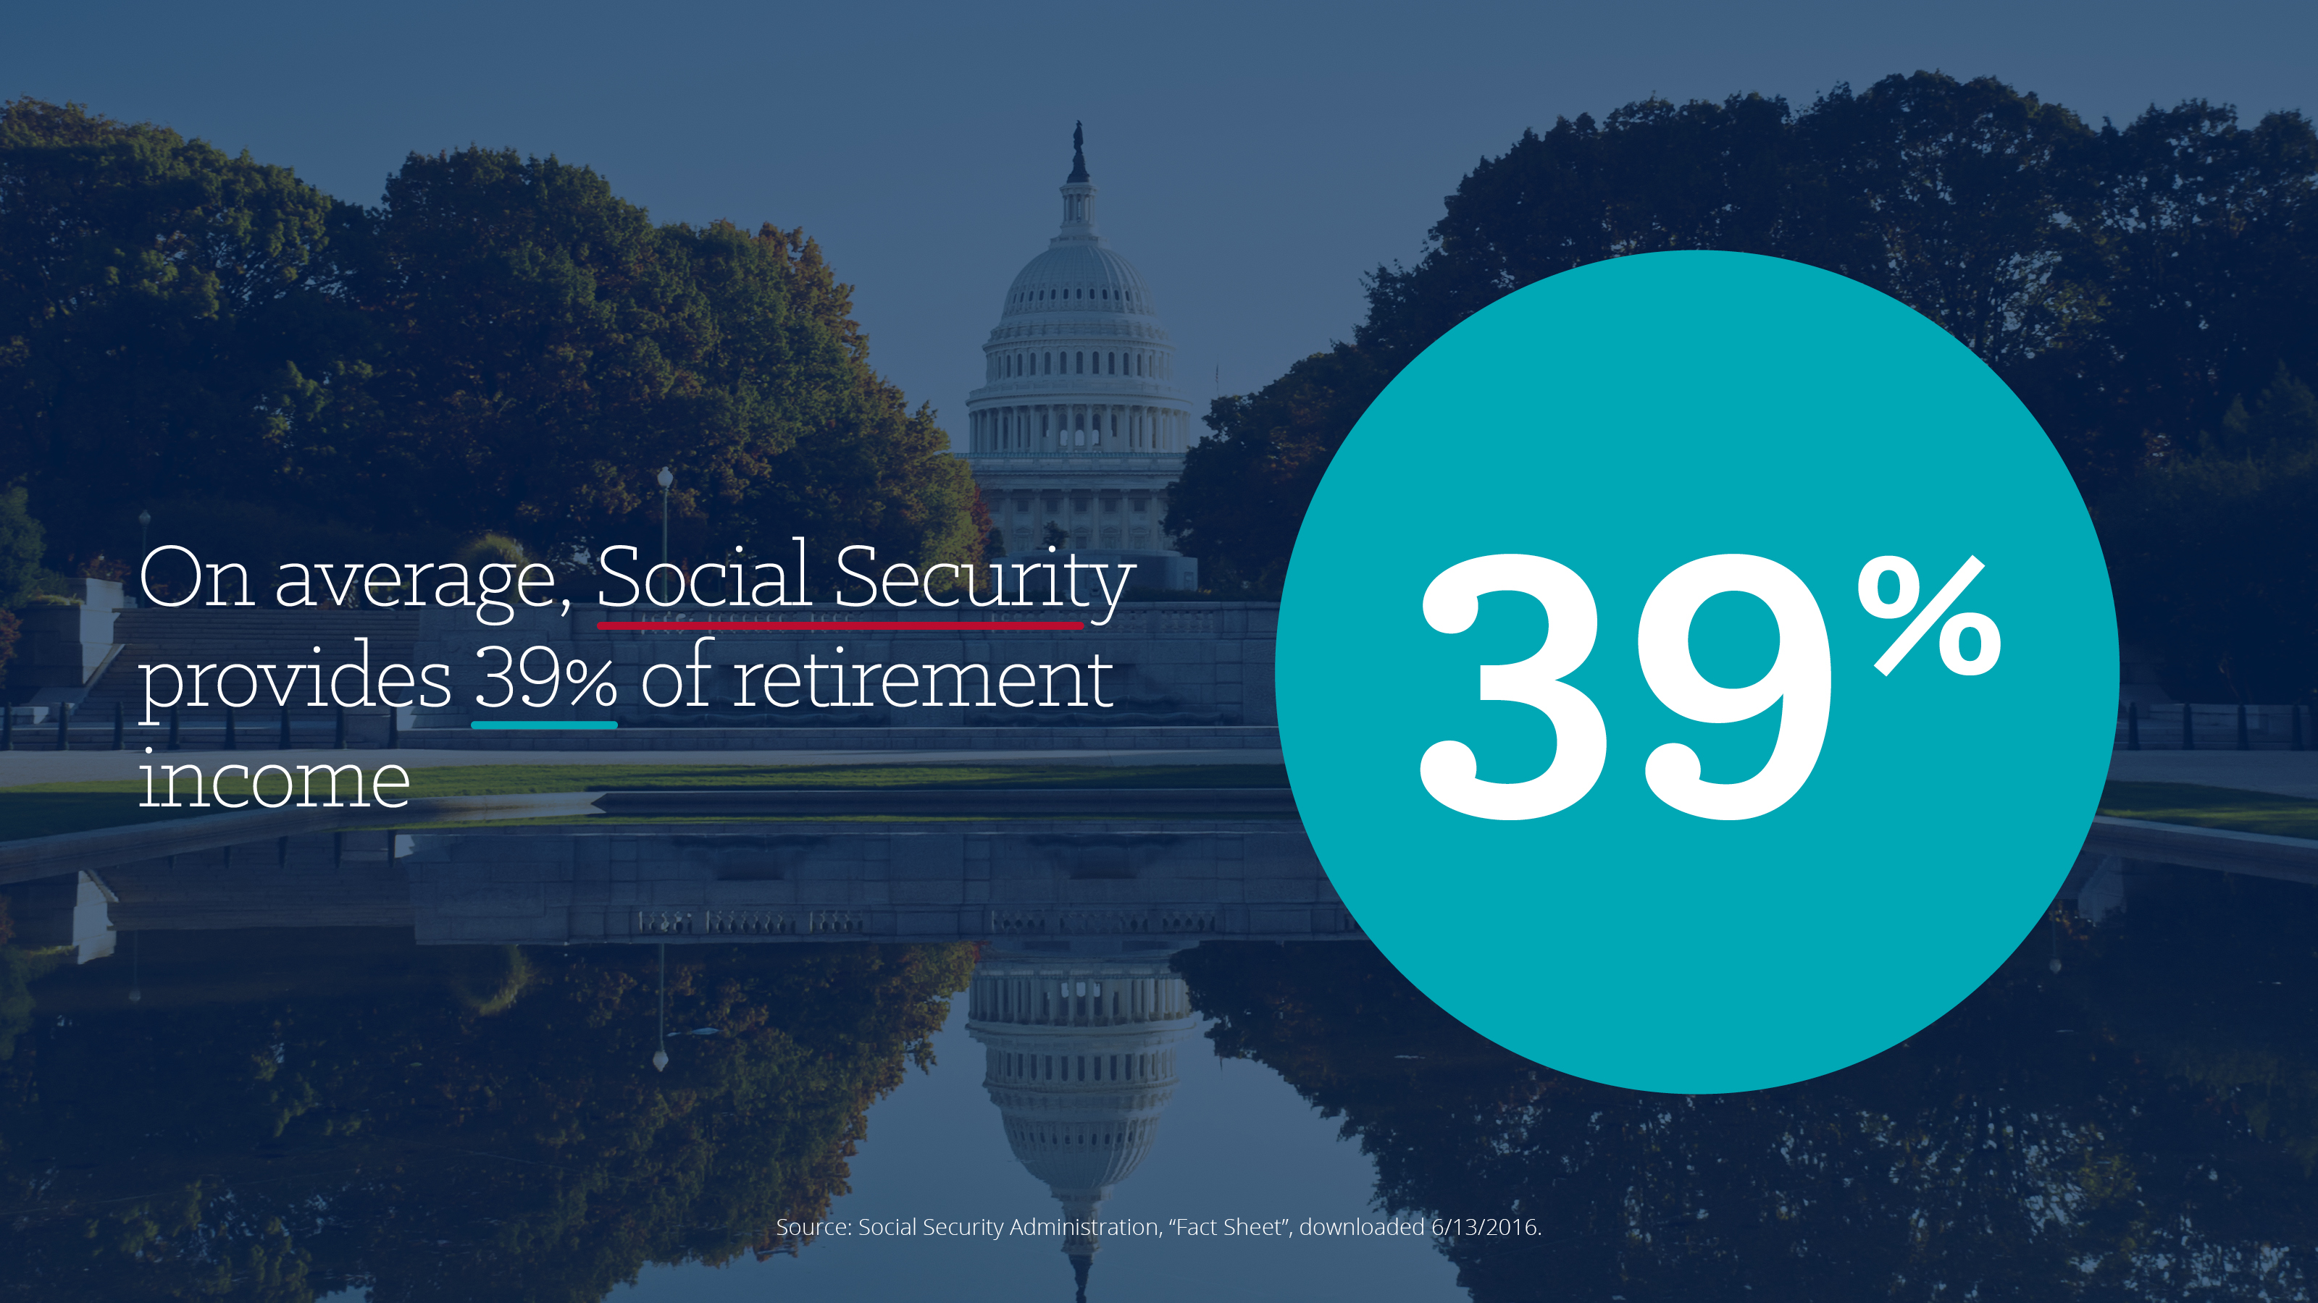
Notes:
Remember at the beginning of the presentation when I told you that many of you expect social security to provide for 35% of your income in retirement? According to the SSA, you all are not that far off. As of October 2015, social security benefits represent about 39% of retirement income and the average monthly check is $1,335 for retired workers.*
*Source: Social Security Administration, “Fact Sheet”, downloaded 6/13/2016.

Slide 46
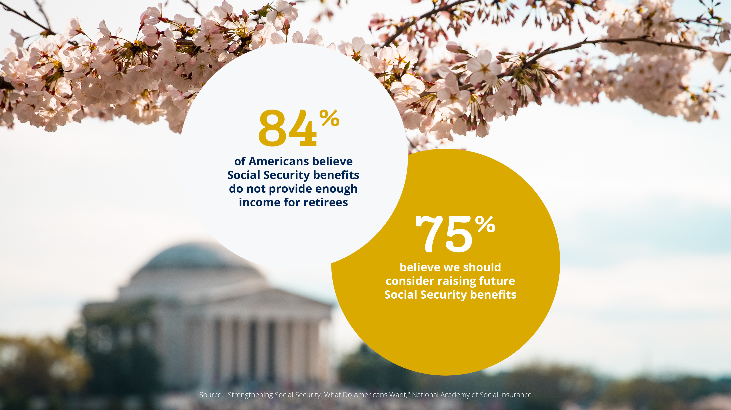
Notes:
So it is no surprise that 84% of Americans believe that Social Security benefits do not provide enough income for retirees, and 75% believe we should consider raising future social security benefits.
But the reality is that the opposite of this may happen.

Slide 47
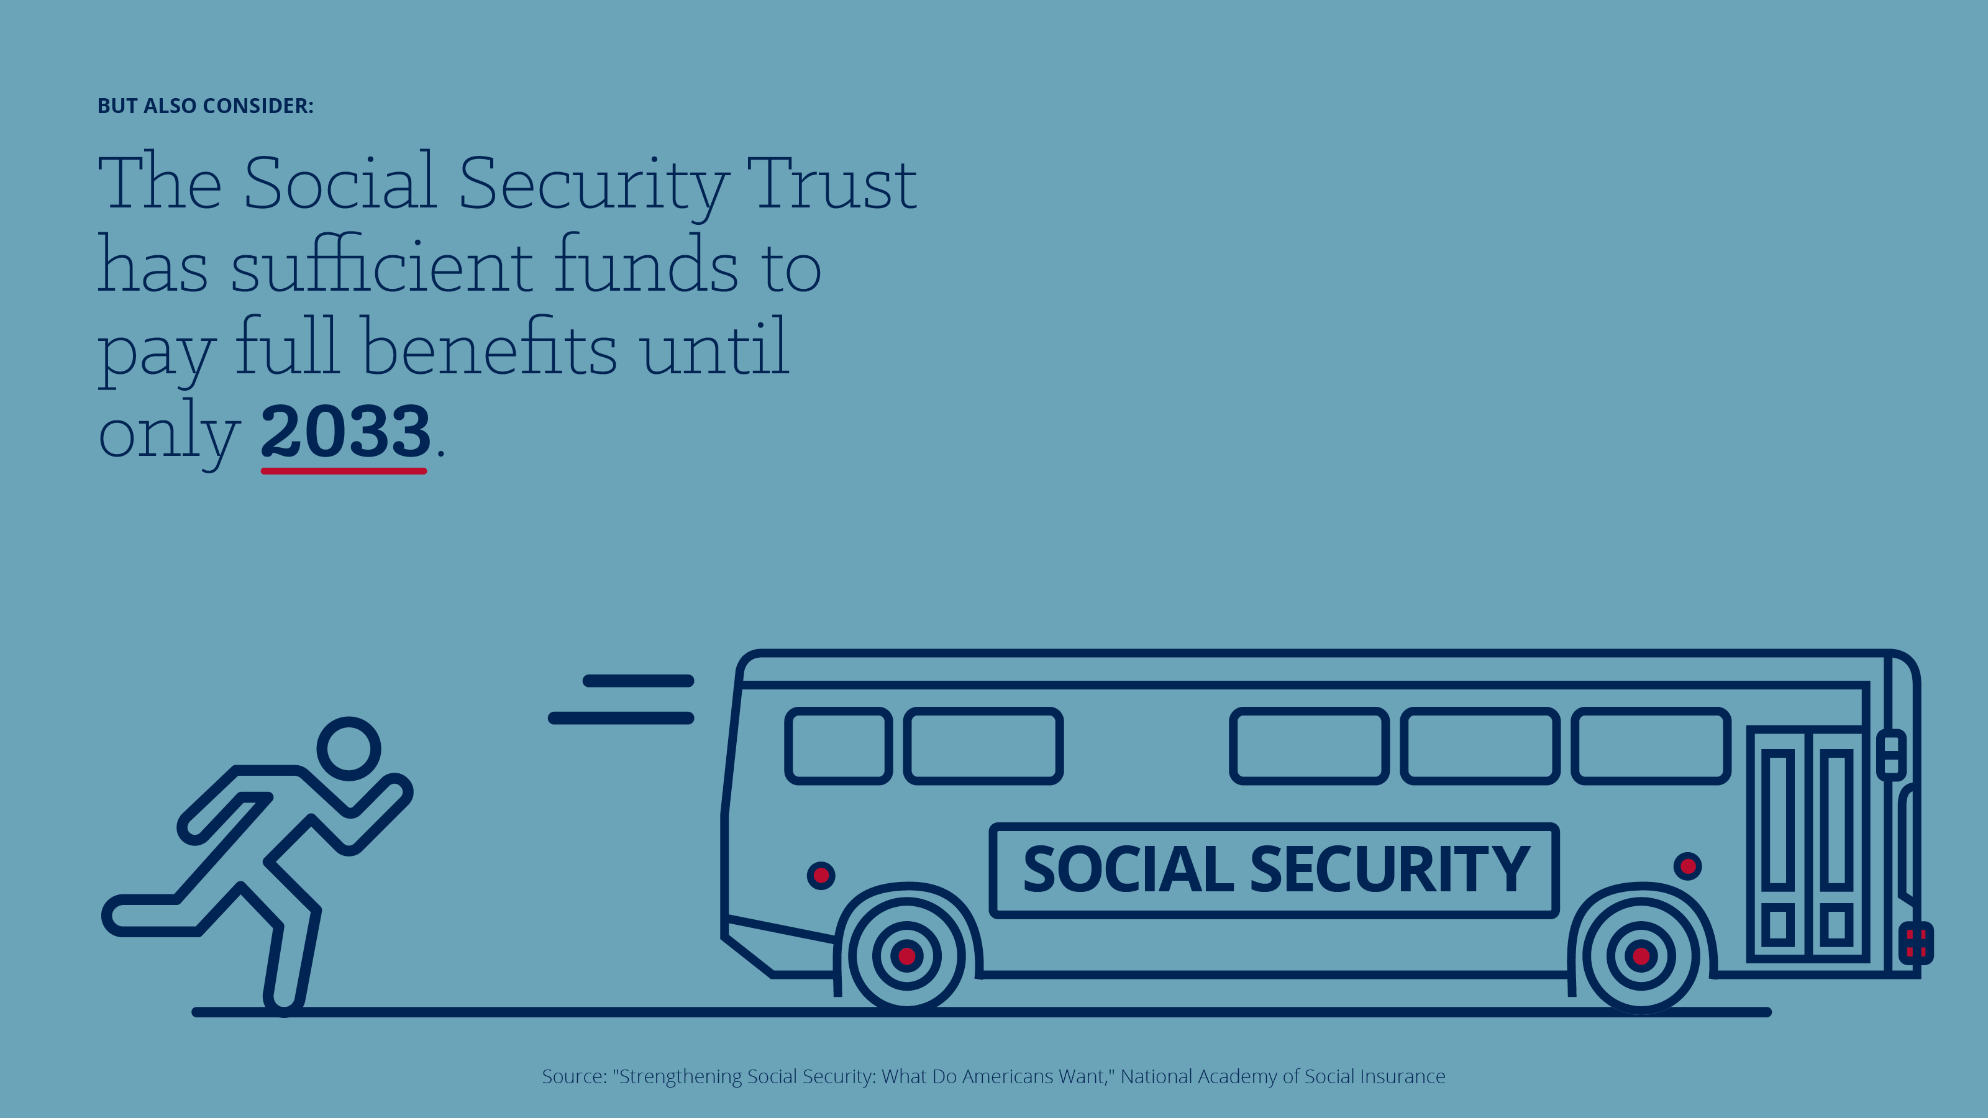
Notes:
READ SLIDE

Slide 48
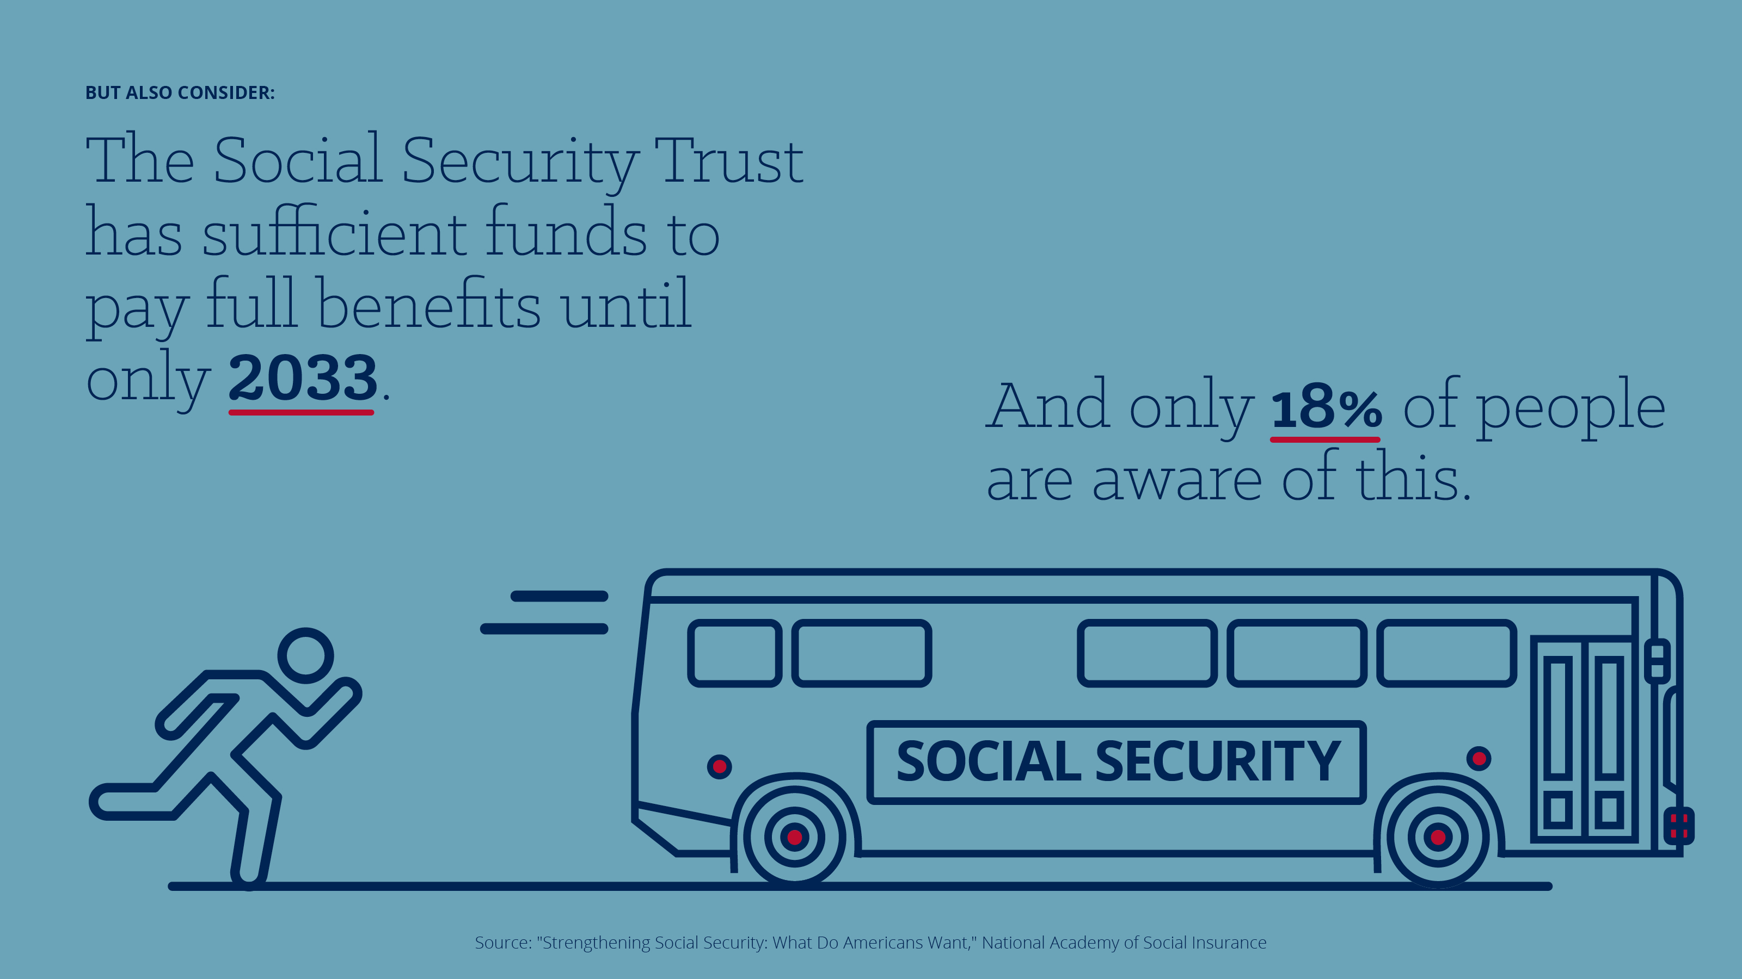
Notes:
And only 18% of people are aware of this.

Slide 49

Notes:
The good news is that there are other places to get protected lifetime income in retirement. And our study shows that overwhelmingly workers want this.

Slide 50
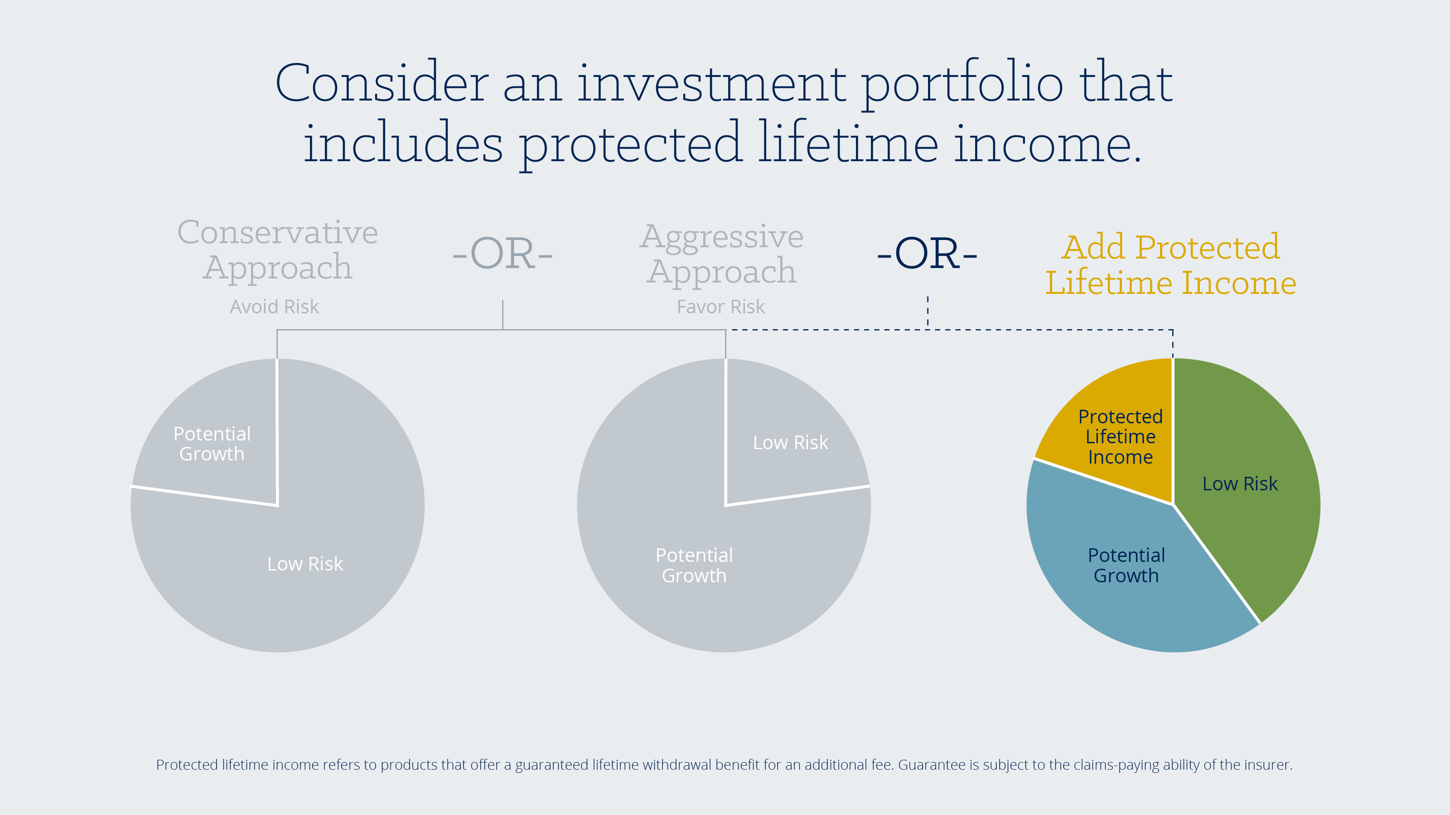
Notes:
In the past, investors have thought of their portfolio as balancing potential growth and risk, but you may want to consider a product allocation that includes protected lifetime income. You no longer need to choose between presumed safety or growth. You can incorporate both while having a level of protected lifetime income.

Slide 51
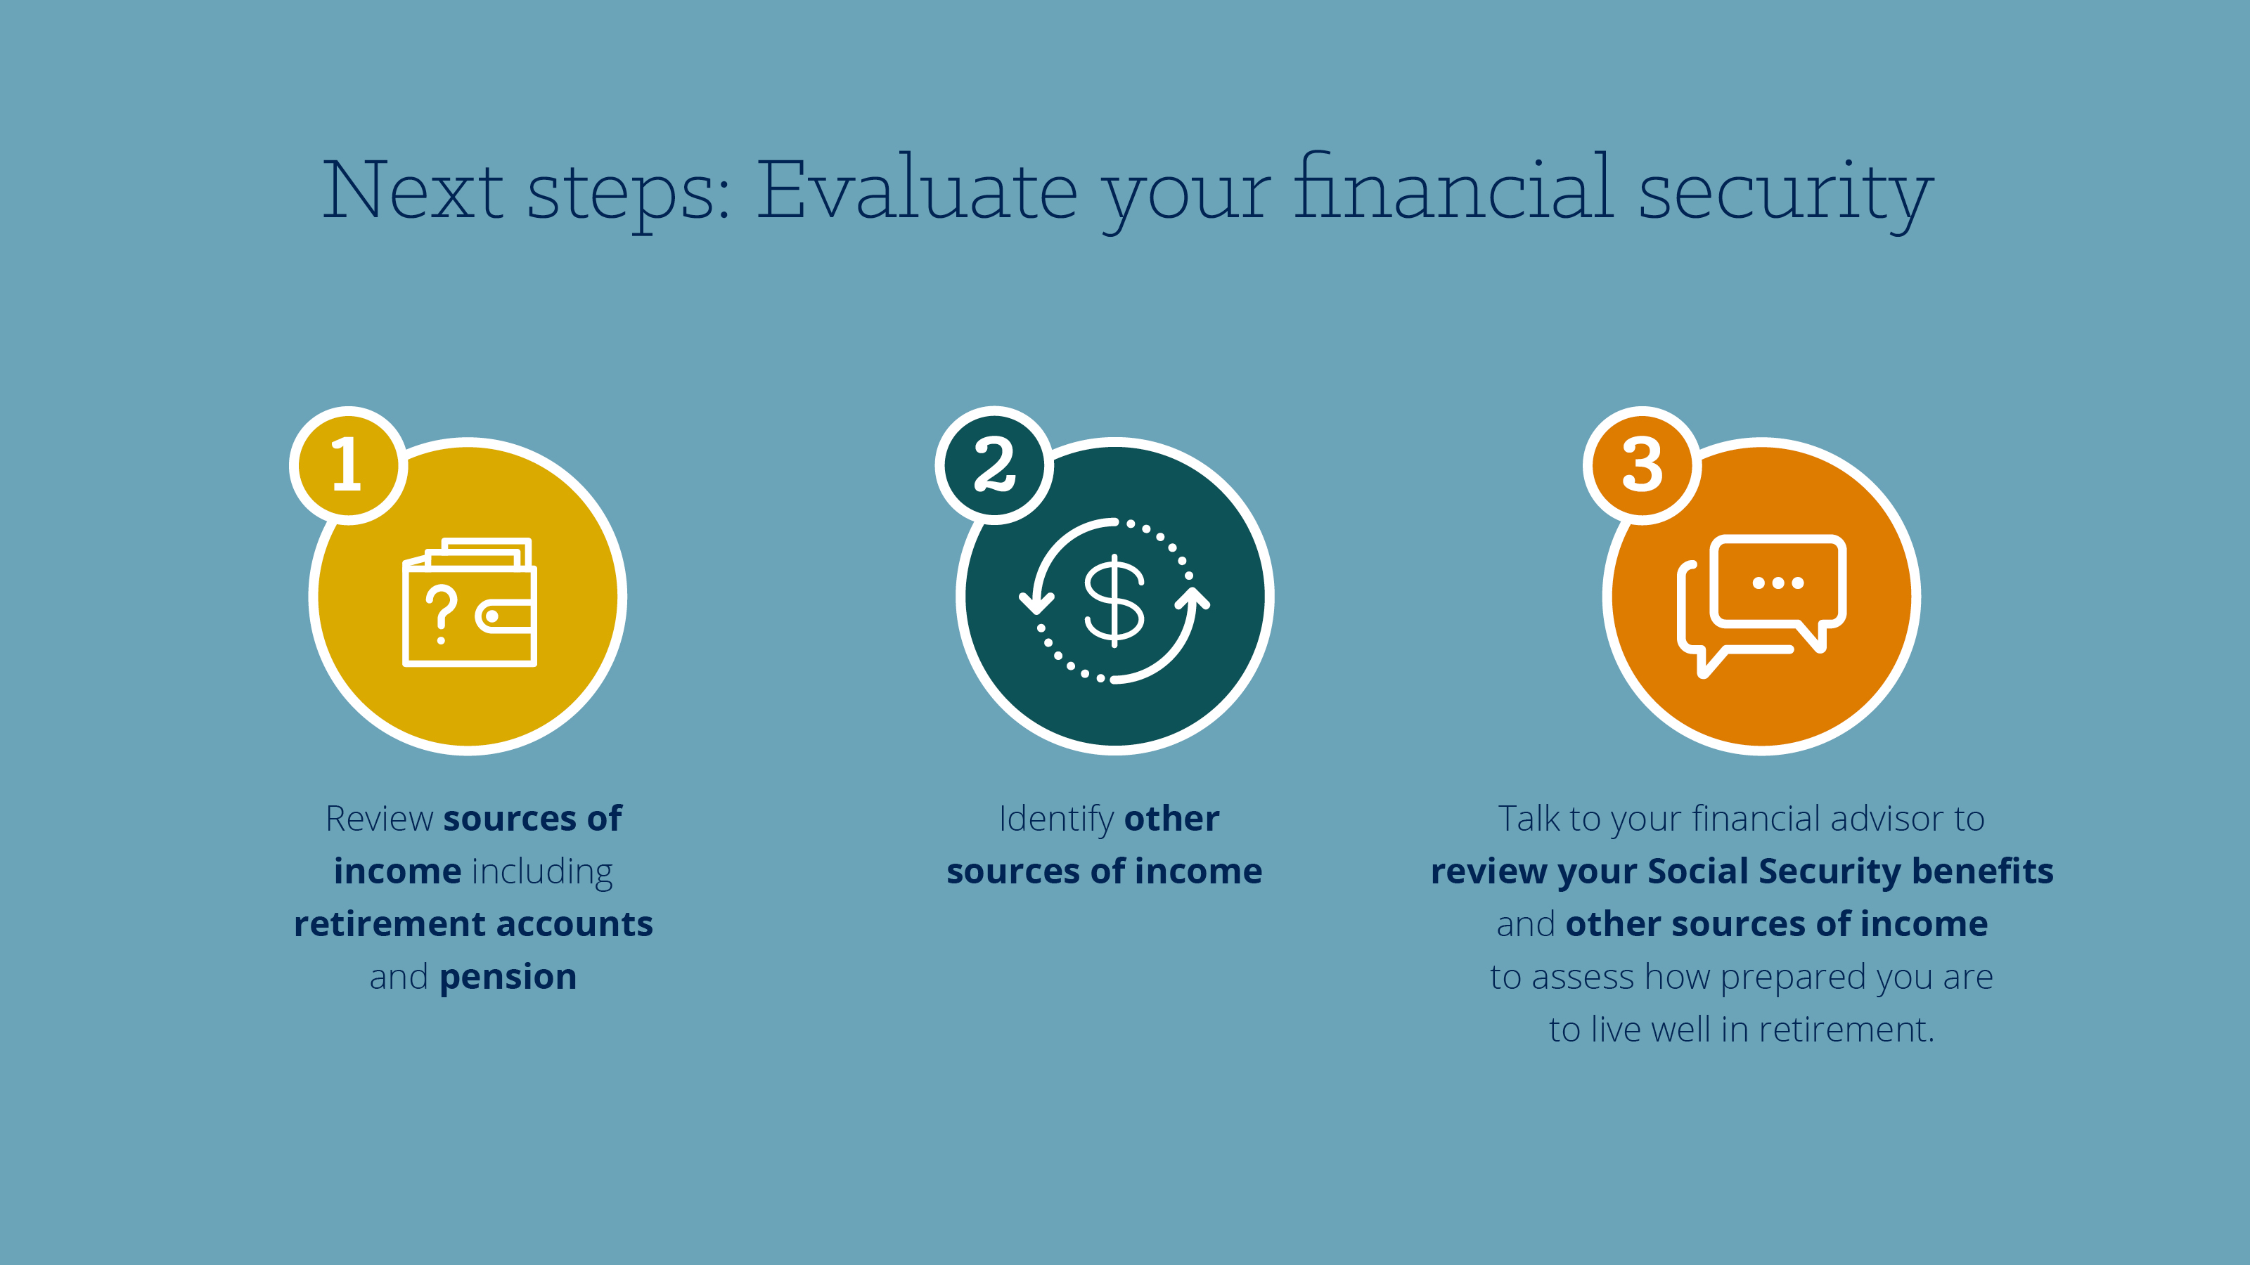
Notes:
READ SLIDE

Slide 52

Great-West Financial® refers to products and services provided by Great-West Life & Annuity Insurance Company (GWL&A), Corporate Headquarters: Greenwood Village, CO; Great-West Life & Annuity Insurance Company of New York (GWL&A of NY), Home Office: NY, NY; and their subsidiaries and affiliates. The trademarks, logos, service marks, and design elements used are owned by their respective owners and are used by permission.
This material was prepared to support the promotion of insurance products underwritten by GWFS Equities, Inc., Member FINRA/SIPC Great-West Life & Annuity Insurance Company (GWL&A) and issued by GWL&A or in New York, Great-West Life & Annuity Insurance Company of New York (GWL&A of NY). Any guarantees are subject to the claims-paying ability of the insurer and do not apply to the subaccounts. GWFS Equities, Inc. is a wholly owned subsidiary of GWL&A. GWL&A is not licensed to do business in New York. Contracts may not be available in all states.
Before purchasing a variable annuity, investors should carefully read the prospectus which contains an annuity’s investment objectives, risks, charges, expenses, and other information associated with the annuity and its investment options. You may obtain a prospectus for the annuity and its underlying funds by calling 877-723-8723. Great-West Life & Annuity Insurance Company and Great-West Life & Annuity Insurance Company of New York do not offer or provide investment, fiduciary, financial, legal, or tax advice, or act in a fiduciary capacity, for any client unless explicitly described in writing. Please consult with your investment advisor, attorney and/or tax advisor as needed.
Variable annuities are long-term investments and may not be suitable for all investors. Earnings are taxable as ordinary income when distributed and may be subject to a 10% additional tax if withdrawn before age 59 ½. An investment in a variable annuity is subject to fluctuating values of the underlying investment options, and it entails risk, including the possible loss of principal. A withdrawal charge may also apply.
Unless otherwise noted: NOT FDIC, NCUA/NCUSIF INSURED | NOT A DEPOSIT | NOT GUARANTEED BY ANY BANK OR CREDIT UNION | NOT INSURED BY ANY FEDERAL GOVERNMENT AGENCY | FUNDS MAY LOSE VALUE | NOT A CONDITION OF ANY BANKING OR CREDIT UNION ACTIVITY
B1016SS AM103028-0217
Notes:
READ SLIDE

