Slide 1





5 Ways Technology Will Change
How You Age
© 2018 by Hartford Funds
© 2018 by Hartford Funds

Slide 2
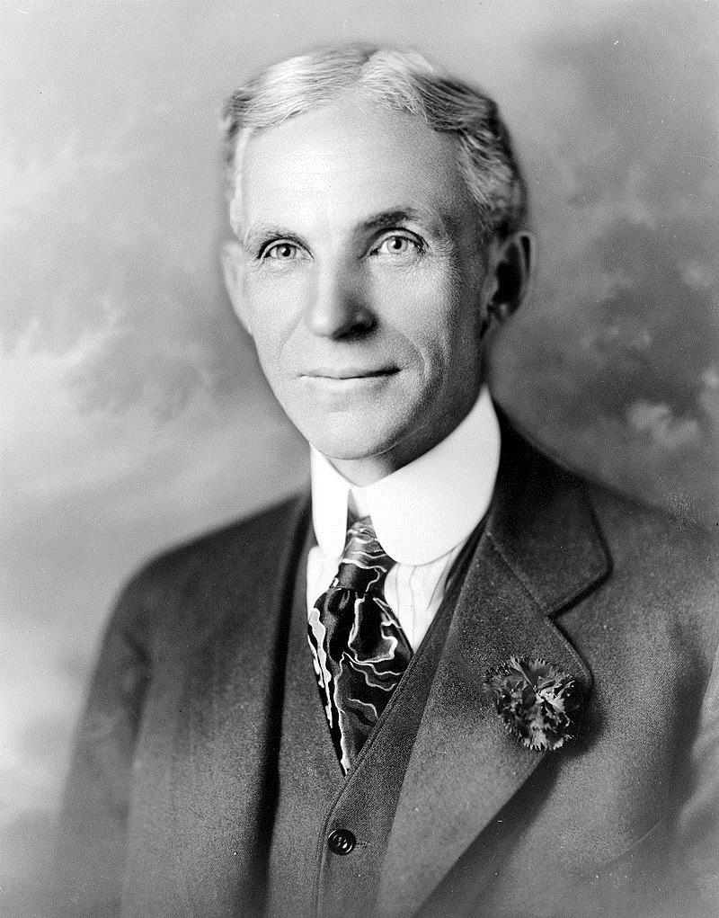
Anyone who stops learning is old, whether at twenty or eighty. Anyone who keeps learning stays young. The greatest thing in life is to keep your mind young.
—Henry Ford
2

Slide 3

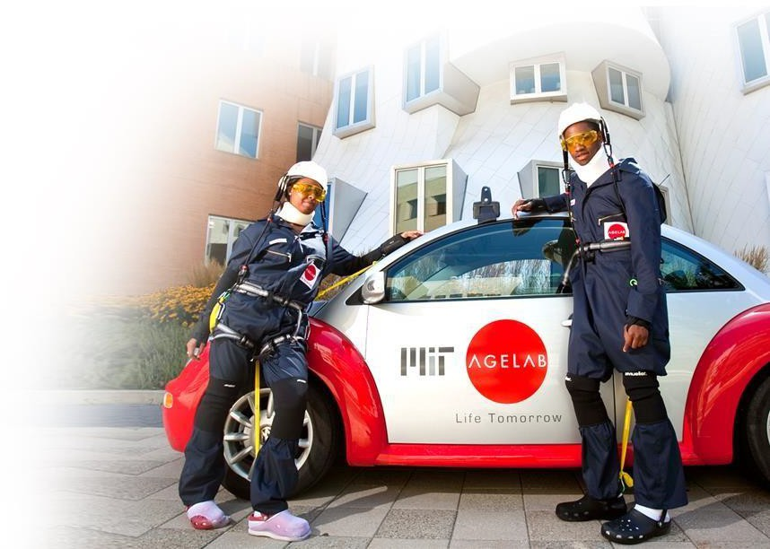
Based within MIT’s School of Engineering’s Engineering Systems Division
Challenges and opportunities of longevity
Consumer behavior and decision making
Trends in demographics,
technology, and lifestyles
© 2018 by Hartford Funds
3

Slide 4

Inventing a New Future
Agenda
Life-Changing Tech
Try It
© 2018 by Hartford Funds
3

Slide 5


Inventing a New Future
© 2018 by Hartford Funds
3

Slide 6
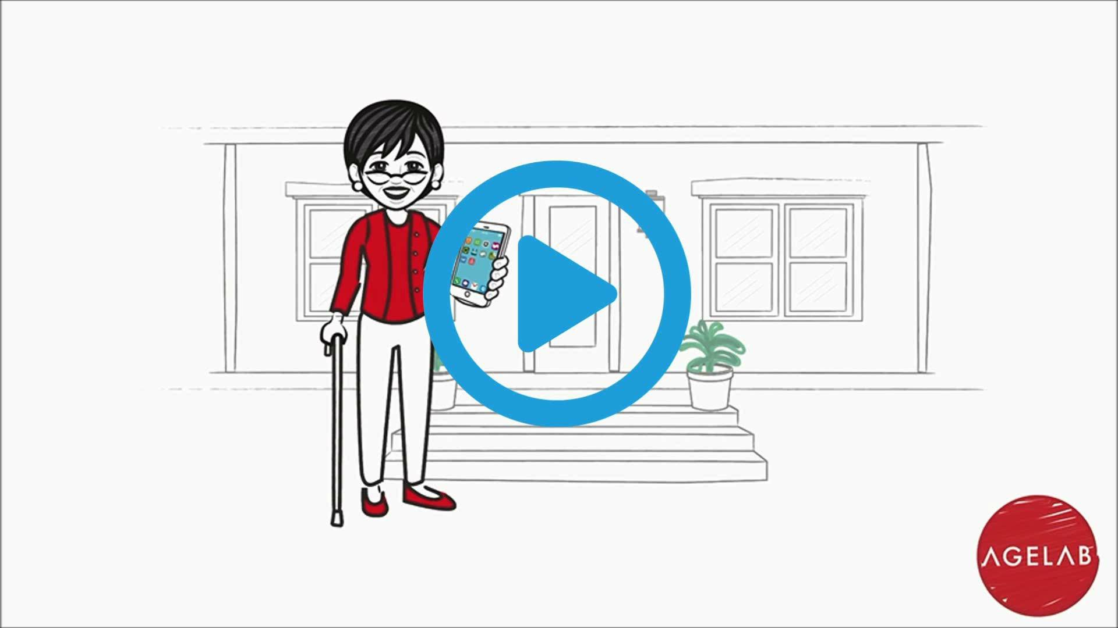
Life on Demand: A Possible Tomorrow
Inventing a New Future
Source: MIT AgeLab, 10/15
6

Slide 7

Inventing a New Future
Boomers Expect More From Their Future
© 2018 by Hartford Funds
7

Slide 8
Older Adults Are Using Technology
Inventing a New Future
Not Cutting Edge
Older adults can be slower than others to embrace technology. For example, the percentage of all Americans who use social-networking sites by age:
But Not Hopeless
Average mobile app usage by age among smartphone users, second quarter of 2015
18-24
Users (millions)
25.6
100 %
Apps used/month
24.1
18-29
33.3
80
30-49
25-64
25.7
60
35-44
32.1
50-64
26.7
40
65-plus
31.4
45-54
25.6
20
55-plus
48.6
0
23.7
2005
2006
2008
2009
2010
2011
2012
2013
2014
2015
Source: Social Media Usage: 2005-2015, Pew Research Center,
10/8/15. Most recent data available used.
Source: How Technology Will Transform Retirement, 11/29/15.
Most recent data available used.
8

Slide 9
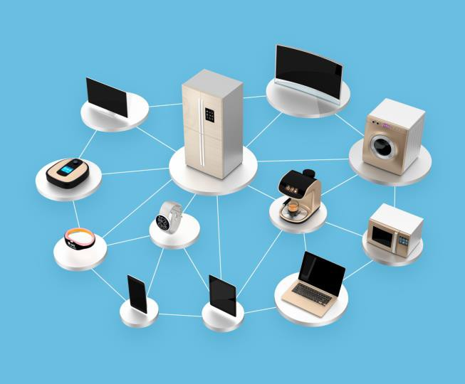
The Internet of Things
(IoT)
Inventing a New Future
The network of physical objects—devices, vehicles, buildings and other items— embedded with electronics, software, sensors, and network connectivity that enables these objects to collect and exchange data.*
*Source: International Telecommunication Union, 2015. Most recent data available used.
8

Slide 10
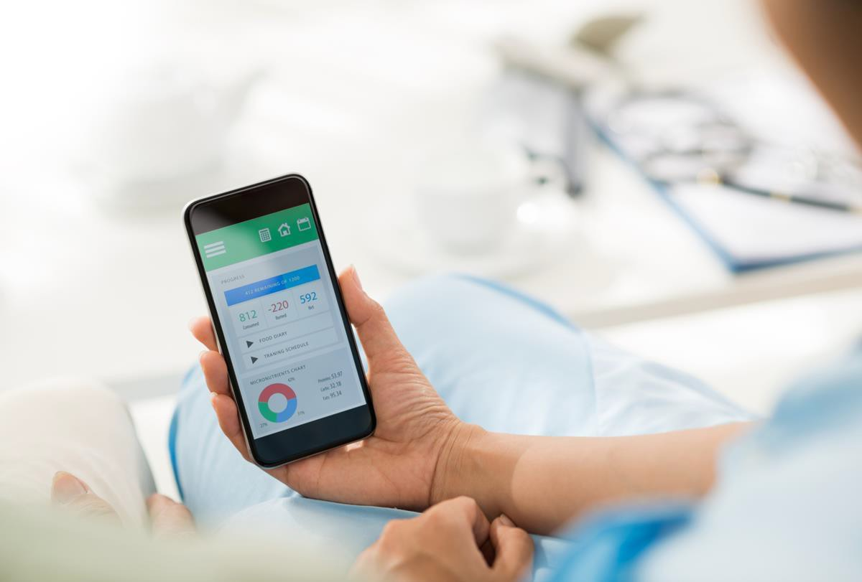
Life-Changing Tech
© 2018 by Hartford Funds
10

Slide 11

Life-Changing Tech
Who will change my light bulbs?
How will I get an ice cream cone?
Who will
I have lunch with?
11

Slide 12
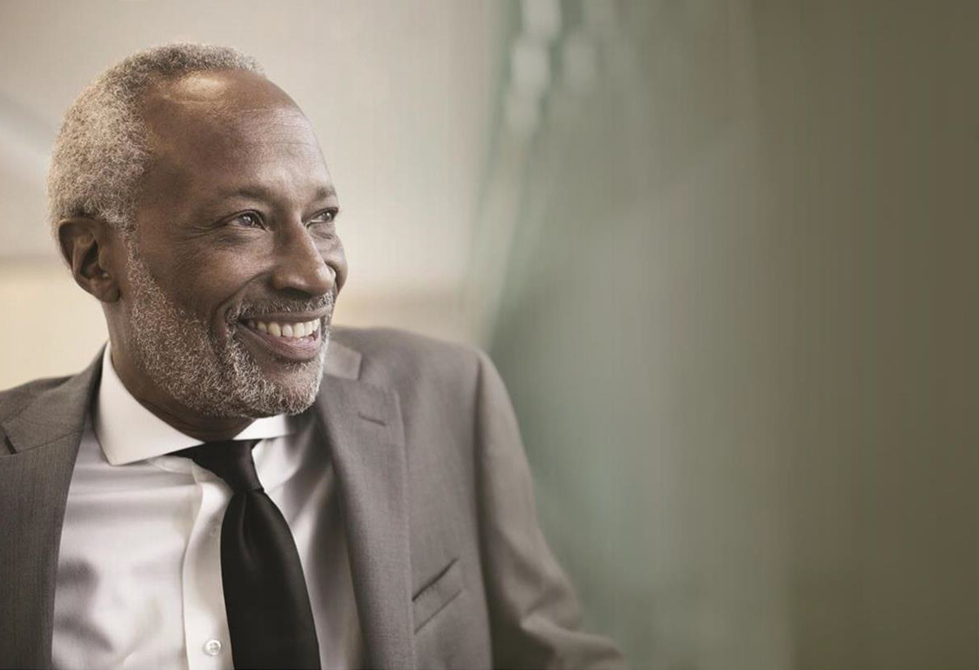
Life-Changing Tech
Staying on the job
  Retirement was once a clear line between working and not working
  Rapidly changing workforce that demands new skills
  Technology is offering new options and flexibility
© 2018 by Hartford Funds
12

Slide 13
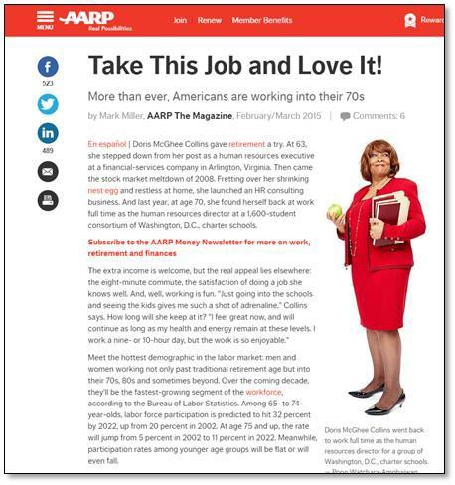
Staying on the Job
Life-Changing Tech
65% of Baby Boomer workers plan to work past age 65 or do not plan to retire*
65%
34% plan to work for enjoyment*
34%
*Source: Transamerica Center for Retirement Studies, Ready or Not: Baby Boomers Are Revolutionizing Retirement, 12/18/14. Most recent data available used.

Slide 14



Apps that Offer Flexible Jobs
Life-Changing Tech
Age spread across the spectrum
30%
1 million
Users over age 60*
26%
24%
“We hear from our passengers that some of our retirees are the most popular drivers.”*
19%
Over ½ of hosts over 40*
10% of hosts older than 60*
18-29
30-39
40-49
50+
Source: Entrepreneur, 1/15. Most recent data available used.
*Source: The on-demand economy: Changing the way we live as we age, The Washington Post, 12/14/15 Most recent data available used.

Slide 15

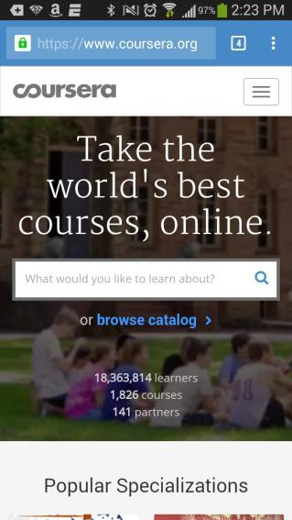




Keeping Skills Sharp
Life-Changing Tech
MOOCs (Massive Open Online Courses)
Coursera
EdX
Khan Academy Lynda.com
One Day University Udacity

Slide 16

Life-Changing Tech
Staying Connected to Friends & Family
  Physical health vs. social life
  Risk of isolation after retirement as friends & family scatter. Loss of spouse
  Friends, family and regular social
interactions keep people vital
© 2018 by Hartford Funds
16

Slide 17
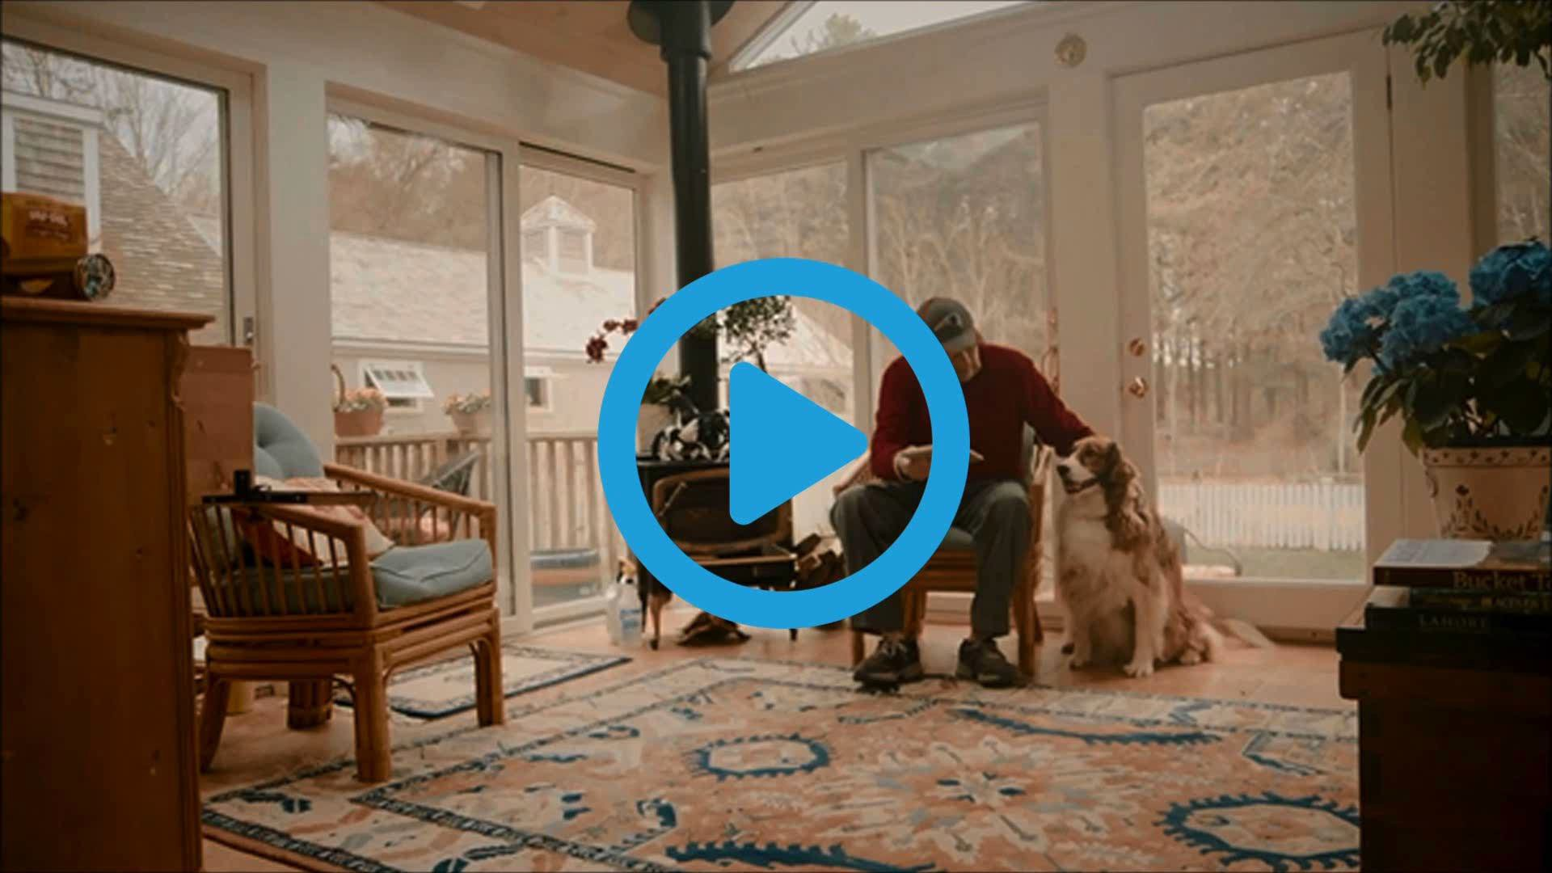
Connected Living
Life-Changing Tech

Slide 18
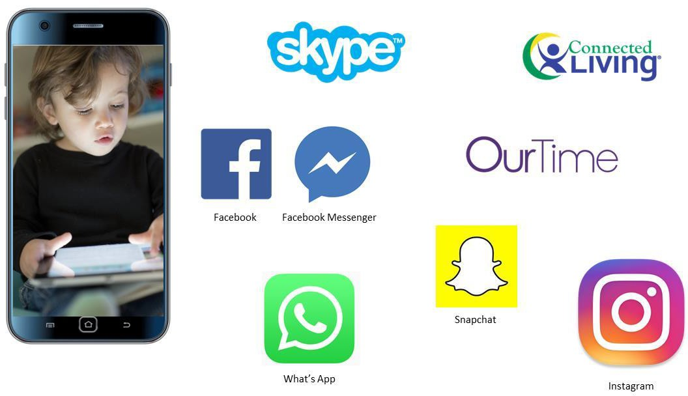

Apps that Help Us Stay Connected
Life-Changing Tech

Slide 19
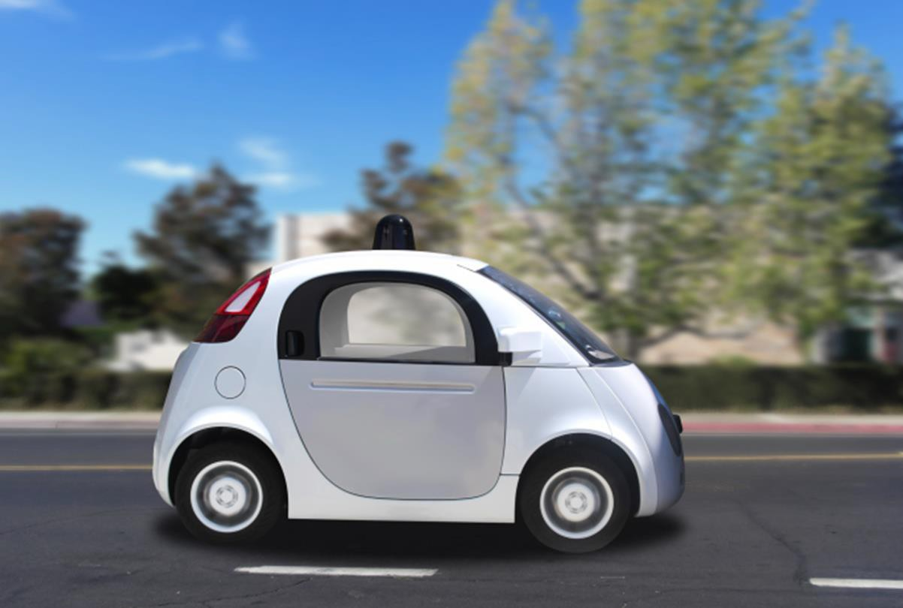
Life-Changing Tech
Staying Mobile
  Being able to get around is a crucial ingredient to a quality life in old age
  Reduced mobility to go where you want leads to declines in both mental and physical well- being
© 2018 by Hartford Funds
19

Slide 20
Life-Changing Tech
"Older Americans who have stopped driving are almost two times more likely to suffer from depression and nearly five times as likely to enter a long-term care facility compared to those who remain behind the wheel.”
Michael Green - AAA spokesman

Slide 21

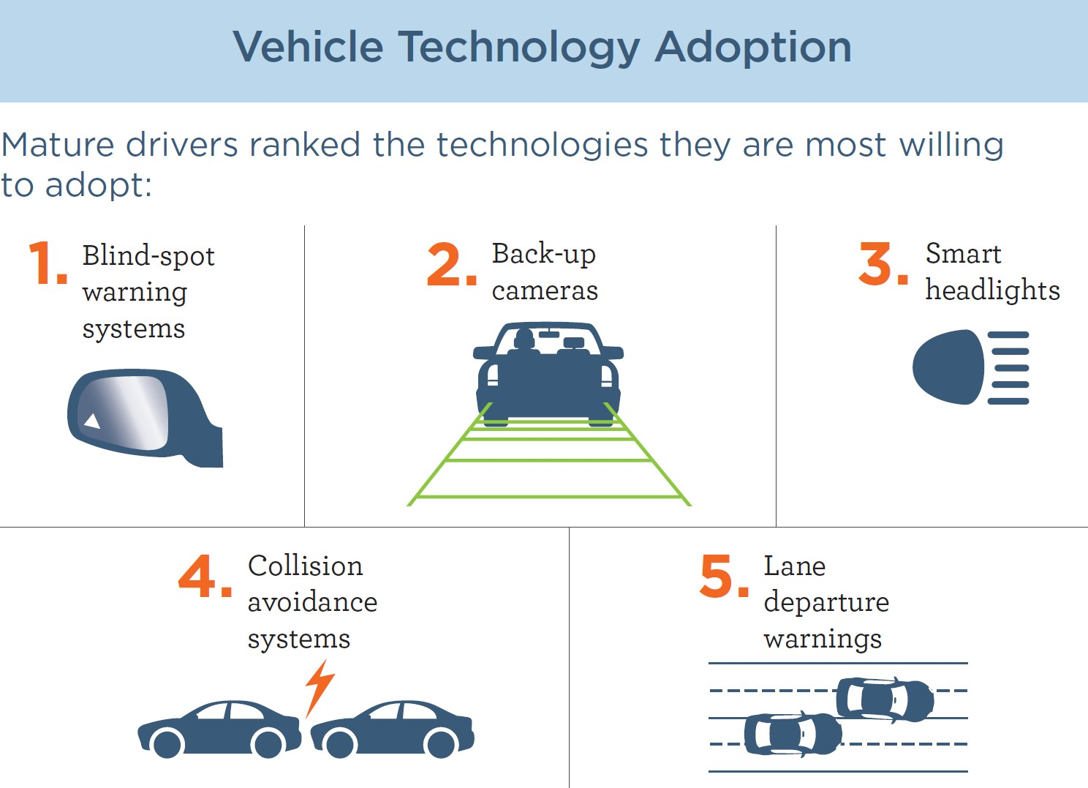
Life-Changing Tech
Source: The Hartford Center for Mature Market Excellence & MIT AgeLab, 2015. Most recent data available used.

Slide 22
Average Annual Expenditures by Age
65 years and older – Avg. Income $48,035
Life-Changing Tech
Food
Housing
Transportation Healthcare Entertainment Cash contributions Other
Avg. Annual Expenses:
$45,756
Transportation: No. 2
15%
Source: Bureau of Labor Statistics Consumer Expenditure Survey, 2016

Slide 23


The Cost of Staying Mobile
Life-Changing Tech
Vs.
Large Sedan
$10,879*
*Source: AAA, Your Driving Costs, Statistic is based on driving 15,000 miles per year, 2017.
?

Slide 24
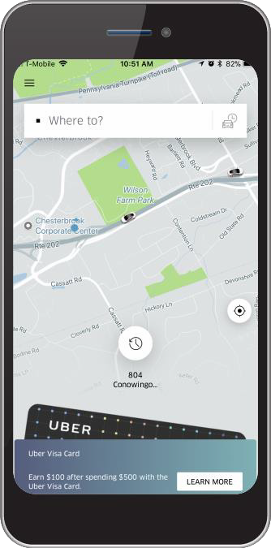








Apps that Can Reduce the Need to Drive
Life-Changing Tech

Slide 25
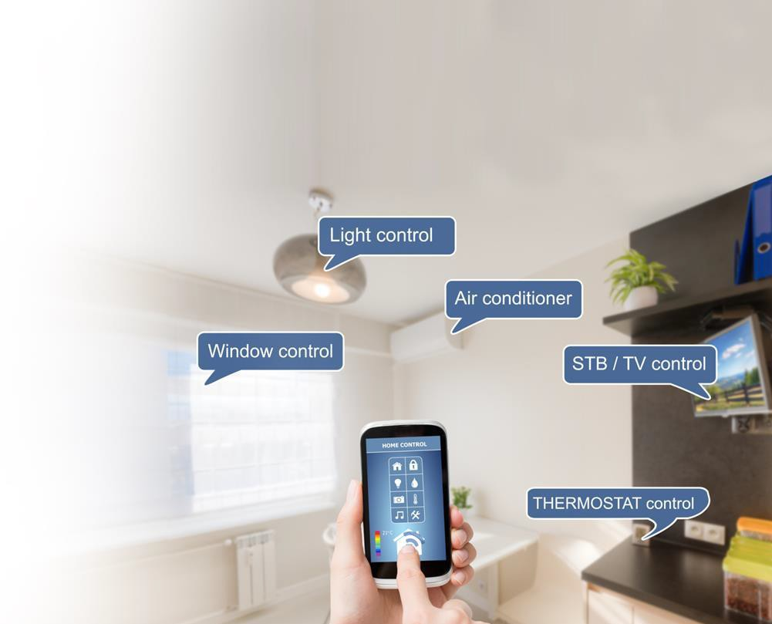
Life-Changing Tech
A House that Keeps Itself
  Taking care of a home can be challenging for retirees
  Tech can help with chores, but also transforms the home into helper, companion and caregiver
© 2018 by Hartford Funds
25

Slide 26

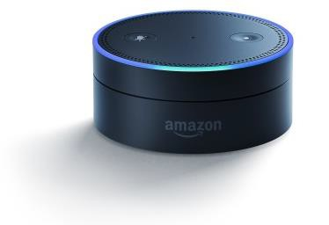
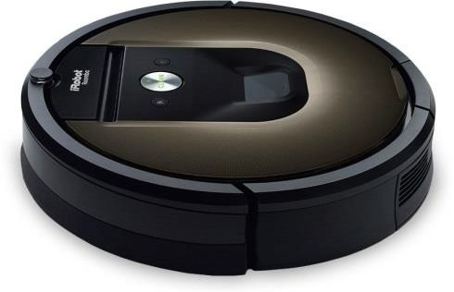



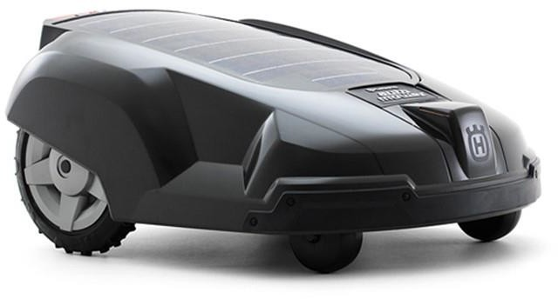
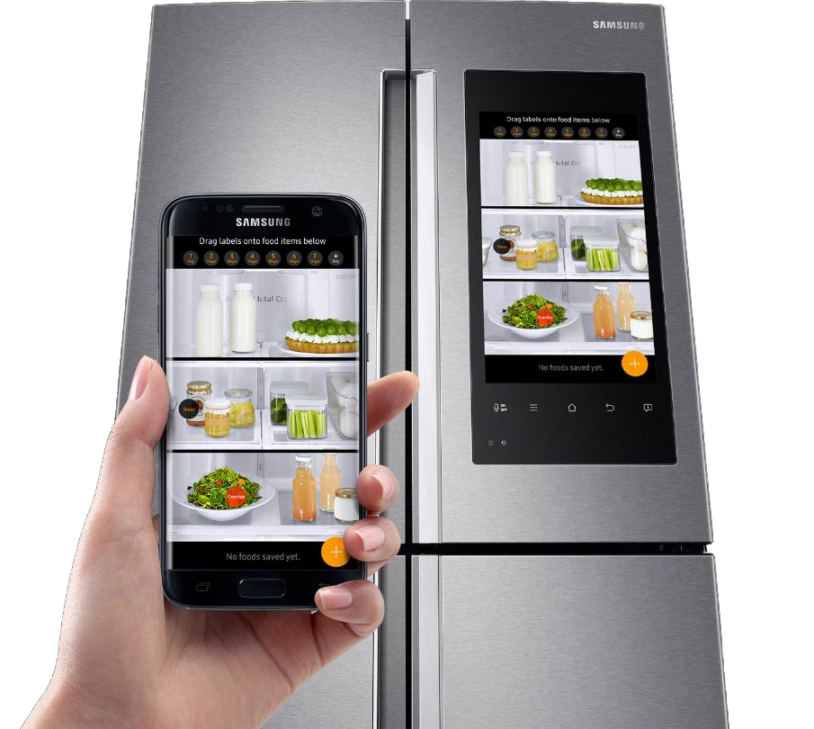

Life-Changing Tech

Slide 27


Apps to Help Around the Home
Life-Changing Tech

Slide 28

5. Machines that Monitor Health
Life-Changing Tech
Retirees deal with multiple chronic conditions even as their ability to manage those conditions diminishes
Keeps family members informed
Monitor physical data
© 2018 by Hartford Funds
28

Slide 29

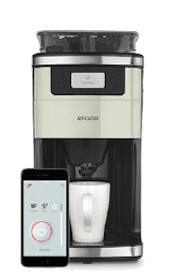


Life-Changing Tech

Slide 30



Health & Caregiving Apps
Life-Changing Tech

Slide 31

Try It
© 2018 by Hartford Funds
31

Slide 32
How to Get Started
Try It
Understand how apps can help you maintain your independence as you age
Identify a few apps, sites, or devices you’d like to try
Research reviews and costs
Try them out

Slide 33
Summary
Inventing a New Future
Living longer and better
Life-Changing Tech
A new array of devices & services
Try It
Start with a few apps

Slide 34
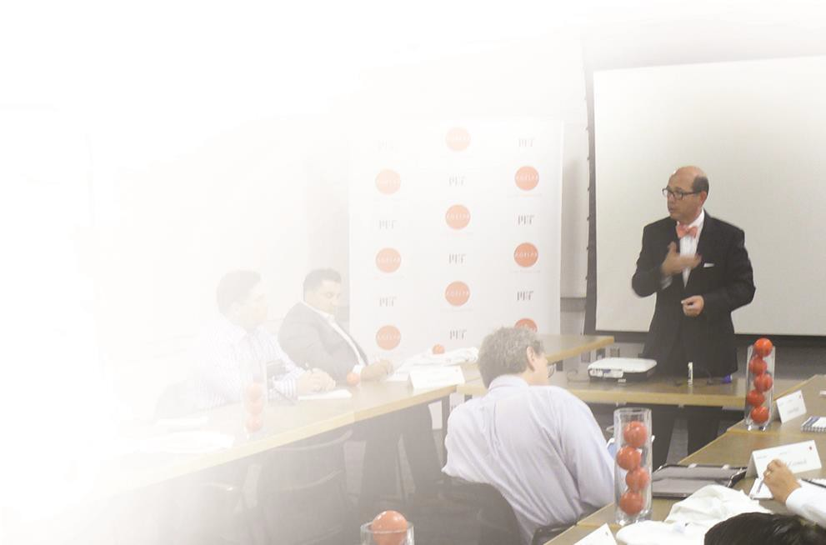

The Bottom Line
Tomorrow’s retirement living will be shaped by technology. While high-tech will provide incredible benefits, it will also bring new costs, both financial and social, that should be considered as a new part of retirement planning.
Dr. Joe Coughlin
Director MIT AgeLab
© 2018 by Hartford Funds
34

Slide 35
The future ain’t what it used to be.
– Yogi Berra.

Slide 36


Next Steps
Do some research of apps, sites and devices using our workbook
Try a few apps – Take an Uber ride.
Make a video call.
Talk to your advisor about how app solutions could fit into your retirement plan
Workbook
Hartford Mutual Funds may or may not be invested in the companies referenced herein; however, no particular endorsement of any product or service is being made.
Hartford Funds Distributors, LLC.
The MIT AgeLab is not an affiliate or subsidiary of Hartford Funds.
All information and representations herein are as of 12/17, unless otherwise noted. SEM_Tech 0718 206031

