Slide 1
Informed Women
Know More
7 Strategies to Help You Take Control
Variable Annuities: Are Not a Deposit of Any Bank • Are Not FDIC Insured by Any Federal Government Agency • Are Not Guaranteed by Any Bank or Savings Association • May Go Down in Value
GE-134319 (1/20) (Exp. 6/20) Cat #149826
Please read the Important Information slide at the end of this presentation.
Notes:
Welcome to our conversation; Informed Women Know More…….

Slide 2
Unique Strengths of Women
Women’s position in the workforce, college graduation rates, and earning power are at all-time highs
60% of all accountants and auditors are women¹
Women control $39.6 trillion (30%) of the world’s wealth, and by 2020 will control $72.1 trillion (37%)²
Women now earn the majority of four-year degrees³
Women earn the majority of doctoral degrees and outnumber men in grad school 135 to 100⁴
1 Labor Force Statistics from the Current Population Survey, Bureau of Labor Statistics, 2018. www.bls.gov
2 Boston Consulting Group, June 2016.
3 Data from the U.S. Census Bureau, March 2017.
4 1 Annual Report on US Graduate School Enrollment and Degrees. The Council of Graduate Schools, September 2017.
Informed Women Know More
Notes:
Women today are in a unique position compared to women of yesteryear. Overall, women have more financial power than ever before and are outperforming men on many levels. This and the next slide highlight just a few of the many examples.

Slide 3
Unique Strengths of Women
Women’s position in the workforce, college graduation rates, and earning power are at all-time highs
52% of all management and professional roles are held by women¹
37% of wives earned more than their husbands²
Women own 11.6 million businesses in the U.S., generating over $1.7 trillion in revenues³
1 Statistical Overview of Women in the Workplace, Catalyst, August 2017. www.catalyst.org
2 Wives who earn more than their husbands 1987–2014, U.S. Bureau of Labor Statistics, 2015.
3 The 2017 State of Women-Owned Businesses, American Express, January 2017.
Informed Women Know More
Notes:
And here are some more examples of the professional and financial gains women are making today.

Slide 4

Yet… Women tend to be more concerned about their financial future
Informed Women Know More
4
Notes:
Despite the fact that women are outpacing many men and continuing to make gains, surveys show that in general, women are more concerned than men, about their financial future.
Since women are clearly doing so well, we might expect women to have a high level of financial confidence.
However, If we look a little deeper we also find that women face unique challenges not felt by most men.

Slide 5

Unique Challenges
for Women
Based on today’s wage gap, women would lose $418,000 over the course of a 40-year career¹
Women are expected to live 81.2 years from birth, outliving their male counterparts by nearly 5 years²
Women earn less money than men over their lifetime, reducing their ability to save
1 The Lifetime Wage Gap, State by State, National Women’s Law Center, March 2017.
2 World Health Organization, February 2017.
Equitable
Informed Women Know More
5
Notes:
Women have unique challenges that make it more difficult for them to secure their financial future.
Women earn less money over their lifetime, reducing their ability to save. This is caused by a number of factors:
Despite educational and professional gains, pay inequity still exists. On average, a woman still earns 80% of what a man earns in the same job.
Also, women are more likely to experience periodic interruptions during their career because of care-giving responsibilities. Pay inequity and work interruptions make it harder for women to save for retirement.
In addition to those challenges, women also live longer than men:
Women’s life expectancy (on average) is 81.2 years, compared to men’s expectancy of 76.5 years. Their retirement savings have to stretch over more years.
Living longer also means that women are more likely to be single;
According to the US Census, as of 2017, 32.6% of the female US population age 65+ is widowed, compared to 11.1% of males. For women age 85 and older, only 17.1% are married with a spouse present.
As a result of all these factors, women face a much greater risk of declining living standards or poverty in old age.
The Sargent Shriver National Center on Poverty Law reported in 2016 that among Americans aged 65 and older, almost twice as many women as men live in poverty. And, as many as half of older women have incomes that render them financially insecure. For older women who live alone, one in five lives in poverty.

Slide 6


7 Value-Boosting Strategies
Practical Strategies for attaining financial security in the future
Equitable
Notes:
To prepare for the unique challenges of retirement years, it’s important to make the most of earning, saving, and investing opportunities.
Let’s go through 7 practical strategies for potentially increasing the value of your money.

Slide 7

STRATEGY
1
Knowledge is Power
Max the Value
Notes:
Practical Strategy #1 is Knowledge

Slide 8
STRATEGY 1: Max the Value
Value of Knowledge
Impact of Guidance
Women who use a financial professional are twice as likely as those that don’t to feel on track or ahead of schedule in retirement planning
Feel more confident and more willing to take risk
Save and invest more ($63,000)
Use multiple financial tools
(DC Plan, IRA’s, Mutual Funds, Stocks/Bonds, Annuities)
Prudential Study; Financial Experience and Behaviors Among Women, 2014 -2015
Notes:
Knowledge is key to success in many areas of life. In the financial arena, research shows that increasing financial knowledge and getting professional guidance has a big impact on both confidence and preparation.

Slide 9
STRATEGY 1: Max the Value
Things to Consider
Life Insurance… have you thought it through?
Many times people avoid thinking of Life Insurance as part of their Financial Plan
Brings about negative emotions
They are covered by their employer
Would rather use the disposable income for current expenses such as the kids, re-doing the kitchen, etc.
As a means of increasing your peace of mind
Find a financial professional who can give you a holistic view of assets
Approach the conversation from the position of “comfort” (i.e., this is for my loved ones)
Determine which product is right based on your stage in life.
— Term Life convertible to Whole Life
— Permanent Life
— Variable life
Notes:
Life Insurance is an example of a financial tool that can provide value in a number of ways. It should be considered as you review your plans and determine what your goals are. When working with a financial professional you can get a clear view of how it might fit into your strategy.

Slide 10
STRATEGY 1: Max the Value
Things to Consider
Long-Term Care
While expensive, long-term care is a way of maintaining your or an elderly family member’s independence in the case of
Illness
Injury
Cognitive Disorder
Assist in caretaking expenses
Assisted Living
Day Care Centers
Hospice
Assess your situation
Understand the expense and benefits
Speak to a financial professional and weigh your options
Notes:
Many of us face the issue of Long Term Care either for our parents or as something we want to put in place for ourselves. A financial professional can help you to understand how it can effect you and your loved ones.

Slide 11

STRATEGY
2
Time & Money
Taking Control
Notes:
Practical Strategy #2 is understanding the relationship between time and money

Slide 12
STRATEGY 2: Taking Control
Why not today?
Compounding
Age | Years Until 65 | Monthly Contribution | Total Contribution | Earnings | Total Value
25 | 40 | $189 | $90.905 | $409,095 | $500,000
30 | 35 | $276 | $115,920 | $384,070 | $500,000
35 | 30 | $407 | $146,689 | $353,311 | $500,000
40 | 25 | $954 | $184,090 | $315,905 | $500,000
45 | 20 | $954 | $229,023 | $270,977 | $500,000
50 | 15 | $1,569 | $282,229 | $217,701 | $500,000
Chart assumes 7% rate of return for illustrative purposes. These figures are not intended to indicate the performance of any specific investments. Taxes and fees were not taken into consideration. Rates of return will vary over time, particularly for long-term investments. Investments offering the potential for higher rates of return also involve a higher degree of risk.
Notes:
Since women generally have to prepare for more time in retirement, using time to best advantage across your lifetime is important.
The earlier you start to save, the longer your assets can potentially grow, thanks to the
power of time and the ability of your earnings to generate additional earnings through
compounding.
Time can be a great boost to the value of your money.
This hypothetical chart shows the potential benefits of compounding, which can be defined as earnings that accrues on the initial principal and the accumulated earnings of a principal deposit. Compounding allows a principal amount to potentially grow at a faster rate than simple earnings, which is calculated as a percentage of only the principal amount.
Assuming a 7% annual return, we see that a 25-year-old with 40 years until retirement
at 65, must invest $189 per month to have $500,000 at age 65. The 25-year-old woman
invested only $90,900 of that total; the other $409,000 comes from the
compounded returns. Her money grew by using the strategy of time.
[CLICK]
The 50-year-old, at the bottom of the chart, averaging the same 7% hypothetical return,
must invest $1,568 a month to reach the same $500,000 goal by age 65. And, the
50 year old contributes a much greater share of the total — $282,299.

Slide 13
STRATEGY 2: Taking Control
But it’s not too late…
Think Positive
Mortgage may be closer to being paid off
Top Earning Years
Better understanding of retirement income needs
Catch-up contributions
Consolidate retirement accounts for easy management
Notes:
Even if you don’t have 20 or 30 thousand dollars to save, don’t be discouraged. There are advantages to being further along in your financial journey. Make a plan to do what you can and stick to it. Just start.
[CLICK]
Chances are your mortgage is closer to being paid off
You are in some of your top earning years so saving may be less of a pinch from a cash flow standpoint
Finally you have a better understanding your retirement income needs.
[CLICK]
The IRS has also chosen to help out older savers. Catch up contributions allow individuals over the age of 50 to save an additional $5,500 a year in their 401(k) plans. This is in addition to their regular annual contributions. That means in 2013, if you are over the age of 50 has the ability to save $23,000 a year in their 401k plan. At a 5% return over 15 years those contribution could potentially equate to $521,000. Even over a 10 year time frame still considering a 5% return that could be over $300,000.
[CLICK]
Also if you have other retirement accounts from previous employers, consider consolidating to your current 401(k) or an IRA to make investment management more simplified.

Slide 14
STRATEGY 2: Taking Control
Annual Expenses to Address During Retirement
Housing | Mortgage, Rent Utilities Insurance Maintenance Other | $____________ $____________ $____________ $____________ $____________
Food | Groceries Dining Out Other | $____________ $____________ $____________
Transportation | Monthly Payments Insurance Fuel & Maintenance Other 30 | $____________ $____________ $____________ $____________ $____________
Healthcare & Insurance | Insurance (Health, Life, Long-Term Care, Disability) Co-Pays & Services Not Covered by Insurance Drugs & Medical Supplies Nursing Home Other | $____________ $____________ $____________ $____________ $____________ $____________
Personal Care | Clothing Products & Services Other | $____________ $____________ $____________
Taxes | Income Taxes Property Taxes Vehicle Taxes | $____________ $____________ $____________
Discretionary | Gifts Charitable Contributions Entertainment Recreation/Travel Hobbies Education Family Care Other | $____________ $____________ $____________ $____________ $____________ $____________ $____________ $____________
 | Total of Retirement Expenses | $ ______________
Don’t be afraid of the ‘B’ Word…
Creating a budget isn’t about limitations
Understanding cash flow creates options
& opportunities
Consider rising healthcare costs
Leave a Cushion
Notes:
Creating a budget isn’t about limitation but instead about taking control.
Knowing where you’re at today will help you understand your opportunities and options. Understanding the ins and outs will not only give you more choices, it will also make planning for a retirement easier. A simple solution is just to begin tracking income and expenses for a few months. This shouldn’t be about cutting back (at least not today) but instead about creating the yardstick to help make future decisions. In creating your expense list, you also want to consider rising health care costs.
Finally, no one wants to feel like they have to watch every penny. It’s important that every plan has flexibility and a cushion.

Slide 15

STRATEGY
3
Value From Variety
Investments
Notes:
Practical Strategy #3 is the importance of diversification

Slide 16
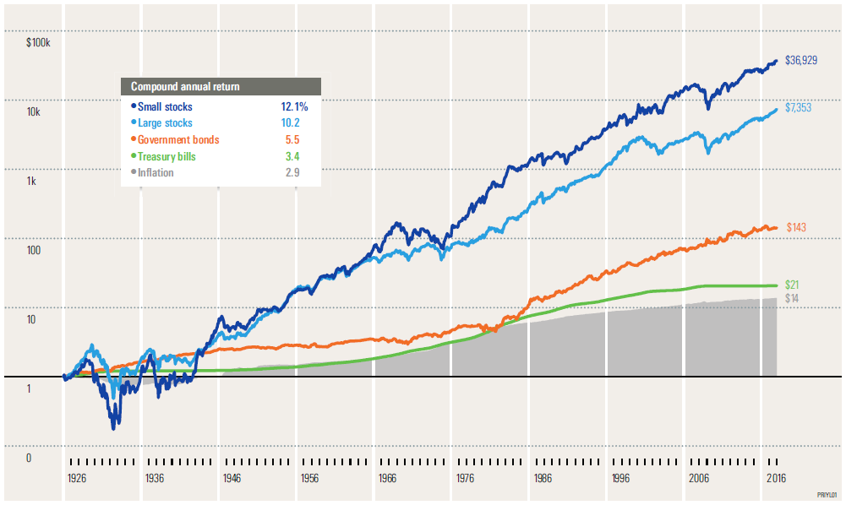
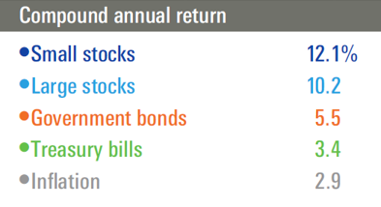
STRATEGY 3: Investments
IBBOTSON® SBBI®
Stocks, Bonds, Bills, and Inflation 1926—2017
Past performance is no guarantee of future results. Hypothetical value of $1 invested at the beginning of 1926. Assumes reinvestment of income and no transaction costs or taxes. This is for illustrative purposes only and not indicative of any investment. An investment cannot be made directly in an index. © Morningstar 2018. All Rights Reserved.
Notes:
Ibbotson® SBBI® 1926–2017
An 90-year examination of past capital market returns provides historical insight into the performance characteristics of various asset classes. This graph illustrates the hypothetical growth of inflation and a $1 investment in four traditional asset classes over the time period January 1, 1926, through December 31, 2017.
Large and small stocks have provided the highest returns and largest increase in wealth over the past 91 years. As illustrated in the image, fixed-income investments provided only a fraction of the growth provided by stocks. However, the higher returns achieved by stocks are associated with much greater risk, which can be identified by the volatility or fluctuation of the graph lines.
Government bonds and Treasury bills are guaranteed by the full faith and credit of the U.S. government as to the timely payment of principal and interest, while stocks are not guaranteed and have been more volatile than the other asset classes. Furthermore, small stocks are more volatile than large stocks, are subject to significant price fluctuations and business risks, and are thinly traded.
About the data
Small stocks in this example are represented by the Ibbotson® Small Company Stock Index. Large stocks are represented by the Ibbotson® Large Company Stock Index. Government bonds are represented by the 20-year U.S. government bond, Treasury bills by the 30-day U.S. Treasury bill, and inflation by the Consumer Price Index. Underlying data is from the Stocks, Bonds, Bills, and Inflation® (SBBI®) Yearbook, by Roger G. Ibbotson and Rex Sinquefield, updated annually. An investment cannot be made directly in an index.

Slide 17
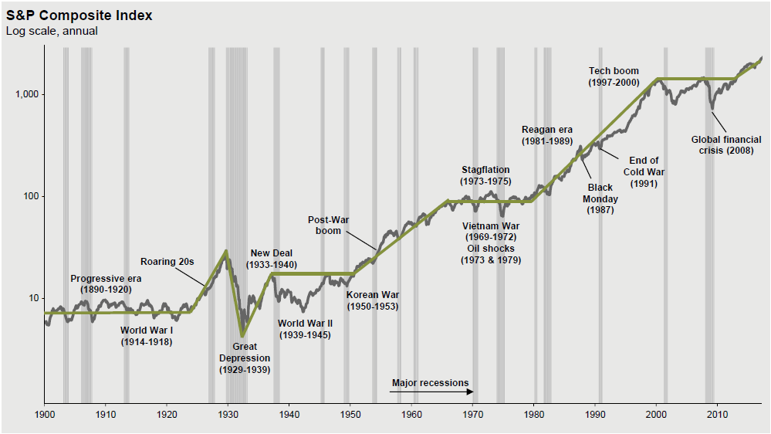
STRATEGY 3: Investments
Stock Market Since 1900
After every decline the market historically bounces back, up over 200% since 2009
Source: J.P. Morgan Market Insights U.S. Q1 2018
Notes:
This is a visual depiction of the market’s performance since 1900. Key points in history are shown, from WW1 to the Great Depression, the Viet Nam War, Black Monday 1987 to the 2008-09 Financial Crisis. The key is that the market continues on a growth trajectory after each of these down turns.

Slide 18

STRATEGY
4
Keeping as Much as You Can
Tax Planning
Notes:
Strategy #4 Managing your retirement investments to limit your taxes

Slide 19
STRATEGY 4: Tax Planning
Variable Annuities
$50k Initial Investment, 8% Hypothetical Return does not represent a specific Product; Illustration on 28% Tax Bracket
$600,000
$500,000
$400,000
$300,000
$200,000
$100,000
$0
Variable Annuities are subject to market risk, including loss of principal. The variable annuity contract, when redeemed, may be worth more or less than the total amount invested.
FPO
FPO
Taxable
Tax-deferred
Tax-deferred, after taxes
Now 10 Years 20 Years 30 Years
This hypothetical chart does not represent actual performance of any specific product or investment. Withdrawals of tax-deferred earnings are subject to ordinary income tax. A 10% federal income tax penalty may also apply if you take the withdrawal before you reach age 59½. Dividends and sales profits on annually taxed investments are generally taxed at capital gains tax rates, which can be lower than ordinary federal income tax rates. Using capital gains tax rates with the taxed annually investment would reduce the difference between the taxed annually and tax-deferred accounts shown above.
Please note that this chart excludes expenses associated with variable annuities, including administration, distribution and mortality & expense charge, and portfolio expense charge. If expenses had been reflected, the taxed-deferred amounts would be lower.
Consider your personal investment horizon and income tax bracket, both current and anticipated, when making an investment decision. These factors, as well as changes in tax rates and the treatment of investment earnings, may further affect the results of this comparison.
Notes:
Start early and supplement your employer-sponsored retirement plans with personal
retirement savings. If you have exhausted all other individual retirement plans, such as
IRAs, consider an annuity. With an annuity, your contributions accumulate tax-deferred.
That means you pay no income tax on earnings until you withdraw them, presumably at
retirement when your tax bracket may be lower.
This chart shows the difference between a tax-deferred investment before taxes,
[CLICK] a tax-deferred investment after taxes,
[CLICK] and a fully taxable investment.
You would have more assets saved for retirement in a tax-deferred investment than in a taxable one even after taxes are paid at withdrawal.
The expenses from AXA Equitable’s Retirement Cornerstone variable annuity are noted here to provide the investor an idea of how returns could be affected if a tax deferred product is purchased.

Slide 20
STRATEGY 4: Tax Planning
Risks of Retirement
The Cost of Taxes
$460,909
Taxable vs. tax-deferred investing over a 30-year timeframe
12% Tax Rate
$425,400
Spending
FPO
24% Tax Rate
$389,891
35% Tax Rate
$315,196
$357,341
Account
Value
Account Value
After Taxes
Taxable Account
(35% Tax Rate)
Tax-Deferred Account
Source: J.P. Morgan Asset Management. 2018. Assumes $5,500 after-tax contributions at the beginning of each year for 30 years and 6.0%annual investment return that is assumed to be subject to ordinary income taxes (capital gains and qualified dividends are not considered in this analysis). Tax-deferred account balance is taken as lump sum and taxed at the 12%, 24% and 35% federal tax rate, respectively, at time of withdrawal. Taxable account contributions are after tax and assume a 35% federal tax rate during accumulation. This hypothetical illustration is not indicative of any specific investment and does not reflect the impact of fees or expenses.
Notes:
Tax-advantaged accounts can shelter income-producing investments from current income taxation and result in greater long-term growth than taxable accounts. Actively managing your tax picture in retirement may help you keep even more of your tax-deferred wealth.

Slide 21
STRATEGY 4: Tax Planning
Differences between Mutual Funds & Variable Annuities
Mutual Funds
Tax Planning of Gains | Any gains on the sale if investments are treated for tax purposes as capital gains. Dividends can be ordinary income or capital gain. Qualified dividends get special tax treatment.
Tax Treatment of Losses | If clients suffer a loss when they sell, they can claim it as a tax deduction or to offset any gains from other investments.
Tax Treatment Upon Transfer | If a client experiences a gain when he or she sells shares in a mutual fund in a taxable account on order to purchase shares of a different mutual fund, this exchange would trigger capital gains taxation.
10% Tax Penalty on Withdrawals | No, not for a non-qualified account.
Guaranteed Income for Life | Generally not available.
Sales Charge | Yes, you may pay up-front sales charge. However, some funds are available load-waived.
Total Fees/Expenses | Advisory, administrative and distribution, and service fees. These vary from fund to fund.
Stepped-Up Cost Basis at Death | Basis equals fair market value at death.
Notes:
There are important differences to consider between mutual funds and variable annuities. When considering the benefits of investing in a mutual fund or variable annuity, it is important for the investor to consider their specific investment goals, time horizon and need or interest in tax deferral.

Slide 22
STRATEGY 4: Tax Planning
Differences between Mutual Funds & Variable Annuities
Variable Annuities
Tax Treatment of Gains | Any gains and earnings within a variable annuity grow on a tax-deferred basis. When withdrawn, gains are taxed as ordinary income.
Tax Treatment of Losses | Any losses in NQ annuities, upon surrender of contract, may or may not be tax-deductible or used to offset any gains from other investments.
Tax Treatment Upon Transfer | Exchanges from one variable annuity contract to another (1035 exchange) will not trigger any tax consequences. However, investors should consider the cost of the new variable annuity, surrender charges, the potential loss of guaranteed option benefits, and any impact to the death benefit. Exchanges or transfers from one variable annuity subaccount to another will not trigger any tax consequences.
10% Tax Penalty on Withdrawals | Yes, before age 59% (certain exceptions may apply)
Guaranteed Income for Life | Yes, choose from single or joint life. Also, some contracts provide guaranteed withdrawal or other guaranteed benefits, typically for an additional charge.
Sales Charge | Yes, usually covered through withdrawal charges, but contracts typically permit limited percentage of contract value to be withdrawn without charge (for example, 10% of your contract per year).
Total Fees/Expenses | Portfolio management, administrative, advisory, and mortality and expenses (M&E) risk charges. M&E charges pay for the insurance risks related to the death benefit. There are also additional charges for optional riders and benefits.
Stepped-Up Cost Basis at Death | The existing cost basis carries over to the beneficiary. Gains are taxed as ordinary income as paid out.
Notes:
Variable annuities can be an attractive financial investment instrument. Understanding how they are structured relative to taxes, penalties, charges etc. is important information when figuring how they might fit into your overall strategy

Slide 23

STRATEGY
5
Estate Planning
Notes:
Practical Strategy #5 is Estate Planning.

Slide 24

STRATEGY 5: Estate Planning
Foundations of Estate Planning
Wills
Durable Power of Attorney
Patient Advocate - Medical Directive
Revocable Trusts
Designating Beneficiaries is Essential
— Keep records up to date
— Review periodically
Notes:
Let’s quickly review some of the basic estate planning documents some of you may have.
Wills provide directions to the Probate Court regarding your personal property. Many wills also provide for guardianship of minor children. Finally most wills are “pour over” wills that distribute assets to a trust after death. A pour over will insures that assets will ultimately pass to the trust (not estate) even if the assets were not titled correctly. Remember generally wills are a matter of public record
[CLICK]
A Durable Power of Attorney designates an individual to handle financial affairs if a person becomes incapacitated
[CLICK]
A Patient Advocate designates an individual to make medical decisions in the event a person cannot make them. A medical directive outlines when and how a person would like to be kept alive.
These documents provide the core of most estate plans. For example it would be rare if a client had a trust but didn’t have a valid will. Also, medical directives have recently gained media attention and are becoming more popular. If you haven’t made decisions regarding your medical directive or appointed a health care advocate consider doing so.
[CLICK]
A Revocable trust allows for an individual to alter or cancel provisions in the trust. During the life of the trust, income earned is distributed to the individual, and only after death does property transfer to the beneficiaries.
[CLICK]
One area that often gets overlooked is beneficiary designations. This is true for retirement accounts, life insurance, and variable annuities. They should be reviewed periodically.

Slide 25

STRATEGY
6
Seeking Stability
Retirement Income Planning
Notes:
Practical Strategy #6 is Seeking Stability.

Slide 26
STRATEGY 6: Retirement Income Planning
Investment Challenges
 | Scenario A | Scenario B
Initial Amount Invested | $250,00 | $250,00
Withdrawal Amount @ 3% inflation | $12,500 | $12,500
Average Return: A and B | +6.6% | +6.6%
Average Market: Return: Years 1—3 | -10.87% | +16.83%
Average Market Return: Years 28-30 | Portfolio exhausted by 18 years | -10.87%
Result: How long $ lasted | 18 years | 30 Years
Result: $ amount left | $0 | $632,606.11
In Distribution
Inflation
Sequence of Returns
Lacking in Losses
Creating sustainable, consistent income
Notes:
It’s important to understand that investing in retirement, for a distribution portfolio is very different than when you’re accumulating assets. The emphasis will no longer be on simply growing your pot of money but instead on the amount and consistency of your paycheck. So the first thing to do is adjust your expectation about what matters.
There are unique challenges to investing in retirement and those include:
Inflation,
sequence of returns,
locking in losses
and creating sustainable consistent income.
Inflation reduces your purchasing power A dollar today will likely be worth less at retirement because of inflation. Since everyday items get more expensive over time, you need to plan for future price increases. While it is difficult to predict inflation rates, even a 3% rate of inflation (just below the historical average of 3.7%) can have a significant impact on purchasing power and on your future standard of living. To bring the point home, think about how much you paid for your first car or how much a movie ticket was when you were younger.
Next comes the notion of sequence of returns. When you’re in the distribution phase of retirement, average returns don’t tell the story. Look at these 2 examples of a $250,000 portfolio. When you earn the return is crucial to your success over the long term. It is important to note that Investors A and B had the same annual returns over 30 years, with each portfolio earning an average annual return of 6.6%, except that Investor A’s annual returns were inverted to represent Investor B’s annual returns. In this hypothetical example, Investor A exhausted her portfolio in only about 18 years, while Investor B maintained a healthy balance for over 30 years.
Locking in losses or reverse dollar cost averaging is another challenge. DCA might have been your best friend as you were saving and accumulating for retirement because it allowed you to buy more shares when the price was low. However, if the market is down and you need to liquidate shares to generate the paycheck, you’re locking in losses. There are a number of strategies your financial professional can share to help you with this issue.
Finally, despite statistics, we are hopeful that you can have a nice long retirement. The goal is to make sure you don’t outlive your income and to do that you need a source of guaranteed consistent income even in down markets. Part of that may come from Social Security or pensions income. Another portion may come your accumulated assets.

Slide 27
STRATEGY 6: Retirement Income Planning
Creating an Income Plan
Understand how expenses change in retirement
Review all sources of retirement income
Non-discretionary expenses should be covered by guaranteed income
Proactive social security strategies
Annuities could meet multiple goals:
— Guaranteed income for life*
— Market participation
— Death benefit options
*Guarantees within an annuity are based upon the claims-paying ability of the issuing company.
Notes:
Review your budget so you can anticipate how it may change in retirement. The good news is that the costs of working will no longer be in the equation. The bad news is that healthcare costs may be higher than expected.
[CLICK]
Next, review all sources of retirement income, including:
• Your Social Security annual benefit statement.
• Your current and prior employer annual retirement benefit plan statements
• Personal savings and investment accounts
• Other sources of income such as rental property
There are a number of proactive planning strategies that might be a viable option for you when considering when to take your Social security benefit. The old notion of you get what you get no longer holds water. Take the time to sit down with your financial professional and carefully consider the best decision for your situation.

Slide 28

STRATEGY 6: Retirement Income Planning
Strategy & Next Steps
What is a Variable Annuity?
Equity exposure
Guaranteed stream of lifetime income
Guaranteed payments to your beneficiaries upon death
Defer taxes
Schedule an appointment to speak to your Financial Professional about putting these strategies in place!
Guarantees within an annuity are based upon the claims-paying ability of the issuing company.
Notes:
We spoke briefly about variable annuities earlier in the presentation. For those of you who are not familiar with annuities, they are long-term financial products designed for retirement. In the most basic terms, a deferred variable annuity is a contract between a client and an insurance company to accumulate funds and then provide lifetime payments.
Variable annuities – while offering important tax advantages – provide other benefits that appeal to many investors. It is appealing as a retirement planning strategy because it can help clients:
- Potentially grow money faster through tax deferral.
- Manage annuity payments more efficiently in retirement.
- Provide death benefit protection to beneficiaries prior to annuitization. Depending on the option selected, death benefit may not be available upon annuitization.
- Access money in retirement through a variety of pay-out options.
Of course, there are certain fees and charges associated with variable annuities, which include, but are not limited to: mortality and expense charges, sales charges, administrative fees, and withdrawal charges.
Guarantees are based on the claims paying ability of the issuing insurance company.
AXA Equitable offers three variable annuities that your financial professional can speak further with you about.
A deferred variable annuity is a long-term financial product designed for retirement purposes. In essence, an annuity is a contractual agreement in which payment(s) are made to an insurance company, which agrees to pay out an income or a lump sum amount at a later date. Typically, variable annuities have mortality and expense charges, account fees, investment management fees, administrative fees and charges for special contract features. In addition, annuity contracts have exclusions and limitations. Distributions taken prior to annuitization are generally considered to come from the gain in the contract first. If the contract is tax-qualified, generally all withdrawals are treated as distributions of gain. Withdrawals of gain are taxed as ordinary income and, if taken prior to age 59 1/2 , may be subject to an additional 10% federal tax. Variable annuities are subject to investment risks, including the possible loss of principal invested.

Slide 29

STRATEGY
7
Be Empowered
Taking Action!
Notes:
We all want to feel empowered when it comes to financially protecting ourselves and loved ones.

Slide 30
STRATEGY 7: Taking Action!
Manageable Steps
Estate Planning
Retirement Income Planning
Calculate your net worth
Review titling of assets
Designate beneficiaries
Consider the distribution on your assets
Consult with a legal professional
Understand investment challenges in retirement
Review proactive Social Security strategies
Consider the value of guaranteed income over the long term
Notes:
There are manageable steps that can help you through the challenges of estate or retirement planning.

Slide 31
STRATEGY 7: Taking Action!
Manageable Steps
Start Today! Work with a Financial Professional You Trust and One Who Understands You
Cash Flow
Know your ins & outs
Investing
Consider tax-deferred retirement accounts
Consider investments that match your risk tolerance with your return expectations
Taxes
Work with your financial professional to understand the difference between Marginal & Effective Tax Rate
Consider the use of annuities to defer income taxes
Notes:
Informed Women Know More
The key steps to getting control and managing your retirement plan are to develop a plan that reflects your cash flow, consider your investing strategy, and gain an understanding of tax implications. A financial professional you can assist you with each of these.

Slide 32
Thank you.

Slide 33
Important Information
A variable annuity is a long-term financial product designed for retirement purposes. There are fees and charges associated with an annuity contract, which include, but are not limited to, operations charges, sales and withdrawal charges, administrative fees, and additional charges for optional benefits. Withdrawals are subject to ordinary income tax treatment and, if taken prior to age 59^{1/2}, may be subject to an additional 10% federal income tax penalty. Variable annuities are subject to investment risks, including the possible loss of principal invested.
Variable annuities are sold by prospectus only, which contains more complete information about the policy, including risks, charges, expenses and investment objectives. You should review the prospectus carefully before you invest or send any money.
Please be advised that this document is not intended as legal or tax advice. Accordingly, any information provided in this document is not intended or written to be used, and cannot be used, by any taxpayer for the purpose of avoiding penalties that may be imposed on the taxpayer. The tax information was written to support the promotion or marketing of the transaction(s) or matter(s) addressed and you should seek advice based on your particular circumstances from an independent tax advisor.
Financial professionals offer securities through AXA Advisors, LLC (NY, NY 212-314-4600), member FINRA/SIPC, and as agents of AXA Network, LLC, (AXA Network conducts business in CA as AXA Network Insurance Agency of California, LLC, in UT as AXA Network Insurance Agency of Utah, LLC, in PR as AXA Network of Puerto Rico, Inc.) offer the annuity and life insurance products of AXA Equitable Life Insurance Company (NY, NY) and those of unaffiliated carriers.
Variable annuities issued by AXA Equitable Life Insurance Company (NY, NY) are co-distributed by AXA Advisors, LLC and AXA Distributors, LLC (members FINRA & SIPC) AXA Distributors, AXA Advisors, AXA Network, and AXA Equitable are affiliated companies and do not provide legal or tax advice.
“Equitable” is the brand name of Equitable Holdings, Inc. and its family of companies, including AXA Equitable Life Insurance Company (NY, NY), issuer of annuity and life insurance products; MONY Life Insurance Company of America (MLOA), an Arizona stock corporation with its main administrative office in Jersey City, NJ and issuer of life insurance; AXA Advisors, LLC (member FINRA, SIPC), AXA Distributors, LLC, AXA Network, LLC (AXA Network Insurance Agency of California, LLC; AXA Network Insurance Agency of Utah, LLC; AXA Network of Puerto Rico, Inc.)
© 2020 AXA Equitable Life Insurance Company. All rights reserved.
GE-134319 (1/20) (Exp. 6/20) Cat #149826

