Slide 1
Keeping Perspective in Volatile Markets
Investing Today

Slide 2
Agenda
Evaluate Volatility
Consider the Noise
Understand Your Threshold
Focus on What You Can Control
Communicate Your Needs
• Not a Deposit • Not FDIC Insured • Not Insured by Any Federal Government Agency
• Not Guaranteed by Any Bank or Credit Union • May Lose Value

Slide 3
Evaluate Volatility

Slide 4
Evaluate Volatility
Volatility:
Is an inherent part of investing
Can create mispricing in securities
Can often cause us to react emotionally
Is a large function of time

Slide 5
Which chart would you prefer your portfolio to look like?
Chart A and B represent the same investment, but Chart A is simply a nine-month period of time within Chart B.¹
¹ Chart A is S&P 500® Index from 11/2009 – 07/2010. Chart B is S&P 500 from 05/2009 – 07/2013. The Standard & Poor’s 500 Index is a capitalization weighted index of 500 stocks designed to measure performance of the broad domestic economy through changes in the aggregate market value of 500 stocks representing all major industries. All indices are unmanaged and may not be invested into directly.
Notes:
The charts teach us an important lesson about volatility.
Chart A is quite volatile and ultimately goes nowhere. Any well-intentioned investor may be influenced to sell and look for better opportunities elsewhere. Chart B shows an upward trend…a very profitable investment. But here’s the catch – Charts A& B are the same investment – the S&P 500. Chart A is simply a nine-month period of time within Chart B. The section within the vertical lines in Chart B illustrates the time period interval that comprised Chart A.
A great long-term investment, even a very profitable one, can have periods of frustrating and poor performance. Those periods can last longer than we would like, but if we allow short-term volatility and performance to influence our investment decisions, we may end up making very costly ones.

Slide 6
Consider the Noise

Slide 7

Consider the Noise
Most information reported by the financial media is “noise,” not news.
Notes:
Noise is information that is exaggerated, short-term in nature and/or not relevant to a long-term investment strategy. But it sure gets our attention. The financial media’s primary goal is to make money, because they need viewers, and they need you to tune in today and come back tomorrow. It is not their job to help you reach your investment goals. They may often present news in a way that elicits emotions and creates a false sense of urgency.

Slide 8


Take a look at the headline below from the Wall Street Journal dated January 24, 2014:
This headline was published when:
The S&P 500 was down just 3.1% from its all-time high
There were only four days of losses
Notes:
[read headline]
This was after only four days of losses, so why would they choose to only highlight those four days? Why not use four weeks or four months? It was done for effect! Had they used a longer time horizon, the tumble would have been just a blip, and they wouldn’t have had a story. Four days after this was published, the market had recouped all of its losses and continued heading higher to make new highs, despite the “spreading fear”.
So what should you do when the media is promoting fear and uncertainty? What if analysts and “experts” are predicting more losses? The key answer to this question is your time horizon. When will you need the money? How many years until you liquidate the entire account? If you don’t plan to liquidate your assets for several years (10 or more), it would be best to view future market losses as opportunities to buy low, not instances to sell. But it is difficult to own (or buy) an asset that is losing value and appears likely to keep going down.

Slide 9

Consider:
Do you anticipate that current events will be worse than Black Monday 1987 or the 2008 Financial Crisis?
How did an investor who was fully invested in stocks before Black Monday and the 2008 Financial Crisis fare seven years after each crisis?
Given your time horizon, what would be the most prudent strategy if market losses occurred in the near future?
Notes:
Consider the following questions when the noise of the media becomes too loud. [read questions]

Slide 10
Understand Your Threshold

Slide 11

Understand Your Threshold
The stock market is volatile by nature.
Notes:
Upon experiencing poor investment performance, many investors have felt compelled to sell, just so they could stop the pain. However good this may feel in the short term, it often results in having to adjust or delay their goals. Most investors can tolerate moderate losses. But significant losses influence investors to abandon their strategy. Defining “moderate” and “significant” losses is different for everyone.

Slide 12

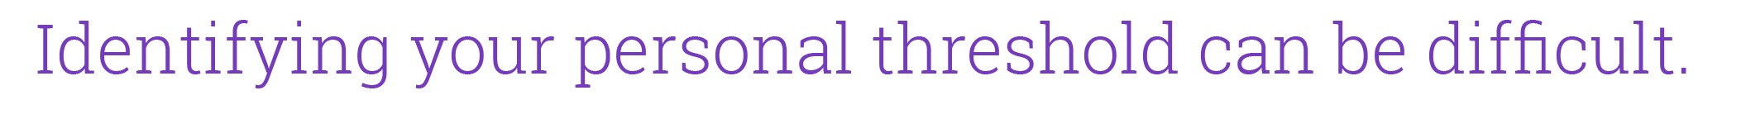
Understand Your Threshold
Answer the following questions:
I would be concerned if my portfolio fell to $___________
I would be devastated if my portfolio fell to $___________
Notes:
It is important to understand your threshold of pain. This threshold identifies when you may be compelled (emotionally) to “throw in the towel” and preserve what you have left. As investors, we often focus on the return that we want, without too much consideration for risk. Yet more people fail to achieve their financial goals because they took too much risk rather than not making as much as they could have in a bull market.
There is no scientific way to determine your exact threshold. Your threshold is not static; it can change as your individual circumstances change. But the following two statements will give you a good idea where your “danger area” resides, and may be helpful in putting together the right investment strategy for you.

Slide 13
Focus on What You Can Control

Slide 14
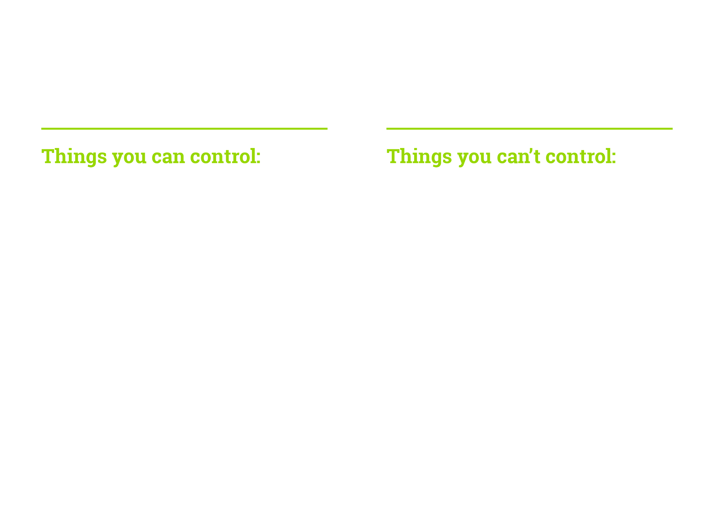
Focus on What You Can Control
Investment allocation
Risk exposure
Tactical strategies (rebalancing, defining when to buy low)
How you react/respond to the things you can’t control
Market performance
Volatility
Economic policies
Headlines
Notes:
In the investment realm, there are many factors that contribute to your performance. Some of those factors are completely within your control and others you have no control over. Unfortunately, we tend to focus on things beyond our control and ignore those things within our control. There are some things you can’t control, such as [read column on right]. The good news though, is that there are things you CAN control [read column on left].
On the following slide, let’s consider the example in which we compare the results of an investor who focused on those things she could control, like utilizing an investment plan, to another that had the best of intentions, but no strategy.

Slide 15
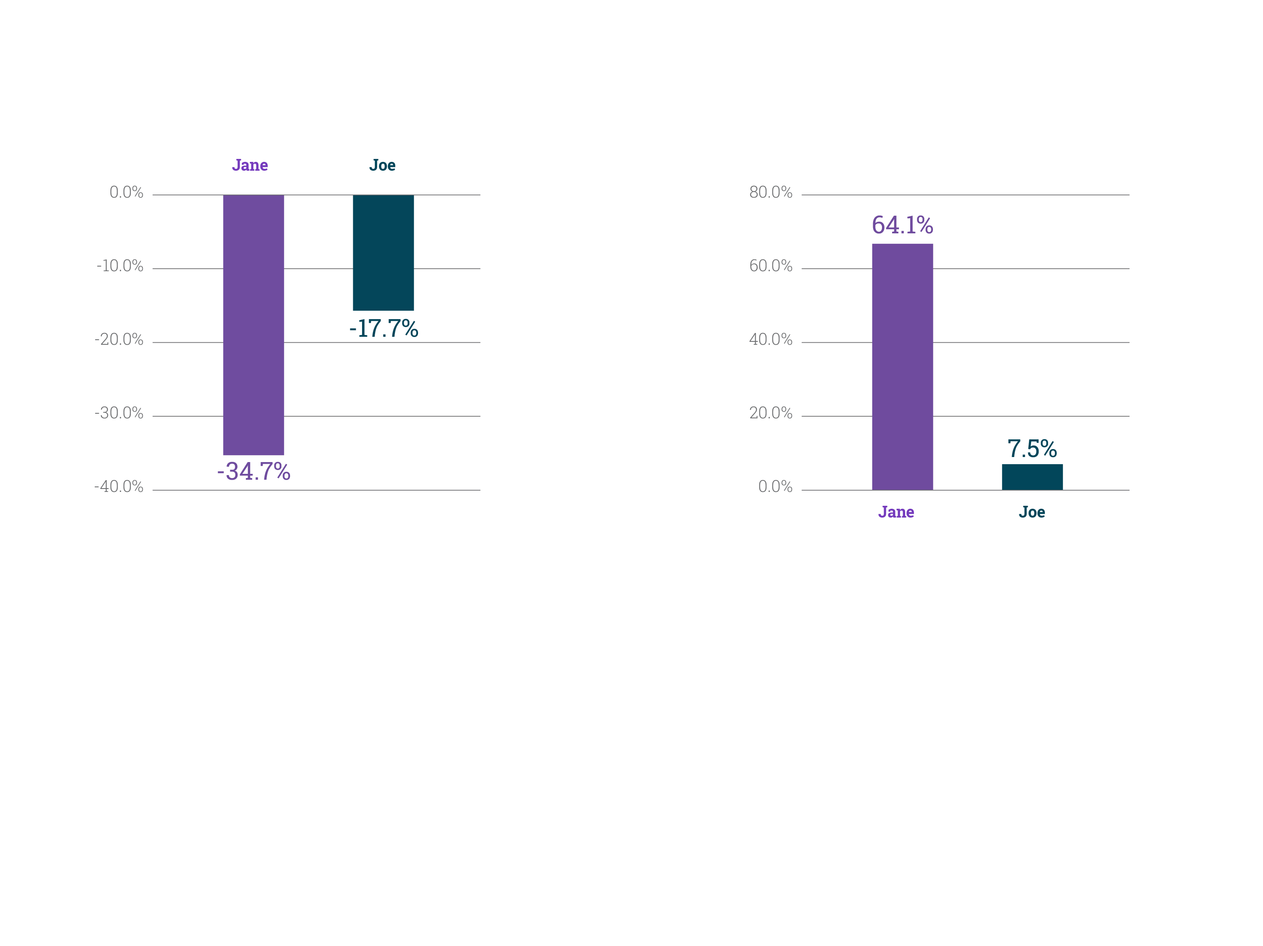
Focus on What You Can Control
Performance as of March 9, 2009
Over the short term, it appears Joe was wise in selling stocks and buying bonds, as evidenced by the outperformance relative to Jane.
Performance as of June 1, 2016
But over the long term, the patience and diligence shown by Jane – sticking with her investment process – paid off handsomely.
Stock performance is represented by changes in the S&P 500 Index over periods defined. Bond performance is represented by changes in the Barclays Aggregate Bond Index over periods defined. Both indices assume reinvestment of dividends. The Barclays U.S. Aggregate Bond Index is an index of the U.S. investment-grade fixed-rate bond market, including both government and corporate bonds. You cannot invest directly into index funds.
Jane had a strategy of rebalancing every year if the allocation deviated 5% or more from the target. In this scenario, Jane rebalanced on the last business day of May in ’08, ’09, ’11, and ’14.
Joe is assumed to have sold all stocks on Oct 31, 2008, and invested all into the bond index.
Notes:
These two charts illustrate the performance of identical investors beginning in June 2007 with a portfolio of 70% stocks and 30% bonds.
Jane had a process that specified an annual rebalancing strategy, which she adhered to religiously, even after experiencing significant losses.
Joe had no such plan, but very good intentions. He always planned to buy low and sell high, but was influenced by losses and a pessimistic forecast to sell stocks at the end of 2008.
The moral of the story? We have to be cognizant of allowing external, uncontrollable factors affect our investment strategy. Stay focused on what you really have an ability to change.
Knowing all of these things about keeping perspective is easy to understand, but how can you have a conversation with your financial professional about your concerns and needs?

Slide 16
Communicate Your Needs
Notes:
We all communicate differently, and sometimes it’s helpful to have a good communication foundation for a mutually rewarding relationship with your financial professional. Luckily, there is a possible solution.

Slide 17


Communicate Your Needs
Considers things objectively – seldom influenced by feelings
Values recognition and praise for accomplishments
Actions are tied heavily to personal values
Is direct and assertive with self and others
Values quality and accountability
Energetically juggles multiple roles and tasks
Puts people and relationships first
Action oriented and loves a challenge
Analytical when making decisions
Easily bored by routine tasks
Content working behind the scenes and enjoys helping others
Confident and results driven
Prefers a structured, methodical approach
Is creative and likes to think outside the box
Is patient with a relaxed attitude
Likes to lead and make things happen
Maintains calm in volatile situations
Is energized by change
Often defers decision-making to accommodate others
Brings drive and focus to issues
_______ A
_______ B
_______ C
_______ D
Notes:
In the evaluation you’ve been given, select the statement that best describes you. Your selected preferences will provide your financial professional information on how to most effectively communicate with you.

Slide 18
Questions

Slide 19

This presentation is based on the white paper entitled, "Investing Today: Keeping Perspective in Volatile Markets" by The Emotional Investor, Jay Mooreland, MS, CFP®. The author is not affiliated with Brighthouse Financial, and is solely responsible for the content of this presentation.
Any discussion of taxes is for general informational purposes only, does not purport to be complete or cover every situation, and should not be construed as legal, tax, or accounting advice. Clients should confer with their qualified legal, tax, and accounting advisors as appropriate.
Brighthouse Financial® and its design are registered trademarks of Brighthouse Financial, Inc. and/or its affiliates.
1808 CLVA526053
© 2019 BRIGHTHOUSE FINANCIAL, INC. L0717497041[1219]
Notes:
Thank you for attending.

