Slide 1

Investing
Your Way
Notes:
Good morning/afternoon everyone. My name is __________, and I’m a [insert title] with Hartford Funds. Thank you for taking time out of your schedule to be here today.
Some of you probably have a friend, a relative, or have heard of a friend of a friend who’s found herself in an unexpected financial dilemma (often based on an unexpected event), being uncomfortable with discussing finances, or a mere lack of awareness—not being engaged in financial conversations. These circumstances can be quite costly. On the other hand, you may also know someone who was better prepared.
What inspires me to give this presentation, what makes it personal to me is… (insert personal story here)
Now, can each of you think of an example of someone who may have found themselves in a dire financial situation? Turn to the person beside you and briefly share that story with them.
(Allow audience time for brief interaction.)
Now, how about someone who prepared herself well? Do you know someone who did that? Please turn to your partner again and next to you and briefly share that story with them.
(Allow audience time for brief interaction.) Having heard those stories, which side do you want to be on?
During our discussion today, we’re going see how these days, women are better positioned than ever before to build their financial future, what they have to prepare for, and how you can do that effectively. Here are the three areas we’ll discuss.
[next slide]

Slide 2



Agenda
Reasons
for Optimism
Challenges
Strategies
Notes:
First we’ll cover…
The Reasons for Optimism, or advantages women have when it comes to investing
Second, we’ll look at…
2. The unique Challenges that women face; things to be conscious of
And third, I’ll provide…
3. Real Strategies for meeting those challenges with the resources that are available today.
Let’s start with the good news.
[next slide]

Slide 3

Reasons
for Optimism
Notes:
[Read slide]
Reasons for Optimism: These are things that women can get excited about and that give them a boost when it comes to financial matters. And here they are…
[next slide]

Slide 4
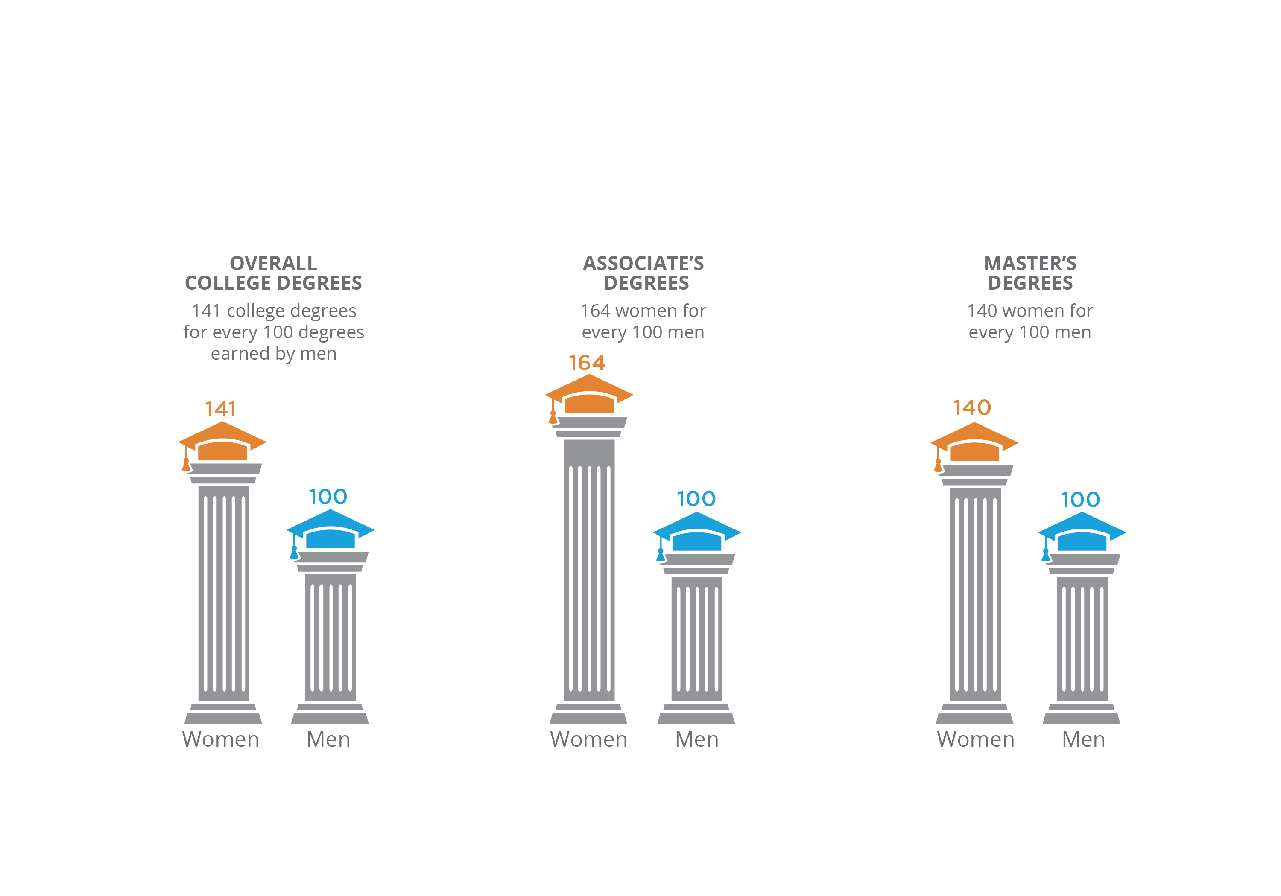
Reasons for Optimism
Women continue to surpass men in college degrees (2017)¹…
¹Prediction: No 2017 graduation speaker will mention this—the growing ‘gender college degree gap’ favoring women, aei.org, May 2017
Notes:
First, women are more educated than ever before. [Read slide]
The gender discrepancy for college degrees is expected to grow over the next decade. The Department of Education forecasts that, by 2025, women will earn 141 college degrees for every 100 degrees earned by men, with especially pronounced differences in associate’s degrees (164 women for every 100 men) and master’s degrees (140 women for every 100 men) earned.¹
But this gender imbalance is hardly new. Women earned a disproportionate share of college degrees at every level of higher education for more than 10 years.
We’ll see how this is paying off.
[next slide]
¹Prediction: No 2017 commencement speaker will mention this—the huge ‘gender college degree gap’ favoring women, aei.org, May 2017

Slide 5

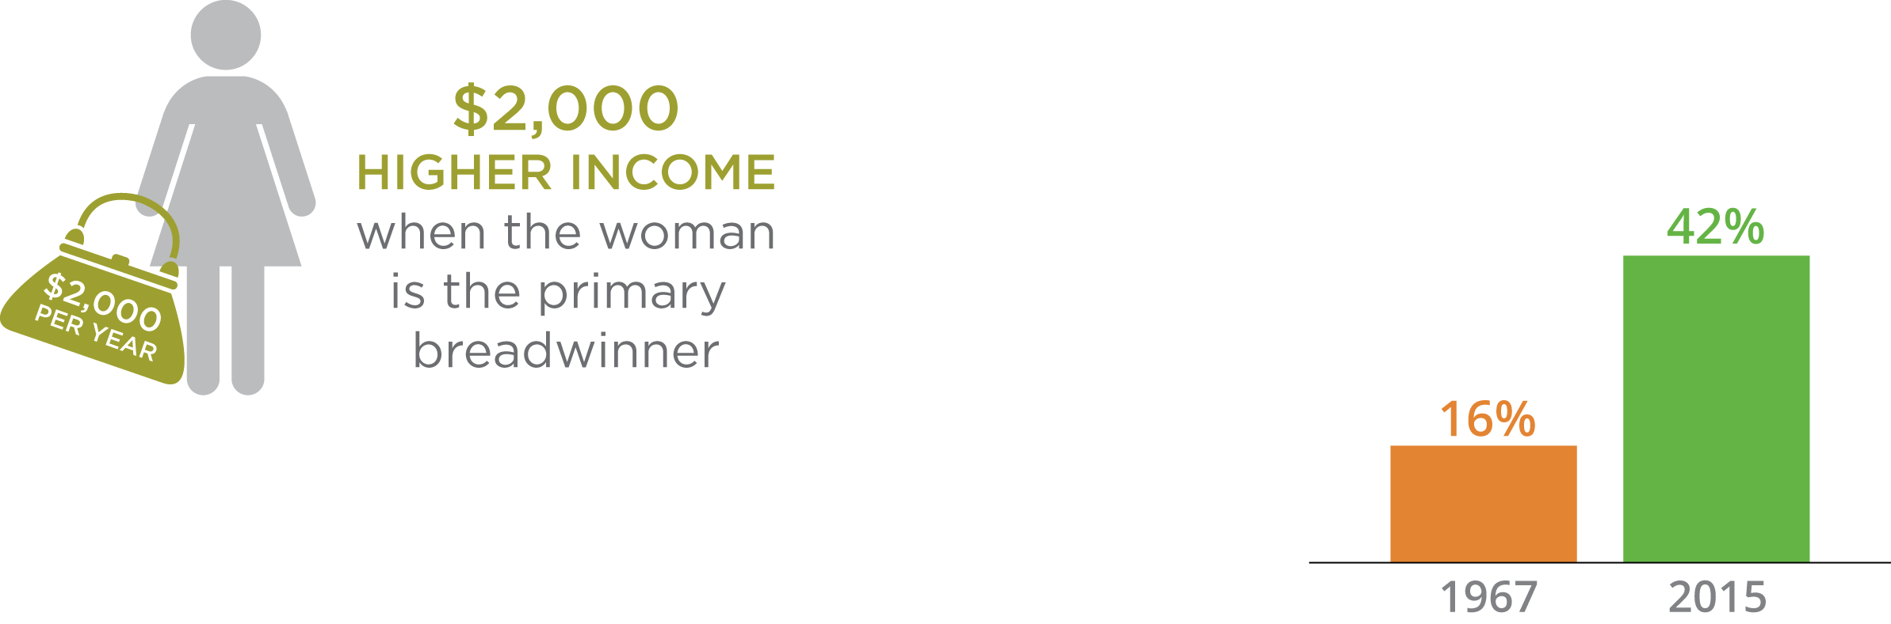
Reasons for Optimism
…income…
In 2015, 42% of mothers were sole or primary breadwinners, bringing in at least half of family earnings.¹
In 1967, there were only 16%.
More women are becoming
the family breadwinner
¹Breadwinning Mothers Are Increasingly the U.S. Norm,
cdn.americanprogress.org, 12/19/16, most recent data available
Notes:
Women today are more financially independent than they’ve ever been.
In 2014, women made up 57% of the labor force,² and 42% of them earned more than their husbands.¹
In fact, when a woman is the primary breadwinner of a family, the total family income is higher.¹
And they’re not just employees, they’re in charge. I’ll show you some impressive statistics [on the following slide].
²United States Department of Labor, Women’s Bureau, Data & Statistics, dol.gov, retrieved 3/17

Slide 6

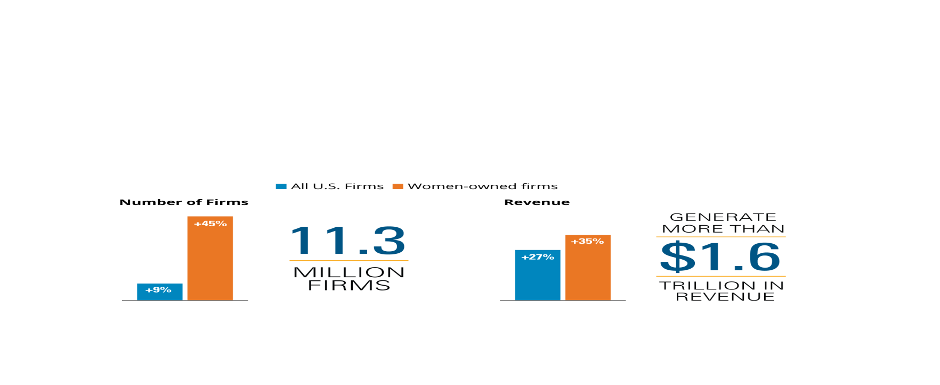
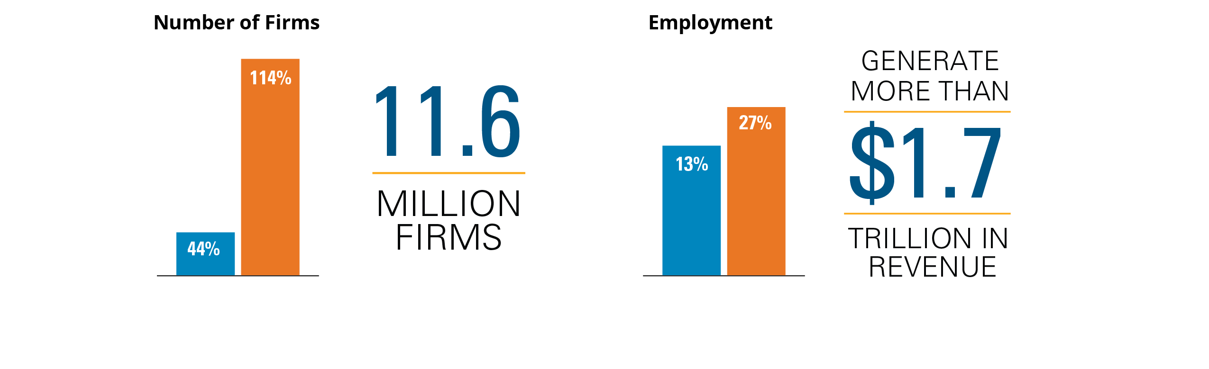
Reasons for Optimism
…are taking charge…
Women-owned businesses are outpacing the national average in growth and employment.¹
Increases since 1997
¹The 2017 State of Women-Owned Businesses Report, americanexpress.com
Notes:
Women are now the majority owners of 39% of the country’s businesses, up from 29% in 2007.
Between 1997 and 2017, the number of women-owned businesses increased by 114%, compared to a 44% increase among all businesses—a growth rate more than 2.5 times the national average—equaling a total of 11.6 million women-owned businesses in the United States.¹
The employment growth rate over the past 20 years was stronger for women-owned businesses than for all businesses: 27% vs. 13%. They employ nearly 9 million people and generate more than $1.7 trillion in revenue.¹
As business owners, women tend to seek new ways to distinguish themselves from the competition, while networking more than their male counterparts with other small business owners. Women entrepreneurs are also more likely to seek help from the Small Business Administration and other resources available to them.
[Read slide]
Author and business coach David Finkel believes that women make better business owners than men, and here are his three reasons:
Women business owners are much better at leading their teams, viewing their employees as whole people, not just "worker bees."²
Woman business owners are more willing to implement systems and controls in their companies, and do so effectively.²
Women are better at building deeper relationships with customers, suppliers, and vendors than men.
But it doesn’t stop there. Next we’ll see more ways women are making their mark.²
¹The 2017 State of Women-Owned Businesses Report, americanexpress.com
²Why Women Make Better Business Owners than Men, inc.com, 9/30/15, most recent data available

Slide 7

Reasons for Optimism
…and leading
Women lead 32 of the world’s foremost companies: General Motors, IBM, PepsiCo, Lockheed Martin, and more¹
the highest number in the
63-year history of the Fortune 500
¹These Are the Women CEOs Leading Fortune 500 Companies, 6/7/17
Notes:
Not only are they working and earning, they’re leading.
[Read slide]
Even in the traditionally male-dominated field of technology there are highly several successful women in the “C-suite.”
Here are just a few of America's richest self-made women in tech:²
Thai Lee, owner, president, and CEO of SHI International (largest woman-owned business in the U.S.)
Sheryl Sandberg, COO of Facebook
Susan Wojcicki, CEO of YouTube
Safra Catz, Oracle co-CEO
Their success might be attributed to a certain characteristic women possess. What is it…?
[next slide]
²Meet America's Richest Self-Made Women In Tech, forbes.com, 5/17/17

Slide 8


Reasons for Optimism
  Three ways women are better investors than men:¹
  Have long-term goals and they stick with a plan
  Don’t try to outsmart the market
  Take fewer risks yet still outperformed men in the past decade
¹Fresh evidence women are better investors than men, money.cnn.com, 3/8/17
Notes:
Rationality. Women are more rational. How does this trait reveal itself in the investment world?
There are three significant ways in which men and women differ on financial decisions.
1. Women tend to focus on longer-term, non-monetary goals, keeping the bigger picture in mind. Instead of merely viewing money as a means to purchase something, they consider money to represent independence and security.
2. Women are more likely to ask for direction. In contrast, the majority of men prefer to make financial decisions entirely on their own.
3. Women tend to be more thorough; take more time making decisions. Women are more likely to research investments in depth before making portfolio decisions, whereas men are more prone to market timing impulses.
The next piece of information should be especially encouraging. [next slide]
Optional:
The data I’m about to share with you has been adapted from an article featured on U.S. News & World Report. It was based on studies from banks and investment firms over the course of a decade, which ultimately determined that women make better investors than men. Why?
Men are competitive. For many men, the most important thing is not the return of an investment, but beating the competition. This often tempts them to make riskier bets, which are less likely to pay off.²
Women take fewer risks. According to research by behavioral scientists, women are more inclined than men to wear seat belts, avoid cigarette smoking and get their blood pressure checked. They are 40% less likely to run yellow traffic lights. So it should come as no surprise that women gravitate toward “safer” investments.²
One investment study concluded that when things go wrong, men get angry, while women become more fearful. Anger can lead people to take action that will lead to more losses, such as doubling down on losing investments. Fearful women, on the other hand, are more likely to avoid market downturns in the first place, and then if they do suffer losses they’re more likely pull in the reins and step away from big disasters.²
²4 Ways Women Are Better Investors Than Men, money.usnews.com, 12/17/13, most recent data available

Slide 9
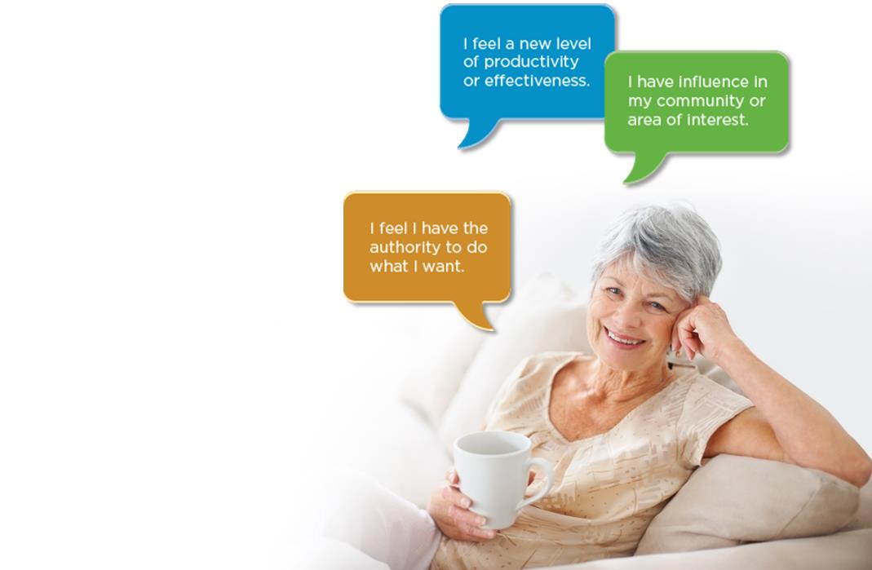
Reasons for Optimism
Women flourish as they age¹
Overall mental health improves with age
General life satisfaction increases with age
Women feel less lonely as they grow older; more affirmed and appreciated
¹Could Aging Be Good for Women?, www.psychologytoday.com, 1/12/2010, most recent data available
Notes:
You know the saying, “I’m not getting older, I’m getting better?,” right? Well, women can say that with assurance.
Improved mental health
According to Dr. Susan Nolen-Hoeksema, a Yale professor of psychology and author, women's lives get better with age, not worse. Rates of depression and anxiety go down as they grow older. Dr. Nolen-Hoeksema attributes that to the innate strengths women possess—coping skills, empathy, ability to listen, and patience—which help them tackle new problems and situations that arise as they age, and to bravely pursue new paths.²
Increased life satisfaction
As noted by Barbara Hannah Grufferman, an author, journalist, and public speaker who focuses on the concerns of women over 50, women have an exceptional ability to connect and engage, allowing them to create and maintain solid networks and relationships throughout their lives. They thrive on the building and nourishing of friendships, and recognize them as an essential part of their ongoing support system, especially when going through difficult times (i.e., dealing with aging parents, illness, death, job loss).
Affirmation & appreciation
Once they reach midlife, women are more confident in their own personal power and are willing to tap into that power to not only help themselves, but to help others, especially other women.² In addition to those on the slide, statements women affirmed in Dr. Susan Nolen-Hoeksema’s research were:
“I have a sense of being my own person.”
“I feel confident.”
I hope those last few slides have lifted your sense of empowerment. If so, hold on top that feeling, because we’re about to shift gears.
²Life After 50: Are Women Better at Aging Than Men?, www.huffingtonpost.com, 3/6/2011, most recent data available

Slide 10

Challenges
Notes:
We can’t avoid addressing the Challenges you face. The things I’m about to share with you probably won’t come as a surprise.

Slide 11
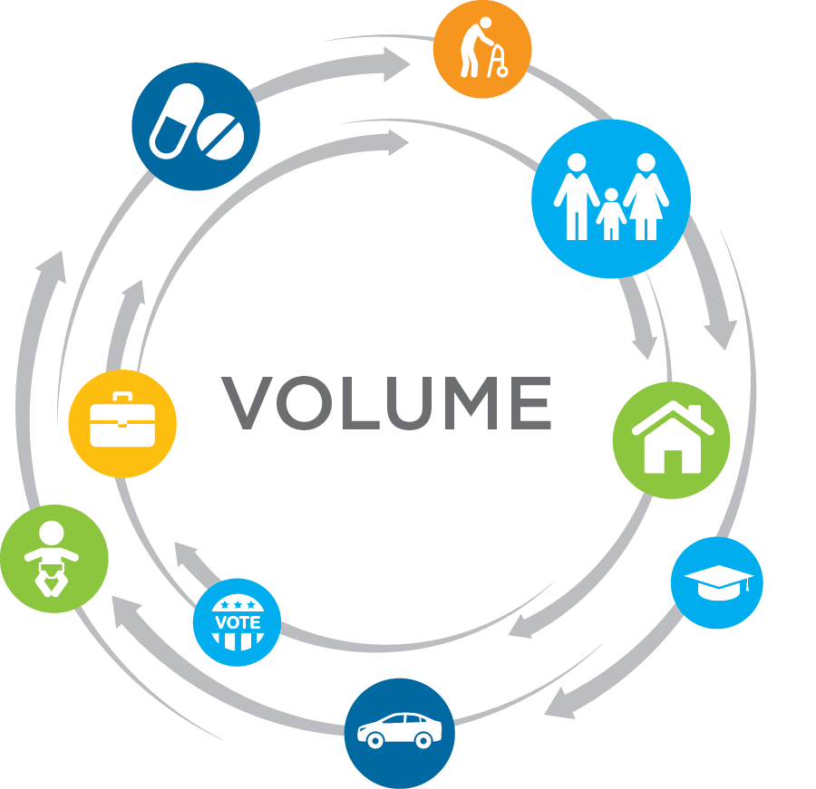

Challenges
Who has time to plan?
Notes:
Women are busy—and that’s an understatement for a lot of you.
A study by MIT’s AgeLab suggests that women juggle many more “roles” than men commonly do, and that managing these roles creates a different set of worries and priorities.¹
In the bubbles, you might see several different areas represented that you can relate to. Some of you are providing care both up and down the generational scale. You’re also caring for our marriages and other relationships, shuttling kids to and from different activities, and fulfilling civic duties. You’re also working hard, and your most important obligations can lie outside of the professional world.
Juggling all of these concerns and priorities can make it even more difficult to find the time and mental capacity to plan for what might be a distant retirement future. You’re contending with multiple priorities that are directly in front of you.
Let’s examine these responsibilities more carefully.
¹Connecting with the women in your workforce, Joseph F. Coughlin, www.tiaa-cref.org, retrieved 5/20/15

Slide 12
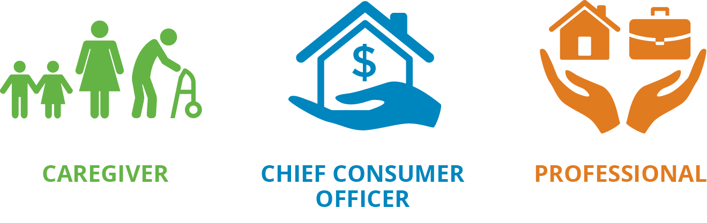
Challenges
  Women often play three complex roles within their families¹
¹Connecting with the women in your workforce, Joseph F. Coughlin, www.tiaa-cref.org, retrieved 5/20/15, most recent data available
Notes:
Women often play three complex roles within their families.¹ These include:
Caregiver: Providing care for children, parents, and in-laws, which can naturally lead to the role of “Head worrier.”
Chief Consumer Officer: Women are mainly responsible for many household spending decisions, ranging from healthcare to groceries.
Professional: Seventy percent of women work full or part time and must juggle all these responsibilities at home and work.
Additionally—and even more concerning, is that women also play a role that Dr. Joe Coughlin, founder and director of the MIT AgeLab, refers to as the neglected role. He says that, “Given many women’s preoccupation with their responsibilities to others—and the stress that often accompanies that juggling act—they end up neglecting the activities and planning critical for their own well-being. Sometimes they may feel guilty taking time for themselves, and sometimes they simply can’t find the hours in the day.
Who can relate to that?
Either way, Dr. Coughlin says that when women neglect financial planning, the negative long-term consequences can be severe. And that’s why I’m so glad you’re here [today/this evening].
If a lack of time isn’t enough, women also struggle with income equality. We’ll see how that computes on the next slide.
¹Connecting with the women in your workforce, Joseph F. Coughlin, www.tiaa-cref.org, retrieved 5/20/15

Slide 13
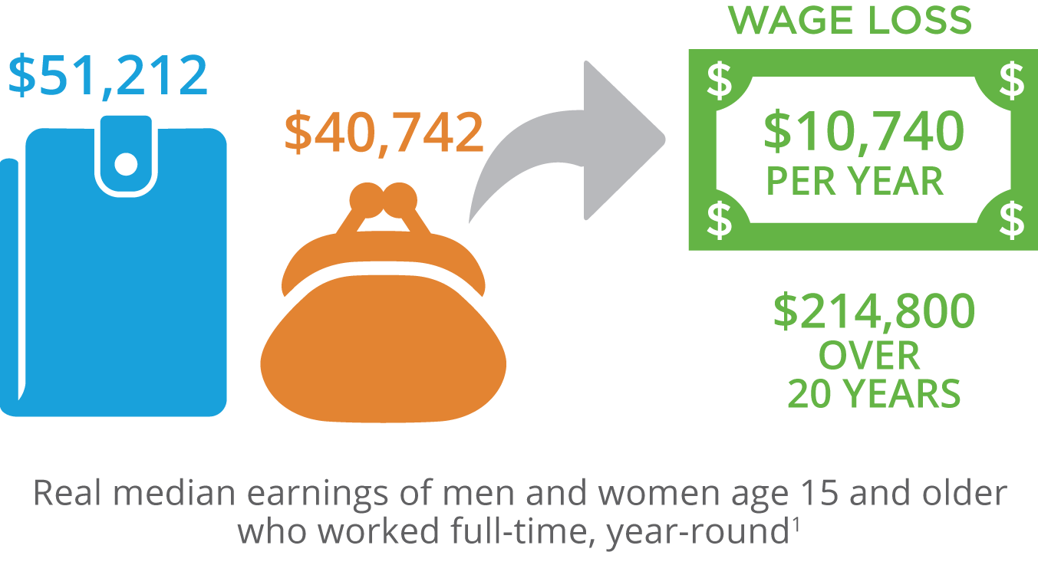
Challenges
Women still earn less than men
¹Data source: U.S. Census Bureau, Income and Poverty in the United States: 2015, issued September 2016, most recent data available
Notes:
I realize this is something you’ve already heard several times, and it must make you cringe each time you do.
According to the White House, full-time working women earn 79% of what their male counterparts earn.¹ Men earn $10,740 more than women on average, to be precise. Over 20 years, that adds up to nearly $215,000 more.
Furthermore, this means that women have to work approximately 90 extra days, or about three months, to earn a male’s salary by the end of the previous year.
While the income gap between men and women has been narrowing over the years, it still exists and needs to be acknowledged.
We’ll see something that contributes to that discrepancy on the following slide.
¹Data source: U.S. Census Bureau, Income and Poverty in the United States: 2015, issued September 2016

Slide 14
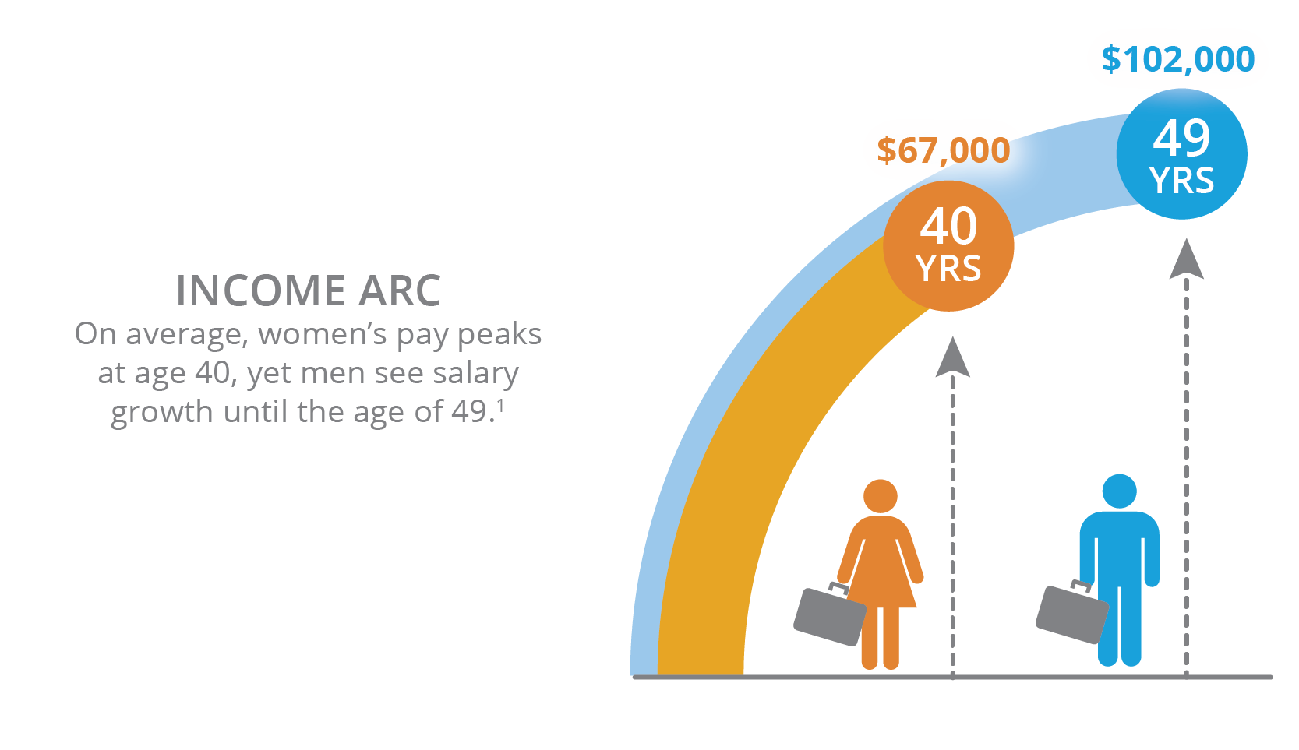
Challenges
Women reach an income threshold earlier than men
¹Here's the age at which you'll earn the most in your career, cnbc.com, 8/18/2017
Notes:
There’s something you may not have heard of before, and it’s called the “income arc.”
When we’re younger, we might think that we’ll continue to make more money over time; that our income is going to “go up in a straight line, in a constantly growing trajectory.”¹
But your money arc is shorter than you think. According to an analysis from PayScale.com, women’s pay peaks at age 40, and, according to their median data, at about $67,000. After that, there may be small bumps in salary, but they rarely outpace inflation—so in real terms, you’ll make that $67,000 for the rest of your career.¹
Maybe that doesn’t sound so bad, except that, based on the same data, men’s salaries continue to grow until age 49, and top out at a median of $102,000.¹
The pay gap is sometimes widened by the next point.
[next slide]
¹Here's the age at which you'll earn the most in your career, cnbc.com, 8/18/2017

Slide 15

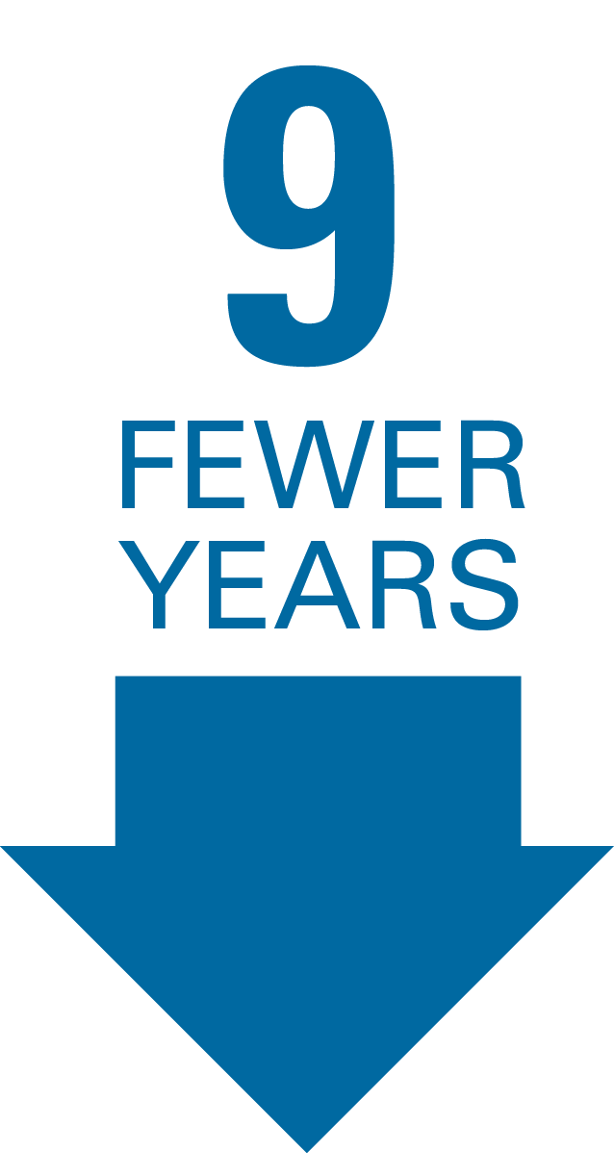
Challenges
Women spend less time
in the work force¹
¹Income Insights: Gender Retirement Gap, tiaa.org, retrieved 3/18
Notes:
Women typically leave the workforce more often than men. Women actually spend an average of 9 fewer years in the workforce than men over a lifetime.¹
Why? One reason is to have children and stay home with them.
According to the Pew Research Center for Social & Demographic Trends, there were 10.4 million stay-at-home mothers in 2012, compared to only two million stay-at-home fathers.^{2,3}
But what about aging parents? They need care as well—and guess who provides it?
(Allow audience time to respond.)
[next slide]
²After Decades of Decline, A Rise in Stay-at-Home Mothers, www.pewsocialtrends.org, April 8, 2014, most recent data available
³Growing Number of Dads Home with the Kids, www.pewsocialtrends.org, June 5, 2014, most recent data available

Slide 16

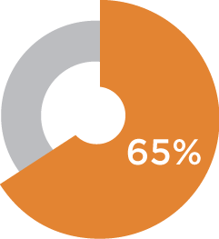
Challenges
Women are main providers of parental care¹
The average caregiver:²
49-year-old woman
married
employed full time
caring for an older
female relative
An estimated 65% of caregivers are female
¹Data source: Caregiver Statistics: Demographics,
caregiver.org, retrieved 3/17
²The Typical Caregiver, August 2015, most recent data available
Notes:
MIT AgeLab confirmed it in an earlier slide—women. In fact, 65% of caregivers are female.¹
The “typical” U.S. caregiver is a 49-year-old woman who’s likely married or living with a partner. She works outside the home, full time, and spends approximately 24 hours per week—the equivalent of another part-time job—providing unpaid care to a female relative for an average of four years.²
Caring for children and aging parents are incredibly important and necessary tasks, but they’re tasks that come at a financial cost.
Let’s look at what those costs can actually amount to.
[next slide]
²The Typical Caregiver, August 2015, most recent data available

Slide 17
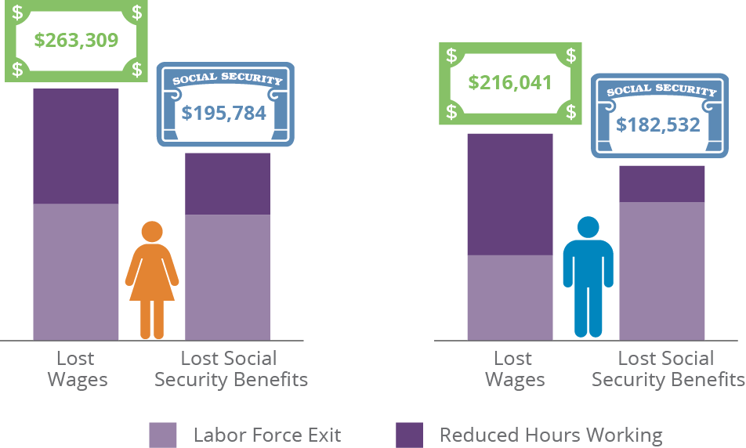
Challenges
Being a caregiver: Cost to women vs. men¹
¹The MetLife Study of Caregiving Costs to Working Caregivers, June 2011, most recent data available
Notes:
Those who care for an aging parent are aging themselves, while providing care at a time when they also need to be planning and saving for their own retirement. While this study may be few years old, you can see the staggering impact of caregiving on their earnings and lifetime wealth.
[Read slide]
Out-of-pocket expenses add to those costs. Family caregivers, typically boomers, are shelling out money to pay for medications, medical bills, in-home care, nursing homes and more.
A study by AARP found that seventy-eight percent of caregivers absorb out-of-pocket costs, which average nearly $7,000 a year. Those costs consumed the equivalent of a fifth of caregivers’ incomes on average. ² The most financially strapped caregivers tap savings or take out loans to meet expenses.
What’s more, as we’ll explore next, women have longer lives to fund, so these expenses have an even bigger impact.
Allow me to elaborate. [next slide]
²Family Caregiving and Out-of-Pocket Costs: 2016 Report, aarp.org, 12/2016

Slide 18
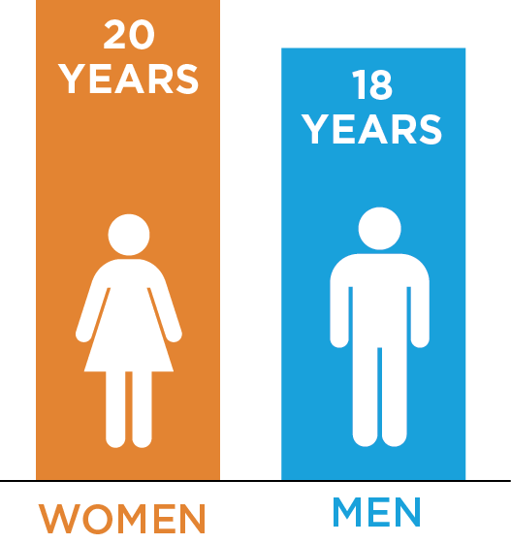
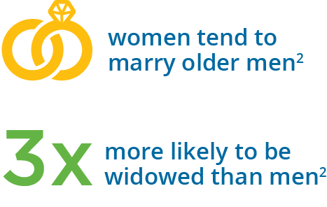
Challenges
Women may have to manage alone…
  Life expectancy at age 65:¹
¹Data source: Mortality in the United States, 2015 , NCHS Data Brief , No. 267, 12/16
²Aging Women, Living Poorer, contexts.org, Fall 2014, most recent data available
16
17
19
20
Notes:
You’ve likely heard this before: Women live longer than men. At age 85 and older, there are nearly TWICE as many women as men, as indicated by the U.S. Census Bureau’s Age & Sex Composition in the United States: 2012. All of this means that you have a good chance of outliving your husband if you’re married.
[Read slide]
If you’re married, you’re presumably planning your savings and retirement plans based on two incomes. What if—even though it’s not what you wish or plan—your husband dies or you get divorced? If your husband or partner passed away, would you be able to easily resume managing the household finances on your own?
Making widowhood even more difficult is the fact that women’s poverty rates jump following a husband’s death. Because women generally live longer, and tend to marry men older than themselves, they’re nearly three times more likely than elderly men to be widowed, and more likely to remain single than widowed men, who have a higher likelihood of remarriage.²
Women take more of a hit financially from widowhood and divorce. About 8% of married older adults
are poor or “near poor.” Among unmarried men, the percentage rises to about 20%. For unmarried women, it’s 27%.³
So, women generally earn less, but live longer, which means their assets have to work harder for longer. Here are a few reasons why.
[next slide]
³The Gray Gender Gap: Older Women Are Likelier to Go It Alone, nytimes.com, 10/7/16

Slide 19
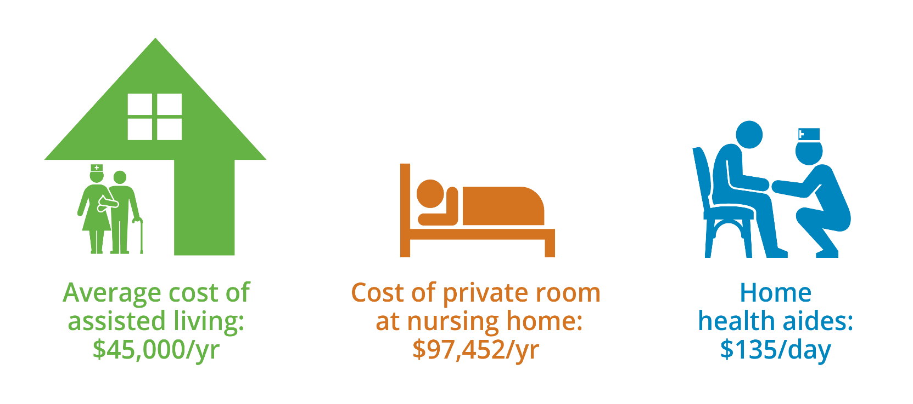
Challenges
…and their money has to last longer
  Help living independently (as of 2015¹)
¹Genworth 2017 Cost of Care Survey, www.genworth.com
Notes:
We just mentioned that women live longer. A 65-year-old woman today can expect to live about 20 more years—and the majority of them will need at least some help living independently. In 2016, the national median cost for assisted living was $43,536 a year, according to Genworth’s 2016 Cost of Care Survey. The annual median cost of a private room in a nursing home was $92,345, and home health aid median hourly rate was $20.
Whether you’re single or married, this means chances are good you’ll live a long time in retirement. It’s crucial that you have a plan for coping with the unexpected.
One more things before we wrap up this section…
[next slide]

Slide 20

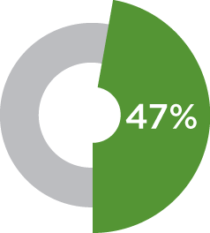
Challenges
Women lack confidence when it
comes to investing
only 47% say they’d be comfortable discussing investing with an advisor independently¹
¹Money Fit Women Study: Executive Summary, fidelity.com, 2015, most recent data available
Notes:
Despite the strides women have made, and that they fully recognize the importance of investing and have a vision for the needs they want to ensure are met, they still lack confidence when it comes to investing.
Why? Geography, generation, source of wealth, and asset level are all factors affecting how women perceive wealth and arrive at decisions about its allocation—so a lack of confidence could be attributed to several factors.
Were you taught about finances growing up?
Research from Bank of America found that as many as two-thirds of women grew up in households where money was not discussed openly. Wells Fargo found that two-thirds of confident women say they were "taught about investing by someone" versus just 39% of those who aren't confident.²
Traditional thinking says it's men who are better at math and analysis, but who's actually better?²
Research also shows that while half of affluent women feel men have more confidence in their investing ability, only a quarter think men are actually more skilled in investing. Confidence and skill are not the same.²
A study by Fidelity Investments found that even when couples interact with a financial advisor, men are still 58% more likely than women to be the primary contact. That may help explain why when male clients pass away, their widows are more likely than not to fire their advisors.³
Compared to men, women remain far more reluctant to talk about their finances⁴
Another study released by Fidelity Investments reports that eight in 10 women have refrained from discussing money with family and friends, partly because the subject is "uncomfortable" or "too personal.” This affects their saving and investing.⁴
“When it comes to financial confidence, women are not slower or less sure of themselves, they just want things done right. They are empowered individuals who manage their decisions according to the exceedingly high standards they set for themselves and others,” the report noted.
You won’t be shocked by the results of what we’ve discussed. [next slide]
²An investment challenge more women need to confront, www.cnbc.com, February 11, 2015, most recent data available
³Why do advisors have such a hard time reaching women?, www.cnbc.com, February 2, 2015, most recent data available
⁴The 'uncomfortable' subject women don't talk about, www.cnbc.com, February 12, 2015, most recent data available
A double-edged sword. It’s been said that women are contemplative, while men are competitive. Because women may not be “competitive” like men when it comes to investing, which can prevent them form taking ego-driven risks, there is a balance that needs to be attained.

Slide 21

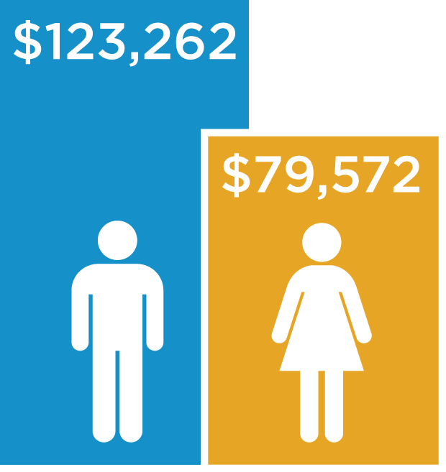
Challenges
Many women are less prepared for retirement than men
Average account balances, 2016¹
¹Women save more than men for retirement: Study, cnbc.com, 2/25/16, most recent data available
Notes:
The unfortunate conclusion is that many women are less prepared for retirement than men.
The odds might seem to be stacked against you. So what do you do?

Slide 22

Strategies
Notes:
Like any big undertaking, it’s best to break it down into steps.
I’ll give you three to important ones get you started.
[Read slide]

Slide 23

Strategies
  Meet with your financial advisor to identify and prioritize your goals
Use the workbook to:
Calculate your net worth
Tally monthly spending
Identify personal goals
Notes:
Step 1: Meet with your financial advisor to identify and prioritize your goals
A study has shown that when women receive financial advice, they’re more apt to implement it. In this particular study, 87% took action. These steps included changing spending habits, increasing monthly savings, establishing a plan for managing debt, and setting up an emergency fund.¹
Getting advice makes a significant difference: 63% of women who have received advice say that they feel confident, compared to 45% of women who haven't.²
This workbook is intended to help you gather and organize your financial information—a crucial first step. Filling out the workbook will give you a snapshot of your current financial situation. It’ll help prepare you before you sit down with your financial advisor to talk about your needs and goals for the future. She or he can help you craft a financial plan to bridge the gap between your goals and reality.
Let’s move on to the second step.
¹More Women Want Financial Advice, But Two-Thirds Don't Know Whom to Trust, the street.com, 11/4/14, most recent data available
²TIAA-CREF Survey: Financial Advice Helps Close the 'Confidence Gap' for Women, www.tiaa-cref.org, October 29, 2014, most recent data available

Slide 24


Strategies
Protect Your Budget
Why Small Expenses Matter
Savings Over
15-Year Period:
Do You:
What if You:
Drink a gourmet coffee every morning?
Have a gym membership you
don’t use?
Head for the closest ATM?
Go out for lunch every day during
the week?
Brewed your own coffee at
home 3 times per week?
Bought a treadmill?
Used your bank’s or a no-fee ATM?
Brown-bagged your lunch?
$33,685
$42,107
$25,264
$105,266
If you invested the money you would’ve
spent on all of these items, you’d have:
$206,322
Coffee example assumes the savings of $4.00 per latte, four times per week ($16.00). Gym example assumes the savings of $20.00 per week. ATM example assumes the savings of $12.00 per week. Lunch example assumes the savings of $50.00 per week. Retirement money example assumes the savings of $98.00 per week on all items. All of the above savings examples use the average annual rate of the S&P 500 Total Return (11.62%) for the past 75 years. Data Source: Morningstar Direct, 2/18.
Past performance is not indicative of future results. For illustrative purposes only. Investors cannot invest directly in an index.
Notes:
Step 2: Protect your budget.
Budgets are personal and subjective, and only you know how to create a budget that satisfies you. Here are a few ways that extra spending can easily be overlooked.
We’ve all heard how little expenses add up quickly, but often we give ourselves a pass on these items, telling ourselves, “It’s only (fill in the blank). While these expenses may seem insignificant, over time, they have a larger impact on our finances than we realize.
So what are some of those big money wasters?
Gourmet coffee: Is buying a coffee to-go part of your morning routine? Spending a few dollars a day on your favorite coffee seem harmless, right? But if you spend $4.00 four times a week, that equals about $64 a month, which then adds up to over $832 a year! Still, there’s no need to start the day groggy or feeling denied. A good portion of that money can be saved by brewing coffee at home. And if you prefer the fancier caffeinated drinks, The Spruce.com published an article that might help: “6 Great Espresso Machines Under $100” (January 3, 2018).
Unused gym memberships: Automatic monthly fees are one of the easiest ways to waste money. If you’ve broken your resolution to work out at the gym, you could be throwing away hundreds of dollars a year. If you’ve been spending $80 a month on a gym membership that isn’t used, that adds up to an $960 a year—more than the price of a treadmill with basic features—that you get to keep. And there won’t be a line of people waiting to use it!
ATM fees: Do you use your bank’s or a no-fee ATM—or just head to the nearest one? Almost everywhere you turn, there's an ATM offering easy access to your cash. Convenient, yes—but fees typically cost about $3 (ATM and overdraft fees hit an all-time high—here’s how much cardholders are paying, cnbc.com, 10/3/17). Ten unnecessary ATM withdrawals a month can up to $30—or almost $360 a year. Obviously you don't want to have to drive too far out of your way to find a no-fee ATM, so be aware of where your bank’s or other free ATMs are located to avoid this.
Not brown-bagging it: Inevitably, a friend will ask you to meet for lunch or you’ll just want to treat yourself to something special. But aiming to bring lunch two to four times per week, depending on what your circumstances are at work, can save you $40 to $80 dollars per week. Aside from being less expensive, “brown-bagging” lunch can also be healthier, giving you control over more nutritious options and serving sizes.
You don’t have to deny yourself the simple pleasures you enjoy, you only need to be conscious of how much you spend on them. Let’s keep going to the third step.

Slide 25
Strategies
Focus on the fundamentals of investing
Avoid investing undue attention in the negative
500
2000
450
400
3
50
1500
CNBC Viewership (in thousands)¹
300
S&P 500 Index²
250
1000
200
150
100
500
3/31/04
3/05
3/06
3/07
3/08
3/09
3/10
3/11
3/12
3/13
3/14
6/30/14
PAST PERFORMANCE DOES NOT GUARANTEE FUTURE RESULTS.
Index descriptions are included on last slide. For Illustrative purposes only. The performance shown is index performance and is not indicative of any mutual fund. Investors cannot invest directly in an index. ¹Data Source: Nielson Media Research/Zero Hedge, June, 2014. CNBC viewership graph uses the most recent data available and is for illustrative purposes to show how CNBC viewership increased during a significant market drop. ²Data Source: Yahoo Finance, 1/16.
Notes:
Step 3: Focus on the fundamentals of investing. What does this really mean?
I’ll give you this example. Evolutionary psychologists and neuroscientists would argue that humans ordinarily seek out news of dramatic, negative events. Despite the fact that ominous headlines can be very upsetting, there appears to be a strong correlation between negative market performance and our curiosity about the news.
When investors are exposed to a steady stream of gloomy news, they’re likely to become concerned about their investments. While that’s certainly understandable, we can’t seem to look away!
Here’s a graph of CNBC viewership versus the S&P 500. Who can tell me when the highest peak viewership was for CNBC? (pause and get responses)
It occurred September 29, 2008. Does anyone remember what happened that day? (pause)
The Dow Jones Industrial Average fell 777 points and the headline read, "Dow has worst day ever."
Who remembers what happened the next day? (pause)
The market was up 485 points. Who remembers reading the headline, "Dow has their best day ever?“ Nobody—because it didn't happen. Or if it did, it was buried in the back section of the newspaper. Why? Because “when it bleeds, it leads” is a popular slogan in media.
In fact as the S&P recovered (that’s the blue line), many of us started tuning out CNBC (the red line) or we tuned in to something else.
This graph shows us that we need to be mindful of our tendency to invest an inordinate amount of attention on negative news when the market drops, which can cause us miss certain investment opportunities.
Now, I’ll give you another reason to maintain that focus. [next slide]

Slide 26
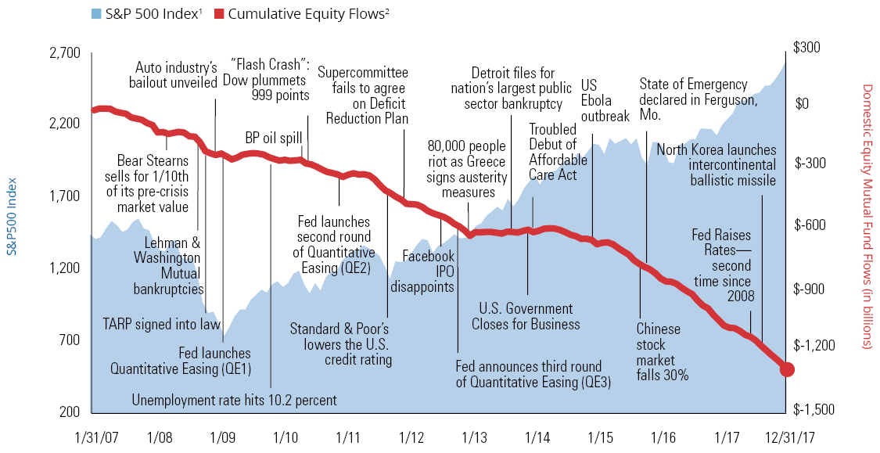
Strategies
Focus on the fundamentals of investing
If it’s not clear, that doesn’t mean it’s bad
PAST PERFORMANCE DOES NOT GUARANTEE FUTURE RESULTS.
Index descriptions are included on last slide. For Illustrative purposes only. The performance shown is index performance and is not indicative of any Hartford mutual fund. Investors cannot invest directly in an index. ¹Data Source: Yahoo Finance, 1/17 ²Data Source: Investment Company Institute, 1/17
Notes:
How many of are familiar with feeling anxious at one time or another? (pause)
The MIT AgeLab tells us that if we’re in an anxious or worried state, we believe that if information isn’t clear, it must be bad.
The blue mountain chart is the S&P 500 Index from 2007 to the end of 2017. We plotted select headlines: the Lehman Brothers or Washington Mutual Bankruptcy, when TARP was signed, the unemployment rate was at 10.2 percent, the “flash crash,” and so on.
What did American investors do at those times? How did we react?
That red line that you see represents what we were doing with our money that was in the stock market. We were pulling it out, pulling it out, pulling it out, pulling it out. And by the way, what's the market doing during that time? Recovering, recovering, recovering. The result? Many investors high returns over the last seven years due to headline-induced fears.
Even though women are generally the more rational investors, and are more likely to ride out the storms, it’s difficult for anyone to persevere when we see this think our investments are in danger. Your financial advisor can provide clarity and discuss the best way to respond.
Having said all of this, I realize that each of you might be at different stage of your life.
[next slide]

Slide 27

Strategies
If you’re approaching or already
in retirement
Simplify multiple IRA accounts by consolidating
Take Required Minimum Distributions to avoid IRS penalties
Get the most out of Social
Security by knowing your options
Control how beneficiaries
receive distributions
There might be additional fees involved in consolidating your IRA accounts.
Notes:
Depending where you are in this journey, you can also discuss the topics listed on the slide with your financial advisor to simplify account management, avoid costly penalties, maximize returns, and control how your assets are distributed to your beneficiaries.
IRA Consolidation
Over the years, you may have accumulated multiple IRAs from previous employers. Your advisor can talk to you about the benefits of consolidation which could also streamline the number of accounts you might be managing.
RMDs
When you reach age 70½ you’re at risk of paying tax penalties if you don’t take required minimum distributions from your IRAs, which are indicated by IRS Form 5498.
Social Security
Knowing the three main factors that can negatively impact Social Security benefits—timing, work, and taxes—can help you avoid being caught by surprise, when it’s too late to make changes. Again, talking to your advisor about the options and implications for taking Social Security benefits can help you make the most of them.
Beneficiary Designations
If you’re not entirely comfortable with your beneficiaries ability to make decisions about what to do with their inheritance, having a strategy for transferring assets to them can give you peace of mind. And don’t forget to make sure your beneficiary designations are up-to-date.
We covered quite a bit of information today, so let’s re-cap briefly.

Slide 28

Investing Your Way
Reasons for Optimism
Advantages women have
Challenges
Specific factors to recognize
Strategies
Take control of your future
Notes:
The Reasons for Optimism women have when it comes to investing
The Challenges that are specific to women
And Strategies for meeting those challenges with the resources that you have today
So what does all of this boil down to?
[next slide]

Slide 29

Main Idea
Use your strengths to proactively
take control of your future
Notes:
[Read slide]
Despite the unsettling statistics we covered earlier, we know that, today, women are much better off—and more financially independent—than they’ve ever been. The progress that’s been made in the last few decades, coupled with the innate skills you possess, you are positioned to build your financial future.
Here’s a plan of action.

Slide 30
Next Steps
Next steps:
1
2
3
Complete pages
7-8 of the workbook
Make an appointment with your advisor
Collaborate to create or refine your future strategy
Notes:
[read slide]
I hope our time together has helped you see the value of partnering with a financial advisor like (Financial Professional’s name), who can collaborate with you to create a sound strategy based on your personal circumstances and financial goals.
Thank you for your time.

Slide 31
Index Descriptions:
Indices are unmanaged, and unavailable for direct investment and do not represent the performance of any Hartford Funds.
Dow Jones Industrial Average is price-weighted average of 30 significant stocks traded on the New York Stock Exchange and the Nasdaq.
S&P 500 Index is an unmanaged list of 500 widely held U.S. common stocks frequently used as a measure of U.S. stock market performance.
Bloomberg Barclays U.S. Aggregate Bond Index is comprised of government securities, mortgage-backed securities, asset-backed securities, and corporate securities to simulate the universe of bonds in the market.
Bloomberg Barclays Long-Term U.S. Treasury Total Return Index includes all publicly issued, U.S. Treasury securities that have a remaining maturity of 10 or more years, are rated investment grade, and have $250 million or more of outstanding face value.
All investments are subject to risk including the loss principal.
All information provided is for informational and educational purposes only and is not intended to provide investment, tax, accounting or legal advice. As with all matters of an investment, tax, or legal nature, you and your clients should consult with a qualified tax or legal professional regarding your or your client’s specific legal or tax situation, as applicable.
This presentation is a general communication intended solely for informational and educational purposes. Nothing in this presentation is intended to be a recommendation or advice.
Hartford Funds Distributors, LLC.
All information and representations herein are as of 12/17 unless otherwise noted.
SEM_WI _0318 205947

