Slide 1
MEDICARE – FILLING THE GAP
NOT A DEPOSIT • NOT FDIC INSURED • MAY LOSE VALUE • NOT BANK GUARANTEED • NOT INSURED BY ANY FEDERAL GOVERNMENT AGENCY
GE-129877(7/19) (EXP 1/21)

Slide 2


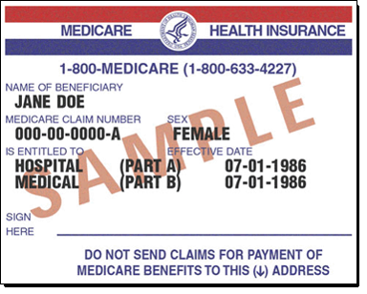

Agenda
Healthcare Costs in Retirement
Medicare Basics
Medicare – What is Covered
Part A (Hospital Insurance)
Part B (Medical Insurance
Part C (Medicare Advantage Plans)
Part D (Medicare Prescription Drug Coverage)
Medicare – Filling the Gap
2
GE-129877(7/19) (EXP 1/21)
Notes:
Today we will discuss (read bullets)
Medicare is a federal program attached to Social Security. It is available to all U.S. citizens 65 years of age or older and it also covers people with certain disabilities. It is available regardless of income. The four-part program includes:
Part A: Hospitalization coverage
Part B: Medical insurance
Part C: Privately purchased supplemental insurance that provides additional services and through which all Medicare services offered by Part A and Part B can be accessed
Part D: Prescription drug coverage

Slide 3


Retirement Healthcare Cost Crisis
On average 10,000 people a day will turn 65 in 2020 and continuing until 2030
In 2016, 15% of the US population was 65 or older
Health care planning in Retirement is a huge and largely unmet market
53% of pre-retirees said it’s important to discuss health care costs with their advisor, 10% have spoken with an advisor
Only 27% of workers have estimated the costs of healthcare in retirement
Source: BLS, US Census, EBRI 2016 Retirement Confidence Survey, Nationwide Healthcare Costs in Retirement Survey
3
GE-129877(7/19) (EXP 1/21)
Notes:
Read slide

Slide 4

Retirement Healthcare Costs Vary
Fidelity Benefits Consulting 2020 Study
Healthview Services 2020 Retirement Health Care Costs Data Report
$285,000
needed for a 65 year old couple retiring this year
$387,644
per 65 year old couple
4
GE-129877(7/19) (EXP 1/21)
Notes:
According to 2 recent surveys conducted by Fidelity and Healthview Services, between $285,000 & over $387,644 in today’s dollars is required for a 65 year old couple to cover their Out of Pocket healthcare expenses in retirement. This is not including the costs covered by Medicare and any Medigap or supplemental insurance. This leads to the conclusion that individual choices related to health and savings are among the key issues that need to be discussed when planning to address future retirement health care costs. The course of this presentation will help us help our clients make those educated decisions.

Slide 5
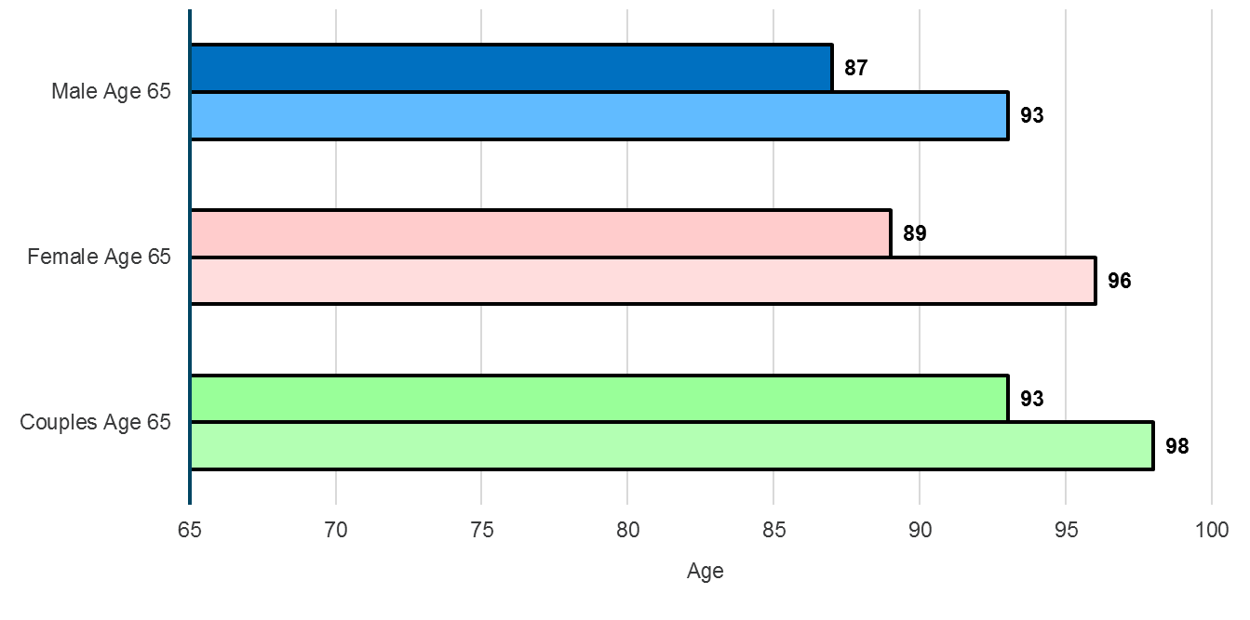
Life Expectancy Today
Life Expectancy Upon Retirement at Age 65
50% chance of living to
25% chance of living to
50% chance of living to
25% chance of living to
at least 1 person has a 50% chance of living to
at least 1 person has a 25% chance of living to
There’s almost a 1-3 chance that at least one member of a 65 year old couple will live to at least age 95
Source: Society of Actuaries’ Annuity RP-2014 Total Healthy Annuitant rates, Scale MP-2014. Figures assume you are in good health.
5
GE-129877(7/19) (EXP 1/21)
Notes:
We know that you’re familiar by now with the statistics around the probability of a married couple having at least 1 person living to age 93 or 98. So we know you appreciate the real risk around longevity. Women have the additional burden of a longer life expectancy. On average, women outlive their husbands by approximately 4 years (assuming a 2 year age difference, husband being 2 years older than the wife). That said, there are an additional 4 years of retirement costs women must budget for due to longevity.

Slide 6
Health Care Costs Versus Inflation
6.0%
2.7%
Expected Inflation Rate
for all goods in 2020
Expected Inflation rate
for Health Care in 2020
Source: https://www.statista.com/statistics/244983/projected-inflation-rate-in-the-united-states/
http://www.aon.com/getmedia/0c375f10-3b16-4d2d-a452-4ae86968525b/2019-Global-Medical-Trend-Report.pdf.aspx
6
GE-129877(7/19) (EXP 1/21)
Notes:
(Read Slide)

Slide 7
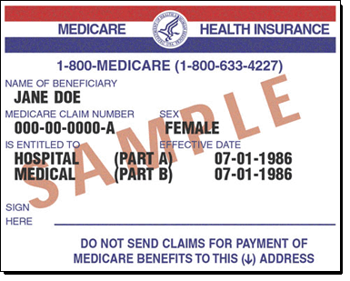
Medicare Basics
What is Medicare?
DEFINITION: Federal health insurance program designed to help US citizens age 65 and over pay for BASIC medical care in retirement
Remember…
Medicare DOES NOT cover all medical costs, in fact, it covers just slightly more than half of medical costs in retirement
7
GE-129877(7/19) (EXP 1/21)
Notes:
(Read Slide)

Slide 8
Medicare Part A – Hospital Coverage
☑
WHAT’S COVERED
WHAT’S NOT COVERED
Inpatient Care in Hospitals
Inpatient Care in a Skilled Nursing Facility
Hospice Care
Home Health Care Services
Inpatient care in a Religious non-medical Health Care Institution
Long Term Care
Outpatient Hospital Care
Doctors office visits
8
GE-129877(7/19) (EXP 1/21)
Notes:
Medicare part A covers a number of services ( read bullets)
Continue with bullets
Part A covers items like:
Hospital meals
X-Rays
Laboratory testing
Blood transfusions
Coronary and Intensive Care
Regular Nursing Services

Slide 9
Medicare Part A – Who’s Covered
Fully Covered
Partially Covered
Age 65
  Or Disabled and receiving Social Security Disability
40 Quarters of Coverage
FICA
No Premium (99% of participants)
Less than 40 quarters of coverage
65 or Older
Younger than age 65, disabled, and Premium-Free Part A coverage ended because you returned to work
Can cost up to $437 each month if you do not qualify for Premium-Free Part A
9
GE-129877(7/19) (EXP 1/21)
Notes:
Costs can vary. Copayments, coinsurance, and deductibles may apply for each service. If you join a Medicare Advantage Plan (like an HMO or PPO) or have other insurance (like a Medigap policy, or employer or union coverage), your costs may be different. Have your client contact the plans their’re interested in to find out about the costs, or visit www.medicare.gov/find‑a‑plan.
We do not have the time to discuss the costs of the different programs. They usually don’t pay a monthly premium for Part A coverage if they or their spouse paid Medicare taxes while working. But Medicare doe s suggest signing up 3 months before any person turns 65 years old.
If they aren’t eligible for premium-free Part A, they may be able to buy Part A if they meet one of the following conditions:
Their 65 or older, and they’re entitled to (or enrolling in) Part B ■■and meet the citizenship and residency requirements.
They’re under 65, disabled, and their premium-free Part A ■■coverage ended because they returned to work. (If they’re under 65 and disabled, they can continue to get premium-free Part A for up to 8.5 years after they return to work.)
Note: The max 2020 premium amount for people who buy Part A is $458.
In most cases, if they choose to buy Part A, they must also have Part B and pay monthly premiums for both. If they have limited income and resources, their state may help they pay for Part A and/or Part B. See page 90. Call Social Security at 1-800-772-1213 for more information about the Part A premium. TTY users should call 1-800-325-0778.
Part A Late Enrollment Penalty
If they aren’t eligible for premium-free Part A, and they don’t buy it when they’re first eligible, their monthly premium may go up 10%. They will have to pay the higher premium for twice the number of years they could have had Part A, but didn’t sign-up. For example, if they were eligible for Part A for 2 years but didn’t sign-up, they will have to pay the higher premium for 4 years. Usually, they don’t have to pay a penalty if they meet certain conditions that allow they to sign up for Part A during a Special Enrollment Period

Slide 10
Medicare Part A – Inpatient Hospital Costs
In Hospital Stay – 2020
Days 1-60
Days 61-90
Days 91-150 (Lifetime Reserve Day, 60 max)
Days 150+
$1,408 Deductible, $0 coinsurance per benefit period
$352 coinsurance
per day
$704 coinsurance
per day
All Costs
Per benefit period
10
GE-129877(7/19) (EXP 1/21)
Notes:
Benefit period
The way that Original Medicare measures your use of hospital and skilled nursing facility (SNF) services. A benefit period begins the day you're admitted as an inpatient in a hospital or SNF. The benefit period ends when you haven't gotten any inpatient hospital care (or skilled care in a SNF) for 60 days in a row. If you go into a hospital or a SNF after one benefit period has ended, a new benefit period begins. You must pay the inpatient hospital deductible for each benefit period. There's no limit to the number of benefit periods.
Lifetime reserve days
In Original Medicare, these are additional days that Medicare will pay for when you're in a hospital for more than 90 days. You have a total of 60 reserve days that can be used during your lifetime. For each lifetime reserve day, Medicare pays all covered costs except for a daily coinsurance.

Slide 11
Medicare Part B – Medical Coverage
☑
WHAT’S COVERED
WHAT’S NOT COVERED
Doctor’s visits
Out-patient hospital care
Physician and occupational therapy
Some home-health costs
Long Term Care/Custodial Care
Most dental care
Eye examinations related to prescribing glasses
Dentures
Cosmetic surgery
Acupuncture
Hearing aids and exams for fitting them
Routine foot care
Get coverage information at www.Medicare.gov/coverage
11
GE-129877(7/19) (EXP 1/21)
Notes:
Medicare part B covers a number of services (read bullets)

Slide 12
Medicare Part B – Standard Premiums/Coverage
Premiums Based on 2018 Income
MAGI Single | MAGI Married Filing Joint | MAGI Married Filing Separate | Part B Premiums
$87,000 or less | $174,000 or less | $87,000 or less | $144.60
$87,001 - $109,000 | $174,001 - $218,000 | Not applicable | $202.40
$109,001 - $136,000 | $218,001 - $272,000 | Not applicable | $289.20
$136,001 - $163,000 | $272,001 - $326 ,000 | Not applicable | $376.00
$163,001 - $500,000 | $326 ,001 - $750,000 | $87,001 - $413,000 | $462.70
$500,001 and above | $750,001 and above | Above $415,000 | $491.60
Covers only 80% of covered costs after deductible
Premiums increase annually
Monthly premiums designed to cover 25% of program cost
*Most people who receive Social Security benefits will pay the standard Part B Premium of $135.50 per month. For those whose 2017 Modified Adjusted Gross Income was above $85,000 for single filers and $170,000 for married filers, an Income Related Monthly Adjustment Amount surcharge is added to the premium.
Source: CMS.gov
12
GE-129877(7/19) (EXP 1/21)
Notes:
(Read Slide)

Slide 13

Medicare Part B – Hold Harmless Provision
The hold harmless provision protects approximately 70% of participants
The hold harmless provision does NOT protect you if:
You are new to Medicare
You are subject to IRMAA
You are currently enrolled in a Medicare Savings Program (MSP), or were previously enrolled in an MSP but no loner qualify due to an increase in income or failed to recertify
13
GE-129877(7/19) (EXP 1/21)
Notes:
COLA is additional income given to Social Security recipients to protect against inflation decreasing the benefit’s purchasing power.
The hold harmless provision protects recipients so long as:
You were entitled to Social Security benefits for November and December of the previous year (2018);
The Medicare Part B premium will be or was deducted from your Social Security benefits in November 2017 through January 2019;
You don’t already pay higher Part B premiums because of Income-Related Monthly Adjustment Amount (IRMAA)
You do not receive a Cost of Living Adjustment (COLA) large enough to cover the increased premium.
The hold harmless provision does NOT protect you if:
You are new to Medicare. You are subject to IRMAA.
You are enrolled in a Medicare Savings Program (MSP). However, the MSP should continue paying for your full Part B premium.
You were enrolled in a Medicare Savings Program in 2018 but lost the program because your income increased or you failed to recertify.

Slide 14
Medicare Part B – When to Enroll
7-Month Initial Enrollment Period
No Delay |  |  |  | Delayed Start
Parts A & B | 3 months prior | 2 months prior | 1 month prior | The month you turn 65 | 1 month after | 2 months after | 3 months after
If you receive Social Security benefits, you will automatically be enrolled in Part B the 1st day of the month you turn age 65
Special Enrollment Period: If over age 65 and still working - can enroll up to 8 months after employment ends
Late enrollment penalty may apply
14
GE-129877(7/19) (EXP 1/21)
Notes:
The initial enrollment period, for people who aren't covered by a group plan at 65, starts three months before you turn 65 and lasts until three months after you turn 65. But although it lasts a total of seven months, you really should plan to enroll in Medicare during that three-month period before you turn 65. Then your Medicare coverage will start on the first day of the month you turn 65.
Also, for those who have already begun to receive Social Security Retirement Benefits prior to age 65, Medicare enrollment will automatically commence at 65.
If you have already begun collecting Social Security benefits Medicare automatically begins the first day of the month you turn 65. If you haven’t begun taking Social Security but you want to enroll in Medicare you should enroll 3 month before, the month you turn, or the three months after you turn age 65. If you wait until the last four months of your Initial Enrollment Period to sign up for Part B, your start date for coverage will be delayed. For example, Mr. Green’s 65th birthday is July 20, 2019. If he enrolls in April, May, or June, his coverage will start on July 1, 2019. However if Mr. Green enrolls in July his coverage will begin Aug. 1st, if he enrolls in Aug. his coverage will start Oct. 1st, if he enrolls in Sept. his coverage will begin Dec. 1st and if he waits until Sept to enroll his coverage won’t begin until Jan. 1st of the following year. If a client enrolls during General Enrollment benefits begin July 1st. In regard to the Special Enrollment Period, if you have COBRA coverage or a retiree health plan, you don’t have coverage based on current employment. You’re not eligible for a special enrollment period when that coverage ends. If you don’t sign up for Part B when you’re first eligible, you may have to pay a late enrollment penalty for as long as you have Medicare. Your monthly premium for Part B may go up 10% for each full 12-month period that you could have had Part B, but didn’t sign up for it.
If under age 65 and disabled, you will be enrolled in Part B after receiving benefits for 24 months

Slide 15
Medicare Part C – Advantage Plans
Medicare Part A Hospital Insurance
Medicare Part B Medical Insurance
Medicare Part C Medicare Advantage Plans
Medicare Advantage Plans may offer extra coverage such as:
  prescription drug coverage (Part D)
  vision
  hearing
  dental
  health and wellness programs
Most plans have a monthly premium in addition to Part B premium
15
GE-129877(7/19) (EXP 1/21)
Notes:
Medicare Part C is often referred to as Medicare Advantage Plans.
Health insurance plans offered by private companies approved by Federal Government but NOT regulated under Medicare
Will provide all of the Part A and Part B services
Does not cover Hospice Care
May offer extra coverage, such as vision, hearing, dental, and/or health and wellness programs at additional cost
Most plans:
Include Medicare prescription drug coverage
Will have a monthly premium in addition to Part B premium
Perhaps one of the most important thing to remember is if you join a Medicare Advantage Plan, you don’t need a Medigap policy. If you already have a Medigap policy, you can’t use it to pay for out-of-pocket costs you have in the Medicare Advantage Plan. If you already have a Medicare Advantage Plan, you can’t be sold a Medigap policy.

Slide 16
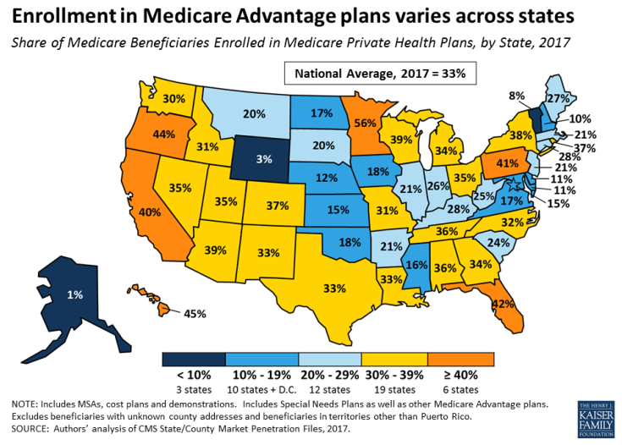
Medicare Part C – National Enrollment
16
GE-129877(7/19) (EXP 1/21)
Notes:
The national average of enrollment is growing rapidly and currently sits at 33% of enrollees nationwide. The chart on the screen from the Kaiser Family foundation shows state by state statistics as well as the national average in 2017.

Slide 17
Medicare Part C – Private Insurance Options
Medicare pays fixed amount for care to the companies offering private insurance options (Medicare Advantage Plans)
Companies must follow rules set forth by Medicare but they can charge different out-of-pocket costs and can have different rules for how services are provided
HMO
PPO
PFFS
MSA
SNP
Health Maintenance Organization
Preferred Provider Organization
Private Fee-For-Service
Medical Savings Account
Special Needs Plan
17
GE-129877(7/19) (EXP 1/21)
Notes:
(Read Slide)

Slide 18

Medicare Part D – Prescription Drug Coverage
Prescription Drug Coverage is provided in Medicare Drug Plans or Medicare Advantage Plans
Must have Medicare Part A and/or B to get Prescription Drug coverage
Prescription Drug Costs:
  Monthly Premiums
  Yearly Deductible
  Copayments or Coinsurance
  Coverage Gap
      Program only provides reduced costs on some prescription drugs
      Does not cover full cost
18
GE-129877(7/19) (EXP 1/21)
Notes:
Medicare Part D is the Prescription Drug Plan. Read slide –
Also if annual income is below certain amounts clients may qualify for a low-income subsidy for prescription drug costs.

Slide 19
Medicare Part D – Premiums
According to the National Council on Aging, the average national monthly premium for Medicare Part D is $34
If your filing status and yearly income in 2018 was
File individual tax return | File joint tax return | File married & separate tax return | You pay each month (in 2019)
$87,000 or less | $174,000 or less | $87,000 or less | your plan premium
$87,001 - $109,000 | $174,001 - $218,000 | Not applicable | $12.200 + your plan premium
$109,001 - $136,000 | $218,001 - $272,000 | Not applicable | $31.50 + your plan premium
$136,001 - $163,000 | $272,001 - $326 ,000 | Not applicable | $50.70 + your plan premium
$163,001 - $500,000 | $326 ,001 - $750,000 | $87,001 - $413,000 | $70.00 + your plan premium
$500,001 and above | $750,001 and above | Above $415,000 | $76.40 + your plan premium
19
GE-129877(7/19) (EXP 1/21)
Notes:
Much like Part B premiums, Part D premiums are means tested. They are set first at the carrier level. Each independent Part D insurance plan carries a different base premium. In addition, as income levels rise, a higher monthly premium is due.
According to the National Council on Aging, the average national monthly premium for Medicare Part D is $34

Slide 20
Medicare Part D – Coverage Gap – aka Doughnut Hole
Deductible
Beneficiary pays an annual deductible, maximum of $435.00
Copayment/Coinsurance
Copayments or Coinsurance payments along with plan payments up to a maximum of $4,020.00 out of pocket, deductible included
Donut Hole
Catastrophic Coverage
Coverage resumes with a copayment or coinsurance for the remainder of the plan year
Coverage Gap, no coverage provided until out of pocket expenditures total $6,350.00
20
GE-129877(7/19) (EXP 1/21)
Notes:
Now that we’ve covered the basics of what Medicare covers and what it doesn’t we should look at potential gaps in coverage. Sometimes you hear it referred to as “the donut hole”. In this example the client has Medicare Part A, B, and D. Even though Medicare picks up a significant portion of the expense there a hole of up to a true cost of $5,100. The question becomes how does a client fill that gap or hole in retirement?

Slide 21
Medicare Part D – Coverage Gap – aka Doughnut Hole
Ms. Smith joins the ABC Prescription Drug Plan. Her coverage begins on January 1, 2020. She doesn’t get extra help and uses her Medicare drug plan membership card when she buys prescriptions.
1.
2.
3.
4.
Yearly Deductible | Copayment or Coinsurance (What you pay at the pharmacy) | Coverage Gap (Doughnut Hole) | Catastrophic Coverage
Ms. Smith pays the first $435 of her drug costs before her plan starts to pay its share. | Ms. Smith pays a copayment, and her plan pays its share for each covered drug until their combined amount (plus deductible) reaches $4,020 | Once Ms. Smith and her plan have spent $4,020 for covered drugs she is in the coverage gap. | Once Ms. Smith has spent $6,350 out-of-pocket for the year, her coverage gap ends. She now only pays a small co-payment until end of year
21
GE-129877(7/19) (EXP 1/21)
Notes:
Let’s take a look at an example of how the doughnut hole works. Read Slide

Slide 22
Medicare Supplemental Insurance - Medigap
Sold by private insurance companies to help pay some of the health care costs not covered by Medicare
Cannot be used with Medicare Advantage Plan (Medicare Part C)
Standardized policies are identified by letters in most states:
Plans A-N
Medigap policies only cover one person.
Best time to buy a policy is the 7-month period in which you are age 65 or older and enrolled in Part B
22
GE-129877(7/19) (EXP 1/21)
Notes:
Sometimes that gap or donut hole will be filled with Medigap insurance. Read slide. Must be clearly identified as “Medicare Supplement Insurance”. Must follow federal and state laws.
A married couple would need policies on each spouse

Slide 23
Standard Benefits to Medigap Policies
Benefits | A | B | C | D | F* | G | K | L | M | N
Medicare Part A coinsurance and hospital costs (up to an additional 365 days after Medicare benefits are used) | 100% | 100% | 100% | 100% | 100% | 100% | 100% | 100% | 100% | 100%
Medicare Part B coinsurance or copayment | 100% | 100% | 100% | 100% | 100% | 100% | 50% | 75% | 100% | $20-$50 ***
Blood (first 3 pints) | 100% | 100% | 100% | 100% | 100% | 100% | 50% | 75% | 100% | 100%
Part A hospice care coinsurance or copayment | 100% | 100% | 100% | 100% | 100% | 100% | 50% | 75% | 100% | 100%
Skilled nursing facility care coinsurance |  |  | 100% | 100% | 100% | 100% | 50% | 75% | 100% | 100%
Medicare Part A deductible |  | 100% | 100% | 100% | 100% | 100% | 50% | 75% | 50% | 100%
Medicare Part B deductible |  |  | 100% |  | 100%
Medicare Part B excess charges |  |  |  |  | 100% | 100%
Foreign travel emergency (up to plan limits) |  |  | 100% | 100% | 100% | 100% |  |  | 100% | 100%
 |  |  |  |  |  |  | Out-of-pocket limit in 2020
 |  |  |  |  |  |  | $5,880 | $2,940
* Plan F also offers a high-deductible plan. If you choose this option, this means you must pay for Medicare-covered costs up to the deductible amount of $2,300 before your Medigap plan pays anything.
23
GE-129877(7/19) (EXP 1/21)

Slide 24
Your Medicare Coverage Choices at a Glance
Step 1: Decide how you want to get your coverage
Original Medicare
Medicare Advantage Plan
(like an HMO or PPO)
Part A
Hospital Insurance
Part B
Medical Insurance
Combines Part A, Part B and usually Part D
Step 2: Decide if you need to add drug coverage
Part D: Prescription Drug Coverage
Part D:Prescription Drug Coverage (if not included)
Step 3: Decide if you need to add
Supplemental coverage
If you join a Medicare Advantage Plan,
You don’t need and can’t be sold a
Medigap policy.
Medigap: (Medicare supplement
Insurance Policy)
24
GE-129877(7/19) (EXP 1/21)
Notes:
There are two main ways to get your Medicare coverage: Original Medicare or a Medicare Advantage Plan. Use these steps to help you decide which way to get your coverage.

Slide 25
The total costs not covered by Medicare
Annual Costs Per Person at Age 65 (as estimated by HealthView)
Hearing & Vision copays & premiums, and hearing aids
$835
Dental copays and premiums
$527
Prescription copays and premiums
$1,327
$5,941
Doctor’s visits/tests copays, Part B premiums
$1,639
Hospital copays and Medigap premiums
$1,613
Assumes Medicare Parts A, B and D, as well as Medigap Plan F premium. Includes vision, dental and hearing. Moderate health costs reflect insurance cost data associated with these self-reported health classifications. Health insurance cost estimates provided by HealthView based on historical data and actuarial projections as of 2016.
25
GE-129877(7/19) (EXP 1/21)
Notes:
Objective of slide:
To educate the audience about the kinds of out of pocket expense that remain, even when an individual is covered by Medicare as well as an average out of pocket cost, to help quantify the gap.
When covering this slide, be sure to:
Remind the audience that Medicare does cover a substantial amount of annual healthcare costs; however, the associated out-of-pocket expenses including monthly premiums for certain program components, deductibles and copayments can quickly mount.
Review all the types of costs they may face when covered by Medicare, as listed on the slide then reveal the average dollar cost associated with each
Tell the audience that Medicare does not cover vision, dental and hearing expenses. There are some Medicare Advantage plans that cover these expenses. As well as “Medigap” supplemental insurance that may alleviate many of these expenses.

Slide 26



Funding Health Care Costs in Retirement
TYPICAL OPTIONS
  Employer-based health insurance coverage
  Personal Savings/Sinking Fund
  Guaranteed Income Benefit Annuities
26
GE-129877(7/19) (EXP 1/21)
Notes:
Here are the typical options.
Read slide.
Unfortunately they are not all equal. We’ll look at the challenges of funding healthcare costs in retirement with some of these options, then look to explore a better option.

Slide 27
Employer Based Health Insurance & Personal Savings
Only 18% of businesses with 200 or more workers offered retiree health benefits to early retirees
Employer may always change or eliminate coverage offered
The personal savings rate as a percentage of disposable income is typically low
  Generally hovers between 1-3%
Source: “Kaiser Family Foundation 2018. https://www.kff.org/report-section/2018-employer-health-benefits-survey-section-11-retiree-health-benefits/
27
GE-129877(7/19) (EXP 1/21)
Notes:
In the past it was common for large employer to pay all of their healthcare costs in retirement. Let’s look at come current statistics. Second bullet point – these numbers are down from 46% and 40% in 1993.
If you are looking at these numbers and statistics chances are you begin feeling a little nervous. What about a some of the other options…

Slide 28


Planning for Health Care Costs in Retirement
RETIREMENT INCOME PLANNING INCLUDES
  Applying for Medicare benefits
  Funding the “hidden” health care costs of approximately $6,000/yr.
  Account for inflation in health care costs
28
GE-129877(7/19) (EXP 1/21)
Notes:
We all know that retirement planning goes beyond assets management and distribution planning. It does include helping clients manage healthcare costs and understanding their Medicare options. Read slide.

Slide 29
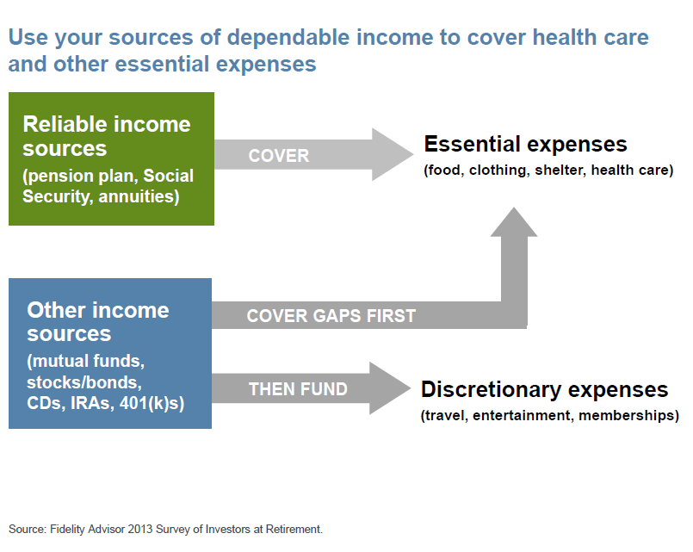
Health Care is an Essential Expense
Budgeting for Healthcare Expenses
29
GE-129877(7/19) (EXP 1/21)

Slide 30



Creating Guaranteed Retirement Income
One of the biggest questions to answer when creating a retirement income plan is determining how much risk may need to shift to a guaranteed source of income
There are tools that can help you answer that question
Equitable’s Retirement Income Worksheet can help to visualize a plan
30
GE-129877(7/19) (EXP 1/21)
Notes:
Planning for Retirement Healthcare involves understanding and filing for Medicare appropriately. In addition, it also is important to consider how to transition personal savings and retirement assets into retirement income streams that will help pay for the costs associated with retirement healthcare.

Slide 31
Equitable’s Retirement Income Worksheet
Step 1
Determine whether or not guaranteed sources of income will provide enough money to cover non-discretionary spending needs during retirement
Step 2
Take the amount of personal savings left over after covering the non-discretionary spending needs and divide it by life expectancy
Step 3
The result is how much you can spend each year on discretionary items
31
GE-129877(7/19) (EXP 1/21)
Notes:
The worksheet uses a two step process.
STEP 1 allows you to determine whether or not guaranteed sources of income will provide enough money to cover non-discretionary spending needs during retirement. If the non-discretionary expenses exceed the guaranteed income, there will be a need for additional funds. The amount of additional money needed is your client’s annual income gap. You can then look to personal savings to fill this gap by purchasing a long-term financial product that will provide cash flow for life. Additionally, since inflation means the need for more money in upcoming years, an inflation multiplier is provided, assuming a 3% rate of inflation.
STEP 2 takes the amount of personal savings left over after covering the non-discretionary spending needs and divides it by life expectancy. The result is how much you can spend each year on discretionary items.

Slide 32

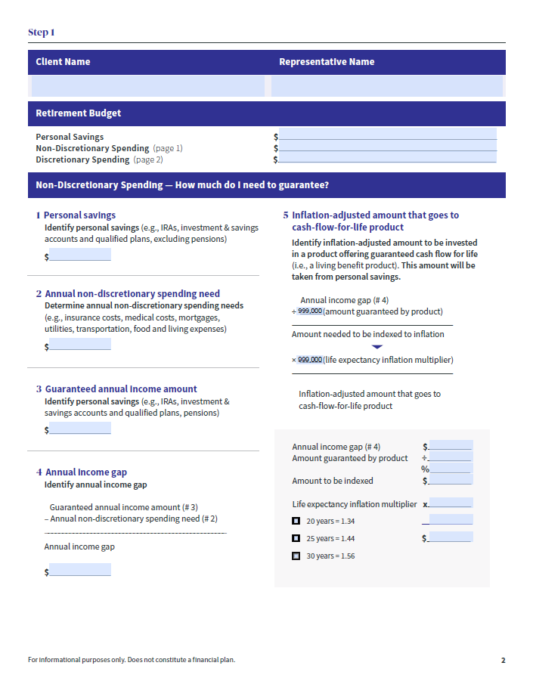

Retirement Income Worksheet
32
GE-129877(7/19) (EXP 1/21)
Notes:
Pages 2 & 3 are where the real work is done.
The process is broken down into two steps.
Step 1 addresses how much of your client’s retirement savings should be allocated to cover non-discretionary expenses. These are defined simply as those things they cannot live without (e.g., housing, food, clothing, and medical expenses).
Step 2 examines how much additional spending can be done after the basic necessities have been covered in Step 1. It also provides a framework of how you can allocate personal savings to avoid many of the risks your clients will face in retirement.
The left-hand shaded region of each step gives you the description of what you need to do.
The far right is where you put in the numbers and do the math.

Slide 33
Income Summary
Proper retirement planning requires a comprehensive approach
Define Goals and Objectives
Understanding how risks impact a distribution portfolio is crucial to lifelong income
Help to manage risk by using guaranteed income strategies
33
GE-129877(7/19) (EXP 1/21)
Notes:
(Read Slide)

Slide 34

Recap
Healthcare Costs in Retirement
Medicare Basics
Medicare – What is Covered
    Part A (Hospital Insurance)
    Part B (Medical Insurance)
    Part C (Medicare Advantage Plans)
    Part D (Medicare Prescription Drug Coverage)
Medicare- Filling the Gap
2020
34
GE-129877(7/19) (EXP 1/21)
Notes:
Today we discussed (read bullets)
Medicare is a federal program attached to Social Security. It is available to all U.S. citizens 65 years of age or older and it also covers people with certain disabilities. It is available regardless of income. The four-part program includes:
Part A: Hospitalization coverage
Part B: Medical insurance
Part C: Privately purchased supplemental insurance that provides additional services and through which all Medicare services offered by Part A and Part B can be accessed
Part D: Prescription drug coverage

Slide 35
What is a Variable Annuity?
A variable annuity is a tax-deferred financial product designed to allow the contract owner in growth potential and provide income for retirement or other long-term life goals. In essence, an annuity at a later date. Variable annuities are subject to market risk including loss of principal a contractual agreement in which payment(s) are made to an insurance company, which agrees to pay out income or a lump sum amount. Earnings are taxable as ordinary income when distributed and may be subject to an additional 10% federal tax if withdrawn before age 59½.
There are certain limitations and restrictions associated with variable annuities. For costs and complete details of coverage, speak to your financial professional/insurance licensed registered representative.
Variable annuities are issued by AXA Equitable Life Insurance Company (AXA Equitable), NY, NY and co-distributed by affiliates AXA Advisors, LLC (member FINRA, SIPC) and AXA Distributors, LLC.
This Medicare presentation is based on our general understanding of the subject matter and is for informational purposes only. It should not be considered tax or legal advice. Accordingly, any tax information provided in this presentation is not intended or written to be used, and cannot be used, by any taxpayer for the purpose of avoiding penalties that may be imposed on the taxpayer. The tax information was written to support the promotion or marketing of the transaction(s) or matter(s) addressed and you should seek advice based on your particular circumstances from your own tax and legal advisors.
The slide discussing the variable annuities issued by Equitable, and the additional information provided below, does not cover all material provisions of these annuity contracts. Variable annuities are sold by prospectus. The prospectus contains more complete information about these contracts, including risks, charges, expenses, investment objectives, limitations and restrictions. Investors should carefully read the prospectus. Contact your Financial Professional for a copy of the current prospectus.
“Equitable” is the brand name of AXA Equitable Financial Services, LLC and its family of companies, including AXA Equitable Life Insurance Company (NY, NY), AXA Advisors, LLC and AXA Distributors, LLC. All guarantees and contractual obligations are backed solely by the claims-paying ability of AXA Equitable Life Insurance Company.
35
GE-129877(7/19) (EXP 1/21)
Notes:
Structured Capital Strategies – Buffered Variable Annuity
Tax Deferred Protected Equity investment strategy with no explicit fee and access to multiple indices with some down side protection.
Set aside a lump sum to grow and protect it for future healthcare expenses
Investment Edge – Investment Only Variable Annuity
Tax deferred investment strategies with 120+ investment options including alternatives with a tax efficient distribution strategy.
Set aside a lump sum to grow for future healthcare expenses in a tax deferred manner. Future income can utilize AXA’s unique Income Edge private letter ruling to gain exclusion ratio distributions, therefore increasing the tax efficiency of the annuity income

Slide 36
Equitable’s Suite of Annuity Products
Variable Annuity with optional Living and Death Benefit Riders
Tax deferred investments with option to fund living and death benefits in the future
Buffered Variable Annuity
Tax Deferred Protected Equity investment strategy with no explicit fee and access to multiple indices with some down side protection
Investment Only Variable Annuity
Tax deferred investment strategies with 120+ investment options including alternatives with a tax efficient distribution strategy.
RETIREMENT
CORNERSTONE
STRUCTURED
CAPITAL STRATEGIES
INVESTMENT EDGE
There is protection from some downside risk; if the negative return is an excess of the Segment Buffer, there is a loss of principal, which could be substantial. The Structured Investment Option does not involve an investment in any underlying portfolio. Instead, it is an obligation of AXA Equitable Life Insurance Company
Please read carefully the Important Information slides for more detailed information on these variable annuity products.
36
GE-129877(7/19) (EXP 1/21)
Notes:
Retirement Cornerstone - Variable Annuity with optional Living and Death Benefit Riders
Tax deferred investments with option to fund living and death benefits in the future
Provide Guaranteed income to contribute to healthcare expenses in the future
Structured Capital Strategies – Buffered Variable Annuity
Tax Deferred Protected Equity investment strategy with no explicit fee and access to multiple indices with some down side protection.
Set aside a lump sum to grow and protect it for future healthcare expenses
Investment Edge – Investment Only Variable Annuity
Tax deferred investment strategies with 120+ investment options including alternatives with a tax efficient distribution strategy.
Set aside a lump sum to grow for future healthcare expenses in a tax deferred manner. Future income can utilize AXA’s unique Income Edge private letter ruling to gain exclusion ratio distributions, therefore increasing the tax efficiency of the annuity income

Slide 37
Important Information
About the Investment Edge® Variable Annuity
Investment Edge® can help investors potentially grow their wealth and keep more of what they earn. It allows them to take advantage of:
-Diversification to capture growth opportunities and help manage volatility.
-Tax deferral to defer current taxes and promote growth.
-Tax-Efficient distributions to adjust their income flow with flexible options available through Income Edge.
Investment Edge® also includes cost- and tax-free rebalancing, a component that helps keep portfolios on track with target allocations.
Diversification and asset allocation do not guarantee a profit, nor do they eliminate the risk of loss of principal.
Income Edge
How it works
Income Edge is available for no additional cost fees and allows investors in non-qualified contracts to elect a customized payment program. When elected, Income Edge is designed to pay out the entire account value via scheduled payments over a set period of time and a portion of each payment is a return of the contract owner’s cost basis and thus excludible from taxes.
Income Edge is not a guaranteed income benefit. Payments from Income Edge are based on account value and selection duration.
How payments are determined
This tax-free amount is calculated by dividing the remaining cost basis by the number of years in the payment period selected and will not change once calculated. Once the contract owner begins taking payments, they may not stop or increase the payment although the contract can be fully redeemed for the then-current account value net of applicable withdrawal charges. The amount of each of the payments made through the Income Edge program is re-determined on an annual basis, meaning that the amount of the payment may vary each years of the payout period. (A combination of adverse investment performance, additional withdrawals and contract fees may reduce the payout period. Income values are not guaranteed)
Additional important information about Income Edge
The income Edge payment program does not represent a life contingent annuitization of the Investment Edge® contract. With a life contingent annuitization, the account value is applied to provide periodic payments for life and the Investment Edge® contract and all its benefits terminate. After the Income Edge election, extra withdrawals are fully taxable. If the contract owner dies after the Income Edge is elected, scheduled payments will continue to the beneficiary and any specified form of death benefit payout that the contract owner selected will be invalidated. There are additional restrictions and limitations, including age restrictions and the payout period being limited to specific time periods. Please see the prospectus for more information including Investment Edge fees and charges. It should be noted that Income Edge is not the only way to take payments that are only partially taxed as this may be accomplished through annuitization of the annuity contract. Unlike a life contingent annuitzation, Income Edge allows for a form of annuity payment that is designed to pay out the entire value of the contract via scheduled payments over a set period of time and provides continuous access to the contract’s account value.
37
GE-129877(7/19) (EXP 1/21)
Notes:
(Read Slide)

Slide 38
Important Information
Structured Capital Strategies®
Structured Capital Strategies® is a variable and index-linked deferred annuity contract that offers a strategy that includes an investment option with a built-in protection feature providing the opportunity to invest for growth up to a Performance Cap Rate with some downside protection. There is a risk of substantial loss of principal because the contract owner agrees to absorb all losses to the extend they exceed the protection provided by the Structure Investment Option at maturity.
Investment Options
Structured Investment Option
The Structured Investment Option permits an investor to invest in one or more Segments, each of which provides performance tied to the performance of a securities or commodities index for a set period (1 year, 3 years or 5 years) up to a Performance Cap Rate.
In addition, to address down market concerns, the Structured Investment Option also includes a downside protection feature, called a Segment Buffer. The Segment Buffer provides an opportunity to invest for growth while minimizing loss.
Investors are protected from some downside risk; If the negative return is in excess of the Segment Buffer, there could be a substantial loss of principal.
The Structured Investment Option does not involve an investment in any underlying portfolio. Instead, it is an obligation of AXA Equitable Life Insurance Company.
Segment Type-Combination of the index option, duration and buffer chosen is what distinguishes the investment option.
Segment Buffer-Built-in protection feature, in which AXA Equitable will absorb the loss up to (-10%,-20 or -30%) of any loss. Investors absorb the loss in excess of the Segment Buffer, so there is a risk of substantial loss of principal.
Segment Duration- Segment start date to Segment maturity Date, available in one, three and five years.
Performance Cap Rate- Maximum potential “ceiling,” or cap, that may be achieved from index gains. This rate is locked in on the Segment Start Date. It may limit potential in up markets.
Variable Investment Options are also available without either Buffers or Performance Cap Rates. The investment return is dependent on the performance of the underlying portfolios and subject to market fluctuations and could include the loss of principal
AXA Equitable Life Insurance Company (AXA Equitable) (NY, NY), issuer of annuity and life insurance products. Distributors: AXA Advisors, LLC (member FINRA, SIPC) and AXA Distributors, LLC. AXA Equitable, AXA Advisors, and AXA Distributors are affiliated companies and do not provide legal or tax advice.
Equitable is the brand name of Equitable Holdings, Inc. and its family of companies, including AXA Equitable Life Insurance Company (NY, NY), and its affiliates. The obligations of AXA Equitable Life Insurance Company are backed solely by its own claims-paying ability.
38
GE-129877(7/19) (EXP 1/21)
Notes:
(Read Slide)

Slide 39
Thank you.

