Slide 1

Helping clients plan
for the costs of
Understanding and planning for
long-term care
Long-term care

Slide 2
Important things to keep in mind
• Not a deposit • Not FDIC or NCUSIF insured • Not guaranteed by the institution
• Not insured by any federal government agency • May lose value
This material is not a recommendation to buy, sell, hold or roll over any asset, adopt an investment strategy, retain a specific investment manager or use a particular account type. It does not take into account the specific investment objectives, tax and financial condition, or particular needs of any specific person. Investors should work with their financial professional to discuss their specific situation.
This material should be regarded as educational information on health care and is not intended to provide specific advice. If you have questions regarding your particular situation, you should contact your legal or tax advisors.
This presentation was not intended by the author to be used, and cannot be used, by anybody for the purpose of avoiding any penalties that may be imposed on you pursuant to the Internal Revenue Code. The information contained herein was prepared to support the promotion, marketing and/or sale of life insurance contracts, annuity contracts and/or other products and services provided by Nationwide Life Insurance Company.
As your personal situations change, so will your life insurance needs. Care should be taken to ensure these strategies and products are suitable for long-term life insurance needs. You should weigh your objectives, time horizon and risk tolerance as well as any associated costs before investing. Also, be aware that market volatility can lead to the possibility of the need for additional premium in the policy. Variable life insurance has fees and charges associated with it that include costs of insurance that vary with such characteristics of the insured as gender, health and age, underlying fund charges and expenses, and additional charges for riders that customize a policy to fit your individual needs.
This information assumes that the life insurance is not a modified endowment contract, or MEC. As long as the contract meets the non-MEC definitions of IRC Section 7702A, most distributions are taxed on a first-in/first-out basis. Surrender charges may apply to partial surrenders. Loans and partial surrenders from a MEC will generally be taxable, and if taken prior to age 59 ½, may be subject to a 10% tax penalty. Loans and partial surrenders will reduce the cash value and the death benefits payable to your beneficiaries, and withdrawals above the variable free amount will incur surrender charges. If your contract were to lapse with
a loan outstanding, the loan amount in excess of basis will be treated as a distribution and all or a portion will be subject to income tax.
Keep in mind that as an acceleration of the death benefit, the payment of long-term care rider benefits will reduce both the death benefit and cash surrender values of the policy. Additionally, loans and withdrawals will also reduce both the cash values and the death benefit. Care should be taken to make sure that life insurance needs continue to be met even if the rider pays out in full, or after money is taken from the policy. There is no guarantee that the rider will cover the entire cost for all of the insured’s long-term care, as this may vary with the needs of each insured. Nationwide pays the long-term care benefit to the policy owner; there is no guarantee the policy owner will use the benefit for long-term care expenses if the policy is owned by someone other than the insured..
Riders are offered at an additional cost and may not be available in all states. A life insurance purchase should be based on the life insurance contract, and not optional riders or features.
Nationwide Investment Services Corporation (NISC), member FINRA. Nationwide Retirement Institute is a division of NISC.
Nationwide, the Nationwide N and Eagle, Nationwide is on your side and Nationwide Retirement Institute are service marks of Nationwide Mutual Insurance Company.
© 2017 Nationwide
NFM-10738AO.6 (03/17)

Slide 3
Today’s Agenda
Why long-term care planning is important
Long-term care challenges
How to create a long-term care plan

Slide 4
Long-term Care
— Realities —

Slide 5
Many will need long-term care…
70%
of people over 65 will need some type of long-term care¹
<8%
have purchased LTC insurance coverage²
¹ 2015 Medicare & You, National Medicare Handbook, Centers for Medicare & Medicaid Services, October 2016.
² Many Americans Worry About Cost of Long-Term Care: Poll. U.S. News & World Report.
September 30, 2013.
Notes:
As Americans have aged, the need for LTC services have continued to increase. Some sources estimate that up to 70% of Americans over the age of 65 are going to need long-term care at some point in their lives. It is estimated that 12 million older Americans will need LTC services by the year 2030.
When we look at the figures of how many Americans actually have long-term care protection, there’s a huge gap between the number of people who are covered and the number who will need long-term care.
Statistics on the general population show that less than 8% of adults as a whole have purchased LTC insurance coverage.

Slide 6
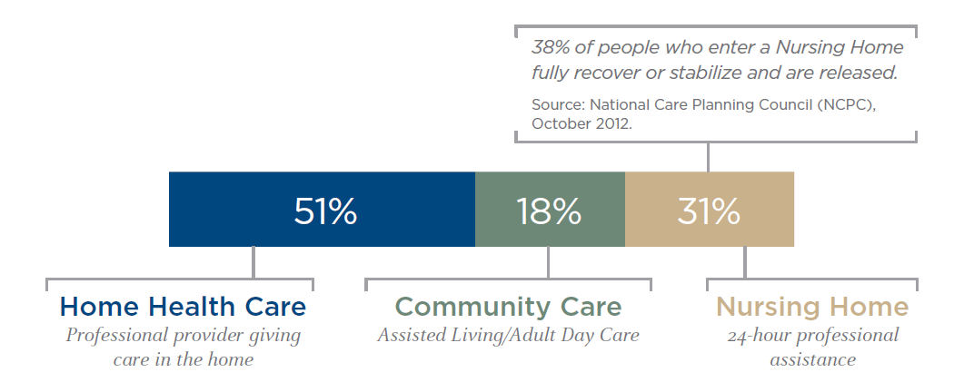
Long-term care doesn’t always mean “nursing home”
Percent of LTC claimants receiving long-term care in these locations:
Source: American Association for Long-term Care Insurance (AALTCI) 2014 Sourcebook.
Notes:
One of the first obstacles we hear when talking about long-term care is the association made between long-term care and “nursing home”. The perception that long-term care means nursing home care can have a negative impact that may keep people from taking action.
But this is also a great opportunity for us to begin to lower those obstacles and start talking about the importance for planning for long-term care.
The reality is, only 31% of long-term care are for nursing home care. 18% of claims are for community care such as assisted living and adult day care, and most claims are for home-based care: 51%.
[CLICK] In fact, over one third of those who receive long-term care in a nursing home setting eventually recover or are released.
It’s important to understand that proper planning results in a person having choices in how they receive care.

Slide 7
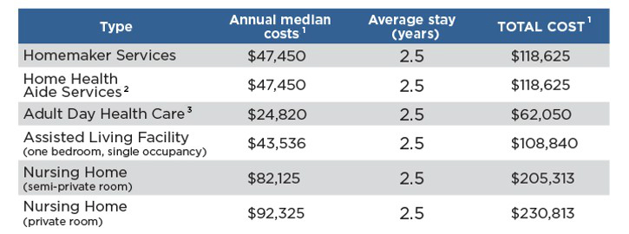
Long-term care is expensive…
U.S. median of existing home prices (August 2015): $228,700⁴
¹ Genworth 2016 Cost of Care Survey.
² Based on 7 days a week, by 52 weeks.
³ Based on 45.5 hours a week, by 52 weeks
⁴ National Association of Realtors, November 2015.
Notes:
And when it comes to the issue of cost, your perceptions are correct.
The costs associated with long-term care are staggering. According to the Genworth’s survey of long-term care costs, the median annual cost of nursing home care is over $92,000 for a private room and over $82,000 for a semi-private room. For the average stay of 2.5 years, total expenditures could exceed well over $200,000. The median annual cost for an assisted living facility is over $43,000.
Keep in mind that home health care can end up being nearly as expensive as nursing home care. The median wage for home health care costs is almost $20 an hour, so if a person needed 44 hours per week of care, it could cost around $47,000 a year.
If that care was needed for the average 4.5-year caretaking period, we might see a total expenditure of over $200,000, which is essentially the same amount of money as for the average nursing home stay in a semi-private room. For comparison purposes, the U.S. median of existing home prices in August 2015 was $228,700.

Slide 8
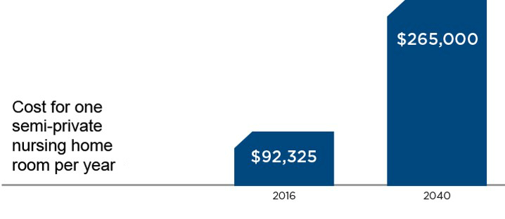
… and getting more expensive
$223,797
13
$83,950
Source: American Association for Long-term Care Insurance (AALTCI) 2016 Sourcebook.
Notes:
What you may not realize or see is the costs of long-term care are getting more expensive, expected to nearly quadruple by 2040 when many boomers are reaching the age when long-term care is increasingly likely. By then, a semi-private room is expected to cost around $265,000 per year based on a modest inflation rate of 4%, which is the expected national average. Some regions of the country may experience greater rates of inflation and have higher costs today.
[no clicks]

Slide 9
Who is preparing for long-term care?
Anyone with assets to protect or pass on to heirs
  E.g., Homes, property, retirement accounts, etc.
Not just for the elderly
  92% of LTC purchasers are under 65
  55% of policies are written for people between 55 to 64
Affluent couples and individuals
  Paying LTC costs out-of-pocket not cost-efficient
Source: American Association of Long-Term Care Insurance, 2015.
Notes:
If you’re still wondering if you’re a candidate for long-term care planning, here are a few qualifications you can consider:
First, do you have assets to protect or pass on to heirs? Such as homes, property, retirement accounts? These are assets you may have to sell in order to pay for long-term care bills or to qualify for Medicaid coverage for LTC costs. (More on Medicaid later.)
Second, you don’t have to be elderly to buy a LTC policy or start to plan. In fact, the majority of policies are purchased by people under age 65.
There’s also an advantage to planning ahead in the 10 years before your 65th birthday. That’s when you’re more likely to be approved for LTC coverage.
Third, even if you’re affluent and can afford to pay all LTC expenses out-of-pocket, you should ask if that’s really the most cost-efficient option. Planning ahead may be a more financially prudent option.

Slide 10








Perceptions of long-term care
Notes:
Long-term care is complicated: There is a general lack of knowledge on how the products work and the cost of delaying purchase.
Long-term care is expensive, especially when purchased at older ages. Since most people do not shop for long-term care until they are older, the cost can be prohibitive.
People are skeptical of the product and provider. Focus groups show that people have a distrust for the LTC industry, especially with all the recent rate increases.
People have other financial responsibilities, such as saving for retirement or helping children and grandchildren.
Loss of premiums. People often don’t want to spend money on a product they may never use, ending up with no return on their investment.
[CLICK] Perhaps most challenging is that 78 percent of Americans surveyed in 2013 by Nationwide thought of “Nursing Home” when asked to describe long-term care. It’s also hard to talk about an unpleasant topic like “nursing homes.”

Slide 11
Misperceptions of payment options
Think that Medicare pays for long-term care¹
Medicare only pays for 100 days and is limited in what it covers²
Plan to use Social Security to pay for long-term care²
The maximum benefit at FRA in 2015 is $32,220.
A semi-private nursing home room: $82,125³
Don’t know that the Affordable Care Act doesn’t cover long-term care¹
The CLASS Act was repealed on Jan. 1, 2013⁴
¹ The 2016 Nationwide/Harris Poll Health Care and Long-term Care Consumer Survey.
² Longtermcare.gov. Medicare and You, 2015. Medicare.gov.
³ Genworth Financial, Cost of Care Survey, 2016.
⁴ Fiscal Cliff Deal Repeals CLASS Act, Creates Long-Term Care Commission. Forbes.com. January 1, 2013.
Notes:
Some may be correct in their perceptions about the costs of long-term care, but wrong in their perspective on how these costs are paid for:
[CLICK] 16% think that Medicare helps pay for long-term care. The reality is that Medicare only covers up to 100 days of “skilled nursing care” per illness. To quality, you must enter a Medicare-approved “skilled nursing facility” or nursing home within 30 days of a hospital stay that lasted at least three days, AND the care in the nursing home must be for the same condition as the hospital stay.
[CLICK] 64% of American’s surveyed plan to use Social Security to help pay for long-term care. It can help, but the maximum benefit for a retiree at full retirement age today is only $32,220. The cost of a semi-private nursing home room today is more than twice that at $82,125.
[CLICK] 55% of Americans polled by Nationwide and Harris thought that the Affordable Care Actpays for long-term care. It doesn’t. The part of the law that might have helped, the CLASS Act, was repealed on January 1, 2013.
Remember, Medicare is only a temporary solution, assuming a person even qualifies for the program. Medicaid is a solution only for the impoverished or when your assets are already depleted. And private health insurance is not going to pay LTC needs.

Slide 12
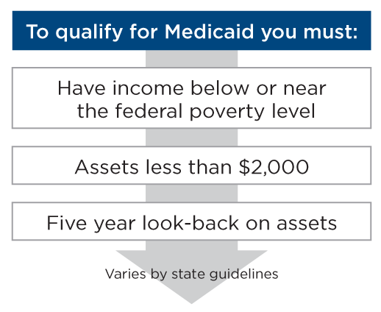
How long-term care expenses are paid: Medicaid
Medicaid covers long-term care for those who have few assets or have exhausted their assets
Source: Medicaid.gov, 2016.
Notes:
Medicaid covers long-term care for those who have few assets or have exhausted their assets.
To qualify for Medicaid, you must:
Have income below or near the federal poverty line
Assets less than $2,000
Five year look-back on assets
State guidelines can vary for Medicaid
Source: medicaid.gov

Slide 13
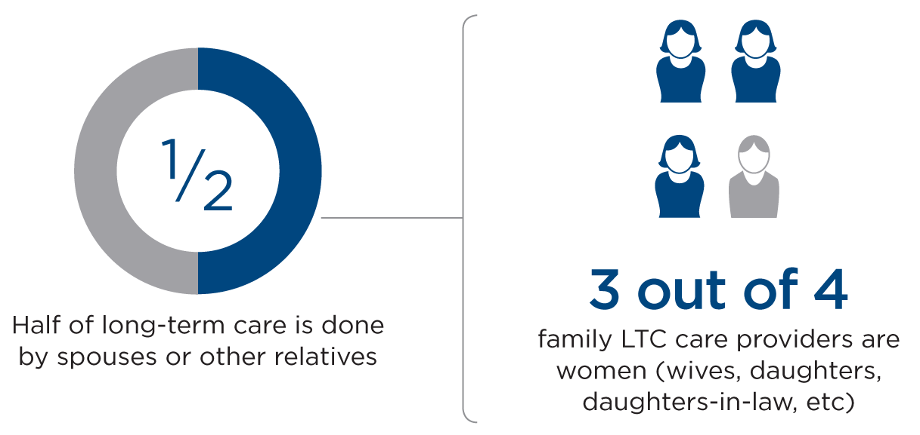
Long-term care is likely to be informal and unpaid
Source: American Association for Long-Term Care Insurance, 2014.
Notes:
In addition to paid care, we must also bring up unpaid informal long-term care, which comprises over 50% of LTC in this country and is primarily provided by spouses or other relatives who are usually daughters or daughters-in-law.
[CLICK] Long-term care is a problem that affects women in particular because they not only are the caregivers, they are the ones left behind to be cared for.

Slide 14
Long-term care realities
Strong likelihood you will need long-term care
LTC costs can be financially devastating
Government programs are not realistic solutions
Women are particularly impacted by long-term care
Notes:
Let’s sum up some of the challenges and realities we just discussed.
There’s a strong likelihood you will need long-term care at some point after age 65
The costs can be financially devastating
It’s like buying another house without the opportunity to mortgage the purchase price
You also can’t live in it, sell it or pass it down to heirs
Government programs are not realistic solutions –
Medicare and retiree health care benefits will generally be very limited.
Medicaid is an option only after you’ve sold off most of your assets
Women are particularly impacted by long-term care
At risk of financial impoverishment after caring for an ailing husband or family member
In need of long-term care for themselves when alone or widowed

Slide 15
Long-term Care
— Challenges —
15
15
15

Slide 16
Medicaid and Medicare are not realistic solutions
Medicaid
Proof of impoverishment at time of claim Assets must be less than $2,000 (varies by state) Five-year look-back on assets to qualify Options for care may be limited
Medicare
Pays a maximum of 100 days of care Daily co-pay after 20 days Begins after 3rd consecutive day in hospital under treatment Covers skilled care only, not chronic
Notes:
Many people assume that government programs like Medicaid or Medicare will cover their long-term care needs. It may help to look at what these programs will actually cover.
[CLICK] The options for using Medicaid for long-term care needs are very limited. The figure varies by state, but an individual’s countable assets have to be about $2,000 or less before Medicaid will cover care. Medicaid, which is a welfare program, will pay for care whether acute or chronic, but an individual has to be impoverished to qualify.
Some people give away their assets (usually to family members) in order to qualify for Medicaid. But the government is making it harder to do this. The government used to look back three years for assets being transferred out of an estate. That period has been increased to five years. Even if individuals are able to give away all their assets five years prior to applying for Medicaid, in doing so they lose control of them.
For those people who do qualify for Medicaid, care choices may be limited. Patients are not necessarily able to choose the location of care or the type of care they will receive. For example, in many areas of the country, Medicaid makes nursing home care the first resort instead of the last resort. Some areas of the country will allow Medicaid to fund home health care, but this varies greatly as state and county provisions do vary across the country.
[CLICK] For Medicare to cover anything, an individual must have a three-consecutive-day stay in a hospital preceding the long-term care need. Even then, Medicare coverage is limited to 100 days. The first 20 days are totally covered, but the patient must pay a co-pay for the remaining 80 days of care, which is in excess of $152 per day! Medicare is intended for acute care, not chronic care, so the moment a condition is diagnosed as chronic, the Medicare coverage stops, even if the 100 days are not used up.

Slide 17
Long-term care is chronic care
 | Skilled care (Short-term care) | Chronic care (Long-term care)
Insurance coverage:
Qualification test:
Qualification examples:
Administered by:
Services include:
Covered by health insurance
and Medicare
Not covered by health insurance
or Medicare (after 100 days*)
Shows continuous signs of
improvement
Patient shows no progress
Short-term IVs, temporary physical and speech therapy
Paralysis, mandatory need for assistance with daily activities,
debilitating stroke
Nurses and doctors in
around-the-clock facility
Varying levels of caregivers requiring routine, repetitive tasks
Hospital, rehabilitation center, physical therapy
Assisted living, nursing home care, adult day care, home health care
* You must qualify for Medicare.
Notes:
First, it is important to understand what constitutes long-term care. Long-term care is CHRONIC care, NOT skilled care.
[CLICK] Skilled care has nothing to do with how sick a patient is -- someone could be in a coma and still be receiving care for an acute condition.
Private health insurance and Medicare only pay for Skilled Care.
The key to skilled care is that the patient continues to show signs of improvement. IVs and tube feeding qualify as skilled care for only a short time. If a patient needs either one for very long, it’s determined to be chronic or maintenance care instead of skilled care.
Physical therapy or speech therapy will be covered after a stroke or accident, but the minute a patient stops showing progress, he or she is determined to be under chronic care and insurance stops paying.
[CLICK] Most long-term care is chronic care. The key to chronic care is the patient does not show progress towards getting better. Oxygen or even respiratory therapy for an emphysema patient is considered to be chronic care, not skilled care.
If a person has a stroke and stops getting better, the care becomes chronic care. If a paralysis patient stops improving, it becomes chronic care. Helping people take a bath, get dressed, get in and out of a chair or bed, go to the bathroom or eat would not qualify as skilled care – it is long-term care which is chronic care.
Long-term care is not covered by health insurance nor is it covered by Medicare after the 100 days if you managed to qualify to begin with.

Slide 18
What qualifies as long-term care?
To qualify for long-term care benefits, a doctor must certify either:
Severe cognitive impairment
Lack of memory, orientation, person, place or time, abstract reasoning or judgment relating to safety (Alzheimer’s would qualify)
OR
Inability to perform two Activities of Daily Living
Standard 6 ADLs: bathing, dressing, using the toilet, eating, transferring (out of bed, chair or wheelchair), continence
Notes:
Next, let’s go over how a person qualifies to receive benefits from a long-term care plan.
Most types of long-term care plans require a doctor to certify one of two qualifying triggers.
[CLICK] The insured must have severe cognitive impairment
[CLICK] – OR – the insured must be unable to perform two out of six activities of daily living, also known as ADLs.
Cognitive impairment relates to a lack of memory, orientation, person, place, or time, abstract reasoning or judgment relating to safety. This category would include Alzheimer’s disease.
The standard ADLs are bathing, dressing, using the toilet, eating, transferring out of a bed, chair or wheelchair and continence.

Slide 19
Long-term Care
— Creating a plan —
19
19
19
19
19

Slide 20
What if you don’t plan for LTC?
Do you have enough resources and support?
Can your family really take care of you?
What would you sell first to cover your bills?
What impact will providing care for you have on your family?
Notes:
Before the ball gets rolling, let’s go over some of the repercussions you’ll likely have to face if you don’t plan. This may be for some of you who are still on the fence about the importance of planning.
First, do you have the financial resources to pay LTC bills out of your own pocket?
Have you involved other family members such as children or important people in your life in these decisions? Are they ready and able to provide support to you?
If you’re expecting a spouse, a child or an in-law to take care of you, ask yourself first if they can really do it?
Are they physically able to provide care? If it’s an older spouse or family member, will they be able to lift you or carry you?
Are they able to reduce their work hours or put jobs on hold to care for you?
Do you want to move to the same town where a child now resides?
Next, have you thought about what asset you would sell first to cover your LTC bills? Is it your house? Is it a grandchild’s college fund?
Also, think about what selling these assets would mean for a surviving spouse. How would it affect their standard of living?
Finally, what about the emotional impact of your family members providing care for you?
Typically, one child carries the load, setting up the potential for arguments and disputes among siblings.
One child will have to have Power of Attorney for you. Which one will it be? Will all of the siblings agree?
How will your children share the expenses of your care?
I raise these questions not to start arguments among family members or to cause stress. I ask them only to open your eyes to the types of decisions and choices that are inevitable with any long-term care situation. By not putting a plan in place now, you’re leaving these questions to be answered at a later date, when you are in need of care and may not have the luxury of time or options to make the best decision for you or your family.

Slide 21
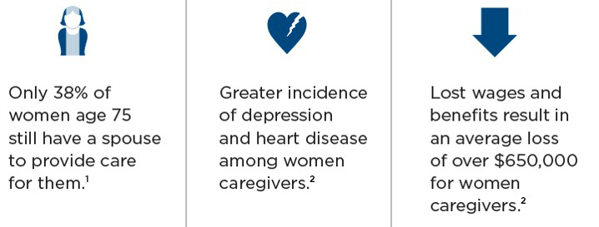
Informal long-term care is physically and financially demanding for women
¹ American Association for Long-Term Care Insurance, 2014.
² Minnesota Women's Press, "Take Time to Make Long-term Care Plans", November 2013.
Notes:
Caretaking can take a toll on a woman who also has to juggle the responsibilities of her own life and family.
When you look at people at age 75, you will find 74% of men have a spouse, while only 38% of women will still have a spouse. This may help explain why 80% of nursing home residents and 75% of assisted living residents are women. Women, most likely to be the caregivers, are also the ones most likely to be left behind needing care themselves.
[CLICK] A female caretaker providing nine hours or more of care per week is six times more likely to suffer depression and twice as likely to have coronary heart disease.
[CLICK] In addition, female caretakers will lose an average of $650,000 in wages, plus a loss of Social Security and pension benefits.

Slide 22
How to get started
Get a personalized LTC cost estimate
Consider your coverage options
  Traditional LTC policy
  Life insurance with LTC coverage
  Life insurance with LTC rider
  Other options for uninsurable situation
Consider potential sources of funding options
  Required distributions from IRAs
  Systematic annuity withdrawals
  Money not needed for retirement income
Notes:
Three simple steps can help you get started in planning for your LTC needs.
First, get an estimate of what your costs may be, personalized for your current health care needs, your family history and your expectations for retirement.
Second, consider your coverage options. Standalone LTC policies and LTC riders on life insurance policies are popular options. But there are also alternate solutions for those who may be considered uninsurable due to pre-existing health conditions.
Third, consider your funding options. Excess assets you have set aside could be efficiently re-purposed for long-term care. For example, required distributions from IRAs are good places to look for money to fund a LTC policy or to put a plan in place.

Slide 23
Start with a Long-term Care Cost Assessment
Determine individual long-term care costs
The Nationwide Long-term Care Cost Assessment
  Powered by calculations from one of the world’s leading actuarial firms
  Provides a personalized estimate of possible long-term care expenses
  You may also include estimates for annual Medicare and out-of-pocket expenses
Notes:
We know that a couple both age 65 today living to average life expectancy could need as much as $280,000 to cover premiums for health insurance coverage and out-of-pocket expenses during retirement. A couple who lives to age 95 could need as a much as $550,000. This example is for an average couple. This is an important number, but a realistic number, based on their personal health history, will be much more valuable.
Fortunately, your advisor can help with a tool called the Nationwide Long-term Care Cost Assessment. This tool was developed by a team of professionals including leading physicians and experienced actuaries using proprietary health risk analysis and up-to-date actuarial cost data. These experts analyze personal health and lifestyle information, healthcare costs, actuarial data and medical coverage. The result is a meaningful, personalized cost estimate that can help you plan for future health care expenses, including Medicare, out-of-pocket and long-term care costs.
With the Nationwide Long-term Care Cost Assessment, we can assess your health status and how it may affect future medical costs. Then we can estimate their years in retirement and health care costs during those years. We can also assess alternative scenarios. For example, what is the financial impact if you retire one year earlier or one year later than you currently plan?

Slide 24
Creating a plan to address long-term care costs
Personalized Long-term Care Cost Assessment
Health profile
Longevity
Impact of not taking action
Estimates of potential costs of care
24
Notes:
Allows you to easily and quickly provide you with possible annual health care cost estimates based on your individual profiles.
The Nationwide Long-term Care Cost Assessment starts with a 3-part questionnaire on the your health history, lifestyle and history of medical conditions. It also allows you to choose a metro region for retirement, which will more accurately calculate the cost of long-term care in that area.
Completing this assessment is a critical first step for planning. The report will tell you about your health profile, health risks, estimated life expectancy based on those risks and hypothetical estimates for health care costs in retirement. Costs are broken out into Medicare, out-of-pocket and long-term care expense categories so you can take an even more detailed look into what their costs will be.
The Nationwide Long-term Care Assessment report will help you determine what you may need to invest today to fund potential health-care costs during retirement. We will utilize tools that allow for “what-if” scenarios. For example, how will a change in your year of retirement affect your out-of-pocket health-care costs?
We can talk about the most appropriate way to decrease your worry about having the funds needed to cover one of the most important expenses you’ll will have during retirement.

Slide 25

Health Care and LTC Cost Assessment
Notes:
Allows you to easily and quickly provide you with possible annual health care cost estimates based on your individual profiles.
The Nationwide Long-term Care Cost Assessment starts with a 3-part questionnaire on the your health history, lifestyle and history of medical conditions. It also allows you to choose a metro region for retirement, which will more accurately calculate the cost of long-term care in that area.
Completing this assessment is a critical first step for planning. The report will tell you about your health profile, health risks, estimated life expectancy based on those risks and hypothetical estimates for health care costs in retirement. Costs are broken out into Medicare, out-of-pocket and long-term care expense categories so you can take an even more detailed look into what their costs will be.
The Nationwide Long-term Care Assessment report will help you determine what you may need to invest today to fund potential health-care costs during retirement. We will utilize tools that allow for “what-if” scenarios. For example, how will a change in your year of retirement affect your out-of-pocket health-care costs?
We can talk about the most appropriate way to decrease your worry about having the funds needed to cover one of the most important expenses you’ll will have during retirement.

Slide 26


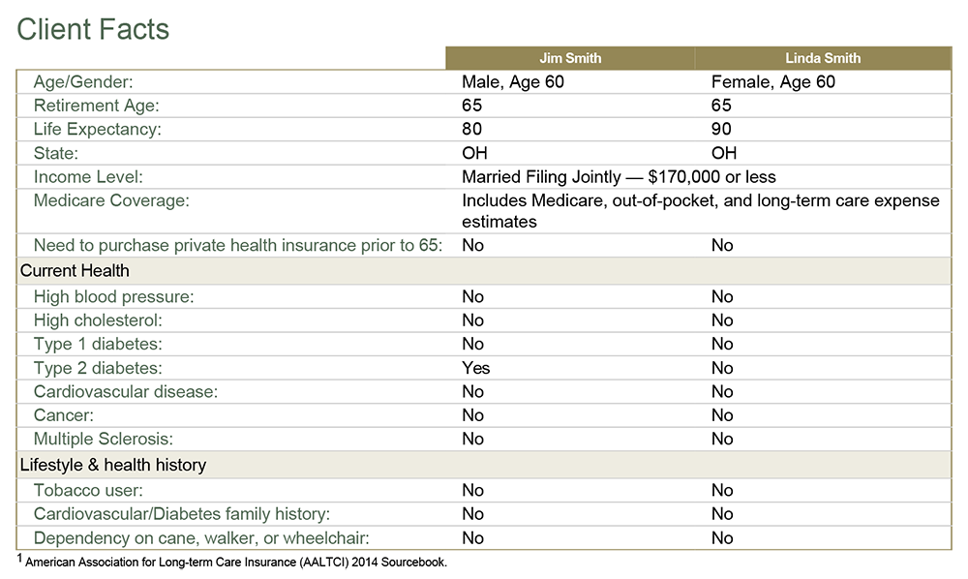
Health Care and LTC Cost Assessment
Health Care and LTC Cost Assessment

Slide 27


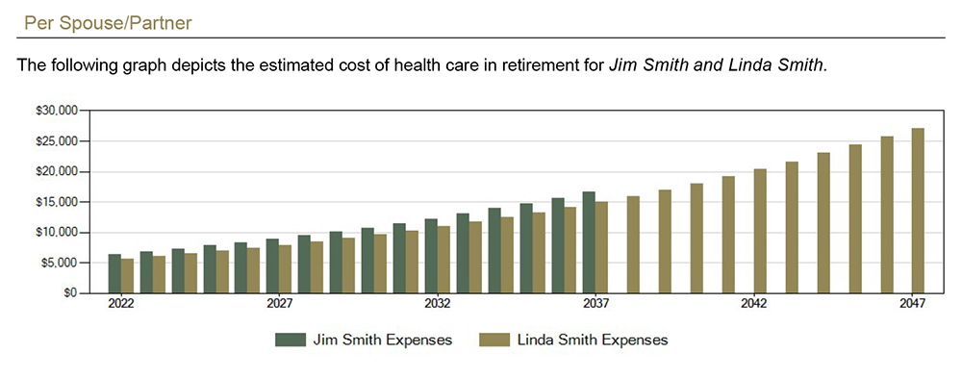
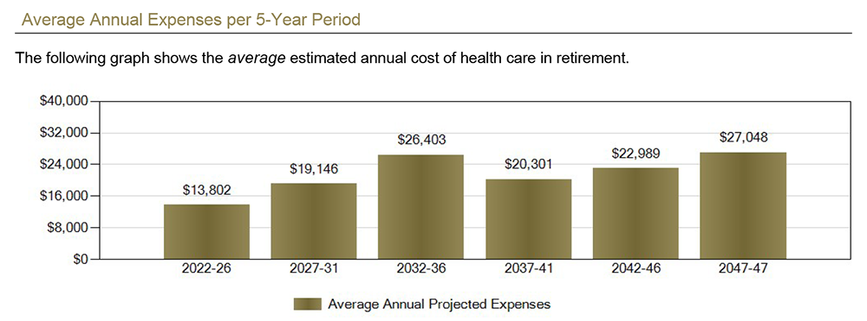
Health Care and LTC Cost Assessment

Slide 28


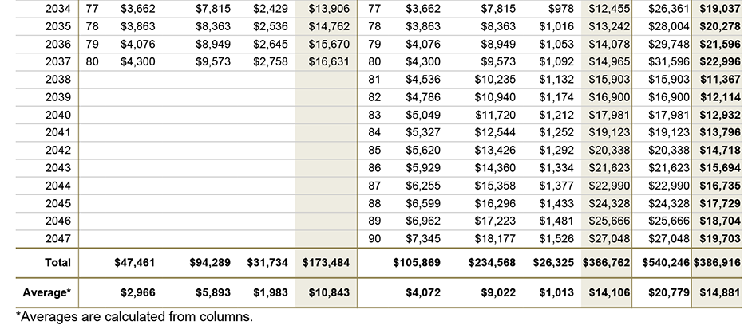
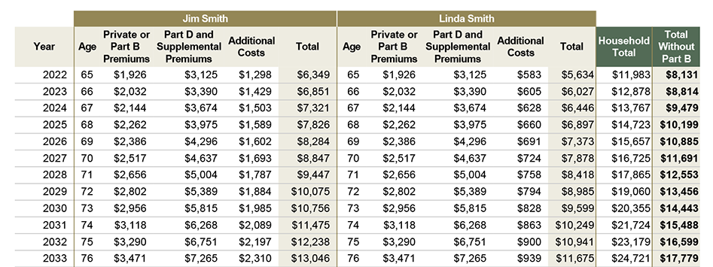
Health Care and LTC Cost Assessment

Slide 29
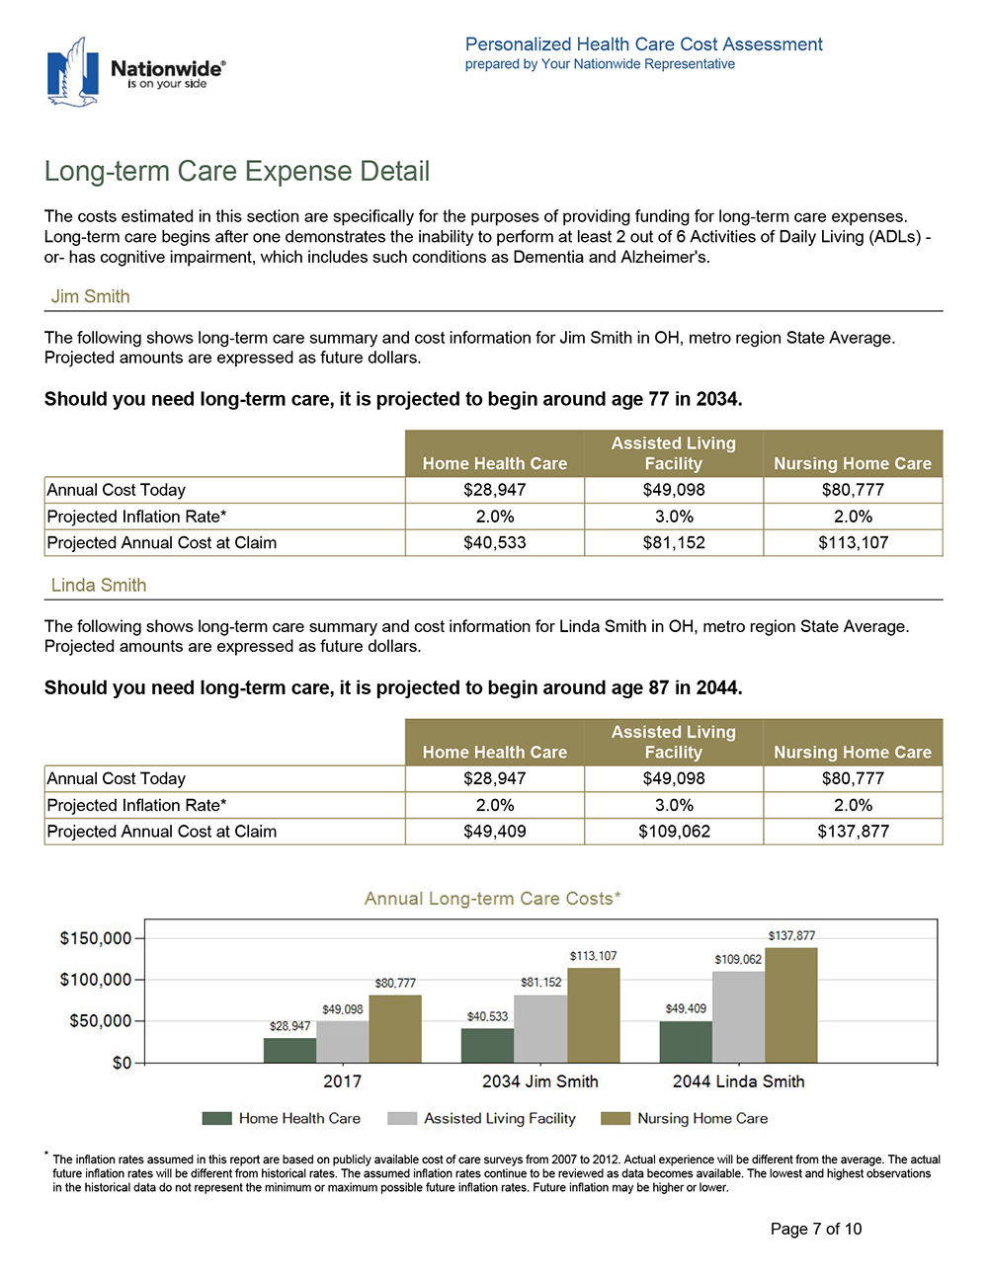
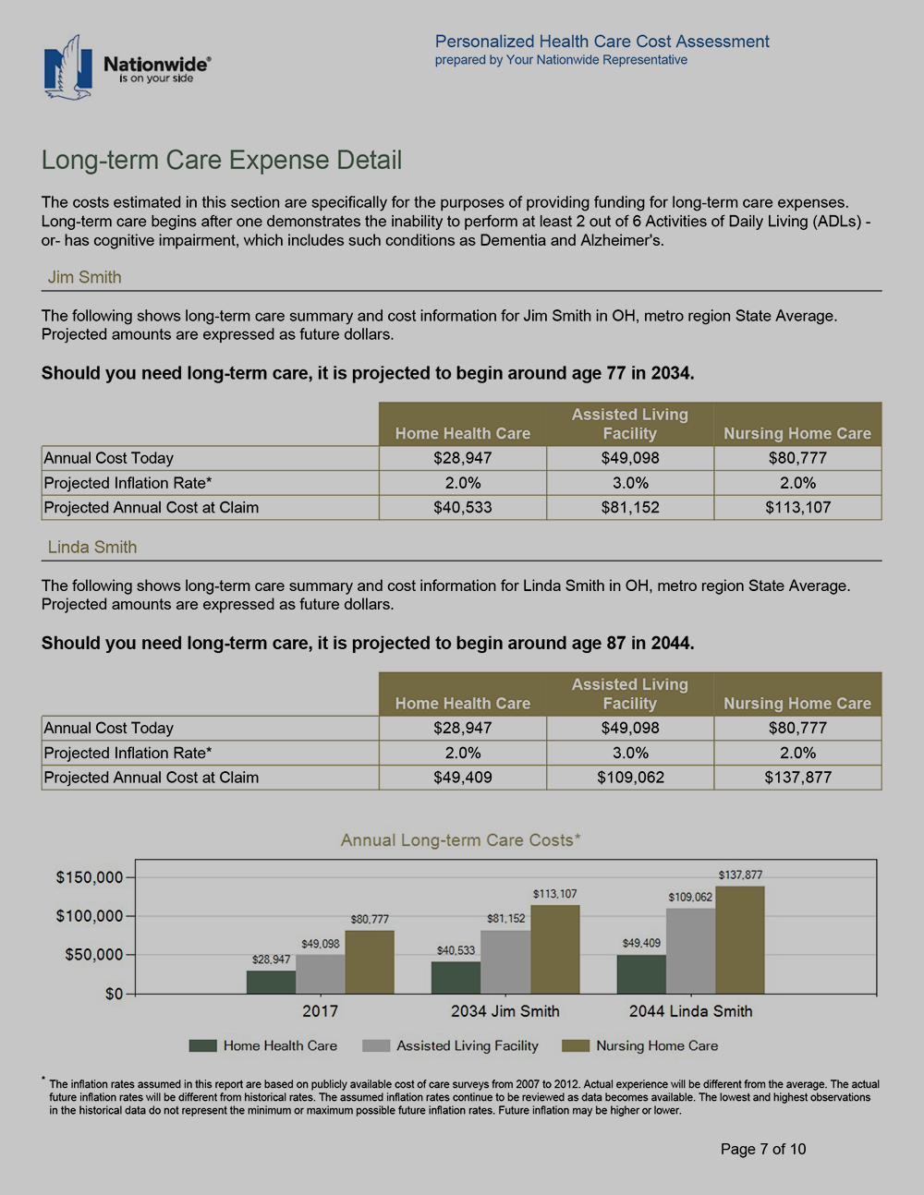
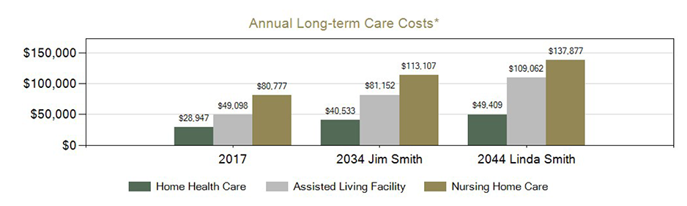
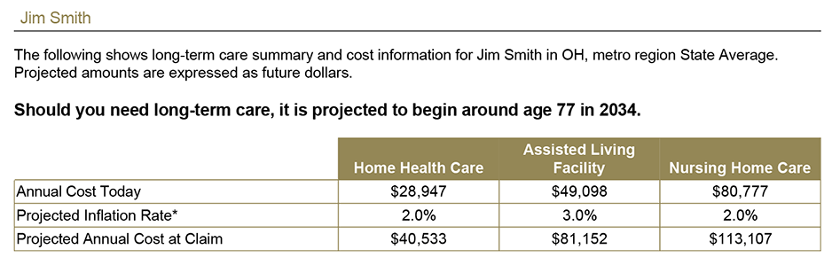
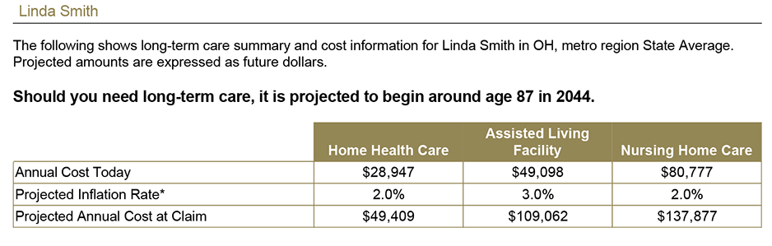
Health Care and LTC Cost Assessment

Slide 30

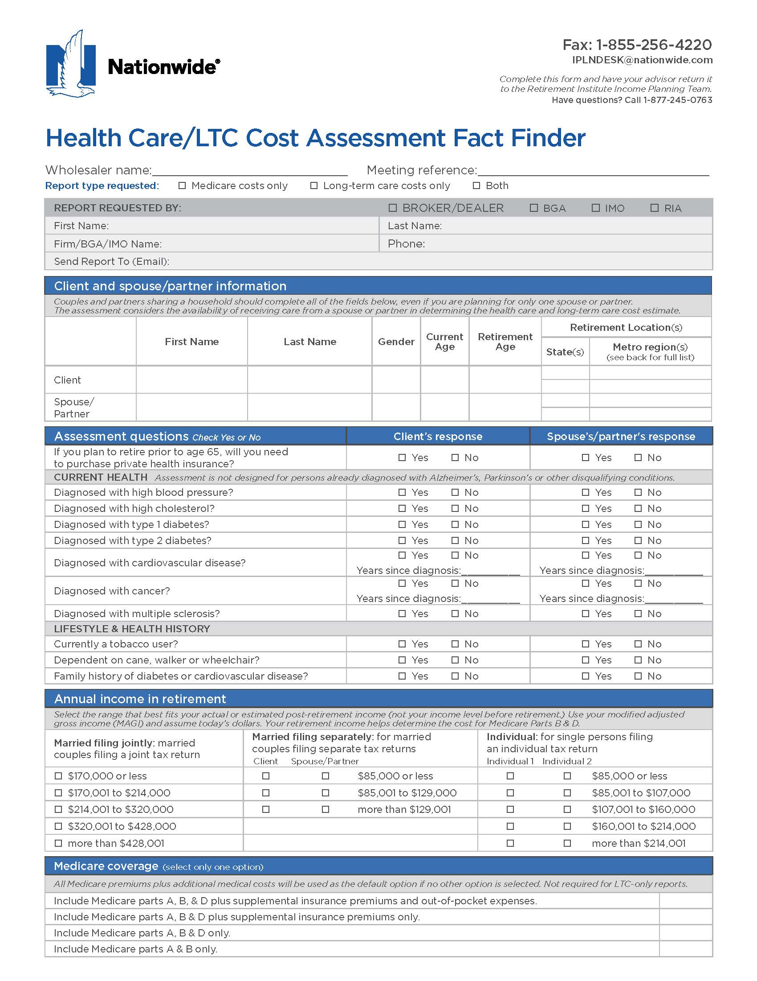
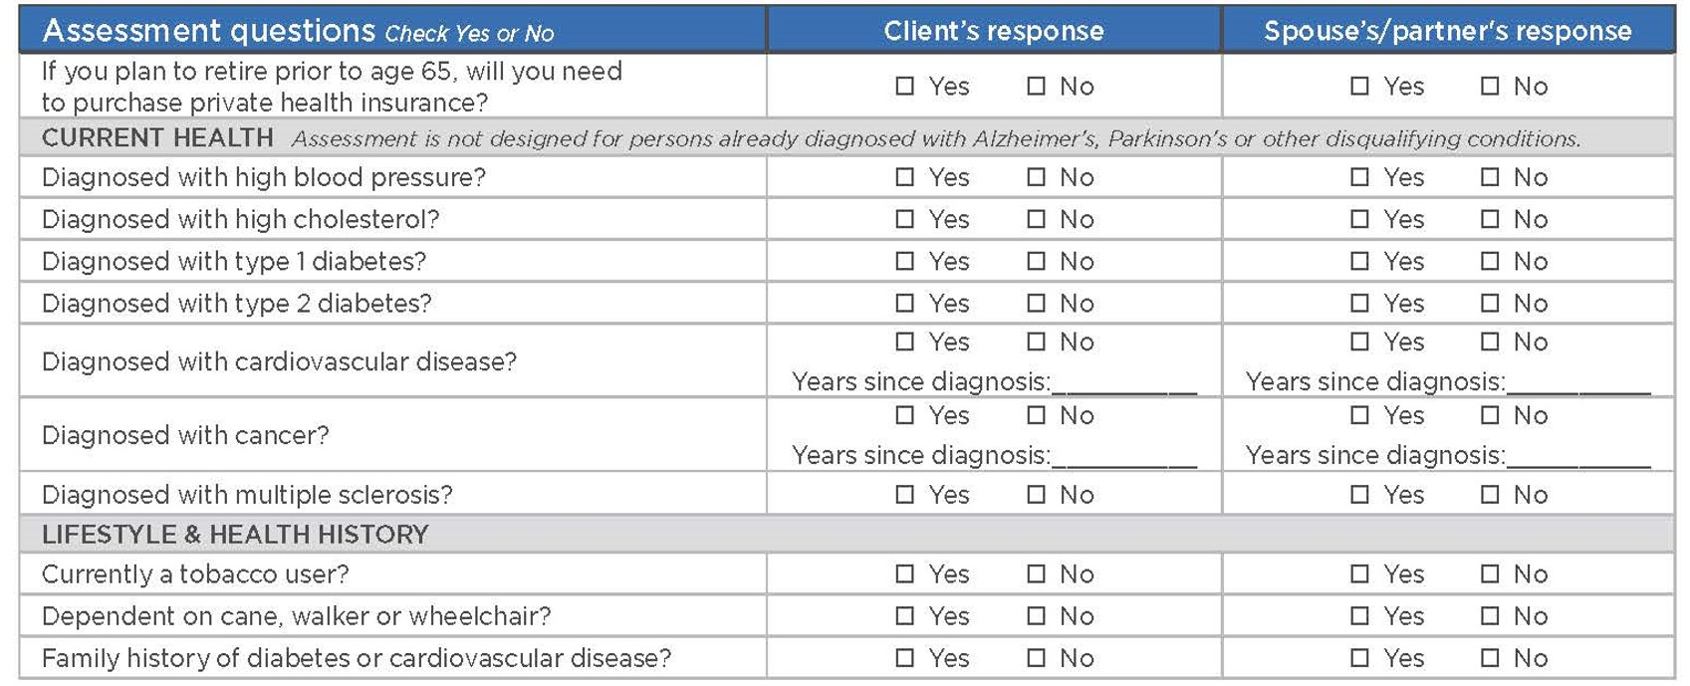
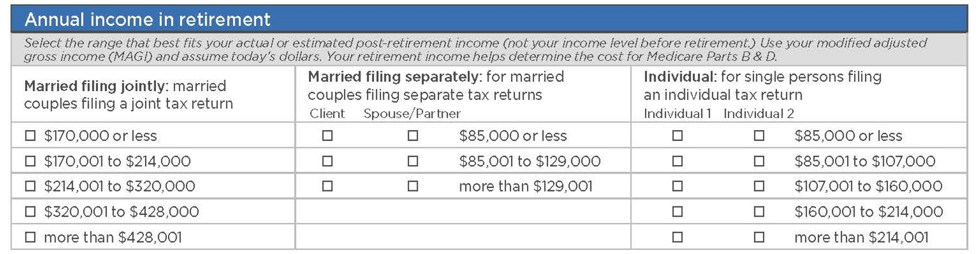
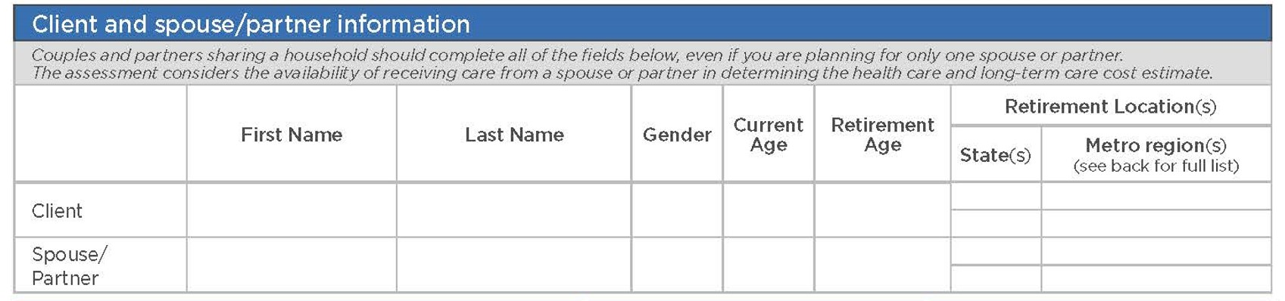


Health Care and LTC Cost Assessment
Notes:
[TALK ABOUT Fact finder]
The information collected on the Health Care Cost Assessment will be kept confidential and used to provide an estimate of your potential health care costs in retirement.
The estimate is based on your specific financial situation and goals, plus your current overall health condition. As your financial situation and health conditions may change over time, these changes may affect future changes. Please keep in mind that the estimates resulting from this fact finder are for hypothetical purposes only and are not guaranteed.

Slide 31
LTC coverage: What to look for
Coverage for all qualified services
Coverage for temporary claims
Cost structure is easy to understand
Future cost increases
Indemnity vs. Reimbursement plans
Notes:
If you’re looking at an LTC policy or rider, you should know not all policies are created equal. Here’s a list of some important things to keep in mind.
First, look to see what services are covered by the policies. Not all LTC services may be covered, so you want to look for the broadest range of all qualified services. Also think of types of care that may evolve in the future. A LTC policy should cover future forms of care and treatment as well.
Second, does the policy offer coverage to temporary claims? There are products (chronic illness riders) that will only cover the condition if it will last the rest of your life.
Is the cost-structure easy to understand and does it account for future cost increases?
Next, know the difference between indemnity and reimbursement plans, on the next slide.

Slide 32
Comparing indemnity & reimbursement plans
Indemnity plans
Pay the entire amount of benefit
Generally, no requirement to submit bills or receipts (some companies require monthly proof of service)
Excess benefits can be used for other purposes
May collect full benefits from multiple policies (Unless care is taken, may cause a taxable event)
Reimbursement plans
Generally have more limitations than indemnity plans
Not all plans pay full benefits if on claim with another company
Plan may limit or deny benefit amount while on Medicare claim
Plan may have a long list of services not covered
This information is general in nature and is not intended to be tax, legal, accounting or other professional advice. The information provided is based on current laws, which are subject to change at any time, and has not been endorsed by any government agency.
Notes:
You will want to be sure to understand the features of your plan and what it covers as not all plans are the same!
[CLICK] Indemnity plans generally offer the insured more flexibility.
The entire amount of benefit is paid out, regardless of what actual costs of care are.
No bills or receipts are required in many cases, though there are a few companies that still require bills to be submitted to verify that a licensed service is continuously involved in care.
Excess benefits not needed for care can be used for any other purpose, whether medical or nonmedical and are still tax free if collected per the IRS formula.
Indemnity policies will not limit what benefits amounts if the client owns more than one policy. However, you will want to keep the IRS tax formula in mind and make sure they do not exceed it if they want to avoid taxation on the excess taken above formula limits.
[CLICK] Reimbursement plans have more limitations than indemnity plans.
Some companies may limit or totally exclude paying benefits if you are collecting from another plan.
They may also share the claim with the second (or multiple companies), which means the client never gets more than the actual cost of care, but the companies collectively pay the claim benefits on a pro-rata basis.
Plan may limit or deny benefit amount while on Medicare claim.
Plans may have a long list of services or circumstances that are not covered as only true qualifying LTC expenses will be reimbursed.
Please note: This information is general in nature and is not intended to be tax, legal, accounting or other professional advice. The information provided is based on current laws, which are subject to change at any time, and has not been endorsed by any government agency.

Slide 33
LTC planning may help
Avoid dependency on government programs and limits on care options
Protect a surviving spouse from financial impoverishment
Preserve a financial legacy for heirs
Notes:
To summarize our discussion, the benefit to planning for long-term care for you is:
Planning ahead for LTC costs may help to avoid dependency on government programs, which can limit your choices on where and how you receive care
Planning may help protect a surviving spouse from financial impoverishment, due to selling off of assets or depleting savings to pay LTC bills or to qualify for Medicaid
And finally, putting a plan for LTC cost in place may help you protect assets you are planning to transfer to your heirs in order to preserve a financial legacy for your family members.

Slide 34
Long-term Care
— Questions? —
34
34
34
34
34
34
34

