Slide 1

Notes:
Presentation Title: Social Security – The choice of a lifetime
Promotional description: The Social Security decision is one of the most important decisions you will face about your retirement – a decision that could potentially result in accumulating hundreds of thousands of dollars in additional retirement income. Providing guidance for this important decision can set the stage for a broader discussion about their retirement income plans. This presentation breaks down and simplifies the many rules and filing options for Social Security, and demonstrates how you can make a suitable decision for your needs by analyzing and comparing different Social Security filing options.
Presentation script begins below:
Good [morning/afternoon/evening]. My name is [Wholesaler name] from Nationwide.
Today’s presentation is focused on the Social Security opportunity.
The choices about when and how to file for their Social Security benefits is one of the most important decisions you will make.
It will have a direct effect on how your essential and discretionary expenses are met throughout retirement, and in most cases the decisions are permanent.
Social Security planning is an opportunity to work with your financial advisor to lay a solid foundation for a comprehensive retirement income solution.
Your financial advisor can help you in making the transition from accumulating assets for retirement to withdrawing those assets during retirement.
Your advisor can also help you understand how to integrate Social Security decisions into a retirement income plan

Slide 2
Important things to keep in mind
• Not a deposit • Not FDIC or NCUSIF insured • Not guaranteed by the institution • • Not insured by any federal government agency • May lose value •
This material is not a recommendation to buy, sell, hold or rollover any asset, adopt an investment strategy, retain a specific investment manager or use a particular account type. It does not take into account the specific investment objectives, tax and financial condition, or particular needs of any specific person. Investors should work with their financial professional to discuss their specific situation.
The content of this presentation is provided for informational purposes only and should not be construed as investment, tax, or legal advice or a solicitation to buy or sell any specific securities product. The information provided is based on current laws, which are subject to change at any time, and has not been endorsed by any government agency.
Nationwide Investment Services Corporation (NISC), member FINRA. The Nationwide Retirement Institute is a division of NISC.
Social Security 360 Analyzer is a service mark of Nationwide Life Insurance Company. Nationwide, the Nationwide N and Eagle, Nationwide is on your side and Nationwide Retirement Institute are service marks of Nationwide Mutual Insurance Company. © 2017 Nationwide
NFM-11701AO.10 (03/17)

Slide 3

3
Notes:
U.S.-Based Mutual
Nationwide® is a Fortune 100 Company based in the U.S.
With more than 30,000 employees, Nationwide is one of the largest financial services employers of America’s workers.
Nationwide has 40 years of experience in workplace retirement savings programs.
Giving back nationally
In 2014, the Nationwide Foundation contributed $10 million to Nationwide Children’s Hospital, establishing the Nationwide Pediatric Innovation fund.
In 2014, Nationwide associates, agents and retirees pledged nearly $10 million to United Way, which is matched dollar for dollar by the Foundation.
Committed to America’s workers
Nationwide started by helping American farmers more than 90 years ago through the sponsorship of the Ohio Farm Bureau Federation.
Nationwide is on track to hire 1,000 armed forces veterans in the next five years, helping them transition to civilian life.
We’ve built long-standing relationships with national organizations, including The National Association of Counties and International Association of Firefighters

Slide 4
Today’s agenda
Social Security – the choice of a lifetime
Social Security basics
Managing the discussion
Notes:
The purpose of my presentation is to help prepare you for the Social Security decision with education and ideas for building a comprehensive retirement income plan.
First, we’ll look at why the Social Security filing decision is the choice of a lifetime – or why your filing decision matters
Then, we’ll get into some of the basics you need to know about Social Security, including the rules for spouses, widows/widowers, divorcees, etc.; and will review recent filing rule changes and implications to filing strategies
Next, we’ll talk about the different filing strategies you can use when making your Social Security decision and to optimize Social Security income for your specific needs

Slide 5
Social Security — The choice of a lifetime —
Notes:
Let’s start with a look at why the Social Security decision is so important.
We say it’s a choice of a lifetime because you generally only get one chance to get this decision right, and the consequences of the decision will reverberate for the rest of your life (including the life of your spouse, if married.)

Slide 6
More than
40%
30%
of retirees
of pre-retirees
underestimate their life expectancy by 5 years or more.
Source: 3rd Annual Harris Poll / Nationwide Social Security Study, 2016
Notes:
More than 40% of retirees and 30% of pre-retirees underestimate their life expectancy by 5 yrs or more

Slide 7

WHY SOCIAL SECURITY IS THE CHOICE OF A LIFETIME
Most file at the earliest possible time
New Social Security claimants in a calendar year¹
60% of individuals filed
early for reduced benefits²
37%
31%
23%
6%
3%
¹ Source: SS Supplement 2015. Table 6.B5, Social Security Administration, 2014 calendar year. ² FRA = Full retirement age. For this data, FRA is 66.
Notes:
Let’s start with a look at the importance of the Social Security filing decision on your retirement income plan.
Most Americans have a base level of understanding of how Social Security works – you pay into the system throughout your career, then at 66 to 67 for today’s retirees you can receive monthly income for the rest of your life.
Some people want to or have to retire early. Social Security allows you to tap your benefit as early as 62, with a reduction in benefits that’s largely permanent.
It’s also possible to delay your benefit beyond your full retirement age, up to age 70. In return for delaying, you earn credits that increase your monthly benefit when you do decide to take them.
What do most people do with their Social Security decision? This chart shows a snapshot of when new Social Security claimants took benefits during a calendar year.
As you can see, the majority of people (60%) filed earlier than full retirement age.
In fact, over one-third of the filers in this year (37%) started benefits at age 62 – the earliest possible age with the largest reduction in benefits
Multiple reasons for doing this – Many may simply need the money or are physically exhausted from a lifetime of work; others may be forced into retirement sooner than planned due to layoffs or health issues; more are doubtful about the future solvency of the Social Security program.
It’s also important to remember that this is by and large a permanent decision.
Once you make your filing decision, there is a 12-month window in which you can change your mind.
For the most part, people don’t reverse this decision.
If they do change their minds, they to suspend receiving their benefits and pay back all benefits they’ve received up to that point.

Slide 8

WHY SOCIAL SECURITY IS THE CHOICE OF A LIFETIME
Changes to filing options
On November 2nd, the Bipartisan Budget Act of 2015 was signed by the President, causing major changes to filing options
The filing restricted option is being phased out; when an individual files, he or she is only eligible for the higher of his or her own benefits, spousal or divorced benefits
After April 29th 2016, file and suspend no longer allows spousal or dependent benefits to be paid while the worker earns delayed retirement credits
Notes:
Prior to talking about why your Social Security filing strategy is a such an important decision, I want to quickly touch on some recent changes that impact this decision.
On November 2, 2015, President Obama signed the Bi-Partisan Budget Act of 2015 into law.
The budget makes important changes to Social Security claiming rules for retirees surrounding the Restricted Application and the Voluntary Suspension.
The changes will have a significant impact on the claiming options retirees have as they consider how and when to file for Social Security benefits, and the conversations advisors need to have with their clients.
Specific rule changes:
Filing restricted option is being phased out; when an individual files he is only eligible for the higher of own benefits, spousal or divorced benefits
As of April 29^{th 2016}, File and Suspend is no longer allow spousal or dependent benefits to be paid while the worker earns delayed retirement credits
Also eliminates the ability to request a retroactive lump sum for all benefits between the date of the request and the date of suspension, so the only reason to request a Voluntary Suspension under the new rules will be to accumulate Delayed Retirement Credits.

Slide 9

Jim and Linda’s Options
Meet Married Couple Jim & Linda Jim is 63 and Linda is 61
$2,400
Jim’s SS benefit at FRA
$1,300
Linda’s SS benefit at FRA
This example is hypothetical and for illustrative purposes only
$233,884
Cumulative benefit
lost by filing early
Cumulative benefit if both file as soon as possible*
Cumulative benefit if both optimize SS benefits
$1,346,558
$1,580,472
Figures as shown represent future value and assume average life expectancy of 85 for men and 88 for women and 2.5% annual cost-of-living adjustments (COLA).
* Represents if Jim files today, and Linda files when she’s 62
Notes:
Let’s look at how the Social Security filing decision can impact one hypothetical couple. (Please note that actual client scenarios will be different than the examples we’ll use during this presentation.)
Meet Jim and Linda
Jim is 63 and Linda is 61
Married for over 30 years
Their household has over $500K in household assets, putting them in the top 13% of US. Households and highest income quintile (Annual income $110,000 and up; 50% of people with over $500K in assets are in highest monthly income quintile)
Based on the distribution of Primary Insurance Amounts, we’ve estimated Jim’s lifetime income would put him in 14% of retired workers that receive a benefit of $2,100 or more.
If you work with mainly wealthy and affluent clients, this will likely be their situation as well.
Linda’s current monthly benefit is $1,300 based on her earnings history which was lower than her husband due to various factors including being out of the workforce for several years for their kids.
Let’s look at the outcome that different Social Security filing decisions would have on this couple.
If both file right now they will take a permanent reduction in benefits of 25%, they would accumulate over $1.3M during their retirement
Assuming life expectancy at age 85 for Jim and 88 for Linda
Figures assume future dollar value of benefit
Also assumes annual cost of living adjustments (COLA) of 2.5%
As a result of Social Security rule changes that happened at the end of 2015 when the Bipartisan Budget Act was passed, Jim and Linda could of filed prior to the April 29 2016 deadline and used the file and suspend with the file restricted strategy to optimize their Social Security benefits.
The optimal benefit would have been $1,580,472 and the strategy was that Jim filed at 66 and then immediately suspended his benefits. Linda would then file restricted for spousal benefits at her FRA, age 66 and then switch to her own benefits at age 70.
They could of gained $233,884 by filing for optimized benefit

Slide 10
Another Option for Jim and Linda
Meet Married Couple Jim & Linda Jim is 63 and Linda is 61
$2,400
Jim’s SS benefit at FRA
$1,300
Linda’s SS benefit at FRA
This example is hypothetical and for illustrative purposes only
$229,022
Cumulative benefit
lost by filing early
Cumulative benefit if both file as soon as possible*
Cumulative benefit if Jim files at 70 and Linda files at 68⁴
$1,346,558
$1,575,580
Figures as shown represent future value and assume average life expectancy of 85 for men and 88 for women and 2.5% annual cost-of-living adjustments (COLA).
* Represents if Jim files today, and Linda files when she’s 62
Notes:
Let’s look at how the Social Security filing decision can impact one hypothetical couple. (Please note that actual client scenarios will be different than the examples we’ll use during this presentation.)
We will have the same assumptions:
Jim is 63 and Linda is 61
Married for over 30 years
Their household has over $500K in household assets, putting them in the top 13% of US. Households and highest income quintile (Annual income $110,000 and up; 50% of people with over $500K in assets are in highest monthly income quintile)
Based on the distribution of Primary Insurance Amounts, we’ve estimated Jim’s lifetime income would put him in 14% of retired workers that receive a benefit of $2,100 or more.
If you work with mainly wealthy and affluent clients, this will likely be their situation as well.
Linda’s current monthly benefit is $1,300 based on her earnings history which was lower than her husband due to various factors including being out of the workforce for several years for their kids.
In this filing option Jim files and immediately suspends his benefit with the intent to delay taking his restricted benefit until age 70 and Linda files for spousal benefits at age 68. Even with the new rules both are still eligible to use the restricted filing option which we incorporated with Linda in this strategy since she has the lower PIA. The catch with the new rules is that since Jim has suspended his benefits it precludes other beneficiaries for filing for benefits. But with this specific case, since Linda does not file until age 68, Jim is already 70 and has unsuspended his benefit because he’s 70 allowing Linda the ability to file restricted.

Slide 11

Another Option for A Single Person
Meet Jim, a single person in retirement Jim is 61
$2,584
Jim’s SS benefit at FRA (age 66)
$255,925
Cumulative benefit
lost by filing early
This example is hypothetical and for illustrative purposes only
$143,739
Cumulative benefit
lost by filing early
Cumulative benefit if Jim files
at 62
Cumulative benefit if Jim
files at 66
Cumulative benefit if Jim
files at 70
Figures as shown represent future value and assume average life expectancy of 85 for men and 2.5% annual cost-of-living adjustments (COLA).
$778,482
$922,221
$1,034,407
Notes:
Some of you are not married and you may wonder what a breakeven chart looks like for a single person. (Please note that actual client scenarios will be different than the examples we’ll use during this presentation.)
Here’s another filing strategy that Jim can use today now that it is after the April 29, 2015 deadline.
We will have the same assumptions:
Jim is 61
Single
His household has over $500K in household assets, putting him in the top 13% of US. Households and highest income quintile (Annual income $110,000 and up; 50% of people with over $500K in assets are in highest monthly income quintile)
Based on the distribution of Primary Insurance Amounts, we’ve estimated Jim’s lifetime income would put him in 14% of retired workers that receive a benefit of $2,100 or more.
If you work with mainly wealthy and affluent clients, this will likely be their situation as well.
In this filing option Jim decides to file at 62, 66, and 70. As you can see, if Jim waits even 4 more years and files at 66, he would gain over $143,739 in cumulative benefits. If he waits until 70, he could cumulate over $1million

Slide 12
WHY SOCIAL SECURITY IS THE CHOICE OF A LIFETIME
Comparing options
Married Couple
Jim files restricted for spousal at 66, files standard at 70;
Linda files standard at 64 years 5 months
Cumulative benefits: $1,580,472
Jim files standard at 70; Linda files standard at 68
Cumulative benefits: $1,575,580
<1% less in benefits
Jim files standard at 66; Linda files at standard 66
Cumulative benefits: $1,416,353
10.4% less in benefits
Jim files standard now; Linda files standard at 62
Cumulative benefits: $1,346,558
14.8% less in benefits
Notes:
[CLICK] This first option is the strategy that Jim and Linda maximize their benefits. In this scenario Linda is able to file restricted at her FRA of 66 and switches to her benefits at 70.
[CLICK] Jim and Linda can still receive about 1% less in combined retirement benefits that received if they use the similar strategy with Jim turning back on his benefits at 70 and Linda filing restricted at 68 and switching to her benefits at age 70
[CLICK] If Jim and Linda both file at 66, they could have over 10% less in cumulative benefits
[CLICK] If both file as early as possible (Jim at 63 and Linda at 62), the difference in accumulated benefits would be over 14% less.

Slide 13
WHY SOCIAL SECURITY IS THE CHOICE OF A LIFETIME
Comparing options
Single Person
Jim files early at 62
Cumulative benefits: $778,482
Jim files at 66
Cumulative benefits: $922,221
18.5% increase in benefits
Jim files at 70
Cumulative benefits: $1,034,407
32.9% increase in benefits
Notes:
[CLICK] This first option is the strategy that Jim files at 62.
[CLICK] Jim can receive over 18% more if he waits until he’s 66
[CLICK] Filing single, Jim could receive over 32% more cumulative benefits if he waits until he’s 70

Slide 14

WHY SOCIAL SECURITY IS THE CHOICE OF A LIFETIME
Will Social Security be there for you?
Based on combined trust fund reserves and current assumptions:
Full benefits payable to at least 2034
With no legislative changes, Social Security would pay 79% of benefits afterward
Source: 2016 Annual Report of the Board of Trustees of the Federal Old-Age and Survivors Insurance and Federal Disability Insurance Trust Funds.
Notes:
One of the most common misconceptions you may hear is around the solvency of the Social Security program. You may hear, “I don’t think Social Security will be around much longer,” so some people may decide to take their benefits as early as possible in case their fears come into fruition.
In 2014, Social Security paid more in benefits than contributions so there is some basis for this concern.
There’s a lot of heated debate in Washington about the future of Social Security. So let’s put out there what the Social Security Administration says.
Based on theoretical combined trust fund reserves and current assumptions and no future changes to existing legislation:
Full benefits are payable to at least 2034
79% of benefits payable afterward
Legislation is likely to change going forward, with the goal of extending the solvency of Social Security.

Slide 15
MANAGING THE SOCIAL SECURITY DISCUSSION
Proposals to address Social Security solvency
Link COLAs to different
inflation indexes
Increase FRA beyond 67
May increase solvency without significant effect on most Americans
Current retirees will see smaller annual benefit increases
Expected to impact workers age 45 and younger to allow time to plan for retiring later
Notes:
Legislation is likely to change going forward, with the goal of extending the solvency of Social Security.
[CLICK] Link cost-of-living adjustments to different inflation indexes
Would result in a slight reduction in future Social Security benefit increases compared with the annual increases today’s Social Security beneficiaries receive.
Chained CPI was part of the proposal ideas but now is off the table.
A minor change such as this would extend the solvency of Social Security with only a minimal impact to the benefits individuals and family members receive.
[CLICK] Increase FRA beyond 67
Expected to impact workers age 45 and younger
Would allow time to plan for later retirement

Slide 16
MANAGING THE SOCIAL SECURITY DISCUSSION
Proposals to address Social Security solvency
Increase or eliminate wage cap
Increase payroll taxes
Raises amount of earned income subject to Social Security taxes
The 2017 cap is $127,200
Currently set at 12.4% split evenly between workers and employers
Notes:
[CLICK] Increase or eliminate wage cap on payroll taxes
Currently set at $127,200 (up by $8,700 from the $118,500 maximum for 2016)
Raises the amount of earned income that would be subject to Social Security taxes
[CLICK] Increase payroll taxes
Currently at 12.4%, split evenly between workers and employers.

Slide 17
MANAGING THE SOCIAL SECURITY DISCUSSION
Average life expectancy and beyond
 | AGE 65 | AGE 65
50% chance of reaching age¹⁴ | 86 | 89
25% cnce of reaching age¹⁴ | 93 | 95
For married couples, there is a 50% chance one spouse will reach age 93
50% chance of reaching age
25% chance of reaching age
Source: 2015 LIMRA Retirement Income Reference Book..
Notes:
You should set reasonable expectations for how long you expect to live.
At age 65, average life expectancy is 86 for a man and 89 for a woman
For a married couple, there’s a 50/50 chance of one spouse reaching age 93
There’s a 25% chance a 65-year-old man will live to 93 and a 65-year-old woman will live to 95.
For a married couple, there’s a 25% chance one spouse lives to 97.
So it’s true that married people tend to live longer lives. There are also other demographic factors that are relevant for some of you.
For example, a man with a bachelor’s degree statistically will live 5 years longer than one with just a high school diploma. (Centers for Disease Control, Health, US. 2011)
For women, the longevity gap between those with college degrees and those with just a high school diploma is 3 years.

Slide 18

Social Security — The basics —
Notes:
Before you get into a Social Security discussion or planning with your clients, there is some basic information you need to be familiar with.
The rules can be complex, but we’ll break down and simplify them to help you have productive conversations with your clients.

Slide 19




SOCIAL SECURITY BASICS What does Social Security offer?
Old Age, Survivors and Disability Insurance (OASDI)
Guaranteed lifetime income
Survivor benefits
Indexed to inflation
Preferential tax treatment
Notes:
First, what does Social Security offer?
Official name is “Old Age, Survivors and Disability Insurance” (OASDI is the acronym) so that tells you who the program is designed to aid
[CLICK]
By itself, Social Security would be a powerful asset in a portfolio [CLICK]
Offers guaranteed lifetime income [CLICK]
Benefit amounts are indexed to inflation to preserve your purchasing power [CLICK]
Offers survivor benefits similar to an annuity [CLICK]
Benefits receive preferential tax treatment compared with ordinary income
A portion of Social Security income will always be tax free, while income from employment, pensions, and retirement plan withdrawals are for the most part taxed fully at the ordinary income tax rate.

Slide 20
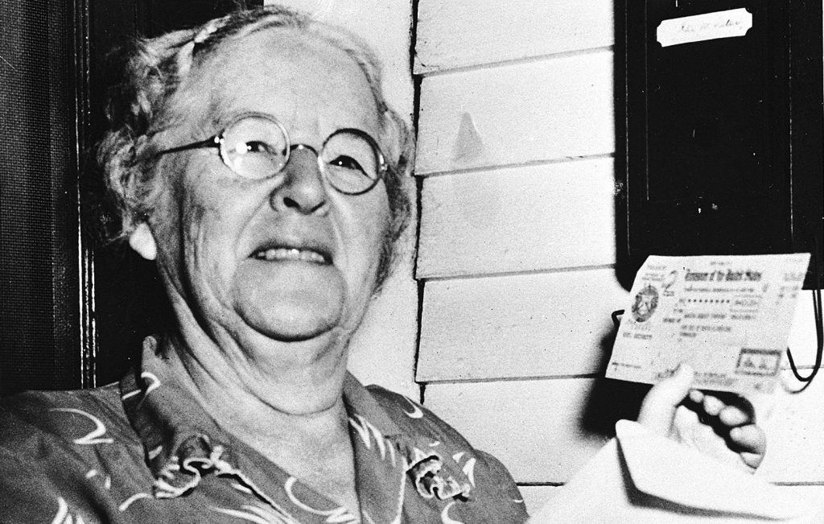
SOCIAL SECURITY BASICS Social Security Act of 1935
Designed to help older Americans living in poverty during the Great Depression
Never meant to be sole source of retirement income
Ida May Fuller First recipient of a monthly Social Security check (1940)
Notes:
The Social Security Act was signed by FDR on August 14, 1935
Created to help older Americans during the Great Depression
In 1935, unemployment was over 25%.
The majority of elderly citizens were in poverty.
Social Security was designed to alleviate the financial hardships many older Americans were experiencing due to the Great Depression.
SS was never meant to be the sole source of retirement income
Ida May Fuller – Vermont resident, first recipient of monthly Social Security benefits
Her story is a good one to relate to clients to show the power of SS benefits
Ida May worked as a Legal Secretary until she retired in 1939
Started collecting benefits in 1940 at age 65 and lived to be 100 years old (died in 1975)
Only paid payroll taxes during her last three years of employment
Accumulated taxes on her salary for the 3 years was $24.75 (not adjusted for inflation)
Received 1st check of $22.54 in 1940 (or $375.56 in 2015 dollars)
Collected a total of $22,888.92 in Social Security benefits by the time she passed away in 1975. (Over $99K in 2015 dollars)

Slide 21
SOCIAL SECURITY BASICS
Primary Insurance Amount (PIA)
Amount received each month if benefits start at full retirement age (FRA)
Based on lifetime Social Security earnings adjusted for inflation
Average indexed monthly earnings (AIME) over highest 35 years of earnings
Benefit reflects a percentage of average monthly earnings
Higher earners receive a smaller percentage than low-wage earners
Maximum PIA for 2017 is $2,687
Social Security statements available on mySocialSecurity (Sign up at ssa.gov/myaccount)
Notes:
There are a few acronyms that I’ll use in this presentation and are important to know. The first is PIA – or Primary Insurance Amount
The formula for calculating Social Security benefits is different than the formulas you typically see used for calculating pension benefits (e.g., “high five” or “last three” earnings years).
[CLICK]
Based on lifetime Social Security earnings adjusted for wage inflation
Highest 35 years of adjusted earnings added together, then divided by 420 (number of months in 35 years) to get a monthly average earnings
Benefit reflects a percentage of this average monthly earnings figure
The higher your lifetime SS earnings, the higher your benefit.
Maximum monthly SS benefit in 2017 is $2,687 plus any delayed retirement credits
If avg. annual income over lifetime earnings was higher than $118,500 (which is the cap for earned income subject to SS taxes), the worker will reach the max of their monthly SS benefits.
Higher earners receive a smaller percentage of their average earnings than low-wage earners as SS benefits.
Maximum PIA for 2017 is $2,687.
PIA is also subject to cost-of-living adjustments (or COLA)
[CLICK]
Know where to point clients to find their current PIA – mySocialSecurity web site
The statement summarizes their earning history, and gives a picture of what your monthly benefit is likely to be when you reach the different decision points of 62, FRA and 70.
The SSA no longer mails these statements annually to people under age 60. Instead, they now mail these statements to people in five year increments starting from 25-60, then annually after 60, unless the individual has signed up for a my Social Security account to access the statement online. (accessible through www.ssa.gov/myaccount)

Slide 22
SOCIAL SECURITY BASICS
Full Retirement Age
Notes:
The next important acronym to know is FRA – or full retirement age.
Used to be 65, and many people still believe 65 is full retirement age
FRA is currently 66 and is gradually increasing to 67, starting with people born in 1943 or later
People born in 1948 will reach FRA @ 66 in 2014.
FRA is 67 for anyone born after 1960
Early filing can occur starting at age 62 up to FRA
For anyone born in 1955 or later, age 66 is considered early
You can delay filing up to age 70 and increase your benefit amount, as we’ll show on the next slide.

Slide 23
SOCIAL SECURITY BASICS
Early and delayed filing affects monthly benefit
Delaying benefits can increase monthly benefit by 32%
Delaying benefits can increase monthly benefit by 77%
132%
116%
124%
100%
108%
86%
93%
75%
80%
% of PIA received
62
63
64
65
66
67
68
69
70
Starting age of SS benefits
Notes:
How does filing earlier or later than FRA affect PIA?
This example is for an individual with an FRA of 66; in other words, born between 1943 and 1954
Filing as early as possible at age 62 results in a permanent reduction in benefits of 25%
Benefit reduction decreases the closer you get to FRA
Delaying benefits increases PIA 8% each year, up to age 70. So someone with an FRA of 66 can increase their monthly benefit by 32% just by delaying benefits as late as possible.

Slide 24
SOCIAL SECURITY BASICS
Early and delayed filing affects monthly benefit
Delaying benefits from 67 to 70 can increase monthly benefits by 24%
Delaying benefits can increase monthly benefits by as much as 77%
124%
108%
116%
93%
100%
80%
86%
70%
75%
% of PIA received
62
63
64
65
66
67
68
69
70
Starting age of SS benefits
Notes:
How does filing earlier or later than FRA affect PIA?
This example is for an individual with an FRA of 67; in other words, born between 1943 and 1954
Filing as early as possible at age 62 results in a permanent reduction in benefits of 30%
Benefit reduction decreases the closer you get to FRA
Delaying benefits increases PIA 8% each year, up to age 70. So someone with an FRA of 67 can increase their monthly benefit by 42% just by delaying benefits as late as possible.

Slide 25
WHY SOCIAL SECURITY IS THE CHOICE OF A LIFETIME
Changes to filing options
On November 2nd, the Bipartisan Budget Act of 2015 was signed by the President, causing major changes to filing options
The filing restricted option is being phased out; when an individual files, he or she is only eligible for the higher of his or her own benefits, spousal or divorced benefits
After April 29th 2016, file and suspend no longer allows spousal or dependent benefits to be paid while the worker earns delayed retirement credits
Notes:
On November 2, 2015, President Obama signed the Bi-Partisan Budget Act of 2015 into law.
The Budget Act made important changes to Social Security claiming rules for retirees surrounding the Restricted Application and the Voluntary Suspension.
The changes will have a significant impact on the claiming options retirees have as they consider how and when to file for Social Security benefits, and the conversations advisors need to have with their clients.
Specific rule changes:
Filing restricted option is being phased out; when an individual files he is only eligible for the higher of own benefits, spousal or divorced benefits
After April 29th 2016 File and Suspend is now longer allow spousal or dependent benefits to be paid while the worker earns delayed retirement credits
Also eliminates the ability to request a retroactive lump sum for all benefits between the date of the request and the date of suspension, so the only reason to request a Voluntary Suspension under the new rules will be to accumulate Delayed Retirement Credits.

Slide 26
WHY SOCIAL SECURITY IS THE CHOICE OF A LIFETIME
Rule change from Section 831(a)
Rule change
Extends deeming rule to those born on or after January 2nd 1954; are no longer be allowed to file restricted for spousal benefits
Deeming is for any age of eligibility, not just month of initial entitlement
Impact
Those born on or after Jan 2nd 1954 have the opportunity to implement timing of Social Security to optimize the income received
Notes:
The first change is in Section 831(a) of the from the Bipartisan Budget Act of 2015. This rule changes the usage of the Restricted Application for spousal benefits.
Prior to the new law, an individual who was eligible for both a spousal benefit based on the work record of a spouse and a retirement benefit based on his or her own work could choose to elect only a spousal benefit at Full Retirement Age.
This allowed his or her own benefit to accumulate 8%-per-year Delayed Retirement Credits and then switch to his or her own larger benefit at any point in the future up to and including age 70. This option is called a Restricted Application.
The new law phases out this option. For people born Jan. 1, 1954, or earlier, the option to file a Restricted Application for only spousal benefits will remain available.
Further, if a participant is not eligible for spousal benefits (because his or her spouse had not yet elected) but later becomes eligible for a spousal benefit, entitlement is automatic and occurs on the first day of eligibility. Since the option to file a Restricted Application for only spousal benefits is only available under prior law at Full Retirement Age and the rules take effect only for people who are currently under age 62, this option is still effectively phased in over a four-year period.

Slide 27
WHY SOCIAL SECURITY IS THE CHOICE OF A LIFETIME
Rule change from Section 831(b)
Voluntary suspension now requires suspension of the wage earners benefit plus suspension of all benefits payable under the wage earner’s record
Dependents can no longer claim other benefits while the wage earner’s benefits are suspended
Anyone who voluntarily suspends (after 1 year) can no longer request retroactive benefits back to the beginning of a suspension
This change is grandfathered and became effective after April 30th 2016
Impact
Those born before May 1st 1950 and who filed for voluntary suspension prior to April 30th 2016 will be grandfathered
Notes:
The second change is in section 831(b) from the Bipartisan Budget Act of 2015.
It concerns voluntary suspensions. Under current law, a lower-earning spouse is eligible for spousal benefits only after the primary wage earner under whose record she is filing has filed for benefits. The checks to the higher wage earner would stop, allowing the higher wage earner’s benefit to grow by 8% per year, increasing not only the retirement benefit, but also the benefit payable to the spouse upon his death.
While the benefit was in suspense, the spouse was able to collect a spouse’s benefit.
The new law causes a Voluntary Suspension to stop all benefits payable under the earnings record of the person whose benefit was suspended. In other words, the spouse will not be able to collect a spousal benefit during the time that the wage earner’s benefit is suspended.
The new law also eliminates the ability to request a retroactive lump sum for all benefits between the date of the request and the date of suspension, so the only reason to request a Voluntary Suspension under the new rules will be to accumulate Delayed Retirement Credits.
This portion of the law is phased in over a much shorter timeframe. Only people who suspended benefits in the past or within the first 180 days after enactment will fall under the old rules, and will continue to fall under the old rules until they reach age 70 or un-suspend benefits. People who request a suspension after 180 days of enactment will fall under the new rules.

Slide 28
WHY SOCIAL SECURITY IS THE CHOICE OF A LIFETIME
Complexity of understanding the rules increases
Individual date of birth | Grandfathered | May 1st 1950 or before | January 1st 1954 or before | January 2nd 1954 or after
Strategies available | Anybody who already filed before the deadline will not be impacted by legislative changes | File and suspend available as long as voluntary suspension occurred prior to April 30, 2016 | Restricted application available, once individual is eligible | Deemed filing rules apply, and timing strategies available
Strategy examples |  | Jim files and suspends, allows his benefits to grow at 8% Linda files restricted, collects spousal benefit and allows her benefit to grow at 8% | Jim collects benefit or was born before May 1, 1950 and files and suspends Linda files restricted to collect spousal benefit and allows her benefit to grow to 8% | Jim files for his benefits Linda files for her benefits and receives spousal access, if spousal benefit is greater than hers
Notes:
The impact on planning for couples is nuanced. There are now three sets of rules:
1) People Born on or before 5-1-1950 (Those who turned 66 for Social Security purposes in April 2016) – Have access to both Voluntary Suspension that allowed auxiliaries to claim as long as the request for Voluntary Suspension occured on or before 4-30-2016, and Restricted Application.
2) People Born on or after 5-2-1950 but before 1-2-1954 – Voluntary Suspension also suspends benefits of other auxiliaries, including spouses and children, and an individual whose benefit is in suspense can’t receive spousal excess. This group still has access to the Restricted Application.
3) People born on or after 1-2-1954 - Voluntary Suspension also suspends benefits of spouse and children, and an individual whose retirement benefit is in suspense can’t receive spousal excess. This group no longer has the option to file a restricted application for spousal benefits.
Couples with age gaps could mean each falls under a separate set of rules

Slide 29

SOCIAL SECURITY BASICS
Social Security filing options
Prior to FRA and for some after FRA
Deemed Filing
File for all eligible benefits, benefits can be reduced if filing prior to FRA.
New law extends deemed filing to all ages for those born on or after January 2, 1954.
At or Beyond Full Retirement Age
File Restricted
Allows you to begin spousal, divorce or survivor benefits
Must be born on or before Jan 1, 1954
File and Suspend
Allows you to fix a mistake
Notes:
You’ll often hear these terms when we’re talking about Social Security filing methods:
Deemed Filing
Filing at or for some after FRA
File for all benefits you are eligible for, benefits can be reduced if filing prior to FRA
Full benefits at FRA, credits for delaying
New law extends deemed filing to all ages for those born on or after January 2, 1954.
[CLICK]
Restricted Filing
Filing restricted allows you to begin spousal benefits, divorce or survivor benefits only
Collecting based on spouse while allowing individual PIA to grow
Must be born on or before Jan 1, 1954 to use with the exception for survivor benefits
File and Suspend
Is the strategy that was available for those born on or before Jan 1, 1954 which allowed the workers to file and immediately suspend benefits allowing their own benefits to earn delayed retirement credits
Now can be used to voluntary suspend benefits and fix a mistake of filing early

Slide 30




SOCIAL SECURITY BASICS
Filing rules for different situations
Surviving spouses
Spouses
Divorced spouses
Dependent children
Disabled individuals

Slide 31
SOCIAL SECURITY BASICS
Impact on filing situations
Spouses
Dependent children
These two groups will be impacted by changes to the Social Security rules
The primary beneficiary must begin benefits before dependents can collect benefits
If the primary beneficiary voluntarily suspends benefits, then all dependent benefits are also suspended
Filing options for survivor’s benefits do not change
Notes:
These two groups will be impacted by changes with the Social Security rules: Spouses and Dependent Children.
Depending on the primary beneficiary’s birthdate, most likely these impacted groups cannot collect benefits until the primary beneficiary begins collecting benefits.
Also, after April 30th, 2016, if the primary beneficiary voluntary suspends benefits, then all dependent benefits are also suspended
It’s important to note that widows are not impacted by the new rules. Filing options for survivor’s benefits will not change.

Slide 32

SOCIAL SECURITY BASICS
Spousal filing rules
Eligibility
Benefits
Eligible at 62
Married for at least one year
One spouse must file for the other to claim benefits
Up to 50% of spouse’s PIA
Notes:
Let’s start this discussion of the filing rules with what will likely be the most common scenario – married couples
78% of mass affluent are married (LIMRA Analysis of 2010 Survey of Consumer Finances, Federal Reserve, 2012)
Spousal benefits can represent significant dollars for a non-working, low benefit spouse
Filing rules for spouses can be complex, but knowing how to apply these rules effectively can help a married couple optimize their benefits, especially for providing income to the surviving spouse.
There is also low awareness among married couples of how these rules work -- 47% of retirees were not aware of spousal SS benefits (Assessing Current and Future Beneficiaries’ Knowledge of Social Security Benefits, AARP, 2011)
This presents an opportunity to provide valuable advice to married clients
Spouses are eligible for benefits based on their working spouses record
To be eligible for spousal benefits, the spouse must be 62 and married for at least one year
Filing for spousal benefits early also reduces benefits
Primary worker has to have filed for benefits
[CLICK]
Benefit
Spouse can receive up to 50% of workers PIA
If claiming both individually and as a spouse, spousal benefit will be subject to the spousal adjustment (individual benefit-50% of spouses PIA)
Filing strategies for married couples are very complex
Most strategies for married couples differentiate with the use of spousal benefits
Cannot receive spousal benefits only
If filing prior to FRA, it is considered a “deemed filing” – in other words, you are filing for all eligible benefits (Deemed filing).
Filing for spousal benefits at FRA allows individual to earn credits on individual benefit
Subject to maximum family benefit for 150 – 180% of higher income earner’s PIA

Slide 33
SOCIAL SECURITY BASICS
For surviving spouses
Eligibility
Benefits
Eligibility
Benefits
Married for at least 9 months
Benefits can be taken as early as age 60*
Currently widowed or remarried after age 60
Up to spouse’s PIA including delayed retirement credits earned
Survivor benefits can be received independent of individual benefits
* Filing from 60 and up to FRA will permanently reduce monthly survivor benefits, but not impact the survivor’s own benefits
Notes:
When working with married couples, it’s also important to know how the rules for surviving spouses work.
6% of US population 55-65 is widowed, 40% of women 65 and older are widowed
Making use of the benefits available can significantly affect lifetime earnings from Social Security
The survivor benefit is at least PIA but can also earn credits. So it’s important for clients to think about survivors when beginning Social Security
A widow or widower is eligible based on deceased spouse’s record
Benefits available as early as age 60
Married for at least 9 months
Children under 18 are eligible as well
[CLICK]
Benefit
Maximum benefit a survivor receives is the greater of deceased spouses benefits, including delayed retirement credits, or 82.5% of deceased PIA.
This is because the SSA limits benefits depending on if and when the deceased began benefits.
Depending on when the survivor elects to receive they will receive between 71.5% and 100% of the survivor benefits.
One time death benefit
Survivor benefits can be used to allow individual insurance amount to grow
Survivor benefits can be received independently of individual benefits
A widow or widower can apply for survival benefits only

Slide 34
SOCIAL SECURITY BASICS
For divorced spouses
Eligibility
Benefits
Married for at least 10 years
Currently unmarried
Ex-spouse does not have to file beyond two years after divorce
Spousal, then survivor benefits
No impact on ex-spouse’s benefit
Not subject to the family maximum
Notes:
If a client is divorced, he or she may also be eligible for SS benefits based on their ex-spouses record. But certain rules apply:
Marriage must have lasted more than 10 years
Client is currently unmarried 60
Benefits can begin at 62 and ex-spouse does not have to apply to enable eligibility if divorce occurred two years ago or longer. (This is called being “independently entitled”).
Can provide opportunities for increased Social Security benefits
Many clients may fall under these eligibility requirements, yet are unfamiliar with the rules
18% of US population between 55-64 are divorced (Source: U.S census bureau, 2012 American Community Survey)
Especially important to female clients since 20% of women aged 45-55 are divorced (Source: U.S census bureau, 2012 American Community Survey)
[CLICK]
Benefits
Spousal benefits
Survivors benefits
Not subject to the family maximum

Slide 35
SOCIAL SECURITY BASICS
For dependent children
Eligibility
Eligibility
Benefits
Dependent under age 18
Disabled dependents if disability occurred before age 22
50% of parent’s PIA
75% of deceased’s PIA
Notes:
It’s also important to consider any other family members who may be eligible to receive benefits from SSA. For example, children who are under 18 and unmarried may also be eligible for Social Security benefits on their parents’ records.
• 40% of U.S households have children in their household (LIMRA Analysis of 2010 Survey of Consumer Finances, Federal Reserve, 2012)
• 25% of mass affluent to affluent households have children 18 and under(LIMRA Analysis of 2010 Survey of Consumer Finances, Federal Reserve, 2012)
Collect based on retired parent
Parent must have filed for benefits, be 62 or older and fully insured (meaning already earned 40 credits to qualify for SS benefits)
Collect survivor benefits from deceased parents
Children can collect if the parent dies before 62. There are two conditions that need to be met in order for a child to collect benefits from a deceased parent:
One credit of coverage for every year between 21 and death
6 credits in the 3 years before death.
There is no early claiming reduction for children's benefits, but also no delayed retirement credits on these benefits
Please note that additional children may be eligible for benefits:
18 and 19 (up to 2 months past 19th birth date) if still attending primary or secondary school
18 and older if disabled (as long as disability started before age 22)
[CLICK]
Benefit
50% of retired parent’s PIA
75% of deceased parent’s PIA
Also note, if a client provides care to a dependent parent, the parent may be able to collect benefits based on their child’s record.
Child must file for individual benefits at 62 or older.
A dependent parent is a parent over the age of 62 receiving over 50% of support from that child.
This has the biggest impact if the supporting child were to pass away.

Slide 36
SOCIAL SECURITY BASICS
For disabled individuals
Eligibility
Benefits
Eligibility
Benefits
Qualifying medical condition
Recent work test (individual)
Duration of work test (individual)
Individual benefit
Spousal benefit
Survivor benefit
Dependent children benefit
Notes:
Family members who are disabled may also qualify for benefits from Social Security.
If an income earner is disabled, benefits for the spouse may be available prior to age 50.
Spousal and survivor benefits
Dependent children are allowed to collect as long as disability occurred before 22
Eligibility:
Must have a qualifying medical condition – The Social Security web site includes an extensive listing of impairments that covers a wide range of medical conditions
Recent work test – Has the individual worked recently enough when disability occurred
Duration of work – Has the individual worked long enough to be fully covered by Social Security benefits

Slide 37
SOCIAL SECURITY BASICS
How working impacts Social Security
If under FRA for the full year
In the year of FRA
(Up to FRA month)
At FRA and beyond
$1 withheld for every $2 above annual limit
($16,920 or $1,410/month)
$1 withheld for every $3 above annual limit
($44,880 or $3,740/month)
No limit on earnings
Withheld earnings are returned
Source: Social Security Administration, 2017
Notes:
You may also be considering to continue to work while receiving Social Security benefits. But depending on the your age, your SS benefits may be reduced.
These benefits are not lost – rather, they are withheld until a person reaches full retirement age. At that point, SS benefits are increased to account for the amount of earned income that was withheld.
If under FRA for the entire year, $1 of SS benefits are withheld for every $2 of earned income above the annual limit
[CLICK] In the FRA year, $1 of SS benefits are withheld $1 for every $3 in earned income
[CLICK] In the month of FRA and beyond, SS benefits will not be reduced.
There’s a common misperception is that this withheld income due to working comes back as a lump sum. That is not correct – instead, benefits are increased to recoup this withheld income. For example, someone who filed for benefits early at 62 receives 75% of PIA then returns to work at 63 through 66, making enough that he would receive no benefits after the reduction. At FRA, the percentage of PIA would go from 75% to 93.3%.

Slide 38
SOCIAL SECURITY BASICS
For same-sex couples
On June 26, 2015, the Supreme Court issued a decision in Obergefell v. Hodges, holding that same-sex couples have a constitutional right to marry in all states
Same-sex couples now recognizes same-sex couples’ marriages in all states, and some non-marital legal relationships
More information at socialsecurity.gov/people/same-sexcouples
Notes:
The June 26th Supreme Court Obergefell v Hodges supreme court now gives recognition to same-sex couples for SSA benefits
The SSA now recognizes same-sex couples’ marriages in all states, and some non-marital legal relationships, for purposes of determining entitlement to Social Security benefits. SSA is encouraging individuals in same-sex marriages to apply even if not sure if eligible for benefits.
More information @socialsecurity.gov/people/same-sexcouples

Slide 39
SOCIAL SECURITY BASICS
For government employees
Windfall elimination provision (WEP)
Reduces individual benefit to prevent higher benefits on top of pension income
Changes formula used to calculate PIA and reductions
As little as 40% of first $885 instead of 90%¹
Reduction cannot be more than ½ of pension amount
Maximum PIA reduction for WEP is $442.50²
1 Social Security Administration. Based on 2015 formula.
2 https://www.ssa.gov/planners/retire/wep-chart.html
Notes:
You may have your Social Security benefit impacted by the Windfall Elimination Provision (WEP)
Generally affects people who earned a pension in a job where they did not pay Social Security taxes (May be government, non-profits, international companies, etc.)
Also worked other jobs long enough to qualify for Social Security benefits
If you have 30 years of earnings that are subject to FICA taxes, this provision does not apply.
WEP reduces individual benefit to prevent higher benefits on top of pension income
Changes formula used to calculate PIA
40% of first $885 instead of 90%
Reduction cannot be more than ½ of pension amount
Maximum PIA reduction for WEP is $442.50 (ssa.gov has this still current in 2017)

Slide 40
SOCIAL SECURITY BASICS
Effect on spousal or survivor’s benefit
Government Pension Offset (GPO)
Reduces a government employee’s Social Security spousal or survivor’s benefits
Benefits are reduced by 2/3 of their government pension
If government pension is large enough, spousal or survivor’s benefit may be eliminated
Notes:
Spouses of government employees may also be impact by these rules, under a different provision called the Government Pension Offset (GPO)
Reduces a government employee’s Social Security spousal and survivor benefits
Benefits are reduced by 2/3 of their government pension
If government pension is large enough, spousal or survivor benefit may be eliminated

Slide 41
SOCIAL SECURITY BASICS
How GPO reduces benefits
Spouse 1
Worked in government throughout career
Receiving $2,100 monthly pension
GPO = $1,400 (2/3 of $2,100)
Spouse 2
Worked in private sector
Paid FICA taxes
PIA: $2,000/month
Notes:
As an example, let’s consider a couple where one spouse worked for the government and did not pay FICA taxes on earnings.
She qualifies for a $2100 monthly pension.
Her government pension offset would be two-thirds of this amount, or $1400 per month.
The other spouse worked in the private sector and paid FICA taxes on earnings.
His Social Security PIA is $2,000 per month
Under normal circumstances – meaning if the GPO didn’t apply to the first spouse – she would qualify for spousal benefits of $1,000 per month and survivor benefits of $2,000
Because GPO does apply in this situation, both her spousal and survivor benefits are reduced by $1,400 per month.
This results in the complete elimination of her spousal benefits
Survivor benefits are only $600 per month.

Slide 42
MANAGING THE SOCIAL SECURITY DISCUSSION
Client concern: Taxation
Taxable retirement income
Partially taxable retirement income
Tax-free
retirement income
Pension Income
Traditional Retirement accounts (401(k), IRA)
Interest and dividend income
Social Security –
Up to 85% taxed
Immediate annuity income
Cash-value of life insurance
Roth IRAs and Roth 401(k)s
Interest from municipal bonds
Loans from life insurance policies
Please note that Nationwide does not provide legal, tax, or accounting advice. You should consult with your accounting or tax professional for guidance regarding your specific financial situation.
Notes:
You may also be concerned with how Social Security benefits will influence how much tax you pay on all of your income.
Social Security isn’t taxed like other retirement income because a portion of it – at least 15% for everyone – is tax-free.
Primary Retirement assets, Pensions and 401(k), are taxed much higher than Social Security
Social Security income has advantages compared to traditional retirement income since it’s only partially taxed
Other sources of retirement income, Roth accounts and municipal bonds, are tax free with tax-free withdrawals of all earnings and principal.
It’s important to consider how retirement assets are taxed when making decisions in retirement

Slide 43
MANAGING THE SOCIAL SECURITY DISCUSSION
Client concern: Taxation
 | Reduced benefits | Maximum benefits
Target pre-tax income | $90,000 | $90,000
Social Security benefits | $30,690 | $54,014
Traditional retirement income | $59,310 | $35,986
Provisional income | $74,655 | $62,993
Delayed filing increases Social Security by 76%
Taxable income decreases by 32%
Total taxable income AGI + income after Social Security income test | $85,397 | $58,130
This example is hypothetical and for illustrative purposes only
Notes:
When filing early, in order for you to reach your desired income, you would have to rely on other taxable assets like 401k and Pensions. Relying on those sources of income results in higher taxable income. Having more income come from Social Security or other tax advantageous assets reduces taxes.
In our Jim and Linda example, we have a married couple whose annual income goal in retirement is $90K.
Filing early results in a lower annual Social Security benefit of $30,690 forcing the client to draw down over $59K from their IRA accounts to meet the $90k income goal
Relying more on fully taxable asset increases your Provisional Income
If a client were to delay benefits and receive $54K a year, they would only draw $35k from an IRA account to reach their desired annual income.
This lowers their provisional income as well
Social Security is taxed at a maximum of 85% of the benefit. The amount of Social Security that is taxed is subject to three tests. (These tests are imbedded in the IRS Publication 915 worksheet used to calculate provisional income and determine taxation of benefits).
In our example, filing early results in a higher taxable income due to a higher Modified Adjusted Gross Income for Social Security benefit taxation which increases the amount of Social Security benefits that get taxed
It is important for you to consider how Social Security filing will affect your taxable income. The filing decision can have significant implication in your taxable income in retirement.

Slide 44
— Managing the —
Social Security
discussion

Slide 45
MANAGING THE SOCIAL SECURITY DISCUSSION
Simplifying Social Security decisions
Nationwide’s Social Security 360 Analyzer® tool
Identifies optimal filing methods and allows you to adjust parameters to compare different strategies
Provides instructions on how to file
Helps you integrate Social Security into your comprehensive retirement income plan

Slide 46
MAKING YOUR SOCIAL SECURITY DECISION
Social Security Assessment
This report is provided for informational purposes only and should not be construed as investment, tax, or legal advice or a solicitation to buy or sell any specific securities product. You should work closely with your financial professional to develop a plan that incorporates your investment objectives, goals, risk tolerance and time horizons based on your specific situation. This report relies upon the accuracy of the data you provide and is an estimate of the Social Security benefit you may receive which will differ from the actual benefit amount you receive at the time of application with the Social Security Administration. The information provided is based on current laws which are subject to change at any time. This report has not been reviewed or endorsed by any government agency.

Slide 47

MANAGING THE SOCIAL SECURITY DISCUSSION
Social Security Assessment

Slide 48
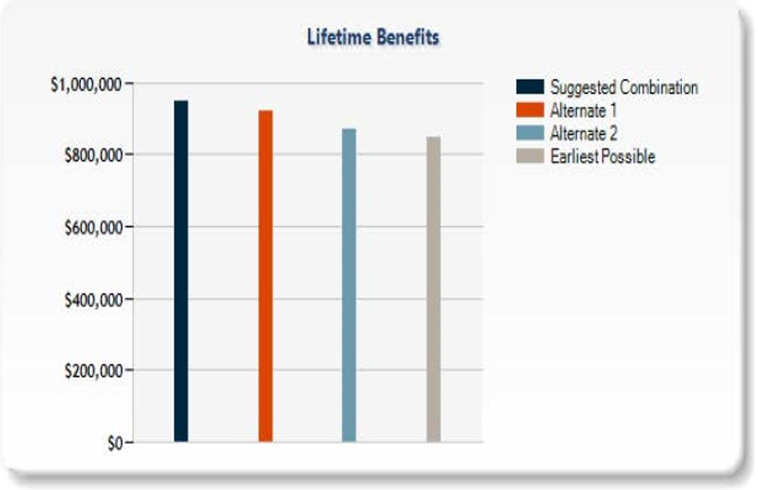
MANAGING THE SOCIAL SECURITY DISCUSSION
Compare filing strategies
The client’s Social Security report shows cumulative benefits of an optimization strategy vs. early filing and alternative filing strategies
Notes:
Based on inputs you provide, the tool will provide an optimal and earliest filing strategy.
In the bar chart, you can compare strategies in terms of cumulative benefits, with dark blue representing the optimal filing strategy.
Cumulative benefits shown in this chart are present value.
The grey bar shows cumulative benefits of the earliest filing strategy.

Slide 49
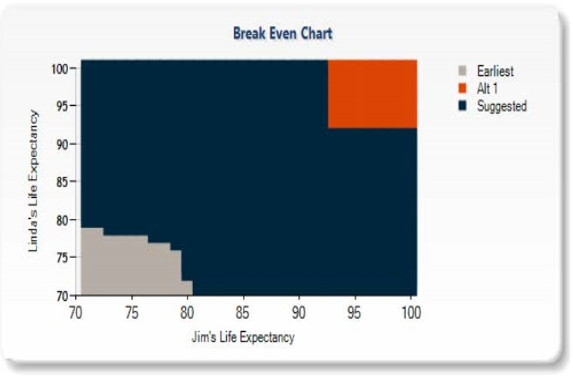
MANAGING THE SOCIAL SECURITY DISCUSSION
Analyze break-even points
Illustrates which of the outlined strategies provides the best outcome at any given set of mortality assumptions for SS claimants
Notes:
If you’re a married couple, you can also analyze your break-even points by optimal, earliest and personalized strategy, based on life expectancy.
The blue area in this analysis shows how the optimal strategy would provide the highest cumulative income if you live past 85.
The black/darker area represents where the earliest filing strategy would provide the highest cumulative benefits
The orange area highlights where a personalized strategy (neither earliest or latest filing strategy) would provide the highest cumulative benefits based on life expectancy

Slide 50
MAKING YOUR SOCIAL SECURITY DECISION
Social Security Strategy Example
The expected lifetime family benefit using the strategy example is: $946,030
Note that this illustration is for educational purposes only.
Jim
66 years - File a Restricted
application for only spousal benefit based on Linda's earnings record.
Your approximate spousal benefit would be $787
File for own benefit at age 70 years.
Your approximate benefit on your own earnings record would be $3,765
Linda
File a standard application for benefits at age 64 years 5 months.
Your approximate monthly benefit would be $1,409
Notes:
Please note that the Social Security report indicates the present value of the cumulative benefit dollar amounts. In the cash flows in the Social Security report represent the future cumulative value of the benefits.

Slide 51
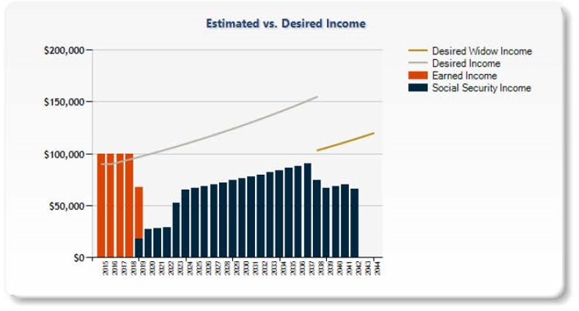
MANAGING THE SOCIAL SECURITY DISCUSSION
Identify income gaps
The report illustrates annual Social Security cash flow for the suggested filing strategy vs. projected retirement income needs.
Notes:
The tool will also graph how your expected Social Security income will cover your desired retirement expenses.
For this analysis, you can discuss with your advisor how other parts of your retirement income plan can help close the gap to your desired retirement income needs.

Slide 52
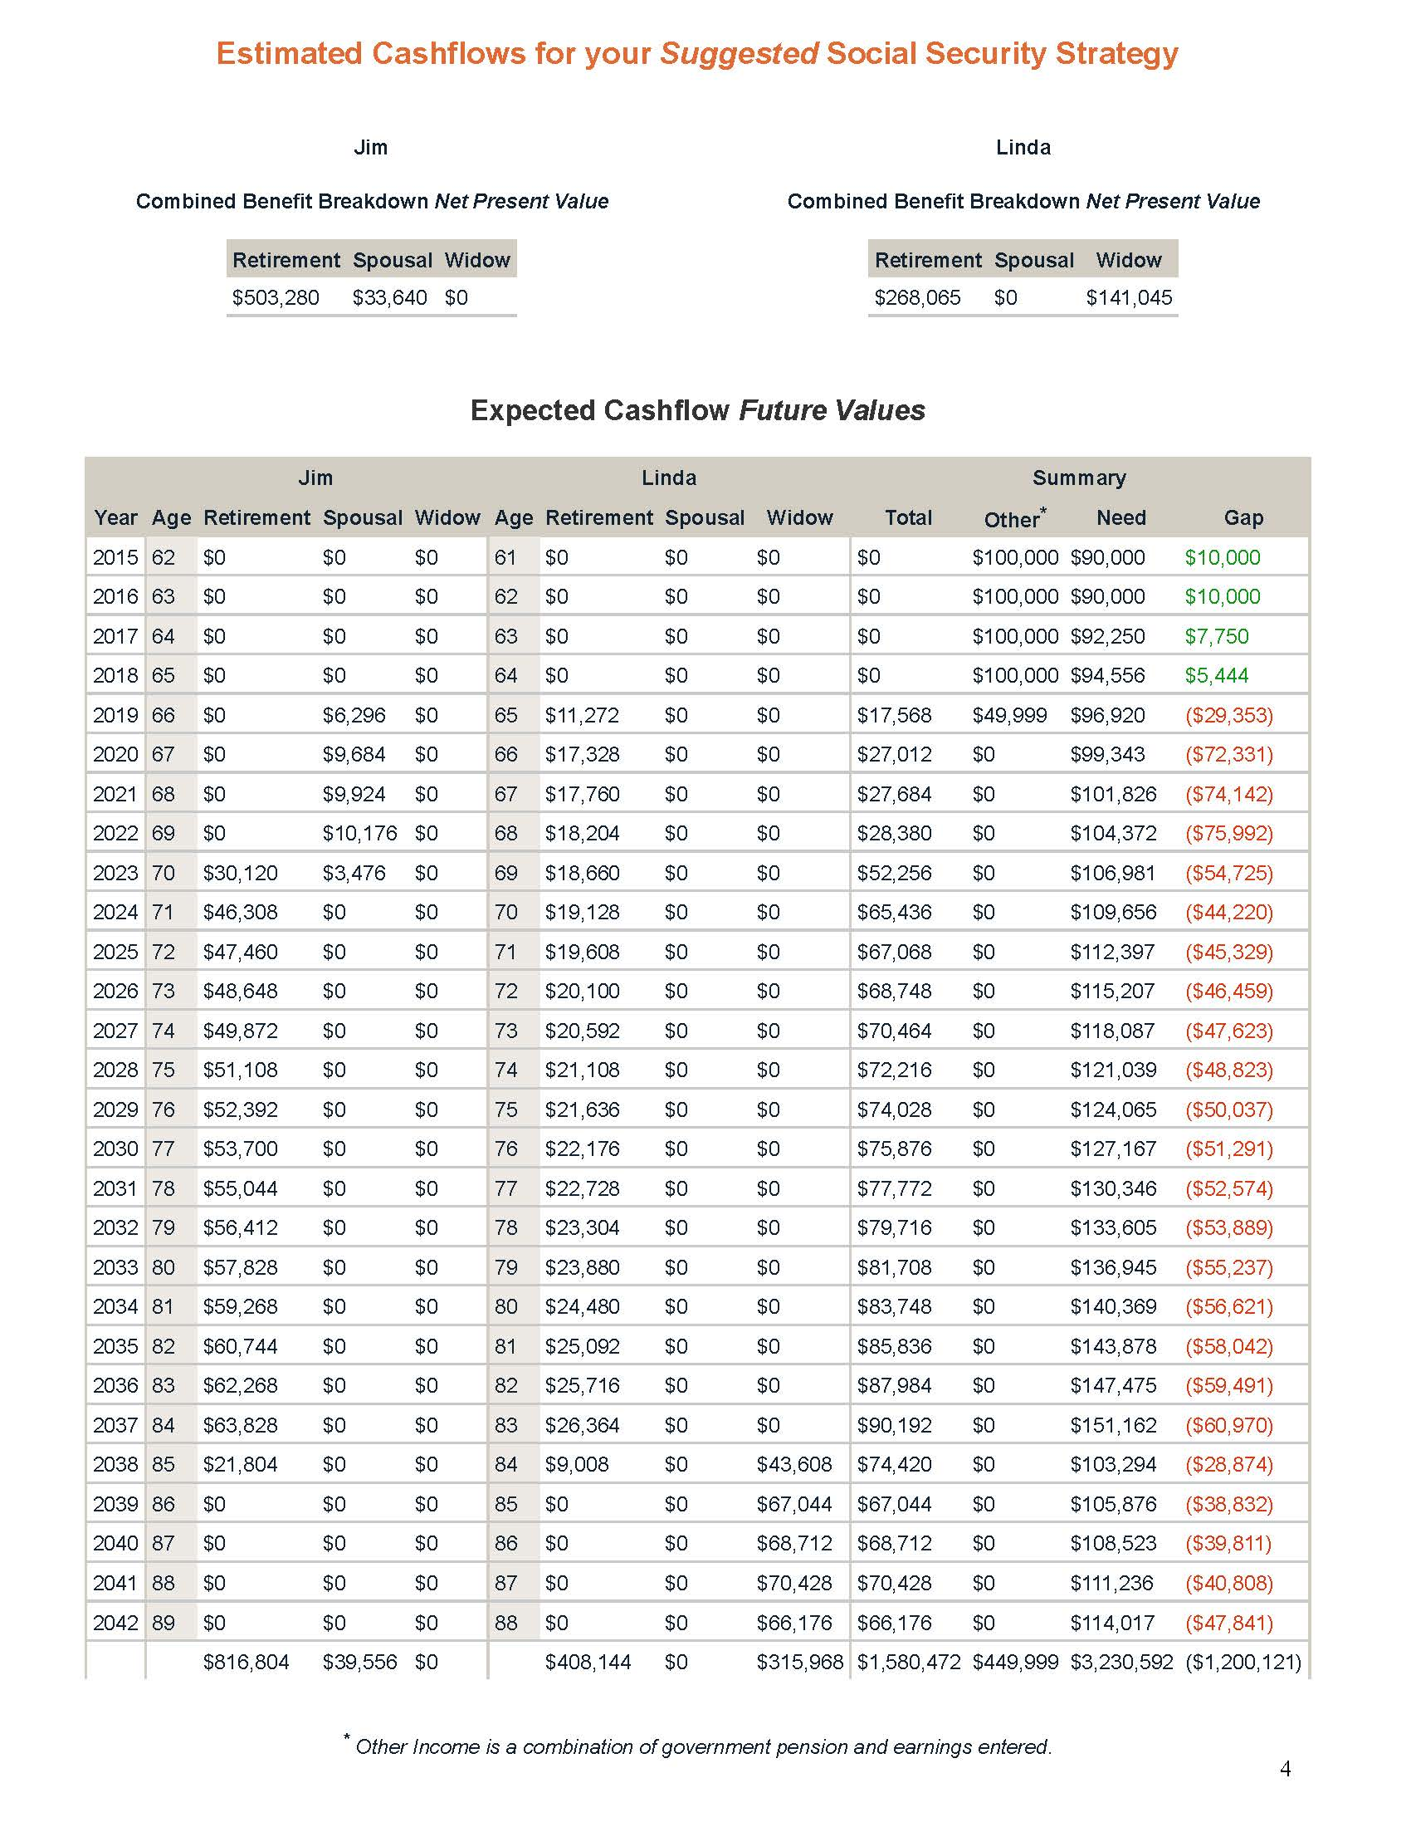
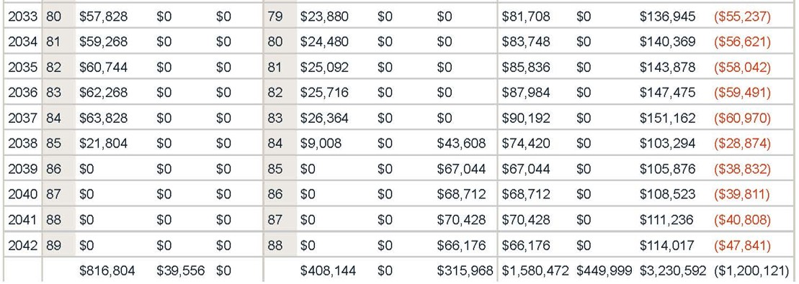
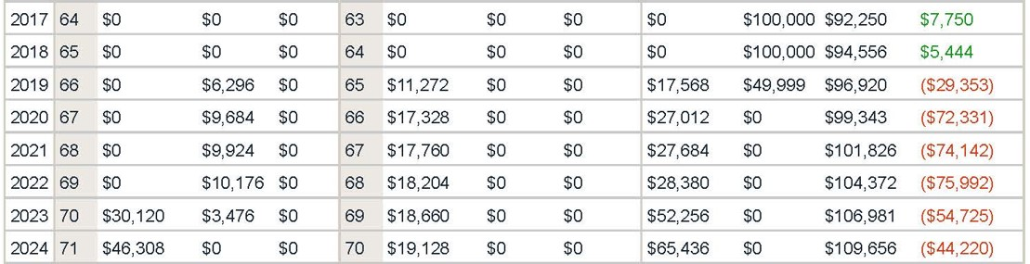
Jim and Linda both maximize their benefits
MANAGING THE SOCIAL SECURITY DISCUSSION
Cashflow analysis helps identify income gaps
After Jim passes away, Linda begins her survivor benefit.
Notes:
The report goes one step further with the Social Security income projection by presenting the actual numbers so you can see in dollars-and-cents terms what their estimated Social Security income is and what their projected retirement income gap would be.

Slide 53
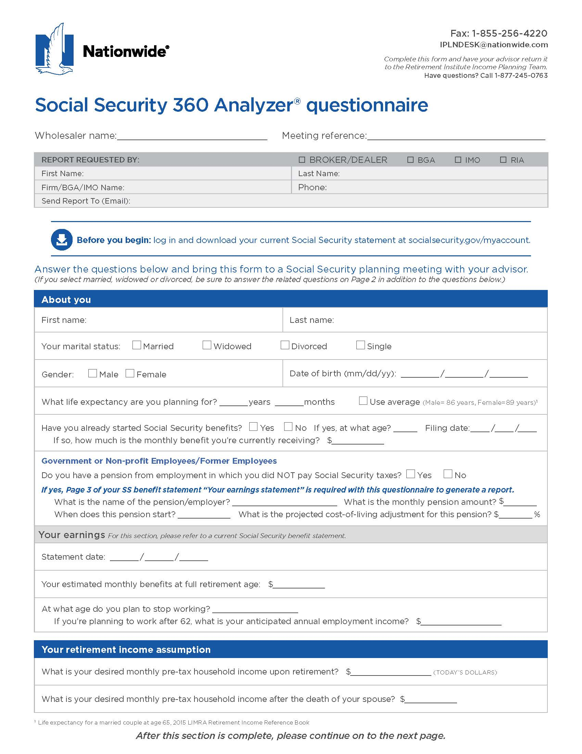
MANAGING THE SOCIAL SECURITY DISCUSSION
Social Security client questionnaire
Helps gather relevant client information to prepare a filing strategy comparison
Marital status
Expected benefit amount
Life expectancy
Planned retirement date
Desired retirement income
Retirement goals, concerns, etc.
Notes:
No individual (single or married) will fit easily into one scenario that allows for simple planning for their Social Security decision. There are many ways you can take advantage of the different Social Security rules out there.

Slide 54
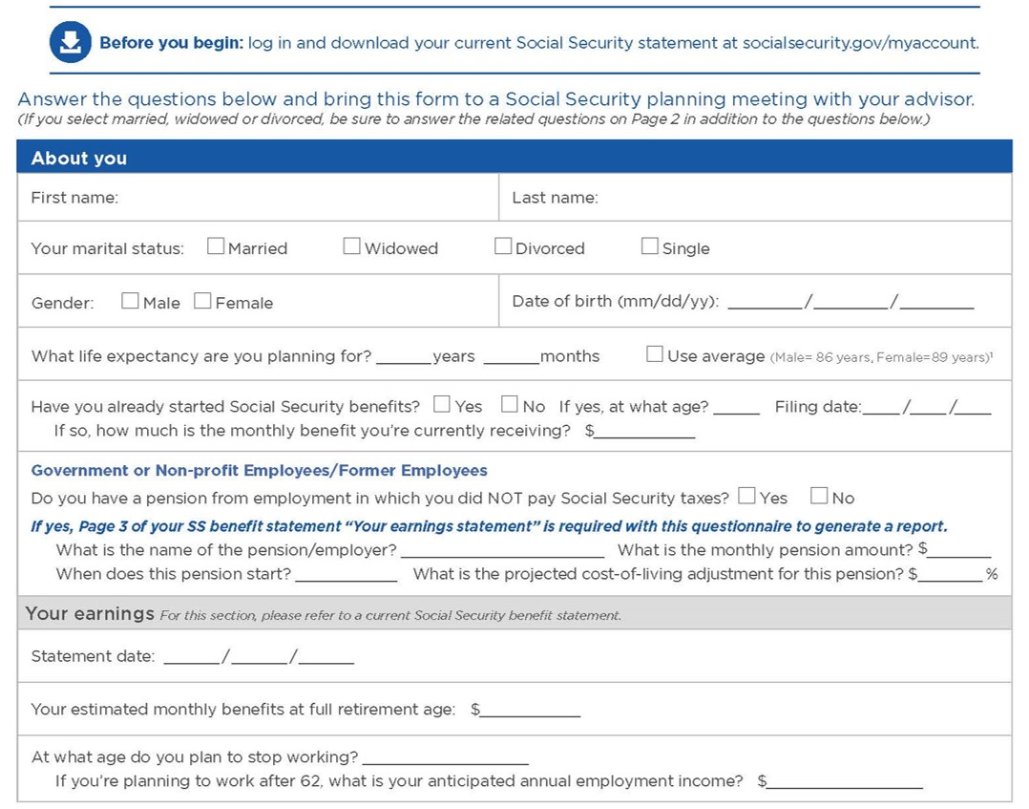
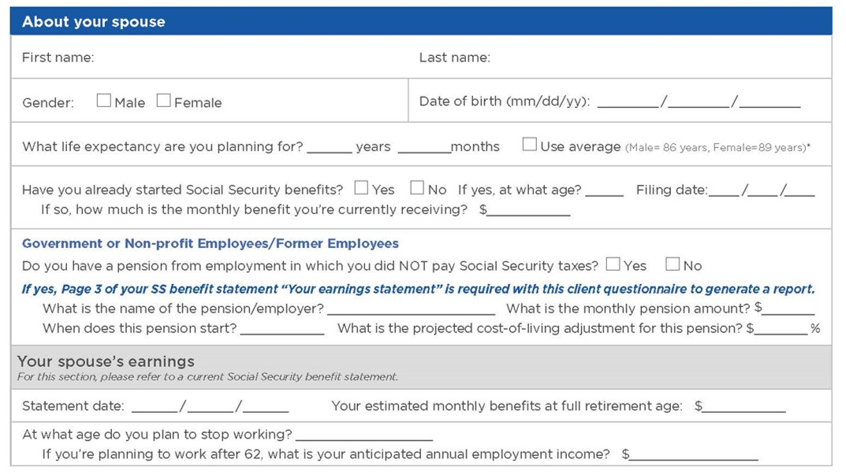
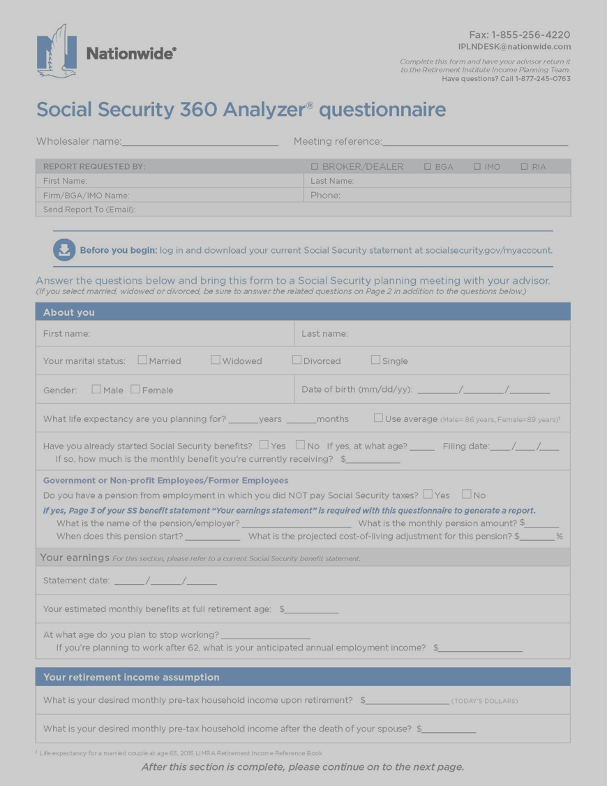
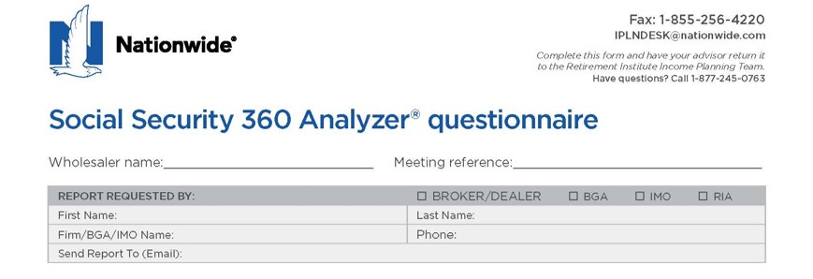
MANAGING THE SOCIAL SECURITY DISCUSSION
Social Security client questionnaire
Notes:
The questionnaire asks a series of questions about your plans for retirement, such as:
Basic information – such as your current and past marital arrangements, the year you were born and your expected SS benefit amount.
Then your retirement income goals

Slide 55
MAKING YOUR SOCIAL SECURITY DECISION
The choice of a lifetime
When and how you file for Social Security is an important decision
Learn how to claim benefits for other family members and how to put the filing rules to work
Consider your filing decision in the big picture of your overall retirement income plan
Notes:
Your Social Security decision is an important one, and how you choose to file matters.
No matter what your income level is, Social Security benefits are a significant source of retirement income
And the choices you make about how to file can have a lasting impact on your financial situation in retirement
Your financial advisor can help you make a Social Security decision that fits within your overall retirement income plan.
Know how to use the power of delaying and how to put the spousal and other rules to work in order to optimize benefits and provide some income protection for a surviving spouse.

Slide 56
MAKING YOUR SOCIAL SECURITY DECISION
Three steps in Social Security planning
Get a good understanding of the basics of Social Security
Make an appointment to discuss your Social Security options
Complete a Social Security questionnaire in advance of the meeting
Notes:
Three steps for planning your Social Security decision.
First, get a good understanding of the basics of Social Security and how you may be able to use the filing rules – your attendance today completes this step.
Next, make an appointment for a one-on-one discussion with your advisor about your Social Security options.
Complete a Social Security fact finder in advance of the meeting and bring it with you to help in the discussion with your advisor.
Thank you for your time today.

