Slide 1
This is a solicitation of insurance. An insurance agent or insurance company will contact you.
The State Life Insurance Company®
Do you have a gap in your strategy?
Overcome your great retirement income gap
PM-852
Notes:
Do you have a gap in your retirement strategy? Let’s talk about the great retirement income gap and make sure you’re prepared to overcome it and retain your peace of mind.

Slide 2
Disclosures
Products are issued and underwritten by The State Life Insurance Company® (State Life), Indianapolis, IN, a OneAmerica company that offers the Care Solutions product suite. Asset-Care Form numbers: L301, R501 and SA31; Annuity Care and Annuity Care II Form numbers: SA34, R508; SA35; Indexed Annuity Care Form numbers: SA36, R529 PPA, R529, R530 PPA and R530. In ID: L301 (ID); SA31, R501; SA34, R508; SA35(ID). Not available in all states or may vary by state. Guarantees subject to the claims paying ability of the issuing insurance company. The policies and long-term care insurance riders have exclusions and limitations. For cost and complete details of coverage, contact your insurance agent or company.
Provided content is for overview and informational purposes only and is not intended as tax, legal, fiduciary or investment advice.
All numeric examples are hypothetical and used for explanatory purposes only. Please note that the replacement of an existing life insurance contract or an annuity must not be made unless all factors are weighed and it is documented as suitable for the client.
[Agency name/logo] is not an affiliate of the companies of OneAmerica.
NOT A DEPOSIT • NOT FDIC OR NCUA INSURED • NOT BANK OR CREDIT UNION GUARANTEED
• NOT INSURED BY ANY FEDERAL GOVERNMENT AGENCY • MAY LOSE VALUE

Slide 3
Preparing for retirement

Slide 4

What’s your goal when mountain climbing?
Or to get back down successfully?
To get to the top?
PM-828
Notes:
What is the goal when climbing a mountain? Most people would say to get to the top.
The answer should really be to get back down the mountain successfully.

Slide 5
Accumulation
Distribution
Notes:
As you’re preparing for retirement, you are in the accumulation phase, or climbing up the mountain. But as you enter retirement and come down the mountain, you enter the distribution phase. It’s an important time to focus on your strategy for retirement income.

Slide 6

Issues that affect your descent
Having enough retirement
income
Low interest rate market
Healthcare costs
Long-term care costs
Notes:
Everyone needs a plan to safely get down the mountain. Certain obstacles can send you on detours or make you halt your descent altogether. These issues and obstacles can include:
Having enough retirement income
Low interest rate market
Rising healthcare costs
Having enough income to pay for long-term care

Slide 7
In your retirement years, what could cause your income needs to suddenly skyrocket?
For example, you are living well on $100,000 per year.
One day you call me to say you need to begin taking out an additional 50-70% more every year in addition to the
$100,000 you’re already using.
What might happen in your life to
cause this situation?
A health issue?
Or you or your spouse need assistance in your
home or a care setting?
Notes:
Consider these questions.

Slide 8
Where do you get the income to fill that gap?
Many will begin liquidating other investments like managed accounts, annuities, or cash equivalents
Will this affect your retirement income plan?
Will your assets last?
Can you get a rate of return high enough to get an additional $75,000 per year for the entire length of your care?
Notes:
Consider these questions.

Slide 9
Health statistics
A majority of Americans age 65+ (70%) will need some form of long-term care in their lifetimes.
Of the 70%, 1-in-5 will require long-term
care for more than 5 years.
Source: “How Much Care Will You Need?” LongTermCare.gov. U.S. Department of Health and Human Services. https://longtermcare.acl.gov/the-basics/how-much-care-will-you-need.html. Web. 21 February 2017.
PM-828
Notes:
Let’s talk more about healthcare costs.

Slide 10
What about Alzheimer’s disease
About 5.5 million Americans of all ages have Alzheimer’s disease in 2017 (1-in-10 people age 65+).
  Of all Americans with Alzheimer’s, an estimated
  5.3 million people are 65 or older.
  By midcentury, someone in the U.S. will develop the disease every 33 seconds.
If you had to pay for long-term care,
where will you make up the difference?
Source: 2017 Alzheimer’s Disease Facts and Figures. Alzheimer’s Association. http://www.alz.org/documents_custom/2017-facts-and-figures.pdf. Web. 2017.
PM-828
Notes:
These numbers will escalate in coming years as the baby boom generation continues to age past 65, when their risk of developing Alzheimer’s disease is highest.

Slide 11
What is long-term care?
More than statistics, facilities and emotional conversations …
Long-term care is another retirement expense that can cause your income needs to increase substantially.

Slide 12
A gap exists
Notes:
Let’s learn more about that gap.

Slide 13
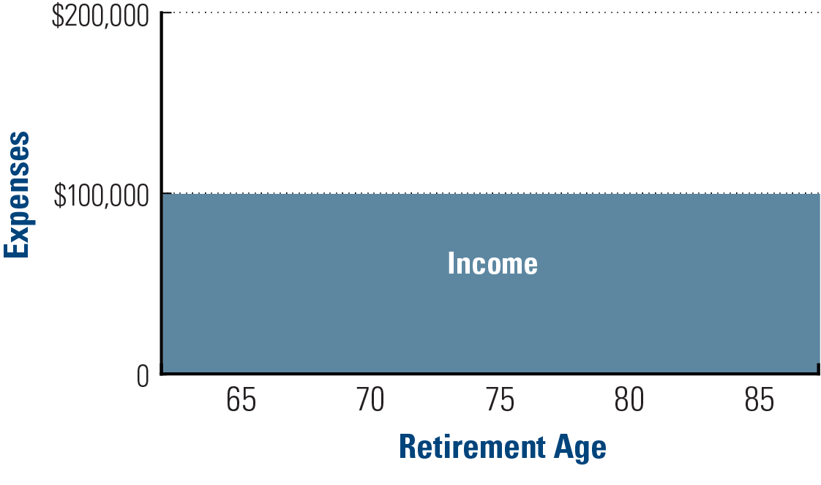
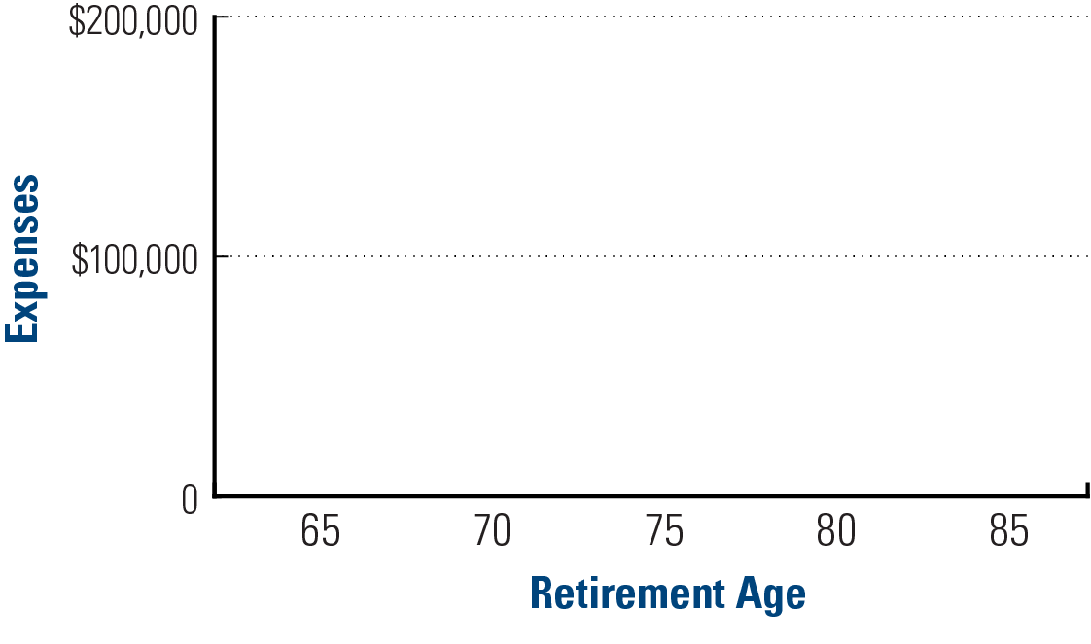
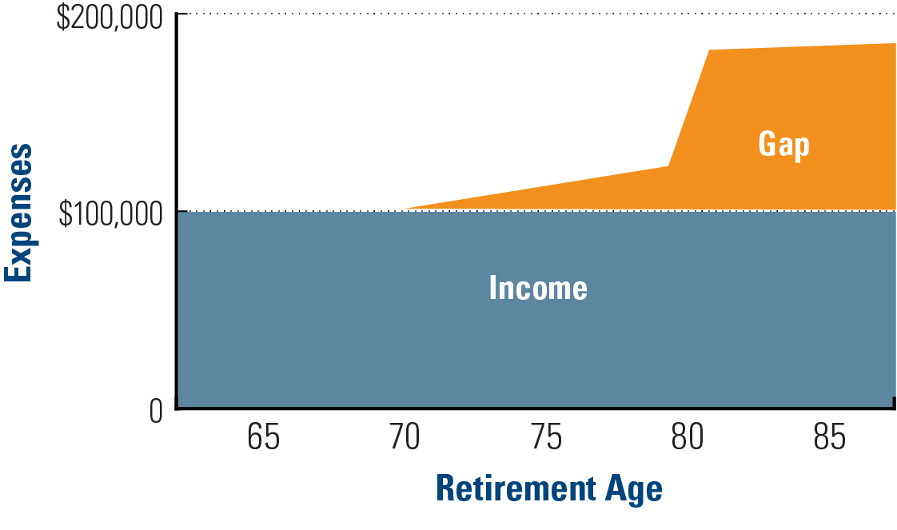
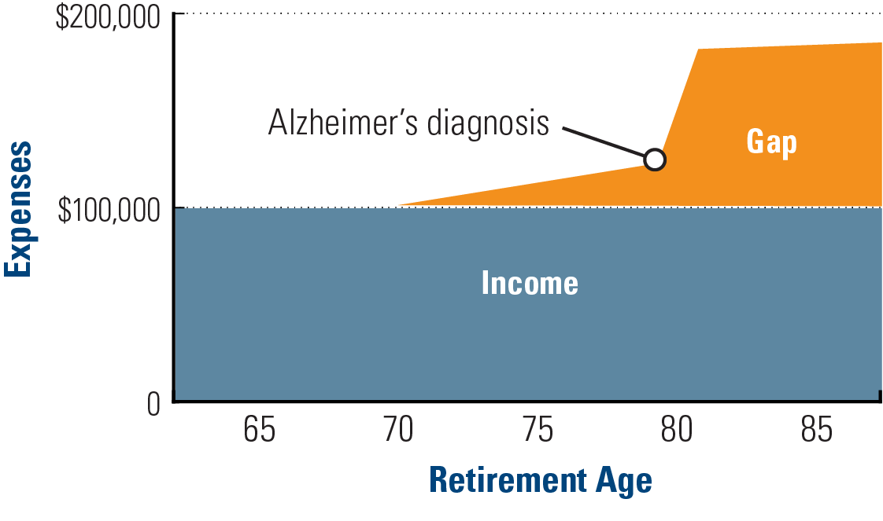
The great retirement income gap
But what happens if your income needs suddenly skyrocket?
But what happens if you’re diagnosed with Alzheimer’s?
An income gap exists when your expenses exceed your expected retirement income.
In this example, you could be living comfortably on $100,000 a year.
PM-828

Slide 14
How to bridge the gap
Option 1: Liquidate other investments
  Managed accounts
  Annuities
  Cash equivalents

Slide 15
How to bridge the gap
Option 2: Asset-based long-term care
Moderate
LIFETIME
to pay for the entire length of care
Aggressive
$$$
Conservative
Typical portfolio assets:
Aggressive — assets positioned for significant growth and accepting the risk of principal loss
Moderate — assets positioned for some growth and accepting some downside risk
Conservative — assets positioned for principal conservation, often with guarantees
PM-828
Notes:
So, how do we create this income stream to fill the “gap”?
If you were to self-fund, this is an example of an option that may work for you. This is the concept of asset-based LTC
If a portfolio has moderate, conservative, or aggressive type assets, most will prefer to use their conservative assets first in the event of needing LTC.
The government has allowed certain life insurance and annuity contracts to be accessed, while alive, tax-free, for expenses associated with needing long-term care.
By using this option, you could reposition an amount into a specific policy that is designed to provide a stream of money to pay LTC expenses to help avoid pulling the money directly out of other investments. Lifetime coverage is the ONLY option to help cover the entire length of an extended care need due to illnesses such as Alzheimer’s, Parkinson’s, and Dementia.

Slide 16
The Care Solutions concept
Base policy
Rider (continuation of benefits) policy
Lifetime
Life insurance or annuity
Funding:
Cash lump sum
Annual premiums
Nonqualified annuities
Qualified money
Cash value life insurance
Rider
Funding:
Cash single premium
Fixed annual premium
Notes:
We rarely get asked, “how does this work if I die?”. Most people understand how life insurance and annuities work when someone passes away. However, we usually get asked, “How does this work if I need it for my care?”.
This diagram that I will show you will explain how the concept works!
We call this our “Timeline”. To the left is day one and a plan will begin with either a life insurance policy or an annuity first. We call this the “Base Policy”. Once the base policy is exhausted, the “Rider” kicks in and keeps paying the amount for lifetime.
You may fund the life policy via cash, CDs, savings, life insurance cash values, and qualified retirement money! There are also payment options available for those using an income stream to pay rather than an asset reposition. The annuity option uses non-qualified money only. The Rider may be funded by single premium or fixed annual premiums. These premiums are guaranteed to never increase and have tax incentives.

Slide 17
Funding examples

Slide 18

Convert a CD or money market account
Hypothetical example
This married couple earns a good income and has done a great job preparing for retirement — except for arranging LTC protection.
They’re not concerned about needing care for the average length of stay because they’ve accumulated assets.
Their main concern is that one or both of them may need extended care due to Alzheimer’s, Parkinson’s or dementia.
They understand lifetime protection is the only option for their needs.
Male, age 60
Female, age 60

Slide 19

Convert a CD or money market account
Hypothetical example
$140,000 premium
$104,895
$35,102
Male, age 60 Female, age 60
Base and rider: $140,000 lump sum from CD
$75,000 per year EACH — lifetime income stream for long-term care expenses
$150,000 per year for BOTH — lifetime income stream for long-term care expenses
Investing $140,000 @ 53% guaranteed would generate $74,200 for lifetime for one
Investing $140,000 @ 106% guaranteed would generate $148,400 for lifetime for both

Slide 20

Using earned income
Hypothetical example
This married couple has a high income and would like to cover all aspects of their retirement strategy.
They saw what their grandparents went through and how their parents had to become caregivers. Now, they want to keep that situation from happening to their children.
They have a health savings account and prefer using tax-free money.
They have plenty of life insurance.
Male, age 49
Female, age 48

Slide 21
Using earned income
Hypothetical example
$3,825 premium
$2,621
$1,204 (using HSA)
Male, age 49
Female, age 48
Base contract: $2,621 per year
Rider contract: $1,204 per year (using the HSA)
$75,000 per year EACH — lifetime income stream specifically for long-term care expenses
$150,000 per year BOTH — lifetime income stream specifically for long-term care expenses

Slide 22

Using required minimum distributions
Hypothetical example
This married couple has an income stream that meets their financial needs. They don’t currently use their RMDs.
The RMD amount is $11,000.
Their financial advisor has managed their investments well, and they don’t want to reposition a lump sum.
They understand the costs and can supplement with other income if they incur care expenses.
Male, age 70
Female, age 71

Slide 23
Using required minimum distributions
Hypothetical example
$11,030 premium
Male, age 70
Female, age 71
$6,994
$4,036
Total premium: $11,030 per year
$60,000 per year EACH — lifetime income stream specifically for long-term care expenses
$120,000 per year BOTH — lifetime income stream specifically for long-term care expenses

Slide 24

Using the income rider on an existing annuity
Hypothetical example
This client is concerned she’ll need care. She doesn’t want to become a burden to her family members, who are scattered across the country.
She has a good income but cannot afford additional expenses.
She bought an annuity with an income rider several years ago and has no plans for that income.
She decided to turn on the $12,000 income rider (withholding 20 percent for taxes) to pay for her policy.
Female, age 65

Slide 25

Using the income rider on an existing annuity
Hypothetical example
$9,600 premium
$7,448
$2,152
Female, age 65
Total premium: $9,600 per year
$79,056 per year — lifetime income stream specifically for long-term care expenses
$6,588 per month — lifetime income stream specifically for long-term care expenses

Slide 26

Using an existing annuity with a 3 percent guarantee
Hypothetical example
This client had an annuity with a 3 percent minimum rate guarantee, about $125,000. She doesn’t need it now but would if “something bad happens.”
To 1035 exchange to another fixed annuity it would need to show tax-free income to pay for long-term care expenses and lifetime benefits to pass the suitability requirements because of the higher guaranteed interest rate.
She liked that the annuity would allow her to stay in her home as long as possible if she became frail. Her children also understood this.
Female, age 81

Slide 27

Using an existing annuity with a 3% guarantee
Hypothetical example
$125,000 premium
$102,500
$22,500
Female age 81
Base and rider contract: $125,000 through a 1035 exchange
$36,000 per year — lifetime income stream specifically for long-term care expenses
Investing $125,000 @ 29% guaranteed would generate $36,000 for lifetime

Slide 28

Using existing annuity through a 1035 exchange
Hypothetical example
This client, recently retired, has a solid strategy and good pension that will provide her the income she needs.
She purchased this annuity years ago with a life insurance death benefit after her husband passed. The value has grown substantially.
When her advisor asked what she plans to do if she becomes frail, she said she’s concerned she won’t have enough. Yet she does not want to pay premiums.
She doesn’t have children, so the idea that the insurance company could pay her care provider when she’s not able to is very appealing.
Female age 63

Slide 29

Using an existing annuity through a 1035 exchange
Hypothetical example
$150,000 annuity
$150,000
$450,000 Continuation of benefits
Female age 63
$600,000
total amount
Base and rider contract: $150,000 through a 1035 exchange. Internal charges pay
for the rider.
$75,400 per year — 8 years of income specifically for long-term care expenses
$6,291 per month — 96 months of income specifically for long –term care expenses

Slide 30
Bridge your gap

Slide 31
Next steps
1. Start the conversation with your loved ones about your potential exposure to long-term care costs — and the impact on your retirement savings
2. Schedule a meeting with your trusted financial professional.
3. Explore the options available for you.
4. Design and complete a financial strategy that meets your objectives
5.Tell your loved ones about your strategy.

Slide 32
Let’s address your great retirement income gap today!
[LOGO]
Contact [agency name].
[phone]
[email]
[website]

