Slide 1

Overcoming the Bottleneck in Your Business
Grow your practice by doing one or two things you already know how to do
Overcoming the Bottleneck in Your Business
Use Focus Management to
Build Your Business
Copyright © 2017 by Hartford Funds. All rights reserved. No part of this document may be reproduced, published or posted without the permission of Hartford Funds.
Notes:
Good morning/afternoon everyone. My name is __________, and I’m a [insert title] with Hartford Funds. Thank you for taking time out of your schedule to be here today.
I’m especially appreciative that you’re here because I realize how precious your time is. As a financial advisor, ineffective time management is often the biggest bottleneck in your business.
That’s why I’m here to talk to you about the topic of time management. I know, I know―you’ve probably been to more training and read books about it; some of which were helpful and some that were not. Maybe you haven’t gotten good advice, and maybe you’ve gotten good advice but haven’t been able to implement it as well as you’d like. Or you haven’t stopped struggling with the same old challenges. Many traditional time management techniques just aren’t relevant any longer in today’s world.
But even if we could magically tack on five more hours to our day, it wouldn’t benefit us if we were still mismanaging that extra time. The problem would still exist.
After this presentation, you’ll learn a method you need to manage your time―your most valued commodity; priceless and irreplaceable―successfully.
And yes, it is possible. I usually tell friends and colleagues, “You’re closer to doing it than you think, and only about two steps away from getting a handle on it.” Really—it’s true!
Next, I’d like to share an analogy with you.
[next slide]

Slide 2

The Time Bank
Notes:
Imagine there’s a bank that you have access to, and it credits your account each morning with $86,400. At the same time, it does not allow your balance to be carried over day to day, because at the end of every day, it will cancel out any remaining money you didn’t use.
Now, if you had access to $86,400 every day, what would you do? You’d probably want to use every dollar, every day. Well, this bank has a name: It’s called Your Time.
Every day, you are credited with 86,400 seconds. And every night it writes off every loss, which would be every second you didn’t invest.
The point I’m making is, there’s never enough time; there’s never too much time. But if you don’t use it, you lose it.
We’re going to cover this topic in three sections.
[next slide]

Slide 3

Agenda
Your Most Precious Commodity
Scaling the Value of
Your Time
Pillars
Notes:
[read slide]
Your most precious commodity
Scaling the value of your time
Pillars

Slide 4

Your Most Precious Commodity
Notes:
Time is our most precious commodity.
Why? It is the only thing in your business that cannot be scaled.
You can scale the number of clients you have in your practice; you can scale the level of assets in your practice; you can scale the number of assets per client. But I have yet to meet someone who can squeeze 25 hours out of a day.
To be a top-performer in your field, you do not need extraordinary skills. If you have them, great! But more than that, you need to focus on the right activities, day after day after day.
We all get the same number of hours in a week. The difference is simply how we spend them. So I ask you, are you spending your time being busy, or are you spending your time being effective? On a daily basis, are you increasing your business, or are you increasing your busyness?
Although we can’t scale your time, we can exponentially increase the value of our time. Not only is it the only possible approach, it’s the rational approach.
Before we talk about how to exponentially scale the value of your time, I need to ask you this question.
[next slide]

Slide 5
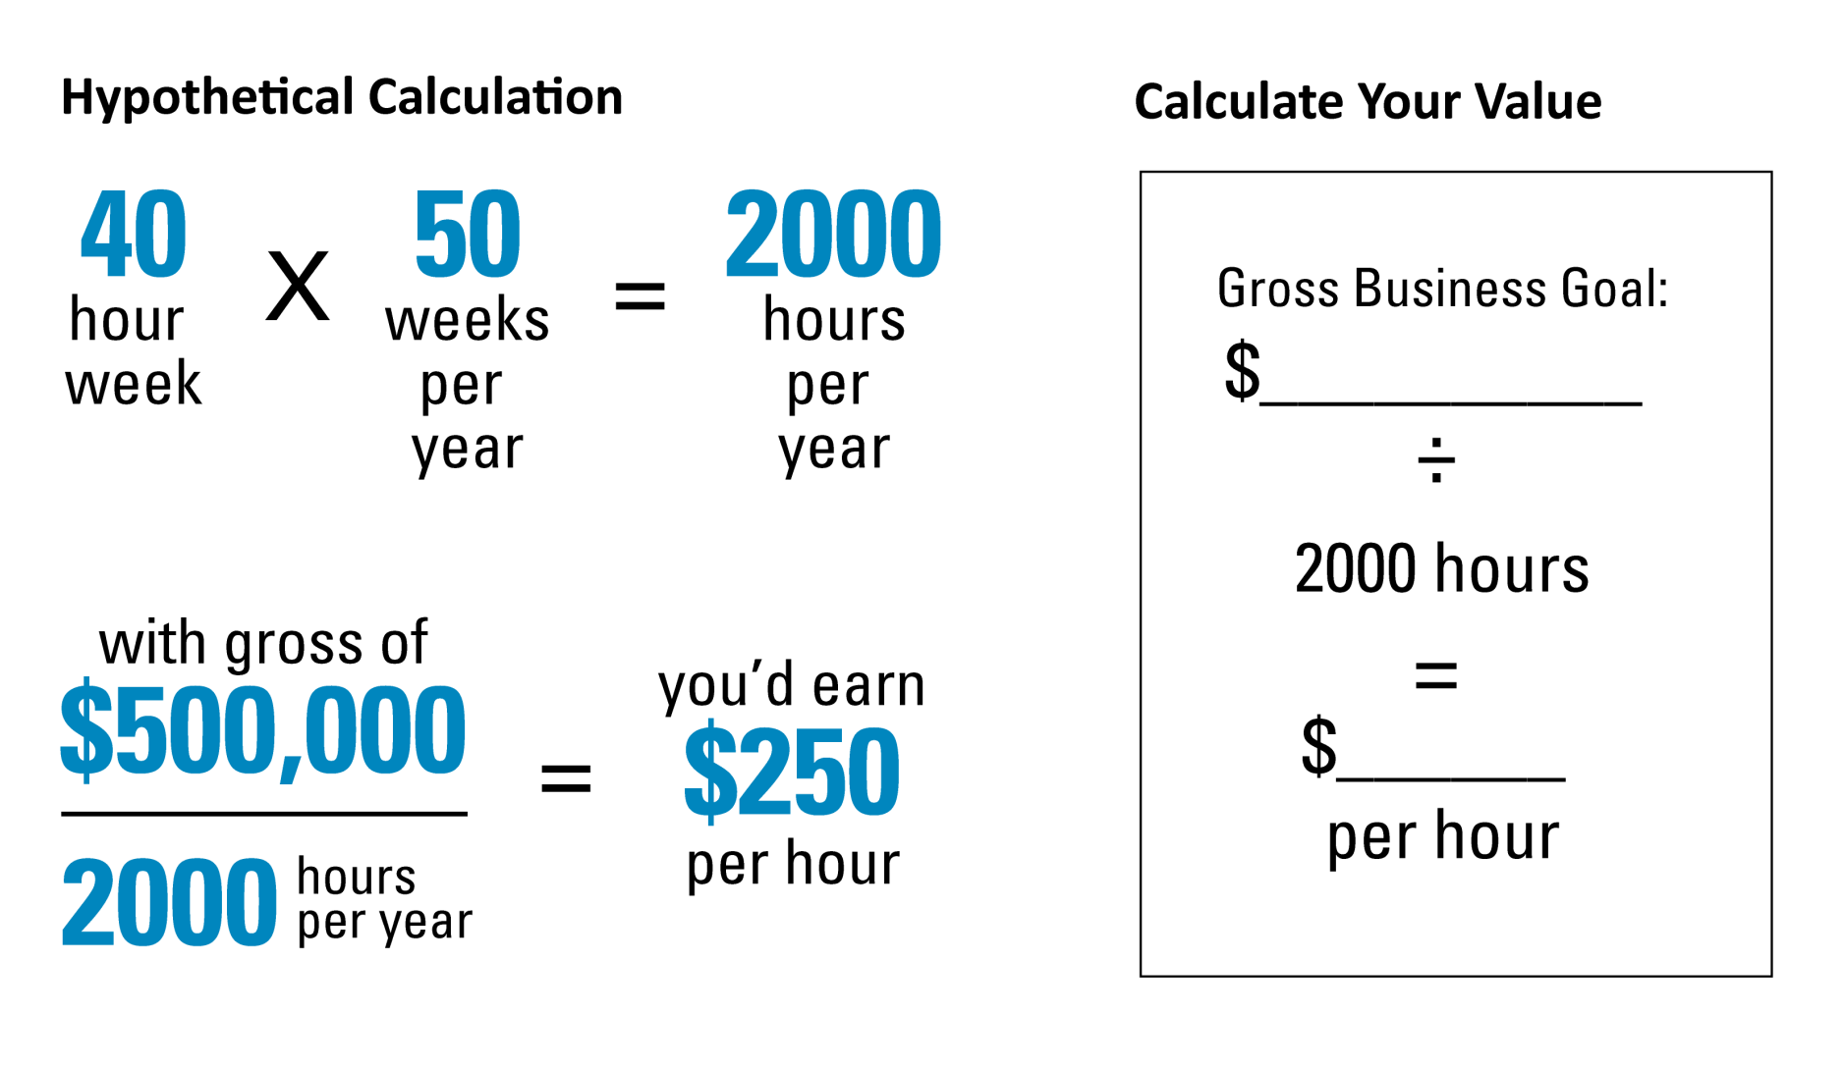
Your Most Precious Commodity
What Is Your Time is Worth?
Notes:
What is your time worth?
Suppose your peak business hours are nine to five, Monday through Friday. Forty hours a week times 50 weeks a year (to factor in time out of the office), equals 2,000 peak office hours.
Now, if you take your gross income and divide it by the number of peak office hours (in this case, 2,000), you will get your “hourly rate.”
You need to do your own calculation to answer the question of What is your time worth? before we can identify who or what is worth your time.
Now that you know what your time is worth, how to we increase the value of those hours?
[next slide]

Slide 6
Your Most Precious Commodity
The 80/20 Rule
80% of productivity is being driven by 20% of your activity
The minority of your activity is driving the majority of your productivity
What are those high-impact activities that we can scale?
Notes:
Surely you’ve heard of the 80/20 rule. It’s not a hard-and-fast rule, but chances are if you look at several key metrics in your business, and even outside your business, there’s a minority producing a majority.
In a business capacity, discovering 80/20 ratios is crucial for maximizing performance. Find the activities that generate the most income (the 20%, generally) and eliminate the rest (the 80%)―those activities that provide only minimal benefits. Focus on the elements of your business that you can improve significantly with your core skills.
In short, work hardest on the components that work hardest for you and therefore produce the best outcomes.
[next slide]

Slide 7

Scaling the Value of Your Time
Notes:
While we obviously cannot increase the amount of hours we have in a day, we can scale the value of our time.
The only way to exponentially increase the value of your time is to look, understand, implement, and execute a model using three categories of time management.
[next slide]

Slide 8
Scaling the Value of Your Time
Urgent/
Significant
Proactive/
Significant
Insignificant
Urgent/
Significant
Proactive/
Significant
Insignificant
Notes:
We need to size up your daily method of operation and determine whether you are spending your time being busy or investing your time being productive. As the great Peter Drucker once said, “Efficiency is doing things right; effectiveness is doing the right things.”
Here is a simplified view of your business day. Each activity you work is based in one of these three categories: Urgent/Significant; Insignificant; Proactive/Significant.
Again, we want to ensure that you are working on the right things at the right time, day after day after day. So let’s define each of these labels.
[next slide]

Slide 9
Scaling the Value of Your Time
Please magnify boxes 1 and 4, with boxes two and three in the background.
Urgent/
Significant
Proactive/
Significant
Insignificant
Urgent/
Significant
Proactive/
Significant
Insignificant
Notes:
Urgent/Significant: These are tasks that tend to get done naturally. An easy example of an important and urgent activity is a client or business meeting and all the activities required to prepare for and host it. If you’re successful in your role, you’re already well-prepared for these meetings and show up on time.
[next slide]

Slide 10
Scaling the Value of Your Time
Urgent/
Significant
Proactive/
Significant
Insignificant
Urgent/
Significant
Proactive/
Significant
Insignificant
Notes:
Insignificant: These tasks are a huge interference on our daily method of operations.
Examples of Insignificant:
Most emails, voice-mails
Almost every random, unannounced client walk-in (or social call)
Unnecessary meetings and interruptions
Meaningless reports
Emails and voicemails: You have to get them at some point but that does not mean right now.
Stephen Covey himself said that “urgency creates the illusion of importance.” If you’re in the practice of checking your iPhone, 80-90% of those email and voice-mail messages are not important. They’re urgent, meaning you need to return the messages at some point but again, not right now—and it’s not significant (or important). These are things often distract us from our priorities.
The consequences of being lured away from important work are stiff, as you’ll see on the next slide.
[next slide]

Slide 11


Scaling the Value of Your Time
The average distraction can cost you 25 minutes to get refocused²
Managing multiple screens
Glancing at your phone
Answering a text
Switching to your desktop to read an email
Reading pop-up messages in the corner of your screen
Off-screen
Coworker’s conversation crossfire
Visit from someone with a “quick question”
²Brain, Interrupted, http://www.nytimes.com/, 5/3/13 , most recent data available
Notes:
Did you know that the average distraction can take a 25-minute bite out of your day, spent on being refocused?
Technology is a blessing in many ways but if not controlled, it’s also a curse.
Gloria Mark is a professor of informatics at the University of California, Irvine, who studies digital distraction. She found that office employees are “interrupted—or self-interrupt—roughly every three minutes.” Interruptions can take both digital and human forms, while “Self-interruption” is basically switching tasks to allow for multi-tasking.
Once sidetracked, it can take approximately 25 minutes for a worker to resume the original task.
In addition, according to a report from the McKinsey Global Institute “the average interaction worker spends an estimated 28 percent of the workweek managing e-mail.”³
That’s nearly a third of a worker’s time—in a week!
Consider this: Your email inbox is someone else’s agenda. When you’re responding to emails, you’re replying to what’s important to them—not to you.
So how to we mitigate those costly interruptions?
[next slide]
³The social economy: Unlocking value and productivity through social technologies, www.mckinsey.com, July 2012, most recent data available used

Slide 12

Scaling the Value of Your Time
Time-blocking
For the Insignificant tasks
The OHIO Principle (Only Handle It Once)
Notes:
The greatest way to avoid getting mired in the Insignificant box is through the art of “time-blocking.”
Time-blocking is essential. You can set a timer 30 minutes and focus exclusively on responding to things like emails and voice-mail messages. During that time, one of two things is going to happen:
You can hold that focus and be blown away by what you can accomplish in 30 minutes,
You’re going to be equally blown away realizing that you aren’t able to stick to one thing for 30 minutes. Either way, you win.
Either way you win. That’s the art of time-blocking.
One method of time-blocking is called the OHIO Principle: Only Handle It Once. If you’re going through your unanswered emails—or voicemails—for 30 minutes, only handle it once. Either do it, delegate it, or delete it. Don’t let the urgent pile up, especially when you’re trying to eliminate it.
[next slide]

Slide 13
Scaling the Value of Your Time
Urgent/
Significant
Proactive/
Significant
Urgent/
Significant
Insignificant
1. Important & Urgent
Proactive/
Significant
Insignificant
4. Neither Urgent nor Important
3. Urgent, but Not Important
Notes:
Because the Insignificant can create the illusion of being important, what suffers the most? The Proactive/Significant. If something is Proactive/Significant, simply put, it means it directly or indirectly leads to the health and/or growth of your business.
“Pings and dings” are constantly pulling us away from those tasks. If you’re attending to Insignificant tasks when it’s prime time for meetings with clients or associates, you’re not using your time wisely. You’re leaving opportunities for growth on the table.
[next slide]

Slide 14
Scaling the Value of Your Time
Examples Proactive/Significant Activities:
Training & development
Marketing
Practice management
Presentation planning and preparation
Strategic planning
Building your acumen & competency in different aspects of your business
2. Important, but Not Urgent
3. Urgent, but Not Important
4. Neither Urgent nor Important
Notes:
[read slide, include a personal story or examples that are analogous to other business professionals; an example from the financial services industry is below]
I’ve worked in financial advisors for years. Many times, colleagues have admitted to me that they’ve been in a conversation with a client or prospect that was leading to an opportunity to position a product or service that would have great for the client, the practice, and the advisor. But the advisor began pumping the brakes, so to speak, because they advisor didn’t have the confidence or competence to go down that path with them; they didn’t have the conviction. And the odds are that if it’s happened once, it’s happened more than once.
So why aren’t more people taking the time to develop the skills in the areas that matter most and are the most lucrative?
Because they’re not urgent. There’s nothing on your calendar giving you a deadline for completing these sorts of projects. You may not feel the consequences or impact of this immediately, but the long-term effect on the health and wealth of your business is significant. Over time, it has a negative impact.
How do we prevent that? We turn the Proactive/Significant box into pillars.
[next slide]

Slide 15

Pillars
Notes:
We need to develop better habits and rituals. Things that, no matter what happens, you’re going to do X amount of the important tasks in said time period.
The problem is that basically everything that will can ultimately lead to the health and/or growth of your business gets pushed to the side because you’re bogged down in day-to-day minutiae: emails, voicemails, and tending to unplanned events at random times that aren’t on our calendar.
Brian Margolis is the founder of ProductivityGiant.com and what he has named the Pillar System. The premise is that the establishment of a few pillars, when prioritized and focused on, are guaranteed to move your business or project forward.
“Pillars” are the reason some people stay busy all day without moving the needle, while others seem to make leaps and bounds without breaking a sweat.
Pillars replace time management with focus management.
[next slide]

Slide 16
Pillars
The 6 Characteristics of a Pillar
Activity in the PRO/Significant category
High-leverage activity
Action or predictable result
Measurable weekly
Something you know how to do
Not already a habit
Notes:
So how do you know if something if a specific activity is a really a pillar?
Here are the six characteristics that define it:
Important, not urgent: Pillars are implemented in the PRO/Significant category
High-leverage activity: “PRO” activities that, when done consistently, have the largest impact on your business
Measurable activity or a predictable result
Activities are performed and measured on a weekly basis
Something you already know how to do but don’t execute on consistently. If you did, it would grow your business and increase your earnings.
An activity that’s not already a habit, but something you want to develop into a habit. It’s not about finding the key, but about finding your key.
So how do you get started?
[next slide]

Slide 17
Pillars
?
Ask Yourself This Question:
What are one or two things you know how to do, that if you did more consistently, it would lead to
better results?
Notes:
[read slide]
What’s one thing you already know how to do, but if you did it more consistently, it would lead to better results? [allow the audience to respond; repeat their answers]
Would you say, answering more emails? Calling people back in a more timely manner? Probably not.
So what would you say? [give audience an opportunity to respond; possible answers below]
Better meetings
Earlier follow-up
Non-sales touches
Consistent communication
Whatever your answer may be, I’m almost certain it’s something that would fall into the Proactive/Significant category―but it keeps getting put off.
Choose a number that you can meet with militant discipline and methodical execution week in and week out—that’s how habits are formed.
[next slide]

Slide 18
Pillars
Real Results
Notes:
[read slide]
(Presenter can provide real-life examples of what advisors have said, attesting to the power of identifying pillars. ProductivityGiant.com provides examples as well.)
In my experience, what people have continuously found is that the activity level required to satisfy their goals is much lower than they think, if they commit to doing the activities consistently over time. It’s a compounding effect.
Set challenging goals you can meet weekly & quantify them
What is the Proactive/Significant activity or activities?
What is the activity level/frequency needed to support that goal?

Slide 19
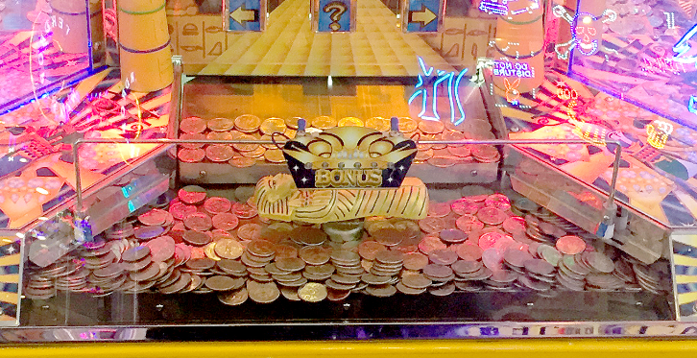
Pillars
Notes:
Coin game analogy: You know that if you put in enough quarters, you’ll eventually create an avalanche.
The same things applies when using pillars in your business. If you do “x activity” enough, I can’t tell you if it’ll be the 5th phone call or the 50th that will be the turning point, but eventually “y” will be the result.
[next slide]

Slide 20
Pillars
Feedback from the Field
“It allowed me to cut through the clutter.”
“The pings and dings no longer dominate my day.”
“I no longer felt overwhelmed all the time.”
“It gave me clarity and simplified my week.”
“I was able to get on track— and stay on track.”
Notes:
As you can see, over time these activities become so solid that all the unimportant emails, requests, shiny objects and inner dialogue that is vying for your attention stand no chance.
(Presenter can share examples of feedback)
[next slide]

Slide 21
Summary
Your Most Precious Commodity Know what your time is worth
Scaling the Value of Your Time Know what’s PRO/Significant vs. Insignificant
Pillars You’re closer than you think
Notes:
To summarize, here’s what we covered:
We’ve demonstrated that time is your most previous commodity. And for many of you, your time is probably much more valuable than your originally thought as you broker it down per hour. We need to continually ask ourselves, “Is this increasing my business, or is this increasing my busyness?”
How do we decrease our business? We do that with time-blocking. How do we increase our business? We do that by focusing on the Proactive/Significant using pillars.
If you want a strategy that moves you towards clarity, simplicity and most importantly, results, use the pillar system.
[next slide]

Slide 22
The Bottom Line
The activity level required to satisfy your goals is much lower than you think—if you commit to doing these activities consistently over time.
Notes:
[read slide; next slide]

Slide 23
Next Steps
Apply the pillar system to your practice:
Understand the 3 activities categories
Know the 6 characteristics of a pillar
Identify your pillars
Enlist the help of an accountability partner
Pillar Execution Worksheet MAI096
Notes:
Here are four steps to get you started. [read slide]
Remember, the best diet in the world is the one you’ll actually stick to. Having an accountability partner can help you stick to a program, or develop habits and rituals. An accountability partner can also help you determine:
Where you are in your business
Where you want to go
What you’re willing to do to get there
We have a worksheet, shown on the slide, that can help you stay on track and put you in the best position to help you succeed and accomplish your goals as quickly as possible.
[next slide]

Slide 24
Brian Margolis and ProductivityGiant.com are not affiliates or subsidiaries of Hartford Funds.
Materials provided by Hartford Funds Distributors, LLC, Member FINRA.
SEM_TIME_BUS PROF_0817 202617

