Slide 1
[Presenter Name], [Presenter Title]
[When presenting in AR, CA, OK, TX or IL, use the phrase “Insurance Sales Presentation.” In CA and AR, add License Number]
Issued by Pruco Life Insurance Company and by Pruco Life Insurance Company of New Jersey..
Prudential Annuities is providing this workshop for informational or educational purposes only and does
not provide investment advice or recommendations about managing or investing your retirement savings.
[Firm Logo(s)]
1015693-00003-00 Ed. 03/2019
Notes:
[REMOVE SLIDE WHEN USING FOR BANK FIRM OR CHASE].
Welcome. My name is _______________. Today we are going to talk about planning for retirement with protected lifetime income from an annuity.

Slide 2
INVESTMENT AND INSURANCE PRODUCTS ARE: NOT FDIC INSURED NOT INSURED BY ANY FEDERAL GOVERNMENT AGENCY NOT A DEPOSIT OR OTHER OBLIGATION OF, OR GUARANTEED BY, THE BANK OR ANY OF ITS AFFILIATES SUBJECT TO INVESTMENT RISKS INCLUDING POSSIBLE LOSS OF THE PRINCIPAL AMOUNT INVESTED
Prudential Annuities®
Planning with Protected Lifetime Income
[When presenting in AR, CA, OK, TX or IL, use the phrase “Insurance Sales Presentation.” In CA and AR, add License Number.]
[Presenter Name], [Presenter Title]
Issued by Pruco Life Insurance Company and by Pruco Life Insurance Company of New Jersey..
Prudential Annuities is providing this workshop for informational or educational purposes only and does not provide investment advice or recommendations about managing or investing your retirement savings.
1015693-00003-00 Ed. 03/2019
Notes:
[REQUIRED SLIDE FOR JP MORGAN CHASE ONLY. REMOVE WHEN USING FOR ALL OTHER FIRMS]
Welcome. My name is _______________. Today we are going to talk about planning for retirement with protected lifetime income from an annuity

Slide 3
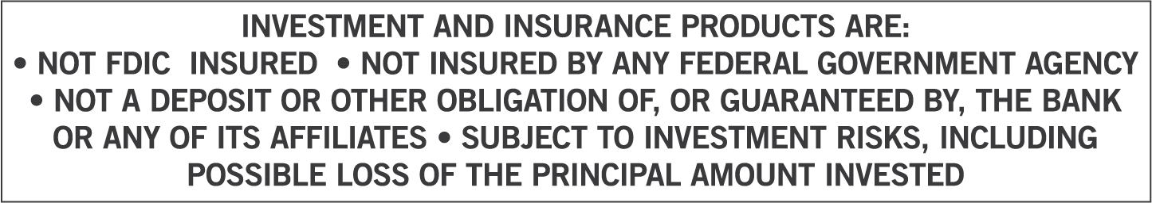
[Presenter Name], [Presenter Title]
[When presenting in AR, CA, OK, TX or IL, use the phrase “Insurance Sales Presentation.” In
CA and AR, add License Number]
Issued by Pruco Life Insurance Company and by Pruco Life Insurance Company of New Jersey.
Prudential Annuities is providing this workshop for informational or educational purposes only and does not provide investment advice or recommendations about managing or investing your retirement savings.
[Firm Logo(s)]
1015693-00003-00 Ed. 03/2019
Notes:
[REQUIRED SLIDE FOR BANK FIRMS ONLY. REMOVE WHEN USING FOR ALL OTHER FIRMS]
Welcome. My name is _______________. Today we are going to talk about planning for retirement with protected lifetime income from an annuity

Slide 4
[Optional Disclosure Slide]
[Investments are offered through [BROKER DEALER NAME], a registered broker dealer. [Insurance is offered through [AGENCY NAME- if applicable.]]
[BROKER DEALER and AGENCY- if applicable], located at [ADDRESS], [is/are] not affiliated with Prudential Financial.]]
Notes:
[Optional Slide]

Slide 5
[For Allstate Financial Services only: This slide must be shown prior to the beginning of the customer presentation]
[Hosted/Presented by:] [PFR Name] Personal Financial Representative [Allstate Financial Services, LLC or LSA Securities (in LA & PA)]
Securities offered by Personal Financial Representatives through Allstate Financial Services, LLC (LSA Securities in LA and PA). Registered Broker-Dealer. Member FINRA, SIPC. Main Office: 2920 South 84th Street, Lincoln, NE 68506. (877) 525-5727. Check the background of this firm on FINRA's BrokerCheck website http://brokercheck.finra.org.

Slide 6
[Required For Merrill Lynch Events Only]
Investing involves risk including possible loss of principal. Information is current as of the date of this material and subject to change.
Any opinions expressed herein are from a third party and are given in good faith, are subject to change without notice, and are considered correct as of the stated date of their issue.
Merrill Lynch, Pierce, Fenner & Smith Incorporated is not a tax or legal advisor. Clients should consult a personal tax or legal advisor prior to making any tax or legal related investment decisions.
Bank of America Corporation (“Bank of America”) is a financial holding company that, through its subsidiaries and affiliated companies, provides banking and investment products and other financial services .
Merrill Lynch makes available products and services offered by Merrill Lynch, Pierce, Fenner & Smith Incorporated (“MLPF&S”), a registered broker-dealer and member SIPC, and other subsidiaries of Bank of America Corporation (BofA Corp). Merrill Lynch Life Agency is a licensed insurance agency and a wholly owned subsidiary of BofA Corp.
Merrill Lynch offers a broad range of brokerage, investment advisory and other services. There are important differences between brokerage and investment advisory services, including the type of advice and assistance provided, the fees charged, and the rights and obligations of the parties. It is important to understand the differences, particularly when determining which service or services to select. The views and opinions expressed in this presentation are not necessarily those of Bank of America Corporation; Merrill Lynch, Pierce, Fenner & Smith Incorporated; or any affiliates. [For more information about these services and their differences, speak with your Financial Advisor.]
Nothing discussed or suggested in these materials should be construed as permission to supersede or circumvent any Bank of America, Merrill Lynch, Pierce, Fenner & Smith Incorporated policies, procedures, rules, and guidelines.
Investment products offered through MLPF&S and insurance and annuity products offered through Merrill Lynch Life Agency Inc.:
[This material should be regarded as educational information on [health care] [and] [Social Security] and is not intended to provide specific advice. If you have questions regarding your particular situation, you should contact your legal or tax advisors.]
Are Not FDIC Insured | May Lose Value | Are Not Bank Guaranteed
Are Not Insured by Any Federal Government Agency | Are Not Deposits | Are Not a Condition to Any Banking Service or Activity

Slide 7
[Required For Morgan Stanley Smith Barney Events Only]
Morgan Stanley Smith Barney is not affiliated with Prudential Annuities.
The views and opinions expressed in this presentation are not necessarily those of Prudential Annuities; or any affiliates. Nothing discussed or suggested in these materials should be construed as permission to supersede or circumvent any Morgan Stanley Smith Barney incorporated policies, procedures, rules, and guidelines. This material should be regarded as educational information on Health Care, Social Security, Taxes and is not intended to provide specific advice. If you have questions regarding your particular situation, you should contact your legal or tax advisors.

Slide 8
Agenda
Income
Challenges
Benefits of Annuities For Income Planning
Dispelling Annuity Myths
Notes:
8
Now, let’s review what we will cover today…our agenda…read from slide…

Slide 9
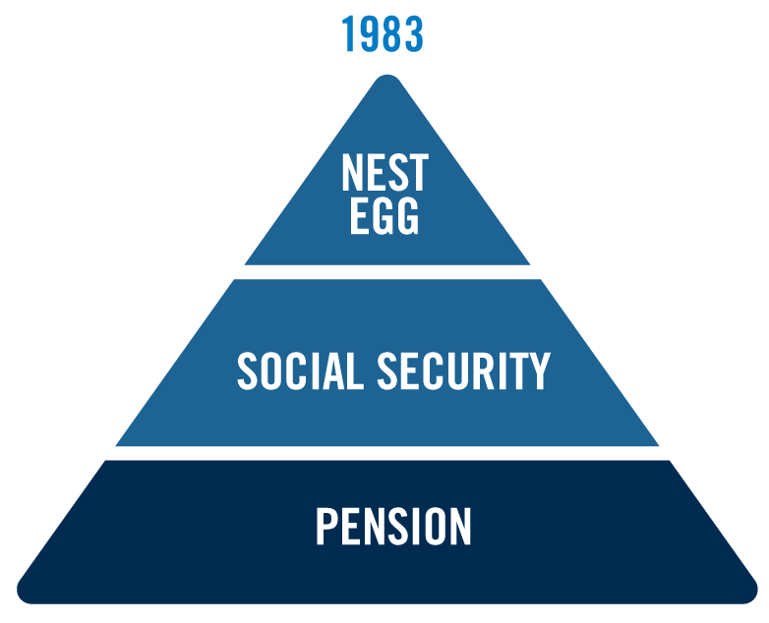
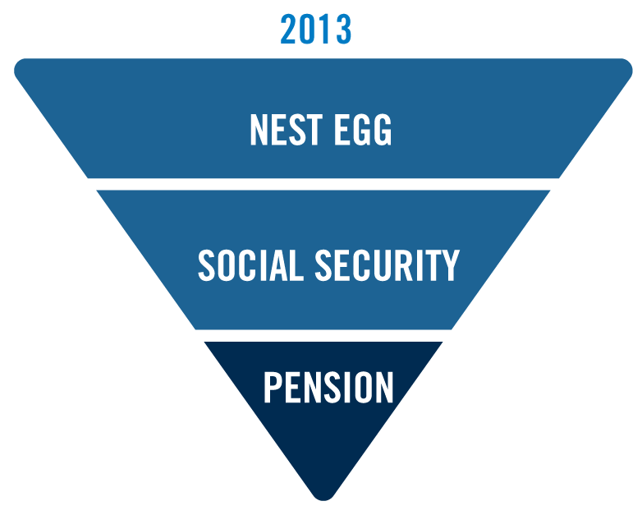
Retirement Income – Yesterday and Today
Yesterday
Today
Notes:
Today, generating retirement income is very different than it was years ago.

Slide 10
What do you know about a bear market?
What is a bear market?
– 20% loss from the most recent market peak*
1
What is the average bear market loss since 1945?
– 31%**
2
How many bear markets will a retiree face on average?
– 5 bear markets**
3
How long does the average bear market last?
– 14 months***
4
How long does it take to recover from a bear market?
– 25 months
If you are taking withdrawals it will take longer to recover, or worse, you may never recover**
5
*http://content.moneyinstructor.com/693/what-bull-bear-market.html
**Bloomberg.com, Ben Carlson: Prepare for the Next Bear Market in Stocks, January 10, 2018
***SPAR, Factset Research Systems Inc., Jan-2017.
Notes:
[Read slide]

Slide 11
Market Risk
12/31/1996 to 3/24/2000
+106%
10/9/2002 to 10/9/2007
+101%
3/9/2009 to 12/31/2017
+295%
3/24/2000 to 10/9/2002
-45%
10/9/2007 to 3/9/2009
-57%
97 | 98 | 99 | 00 | 01 | 02 | 03 | 04 | 05 | 06 | 07 | 08 | 09 | 10 | 11 | 12 | 13 | 14 | 15 | 16 | 17
Source: Yahoo Finance, 2018. Market returns represented by S&P 500 Price Return Index. Returns assume no reinvestment of dividends. Past performance is not indicative of future returns.
Notes:
Market trends are one of the most important factors in portfolio longevity, perhaps second only to the retirement account’s withdrawal rate. Investors
typically spend decades saving for retirement. Systematic investing in a fluctuating market, coupled with historically rising trends, has helped many Americans
accumulate sizeable retirement accounts. However, when Americans retire, stop contributing to their retirement accounts and start withdrawing funds from those accounts, they become much more susceptible to market risks.

Slide 12
Facing a Downturn on the Doorstep of Retirement
In the first two years, Linda’s portfolio has positive growth. At this point, she is feeling very good about retiring in three years.
In the next two years, Linda’s portfolio loses value due to poor market performance.
With one year to go until she plans to retire, Linda has significantly less money in her portfolio than she did at its high point two years ago.
10%
$616,000
45%
12%
-19%
Linda now has a tough decision to make
Delay her retirement and work longer?
Hope for unrealistic (45% in 1 year) returns to recover from her losses?
Retire as previously planned and lower her standard of living?
-15%
$424,116
Intended Retirement
Years to retirement
This is a hypothetical example for illustrative purposes only. It does not reflect a specific annuity, an actual account value, or the performance of any investment.
Notes:
Let's look at a hypothetical example of what can happen if your investments lose money just before you retire. Here is the story of Linda, and what happened with her portfolio in the five years before her planned retirement.
[Click] In the first 2 years, Linda's portfolio has positive growth. At this point, she's feeling very good about retiring in 3 years.
[Click] In the next 2 years, Linda's portfolio loses value due to poor market performance.
[Click] With 1 year to go until she plans to retire, Linda has significantly less money in her portfolio than she did at its high point 2 years ago.
[Click] Linda has a tough decision to make:
1. Delay her retirement and work longer
2. Hope for unrealistic returns (a 45% gain in one year) to recover from her losses
3. Retire as previously planned and lower her standard of living

Slide 13
Facing a Downturn in Retirement
Recovery from losses is even more difficult when you start taking income from your investments.
63%
42%
% of Gain Required over 3 Years
26%
Withdrawal rate
4%
4%
4%
10%
20%
30%
% of Loss
This is a hypothetical example for illustrative purposes only. It does not reflect a specific annuity, an actual account value, or the performance of any investment. Chart assumes a one-year decline from the initial value of an investment.
Notes:
So you just saw that it can be difficult to recover from a stock market loss - and that was when there were no withdrawals being taken. But what happens when you are taking withdrawals from your investments and you suffer a loss? Unfortunately, recovering to breakeven is even more difficult.
This chart assumes a one-year decline from the initial value of an investment. At a 4% withdrawal rate, the percentage of gain required over a 3-year period is now 26%, 42%, and 63%.

Slide 14
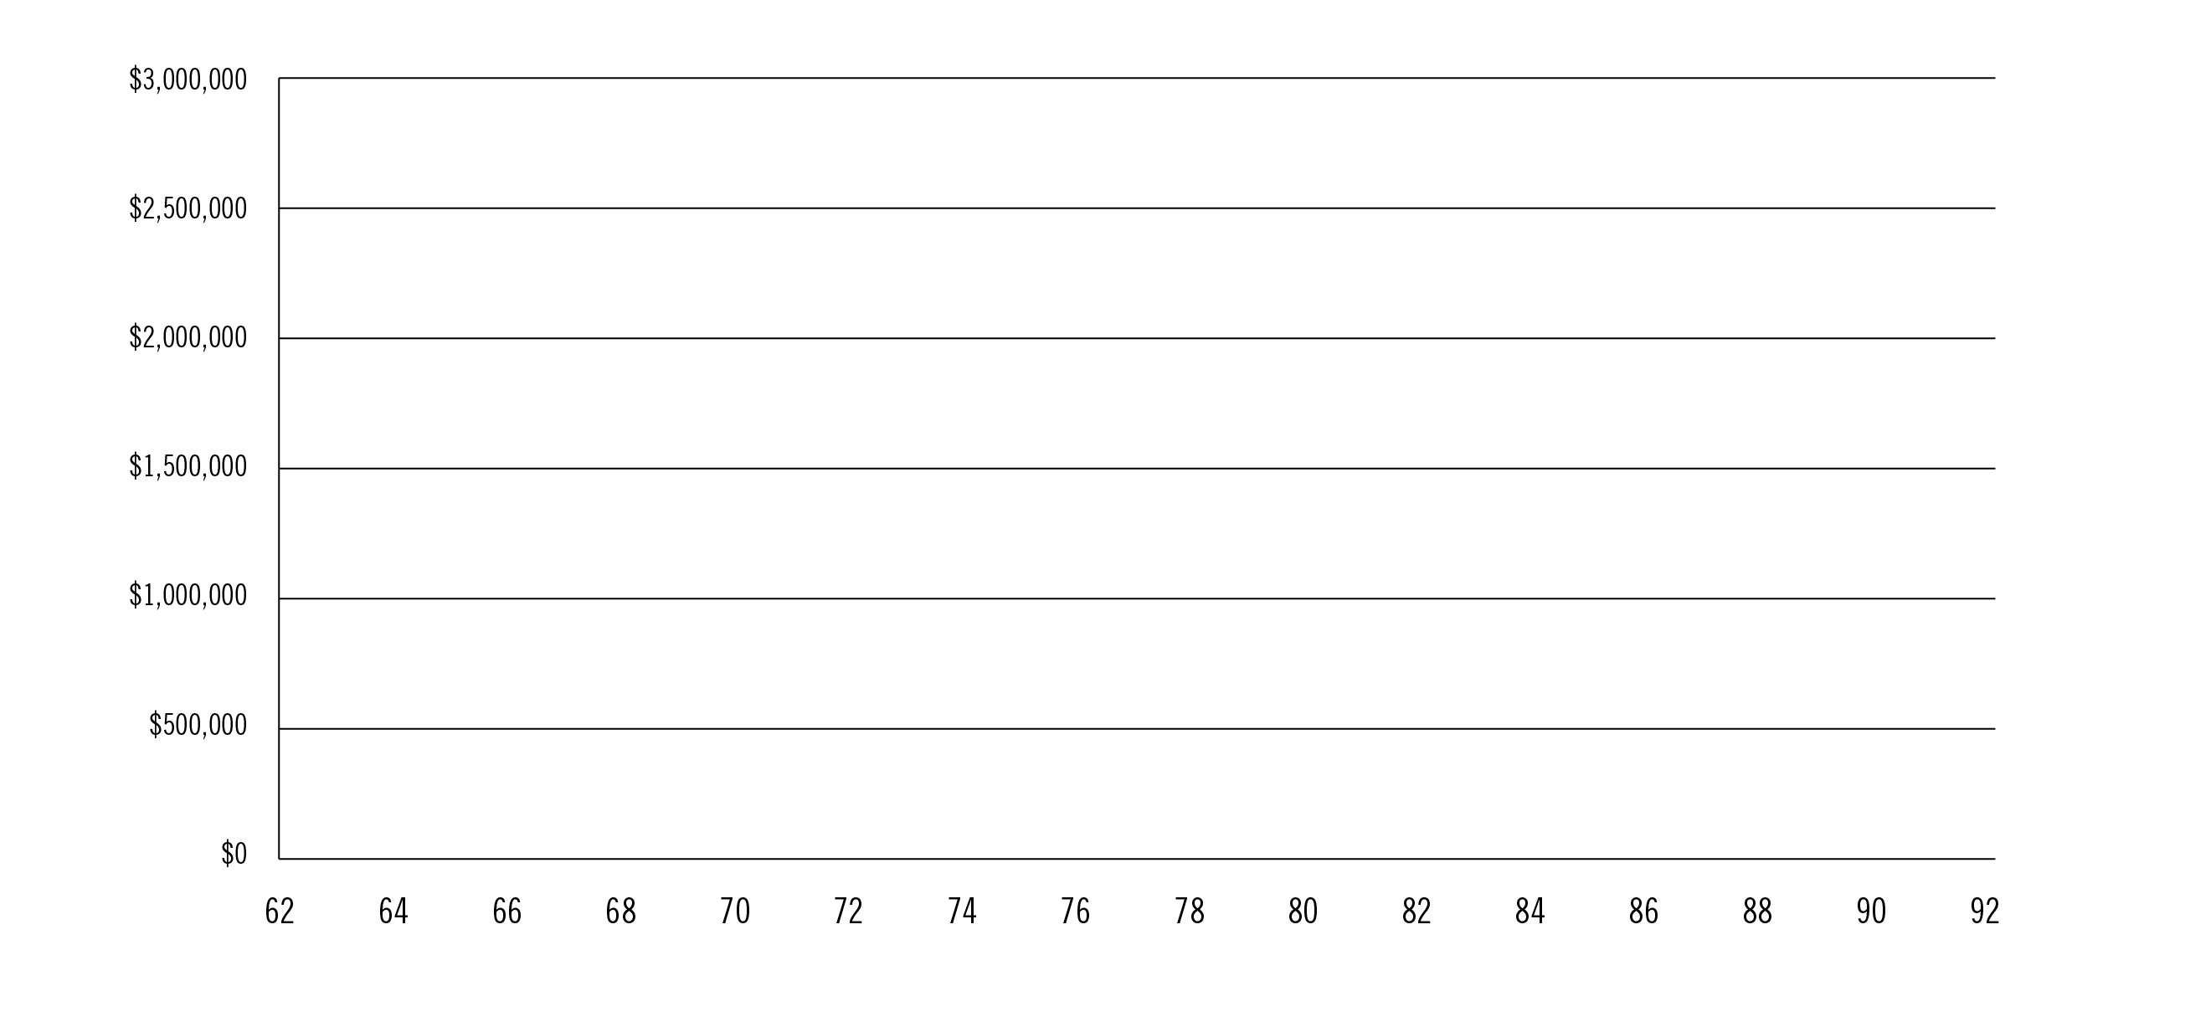
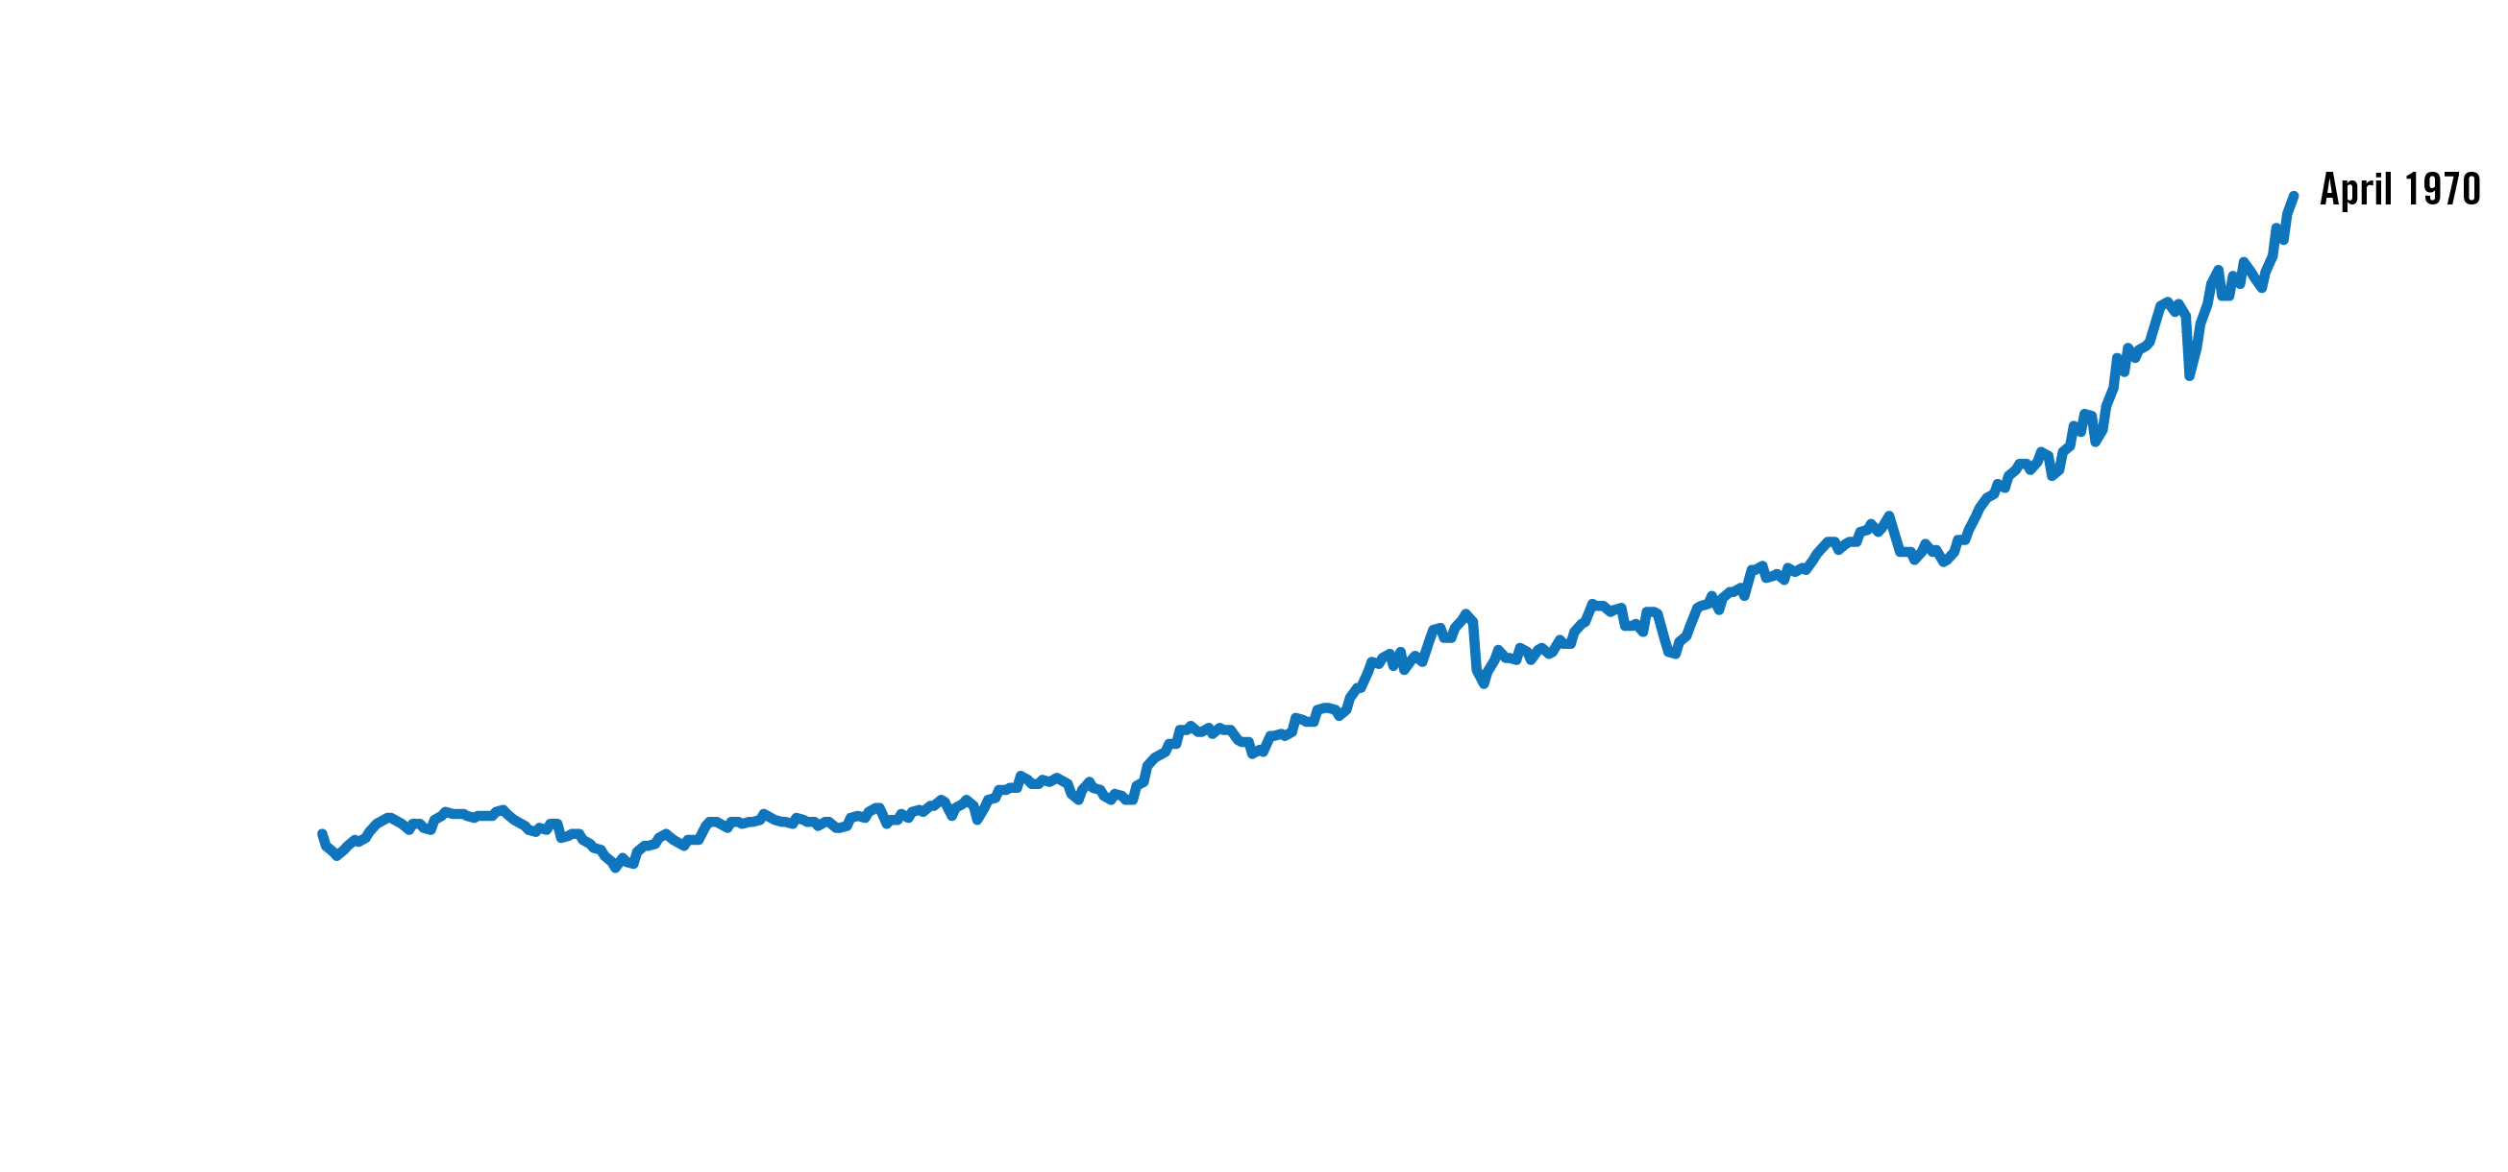
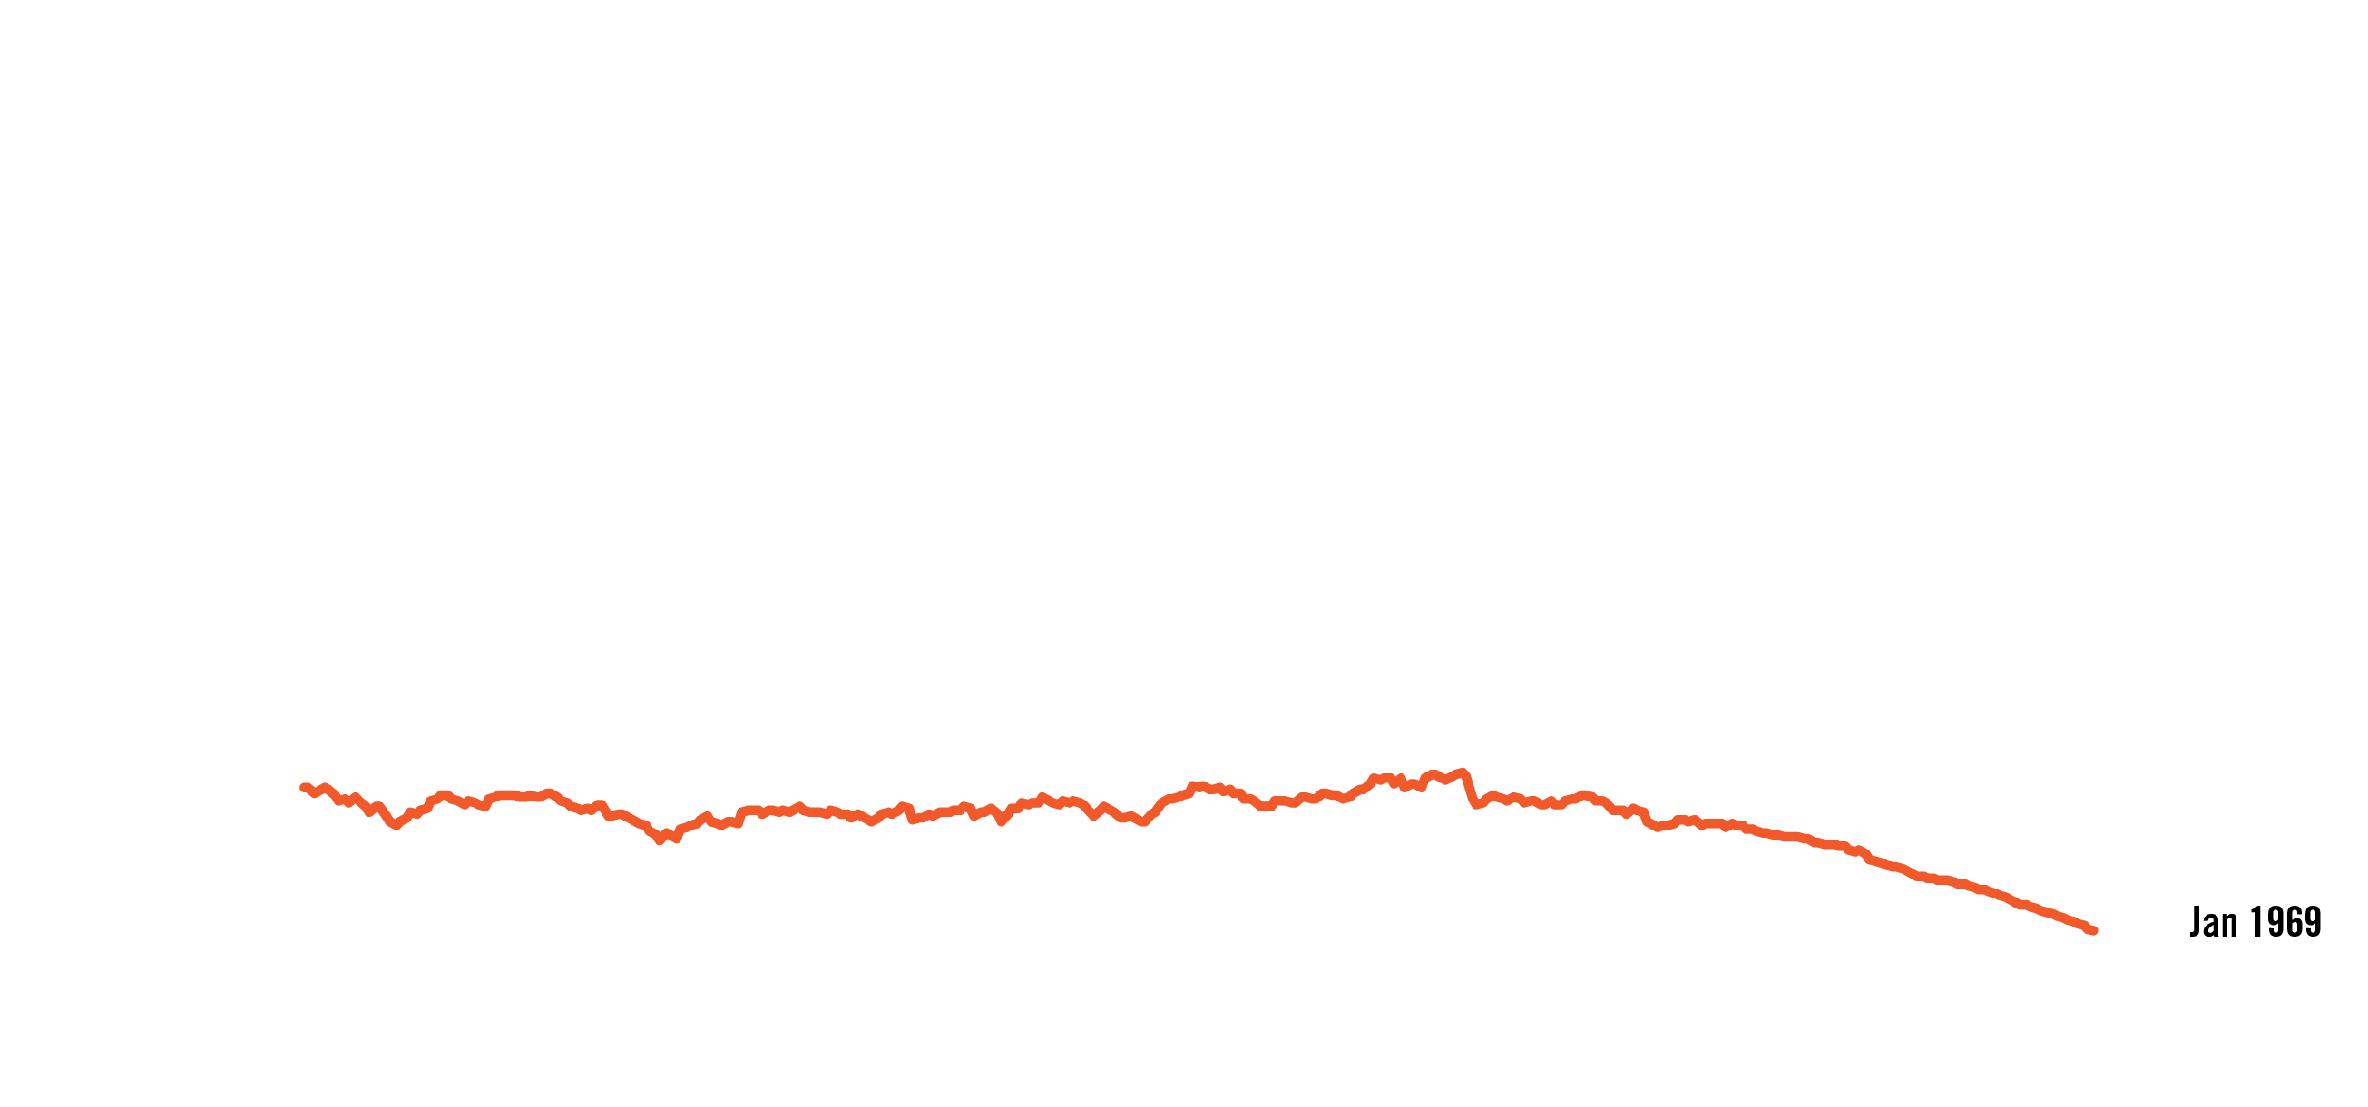
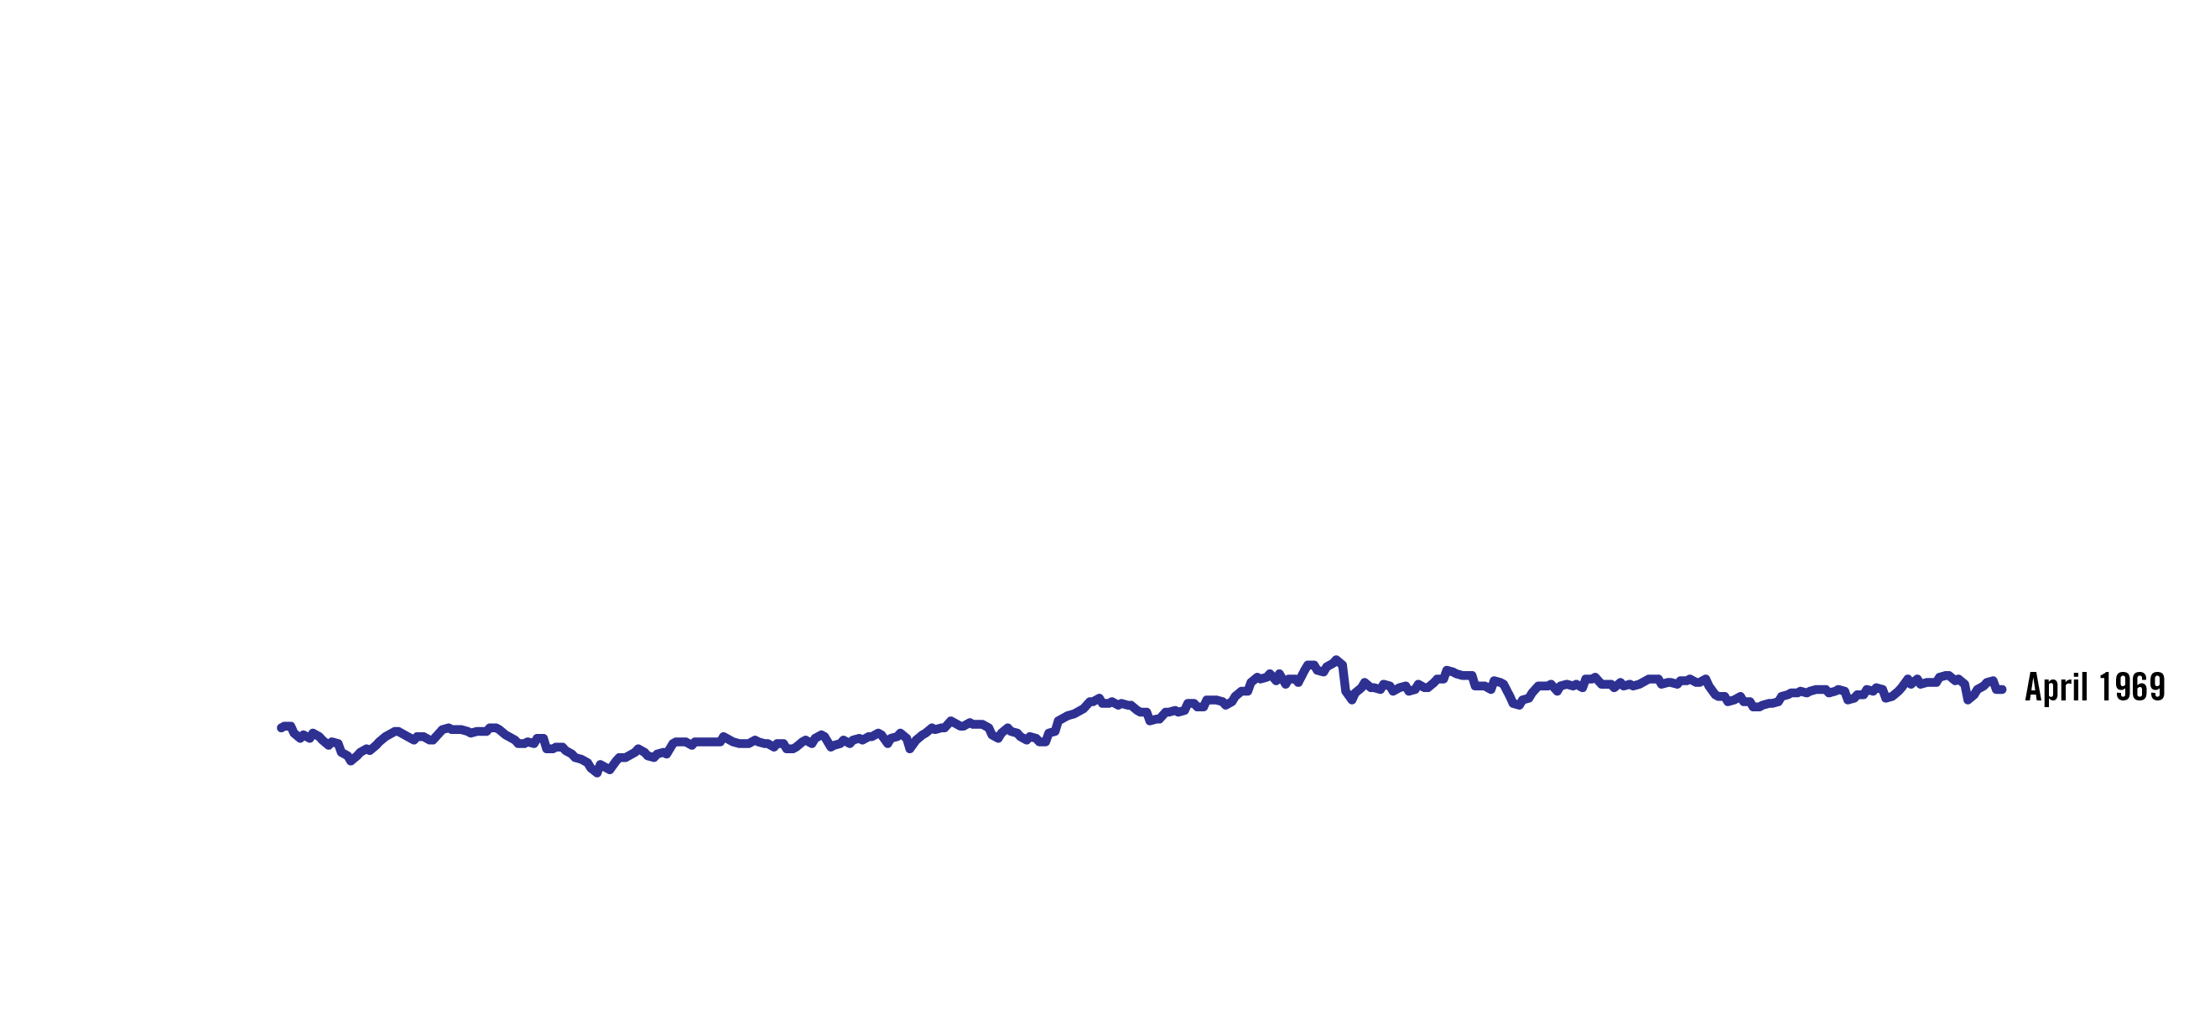
What Market Will You Retire Into? A long-term view
30 years of retirement - Chart assumes retirement at age 62
Value of portfolio for those retiring from April 1968 to April 1970
Investor’s Age
Source: 2015 LIMRA Retirement Book
Chart assumptions: $500,000 initial investment; 4.05% withdrawal adjusted annually for inflation; 42.5% Large Cap, 17.5% Small Cap, 40% Intermediate Government Bond; rebalanced annually and benchmarked respectively to the S&P 500 index, Russell 2000 index, and the Bloomberg Barclays US Aggregate bond index; rebalanced annually. Note it is not possible to invest directly in an index.
Notes:
So when you retire (what kind of market you retire into) has a big impact on how long your retirement investments may last.
[Click.] Let’s take a look at a 30-year retirement beginning in or just before 1970.
[Click.] If you retired and began distributions in April 1970, you would have over $1.5 million dollars when you are 86 years old.
[Click.] But if you retired a year earlier, in April 1969, you would have about $600,000.
[Click.] And, if you retired just a few months before, in January 1969, you would run out of money by age 91.
Source: 2015 LIMRA Retirement Book
$500,000 initial investment; 4.05% withdrawal adjusted annually for inflation; 42.5% Large Cap, 17.5% Small Cap, 40% Intermediate Government Bond; rebalanced annually

Slide 15
Investor Behavior Risk
Source: Barclays, Bloomberg, FactSet, Standard & Poor’s; Dalbar Inc.; J.P. Morgan “Guide to the Markets” September 30 2018
Indices used are as follows: EAFE: MSCI EAFE, Oil: WTI Index, Bonds: Bloomberg Barclays U.S. Aggregate Index, Homes: median sale price of existing single-family homes, Gold: USD/troy oz., Inflation: CPI. Average asset allocation investor return is based on an analysis by Dalbar Inc., which utilizes the net of aggregate mutual fund sales, redemptions and exchanges each month as a measure of investor behavior. Returns are annualized (and total return where applicable) and represent the 20-year period ending 12/31/17 to match Dalbar’s most recent analysis. Guide to the Markets – U.S. Data are as of September 30, 2018
SL 0090 12/2018
Notes:
That is the reality of market results, but what about investor results? Let’s quantify the effects for the average investor. Dalbar looked over a 20-year period, from 1996 to 2017, and while the S&P 500 Index gained an average of 7.68%. What we see is that Stocks beat bonds, bonds beat cash all while inflation ate away at our purchasing power. However investor returns were dramatically less, barely beating inflation at only 2.29%.
This result suggests that individual investors may overreact to near-term events rather than relying on the strength of the market to perform over time. They typically buy high in times when the market is up and they sell low at times when the market is down. And they do that out of human emotion based. With a faster news cycle, information at people’s finger tips, investors are often doing the wrong thing, at the wrong time for the wrong reason.
And there has been no shortage of market events that lead to this type of behavior.
Sources: BlackRock; Bloomberg; Informa Investment Solutions; Dalbar. Past performance is no guarantee of future results. It is not possible to directly invest in an index. Oil is represented by the change in price of the NYMEX Light Sweet Crude Future contract. Contract size is 1,000 barrels with a contract price quoted in US Dollars and Cents per barrel. Delivery dates take place every month of the year. Gold is represented by the change in the spot price of gold in USD per ounce. Homes are represented by the National Association of Realtors’ (NAR) Existing One Family Home Sales Median Price Index. Stocks are represented by the S&P 500 Index, an unmanaged index that consists of the common stocks of 500 large-capitalization companies, within various industrial sectors, most of which are listed on the New York Stock Exchange. Bonds are represented by the Barclays US Aggregate Bond Index, an unmanaged market-weighted index that consists of investment-grade corporate bonds (rated BBB or better), mortgages and US Treasury and government agency issues with at least 1 year to maturity. International Stocks are represented by the MSCI EAFE Index, a broad-based measure of international stock performance. Inflation is represented by the Consumer Price Index. Average Investor is represented by Dalbar’s average asset allocation investor return, which utilizes the net of aggregate mutual fund sales, redemptions and exchanges each month as a measure of investor behavior. Returns are annualized (and total return where applicable) and represent the 20-year period ending 12/31/16 to match Dalbar’s most recent analysis.

Slide 16
Withdrawal Rate Risk What is a safe and sustainable Withdrawal Rate?
Answer: The rate one can safely withdraw from their retirement portfolio without prematurely depleting the account
Opinions on Safe Withdrawal Rates have varied over time
Some expert opinions over time:
Bengen (1994)¹: | 4%
Guyton (2004)²: | 3.6% - 5.8%
Milevsky & Huang (2010)³: | 3%
Pfau (2017)⁴: | 2.4%
1. “Determining Withdrawal Rates Using Historical Data”, William Bengen, Journal of Financial Planning, October 1994
2. “Decision Rules and Portfolio Management for Retirees: Is the ‘Safe’ Initial Withdrawal Rate Too Safe?”, Jonathan Guyton; FPA Journal; October 2004
3. “Spending Retirement on Planet Vulcan: The Impact of Longevity Risk Aversion on Optimal Withdrawal Rates”; M.A. Milevsky & H. Huang; Retirement Income Journal, March 2010
4. “Retirement Income Dashboard For a Benchmark Couple Both Turning 65 in April 2017”; Conservative portfolio (25% stock allocation) with 2% spending COLA; Wade Pfau at https://retirementresearcher.com/dashboard/
SL 0092 03/2018
Notes:
Another challenge of living longer is how much money you can safely take out of your retirement investments each year.
How much can you safely withdraw from your portfolio so it lasts for the rest of your life?
In theory, a safe withdrawal rate is the maximum amount of money you can withdraw from a retirement portfolio with zero probability of depleting these savings during your lifetime. This is also referred to as a “Sustainable Withdrawal Rate.”
As you can see, over time, financial experts have had different opinions on what a safe withdrawal rate is, depending on the prevailing market conditions. For example, in the past, a safe withdrawal rate has been viewed as being as high as almost 6%. But in today’s low interest rate environment, the latest estimates are actually lower than 3%.
Bengen = “Determining Withdrawal Rates Using Historical Data”, William Bengen, Journal of Financial Planning, October 1994
Trinity Study = “Retirement Savings: Choosing a Withdrawal Rate that is Sustainable”; Cooley, Hubbard & Walz;; Journal of the American Associatron of Individual Investors; February 1998
Jonathan Guyton = “Decision Rules and Portfolio Management for Retirees: Is the ‘Safe’ Initial Withdrawal Rate Too Safe?”, Jonathan Guyton; FPA Journal; October 2004; range 3.4% to 5.8%
Bengen = “Conserving Client Portfolios During Retirement”; William Bengen; FPA Press, 2006
Kitces = “Resolving the Paradox – Is the Safe Withdrawal Rate Sometimes Too Safe?”; Michael Kitces; The Kitces Report; May 2008; assumes a 60/40 equity fixed income allocation
Milevsky/Huang = “Spending Retirement on Planet Vulcan: The Impact of Longevity Risk Aversion on Optimal Withdrawal Rates”; M.A. Milevsky & H. Huang;; range 3.0% to 7% (highly risk averse to less risk-averse)
Pfau= Retirement: Income dashboard 4/2107

Slide 17
Required Minimum Distributions (RMDs) & Sustainable Withdrawals
RMDs increase each year*
Age
70½
75
80
85
90
3.6%
4.4%
5.4%
6.8%
8.8%
*If the spouse is the sole beneficiary and is more than 10 years younger, the RMD rate is lower.
Notes:
OPTIONAL SLIDE
According to the IRS tables, at age 70 ½ clients with IRAs and 401(k)s will need to withdraw, at a minimum, 3.6% of the value of the IRA. As you can see, the withdrawal quickly increases. This could challenge the sustainable withdrawal rates for your clients.
*RMDs must begin by April 1 of the year after the person attains age 70 1/2 and must continue annually

Slide 18
Your Retirement Journey Could Last Longer Than You Think…
Expected life span of individuals and couples age 65
Multiplier:
Greater probability of:
Facing a bear market
Healthcare costs rising
Interest rate fluctuation
50% are expected to live to age:
Men 87
Women 90
Couples (Surviving spouse) 94
Source: Society of Actuaries RP-2014 Mortality Table projected with Mortality Improvement Scale MP-2014 as of 2016
Notes:
Retirees may have an incorrect perception about retiring. They may focus on getting older, but neglect to think about how they may live longer and spend more time in retirement. Longevity risk is the risk that investors will outlive their money.
When creating a strategy for transitioning savings to retirement income, the issue of longevity is an important consideration. As you can see, a 65-year-old married couple has a 50% chance that one member will live to age 94. That’s almost 30 years. One of the challenges of this is how to generate income during that 30 years.
This also brings up the potential need for spousal protection planning. It is likely that one spouse will outlive the other, in many instances the surviving spouse's income may be reduced.
Finally, longevity is the multiplier risk- meaning the longer you live, the greater the probability that the other risks we have talked about will happen.

Slide 19
Using Annuities to Help Mitigate Retirement Income Risks
What’s an annuity?
A contract between you and an insurance company that is designed for
long-term savings for retirement purposes
Provides guaranteed income for either a specified period of time or for life
Earnings grow tax deferred
Can be purchased with either a single payment or a series of payments (depending on the annuity)
Can be owned by a single person, or jointly with a spouse or another person
Offers death benefits so you can leave a legacy for your loved ones
Guarantees backed by the claims-paying ability of the insurance company

Slide 20
A Variable Annuity with an Income Benefit* Can Provide:
1. A guaranteed income stream for as long as you live
2. Income that is protected from market downturns
3. Guaranteed income growth for those taking income later
*Certain income benefits are optional and available for an additional fee.
Withdrawals in excess of the income amount impact the value of a product or benefit and can also affect the certainty of the income. An excess withdrawal occurs when cumulative Lifetime Withdrawals exceed the income amount in an annuity year. If an excess withdrawal is taken, only the portion of the Lifetime Withdrawal that exceeds the remaining income amount for that year will proportionally and permanently reduce future guaranteed amounts. If an excess withdrawal reduces the account value to zero, no further amount would be payable and the contract terminates.
All references to guarantees, including obligations arising under any annuity contract guarantees, rider guarantees, optional benefits, fixed account crediting rates, index-based interest crediting or annuity payout rates are backed by the claims-paying ability of the issuing insurance company. Those payments and credits and the responsibility to make them are not the obligations of the third party broker/dealer from which this annuity is purchased or any of its affiliates. All guarantees, including optional benefits, do not apply to any underlying investment options.
Notes:
20
[Read slide.]

Slide 21
“I’ve Heard Annuities are Expensive”
Typical Annuity Expenses
Investment Management Fees
Insurance Charges (M&E)
Rider Fees
Administrative Charges
Don’t Consider Costs in the Absence of Value
Ask yourself: What features do I want to pay for?
Notes:
Read Slide

Slide 22
Insuring Our Most Important Assets
We Insure Our Cars | We Insure Our Homes
288 million vehicles in U.S.¹ 7.3 million reportable crashes² | 120 million occupied residences³ 371,500 home fires⁴
2.5% chance of a car accident | 0.3% chance of a home fire
¹ National Highway Transportation Safety Administration; “Quick Facts 2016”; February 2018
² U.S. Dept. of Transportation; Traffic Safety Facts; “Police-Reported Motor Vehicle Traffic Crashes in 2016”; March 2018
³ Federal Reserve Economic Data; St. Louis Federal Reserve at http://fred.stlouisfed.org; Owner/Renter Occupied Housing Units, Oct 2017
⁴ National Fire Protection Association; “Fire Loss in the United States During 2016”; September 2017; residential structure fires
Notes:
Read Slide

Slide 23
Insuring Our Most Important Assets
Our Retirement?
$26.1 trillion of retirement assets¹ Average retiree faces a bear market every 3.5 years² 50% chance one spouse will live to age 94³
Likelihood income won’t last a lifetime?
¹ Investment Company Institute (ICI), Quarterly Retirement Market Data; 1Q 2017
² Bloomberg Financial, January 2016
³ Society of Actuaries RP-2014 Mortality Table projected with Mortality Improvement Scale MP-2014 as of 2016
Notes:
Read Slide

Slide 24
“I’ve Heard Annuities are Complex”
Annuities are designed to solve for complex needs
Annuities help manage critical retirement risks
Longevity Risks
Market Risks
Sequence of Returns Risk
Investor Behavior Risks
Withdrawal Rate Risks
Notes:
24
Read Slide

Slide 25
“I’ve Heard Annuities Tie Up My Money”
Annuities are long-term investments which can provide income that will LAST a lifetime
Understanding Surrender Charges:
Annuities may offer limited liquidity, which provides incentive to hold the contract and reap the benefits they were designed to deliver
If investor surrenders within a defined period, insurance company can recover its costs
Some of today’s variable annuities provide protected lifetime income, without giving up total control of your money*!
* Certain income benefits are optional and available for an additional fee.
Notes:
Read Slide

Slide 26
Additional considerations:
As you work together with your financial professional it is important to consider all aspects of an annuity, including the fact that it is possible to lose money. Some of these considerations include:
Fees & Charges- May apply and will vary depending on the annuity product chosen and any optional features selected.
Access to Money- Generally allows up to 10% of purchase payments without incurring any charges. This may vary on the annuity that is chosen.
Withdrawals- Taxable amounts are subject to ordinary income tax and, if made prior to age 59½, may result in an additional 10% federal income tax penalty.
Suitability- Investors should consider all aspects of an annuity including investment objectives, policies, management, risks, charges and expenses carefully before investing.
Notes:
(Read slide)

Slide 27
Retirement Income Planning
Planning for Retirement is the #1 Financial Priority of Americans Today*
Top 3 Financial Concerns
 | Retirees |  | Pre-Retirees
#1 | Maintain Lifestyle Thru Retirement | 68% | Saving for Retirement | 58%
#2 | Not Running Out of Money in Retirement | 59% | Maintain Lifestyle in Retirement | 41%
#3 | Affording Healthcare | 53% | Covering Basic Monthly Expenses | 38%
*Perspectives on Retirement, 2016 Retirement Preparedness Survey, Prudential Investments, a PGIM Business
Notes:
Read Slide

Slide 28
Retirement Income Planning Example
Guaranteed Sources of Income
(Pension, Social Security, Annuities)
Cover Essentials
Essential Expenses
(Housing, Food, Clothing, Healthcare, Transportation)
Consider Converting Assets into Cash Flow
Cover Gap
Other Sources of Income
(Mutual Funds, Stocks, Bonds, CDs, Real Estate)
Discretionary Expenses
(Travel, Restaurants, Entertainment)
Discretionary
Notes:
As you prepare for retirement, it can be helpful to categorize your income sources as well as your expenses. Then you can decide what income sources you'll use to cover certain expenses.
[Read slide.]

Slide 29
Example #1- Covering Essential Expenses
Essential Expenses $52,000
Housing/Food/Clothing/Transportation $41,000
Healthcare $11,000
Guaranteed Income Sources $40,000
Pension $18,000
Social Security $22,000
Income Gap to Cover Essential Expenses ($12,000)
Notes:
Read Slide

Slide 30
Example #1- Converting Assets to Cash Flow Investment needed to generate $12,000/Yr at age 65
Non-guaranteed investment with 3.5% withdrawal
$343,000
Funding Variable Annuity at age 65
$200,000
41% Less
The hypothetical example assumes an income percentage of 6.0% at age 65 and is for illustrative purposes only. It does not reflect a specific annuity, an actual account value or the performance of any investment.
SL 0071 02/2018
Notes:
Read Slide

Slide 31
Example #2- 30 Year Retirement Likelihood of success
Withdrawal Rate¹ |  | Stock/Bond Mix
 |  | 100/0 | 80/20 | 60/40 | 40/60 | 20/80
3% |  | 90% | 93% | 96% | 97% | 98%
4% |  | 77% | 79% | 80% | 80% | 74%
5% |  | 60% | 60% | 56% | 46% | 28%
6% |  | 44% | 40% | 32% | 19% | 5%
7% |  | 31% | 25% | 16% | 6% | 0%
8% |  | 20% | 14% | 7% | 1% | 0%
Source: T. Rowe Price 2016. Analysis of 30 year period. IMPORTANT: The information regarding the likelihood of various investment outcomes is hypothetical in nature, does not reflect actual investment results, and is not a guarantee of future results. The simulations are based on a number of assumptions. There can be no assurance that the results shown will be achieved or sustained. The charts present only a range of possible outcomes. Results may vary, and such results may be better or worse than the simulated scenarios. Clients should be aware that the potential for loss (or gain) may be greater than demonstrated in the simulations. *The following allocations include short-term bonds: 60/40 is 60% stocks, 30% bonds, and 10% short-term bonds; 40/60 is 40% stocks, 40% bonds, and 20% short-term bonds; and 20/80 is 20% stocks, 50% bonds, and 30% short-term bonds. The probabilities shown are the likelihood of having at least $1 remaining in the portfolio at the end of the retirement period.
1. Assumes withdrawal is increased 3% annually for inflation.
Notes:
(Slides 30-32 are optional slides) Read through- discuss 80% probability of success with a 4% withdrawal and a 60/40 portfolio.

Slide 32
Example #2- Creating Lifetime Income
$1,000,000 to invest for retirement at age 67
$1,000,000
X
4.0%
=
$40,000
Invested in equity and bond investments
Annual withdrawal rate
Annual income, not guaranteed, affected by market swings
80% probability of successfully funding a 30-year retirement*
Is there another option to help create income with a guarantee?
This is a hypothetical example for illustrative purposes only.
* Based on T. Rowe Price study cited on slide 30, assuming a withdrawal rate of 4% and an allocation of 60% stocks, 30% bonds and 10% short-term bonds. Success defined as having at least $1 remaining in the portfolio at the end of the retirement period. Assumes withdrawal is increased 3% annually for inflation.
Notes:
(Slides 30-32 are optional slides) Are there other potential advantages to incorporating guaranteed income streams into your portfolio?
Let’s say you have a recently retired with $1 million in assets and a need for immediate income of $40,000 per year to supplement other sources of retirement income. One potential solution would be to allocate the entire $750,000 into a portfolio of equities and bonds, and take a 4% annual withdrawal to create the $40,000 per year of income needed. This strategy may work, but the income would not be guaranteed and would be
susceptible to the ups and downs of the market.
You could consider another strategy to help create income with a guarantee.

Slide 33
Example #2- Reducing Withdrawal Rates from Non-Guaranteed Investments
Retirement Portfolio of $1,000,000
A two-part investment strategy
PART ONE
PART TWO
$400,000
Variable Annuity
$600,000
Other Investments
$24,000
Guaranteed income for life
$16,000*
2.7% withdrawal rate
Over 96% success probability*
This is a hypothetical example for illustrative purposes and does not reflect a particular product.
* Based on T. Rowe Price study cited on slide 30, assuming a 3% annual withdrawal and an allocation of 60% stocks, 30% bonds and 10% short-term bonds. Success defined as having at least $1 remaining in the portfolio at the end of the retirement period. Assumes withdrawal is increased 3% annually for inflation.
SL 0072b
Notes:
(Slides 30-32 are optional slides) You might consider a two-part strategy
Part 1 – take $400,000 and allocate it to an annuity contract with a [6%] payout rate. This would generate [$24,000] annually.
You now need to generate only [$16,000] annually from the remainder of the portfolio. To do so, you need to achieve a withdrawal rate of [2.70%].
Part 2 – You place the remaining $600,000 in a portfolio of equities and fixed income instruments to generate the remainder of the needed cash flow. The total cash flow is now $30,000. Because the required withdrawal rate is only [2.70%] the likelihood that you will be able to sustain income through retirement increases.
This allocation also increases income flexibility. For example, if the withdrawal rate on the non-annuity portfolio was increased to 4%, your cash flow would increase from $40,000 to [$48,000] a [20%] increase.
This two-part strategy creates a more efficient retirement portfolio because the guaranteed income from an annuity helps to take the pressure off the other investments. As a result, the money has the opportunity to work harder.

Slide 34
Potential Benefits of Annuities in Planning for Retirement
Transfers Some Risk to Insurance Company
Increased Portfolio Longevity
Improved Probability of Success
Takes Pressure Off Other Assets
Frees Up Other Assets
Potentially Increased Retirement Income
Notes:
34
Now, let’s review the benefits of annuities in Retirement Income Plans.

Slide 35
Investor Satisfaction
Annuities - Receiving Income
IRA
Stocks/Bonds/Mutual Funds held Outside IRA/401(k)
Annuities - General
Real Estate/ Rental Property
401(k)
Cash Value Life Insurance
Savings Accounts/ CDs
Source: IRI, “It’s About Income, Inaugural Study on the American Retirement Experience,” September 2016; Represents those investors “very/somewhat satisfied”
Notes:
So we have talked about how adding a variable annuity to a plan can be beneficial for financial outcomes. Now let’s look at the emotional side of what consumer feel, perceive, understand, and expect when it comes to annuities and the value proposition of guaranteed lifetime income solutions. Did you know that over 70% of those who own annuities are satisfied with their investment, which is higher than any other investment type?

Slide 36
Summary
Prepare for challenges to your retirement income
Take time to understand annuity benefits and features
Consider your objectives, goals and time horizon to determine if an annuity could make sense as a part of your overall plan

Slide 37
Disclosures
Investors should consider the contract and underlying portfolios' investment objectives, policies, management, risks, charges and expenses carefully before investing. This and other important information is contained in the prospectus, which can be obtained from your financial professional. Please read the prospectus carefully before investing.
Variable annuities are issued by Pruco Life Insurance Company (in New York, by Pruco Life Insurance Company of New Jersey), Newark, NJ (main office) and distributed by Prudential Annuities Distributors, Inc., Shelton, CT. All are Prudential Financial companies and each is solely responsible for its own financial condition and contractual obligations.
This material is being provided for informational or educational purposes only and does not take into account the investment objectives or financial situation of any of your clients or prospective clients. The information is not intended as investment advice and is not a recommendation about managing or investing your client’s retirement savings. Clients seeking information regarding their particular investment needs should contact a financial professional.
Annuity contracts contain exclusions, limitations, reductions of benefits, and terms for keeping them in force. Your licensed financial professional can provide you with complete details.

Slide 38
Disclosures
Prudential Annuities and its distributors and representatives do not provide tax, accounting, or legal advice. Please consult your own attorney or accountant.
S&P 500® Index is a market capitalization-weighted index of the 500 widely held stocks often used as a proxy for the stock market. S&P chooses the member companies for the 500 based on market size, liquidity and industry group representation.
Russell 2000® Value Index is a market-weighted total return index that measures the performance of companies within the Russell 2000 Index having lower price-to-book ratios and lower forecasted growth values.
Bloomberg Barclays U.S. Aggregate Bond Index covers the USD-denominated, investment grade, fixed rate, taxable bond market of SEC-registered securities. The index includes bonds from the Treasury, Government-Related, Corporate, Mortgage-Backed Security (MBS), Asset-Backed Security (ABS) and Commercial Mortgage-Backed Security (CMBS) sectors.
© 2019 Prudential Financial, Inc. and its related entities. Prudential Annuities, Prudential, the Prudential logo, the Rock symbol, and Bring Your Challenges if applicable are service marks of Prudential Financial, Inc. and its related entities, registered in many jurisdictions worldwide.
[Ref# 3887354]

