Slide 1
SOCIAL SECURITY
GETTING THE MOST OUT OF YOUR BENEFITS
Investment and Insurance Products Are: Not FDIC Insured • Not Insured by Any Federal Government Agency • Not a Deposit or Other Obligation of, or Guaranteed By, the Bank or any of its Affiliates •
Subject to Investment Risks, Including Possible Loss of Principal Amount Invested
.
GE-2198855 (8/18) (Exp. 8/20)
Notes:
Hello everyone and thank you for joining us today. Today, I am going to talk about an important topic, Social Security. It is important to you, it is important to me, and approximately 180 million other people in the United states who are not in this room. I know you have questions or want to know more.

Slide 2
Agenda
1
Understanding the Value of Social Security
2
The Different Types of Social Security Benefits
3
Other Factors Impacting Social Security Benefits
4
Taxation of Social Security Benefits
5
Recent Developments Impacting Social Security
6
Benefit Collection Strategies
7
Resources from AXA
Investment and Insurance Products Are: Not FDIC Insured • Not Insured by Any Federal Government Agency • Not a Deposit or Other Obligation of, or Guaranteed By, the Bank or any of its Affiliates •
Subject to Investment Risks, Including Possible Loss of Principal Amount Invested
.
2
GE-2198855 (8/18) (Exp. 8/20)
Notes:
Let’s take a look at what I’m going to cover over the next hour.

Slide 3




Understanding the Value of Social Security
  In 2016, over 61 million Americans received almost $870 billion in Social Security benefits¹
  9 out of 10 (90%) individuals age 65 and older receive Social Security benefits making it the #1 federal entitlement program²
Social Security Value:
  Provides income you can’t outlive
  Provides income that is inflation adjusted
  Provides survivorship benefits
1 Source: Social Security Administration (SSA) Basic Facts October 2016
2 Source: https://www.ssa.gov/news/press/basicfact.html as of 8/15/2016
Investment and Insurance Products Are: Not FDIC Insured • Not Insured by Any Federal Government Agency • Not a Deposit or Other Obligation of, or Guaranteed By, the Bank or any of its Affiliates •
Subject to Investment Risks, Including Possible Loss of Principal Amount Invested
.
3
GE-2198855 (8/18) (Exp. 8/20)
Notes:
Social Security is a major source of income for most people age 65 and over.
The Social Security program was originally established to provide the base of financial protection for working people and their families when earnings are lost due to retirement.
For those who qualify for benefits, Social Security is a retirement income source with choices and therefore some degree of control.
Social Security is often the foundation or starting point of the retirement income analysis.
Qualifying for Social Security retirement benefits
Must be fully insured
For most workers, that means you need 40 credits – or about 10 years of work (at four quarters each year) – to qualify for retirement benefits. Through the years, the way you earn credits has changed. In 2014, one credit is recorded for every $1,200 you earn during the year.
Your retirement benefit is based on your primary insurance amount.
To figure your primary insurance amount (PIA), you need to know your average indexed monthly earnings (AIME), which is based on your lifetime earnings history.
Social Security then averages your 35 highest years of indexed earnings and uses that average when it calculates your primary insurance amount.
Your full retirement age
In fact 74% of people collecting Social Security benefits today are collecting reduced amounts because they collected early, often as early as age 62. Why, in the face of longevity, do many people collect benefits when they hit age 62? Probably because they can. Even though so many of our client's are concerned with longevity, they are willing to accept reduced benefits for life to avoid not getting their fair share of benefits because they may die early.
But longevity is a reality. In 2012 there were over 1.9 million people over the age of 90 collecting Social Security benefits. There were about 55,000 people over the age of 100 collecting benefits.

Slide 4
3 Types of Social Security Benefits
Based on an individuals work history
Full benefit at Full Retirement Age
Based on highest 35 years of Earnings
RETIREMENT
Additional benefit available to married couple in certain situations
Based on 50% of Spouse’s Benefit
May be available to divorced couples
SPOUSAL
Benefit available to surviving spouses
May be available to divorced spouses
SURVIVOR
Please note this information is as of 8/15/16
Investment and Insurance Products Are: Not FDIC Insured • Not Insured by Any Federal Government Agency • Not a Deposit or Other Obligation of, or Guaranteed By, the Bank or any of its Affiliates •
Subject to Investment Risks, Including Possible Loss of Principal Amount Invested
.
4
GE-2198855 (8/18) (Exp. 8/20)
Notes:
Let's talk about benefits that are available to spouses who did not work outside of the home, did not have the required 40 quarters of covered earnings, or were working for an employer exempted from paying into the system.
A spouse can get up to 50% of the primary worker’s income benefit. This is in addition to the benefit received by the worker themselves.
In many cases a spouse is fully insured under Social Security, but they will be entitled to the larger of their own benefit or 50% of a spouses benefit.
And, for individuals who have been previously married: If the marriage lasted at least 10 years and they haven’t remarried, they are entitled to 50% of the former spouses’ benefit so long as it is greater than their own. It is important to note that the spousal benefit payable here does not reduce the former spouse’s benefit.
Survivor benefits work very similar to spousal benefits. A surviving spouse will receive the higher of their own benefit or that of the deceased spouse.
In general two requirements must be met for survivor benefits to be paid:
Survivor must be at least 60 (50 for disabled)
Married at least 9 months prior to death unless death was accidental.

Slide 5
How Social Security Works
Investment and Insurance Products Are: Not FDIC Insured • Not Insured by Any Federal Government Agency • Not a Deposit or Other Obligation of, or Guaranteed By, the Bank or any of its Affiliates •
Subject to Investment Risks, Including Possible Loss of Principal Amount Invested
.
5
GE-2198855 (8/18) (Exp. 8/20)

Slide 6
Social Security: Estimating Benefits
Estimate Social Security Benefits with:
  Annual Social Security Statement
  www.socialsecurity.gov
  www.ssa.gov
    Click on Estimate Your Retirement Benefits for online calculators
Investment and Insurance Products Are: Not FDIC Insured • Not Insured by Any Federal Government Agency • Not a Deposit or Other Obligation of, or Guaranteed By, the Bank or any of its Affiliates •
Subject to Investment Risks, Including Possible Loss of Principal Amount Invested
.
6
GE-2198855 (8/18) (Exp. 8/20)
Notes:
Ok, now that you have a better understanding of how it works, let’s get to the important stuff. Estimating how much you will get.
[POINT TO IMAGE OF THE SS STATEMENT ON THE SCREEN]
Now I’m sure everyone in here recognizes this. You can go to the Social Security website www.socialsecurity.gov or www.ssa.gov and download the statement. Both of these addresses will get you where you need to be.
On the left hand side of the landing page you will see a link called “Estimate Your Retirement Benefits.” Click there and follow the instructions on how to use the different calculators.

Slide 7
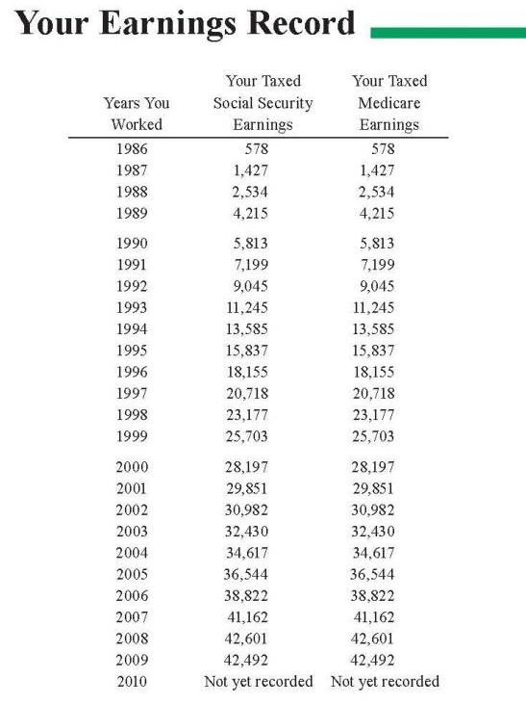
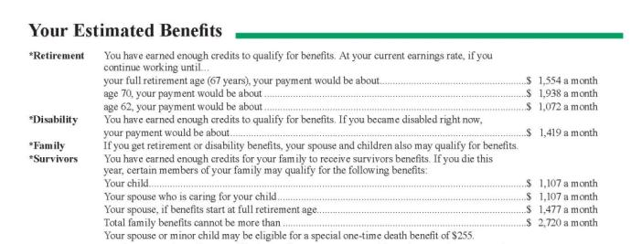
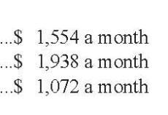
Individual Benefits
Best 35 Years
Online Statements or
Retirement Estimator
www.ssa.gov
Source: Social Security Administration (www.ssa.gov).
Investment and Insurance Products Are: Not FDIC Insured • Not Insured by Any Federal Government Agency • Not a Deposit or Other Obligation of, or Guaranteed By, the Bank or any of its Affiliates •
Subject to Investment Risks, Including Possible Loss of Principal Amount Invested
.
7
GE-2198855 (8/18) (Exp. 8/20)
Notes:
Most workers pay into the program with each paycheck and will qualify for Social Security benefits at retirement. Workers pays FICA tax up to the Social Security wage base toward Social Security. This amount is matched by the worker’s employer. To be fully insured, a worker needs 40 credits. A maximum of 4 credits can be earned per year.
Currently, any of your clients who are paying FICA taxes and are at least age 60 should be receiving a Social Security benefits statement in the mail about three months before their birthday. This statement includes their earnings record on page 3. You should encourage them to check this carefully because their benefits will be based off this record, mistakes and all. If they spot any mistakes, have them call the Social Security administration to correct them.
Benefits are based on the best 35 years of work history and the benefits reflected on your statement reflect the assumption that the client will continue to earn his or her current salary (from the last two years) until they begin to collect benefits.
You should also review the information on page 2 with your clients. This is where they will find three key numbers: their monthly benefits if they elect to collect at their full retirement age, their monthly benefits if they collect at age 70 and their monthly benefits if they collect at age 62.
The Social Security Administration has a calculator on their website which will allow you and your clients to modify the expected retirement date and wage assumptions to create a more accurate estimate of expected benefits.

Slide 8
The Tradeoff for Individual Benefits
Full Retirement Age (FRA)
65
1937 or earlier
66
1943-1954
67
1960 and later
Age 62
Collect 100% Benefit Base
Age 70
Reduced Benefits
Increased Benefits
Source: Social Security Administration (www.ssa.gov).
Investment and Insurance Products Are: Not FDIC Insured • Not Insured by Any Federal Government Agency • Not a Deposit or Other Obligation of, or Guaranteed By, the Bank or any of its Affiliates •
Subject to Investment Risks, Including Possible Loss of Principal Amount Invested
.
8
GE-2198855 (8/18) (Exp. 8/20)
Notes:
You have the option to start collecting your benefits anytime between age 62 and age 70. However, if you collect before full retirement age, you will collect reduced benefits. If you wait until full retirement age, you will be eligible for your full benefits (also known as your primary insurance amount). If you wait until after full retirement, you will be eligible for an increased benefit.
Full retirement age is not the same for everyone. For those born 1937 or earlier, it is 65. For those approaching retirement right now, it is right around age 66 which we will use as full retirement age for the remainder of the seminar.

Slide 9
Collecting Early: The Cost
Cost of Collecting Social Security Early
Percentage of FRA Benefits
Source: Social Security Administration (www.ssa.gov). Assumes full retirement age of 66. This information is as of 8/15/2016.
Investment and Insurance Products Are: Not FDIC Insured • Not Insured by Any Federal Government Agency • Not a Deposit or Other Obligation of, or Guaranteed By, the Bank or any of its Affiliates •
Subject to Investment Risks, Including Possible Loss of Principal Amount Invested
.
9
GE-2198855 (8/18) (Exp. 8/20)
Notes:
As we saw before, most people take benefits before full retirement age. If you elect to take benefits early, your benefits will be permanently reduced. The payment is not adjusted when you reach FRA. What else should you consider before you agree to a permanently reduced benefits?
Percentage of monthly reduction and total reductions are approx due to rounding. Actual reductions are 5/9 of 1% per month or .555 for the first 3 years and 5/12 of 1% (.416) for subsequent months.

Slide 10
Collecting Late: The Guaranteed Increase
Increases for Collecting Late
Percentage of FRA Benefits
Source: Social Security Administration (www.ssa.gov). Assumes full retirement age of 66 and individual born in 1943 or later.
Investment and Insurance Products Are: Not FDIC Insured • Not Insured by Any Federal Government Agency • Not a Deposit or Other Obligation of, or Guaranteed By, the Bank or any of its Affiliates •
Subject to Investment Risks, Including Possible Loss of Principal Amount Invested
.
10
GE-2198855 (8/18) (Exp. 8/20)
Notes:
On the other hand, if you wait to collect benefits, you will be awarded guaranteed increases to your benefits of 8% per year (assuming you were born in 1943 or later) per year deferred beyond full retirement age up until age 70. For someone with a FRA of age 66, this could be an increase of 32% by age 70.

Slide 11
Spousal Benefits
A spouse can get 50% of primary worker’s benefits
A spouse will get the higher of their own benefit or the spousal benefit
Former spouses may be entitled to spousal benefits, but they must have been married for at least 10 years
Collecting a
Spouse’s Benefits
48%
Collecting own
benefits only
24%
Collecting deceased
spouses benefits only
28%
Collecting both
benefits
Source: Social Security Administration’s Annual statistical supplement, 2014. Assumes full retirement age of 66 and primary insurance amount of $2,200.
Investment and Insurance Products Are: Not FDIC Insured • Not Insured by Any Federal Government Agency • Not a Deposit or Other Obligation of, or Guaranteed By, the Bank or any of its Affiliates •
Subject to Investment Risks, Including Possible Loss of Principal Amount Invested
.
11
GE-2198855 (8/18) (Exp. 8/20)
Notes:
Let's talk about benefits that are available to spouses who did not work outside of the home, did not have the required 40 quarters of covered earnings, or were working for an employer exempted from paying into the system.
A spouse can get up to 50% of the primary worker’s income benefit. This is in addition to the benefit received by the worker themselves.
In many cases a spouse is fully insured under Social Security, but they will be entitled to the larger of their own benefit or 50% of a spouses benefit.
And, for individuals who have been previously married: If the marriage lasted at least 10 years and they haven’t remarried, they are entitled to 50% of the former spouses’ benefit so long as it is greater than their own. It is important to note that the spousal benefit payable here does not reduce the former spouse’s benefit.

Slide 12
Spousal Benefits
Maximum Spousal Benefit Amount is 50%
150%
50%
50%
50%
50%
50%
100%
46%
41.5%
37.5%
Percentage of FRA Spousal Benefits
35%
50%
0%
Age 62
Age 63
Age 64
Age 65
Age 66
Age 67
Age 68
Age 69
Age 70
(FRA)
Source: Social Security Administration (www.ssa.gov).
Investment and Insurance Products Are: Not FDIC Insured • Not Insured by Any Federal Government Agency • Not a Deposit or Other Obligation of, or Guaranteed By, the Bank or any of its Affiliates •
Subject to Investment Risks, Including Possible Loss of Principal Amount Invested
.
12
GE-2198855 (8/18) (Exp. 8/20)
Notes:
Based on when a spouse collects those benefits can impact the total he/she takes home. If she collects spousal benefits before FRA, her spousal benefits will be reduced. On the other hand, he/she is not rewarded for waiting beyond FRA. Spousal benefits do not receive delayed retirement credits, so there’s little incentive to wait to collect beyond full retirement age.

Slide 13
Survivor Benefits
A surviving spouse will receive the higher of either their own benefit or their deceased spouse’s benefit
Requirements:
  The surviving spouse must be at least 60 years old.
    The surviving spouse must be at least 50 years old if disabled.
  You must be married for at least 9 months prior to your spouse’s death.
    There are exceptions for accidents.
Investment and Insurance Products Are: Not FDIC Insured • Not Insured by Any Federal Government Agency • Not a Deposit or Other Obligation of, or Guaranteed By, the Bank or any of its Affiliates •
Subject to Investment Risks, Including Possible Loss of Principal Amount Invested
.
13
GE-2198855 (8/18) (Exp. 8/20)
Notes:
Survivor benefits work very similarly to spousal benefits. A surviving spouse will receive the higher of their own benefit or that of the deceased spouse.
In general two requirements must be met for survivor benefits to be paid:
Survivor must be at least 60 (50 for disabled)
Married at least 9 months prior to death unless death was accidental.

Slide 14
Divorced Rules
Spousal Benefits
  Married to ex-spouse for 10+ years
  Unmarried
  Both are at least age 62
  Divorced for at least 2 years*
Survivor Benefits
  Married to ex-spouse for 10+ years
  Unmarried or married after age 60
  At least age 60
Source: Social Security Administration’s Annual statistical supplement, 2014. Assumes full retirement age of 66 and primary insurance amount of $2,200.
*2 years does not apply if the individual was eligible for spousal benefits at the time of divorce.
Source: Social Security Administration (www.ssa.gov).
Investment and Insurance Products Are: Not FDIC Insured • Not Insured by Any Federal Government Agency • Not a Deposit or Other Obligation of, or Guaranteed By, the Bank or any of its Affiliates •
Subject to Investment Risks, Including Possible Loss of Principal Amount Invested
.
14
GE-2198855 (8/18) (Exp. 8/20)
Notes:
Read slide.

Slide 15
Other Factors Impacting Social Security Benefits
Investment and Insurance Products Are: Not FDIC Insured • Not Insured by Any Federal Government Agency • Not a Deposit or Other Obligation of, or Guaranteed By, the Bank or any of its Affiliates •
Subject to Investment Risks, Including Possible Loss of Principal Amount Invested
.
15
GE-2198855 (8/18) (Exp. 8/20)

Slide 16
Life Expectancy Today
Life Expectancy Upon Retirement at Age 65
50% chance of living to
25% chance of living to
50% chance of living to
25% chance of living to
at least 1 person has a 50% chance of living to
at least 1 person has a 25% chance of living to
There’s almost a 1-3 chance that at least one member of a 65 year old couple will leave to at least age 95¹
Source: Society of Actuaries’ Annuity RP-2014 Total Healthy Annuitant rates, Scale MP-2014. Figures assume you are in good health.
1: https://us.axa.com/annuities/retirement-cornerstone/app/ycnLongevity.html as of 8/15/2016
Investment and Insurance Products Are: Not FDIC Insured • Not Insured by Any Federal Government Agency • Not a Deposit or Other Obligation of, or Guaranteed By, the Bank or any of its Affiliates •
Subject to Investment Risks, Including Possible Loss of Principal Amount Invested
.
16
GE-2198855 (8/18) (Exp. 8/20)
Notes:
We know that you’re familiar by now with the statistics around the probability of a married couple having at least 1 person living to age 93 or 98. So we know you appreciate the real risk around longevity. But the statistics around Social Security benefits indicate people who are collecting benefits today aren’t waiting to collect benefits.

Slide 17
Collecting Early: Continuing to Work
2020 Retirement Earnings Limit
Your Age | 2020 limit | What Happens Above the Limit
Under FRA | $18,240/year | $1 of benefits withheld per $2 of earnings above limit
Year reach FRA | $48,600/year | $1 of benefits withheld per $3 in earnings above limit for months prior to reaching FRA
Month reach FRA and beyond | None | Nothing
Applies to any retirement benefits collected before FRA.
Earnings limit looks at earned income only.
Source: Social Security Administration (www.ssa.gov).
Investment and Insurance Products Are: Not FDIC Insured • Not Insured by Any Federal Government Agency • Not a Deposit or Other Obligation of, or Guaranteed By, the Bank or any of its Affiliates •
Subject to Investment Risks, Including Possible Loss of Principal Amount Invested
.
17
GE-2198855 (8/18) (Exp. 8/20)
Notes:
Social Security benefits are intended to be supplemental retirement income. So the SSA really wants you to be retired when you collect them. Therefore, they will penalize clients for collecting early if they are not actually retired. If you collect benefits early, you will be subject to an annual earnings test which looks exclusively at salary. Prior to full retirement age, if you earn more than the threshold amount ($18,240 in 2020), you lose $1 of benefits for every $2 earned over the threshold. Now keep in mind, this is on top of already reduced benefits.
For the year in which you reach full retirement age, a different rule applies. The threshold is $48,600 in 2020. And the rule is that you lose $1 in benefits for every $3 in earnings over the threshold. Once full retirement age is reached (in August and beyond), there is no threshold so you can earn any amount after that with no reduction in benefits.
This applies to all retirement benefits – individual, spousal, child and survivor – collected before FRA.

Slide 18
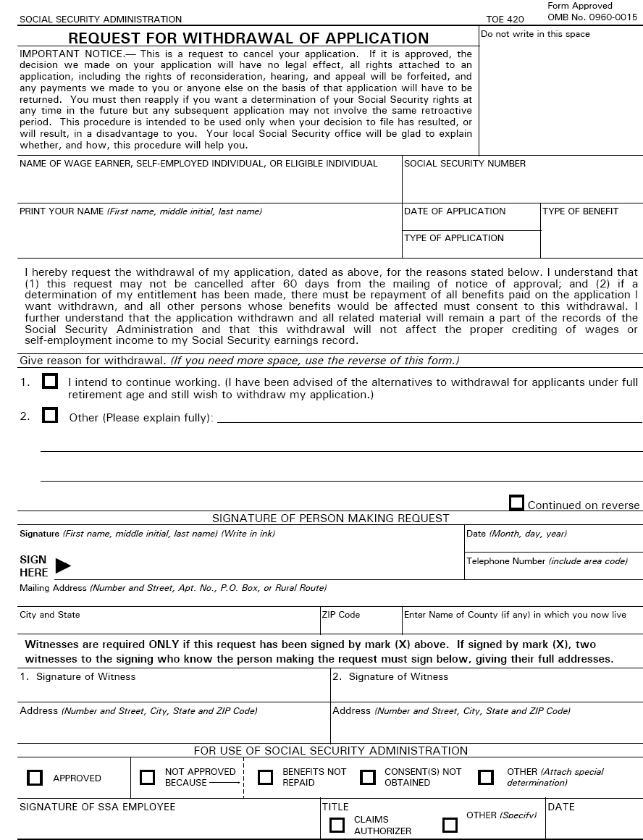
Changing Your Mind
Investment and Insurance Products Are: Not FDIC Insured • Not Insured by Any Federal Government Agency • Not a Deposit or Other Obligation of, or Guaranteed By, the Bank or any of its Affiliates •
Subject to Investment Risks, Including Possible Loss of Principal Amount Invested
.
Source: Social Security Administration (www.ssa.gov).
18
GE-2198855 (8/18) (Exp. 8/20)
Notes:
If you start collecting benefits prior to FRA and then find yourself returning to work and having your benefits withheld, you can consider a Withdrawal of Application. This essentially allows a do-over. You need to repay the SSA everything you received to date, along with any family benefits paid on your work history, and then you can subsequently apply as if it were your first time applying. The SSA has recently restricted the use of the Withdrawal to within 12 months of collecting benefits and will only allow one withdrawal per lifetime.
The SSA has recently restricted the use of the Withdrawal to within 12 months of collecting benefits and will only allow one withdrawal per lifetime.

Slide 19
Taxation of Social Security Benefits
Investment and Insurance Products Are: Not FDIC Insured • Not Insured by Any Federal Government Agency • Not a Deposit or Other Obligation of, or Guaranteed By, the Bank or any of its Affiliates •
Subject to Investment Risks, Including Possible Loss of Principal Amount Invested
.
19
GE-2198855 (8/18) (Exp. 8/20)

Slide 20

Social Security Taxation
Will my Social Security benefit be taxable?
  If Provisional Income is over base amount, a portion of your benefit will be taxable
  You have the ability to reposition assets to reduce tax liability
Investment and Insurance Products Are: Not FDIC Insured • Not Insured by Any Federal Government Agency • Not a Deposit or Other Obligation of, or Guaranteed By, the Bank or any of its Affiliates •
Subject to Investment Risks, Including Possible Loss of Principal Amount Invested
.
20
GE-2198855 (8/18) (Exp. 8/20)
Notes:
One question that commonly will be asked when discussing Social Security is “will my Social Security benefit be taxed”. In order to answer that question you will need to understand the calculation method used to determine the taxability of Social Security. The calculation will determine “provisional income”. Once the provisional income is determined you will be able to determine if your Social Security benefit will be taxable.
Even if you discover that your SS benefit will be taxable you still have the ability to reposition assets in the portfolio as tax-deferred investments are not part of the provisional income calculation.
The SSA has recently restricted the use of the Withdrawal to within 12 months of collecting benefits and will only allow one withdrawal per lifetime.

Slide 21
Taxation of Social Security Benefits
Provisional Income =
½ Social Security Benefits + Modified Adjusted Gross Income
Married,
Filing Jointly
$0
$32,000
$44,000
Single
$0
$25,000
$34,000
0% of Benefits are Taxable
0-50% of Benefits are Taxable
7-85% of Benefits are Taxable
Source: Social Security Administration (www.ssa.gov).
Investment and Insurance Products Are: Not FDIC Insured • Not Insured by Any Federal Government Agency • Not a Deposit or Other Obligation of, or Guaranteed By, the Bank or any of its Affiliates •
Subject to Investment Risks, Including Possible Loss of Principal Amount Invested
.
21
GE-2198855 (8/18) (Exp. 8/20)
Notes:
You may have to pay taxes on your Social Security retirement benefits. If your provisional income (1/2 SS benefits + MAGI) is below $25,000 if you’re single or $32,000 if you’re married, your benefits are tax-free. If it’s above these amounts but below $34,000 if you’re single or $44,000 if you’re married, your benefits could be taxable anywhere between 0% and 50%. If it’s above $34,000 if you’re single or $44,000 if you’re married, your benefits could be taxable anywhere between 7% and 85%.
If any of your benefits are taxable, you add that amount onto your taxable income for the year and are taxed at your appropriate marginal income tax rate.
The SSA has recently restricted the use of the Withdrawal to within 12 months of collecting benefits and will only allow one withdrawal per lifetime.

Slide 22
Developments Impacting Social Security
Investment and Insurance Products Are: Not FDIC Insured • Not Insured by Any Federal Government Agency • Not a Deposit or Other Obligation of, or Guaranteed By, the Bank or any of its Affiliates •
Subject to Investment Risks, Including Possible Loss of Principal Amount Invested
.
22
GE-2198855 (8/18) (Exp. 8/20)

Slide 23
Social Security Claiming Strategies: What Has Changed
Social Security Claiming Strategies: What Has Changed
The Bipartisan Budget Act of 2015
Eliminated the File and Suspend Strategy
  In order for a spouse to collect a spousal benefit the other spouse must also be collecting a social security retirement benefit.
  Effective Date – 6 months after bill goes into effect. (May 2016)
  Anyone currently using this strategy will be grandfathered in.
Eliminated the Restricted Application Strategy
  If an individual reaches Full Retirement Age they can no longer collect a spousal benefit instead of their own and allow their own benefit to receive Delayed Retirement Credits.
  Will affect anyone turning 62 after 2015.
Investment and Insurance Products Are: Not FDIC Insured • Not Insured by Any Federal Government Agency • Not a Deposit or Other Obligation of, or Guaranteed By, the Bank or any of its Affiliates •
Subject to Investment Risks, Including Possible Loss of Principal Amount Invested
.
23
GE-2198855 (8/18) (Exp. 8/20)
Notes:
The Bipartisian Budget Act of 2015 eliminated two popular claiming strategies : File and Suspend and Restricted Application
Let’s get into the details of those changes on the next few slides.
The SSA has recently restricted the use of the Withdrawal to within 12 months of collecting benefits and will only allow one withdrawal per lifetime.

Slide 24
File and Suspend
What is File and Suspend?
What is it?
At Full Retirement Age one spouse files for Social Security benefits, but suspends payments
Delayed retirement credits will continue to accrue for the covered worker
Why…
Filing for benefits will open that individual’s work record so the spouse can begin collecting spousal benefits
The individual who suspended their benefits collects Delayed Retirement Credits (DRC) on their benefit
Investment and Insurance Products Are: Not FDIC Insured • Not Insured by Any Federal Government Agency • Not a Deposit or Other Obligation of, or Guaranteed By, the Bank or any of its Affiliates •
Subject to Investment Risks, Including Possible Loss of Principal Amount Invested
.
24
GE-2198855 (8/18) (Exp. 8/20)
Notes:
Read Slide
The SSA has recently restricted the use of the Withdrawal to within 12 months of collecting benefits and will only allow one withdrawal per lifetime.

Slide 25
Restricted Application
What is Restricted Application?
What is it?
Strategy in which an individual who has reached Full Retirement Age (FRA) elects to receive a 50% Spousal Benefit instead of collecting their retirement benefit.
Why…
Allows an individual at FRA to access income based on Spousal Benefit without compromising DRC’s on own Benefit.
The individual’s spouse would need to have filed for their retirement benefit.
Only one spouse in a couple can do this.
Investment and Insurance Products Are: Not FDIC Insured • Not Insured by Any Federal Government Agency • Not a Deposit or Other Obligation of, or Guaranteed By, the Bank or any of its Affiliates •
Subject to Investment Risks, Including Possible Loss of Principal Amount Invested
.
25
GE-2198855 (8/18) (Exp. 8/20)
Notes:
Read Slide
The SSA has recently restricted the use of the Withdrawal to within 12 months of collecting benefits and will only allow one withdrawal per lifetime.

Slide 26
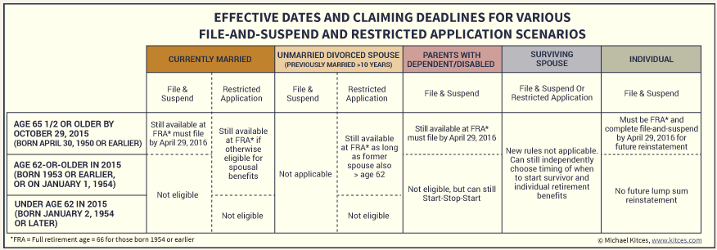
Effective Dates and Claiming Deadlines
Investment and Insurance Products Are: Not FDIC Insured • Not Insured by Any Federal Government Agency • Not a Deposit or Other Obligation of, or Guaranteed By, the Bank or any of its Affiliates •
Subject to Investment Risks, Including Possible Loss of Principal Amount Invested
.
26
GE-2198855 (8/18) (Exp. 8/20)
Notes:
This chart contains a summary of all of the changes to Social Security claiming strategies and the applicable effective dates.
The SSA has recently restricted the use of the Withdrawal to within 12 months of collecting benefits and will only allow one withdrawal per lifetime.

Slide 27
Benefit Collection Strategies
Investment and Insurance Products Are: Not FDIC Insured • Not Insured by Any Federal Government Agency • Not a Deposit or Other Obligation of, or Guaranteed By, the Bank or any of its Affiliates •
Subject to Investment Risks, Including Possible Loss of Principal Amount Invested
.
27
GE-2198855 (8/18) (Exp. 8/20)

Slide 28
Benefit Collection Strategies
Benefit Collection Strategies
In the next few slides we will walk through 3 of the most common Spousal Benefit Claiming Strategies:
    Married Couple – Collect at Age 62
    Married Couple – Collect at Age 66 (FRA)
    Married Couple – Collect at Age 70
  Assumptions:
    Rob and Mary are a married couple who will live until age 85
    Rob and Mary are both currently age 62
Investment and Insurance Products Are: Not FDIC Insured • Not Insured by Any Federal Government Agency • Not a Deposit or Other Obligation of, or Guaranteed By, the Bank or any of its Affiliates •
Subject to Investment Risks, Including Possible Loss of Principal Amount Invested
.
28
GE-2198855 (8/18) (Exp. 8/20)
Notes:
A spouse can get up to 50% of the primary worker’s income benefit. This is in addition to the benefit received by the worker themselves.
In many cases a spouse is fully insured under Social Security, but they will be entitled to the larger of their own benefit or 50% of a spouses benefit.
And, for individuals who have been previously married: If the marriage lasted at least 10 years and they haven’t remarried, they are entitled to 50% of the former spouses’ benefit so long as it is greater than their own. It is important to note that the spousal benefit payable here does not reduce the former spouse’s benefit.

Slide 29
Married Couple – Hypothetical Example
Rob
PIA: $2,000
Mary
PIA: $500
$3,640
$3,365
$3,000
$2,225
$0
Delayed Retirement Credits do NOT impact Spousal Benefits
Source: Social Security Administration (www.ssa.gov).
Investment and Insurance Products Are: Not FDIC Insured • Not Insured by Any Federal Government Agency • Not a Deposit or Other Obligation of, or Guaranteed By, the Bank or any of its Affiliates •
Subject to Investment Risks, Including Possible Loss of Principal Amount Invested
.
29
GE-2198855 (8/18) (Exp. 8/20)
Notes:
SCENARIO 1: LONGEVITY ASSUMPTIONS: HUSBAND, 82; WIFE, 85
Husband's Information
Year of Birth 1954
Full Retirement Age (FRA) 66
Primary Insurance Amount
(Benefit at FRA) $2,000
Wife's Information
Year of Birth 1954
Full Retirement Age (FRA) 66
Primary Insurance Amount
(Benefit at FRA) $500
Assumed Growth Rate
Cost-of-Living Adjustment (COLA) 3.0%
Hybrid Assumptions
Age Husband Collects 70
Age Husband Collects Spousal --
Age Wife Collects 62
Age Wife Collects Spousal 70

Slide 30
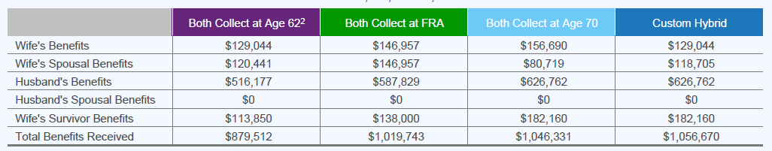
Benefit Collection Strategies Summary
Benefit Collection Strategies
  Estimated Lifetime Benefits:
Investment and Insurance Products Are: Not FDIC Insured • Not Insured by Any Federal Government Agency • Not a Deposit or Other Obligation of, or Guaranteed By, the Bank or any of its Affiliates •
Subject to Investment Risks, Including Possible Loss of Principal Amount Invested
.
30
GE-2198855 (8/18) (Exp. 8/20)
Notes:
A spouse can get up to 50% of the primary worker’s income benefit. This is in addition to the benefit received by the worker themselves.
In many cases a spouse is fully insured under Social Security, but they will be entitled to the larger of their own benefit or 50% of a spouses benefit.
SCENARIO 1: LONGEVITY ASSUMPTIONS: HUSBAND, 82; WIFE, 85
Husband's Information
Year of Birth 1954
Full Retirement Age (FRA) 66
Primary Insurance Amount
(Benefit at FRA) $2,000
Wife's Information
Year of Birth 1954
Full Retirement Age (FRA) 66
Primary Insurance Amount
(Benefit at FRA) $500
Assumed Growth Rate
Cost-of-Living Adjustment (COLA) 3.0%
Hybrid Assumptions
Age Husband Collects 70
Age Husband Collects Spousal --
Age Wife Collects 62
Age Wife Collects Spousal 70
After Wife’s age 74 the couple would be better off collecting at FRA than collecting at 62
After Wife’s age 82 the hybrid approach would be best.

Slide 31

Next steps
Understand the fundamental rules
Recognize the options and benefits available
Work with your financial professional to make the best collection decision for your retirement plan
Investment and Insurance Products Are: Not FDIC Insured • Not Insured by Any Federal Government Agency • Not a Deposit or Other Obligation of, or Guaranteed By, the Bank or any of its Affiliates •
Subject to Investment Risks, Including Possible Loss of Principal Amount Invested
.
31
GE-2198855 (8/18) (Exp. 8/20)
Notes:
Read slide

Slide 32
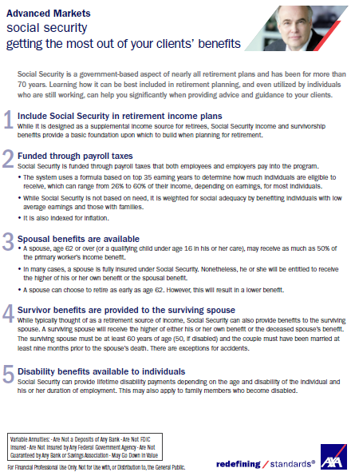
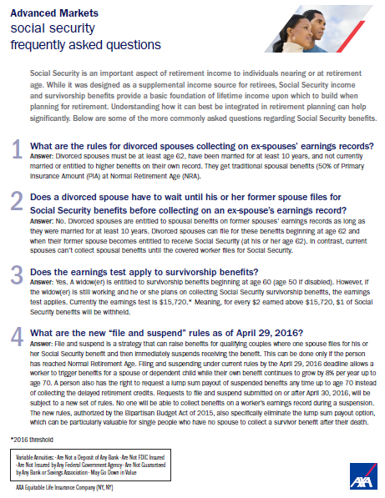

Equitable’s Social Security Tools and Resources
Social Security resources to help explain how variable annuities can help solve retirement challenges
  Social Security FAQ
  Social Security 10 Point Summary
Investment and Insurance Products Are: Not FDIC Insured • Not Insured by Any Federal Government Agency • Not a Deposit or Other Obligation of, or Guaranteed By, the Bank or any of its Affiliates •
Subject to Investment Risks, Including Possible Loss of Principal Amount Invested
.
32
GE-2198855 (8/18) (Exp. 8/20)
Notes:
Click to add notes

Slide 33

How We Can Help
Please contact any Advanced Markets Team Members below for any Social Security Questions.
Advanced Market Support
  Laird Johnson, ChFC®, CLU®
  Rob Burns, RICP®
  Nathan Lew, CFP®, CLU®, ChFC®, RICP®
  Stu Farmer, CLU®, ChFC®
  Contact Number: 800-316-9981
Investment and Insurance Products Are: Not FDIC Insured • Not Insured by Any Federal Government Agency • Not a Deposit or Other Obligation of, or Guaranteed By, the Bank or any of its Affiliates •
Subject to Investment Risks, Including Possible Loss of Principal Amount Invested
.
33
GE-2198855 (8/18) (Exp. 8/20)
Notes:
Click to add notes

Slide 34
Important Information
Please be advised that this presentation is not intended as legal or tax advice. Accordingly, any tax information provided in this document is not intended or written to be used, and cannot be used by any taxpayer for the purpose of avoiding penalties that may be imposed on the taxpayer. The tax information was written to support the promotion or marketing of the transaction(s) or matter(s) addressed, and clients should seek advice based on their particular circumstances from an independent tax advisor.
This material is provided for educational purposes only and does not constitute investment advice. The information contained herein is based on current tax laws, which may change in the future. AXA Equitable cannot be held responsible for any direct or incidental loss resulting from applying any of the information provided in this publication or from any other source mentioned. The information provided in these materials does not constitute any legal, tax or accounting advice. Please consult with a qualified professional for this type of advice.
AXA Equitable Life Insurance Company(NY,NY). Distributors: AXA Advisors, LLC and AXA Distributors, LLC. AXA Equitable, AXA Advisors, and AXA Distributors are affiliated companies and do not provide legal or tax advice.
“AXA” is the brand name of AXA Equitable Financial Services, LLC and its family of companies, including AXA Equitable Life Insurance Company (NY, NY) (AXA Equitable) AXA Advisors, LLC; and AXA Distributors, LLC. The obligations of AXA Equitable are backed solely by its claims paying ability.
Investment and Insurance Products Are: Not FDIC Insured • Not Insured by Any Federal Government Agency • Not a Deposit or Other Obligation of, or Guaranteed By, the Bank or any of its Affiliates •
Subject to Investment Risks, Including Possible Loss of Principal Amount Invested
.
34
GE-2198855 (8/18) (Exp. 8/20)
Notes:
Read slide

Slide 35
Thank you.

