Slide 1


[When presenting in AR, CA, OK, TX or IL, use the phrase “Insurance Sales Presentation.” In CA and AR, add License Number]
Issued by Pruco Life Insurance Company and by Pruco Life Insurance Company of New Jersey.
Prudential Annuities is providing this workshop for informational or educational purposes only and does not provide investment advice or recommendations about managing or investing your retirement savings.
[Firm Logo(s)]
1033803-00001-00 Ed. 04/2020
Notes:
[REMOVE SLIDE WHEN USING FOR BANK FIRM OR CHASE].
Welcome. My name is ______________. Today we are going to discuss retirement planning for spouses. We'll talk about the unique challenges that spouses face as they plan for their retirement, and how to protect a surviving spouse.
Should you have any questions as we go through the material, feel free to ask.

Slide 2
INVESTMENT AND INSURANCE PRODUCTS ARE:
NOT FDIC INSURED NOT INSURED BY ANY FEDERAL GOVERNMENT AGENCY NOT A DEPOSIT OR OTHER OBLIGATION OF, OR GUARANTEED BY, THE BANK OR ANY OF ITS AFFILIATES SUBJECT TO INVESTMENT RISKS INCLUDING POSSIBLE LOSS OF THE PRINCIPAL AMOUNT INVESTMENT
Prudential Annuities®
A Closer Look At Your Spousal Protection Strategies
[Presenter Name], [Presenter Title]
[When presenting in AR, CA, OK, TX or IL, use the phrase “Insurance Sales Presentation.” In CA and AR, add License Number.]
Issued by Pruco Life Insurance Company and by Pruco Life Insurance Company of New Jersey
.
Prudential Annuities is providing this workshop for informational or educational purposes only and does not provide investment advice or recommendations about managing or investing your retirement savings.
1002566-00002-00 ORD208282 Ed. 08/2018
1033803-00001-00 Ed. 04/2020
Notes:
[REQUIRED SLIDE FOR JP MORGAN CHASE ONLY. REMOVE WHEN USING FOR ALL OTHER FIRMS]
Welcome. My name is _______________. Today we are going to look at some strategies to help you get the most from your Social Security benefit.

Slide 3

[When presenting in AR, CA, OK, TX or IL, use the phrase “Insurance Sales Presentation.”
In CA and AR, add License Number]
Issued by Pruco Life Insurance Company and by Pruco Life Insurance Company of New Jersey.
Prudential Annuities is providing this workshop for informational or educational purposes only and does not provide investment advice or recommendations about managing or investing your retirement savings.
[Firm Logo(s)]
1033803-00001-00 Ed. 04/2020
Notes:
[REQUIRED SLIDE FOR BANK FIRMS ONLY. REMOVE WHEN USING FOR ALL OTHER FIRMS]
Welcome. My name is ______________. Today we are going to discuss retirement planning for spouses. We'll talk about the unique challenges that spouses face as they plan for their retirement, and how to protect a surviving spouse.
Should you have any questions as we go through the material, feel free to ask.

Slide 4
[Required For Merrill Lynch Events Only]
Investing involves risk including possible loss of principal. Information is current as of the date of this material and subject to change.
Any opinions expressed herein are from a third party and are given in good faith, are subject to change without notice, and are considered correct as of the stated date of their issue.
Merrill Lynch, Pierce, Fenner & Smith Incorporated is not a tax or legal advisor. Clients should consult a personal tax or legal advisor prior to making any tax or legal related investment decisions.
Bank of America Corporation (“Bank of America”) is a financial holding company that, through its subsidiaries and affiliated companies, provides banking and investment products and other financial services .
Merrill Lynch makes available products and services offered by Merrill Lynch, Pierce, Fenner & Smith Incorporated (“MLPF&S”), a registered broker-dealer and member SIPC, and other subsidiaries of Bank of America Corporation (BofA Corp). Merrill Lynch Life Agency is a licensed insurance agency and a wholly owned subsidiary of BofA Corp.
Merrill Lynch offers a broad range of brokerage, investment advisory and other services. There are important differences between brokerage and investment advisory services, including the type of advice and assistance provided, the fees charged, and the rights and obligations of the parties. It is important to understand the differences, particularly when determining which service or services to select. The views and opinions expressed in this presentation are not necessarily those of Bank of America Corporation; Merrill Lynch, Pierce, Fenner & Smith Incorporated; or any affiliates. [For more information about these services and their differences, speak with your Financial Advisor.]
Nothing discussed or suggested in these materials should be construed as permission to supersede or circumvent any Bank of America, Merrill Lynch, Pierce, Fenner & Smith Incorporated policies, procedures, rules, and guidelines.
Investment products offered through MLPF&S and insurance and annuity products offered through Merrill Lynch Life Agency Inc.:
[This material should be regarded as educational information on [health care] [and] [Social Security] and is not intended to provide specific advice. If you have questions regarding your particular situation, you should contact your legal or tax advisors.]
Are Not FDIC Insured | May Lose Value | Are Not Bank Guaranteed
Are Not Insured by Any Federal Government Agency | Are Not Deposits | Are Not a Condition to Any Banking Service or Activity
Notes:
Required for Merrill Lynch only. Read slide

Slide 5

[Required For Morgan Stanley Smith Barney Events Only]
Morgan Stanley Smith Barney is not affiliated with Prudential Annuities.
The views and opinions expressed in this presentation are not necessarily those of Prudential Annuities; or any affiliates. Nothing discussed or suggested in these materials should be construed as permission to supersede or circumvent any Morgan Stanley Smith Barney incorporated policies, procedures, rules, and guidelines. This material should be regarded as educational information on [Health Care, Social Security, Taxes] and is not intended to provide specific advice. If you have questions regarding your particular situation, you should contact your legal or tax advisors.
Notes:
Required for Morgan Stanley Only. Read Slide

Slide 6
[For Allstate Financial Services only: This slide must be shown prior to the beginning of the customer presentation]
[Hosted/Presented by:]
[PFR Name]
Personal Financial Representative
[Allstate Financial Services, LLC or LSA Securities (in LA & PA)]
Securities offered by Personal Financial Representatives through Allstate Financial Services, LLC (LSA Securities in LA and PA). Registered Broker-Dealer. Member FINRA, SIPC. Main Office: 2920 South 84th Street, Lincoln, NE 68506. (877) 525-5727. Check the background of this firm on FINRA’s BrokerCheck website http://brokercheck.finra.org.
Notes:
[OPTIONAL SLIDE]. Read slide

Slide 7
[Optional Disclosure Slide]
[Investments are offered through [BROKER DEALER NAME], a registered broker dealer. [Insurance is offered through [AGENCY NAME- if applicable.]]
[BROKER DEALER and AGENCY- if applicable], located at [ADDRESS], [is/are] not affiliated with Prudential Financial.]]
Notes:
[OPTIONAL SLIDE]. Read Slide

Slide 8
The Landscape Has Shifted
U.S. Government Accountability Office confirms the three traditional pillars of retirement income - Social Security, employer-sponsored retirement plans and individual savings -no longer provide adequate retirement security for a growing number of Americans.¹
“For widows and widowers, the outlook can be particularly unnerving.”²
Widows need 79% of a couples income to maintain standard of living. Half will have only 62% or less.³
72% of retirees encountered one “Financial Shock”
24% of Surviving Spouses encountered 4 or more “Financial Shocks”⁴
1. U.S. Government Accountability Office, “The Nation’s Retirement System,” February 2019
2. Prudential, Providing for a Surviving Spouse in Retirement, 2018
3. Center for Retirement Research at Boston College, “Will the Financial Fragility of Retirees Increase,” February, 2018.
4. Society of Actuaries, “2015 Risks and Process of Retirement Survey,” January 2016.
Notes:
Fundamental change has shaken the foundation of the U.S. retirement system. A recent report from the U.S. Government Accountability Office confirms that the three traditional pillars of that system—Social Security, employer-sponsored retirement plans, and individual savings—no longer provide adequate retirement security for a growing number of Americans. For widows and widowers, the outlook can be particularly unnerving.
A widow needs, on average, 79% of a couple’s income to maintain her standard of living after the death of her husband. Yet in a study of married women expected to enter retirement over the next quarter century, half are projected to have only 62% of the couple’s income, or less, when widowed.
Surviving spouses also may be more at risk in retirement if they were part of a two-income household, another phenomenon that continues to become increasingly common. Dual-income households typically spend more on fixed expenses (e.g., larger mortgages, auto payments, etc.) while both spouses are working, since two incomes allow them to “afford” more. Having built a lifestyle dependent on two incomes, though, the untimely death of a spouse can create challenges in retirement since household income can then go down more than household expenses.

Slide 9
Fundamental Changes and Trends
Demise of the Defined Benefit Pension Plan
Increased Longevity
Changes to Social Security
Rising Healthcare Costs
Notes:
Optional Slide Read Slide

Slide 10
Surviving Spouses Need To Prepare for Change
Reduced Social Security benefits
Pension potentially reduced
Reduced retirement accounts
Taxes potentially rising
Medicare premiums rising
Increased withdrawal rate
Longevity risk magnified by market volatility, rising healthcare costs, and low interest rates
Notes:
Read Slide. While living longer has great upside, it also can mean that the risk to your retirement savings, like market volatility, rising healthcare costs, and low interest rates, can become greater.

Slide 11
Surviving Spouse’s Checklist
Year One | Year Two | Year Three
Probate Will Execute Trusts Retitle Assets Elect Distribution Option for Retirement Accounts Make Insurance Claims Social Security Survivorship Decision | Joint to Single Tax Return – loss of 1 standard deduction Selling home in non-community property state | Joint to Single Medicare Premium Last Year to Take Advantage of Joint Home Sale Exclusion Surviving Spouse may need long-term care
Notes:
In addition to the significant emotional challenges, there is also the financial side of things to deal with. Your financial professional can help you during this difficult time that can take several years. This checklist can help you be prepared for some of the issues you will need to address and consider.

Slide 12
Longevity Risks
Expected life span of individuals and couples age 65
50% are expected to live to age:
Multiplier:
Greater probability of:
  Facing a bear market
  Healthcare costs rising
  Interest rate fluctuation
Men 87
Women 90
Couples (Surviving spouse) 94
Source: Society of Actuaries RP-2014 Mortality Table projected with Mortality Improvement Scale MP-2014 as of 2016
Notes:
Retirees may have an incorrect perception about retiring. They may focus on getting older, but neglect to think about how they may live longer and spend in retirement. Longevity risk is the risk that investors will outlive their money.
When creating a strategy for transitioning savings to retirement income, the issue of longevity is an important consideration. As you can see, a 65-year-old married couple has a 50% chance that one member will live to age 94. That’s almost 30 years. One of the challenges of this is how to generate income during that 30 years.
This also brings up the potential need for spousal protection planning. It is likely that one spouse will outlive the other, in many instances the surviving spouse's income may be reduced.
Finally longevity is the multiplier risk- meaning the longer you live the greater the probability that the other risks we have talked about will happen.

Slide 13
Potential Spousal Protection Strategies
Pensions and Longevity
Consider:
Survivor benefit options
Withdraw only safe and sustainable amounts
Create additional sources of guaranteed income
Joint life income benefits
Life insurance
Notes:
Read Slide

Slide 14
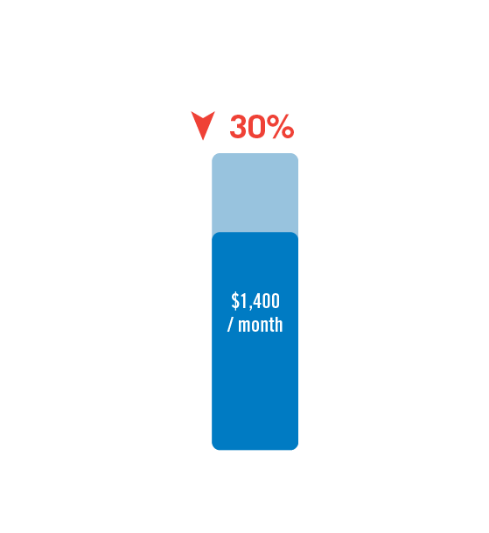
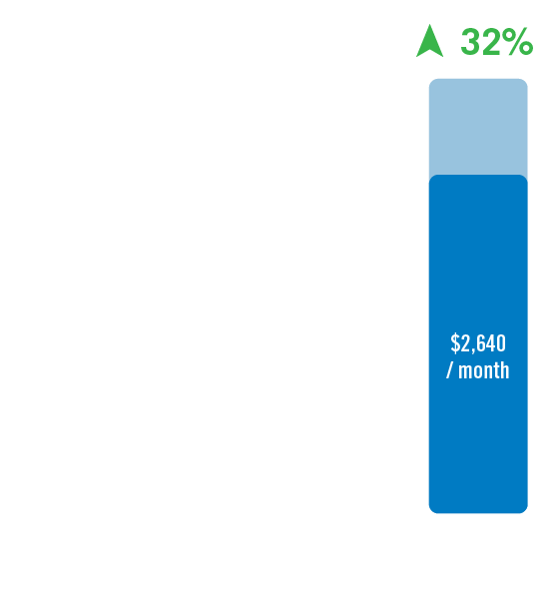
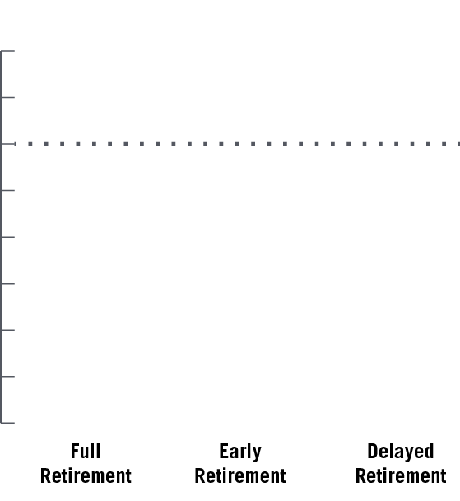
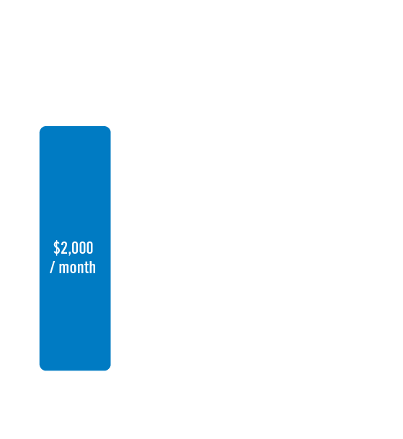
Social Security:
When to commence benefits?
  Full Retirement Age (FRA)
  Early retirement
  Delayed retirement credits
Up to
As much as
71% of men take reduced benefits*
75% of women take reduced benefits*
*Source: Social Security Administration, Master Beneficiary Record, 100 percent data. Social Security Annual Statistical Supplement 2018, Table 6.B5.1
This is a hypothetical example of the Social Security benefits that could be received from the government and is for illustrative purposes only. As the specifics for your situation may be different, please go to ssa.gov for more information. To confirm your full retirement age, go to ssa.gov.
Notes:
As you can see from the graph on this slide, there are choices individuals can make in terms of when to take Social Security benefits. At full retirement age (FRA), they will receive full Social Security benefits. What happens, though, if they decide to take benefits prior to, or after, full retirement age?
[CLICK in ER]
[CLICK in DR]
Taking benefits early may result in not only reduced payments for the life of the Social Security recipient but also reduced survivor benefits for the spouse. Since women tend to live longer than men, this could adversely affect women more than men.
[Click.] In fact, 71% of men take their Social Security benefit before their full retirement age, and 75% of women take reduced benefits.

Slide 15
Social Security
Spousal benefits
Married individuals can claim Social Security benefits based on
If electing based on spouse’s earnings record
  Personal earnings record, or
  Spouse’s earnings record
  Spousal benefit is up to 50% of their spouse’s Social Security benefit*
  Cannot claim spousal benefit until the spouse files for benefits
46%
of women age 62 and over receive benefits based in whole or in part on their husband’s benefits**
* ”Retirement Benefits”; SSA Publication No. 05-10035, ICN 457500; January 2018
** “Fast Facts and Figures About Social Security, 2018”, “Women with Dual Entitlement”; SSA Publication 13-11785, September 2018
Notes:
It should be noted that it is possible to receive benefits even if the taxpayer never worked or did not have enough credits to be eligible for benefits. Taxpayers who are married can receive Social Security benefits based on their spouse’s earnings history. If a married taxpayer has met the 40 quarter requirement, the taxpayer can elect to receive benefits based on the taxpayer’s personal earnings record or the taxpayer’s spousal benefits.
[CLICK]If benefits are based on the spouse’s earnings history, the spousal benefit is up to 50% of the working spouse’s Social Security benefit. However, the taxpayer cannot claim spousal benefits until the working spouse files for benefits.
This is an important fact since 46% of women over 62 receive benefits based on their husbands' benefits.

Slide 16

Social Security
Survivor benefits
Surviving spouse can receive or step up to the benefit of the deceased spouse
  If survivor is full retirement age,
  100% of spouse’s benefit
  Survivor benefits generally
  begin at age 60
  Survivor benefits reduced if received before full retirement age – up to 28.5%
  Exceptions for widowers with children who are under 19
  Survivor can switch to his or her
  own benefits
  Advantageous if greater when full retirement age reached
Source: “Survivor Benefits”; SSA Publication No. 05-10084, ICN 468540; March 2018
Notes:
Another way a spouse can receive Social Security benefits is when his/her spouse passes away. This type of benefit is known as survivor benefits. If the surviving spouse is at full retirement age, the benefit will step up to 100% of the deceased spouse’s benefit.
Survivor benefits can start as early as age 60, but if they begin this early the benefit will be reduced.
It is important to remember that a spouse can collect survivor benefits, and at some later point switch over to his/her own benefits. In other words, collecting survivor benefits will not have an effect on your own benefits.

Slide 17
Potential Spousal Protection Strategies
Social Security
Consider:
Delaying Social Security benefits
Maximizing survivor benefits
Supplement benefits with other sources of guaranteed income
Life insurance and annuities to help offset lost benefit due to death of spouse
Notes:
Read Slide

Slide 18
Review Healthcare and Long-term Care Costs
Second largest
expense in retirement¹
26% are “very confident” that they will have enough money to take care of medical expenses in retirement²
Does not include long-term care costs³
HEALTHCARE
Can take a healthy bite out
of retirement savings.
It is estimated that an average, healthy 65-year-old couple will need
$285,000
to pay for medical expenses for
the remainder of their lives.¹
¹ Fidelity Benefits Consulting estimate, 2019. Healthcare and nursing home costs may vary by state.
² Bureau of Labor Statistics, Consumer Expenditure Survey 2017; Table 1300 Mean annual expenditures by age; Age 75+
³ Employee Benefits Research Institute (EBRI), 2018 Retirement Confidence Survey, April 24, 2018
Notes:
When it comes to retirement planning, don’t overlook the cost of healthcare. Take the time to review healthcare needs, costs and coverage. If you retire before Medicare eligibility, you and your family will want to make sure you have the appropriate healthcare insurance.
An average 65-year-old couple can expect to have $285,000 of healthcare costs not covered by Medicare. This figure does not include any long-term care costs they may incur.
Furthermore, the $285,000 figure is just an average. It could be more depending on length of life and region of the country.
Out-of-Pocket Healthcare Costs
Part B and D Medicare premiums
Deductibles, co-insurance, co-pays
Medicare does not cover:
Acupuncture
Routine dental or eye care
Dentures
Routine foot care
Cosmetic Surgery
Hearing aides and exams for fitting
Long-term care
Source: Fidelity Investments retiree health costs estimate, 2019. Healthcare and nursing home costs may vary by state.

Slide 19
Reduce Costs by Reducing Modified Adjusted Gross Income (MAGI)
Keeping MAGI low can help lower healthcare costs:
  Reduces premium for Medicare Part B
  Increases ability to take advantage of medical expense deduction
  Other tax-related benefits
How to keep MAGI low:
Roth IRAs 401(k)s IRA Tax-efficient Mutual Funds | Municipal Bonds HSAs Annuities Life Insurance
Notes:
Optional Slide
Keeping taxable income as low as possible has other benefits beyond reducing the tax burden.
The premiums paid for Medicare Part B are tied to your level of income. For example, joint filers who reduce their income from $175,000 to $165,000 could reduce their individual monthly Part B premium from $187.50 per month to $134, a reduction of $53.50 per month, or a savings of $1,284 per year in total premiums for the couple.
Also, taxpayers are allowed to deduct medical expenses which exceed 10% of income in a given year (7.5% for taxpayers age 65 or older in 2013). The lower the taxpayer’s income, the easier it is to meet this hurdle.
Also, since premium subsidies provided through the Affordable Care Act are tied directly to income, lowering income increases the likelihood that you can qualify for a premium subsidy, as well as the size of the subsidy.
There are many strategies you can employ to help you keep your income low:
Roth IRAs payouts
401(k) contributions
IRA contributions*
Tax-Efficient Mutual Funds
Municipal Bonds
Life Insurance
HSAs
Variable Annuities (during deferral period)
*Potentially tax deductible based on income and participation by individual or spouse in an employer retirement plan

Slide 20
Potential Spousal Protection Strategies
Healthcare
Consider:
Long term care insurance
Reduce Medicare costs by reducing MAGI-
Create additional Sources of guaranteed income to cover healthcare costs
Health Saving Accounts (HSAs)
Life insurance with an optional chronic illness benefit
Notes:
Read Slide

Slide 21
Retirement Income Planning Example
Guaranteed Sources of Income
(Pension, Social Security, Annuities)
Cover Essentials
Essential Expenses
(Housing, Food, Clothing, Healthcare, Transportation)
Cover Gap
Consider Converting Assets into Cash Flow
Other Sources of Income
(Mutual Funds, Stocks, Bonds, CDs, Real Estate)
Discretionary Expenses
(Travel, Restaurants, Entertainment)
Discretionary
Notes:
OPTIONAL SLIDE
As you prepare for retirement, it can be helpful to categorize income sources as well as your expenses. Your financial advisor can help you decide what income sources you’ll use to cover certain expenses.
[Read slide.]

Slide 22
Summary
Retirement income is decreasing
Retirement liabilities are increasing
Achieving a secure retirement is becoming more challenging
Future widows and widowers are particularly vulnerable to outliving retirement income
Notes:
Read Slide.

Slide 23
Disclosures
Annuities are issued by Pruco Life Insurance Company (in New York, by Pruco Life Insurance Company of New Jersey), Newark, NJ (main office) and distributed by Prudential Annuities Distributors, Inc., Shelton, CT. All are Prudential Financial companies and each is solely responsible for its own financial condition and contractual obligations. Prudential Annuities is a business of Prudential Financial, Inc.
[Life insurance is issued by Pruco Life Insurance Company (in New York, by Pruco Life Insurance Company of New Jersey). Variable policies are offered through Pruco Securities, LLC (member SIPC).]
[(Use in TX/UT/FL)Annuity contracts [and life insurance policies] contain exclusions, limitations, reductions of benefits, and terms for keeping them in force. Your licensed financial professional can provide you with complete details.]
​
Notes:
Read Slide

Slide 24
Disclosures
All references to guarantees, including the benefit payment obligations arising under the annuity contract guarantees, rider guarantees, optional benefits, any fixed account crediting rates or annuity payout rates are backed by the claims-paying ability of Pruco Life Insurance Company and Pruco Life Insurance Company of New Jersey. Those payments and the responsibility to make them are not the obligations of the third party broker/dealer from which this annuity is purchased or any of its affiliates. All guarantees, including optional benefits, do not apply to the underlying investment options.
Tax deferral is provided by an IRA and other qualified retirement plans. When a variable annuity contract is used to fund a qualified retirement plan it is important to consider its features other than tax deferral, including lifetime income payout option, the death benefit protection, and the ability to transfer among investment options without sales or withdrawal charges.
Because qualified retirement plans, IRAs and variable annuities offer a tax-deferral feature, you should carefully consider the other features, benefits, risks, and costs associated with a variable annuity before purchasing one in either a qualified plan or an IRA. Before purchasing a variable annuity, you should take full advantage of your 401(k) and other qualified plans.
© 2020 Prudential Financial, Inc. and its related entities. Prudential Annuities, Prudential, the Prudential logo, and the Rock symbol, are service marks of Prudential Financial, Inc. and its related entities, registered in many jurisdictions worldwide.
[REF# 9498406]
Notes:
Read Slide.

