Slide 1


The Quality of Life
Copyright © 2019 by Hartford Funds. All rights reserved. No part of this document may be reproduced, published or posted without the permission of Hartford Funds.
Notes:
Good morning/afternoon everyone. My name is __________, and I’m a [insert title] with Hartford Funds. Thank you for taking time out of your schedule to be here today.
Before we delve into this presentation, let’s just take a moment to talk about what the MIT AgeLab is and what it was designed to do. MIT’s AgeLab is a multi-disciplinary organization housed in MIT’s School of Engineering, and incorporates students from Harvard Medical School along with students from MIT’s Sloane School of Business. It was founded in 1999 by Dr. Joe Coughlin, who continues to be its director, and The Hartford was a founding sponsor. Dr. Coughlin serves as a consultant to companies and governments world-wide to develop products, policies, and strategies to help those who are living longer to live better. The AgeLab studies aging around the world—not just in the US—and in a host of industries, not just financial services.
Based on trends in longevity, lifespans will continue to increase. The main purpose of the AgeLab is to study how changes in demographics, technology, and culture are impacting the way we do things. In fact, their slogan is Inventing Tomorrow and that’s really what they’re in place to do, but we’re here to talk about three seemingly unrelated items..
A light bulb, an ice cream cone, and a fork may not mean much to you at this point, but through the course of the presentation the significance of these three images and how they relate to our quality of life will become clear.

Slide 2
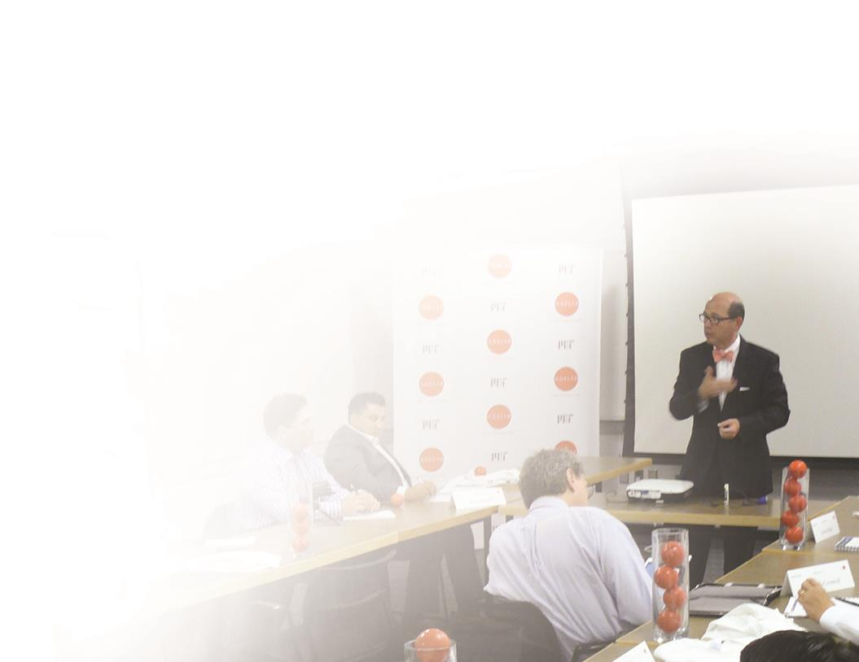
Based within MIT’s School of Engineering’s Engineering Systems Division
Challenges and opportunities of longevity
Consumer behavior and decision-making
Trends in demographics, technology, and lifestyles
2
Copyright © 2019 by Hartford Funds. All rights reserved. No part of this document may be reproduced, published or posted without the permission of Hartford Funds.
Notes:
The MIT AgeLab was created in 1999 to invent new ideas and creatively translate technologies into practical solutions that improve people’s health and enable them to “do things” throughout the lifespan. Based within MIT’s School of Engineering’s Engineering Systems Division, the AgeLab applies consumer-centered systems thinking to understand the challenges and opportunities of longevity and emerging generational lifestyles to catalyze innovation across business markets. The MIT AgeLab provides insights to Hartford Funds about consumer behavior and decision-making, and trends in demographics, technology, and lifestyles. These trends impact the way people do business with financial-services providers.

Slide 3

Where do you begin?
3
Copyright © 2019 by Hartford Funds. All rights reserved. No part of this document may be reproduced, published or posted without the permission of Hartford Funds.
Notes:
On the screen you’ll see a pile of puzzle pieces.
Pretend that you came here to put together a jigsaw puzzle. What do you think the most important first step would be?
Yell it out. Finding the edges, right, I always hear the same two answers. Edges are one. The other guesses? Corners—edges and corners are the most popular answers. Sometimes people say, “Flip the pieces over” or “Start with the colors. “
While these are all important steps, they’re not the most important first step. Before we do anything, we have to look at the picture on the box. Once we understand what the picture on the box looks like, we can begin to align the pieces to make sure the image comes forth.

Slide 4

Agenda
Personal Agenda
3 Questions
Intentional Investing
Copyright © 2019 by Hartford Funds. All rights reserved. No part of this document may be reproduced, published or posted without the permission of Hartford Funds.
Notes:
Here’s what we’ll talk about today.
First, we’ll talk about personal agendas. What’s on our personal agenda? How does it get there, and why is it so difficult to stay focused on things in today’s culture? We’ll touch on some of the reasons why life is more complicated than ever.
Second, I’ll share three critical questions that MIT AgeLab says anyone over age 45 must ask either themselves or those they love and care for.
Third, we’ll discuss how the answers to those questions can impact the way we invest; how we can invest more intentionally to assemble that image, or make our vision for our future come to life.

Slide 5

Personal Agenda
Copyright © 2019 by Hartford Funds. All rights reserved. No part of this document may be reproduced, published or posted without the permission of Hartford Funds.
Notes:
So what is a personal agenda, and why is it so hard to manage things in today’s society?

Slide 6

Personal Agenda
Volume
Health
Work
Home
Marriage
Civic
Engagement
Transportation
Friends
Life Planning
Children
Retirement
Eldercare
Self
Education
Faith
Notes:
The MIT AgeLab tells us that in today’s society the volume, velocity, and complexity of life today makes managing it more difficult than ever before. Some of us are managing as many as four, and sometimes five generations, providing care both up and down the generational scale. In the bubbles, you might see several different areas you can relate to, whether it’s retirement, civic engagement, marriage, transporting kids, or any of the other things on the screen. Juggling all of these concerns and priorities has made it even more complicated―again by the size of our families and the breadth of our interests―due to how much longer we are living.

Slide 7
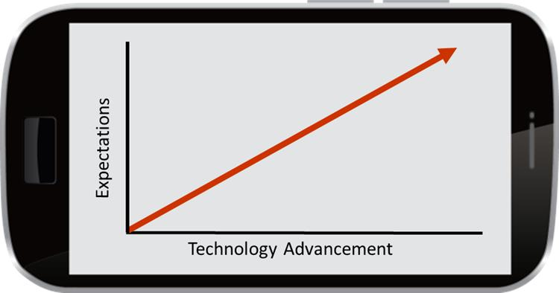
Personal Agenda
Velocity
Technology increases productivity, but decreases time to think
Information overload
Impact of technology
Changing standards & expectations
Notes:
Life is coming at us at maximum velocity.
Normally, my iPhone would be in pocket. Does anyone know what year the Apple iPhone was introduced to the United States market? Any guesses?
It was 2007. The technology has only been around for roughly a decade. Has anyone tried to talk to their grandchildren lately via e-mail, text, or call them on their cell phones? It’s changed the way we communicate. It’s also changed the way we make purchases, the way we evaluate products and services, and the way we seek information.
Technology has a profound impact on the way we do things. With each new gadget, we ask, “This is going to do what?” Initially we think it’ll give us more free time, allowing us to pause and reflect and just be. But what has it done instead? It’s caused us to cram more and more into our day. So the increased volume of issues are coming at us with increased velocity, right? Because in today’s culture, if you don’t answer my texts within 30 minutes I start getting impatient and annoyed.

Slide 8
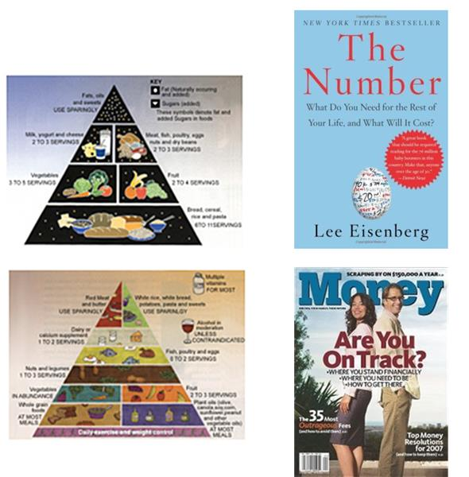
Complexity
Personal Agenda
More choices, more difficult decisions
Clear and unclear tradeoffs and risks
Changing standards and information
Notes:
I always characterize this as, “just when you thought you knew all the answers, they change the questions.” Just when you thought your blood pressure was within a manageable range, they change the standards, right? Just when you learn how to eat in the food pyramid, it’s not a pyramid anymore―it’s my plate. New research uncovering new techniques also uncovers new standards. Information is everywhere, but has it made making decisions any easier? More than ever we have information available at our fingertips, but many would say it’s actually complicated the process.

Slide 9
Personal Agenda
Increased Longevity Increases Danger of Not Planning
At age 65, your probability of living to various ages
Age
Male
Female
One Member of a Couple
80
71%
81%
94%
85
53%
65%
84%
90
34%
44%
63%
95
17%
23%
36%
Data source: Society of Actuaries Annuity 2000 Mortality tables. Most recent data available. Longevity data presented does not reflect mortality from birth statistics available from U.S. Census Bureau.
Notes:
Somewhere between year 2015 and 2020 it’s projected that the world’s population of people over age 65 will exceed the population of people under age five for the first time in history. So we have a crossing of the lines, if you will.
Why is that happening? It’s because of longevity trends not only in the United States, but around the world. The slide in front of you is a life expectancy chart and has a bunch of numbers on it, so I’ll make this easy for you. Look at the bottom right corner of the chart; it’s what we call the rule of 63/36. The rule of 63/36 states that for two people both aged 65 and married today in the United States, there’s a 63% chance that one of the two will live to age 90. Just flip those numbers around and there is a 36% that one of the two will live to age 95. Ladies, I probably don’t need to tell you who that’ll be, but what we do find is that Americans in general tend to underestimate their longevity.
Raise your hand if your parents or grandparents lived to age 85. Anybody in the room? How about age 90? Past age 95? Age 100?
The fastest growing age group is centenarians. Why? Life expectancies are increasing because of advances in medical therapies and technologies and healthier lifestyles. Generally speaking, when we look at demographic trends the fact that we’re living longer is no accident.

Slide 10
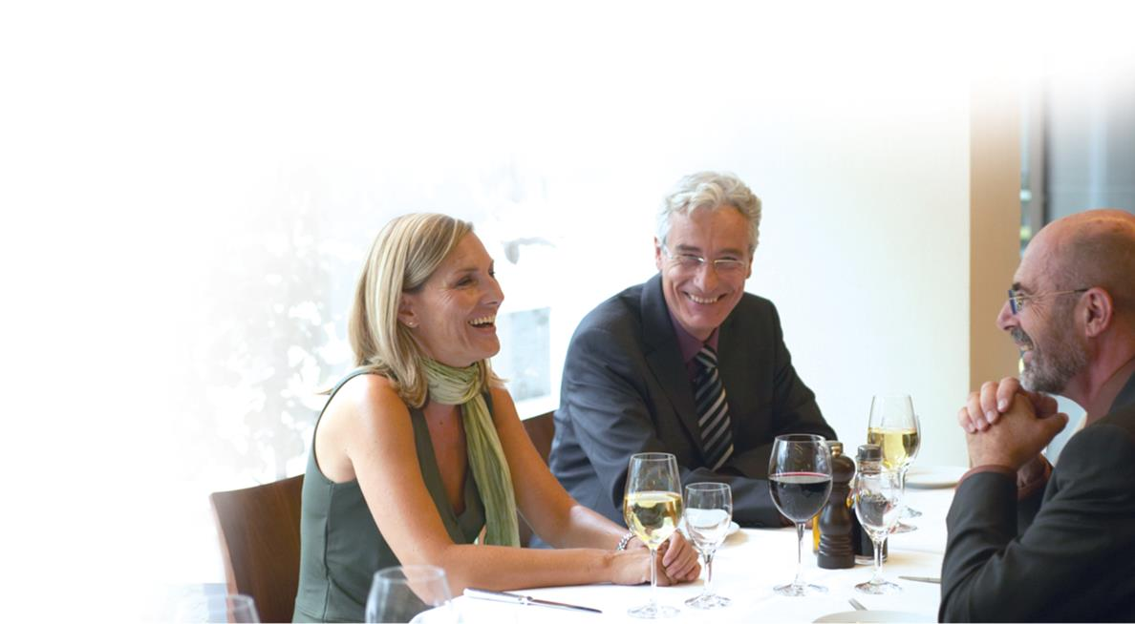
3 Questions
Copyright © 2019 by Hartford Funds. All rights reserved. No part of this document may be reproduced, published or posted without the permission of Hartford Funds.
Notes:
So when we think about aging and living longer, what becomes most important? That brings us to the three questions―three questions that can predict the future quality life. Now I warn you, these questions are going to underwhelm you with their simplicity, especially coming from the rocket scientists in Cambridge, Massachusetts, right?
But there is a method to their madness.

Slide 11

3 Questions
Who will change my light bulbs?
How will I get an ice cream cone?
Who will I have lunch with?
Notes:
And here they are:
Who will change my light bulbs?
How will I get an ice cream cone? and
Who will I have lunch with?
Your reaction might be “What in the world is this guy talking about? Is he crazy?” Just bear with me.
As we move through the presentation today and I explain the research behind these questions, I want you to begin thinking about asking yourself these questions, either of yourself or someone you care about. How would your loved ones begin to answer them?
By the way, the answers probably won’t come to you over a period of days or even weeks. These are answers that are shaped over a period of time.

Slide 12

3 Questions
Who will change my light bulbs?
Notes:
According to AARP, nearly 80% of adults age 55 and older intend to stay in their own homes for as long as possible.¹
But how many of them have spent more than 20 or 30 minutes thinking about the services or modifications that might be necessary to allow them to live safely and independently in their 80s or early 90s?
¹Most Retirees Prefer to Stay Put, aarp.org, 10/10/18

Slide 13
3 Questions
Largest Expense: Housing
Consumer Expenditures—65 Years and older
Avg. Income: $48,570
Avg. Age: 74.3
Household size: 1.7
Source: Bureau of Labor Statistics Consumer Expenditure Survey, 2016-2017, September 2018
Notes:
If we look at how Americans spend money after age 65, you’ll see that housing is the largest expense. What this graph accounts for are average monthly expenses, covered by money that’s coming out of our savings and out of our pockets. Housing is more than a third of the average monthly budget. What’s the money being spent on?

Slide 14





3 Questions
How will I age in place?
Home modifications
Home maintenance
Housekeeping
Grocery delivery
Laundry services
Notes:
Sometimes housekeeping services. At some point that becomes difficult to keep up with. How about maintenance, handyman services? Fixing things we could easily do ourselves in the past also become challenging and even risky. The idea of a parent or loved one climbing a stepladder to change a light bulb probably makes you a bit nervous.
So we’re going to need services, maybe grocery delivery, laundry… but that last one, home modifications, is really important to think about.

Slide 15
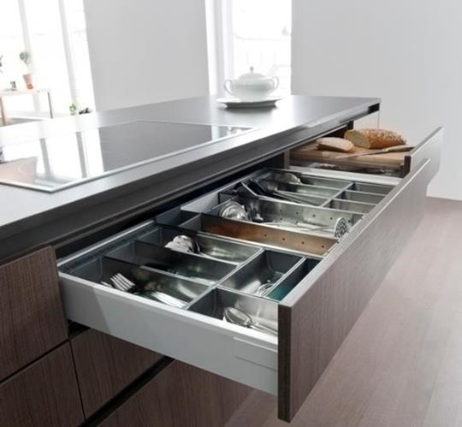
3 Questions
Top 10 Design Trends for Aging in Place
Level entry way
Live on one floor
Kitchen and bath improvements
Storage within easy reach
Appliances at comfortable heights
More drawers
Doors that go away
Lavatory designs invite an open knee space
Comfort- or right-height toilet seats
No-threshold showers
Source: http://aginginplace.com/home-modification/test-page/
Notes:
Here are the top 10 trends in modifications designed for aging in place. This is becoming so popular that there’s an entire division of the home building industry that’s focusing on adapting existing homes for an aging population.
Level entry ways, living on one floor, kitchen and bathroom improvements... all 10 of these things are meant to prevent one thing from happening in the home. What is it? Falling. A fall can change the picture on the box in a heartbeat.
Today in the United States 40% of women over age 65 live by themselves, either because they’re divorced, widowed, or were never married in the first place. Not only do they have more to manage on their own, but living alone can require extra planning in terms of both budget and safety.

Slide 16

3 Questions
“Village” movement
Continuing care retirement community
Beacon Hill “Village”
Notes:
In addition to downsizing, some people are opting for a different style of living and moving closer to cities or town centers. These provide access to many of the services that we’ll likely need.
One new trend is called the village movement. It began with a group of folks near Boston in an area called Beacon Hill. These folks loved their neighborhood but had children who were geographically dispersed. So relying on children to contribute to home care and maintenance might not have been an option as it had been in previous generations. Still, they wanted to stay and age in that same neighborhood. So what did they do? They formed what was essentially a housing association, calling it a village. The purpose of this association was to negotiate for services; things like home modifications, and transportation and housekeeping services on behalf of the neighborhood. Utilizing that network to allow them to stay in that neighborhood was a new convention. We’ve seen these villages popping up all across the United States to support aging in place.
The second thing I’ll mention is a continuing care retirement community. You may know them as independent living, assisted living and skilled nursing communities. These are not the “nursing homes” many of us envision. They’re now fully integrated communities offering socialization, recreation, education, medical care, and transportation services. It’s like going back to college again. You have a dormitory, a meal plan and lots of friends to do things with.

Slide 17

3 Questions
How will I get an ice cream cone?
Notes:
So the next question is “How will I get an ice cream cone?”
What are the small things that make like worth living? So we talk about ice cream because it’s a simple pleasure, right? It’s a treat that lot of people enjoy.

Slide 18

3 Questions
Your Priorities
Educate
Recreate
Congregate
Donate
Notes:
I’d like you to think about things you’d like to maintain access to in four categories:
1. Where were you educated? I mean more than just a college or university. Perhaps it was armed services or vocational training. When and where during your formative years did you begin to form your identity?
Oftentimes folks in retirement want to revisit those types of communities, whether they’re college alumni associations, groups of veterans who served in the same branch of the service, or people we have things in common with. Where we were educated can provide that.
2. Think about where you recreate. What do you like to do?
3. How about where you congregate? Where do you meet other people where do you socialize?
4. And last, where do you donate? And I don’t mean cash necessarily. Where do you donate your time and your talent.
So educate, recreate, congregate, donate. If you know those four things my guess is we can probably determine what’s going to motivate you as you age. In other words, the things you want to maintain access to. To illustrate this, I’ll share with you exactly where Americans spend their money today and it’s tied to their priorities.

Slide 19
3 Questions
Food Expense
Consumer Expenditures—65 Years and older
Avg. Income: $48,570
Avg. Age: 74.3
Household size: 1.7
Source: Bureau of Labor Statistics Consumer Expenditure Survey, 2016-2017, September 2018
Notes:
So food represents now 13% of the average monthly outlay for Americans over age 65.
By the way that’s split; roughly 60% of that food expense is spent on groceries, and the and the other 40% on dining out. We can view dining out as “recreating” or “congregating,” right?

Slide 20
3 Questions
Entertainment Expense
Consumer Expenditures—65 Years and older
Avg. Income: $48,570
Avg. Age: 74.3
Household size: 1.7
Source: Bureau of Labor Statistics Consumer Expenditure Survey, 2016-2017, September 2018
Notes:
How about entertainment? What do we do for fun? That’s about 5% of our budget.

Slide 21
3 Questions
Cash Contribution Expense
Consumer Expenditures—65 Years and older
Avg. Income: $48,570
Avg. Age: 74.3
Household size: 1.7
Source: Bureau of Labor Statistics Consumer Expenditure Survey, 2016-2017, September 2018
Notes:
How about cash contributions, donations? About 5% of the average out-of-pocket expenses are contributions.
Now I have a trick question for you. What do you think is the number two average monthly expense for Americans over age 65?

Slide 22

3 Questions
Notes:
Transportation.
Transportation is the second largest. The cost of maintaining, insuring, fueling, and replacing your automobiles.
Your means of accessing those motivators is the second largest category of spending.
Men in the room are going to be very interested in hearing this.
Men, if we’re fortunate enough to make to age 85 and you want to be a Casanova at the senior living center, there’s one skill you’ll want to keep sharp―and it’s not the dancing. It’s driving. And if you can drive at night, you’ve achieved rock star status.
Remember who the most popular kid was in high school? It was the one who was borrowing dad’s keys, with the car that everybody could pile in go wherever we want. I’m here to tell you that the same thing holds true on the other end of aging parabola.

Slide 23
3 Questions
Second Largest Expense: Transportation
Consumer Expenditures—65 Years and older
Avg. Income: $48,570
Avg. Age: 74.3
Household size: 1.7
Source: Bureau of Labor Statistics Consumer Expenditure Survey, 2016-2017, September 2018
Notes:
So transportation is about 15% of the out of pocket expenditures for the average American over age 65.
Transportation equals independence in this country. How will we maintain our access to the things that make life worth living, especially if we’re living into our later 80s or early 90s, and driving is no longer a safe option? How will we still enjoy the things that are important to us?
I’ll just share with you a couple of trends we’ve seen. I mentioned one of them already—people are moving closer to city and town centers. Americans over age 65 are also moving in and around college and university environments. Why? They have education. They have culture: music, art, and theater. They have sports for sports enthusiasts. What else do they have? Medical facilities, teaching hospitals, clinics, health networks. And if they don’t offer walkable access to things, they have better developed systems of public transportation and services which can allow us to easily go where we need to.
Something I’ve observed across the United States are new living communities that I call multiplexes. They have movie theaters, high-end retailers and restaurants, and usually they’re self-contained, well lit, very nicely designed, and usually within three to four miles of a medical complex. If you look closely, the living units within these multiplexes are being bought by 50 to 70 year olds. This is one way to prevent a dramatic drop off in our quality of life if and when we are no longer able to drive.

Slide 24

3 Questions
Who will I have lunch with?
Notes:
And last, the third question.
Who I have lunch with deals with your social network. Not the online kind, but social networks in terms of where you go to meet real people.
I’ll share with you the results of a survey that I’d like you to think about. We asked 30,000 Americans all across the United States four questions.
We ask them their gender, the year of their birth, their zip (to get any socioeconomic data we needed). Now here’s the most important question.
Tell me two things you envision doing after age 65. If they were already age 65 we asked them to tell us two things they envisioned doing in about three years.
No matter where we went, no matter what the socioeconomic demographic, what do you think the top two answers were? Any guesses? Number two was travel. Most post retirees tell us they do travel, but probably not as much as they thought they were as pre-retirees. They spend more time with family and close social networks around them.
The number one answer is going to surprise you. It was work. But not work in the same fashion as the first 20 or 30 years of your career. Perhaps working for a nonprofit or working part time. We heard small business owners say that their business is their retirement, it’s their passion.
Initially we thought it was economic, but it actually has a lot of do with their social network.

Slide 25
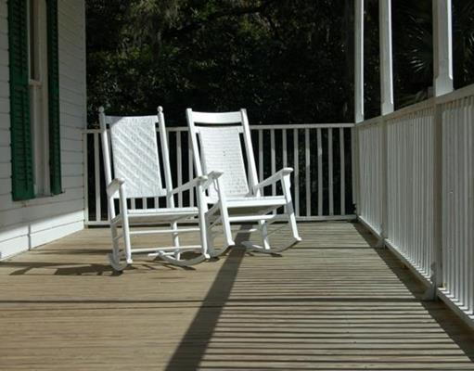
3 Questions
Boomers Demographics: A Different Retirement
More likely to live alone
Have fewer children
Live in suburban and rural locations
Notes:
Men, we tend not to think outside of the immediate family, ourselves and perhaps our spouse, and our top responses usually end in “-ing” and relate to a hobby: golfing, hunting, fishing, hiking, etc. As we put together our pictures on the box, it’s extremely important that, if you’re a member of a couple, you trade notebooks because we tend to put together pictures that suit us. But we don’t spend the time or talk about what our pictures look like together.
Demographic changes reveal that we’ve had fewer children who are living more geographically dispersed, while we’re living mostly in suburban and rural locations, in areas where services we need as we age may not be readily available.

Slide 26
3 Questions
Fewer 40–54 Caregivers
Average Age Distribution Projections for 2010 by Five-Year Age Segment
Source: MIT AgeLab, 2014. Most recent data available used.
Notes:
I’ll share with you what those demographics look like to the researchers of the AgeLab.
This graph essentially shows us changes by age cohort between the years of 2010 and 2020. So let me point out two numbers to you. The number of 70- to 74-year-olds (this one probably won’t surprise you, you’ve been hearing about it forever)─there will be 56% more 70- to 74-year-olds in the United States in 2020 than there were in 2010. Not surprising. The more important number on the graph is look at the 40 to 54 year olds. The growth rates are actually negative. The reason that’s so important is because there’s another name for that group: we call them the caregivers. And what I will say is it’s more than a social security problem it’s a social support problem. Many folks have a broken mental model of how they’ll age; contributions from family members who either don’t exist or they don’t have any capacity to be able to help as they did in previous generations.
In order to help us age well, we’ll need to supplement our care with paid services or contributions from our social networks, our church communities, our civic communities, our friends and our neighbors.

Slide 27
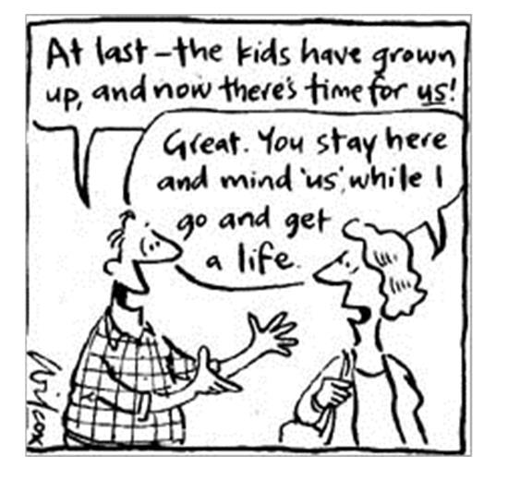
3 Questions
Maintaining Your Social Network
Women
Quickly rebuild social networks
Focus on friends & family
Live longer
Men
Social network largely centered on work or activity-based
Network will naturally dissipate sooner due to mortality
Self-focused
Notes:
This comic strip makes light of this a little bit.
(Read slide)
Ladies, you’ll be more apt to rebuild the social circles away from the primary workplace than men will. Men, a caution to us: We have a tendency to do one of two things. If we don’t work, we have a tendency to withdraw. The health and breadth of our social network is one of the single biggest factors in healthy aging. Get out there and try new things. Find people with similar interests. Set new goals and challenges for yourself.
It’s your social network that will get you physically active, off the couch and out the door, giving you a place to go and keeping you physically moving. It’s also your social network that will keep you mentally stimulated. New people, new problems, new challenges to overcome, opportunities to explore... So as you think about that picture on the box, what is it you imagine yourself doing? Chances are, especially if you’re still involved in the workforce, things are happening so quickly that you don’t give much pause to what you want to explore later on.

Slide 28
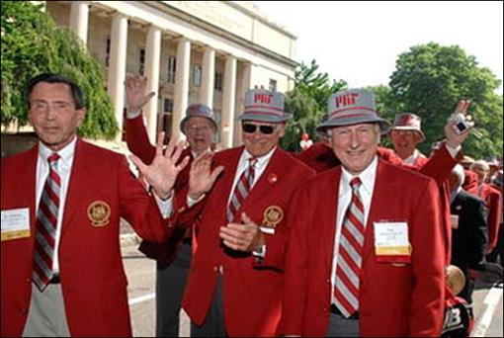
3 Questions
“A person has to have a reason to get up in the morning." For some that means continuing to work full- or part-time, while others believe that volunteering in causes they care about brings joy and meaning.
—The Cardinal & Gray Society
Notes:
In fact this group, the Cardinal & Gray Society, embraces this. They graduated from MIT at least 50 years go. And of course, you can’t get a group like that together and not ask them kind of what their secret is .
One quote is “…working through retirement and developing new pursuits is about maintaining a sense of purpose.” What is our purpose?
And the second quote “A man (or woman) has to have a reason to get up in the morning.” For some that means continuing to work full- or part-time, while others believe that volunteering in causes they care about brings joy and meaning.”
Again, having this purpose, having someplace to be, with a social network around you that supports you and gives you things to look forward to, is incredibly important.

Slide 29
3 Questions
Social Interaction in Older Adults
Risks of Isolation
Potential health benefits
Loneliness and depression
Low physical activity
High blood pressure
Greater risk of death
Lower risk for cardiovascular problems, some cancers, osteoporosis, and rheumatoid arthritis
Lower risk for Alzheimer's disease
Lower blood pressure
Lower risk for mental health issues
Source: Researchers Confront an Epidemic of Loneliness, nytimes.com, 9/6/16
Notes:
Unfortunately a fall is not the only means of isolation, sometimes it’s self imposed. And we do have to take remedies against this, be on guard for the fact that we are withdrawing.
As you can see, creating and maintaining a strong social network is one of the keys to healthy aging.
I’ll give you some ideas for how you can do that.

Slide 30
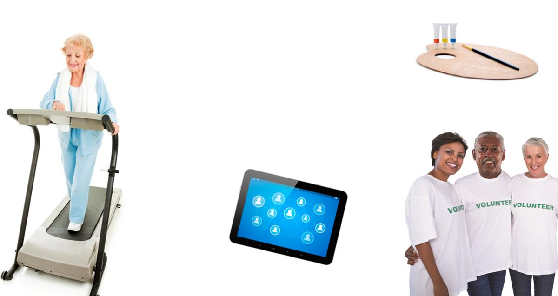
3 Questions
Creating a Strong Social Network
Visit a social center & participate in activities
Join a group focused on physical activity or a hobby you enjoy
Enroll in a course
Join a gym
Remain physically active
Integrate younger people
Volunteer
Copyright © 2019 by Hartford Funds. All rights reserved. No part of this document may be reproduced, published or posted without the permission of Hartford Funds.
Notes:
(Read slide)
One of the reasons why these condominium units are popular and also beneficial is because, who’s there? Who are the people who live there surrounded by? People of all ages, shapes, and sizes, right? The diversity of a social network is really important.

Slide 31
3 Questions
Consumer Expenditures—65 Years and older
Avg. Income: $48,570
Avg. Age: 74.3
Household size: 1.7
Source: Source: Bureau of Labor Statistics Consumer Expenditure Survey, 2016-2017, September 2018
Notes:
Here’s how we left our chart. We’ll move on to the next slice of the pie.

Slide 32
3 Questions
Health Care Expense
Consumer Expenditures—65 Years and older
Avg. Income: $48,570
Avg. Age: 74.3
Household size: 1.7
Source: Source: Bureau of Labor Statistics Consumer Expenditure Survey, 2016-2017, September 2018
Notes:
You were probably wondering about health care, which makes up 13% of expenditures. Remember, this is 13% of out-of-pocket expenses on an average on monthly basis.
We expect that these numbers will grow. Not necessarily because something will happen to Medicare or anything like that, but because we’re in the midst of a healthcare revolution in this country. Perhaps some of you have been involved in the healthcare industry, from unmapping and mapping the genome and training cells to fight against the diseases within our own bodies, to the devices and the therapies that are on the horizon. We read and hear about these incredible advancements all the time.
The question is, where will financing come from to pay for that?

Slide 33
3 Questions
Other Expenses
Consumer Expenditures—65 Years and older
Avg. Income: $48,570
Avg. Age: 74.3
Household size: 1.7
Source: Source: Bureau of Labor Statistics Consumer Expenditure Survey, 2016-2017, September 2018
Notes:
We’ll round this out with our all-inclusive “other” category, which captures the final 15% of everything else we need and do, and this is how the picture looks.

Slide 34

Intentional Investing
Copyright © 2019 by Hartford Funds. All rights reserved. No part of this document may be reproduced, published or posted without the permission of Hartford Funds.
Notes:
Let’s talk about how this impacts investing and how we approach it because if you want all these pieces to fit together here is the way I think about it.

Slide 35

Intentional Investing
Copyright © 2019 by Hartford Funds. All rights reserved. No part of this document may be reproduced, published or posted without the permission of Hartford Funds.
Notes:
Throughout our lives we tend to collect things. We also collect investments.
We collect stocks, we collect IRAs, we collect retirement plans, but we don’t pause to assess them—again because of the volume, velocity and complexity that life is coming at us—to ask ourselves if those pieces are being aligned in a way that it will bring forth the image on the puzzle.
Let’s face it, if we were putting together a jigsaw puzzle the easy part is the picture doesn’t change. It’s static. But as life progresses, things change. Goals change, people change, circumstances change, and we need a strategy that shifts with and adapts to those changes.

Slide 36

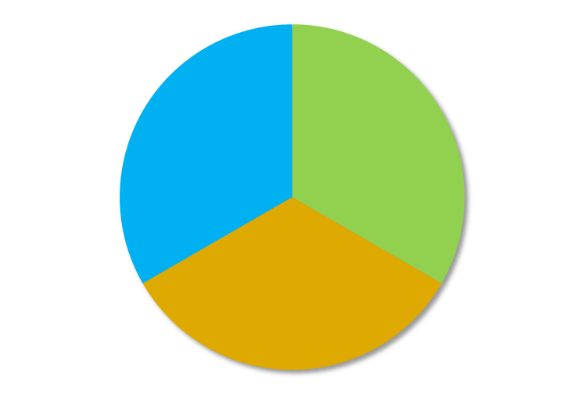
Intentional Investing
Quantity
Quality
Stocks
Bonds
Cash
Notes:
Here you’ll see two models.
When we talk about investments and financial planning, the majority of people tend to go right to stocks, bonds, cash, assets, liability, net worth―just the facts. That’s the quantitative model. It’s not incorrect, but it is incomplete.
From time to time, we need to step back and reevaluate what that picture on the box looks like, and make sure those pieces are aligned with the image they’re trying to bring forth. That’s the qualitative model.
That’s why we use light bulbs, ice cream cones, and lunch. A lot of times when I ask people about their investments and what their investments are doing for them, I’ll hear about what stocks or bonds or mutual funds they own, and so on. That’s not actually what I am interested in. I am interested in is how they’re employing them; how they relate to the qualitative parts.

Slide 37
Main Idea
“Effective planning must be about more than financial security. The new face of retirement planning must go beyond money, and adopt an integrated and holistic approach to helping people prepare to live longer and well.”
—Dr. Joe Coughlin, MIT AgeLab
Copyright © 2019 by Hartford Funds. All rights reserved. No part of this document may be reproduced, published or posted without the permission of Hartford Funds.
Notes:
I’ll end here with a quote from Dr. Joe Coughlin, who is the director of the MIT AgeLab.
(Read slide)

Slide 38
Summary
Personal Agenda
Volume, velocity & complexity
3 Questions
Light bulbs, ice cream, lunch
Intentional Investing
Quality over quantity
Notes:
Now I’m going to quote my favorite philosopher, Yogi Berra, who said “The future ain’t what it used to be.”
I agree with that. For that reason, we’ll continue to do our research at the MIT AgeLab.
Thank you for your time and for being a great audience.

Slide 39
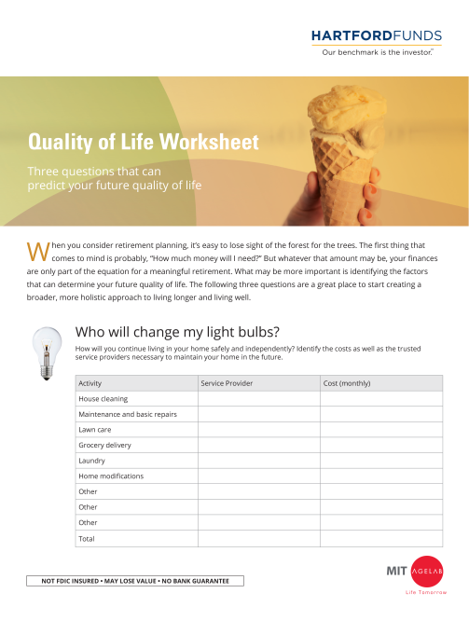
Next Steps
Next Steps
Review the white paper
Complete the top section of page 2 in the worksheet: How will I get an ice cream cone?
Make an appointment with your advisor to finish the worksheet and discuss your answers
Client worksheet
The MIT AgeLab is not an affiliate or subsidiary of Hartford Funds.
Hartford Funds Distributors, LLC, Member FINRA.
All information and representations herein are as of 3/19, unless otherwise noted.
SEM_QOL_0319 211069
Notes:
Now I’m going to quote my favorite philosopher, Yogi Berra, who said “The future ain’t what it used to be.”
I agree with that. For that reason, we’ll continue to do our research at the MIT AgeLab.
Thank you for your time and for being a great audience.

