Slide 1



1218
Securities may lose value and are not insured by the FDIC or any federal government agency. They are not a deposit of or guaranteed by any bank, bank affiliate, or credit union.
1

Slide 2
IMPORTANT DISCLOSURES
Neither Transamerica nor its agents or representatives may provide tax or legal advice. Anyone to whom this material is promoted, marketed, or recommended should consult with and rely on their own independent tax and legal advisors regarding their particular situation and the concepts presented herein.
Securities may lose value and are not insured by the FDIC or any federal government agency. They are not a deposit of or guaranteed by any bank, bank affiliate, or credit union.
Transamerica Resources, Inc. is an Aegon company and is affiliated with various companies which include, but are not limited to, insurance companies and broker dealers. Transamerica Resources, Inc. does not offer insurance products or securities. The information provided is for educational purposes only and should not be construed as insurance, securities, ERISA, tax, legal or financial advice or guidance. Please consult your personal independent advisors for answers to your specific questions. Securities are offered through Transamerica Capital, Inc. FINRA member.
2

Slide 3
“The trouble with retirement is that you never get a day off.”
—Coach Abe Lemons
Abe Lemons is not affiliated with, endorsed, or sponsored by Transamerica
3

Slide 4
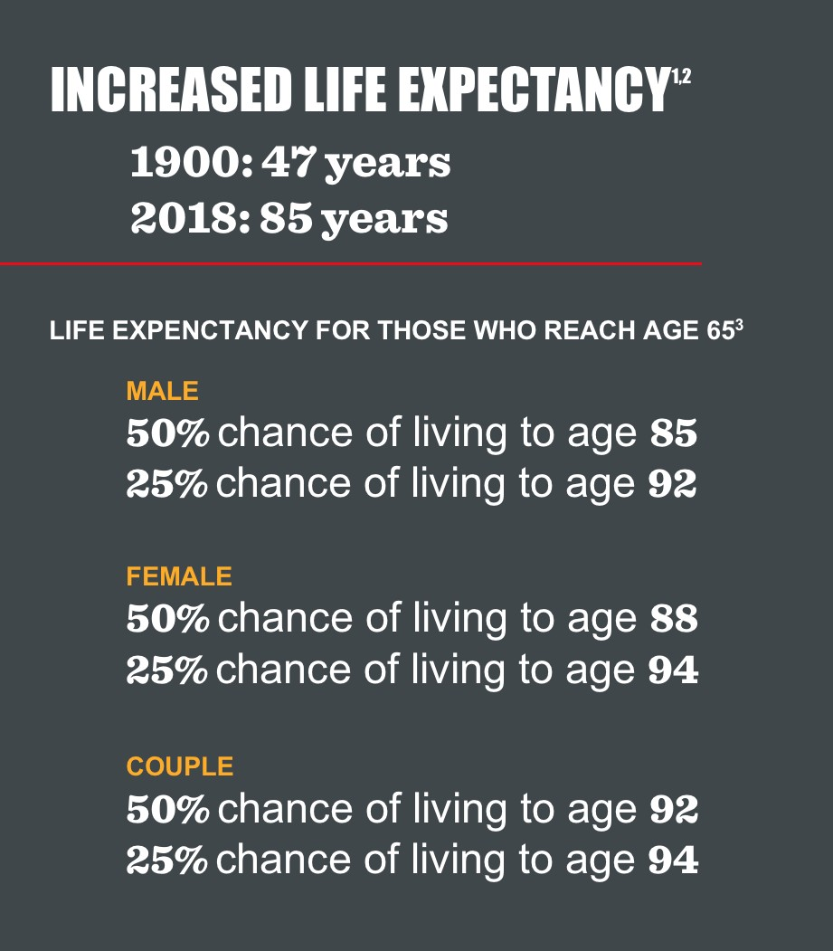

Transamerica is not affiliated with Time Magazine.
¹United States Bureau of the Census. Accessed online 02/16/2018 www.census.gov
²Social Security Administration. Accessed online 02/16/2018 www.ssa.gov
³American Society of Actuaries; data based on non-smoking individuals and couples
4

Slide 5
IS THIS RETIREMENT?
Net Asset Value
ASSET ALLOCATION
Diversification
Fund Turnover
MORNINGSTAR
Bonds
401(k)
Volatility
Dividends
S&P 500
Dow Jones
INDEX
Mutual Funds Inflation
SMALL CAP
Annuities
Certificate of Deposit
DURATION
Expense Ratio
ETFs
INTEREST RATES
Beta
Alpha
Risk
Maturity
Sharpe Ratio
T-bills
Stocks
Taxes
YIELD
Breakpoint
Return
Blue Chip
FIXED INCOME
IRAs
NASDAQ
Large Cap
Dollar Cost Averaging
BENCHMARK
5

Slide 6
BEYOND MONEY
Special Needs Trust
Support Groups
SOCIAL SECURITY
HEALTH CARE DIRECTIVE
Work
Irrevocable Trusts
End of Life Preparing
Caregiver Living Will
Assisted Living
HOUSING
MEDICAID
Reverse Mortgage Elder Law
Revocable Trust
Springing Power ofAttorney
Supplemental Plans
Hospice
ESTATE PLANNING
Adult Day Care
Alzheimer’s
Parents
Home Renovations
Disability
Grandchildren
DIVORCE
Children
Long Term Care
MEDICARE
Durable Power ofAttorney
NURSING HOME
Dementia
Technology
Beneficiary Planning
6

Slide 7



THE INTERSECTION OF WEALTH + HEALTH
Social Security
Healthcare
Aging
7

Slide 8

8
8

Slide 9
“The question isn’t at what age I want to retire, it’s at what income.”
—George Foreman
George Foreman is not affiliated with, endorsed, or sponsored by Transamerica
9

Slide 10

SOCIAL SECURITY
NO SINGLE FILING STRATEGY IS RIGHT FOR EVERYONE.
IMPACT OF FILING AGE ON THE BENEFIT AMOUNT
Eligible for a reduced benefit at age 62
Eligible for a full benefit at Full Retirement Age (FRA)
Eligible for Delayed Retirement Credits of 8% per year between FRA and age 70 (Born 1943 of later)
Careful considerations and assumptions is needed in selection a filing strategy
Failure to employ an optimized filing strategy may result in the loss of thousands of dollars of potential benefits
This material is not connected with or endorsed by the Social Security Administration.
Source: Social Security Administration, Retirement Planner, Retirement Benefits by Year of Birth 2018, and Delayed Retirement Credits 2018, www.SSA.gov
10

Slide 11

SOCIAL SECURITY
WHAT IF YOU’VE ALREADY FILED
AND REGRET THE DECISION?
REPAIR STRATEGIES:
The “Pay-back”
The “Start-Stop-Start”
Source: Social Security Administration, Retirement Planner, Retirement Benefits by Year of Birth 2018, and Delayed Retirement Credits 2018, www.SSA.gov
11

Slide 12

SOCIAL SECURITY: FACTORS TO CONSIDER
THE NEED FOR INCOME AND EMPLOYMENT
Wage income prior to FRA may result in a withholding of benefits
Wage income may also impact the taxation of benefits
FAMILY SITUATION
Other family members may be eligible for Social Security benefits based on your record
Source: Social Security Administration, “How Work Affects Your Benefits,” www.SSA.gov
12

Slide 13

SOCIAL SECURITY: FACTORS TO CONSIDER
MARITAL STATUS AND FILING STRATEGIES
A coordinated filing strategy between spouses can help optimize the amount received
from Social Security
Divorced spouses may be eligible for benefits
HEALTH AND LONGEVITY
Other sources of income may help bridge the gap so delayed retirement credits can be maximized, if appropriate
Source: Social Security Administration, “How Work Affects Your Benefits,” www.SSA.gov
13

Slide 14
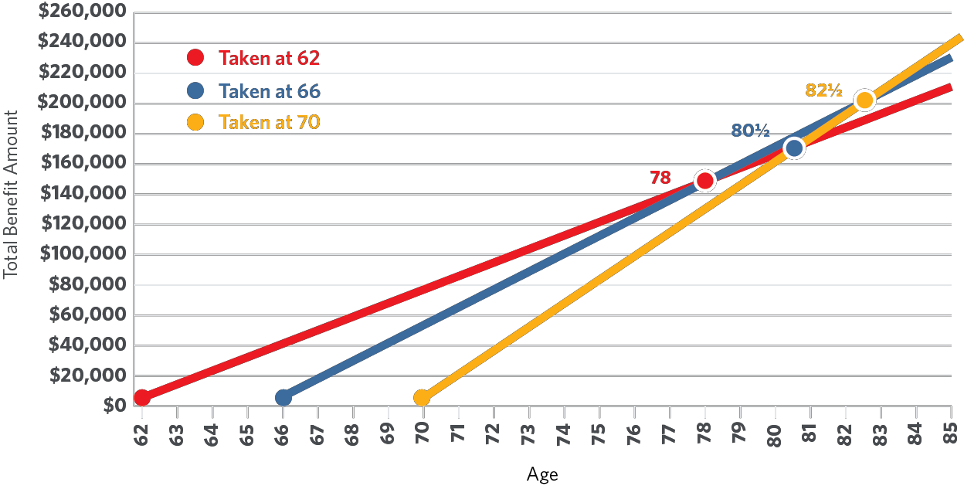
SOCIAL SECURITY
*Source: American Society of Actuaries; data based on non-smoking individuals and couples Social Security Administration, “When to Start Receiving Benefits,” www.SSA.gov
14

Slide 15

Discuss claiming strategies with your financial professional. | Determine how Social Security fits into your overall retirement.
Consider longevity. What if you or your spouse live a long time? | Implement a strategy that is tailored to your personal circumstances.
15

Slide 16

16

Slide 17
“America’s healthcare system is neither healthy, caring, nor a system.”
—Walter Cronkite
Walter Cronkite is not affiliated with, endorsed, or sponsored by Transamerica
17

Slide 18
HEALTH CARE
HEALTH CARE IS A MAJOR COST IN RETIREMENT, AND ONE THAT PROBABLY CONCERNS MANY OF YOU.
25%
of Americans consider the cost of health care to be their biggest financial concern¹
$275K
The average healthy 65 year old couple will spend an average of $275,000 in healthcare during retirement²
70%
of people turning age 65 are expected to use some form of long term care during their lifetime³
¹ "Health Care Is Top Concern For American Families. Monmouth University Poll. February 7, 2017.
² Fidelity’s Benefits Consulting, 2017. The estimate assumes no employer-provided retiree health care coverage and applies to retirees with traditional Medicare insurance coverage with life expectancies of 20 years for men and 22 years for women.
³ 2017 U.S. Department of Health and Human Services.
18

Slide 19

HEALTHCARE IN RETIREMENT
MEDICARE IS NOT AUTOMATIC
If you are retired and not collecting Social Security, you must enroll in Medicare during your initial enrollment period:
3 MONTHS BEFORE | THE MONTH YOU TURN 65 | the month you turn 65 | 3 MONTHS AFTER | THE MONTH YOU TURN 65
Failure to enroll on time subjects you to late enrollment penalties and means you do
not have health insurance coverage.
If you are still working, check with your employer’s human resources department to determine how your health insurance coverage integrates with Medicare and if you qualify for a later special enrollment period.
This material is not connected with or endorsed by the Federal Medicare Program
19

Slide 20

HEALTHCARE IN RETIREMENT
MEDICARE IS NOT AUTOMATIC
MEDICARE DOES NOT COVER YOUR SPOUSE OR FAMILY
Unlike Social Security, Medicare is an individual benefit
No coverage is provided to spouses or family members through Medicare
Additional health insurance may be required for your spouse and family members when
you enroll in Medicare
20

Slide 21

HEALTHCARE IN RETIREMENT
MEDICARE IS NOT AUTOMATIC
MEDICARE DOES NOT COVER YOUR SPOUSE OR FAMILY
MEDICARE DOES NOT COVER EVERYTHING
Original Medicare does not cover:
Hearing aids
Dental and dentures
Eye exams related to prescribing glasses
Foot care
Acupuncture
Medical services in foreign countries
Co-pays, coinsurance, deductibles
21

Slide 22

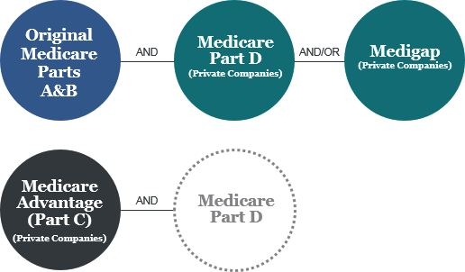
HEALTHCARE IN RETIREMENT
IT IS NOT AUTOMATIC
IT DOES NOT COVER YOUR SPOUSE OR FAMILY
IT DOES NOT COVER EVERYTHING
YOU HAVE CHOICES
22

Slide 23
MEDICARE
THERE ARE TWO WAYS MOST INDIVIDUALS CAN GET MEDICARE COVERAGE. AN INDIVIDUAL’S PERSONAL CIRCUMSTANCES AND HEALTHCARE NEEDS CAN HELP DETERMINE HOW THEY SHOULD OBTAIN COVERAGE.
ORIGINAL MEDICARE (PARTS A & B)
+ PART D AND MEDIGAP
MEDICARE ADVANTAGE PLANS (PART C)
OR
Part A: Hospitals, skilled nursing facility stays, and hospice care
Part B: Physician visits, outpatient services, and home health visits
Part D: Optional prescription drug policy
Medigap: Optional standardized plans available through private insurers for out of pocket costs, deductibles and co-pays. (Medigap Plan F typically has the most coverage)
This combines Part A, B, and usually D through a private company approved by Medicare
People who prefer coverage from one provider may be inclined to opt for Part C
Part C plans can cover vision, dental and hearing
Source: Medicare and You 2018, www.Medicare.gov.
23

Slide 24
MEDICARE COST COMPARISON
CONSIDERATIONS MAY INCLUDE COSTS, SERVICES NEEDED,
FLEXIBILITY, AND DOCTOR PREFERENCE.
ORIGINAL MEDICARE (PARTS A & B)
+ PART D AND MEDIGAP
MEDICARE ADVANTAGE PLANS
(PART C)
OR
There may be no Part A premium for people who paid Medicare taxes while working
The standard premium for Part B in 2019 is
$135.50/month per person¹
The standard premium for Part D in 2019 is $32.50¹
Medigap Plan F premiums in Colorado can range from $140 - $271/month in 2019 and can vary based on health, age, and location²
Medigap plans may help reduce out-of-pocket costs
Average monthly premium for 2019 is
$28/month, but can range from $0 – over
$200/month in addition to the cost of Part A and Part B^{3,4}
Lower premiums typically mean higher deductibles and higher out-of-pocket costs
For many plans, out-of-network providers will result in higher out-of-pocket costs
¹Source: Centers for Medicare and Medicaid Services; www.cms.gov
²www.Medicare.gov. Medigap Policy Search for zip code 80202 for people under age 65. ³https://www.cms.gov/newsroom/fact-sheets/2019-medicare-advantage-and-part-d-prescription-drug-program-landscape ⁴http:www.mymedicarematters.org/costs/part-c/ 2018
24

Slide 25
MEDICARE COMPARISON
 | ORIGINAL MEDICARE (PARTS A + B) | ORIGINAL MEDICARE PLUS MEDIGAP | MEDICARE ADVANTAGE HMO | MEDICARE ADVANTAGE PPO
Can I see any doctor? | Yes, if they accept Medicare | Yes, if they accept Medicare | No. In-network doctors only | Yes. Out of network for a higher cost
Where can I get non- emergency care? | Anywhere in the US | Anywhere in the US | For most plans, in your area | For most plans, in your area
Where can I get emergency care? | Anywhere in the US | Anywhere in the US | Anywhere in the US | Anywhere in the US
Do I need a referral to see a specialist? | No | No | Usually | No, but the out-of- network copay may be higher.
How do I get drug coverage? | Part D | Part D | You must join a Medicare Advantage plan with drug coverage* | You must join a Medicare Advantage plan with drug coverage*
Is there a cap on out-of- pocket expenses? | No | No | Yes | Yes
Will it cover hearing and vision? | No | No | Some plans do | Some plans do
*If you don’t get a Medicare Advantage plan with drug coverage then you would need to get Part D coverage. Source: My Medicare Matters; www.mymedicarematters.org
25

Slide 26

HEALTHCARE IN RETIREMENT
IT IS NOT AUTOMATIC
IT DOES NOT COVER YOUR SPOUSE OR FAMILY
YOU HAVE OPTIONS
IT DOES NOT COVER EVERYTHING
IT DOES NOT COVER THE COST OF LONG TERM CARE
THE AVERAGE COST OF AN ASSISTED LIVING FACILITY IN 2018 WAS
$48,000 PER YEAR¹
THE AVERAGE COST OF A SEMI-PRIVATE NURSING HOME ROOM IN 2018 WAS $89,297 PER YEAR¹
¹Genworth 2018 Cost of Care Survey, October 2018
26

Slide 27

LONG TERM CARE
YOU CAN COVER LONG TERM CARE COSTS IN THREE PRIMARY WAYS.
PERSONAL SAVINGS
Self-funded/insured
Reverse mortgage
Reliance on family members for care
PRIVATE INSURANCE
Long term care insurance
Life insurance and annuity LTC riders, if appropriate
MEDICAID
It is recommended to meet with an eldercare attorney to determine Medicaid options and strategies in your state
27

Slide 28

Discuss healthcare options with your financial professional. | Budget for deductibles, copays, and coinsurance.
Enroll in Medicare
on time to avoid | Explore long term care
penalties or a lapse | insurance options.
in coverage.
28

Slide 29

29

Slide 30
“Age is an issue of mind over matter. If you don’t mind, it doesn’t matter”
—Mark Twain
Mark Twain is not affiliated with, endorsed, or sponsored by Transamerica
30

Slide 31

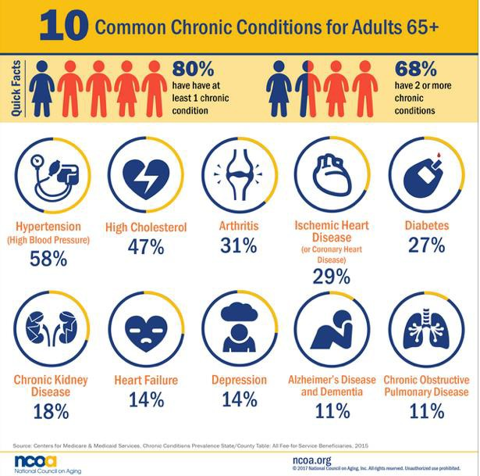
CHRONIC AND CATASTROPHIC CONDITIONS
MANAGING CHRONIC AND CATASTROPHIC HEALTH CONDITIONS IN RETIREMENT:
Budget and prepare for the costs of chronic conditions, which become more common with age.
Prepare for catastrophic conditions that could impact your capacity, both physical and financial.
Consider the impact of cognitive decline.
https://www.ncoa.org/blog/10-common-chronic-diseases-prevention-tips/
31

Slide 32

ALZHEIMER’S AND DEMENTIA
TIMING IS CRITICAL WHEN SOMEONE IS DIAGNOSED WITH THE DISEASE.
Alzheimer’s is a progressive disease
Alzheimer’s patients are prone to money mismanagement, poor financial choices and are vulnerable to elder fraud
There are more than 16 million caregivers of victims of Alzheimer’s and other dementias¹
Legal decisions and documents will be required
To draft certain legal documents, you may be required to demonstrate “legal capacity” to make decisions
Wills
Advance Directives
POAs
^{1.} Alzheimer's Disease Caregivers. Alzheimer’s Association. March 2018
32

Slide 33
POWERS OF ATTORNEY
THE TOOLS USED TO PREPARE FOR COGNITIVE DECLINE OR ANY OTHER CATASTROPHIC HEALTH CONDITION ARE THE SAME. SOME OF THE PRIMARY ELEMENTS OF A SOLID PLAN INCLUDE:
GENERAL POWER OF ATTORNEY
Grants broad powers, terminates upon death, disability or incapacitation.
DURABLE POWER OF ATTORNEY
Includes a durable clause that keeps the POA in force after the incapacity of the principal but will end upon death.
SPECIAL OR LIMITED POWER OF ATTORNEY
The agent is only granted power over limited or specific areas, such as finances or healthcare.
SPRINGING POWER OF ATTORNEY
The POA is not active until the occurrence of a specific event.
33

Slide 34

DEATH OF A SPOUSE
THE DEATH OF A SPOUSE WILL HAVE BOTH AN EMOTIONAL AND A FINANCIAL IMPACT ON YOU AND YOUR FAMLY. IN MOST INSTANCES, THE MORE YOU’RE PREPARED FOR THE EVENT, THE BETTER OFF YOU WILL BE.
ESTATE PRESERVATION
SOCIAL SECURITY
SURVIVOR BENEFITS
You should have copies of applicable estate planning documents on file (e.g. Trusts, POAs, Advance Directives).
Remember that a qualified estate planning attorney will need to update these documents as needed.
It is recommended that all documents, passwords, account information, titles, and contacts be kept in a safe place and location known by a trusted individual.
A surviving spouse is eligible
for a survivor benefit equal to what the deceased was receiving, or was eligible to receive.
Other family members may also be eligible.
34

Slide 35

Talk to your financial professional about your wishes. | Ensure you have the proper Power of Attorney in place.
Review your will and other estate planning documents. | Communicate your wishes to your loved ones.
35

Slide 36
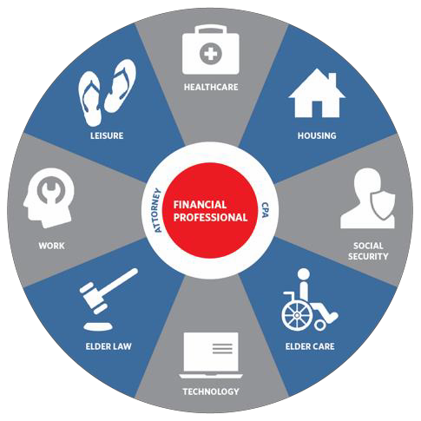




GOING BEYOND MONEY
RETIREMENT IS A JOURNEY AND IT TAKES A TEAM
Gathering and organizing resources can be beneficial
YYOOUU
Be informed
Leverage experience professionals to help prepare
36

Slide 37

111407R1
37

