Slide 1
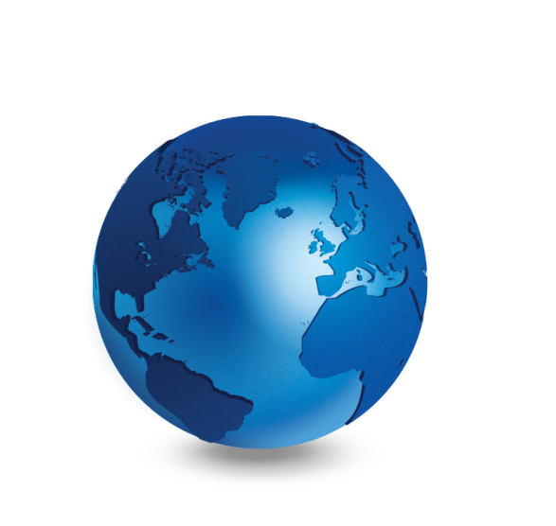


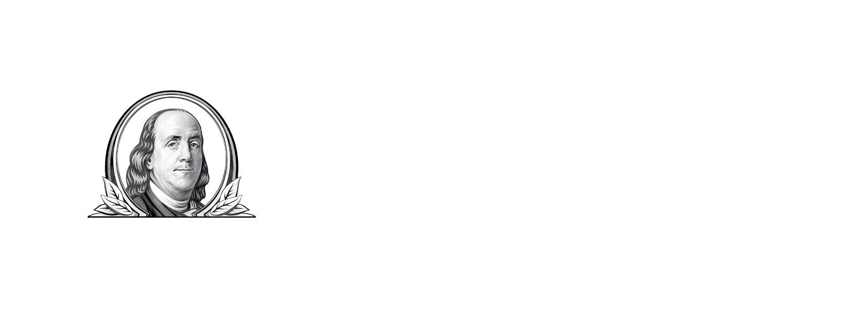
Global: The New Core
Not FDIC Insured | May Lose Value | No Bank Guarantee

Slide 2
Franklin Templeton
A Trusted, Long-Term Partner in Investment Management
Focus on Investment Excellence
Global Perspective Shaped by Local Expertise
Strength and Experience
Notes:
Sales Script
Good morning/afternoon/evening. My name is ________ and I represent Franklin Templeton.
Since 1947, our firm has been dedicated to delivering exceptional asset management for our clients. We’re proud to be one of the world’s largest and most trusted asset management firms. Our success comes from our core strengths:
Our focus on investment excellence
Our unique multiple manager structure brings world-class investment teams together in a single firm.
Our specialized teams cover all major investment styles and types, from traditional to alternative.
We are as diligent about assessing risk as we are about seeking reward.
Our global perspective, shaped by local expertise
We have over 600 investment professionals in 25 countries, with access to trading 24 hours a day, 7 days a week.
Our in-depth understanding of local culture, companies and economies makes us unique as a global partner.
The strength and experience gained from over 70 years of active management and commitment to reliable, personalized service
We manage $650 Billion in assets for clients in more than 170 countries.
And we run our business with the same prudence we apply to asset management; diversifying by investment objective, geography and client type.
We believe these strengths uniquely position us to offer clients the expertise of many with the strength of one.
Data and number of countries as of December 31, 2018.

Slide 3

1989
The Rise
of Capitalism
Notes:
Let’s start by thinking back to 1989 and the fall of the Berlin Wall. No one knew it was going to happen, but when it did, it was widely considered to be a game changer; a chance to take advantage of new opportunities that opened up around the world.
Let me show you some examples.

Slide 4
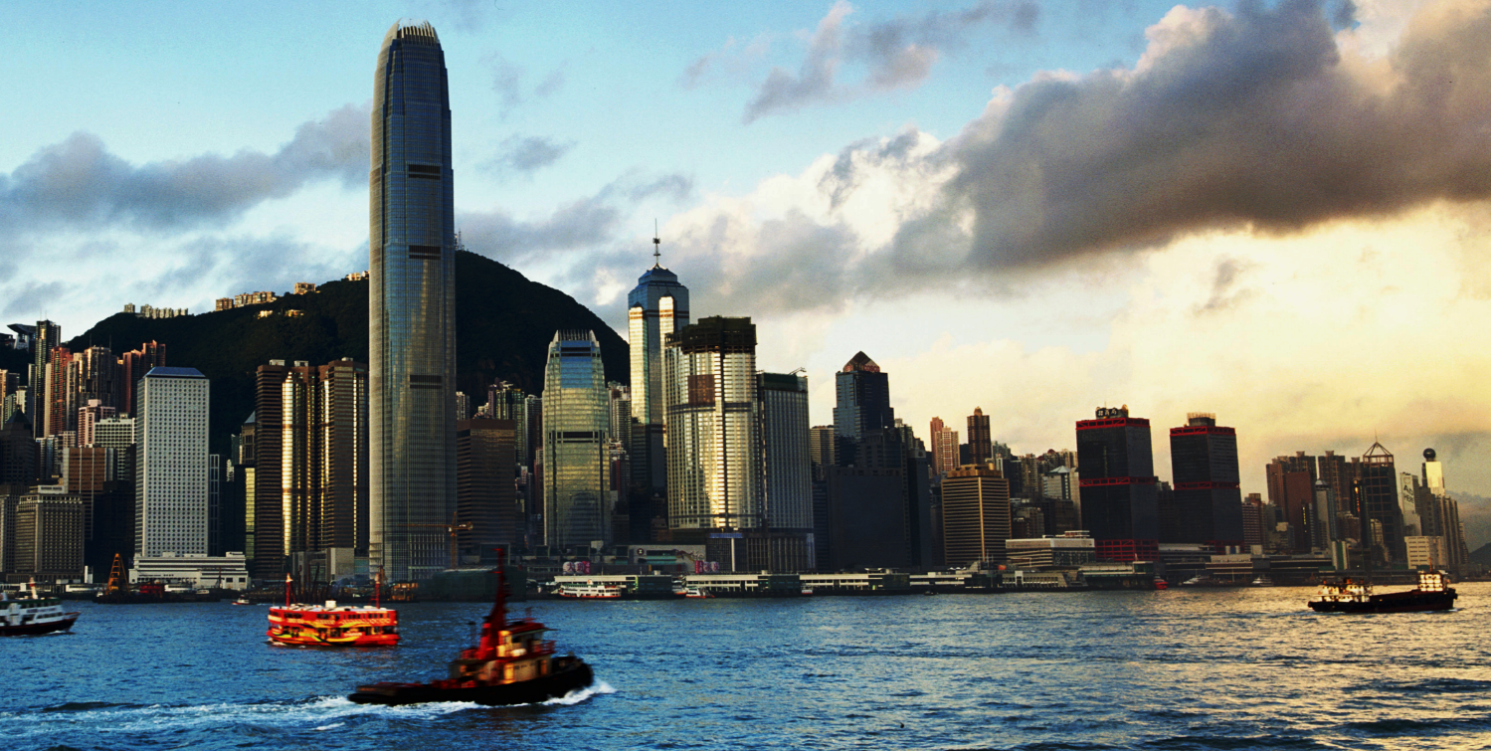
What the Markets Looked Like Then and Now
Hong Kong Hang Seng Index
1989 2,837 | 06/30/19 28,543
Source: The Stock Exchange of Hong Kong Limited, as of June 30, 2019. Index levels are in Hong Kong dollars.
Notes:
Look at the incredible growth of the Hong Kong Hang Seng Index. In 1989, it was less than 3,000. At the end of June 2019, it was over 28,000.

Slide 5
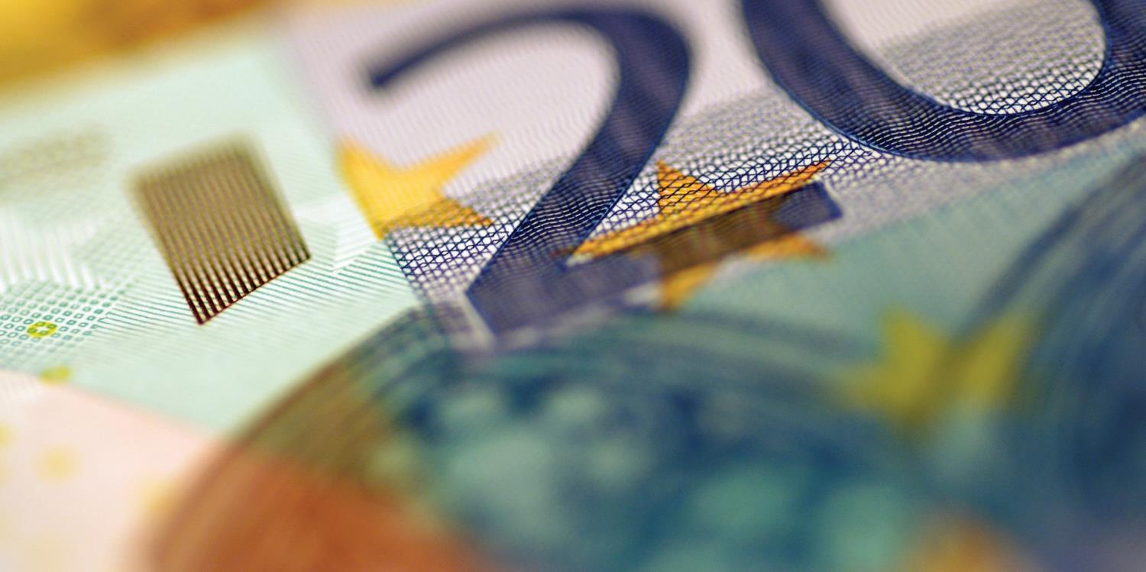
What the Markets Looked Like Then and Now
Debt to GDP Ratio
2000 Developed Markets 71% Emerging Markets 48% | 2019 Developed Markets 103% Emerging Markets 53%
Source: International Money Fund, World Economic Outlook Database, as of April 2019. Most recent data available. Public Debt (% of GDP) is represented by General Government Gross Debt (% of GDP). Developed Markets are represented by Advanced Economies as defined by the IMF; Emerging Markets are represented by Emerging Market and Developing Economies as defined by the IMF.
Notes:
Gross Domestic Product (GDP) is a measurement of the value of total goods and services produced by a country. It’s one way to measure the “health” of an economy. The debt to GDP ratio refers to how much debt a country has in relation to its GDP (value of goods produced). The lower the percentage, the healthier the economy is.
You can see that the debt to GDP ratio for developed markets, or advanced economies as defined by the International Monetary Fund, has increased significantly since 2000 (oldest data available), going from 71% to over 100% by the end of 2019.
In contrast, the debt to GDP ratio for Emerging Markets hasn’t changed much since 2000.
At 52%, emerging markets’ debt-to-GDP has remained far below the level of developed markets.
The results are even more dramatic on a country-by-country basis. For example, Turkey’s debt to GDP ratio went from 52% in 2000 to an impressive 29% in 2018.

Slide 6
Today’s Discussion
How the World is Changing
Our World is More Connected than Ever
Is Your Portfolio as Global as it Should Be?
Global is Core to Franklin Templeton
Notes:
Here are the topics that will be covered today as we look at Global—The New Core:
How the World Is Changing
Our World Is More Connected Than Ever
Is Your Portfolio as Global as It Should Be?
Global Is Core to Franklin Templeton

Slide 7
How the World
Is Changing
Notes:
First, let’s look at how the world is changing.

Slide 8
The World’s Middle Class is Growing
  Percentage and Size of the World’s Middle Class Population
PROJECTED
70%
4.7
Billion
50%
3.8
Billion
30%
2.3
Billion
1.2
Billion
1.6
Billion
861
Million
1.0
Billion
668
Million
10%
1965
1975
1985
1995
2005
2015
2025
2030
Sources: Homi Kharas, Brookings Institution, 2017. Most recent data available.
Notes:
The growth of the middle class is projected to increase rapidly and steadily over the coming years.
The rate of increase of the middle class is approaching an all-time high.
Already, about 140 million are joining the middle class annually; this number could rise to 170 million in 5 years time.

Slide 9
Asia is Leading the Way
  Number (in millions) of Global Middle Class by Region
Sources: Homi Kharas, Brookings Institution, 2017. Most recent data available.
Notes:
Much of the growth in the middle class is expected to come from Asia.
By 2030, nearly two thirds of the world’s middle class is projected to be in Asia.

Slide 10
Potential for Increased Consumption
  Projected Spending Middle Class (in USD)
2015
2030 (Projected)
$34.8 trillion
$63.9 trillion
North America
Europe
Central & South America
Asia Pacific
Middle East & Africa
Sources: Homi Kharas, Brookings Institution, 2017. Total Consumption in USD. Most recent data available.
Notes:
An increase in the size of the middle class is generally predictive of an increase in spending due to the growth in disposable income that comes with it.
Here’s a look at projected spending by the middle class. You can see that by 2030, spending is projected to exceed $63 trillion (in US dollars).
Looking at Asia, spending is projected to reach $34.8 trillion dollars, an almost three-fold increase from only 15 years earlier.
The impact of this spending increase in Asia can already be seen. If we take a look at the automobile industry, for example, back in 2009, average monthly car sales in China surpassed those in the US for the first time in history. As of December 31, 2018, the 12-month rolling average for car sales in China was 2.3 million units versus 1.6 million units in the US.¹
1. Sources: China Association of Automobile Manufacturers, U.S. Bureau of Economic Analysis.

Slide 11
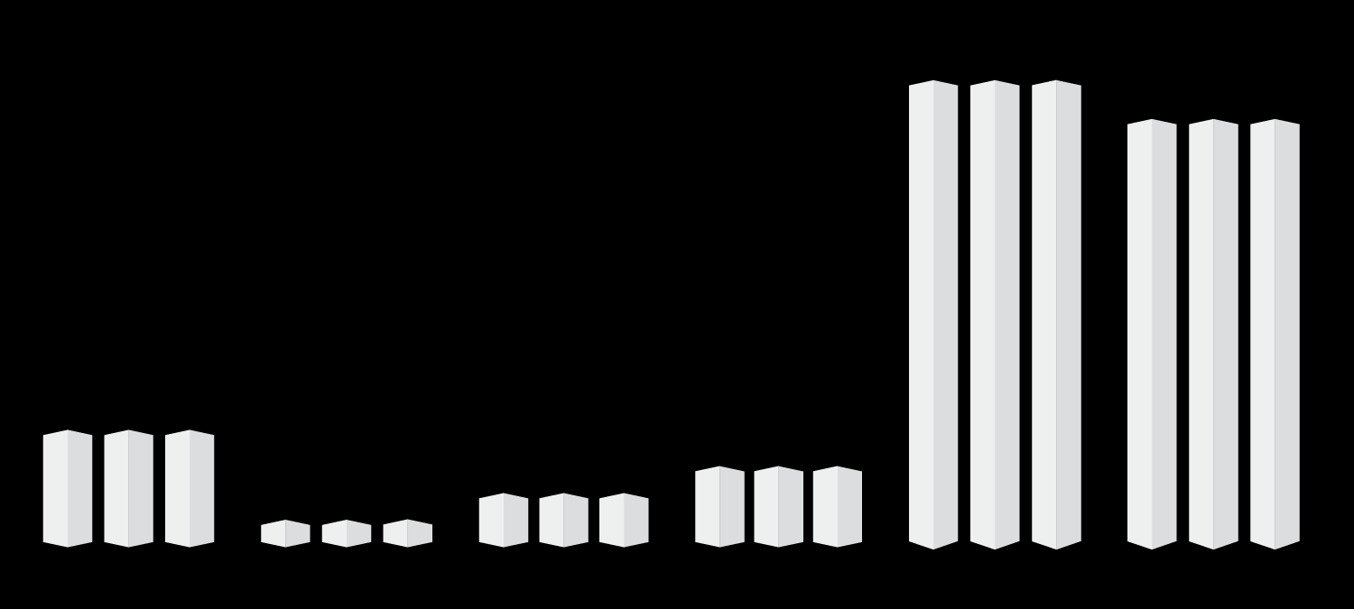
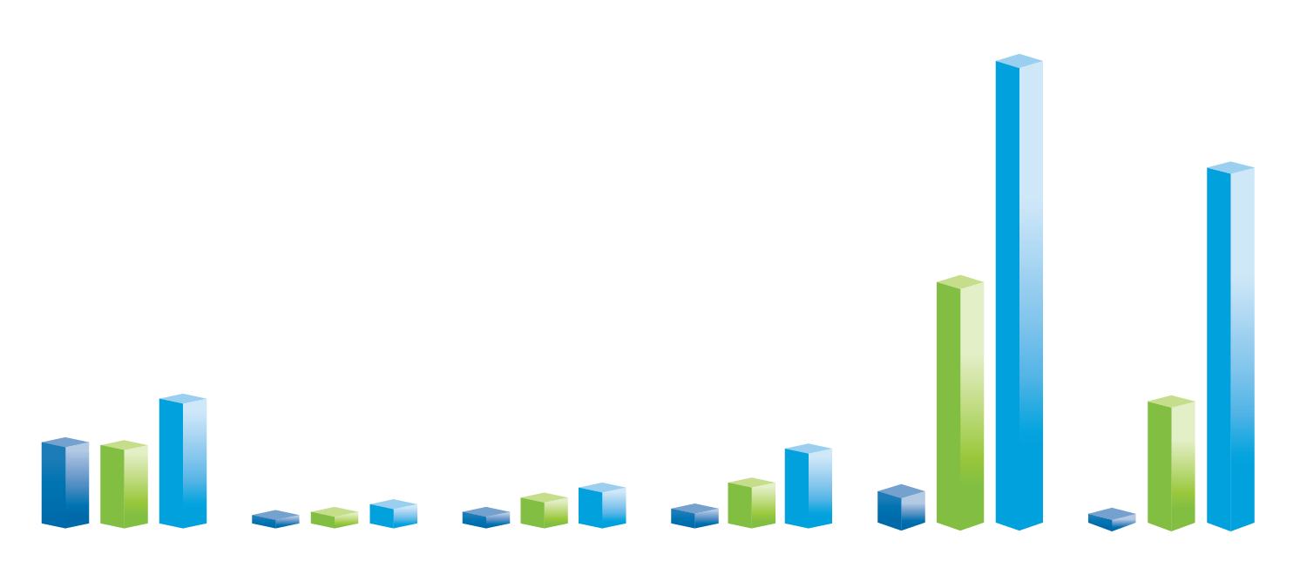
The Global Opportunity
Solid bars show current consumption of passenger cars, cell phones and number of internet users.
Shaded bars show potential based on population.
1.4 Billion
Population
104.6%
PASSENGER CARS
INTERNET USERS
CELL PHONES
1.3 Billion
Population
87.3%
54.3%
325 Million
Population
210 Million
Population
122.0%
130 Million
Population
29.5%
40 Million
Population
78.6%
76.2%
113.0%
130.0%
63.9%
88.5%
60.9%
6.9%
55.4%
76.0%
27.8%
21.0%
1.8%
UNITED STATES
POLAND
MEXICO
BRAZIL
CHINA
INDIA
Sources: © 2017 The World Bank: World Development Indicators: United Nations, World Population Prospects; International Road Federation, World Road Statistics; and International Telecommunication Union, World Telecommunication/ICT. As of 2015 (based on most recent data available, 2005–2015).
Internet users are defined as people having access to the worldwide network.
Notes:
This chart shows the potential for increased consumption of consumer products and services, and how much market penetration there has been in the US and in each of these countries. The three we’ve chosen to highlight are cars, cell phones and internet users.
As you can see, roughly 80% of the people in the US own a car, 76% are using the internet and 122% have a cell phone. Compared to the US, ownership of cars, cell phones and the number of internet users is far lower in these other countries. But let’s put this further into context.
[CLICK] The shaded bars represent the total population of these countries. Over 325 million for the US, 40 million for Poland, 130 million for Mexico, 210 million for Brazil, and India and China with well over 1 billion people.
The population size really impacts the way we look at market penetration. You can see that there is significant potential for increased consumption based on the total population size—especially in China and India. For example, although India has more cell phone subscribers than there are Americans, there is still room to grow. And when you look at cars and internet use—there is even more potential.
How can you position yourself advantage of the projected spending boom?

Slide 12
Our World Is More Connected Than Ever
Notes:
While the demographics of the world are rapidly changing, so too is how we communicate with each other. We are more connected than ever before.

Slide 13
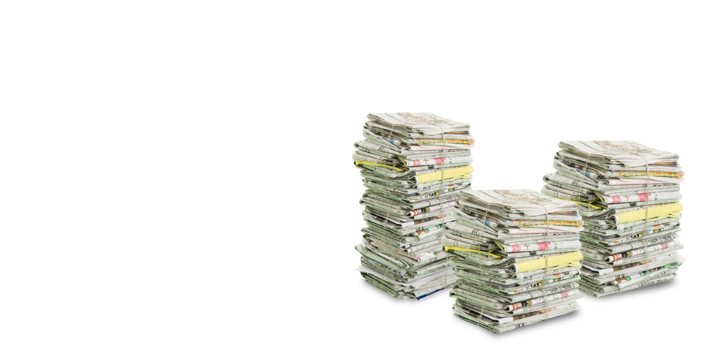
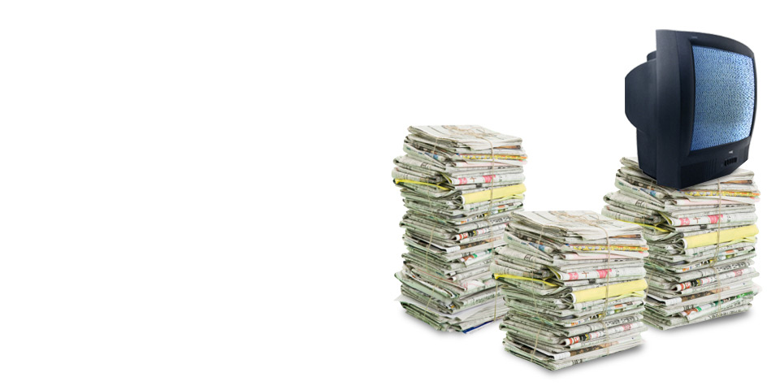
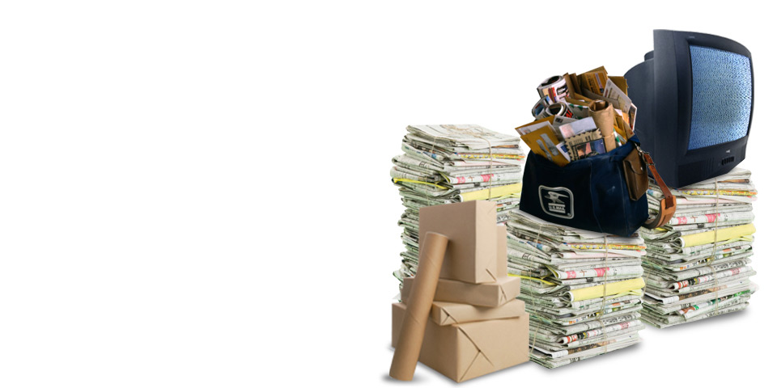

Global Communications Circa 1989
62 Million
total US daily newspaper circulation
40% of the US
watched network news nightly
161.6 Billion
pieces of mail were handled by the USPS
4 Million
fax machines
Sources: Journalism.org, Nielsen Media Research, USPS, ideafinder.com.
Notes:
As people around the world enter the middle class, they gain the purchasing power to consume a wider variety of goods and services, including technology.
Back in 1989, our methods of getting news and communicating with each other were slower and more cumbersome fax machines were all the rage and most of the world hadn’t heard of email yet.

Slide 14


Today People Around the World Are Linked
  Number of Active Users
2.4 Billion
1 Billion
333 Million
203 Million
1.1 Billion
Sources: World Development Indicators: United Nations, World Population Prospects. Facebook.com, Instagram.com, Twitter.com, Snapchat.com, Tencent.com. Logos are trademarks of their respective owners and are used for illustrative purposes and should not be construed as an endorsement or sponsorship of Franklin Templeton Investments.
13
Notes:
Social media has become part of the day-to-day “norm” for many of us. It’s almost hard to remember a time when checking Facebook wasn’t part of our lives. Here are some impressive stats for several social media platforms that illustrate just how connected we are.
As of June 2019, there were more than 2.3 billion active Facebook users worldwide. In fact, if Facebook was a country, it would be the most populous in the world.¹
Of the 1 billion active Instagram users, more than 500 million report using this hugely popular mobile photo sharing network daily.
Twitter usage has also increased significantly. As of March 2019, there were more than 333 million Twitter users. The first tweet was sent on March 21, 2006 by Jack Dorsey, the creator of Twitter. It took over three years to reach the one billion tweets milestone. Today, it takes less than 24 hours.
And a newer example, Snapchat, has more than 200 million active users all over the world.
Lastly, and an example you may not be familiar with, WeChat, launched in 2011, has been enhancing the lives of hundreds of millions users with its innovative features. If WeChat was a country, it would be the third most populous in the world.¹
1. Population Data from The World Bank.

Slide 15
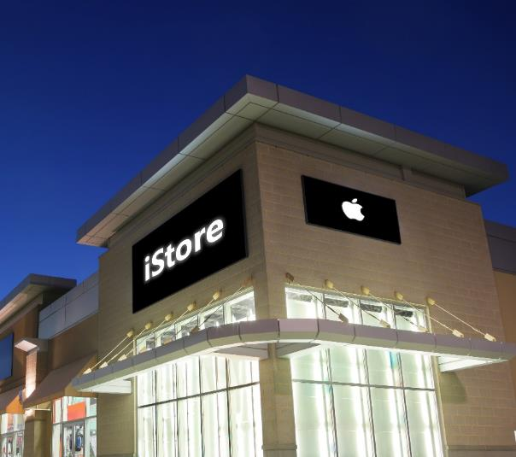
Companies Around the World Are Linked Too
  Selected Countries and Companies Involved in the Production of Apple Products
Headquarters | Manufacturer
United States | 3M Company Intel Corp. Skyworks Solutions Inc. Cirrus Logic Inc.
South Korea | Samsung Electronics Co., Ltd.
Japan | Murata Manufacturing Co., Ltd. Toshiba Corp.
Netherlands | DSM Engineering Plastics Co., Ltd.
United Kingdom | Diodes Inc.
14
Source: Apple Supplier List, June 2019.
Notes:
Here is an example of the sum being greater than the individual parts. Apple is truly a global company with product components coming from all over the world.

Slide 16
Us companies go global
Notes:
Now let’s talk about the globalization of some US companies. Some of this information may surprise you.

Slide 17



Born in the USA, Adopted Globally
  Percentage of Revenues Generated Overseas
64%
65%
59%
61%
67%
54%
59%
97%
Sources: Data is as of company’s latest financial statements: May 31, 2018 (Nike, Inc.), December 31, 2018 (McDonald’s Corp., eBay Inc., 3M Co., Mastercard Incorporated, Alphabet (represented by Google Inc.)., Chevron Corp.), September 30, 2018 (Qualcomm, Inc.). Foreign Revenue is based on Total Revenue – Domestic Revenue. Logos are trademarks of their respective owners and are used for illustrative purposes and should not be construed as an endorsement or sponsorship of Franklin Templeton Investments.
Notes:
Many well-known US-based S&P 500 companies receive a majority of their revenues from overseas. Here are some examples.

Slide 18


The US is a Global Market Too
  Percentage of Revenues Generated from the US
I N D I A
J A P A N
T A I W A N
24%
38%
61%
I R E L A N D
I S R A E L
H O N G K O N G
60%
25%
39%
Sources: Most recent data available in each company’s latest financial statements: March 31, 2019 (Infosys Ltd., Nintendo Co. Ltd., VTech Holdings Ltd., Experian PLC), December 31, 2018 (Taiwan Semiconductor Manufacturing Co. Ltd., Teva Pharmaceutical Industries Ltd.). Logos are trademarks of their respective owners and are used for illustrative purposes and should not be construed as an endorsement or sponsorship of Franklin Templeton Investments.
Notes:
Of course this works both ways–many overseas companies receive a significant portion of their revenues from the US.
Note to the presenter:
Infosys Limited is an Indian multinational corporation that provides business consulting, information technology and outsourcing services.
Nintendo Co., Ltd. is a Japanese multinational consumer electronics and video game company headquartered in Kyoto.
Taiwan Semiconductor Manufacturing Company, Limited, is the world's largest dedicated independent semiconductor foundry, with its headquarters and main operations located in the Hsinchu Science and Industrial Park in Hsinchu, Taiwan.
Experian PLC is a consumer credit reporting company headquartered in Dublin, Ireland.
Teva Pharmaceutical Industries Ltd is an Israeli multinational pharmaceutical company headquartered in Petah Tikva, Israel.
VTech is a Hong Kong-based global supplier of electronic learning products from infancy to preschool and the world's largest manufacturer of cordless phones.

Slide 19
A Comparison of S&P 500 Companies’ Returns
  Cumulative Total Return
  (20-year period ended June 30, 2019)
81
Percentage
Point Difference
This chart is for illustrative purposes only and does not reflect the performance of any Franklin Templeton fund.
Past performance does not guarantee future results.
Source: © 2019 Ned Davis Research Group, Inc.
“More Global” represents S&P 500 companies with reported pre-tax income of more than 50% from foreign operations. “Less Global” represents S&P 500 companies with reported pre-tax income of less than 50% from foreign operations. Indexes are unmanaged and one cannot invest directly in an index. Past performance does not guarantee future results. S&P 500 Index is a market capitalization-weighted index of 500 stocks designed to measure total US equity market performance.
Notes:
Business is borderless and so are opportunities. Companies that realize this and pursue global business (the blue bar on the left), have fared better over time than those who have not (grey bar on the right).
S&P 500 companies that have 50% or more of their pre-tax income from outside the US have had better returns over the 20-year period ended June 30, 2019 than those with less than 50%.

Slide 20
Is Your Portfolio as Global as It Should Be?
Notes:
With all of the global opportunities today, it begs the question, is your portfolio as global as it should be?

Slide 21


Are Investors Out of Step?
  US Investors Remain Highly Allocated to
  Domestic Opportunities
  (as of December 31, 2018)
US Retail Investors' Equity Allocation
World Stock Market Capitalization
US
Foreign
As of 12/31/18.
Sources: US Retail Investors: ICI. Based on total net assets of Equity mutual funds invested in World Equity funds; World Market Capitalization: MSCI Perspectives. Most recent data available.
20
Notes:
With the changes in the global investment landscape world, US retail investors may be out of step.
Here we can see that, as of December 31, 2018, the average US retail investor had allocated less than a quarter (23%) of their portfolio to foreign stocks.
However, when you look at the entire world stock market capitalization, you can see that 46%, almost half of the world’s equity investment opportunities were outside the US.
This means that despite the growing number of investment opportunities found outside the US, many investors aren’t adjusting their portfolios to potentially benefit from them, choosing instead to invest domestically.
Granted, investing internationally does come with risks, but it also offers the potential for reward.

Slide 22
Foreign Stocks Have Recently Been Less Expensive
  (as of June 30, 2019)
Region | Price-to-Earnings | Price-to-Book | Price-to-Cash Flow | Dividend Yield
US Market | 20.9x | 3.5x | 13.9x | 1.9%
Developed Markets | 15.0x | 1.6x | 8.9x | 3.4%
Emerging Markets | 13.5x | 1.6x | 8.4x | 2.8%
Frontier Markets | 12.5x | 1.8x | 8.8x | 4.3%
Figures reflect last twelve months performance.
Source: MSCI. The US Market is represented by the MSCI USA Index; Developed Markets are represented by MSCI EAFE Index; Emerging Markets are represented by the MSCI Emerging Markets Index; Frontier Markets are represented by MSCI Frontier Markets Index. The MSCI USA Index is a free float-adjusted, market capitalization-weighted index that is designed to measure the equity market performance of the United States. The MSCI EAFE index is an equity index which captures large and mid cap representation across Developed Markets countries around the world, excluding the US and Canada. The MSCI Emerging Markets Index is a free float-adjusted, market capitalization-weighted index that is designed to measure the equity market performance of global emerging markets. The MSCI Frontier Markets is a free float-adjusted, market capitalization-weighted index that is designed to measure the equity market performance of global frontier markets. MSCI makes no warranties and shall have no liability with respect to any MSCI data reproduced herein. Indexes are unmanaged and one cannot invest directly in an index.
Notes:
This chart shows how domestic and foreign stocks line up based on valuations (the bigger the number, the more expensive) along with their respective dividend yields.
Investment opportunities in emerging and frontier markets have recently appeared more attractive on a valuation basis compared to the US (as of June 30, 2019).

Slide 23






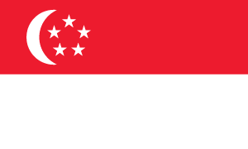




Leaders Rotate: Traditional World View
Top Performing Stock Markets of Developed Countries
Rank | 2018 | 2017 | 2016 | 2015 | 2014
1 | Finland | Austria | Canada | Denmark | Israel
2 | New Zealand | Hong Kong | New Zealand | Ireland | USA
3 | USA | Singapore | Norway | Belgium | New Zealand
US
3
16
6
11
2
Rank | 2013 | 2012 | 2011 | 2010 | 2009
1 | Finland | Belgium | Ireland | Sweden | Norway
2 | Ireland | Germany | New Zealand | Denmark | Australia
3 | USA | Denmark | USA | Hong Kong | Singapore
US
3
15
3
7
17
Source: © 2018 Morningstar, MSCI. Based on the MSCI World Index. The performance of countries and unmanaged indexes does not reflect expenses and may not correspond to the performance of
a mutual fund, which may be actively managed and incur expenses. One cannot invest directly in an index. The MSCI World Index is a free float-adjusted, market capitalization-weighted index that is designed to measure the equity market performance of global developed markets. MSCI makes no warranties and shall have no liability with respect to any MSCI data reproduced herein. Indexes are unmanaged and one cannot invest directly in an index.
Notes:
This table shows the top 3 performing stock markets for the last 10 years. You can see that these countries can all be considered “developed countries”.
The grey row under each year shows where the US placed. You can see that the US was never the top performing market—ranked as high as 2nd and as low as 17th.

Slide 24


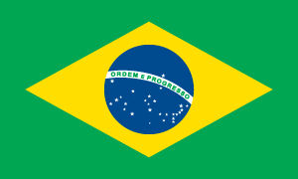


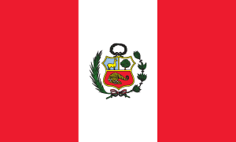
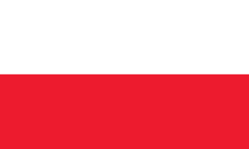
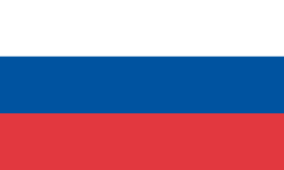

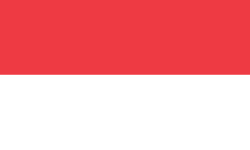
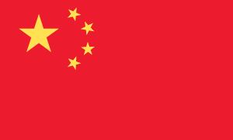


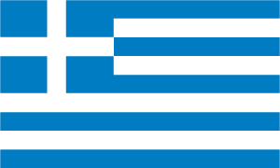
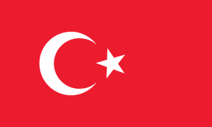




Leaders Rotate: Today’s World View
Top Performing Stock Markets Including Developing Countries
Rank | 2018 | 2017 | 2016 | 2015 | 2014
1 | Qatar | Austria | Brazil | Hungary | Egypt
2 | Peru | Poland | Russia | Denmark | Indonesia
3 | Russia | China | Peru | Ireland | Philippines
US
8
33
17
13
10
Rank | 2013 | 2012 | 2011 | 2010 | 2009
1 | Greece | Turkey | Ireland | Thailand | Brazil
2 | Finland | Philippines | Indonesia | Peru | Indonesia
3 | Ireland | Egypt | New Zealand | Chile | Russia
US
4
29
4
22
38
Source: Morningstar, MSCI. Based on the MSCI All Country World Index. The performance of countries and unmanaged indexes does not reflect expenses and may not correspond to the performance of
a mutual fund, which may be actively managed and incur expenses. One cannot invest directly in an index. The All Country MSCI World Index is a free float-adjusted, market capitalization-weighted index that is designed to measure the equity market performance of global developed and emerging markets. MSCI makes no warranties and shall have no liability with respect to any MSCI data reproduced herein. Indexes are unmanaged and one cannot invest directly in an index.
Notes:
When emerging markets are added to the mix, the results change dramatically.
Here we see the top three performing markets over the last 10 years based on the
MSCI All Country World Index, which includes the markets of both developed and developing markets.
You can see that over the past decade, the US ranked as high as 4th and as low as 38th.

Slide 25
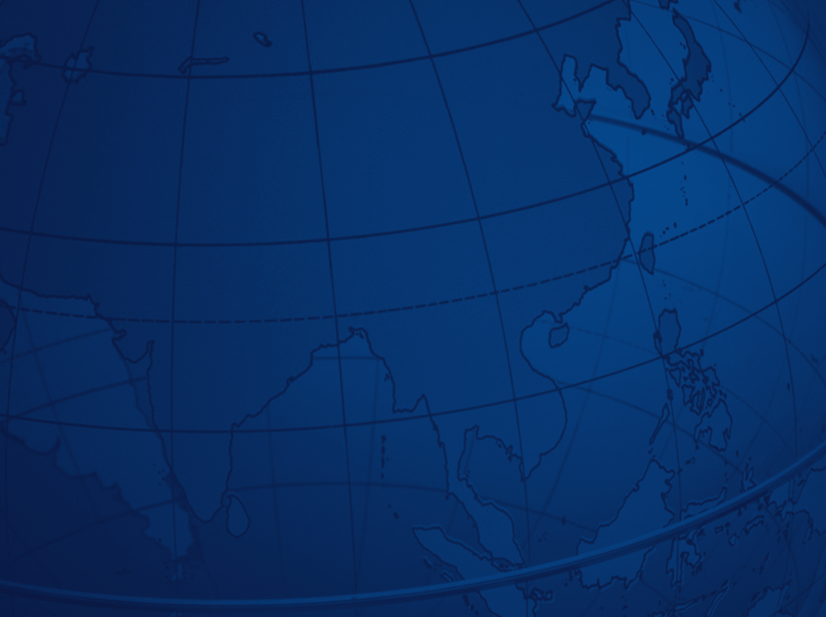
“
If you search worldwide, you will find more and better bargains
than by studying only one nation.”
–
  SIR JOHN TEMPLETON
    Templeton Funds Founder and Former Chairman
Notes:
The ageless wisdom of Sir John’s view on investing is very apparent today.

Slide 26
Global is Core to Franklin Templeton
OFFICES IN 35 COUNTRIES REPRESENTING 85% OF THE WORLD’S GDP¹
United States
Bahamas
Canada
Australia
United Kingdom
Luxembourg
Switzerland
Germany
Argentina
Brazil
France
India
Italy
Japan
Netherlands
Poland
South Africa
South Korea
UAE
Spain
Sweden
China
Austria
Mexico
Turkey
Hungary
Vietnam
Malaysia
Romania
Thailand
Colombia
Belgium
Singapore
Chile
Israel
1. Source for GDP: International Monetary Fund, World Economic Outlook Database, June 2019. Most recent data available.
Notes:
Franklin Templeton takes a global perspective on the world of investing. We have offices in 35 countries that when combined, represent 85% of the world's GDP.¹
1. Source: International Monetary Fund, World Economic Outlook Database, June 2019. Most recent data available.

Slide 27
Franklin Templeton’s Global and International Lineup
Franklin Global Listed Infrastructure Fund¹Franklin International Growth Fund
Franklin Liberty International Opportunities ETF
Franklin LibertyQ Emerging Markets ETF
Franklin LibertyQ Global Dividend ETF
Franklin LibertyQ Global Equity ETF
Franklin LiberyQ International Equity Hedged ETF
Franklin Mutual Beacon Fund
Franklin Mutual Global Discovery Fund
Franklin Mutual European Fund
Franklin Mutual International Fund²
Franklin Mutual Quest Fund
Templeton China World Fund
Templeton Developing Markets Trust
Templeton Emerging Markets Bond Fund
Templeton Emerging Markets Small Cap Fund
Templeton Foreign Fund
Templeton Frontier Markets Fund³
Templeton Global Balanced Fund
Templeton Global Bond Fund
Templeton Global Smaller Companies Fund
Templeton Global Total Return Fund
Templeton Growth Fund
Templeton International Bond Fund
Templeton World Fund
Franklin LibertyShares ETF lineup also includes 23 passively-managed ETFs that provide exposure to single-country and regional equity markets at a low cost.
1.This fund is scheduled to be liquidated on 11/6/19. In preparation for the liquidation, the fund closed to new investors on 8/19/19, and will close to all investors on 11/4/19. Future dates are subject to change. Shareholders may exchange their investment for another Franklin Templeton fund prior to the liquidation.
2. This fund is proposing to reorganize into Franklin Mutual Global Discovery Fund effective 2/21/20, subject to shareholder approval. In preparation for the proposed reorganization, the fund will close to new investors with limited exceptions on 8/27/19. These dates are subject to change.
3. Templeton Frontier Markets Fund is expected to be liquidated prior to the fund's 3/31/20 fiscal year-end but may be delayed if unforeseen circumstances arise. In preparation for the liquidation, the fund closed to new investors on 8/19/19. Future dates are subject to change. Shareholders may exchange their investment for another Franklin Templeton fund prior to the liquidation.
Notes:
You can see just how global Franklin Templeton is with 25 global and international mutual funds and ETFs. Global is core to Franklin Templeton.
NOTE: Please remove this slide when presenting to Edward Jones advisors

Slide 28
Today’s Discussion
How the World is Changing
Our World is More Connected than Ever
Is Your Portfolio as Global as it Should Be?
Global is Core to Franklin Templeton
Notes:
Here are the topics that were covered today as we looked at Global—The New Core:
How the World Is Changing
Our World Is More Connected Than Ever
Is Your Portfolio as Global as It Should Be?
Global Is Core to Franklin Templeton
Now that you have learned about the benefits of having a global portfolio, talk to your financial advisor about a strategy you can use to put this idea into action.

Slide 29
A Few Words About Risk
  All investments involve risks, including possible loss of principal. Special risks are associated with foreign investing, including currency fluctuations, economic instability and political developments. Investments in emerging markets, of which frontier markets are a subset, involve heightened risks related to the same factors, in addition to those associated with these markets’ smaller size, lesser liquidity and lack of established legal, political, business and social frameworks to support securities markets. Because these frameworks are typically even less developed in frontier markets, as well as various factors including the increased potential for extreme price volatility, illiquidity, trade barriers and exchange controls, the risks associated with emerging markets are magnified in frontier markets.

Slide 30
    Investors should carefully consider a fund’s investment goals, risks, charges and
    expenses before investing. To obtain a mutual fund or ETF summary prospectus and/or prospectus, which contains this and other information, talk to your financial advisor, call us
    at (800) DIAL BEN/342-5236 or visit franklintempleton.com. Please carefully read the prospectus before you invest or send money.
    Important data provider notices and terms available at franklintempletondatasources.com
Franklin Templeton Distributors, Inc.
One Franklin Parkway
San Mateo, CA 94403-1906
  franklintempleton.com
GNC PPT 08/19

