Slide 1
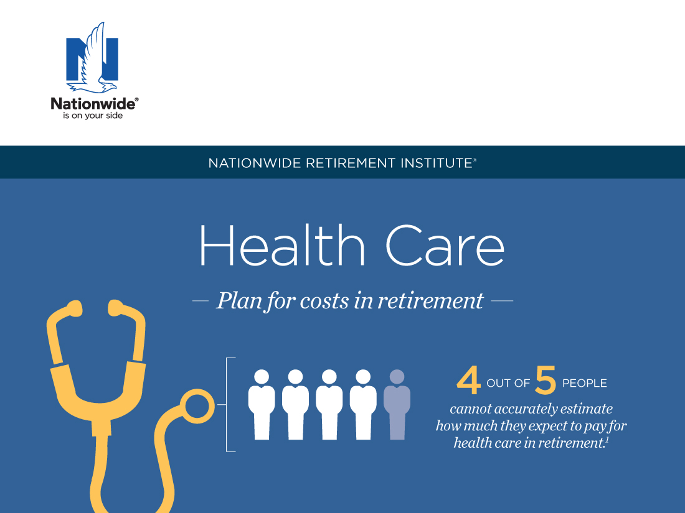
¹ “Health Care and Long-Term Care Study,” a consumer study of U.S. adults ages 50 and up,
Nationwide/Harris Poll Survey (May 2019).
Notes:
Health care is consistently among the primary concerns of retirees and pre-retirees as they consider their post-employment finances.
This concern is due, in part, to the historical growth in health care expenses relative to overall inflation, the on-going debate among our political leaders how to best fund, manage and deliver health care to retirees, and the shift in retirement income and retiree health care responsibilities from employer-sponsored defined benefit plans and retiree medical insurance plans to the individual’s personal savings and private insurance. There is also a growing awareness of the effects of increased longevity and better medical care on an individual’s potential need for non-medical long-term living assistance.
Today, we’ll examine how you can help clients place the health care expense question into their overall retirement income plan, understand the importance of planning for health care-related expenses in retirement, and the options available to them to address and manage their health care expense risk.

Slide 2
Important things to keep in mind
• Not a deposit • Not FDIC or NCUSIF insured • Not guaranteed by the institution • Not insured by any federal government agency • May lose value
This material is not a recommendation to buy, sell, hold or roll over any asset, adopt an investment strategy, retain a specific investment manager or use a particular account type. It does not take into account the specific investment objectives, tax and financial condition, or particular needs of any specific person. Investors should work with their financial professional to discuss their specific situation.
This material should be regarded as educational information on health care and is not intended to provide specific advice. If you have questions regarding your particular situation, you should contact your legal or tax advisors.
This information is general in nature and is not intended to be tax, legal, accounting or other professional advice. The information provided is based on current laws, which are subject to change at any time, and has not been endorsed by any government agency.
Nationwide Investment Services Corporation (NISC), member FINRA, Columbus, OH. Nationwide Retirement Institute is a division of NISC.
Nationwide, the Nationwide N and Eagle, Nationwide is on your side and Nationwide Retirement Institute are service marks of Nationwide Mutual Insurance Company. © 2019 Nationwide
NFM-10373AO.22 (08/19)
Notes:
[READ SLIDE]

Slide 3
Challenge
— The retirement income —
Notes:
[READ SLIDE]

Slide 4
Retirement decision points
The retirement income challenge
Retirees need to make a series of important decisions between ages 55 and 70½
Earliest age to begin Social Security benefits (at reduced amount)
Full Social Security
benefit
eligibility
Maximum Social Security benefit eligibility
Age
62
Age
66–67
Age
70
Age
55
Age
59½*
Age
65
Age
70½
If retired and have a 401(k), may withdraw without IRS penalty
Can withdraw tax-deferred assets without IRS penalty *Age 50 for Public Safety Workers
Must take RMDs (Required Minimum Distribution) from IRAs
Medicare eligibility
Source: The Retirement Income Reference Book, 2018, LIMRA.
Notes:
Retirees must plan for many decisions, most of them guided by law, between the ages of 55 and 70½. These decisions may largely influence retirement success as well as long-term financial adequacy – how and when you withdraw, and how to get the most from retirement benefits like Social Security and Medicare.
This means that everyone needs to be educated before and after retirement to make decisions at these key ages.

Slide 5
The retirement income challenge
How do I invest for growth?
How do I protect my assets?
How much income can I take and when?
ASSET & PRODUCT
ALLOCATION
RISK MANAGEMENT
INCOME
Source: The Retirement Income Reference Book, 2015, LIMRA.
Notes:
Retirees have three questions to ask with regard to retirement income:
How do I invest for growth?
How do I protect my assets?
Home much income can I take and when?

Slide 6
The retirement income challenge
Market loss
Inflation
Risk before retirement
Outliving assets
Health care costs
Inadequate income for surviving spouse
Risk in retirement
Source: The Retirement Income Reference Book, 2015, LIMRA.
Notes:
Risks differ for pre-retirees and retirees. For example, if you’re a retiree, you could face additional risks that pre-retirees do not:
Market loss and inflation risks continue, but their risk is amplified.
Risks of outliving assets, incurring larger-than-expected health care costs and losing a spouse on whom they rely for income are new risks they’ll face.

Slide 7
The retirement income challenge
Percentage of private-sector workers employed by establishments offering health insurance to retirees, 1997-2014
Source: EBRI estimates from various tables at http://meps.ahrq.gov/mepsweb/data_stats/quick_tables_search.jsp?component=2&subcomponent=1
Notes:
Fewer employers offer retiree health insurance and benefits. According to EBRI:
Fewer and fewer employers are covering retiree health insurance; in addition, the retirees covered in employer plans face rising premiums, higher out-of-pocket expenses and strict eligibility requirements
Many employers are not obligated to continue retiree health coverage, and retirees presently enjoying the benefit may face cancellation
This means:
The uncertainty of company-provided retiree health insurance adds another level of complexity, particularly for retirees not yet eligible for Medicare; therefore, increased health insurance premiums and care costs may negatively impact their ability to pay for other basic needs
This, together with the spiraling cost of Medicare, may well explain why retirees and pre-retirees are so concerned about health care costs; if their programs are eliminated, what will they do and will they be able to shoulder the cost?

Slide 8
The retirement income challenge
Consumer estimate of annual health care costs in retirement
$26K+:
$16K - $25K:
$11K - $15K:
$6K - $10K:
$1K - $5K:
Not sure/can’t estimate:
 | 1%
 | 1%
 | 3%
 | 10%
 | 40%
 | 44%
84%
have underestimated, or don’t know their medical costs
Nationwide/Harris Poll "Health Care and Long-Term Care Study." Consumer study of 1,462 adults 50 and older with investable assets $50K or more and 516 adults 50 and older who are caregivers, 2019.
Notes:
According to a study by Nationwide titled “Health care costs in retirement”, over three-quarters of consumers underestimate, or have no idea about health care costs.
Almost half of adults can’t estimate their health care costs in retirement (44%) or their LTC costs (67%) for themselves.
However, among those who provided an estimate, the annual costs for health care in retirement are expected to be approximately $5,900 for themselves; the estimate is considerably higher for LTC costs at $43,100.

Slide 9
Health care
― Understanding ―
Notes:
[READ SLIDE]

Slide 10
The health care opportunity
Understanding health care
Managing the cost of health care is one of the most complex issues facing society
Will likely be among your greatest expenses in retirement
Notes:
As I mentioned at the beginning of the presentation, the rising cost of health care has become one of the largest and most complex issues facing our country. In fact, it’s likely to be one of your greatest expenses in retirement. And while it ranks as a top concern, most Americans aren’t thinking about—much less planning for—their health care costs in retirement.
When you think about future health care costs, it is important to consider inflation. Health care spending continues to rise at the fastest rate in our history. According to the CMS, U.S. health care spending is projected to reach nearly $5.5 trillion by 2025. The agency attributed the increase in large part to the United States’ aging population and rising prices for health care services.

Slide 11
Understanding health care
The impact of health care costs on retirement income
Understanding health care specifics
Notes:
[READ SLIDE]

Slide 12
Understanding health care
Health care expenses
23%
Out-of-pocket prescription drug expenses
45%
Medicare cost-sharing provisions
32%
Premiums for Medicare, Part B & D
Source: Medicare.gov, 2017.
Notes:
To do this, let’s break down health care expenses for the average retired couple.
Nearly half of their expenses are Medicare cost-sharing provisions such as copays and deductibles. It’s important to note that Premiums for Medicare Parts B and D as well as out of pocket expenses make up over half their expenses.
It’s been estimated that a couple retiring now will need between $296,000 and $399,000 to cover their out of pocket health care expenses.
It’s important to note that the pie chart does not include other health-related expenses, such as over-the-counter medications, most dental services and long-term care.

Slide 13
Understanding health care
Health care expenses
Out-of-pocket health care estimates for a 65-year-old couple can reach $296,000−$399,000 during retirement.
Source: "Savings Medicare Beneficiaries Need for Health Expenses: Some Couples Could Need as Much as $400,000, Up From $370,000 in 2017" at age 65 assuming 90% chance of having enough savings, EBRI, October 8, 2018.
Notes:
It’s been estimated that a couple retiring now will need between $296,000 and $399,000 to cover their out of pocket health care expenses.

Slide 14
Understanding health care
Health care expenses
Medicare covers only about 62% of expenses associated with health care services
Source: MedicareSolutions.com, May 23, 2017
Notes:
Americans, on the whole, are not prepared for the reality of health care costs in retirement. In addition, Americans don’t really understand how Medicare works. For example, 47% of people surveyed think that Medicare helps pay for long-term care, and it does not. In fact, according to MedicareSolutions, Medicare covers 62% of expenses associated with health care services. Individuals are in large part responsible for covering the other 38%.
The Medicare website states, "It is important … to understand that Medicare does not cover everything, and it does not pay the total cost for most services or supplies that are covered.“
The website has a Medicare Coverage Database where you can search for Medicare Coverage information by state and coverage topic. Entering information into the Medicare Coverage Database will most likely reinforce the idea that “Medicare does not cover everything.” For example, I entered a few coverage topics in Massachusetts and received the following information:
Medicare does not cover an eye exam.
Generally Medicare does not cover eyeglasses or contact lenses.
Medicare does not cover routine hearing exams or hearing aids.- Medicare does not cover routine dental care or most dental procedures such as cleanings, fillings, tooth extractions or dentures. Medicare does not pay for dental plates or other dental devices.

Slide 15
Understanding health care
Option 1
Original Medicare Part A and Part B +
Secondary insurance GHI, MedSup +
Rx coverage Part D or GHI
Option 2
Medicare Advantage (Part C) 1. Hospitalization 2. Medical 3. Rx (MA-PD)
or
Notes:
Let’s talk more about Medicare to get a better understanding of what we’re dealing with.
[OPTIONAL]
Medicare is a federal health insurance program administered by the Centers for Medicare and Medicaid Services (CMS) for people 65 and older, any age and disabled, or those diagnosed with End Stage Renal Disease (ESRD).

Slide 16
Understanding health care
Option 1 – Medicare Part A: Hospital Insurance
Patient costs for an in-hospital stay, 2019
Days 1−60 | $1,364 deductible
Days 61−90 | $341 per day copay
Days 91−150 | $682 per day copay
Days 150+ | All costs
Inpatient hospitalization
Skilled nursing facilities
Home health care
Hospice
Source: Medicare.gov, October 2018.
Notes:
Let’s just look at an overview of what Medicare Part A doesn’t cover. Notice the high out-of-pocket cost for an extended hospital stay.

Slide 17
Understanding health care
Option 1 – Medicare Part B: Medical Insurance
Individual pays, 2019
Monthly premium (based on MAGI)
$185 deductible
20% coinsurance on doctors’ services and outpatient care
Doctors/providers
Preventive benefits
Durable medical equipment
Outpatient services
Source: Medicare.gov, October 2018.
Notes:
Let’s look at an overview of what Medicare Part B doesn’t cover. Please also note that your income in retirement determines the monthly premium for Medicare Part B – the higher the modified adjusted gross income, the higher the premium.
Changes to original Medicare under the Affordable Care Act, in effect since 2011:
No out-of-pocket costs for most preventive services
Part B Deductible and Coinsurance will be waived
Annual Wellness Visit
Comprehensive health risk assessment
Personalized Prevention Plan
Health advice and referral to education and preventive counseling

Slide 18
Understanding health care
Option 1 – Medicare Part B: Monthly Premiums
If Your Yearly Income in 2017 was:
You pay (2019)
Filed individual tax return | Filed joint tax return
$85,000 or less | $170,000 or less | $135.50*
$85,001−$107,000 | $170,001 - $214,000 | $189.60
$107,001−$133,500 | $214,001 - $267,000 | $270.90
$133,501−$160,000 | $267,001 - $320,000 | $352.20
$160,001−$499,999 | $320,001 - $749,999 | $433.40
above $500,000 | above $750,000 | $460.50
*If protected with the hold-harmless provision, it's $130, on average.
Source: Medicare.gov, October 2018.
Notes:
Let’s look at an overview of what Medicare Part B doesn’t cover. Please also note that your income in retirement determines the monthly premium for Medicare Part B – the higher the modified adjusted gross income, the higher the premium. It covers expenses for doctors, equipment and some preventive services.
Premiums are paid monthly, starting at just over $135 and scale up based on your modified adjusted gross income. (Your adjusted gross income plus your tax exempt interest income). Please note that your income in retirement determines the monthly premium for Medicare Part B -- the higher the modified adjusted gross income, the higher the premium.
$85,000 or less $170,000 or less $135.50* *If protected by the hold-harmless provision; it’s $130, on average.

Slide 19
Understanding health care
Option 1 – Medicare Part D: Prescription Drug Coverage
Available two ways:
Stand-alone Prescription Drug Plans (PDPs)
Through Medicare Advantage Plans (MAPDs)
ALL people with Medicare can get Part D
Open Enrollment October 15 to December 7:
Other enrollment times based on circumstance
Coverage begins January 1
Notes:
All people with Medicare have the option to join a plan that covers prescription drugs.
Anyone who has Medicare Part A (Hospital Insurance), or Medicare Part B (Medical Insurance), or both Part A and Part B is eligible to join a Medicare prescription drug plan and must enroll in a plan to get Medicare prescription drug coverage. However, those who live outside the U.S. or who are incarcerated may not enroll and are not eligible for coverage.
Costs will vary depending on the plan; at a minimum, plans must provide a standard level of coverage as shown here. Plans may offer more coverage and additional drugs for a higher monthly premium.

Slide 20
Understanding health care
Option 1 – Medicare Part D: Prescription Drug Coverage (2019)
You pay
95% Medicare benefit
(catastrophic coverage)
Beneficiary pays 5% (min. co–pay)
$3.40 generic or $8.50 brand
Medicare pays
$5,100 out-of-pocket reached
$8,906 in total drug costs
100%
No Medicare coverage
in donut hole
The donut hole is large and expensive
Beneficiary pays 100%
25% of the cost for brand name medications
37% of the cost of generic medications
$3,820 in total drug costs
75%
Medicare benefit
(initial coverage)
Beneficiary pays 25% or flat co-pay amounts based on formulary
100% Deductible
Beneficiary pays $415
Source: Medicare.gov, October, 2018..
Notes:
This slide provides an overview of what Medicare Part D covers and what it doesn’t.
Some recent changes to Medicare Part D include:
• Annual Deductible: $0 – $415
• Co-pays: 25% or flat co-pay amounts based on formulary
• Coverage Gap (donut hole): $3,820 - $8,906 in total drug costs
• Coverage Gap the insured pays: 25% of the cost on brand name medications and 37% of the cost on generic medications during coverage gap
• Catastrophic Coverage is reached after $5,100 is spent out of pocket: approximately 5% co-pay after coverage gap
The “donut hole” discounts will increase each year until the gap is closed in 2020. After that, retirees will be responsible for 25% of all prescription drug costs after the deductible until they reach the level of catastrophic coverage.

Slide 21
Understanding health care
Option 1 – Medigap: Medicare supplemental insurance
Pay only after Original Medicare (Parts A & B)
Flexibility to see any doctor who accepts Medicare
Open Enrollment − Six months beginning with Part B effective date at age 65 or older
Notes:
This slide provides an overview of Medigap coverage. [Read bullets.]
Additional talking points:
In 2019 there are still 10 standard plans offering different levels of coverage, (plan options A through N); however, starting January 1 2020, Medigap Plans C and F will no longer be available due to not being allowed to cover the Medicare Part B deductible. (If you already have either of these two (2) plans before January 1, 2020, you’ll be able to keep you plan. If you were eligible for Medicare before January 2, 2020, but not yet enrolled, you may be able to buy one of these plans.)
Different premiums for same coverage, depending upon insurance company
No coverage for prescription drugs, dental, hearing or vision

Slide 22
Understanding health care
Cost of Medicare Premiums
 | Monthly | Annual
Medicare Part A | $0 | $0
Medicare Part B | $135.50* | $1626.00¹
Medicare Part D | $32.50 | $390.00²
Medigap Policy G | $169.00 | $2,028.00³
Total per person | $337.00 | $4,044.00
Total per couple | $674.00 | $8,088.00
*If protected with the hold-harmless provision, it's $130, on average.
This grid shows you the actual cost of premiums based on a couple’s annual income below $170,000 married filed jointly. This is for illustrative purposes only.
¹ Medicare.gov, October 2018.
² Center for Medicare & Medicaid Services, CMS.gov, October 2018.
³ Medicare.gov, October 2018. Cost for Medigap Supplement Policy G in Columbus, Ohio. Ranges from $97-169.
Notes:
For this discussion let’s look at a couple who is married, filing jointly with a MAGI below $170,000. Both husband and wife are healthy and will not have any additional health care expenses besides required premiums.
Medicare Part B premiums are based on your MAGI. This grid shows you the actual cost of premiums based on a couple’s annual income below $170,000 married filed jointly is $135.50 per month.
Medicare Part D premiums are on average about $390 per year (varies by state) and are subject to the plan a person selects. The plan would be selected based on the prescription drugs being taken.
Medigap insurance can vary by carrier and plan option. The upper premium in Ohio for 2019 is $169.00 per person per month for an annual cost of about $2,028. This would cover Medigap Policy G, which is considered to be the benchmark after Policy C and F are no longer available to new enrollees after January 1, 2020.
Medigap G policies range between $97 and $169 per month in Columbus, Ohio.

Slide 23
Understanding health care
Option 2 – Medicare Part C: Medicare Advantage Plans
Offered by private companies to replace Original Medicare and secondary insurance
Numerous options by county:
Managed Care (HMO/PPO)
Non-Managed Care (PFFS/MSA)
Most plans include Part D benefit (MA-PD)
continued >
Notes:
Let’s go over Medicare Part C and what is included (and not included) in the plan.

Slide 24
Understanding health care
Option 2 – Medicare Part C: Medicare Advantage Plans (continued)
Hearing, dental, and vision may be covered
Costs may increase for out-of-network doctors
Available to those:
As an alternative to Parts A & B
That live within the plan’s service area (county)
That do NOT have End Stage Renal Disease
Enrollees pay Part B premium and any other applicable costs

Slide 25


Understanding health care
Applying for Medicare
Enrollment is automatic if clients get Social Security or Railroad Retirement benefits prior to Medicare eligibility
All others must apply with Social Security (or Railroad Retirement) during their seven-month Initial Enrollment Period (IEP)
Three months before 65th birthday
Month of 65th birthday
Three months after 65th birthday
The sooner, the better.
Notes:
Social Security tells people it is best to apply for Medicare three months before age 65. You don’t have to be retired to get Medicare. The retirement age for full Social Security benefits is slowly going up to age 67, but you can still get full Medicare benefits at age 65. You can’t get Medicare benefits before age 65 unless you have a disability or End Stage Renal Disease. If you are already receiving Social Security benefits (for example, getting early retirement), you will be automatically enrolled in Medicare without having to apply again. You will get a Medicare card and other information about three months before age 65 or before their 25th month of disability benefits.

Slide 26

Understanding health care
Leverage these health care planning resources
Medicare www.Medicare.gov 1-800-MEDICARE www.MyMedicare.govA
Eldercare.org
State Health Insurance Programs (SHIP)
Benefitscheckup.org
Social Security Administration www.SocialSecurity.gov 1-800-772-1213
Notes:
Here are a few resources for furthering your health care planning knowledge. Please note that SHIP programs and contact information vary by state.

Slide 27
Creating a plan
— to address health care costs —
Notes:
[READ SLIDE]

Slide 28
Creating a plan to address health care costs
Americans underestimate retirement health care costs
The majority of pre-retirees have underestimated the cost of health care in retirement
Help you eliminate the guesswork with a personalized Health Care Cost Assessment from Nationwide
Notes:
[READ SLIDE]

Slide 29

Start with a Health Care Cost Assessment
Determine individual health care costs
The Nationwide Personalized Health Care Cost Assessment
Powered by calculations from one of the world’s leading actuarial firms
Provides a personalized estimate of possible annual health care expenses
Includes estimates for Medicare, out-of-pocket and long-term care expenses
Notes:
We know that a couple both age 65 today living to average life expectancy could need as much as $296,000 to cover premiums for health insurance coverage and out-of-pocket expenses during retirement. A couple who lives to age 95 could need as a much as $399,000. This example is for an average couple. This is an important number; but a realistic number for you, based on your personal health history, will be much more valuable.
Fortunately, we can help you with a tool called the Nationwide Health Care Cost Assessment. This tool was developed by a team of professionals, including leading physicians and experienced actuaries, using proprietary health risk analysis and up-to-date actuarial cost data. These experts analyze personal health and lifestyle information, healthcare costs, actuarial data and medical coverage. The result is a meaningful, personalized cost estimate that will help you plan for future health care expenses, including Medicare, out-of-pocket and long-term care costs.
With the Nationwide Health Care Cost Assessment, we can assess your health status and how it may affect your future medical costs. Then we can estimate your years in retirement and health care costs during those years. We can also assess alternative scenarios. For example, what is the financial impact if you retire one year earlier or one year later than you currently plan?

Slide 30
Creating a plan to address health care costs
Personalized Health Care Cost Assessment
HEALTH PROFILE
LONGEVITY
AVERAGE ANNUAL EXPENSES FOR HEALTH CARE
IMPACT OF NOT TAKING ACTION
Notes:
The personalized health care cost assessment allows us to easily and quickly provide you with possible annual health care cost estimates based on your individual profiles.
The assessment starts with a 3-part, 15-question fact finder on your health history, lifestyle and history of medical conditions. It also allows you to choose a metro region for retirement, which will more accurately calculate the cost of long-term care in that area.
Completing this assessment is a critical first step for planning. The report will tell you about your health profile, health risks, estimated life expectancy based on those risks and hypothetical estimates for health care costs in retirement. Costs are broken out into Medicare, out-of-pocket and long-term care expense categories so you can take an even more detailed look into what your costs will be.
The report will help you determine what you may need to invest today to fund your health care costs during retirement. We will utilize tools that allow for “what-if” scenarios. For example, how will a change in your year of retirement affect your out-of-pocket health care costs?
You can discuss the most appropriate way to save so that you can feel more confident about having the funds needed to cover one of the most important expenses you will have during retirement.

Slide 31

Health Care and LTC Cost Assessment
Notes:
The personalized health care cost assessment allows us to easily and quickly provide you with possible annual health care cost estimates based on your individual profiles.
The assessment starts with a 3-part, 15-question fact finder on the your health history, lifestyle and history of medical conditions. It also allows you to choose a metro region for retirement, which will more accurately calculate the cost of long-term care in that area.
Completing this assessment is a critical first step for planning. The report will tell you about your health profile, health risks, estimated life expectancy based on those risks and hypothetical estimates for health care costs in retirement. Costs are broken out into Medicare, out-of-pocket and long-term care expense categories so you can take an even more detailed look into what your costs will be.
The report will help you determine what you may need to invest today to fund your health care costs during retirement. We will utilize tools that allow for “what-if” scenarios. For example, how will a change in your year of retirement affect your out-of-pocket health care costs?
You can discuss the most appropriate way to save so that you can feel more confident about having the funds needed to cover one of the most important expenses you will have during retirement.

Slide 32
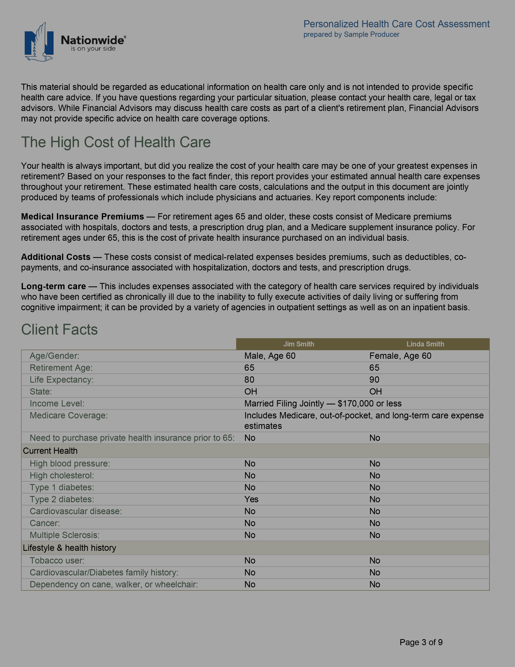
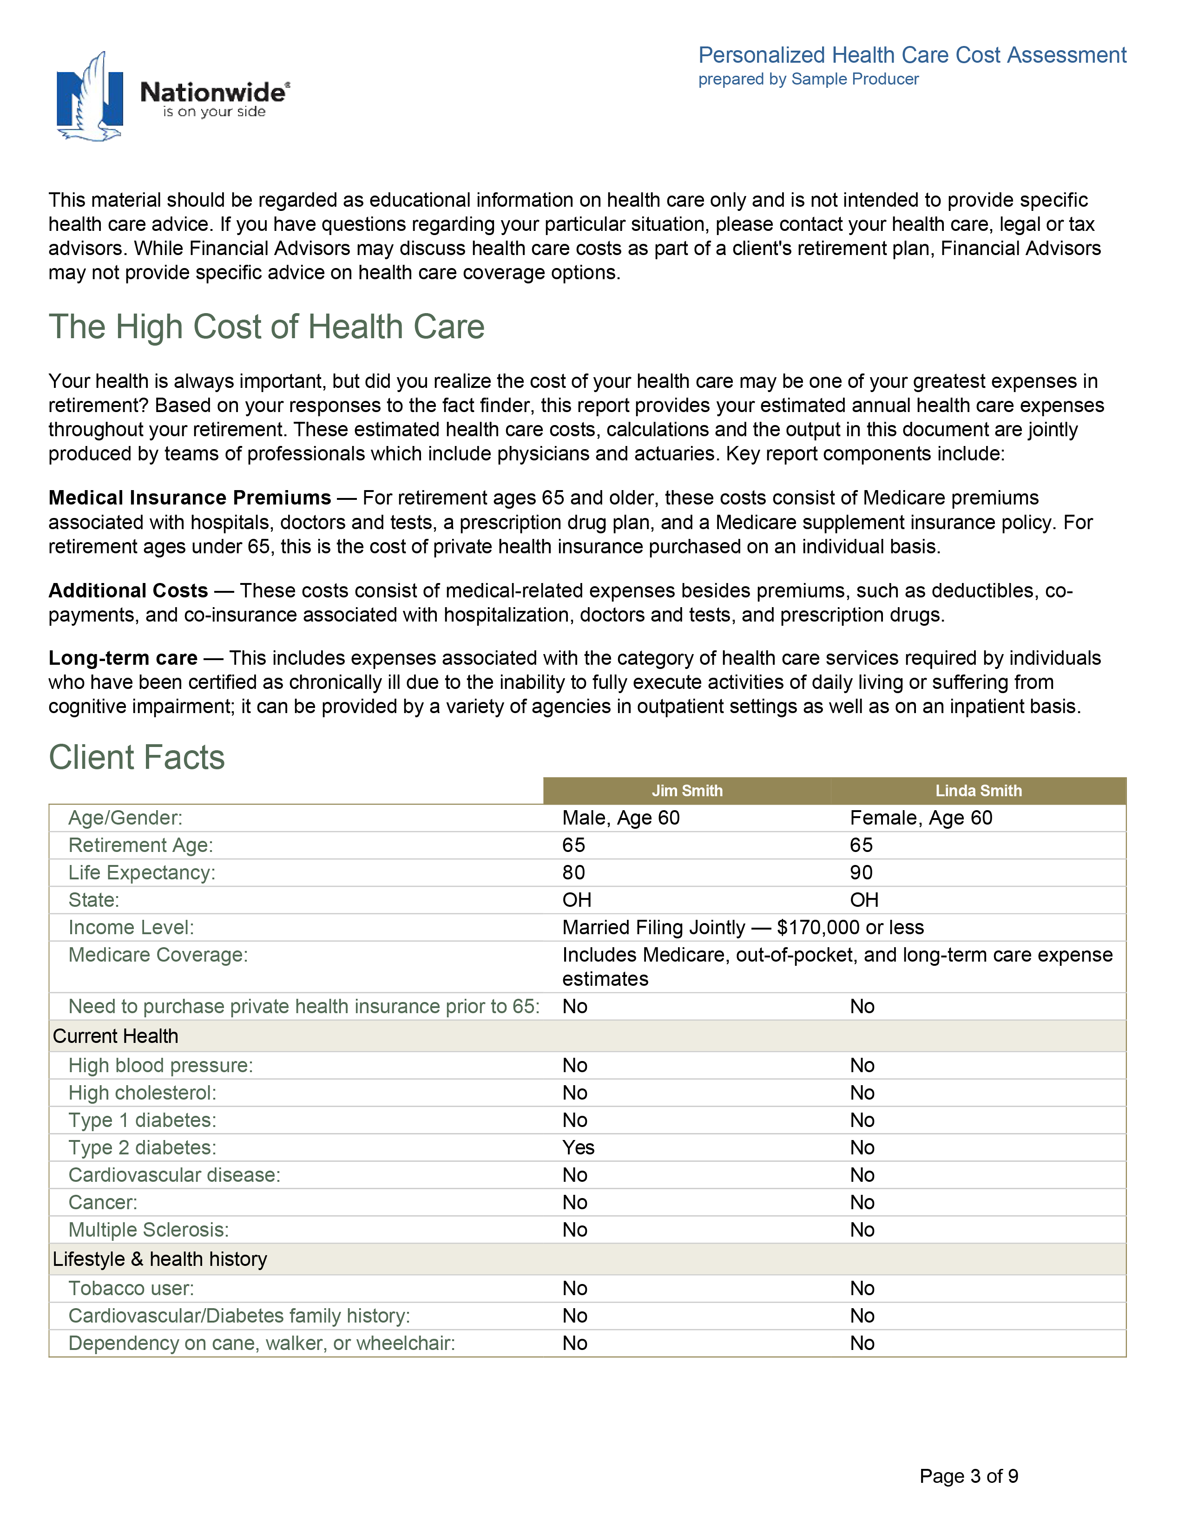
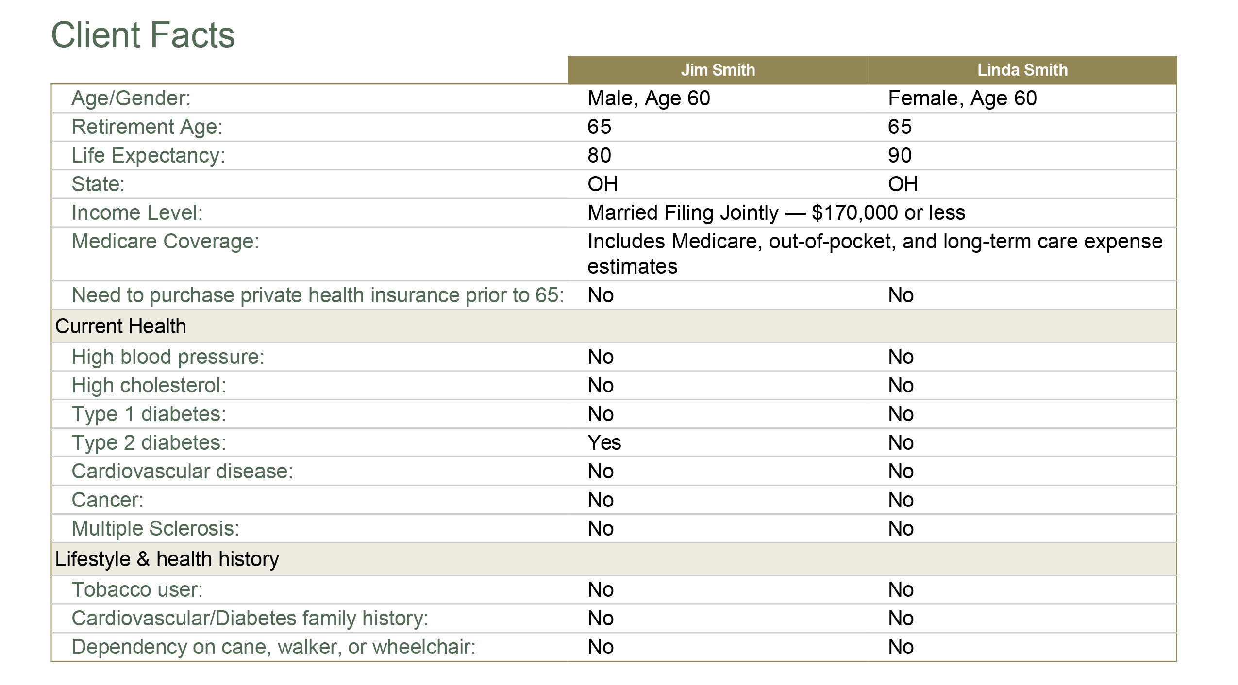
Health Care and LTC Cost Assessment
Health Care and LTC Cost Assessment

Slide 33
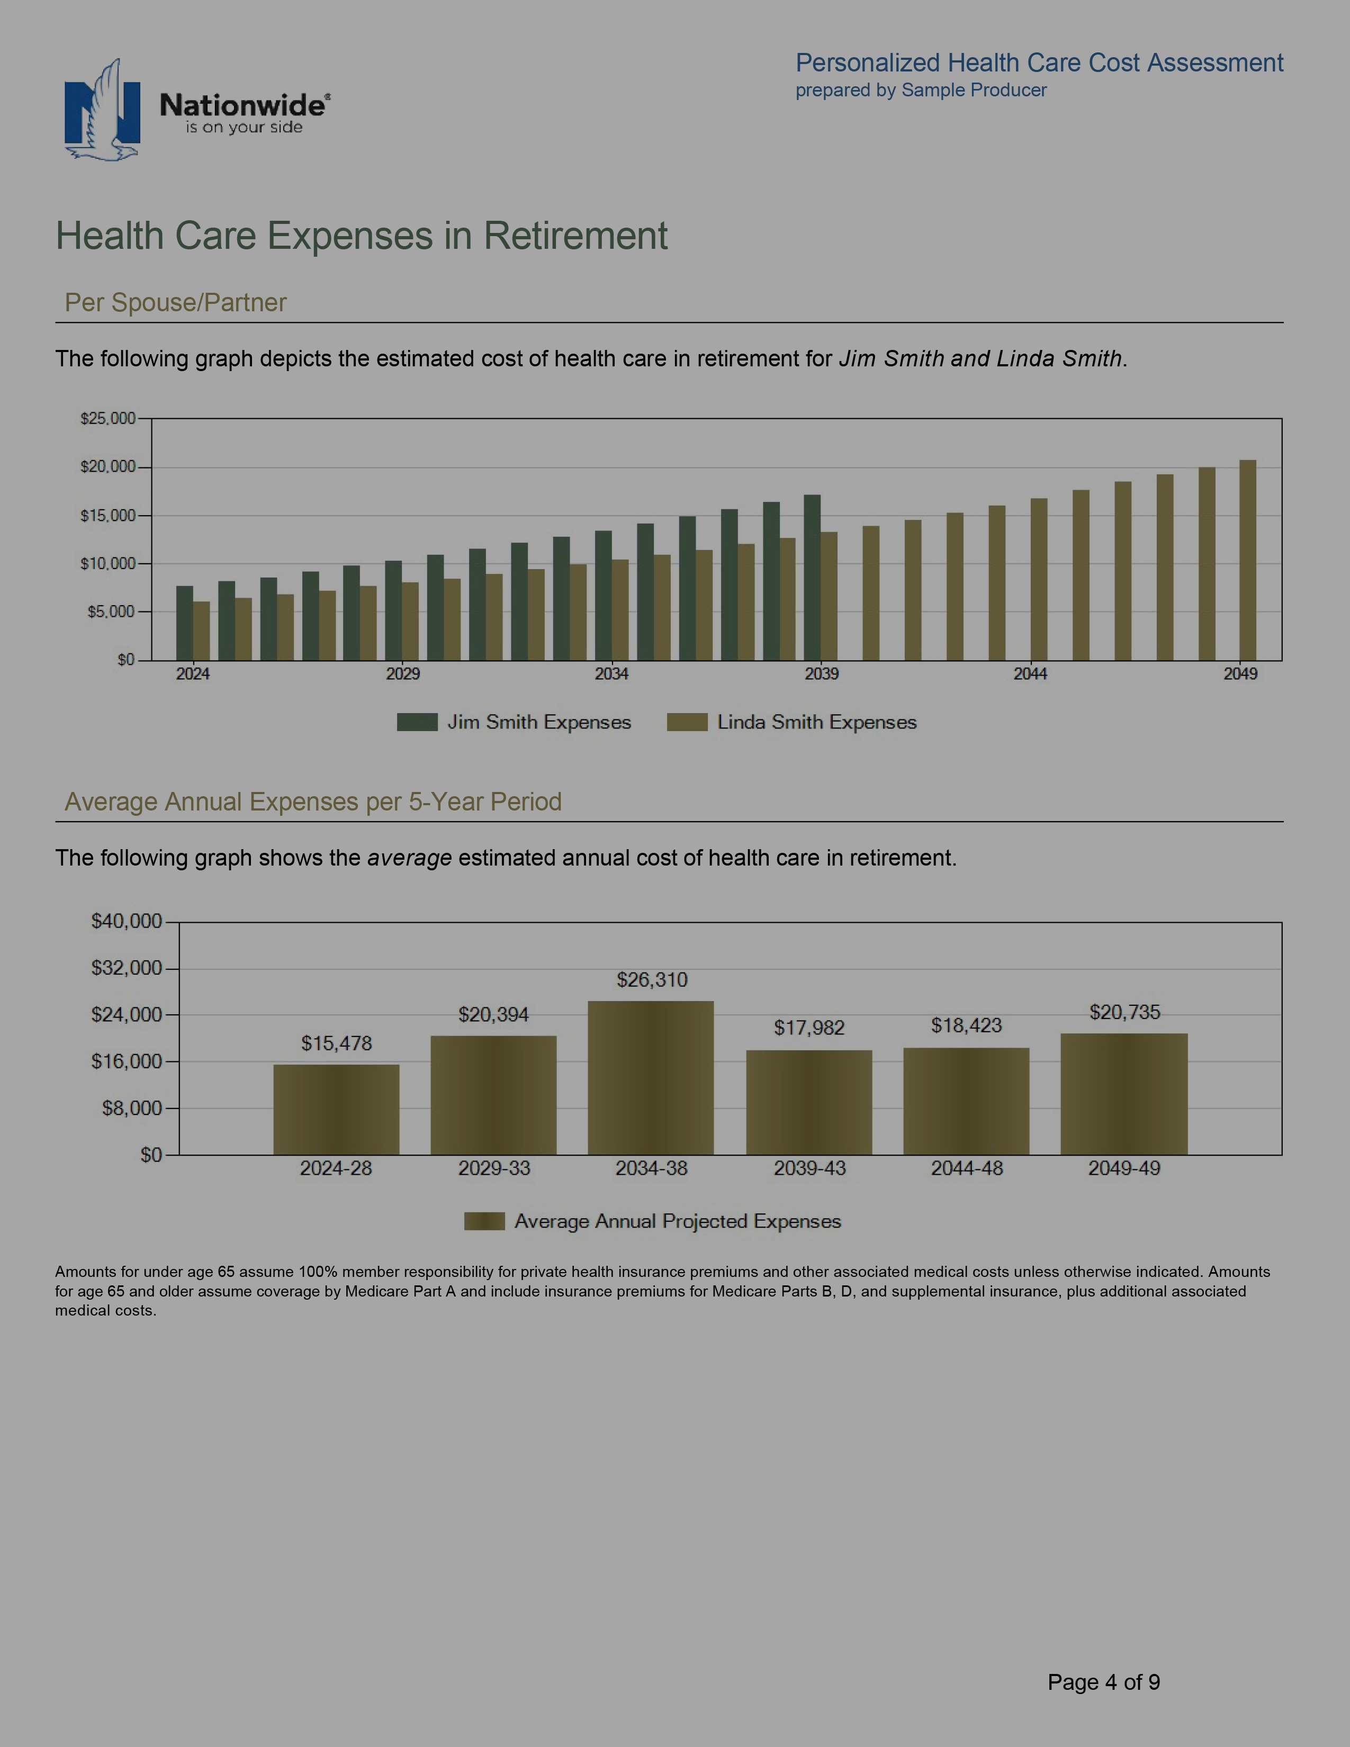
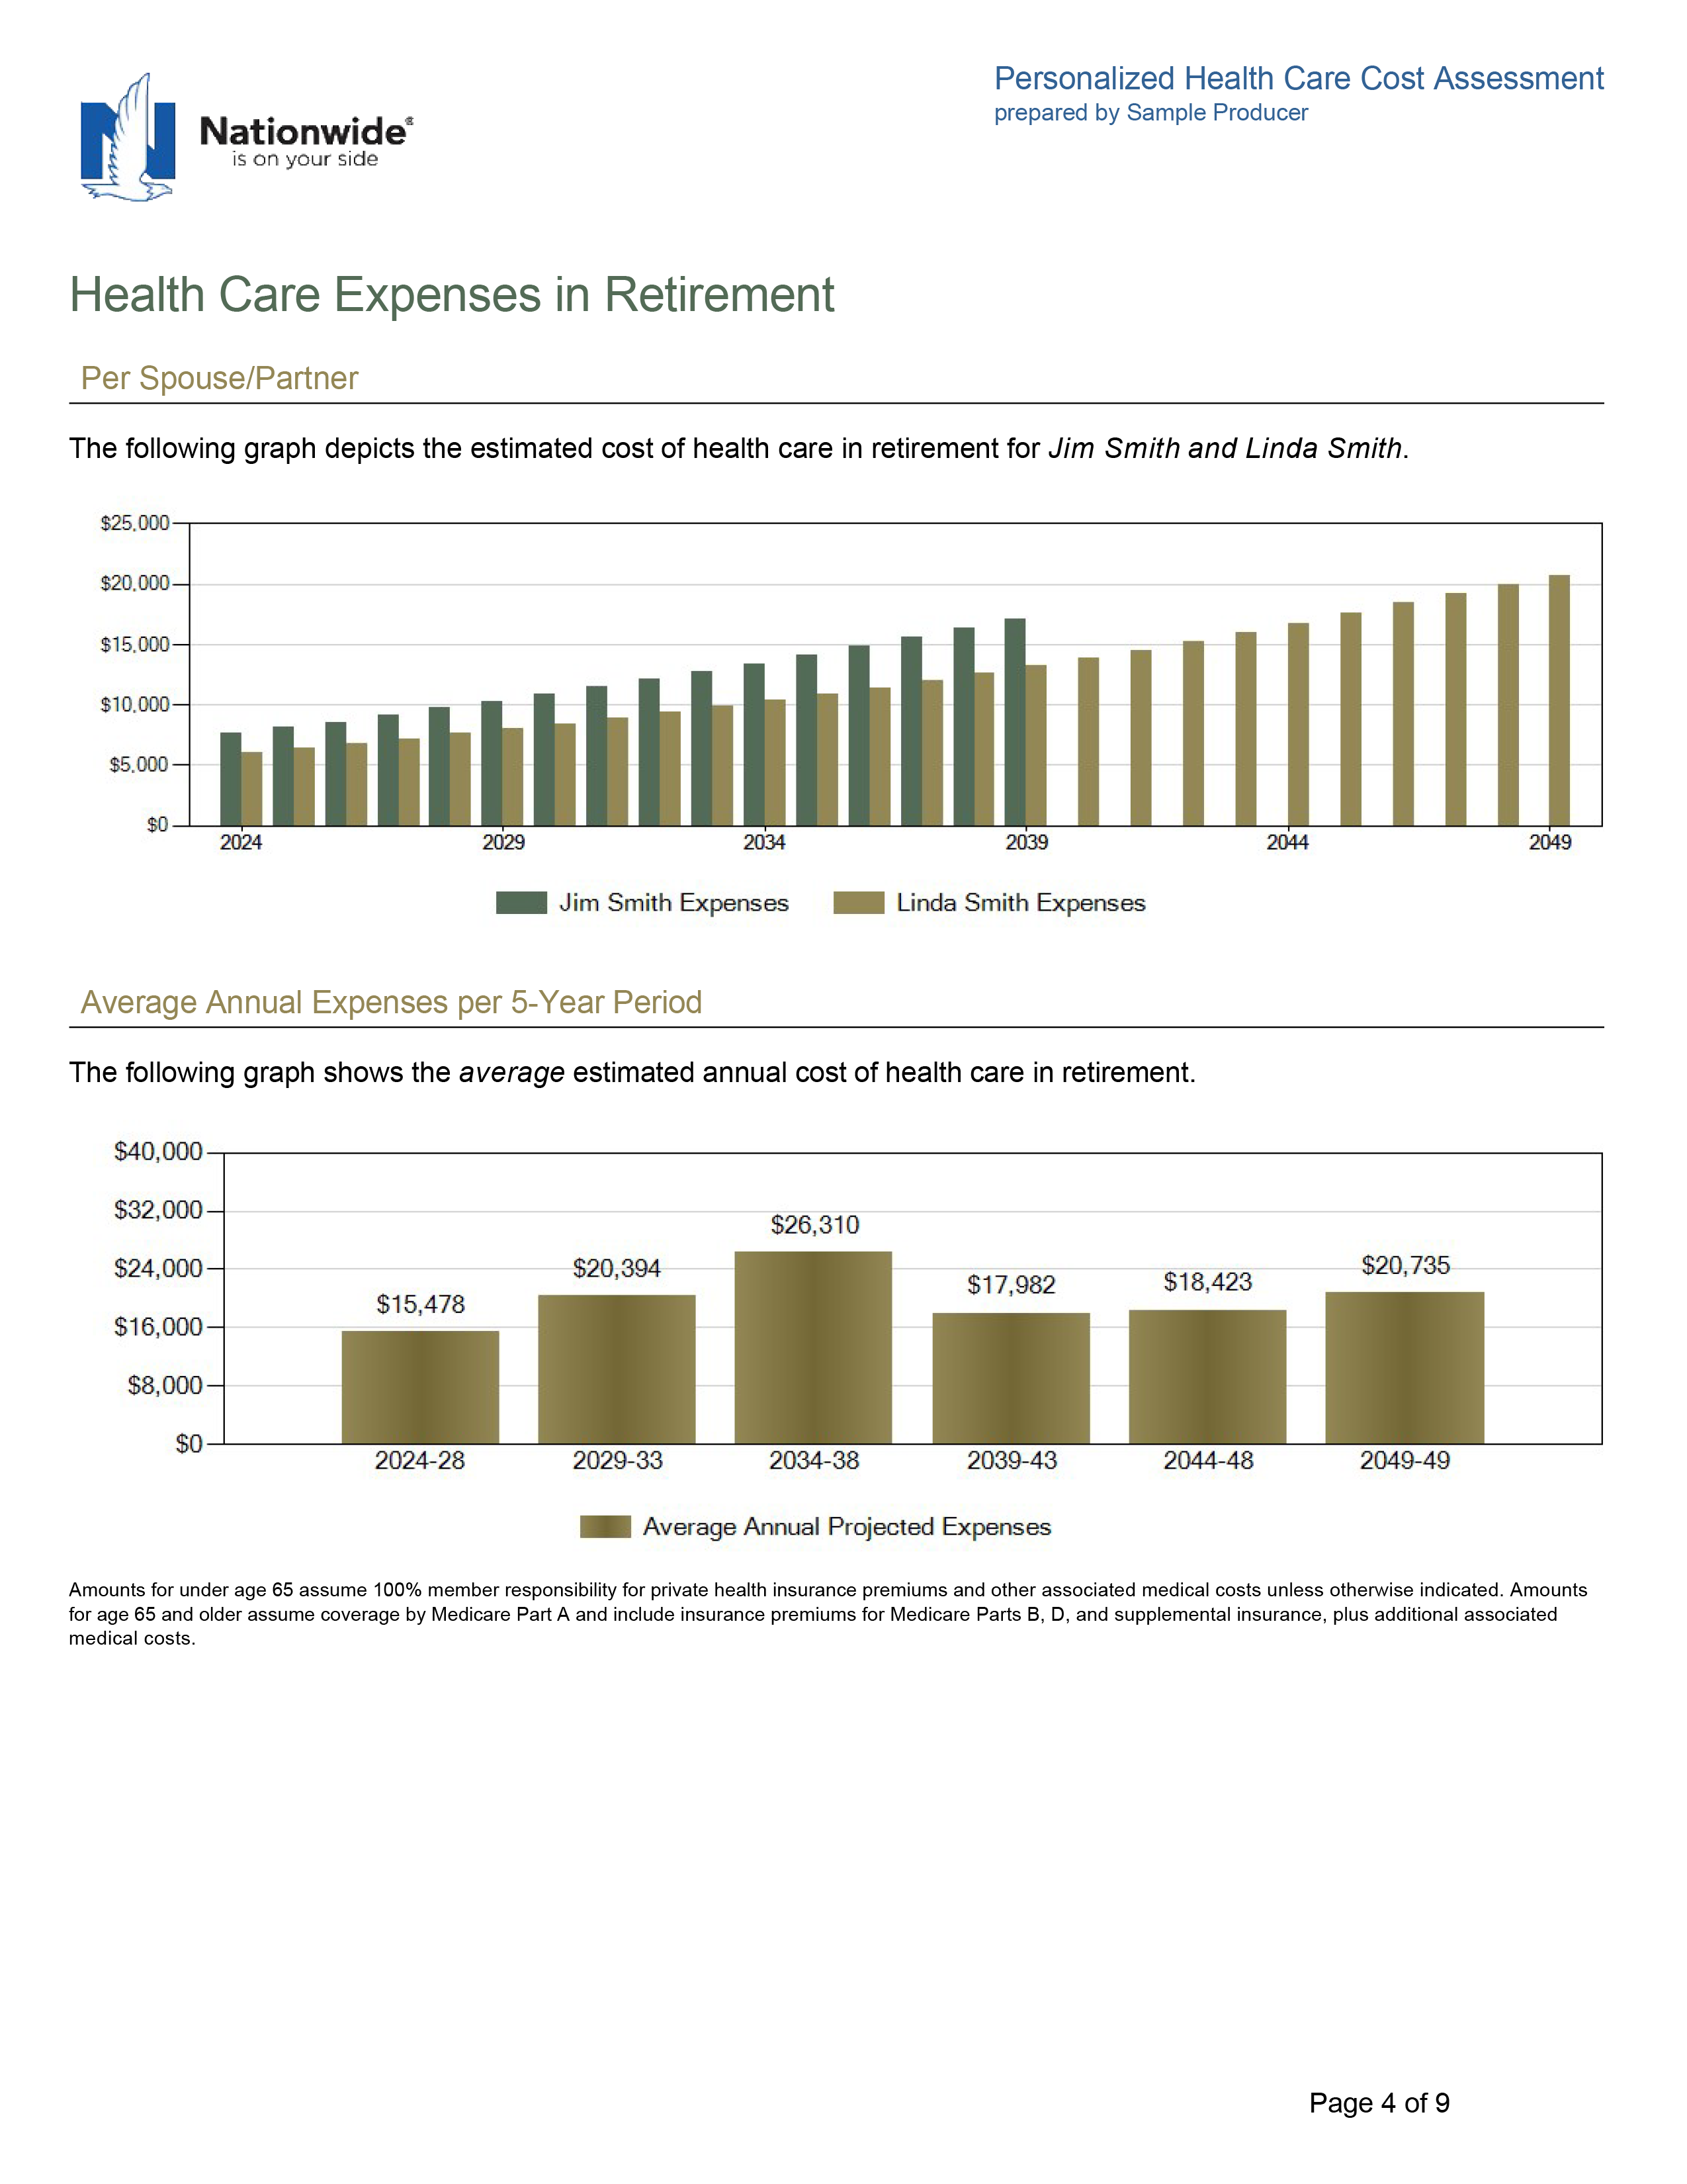
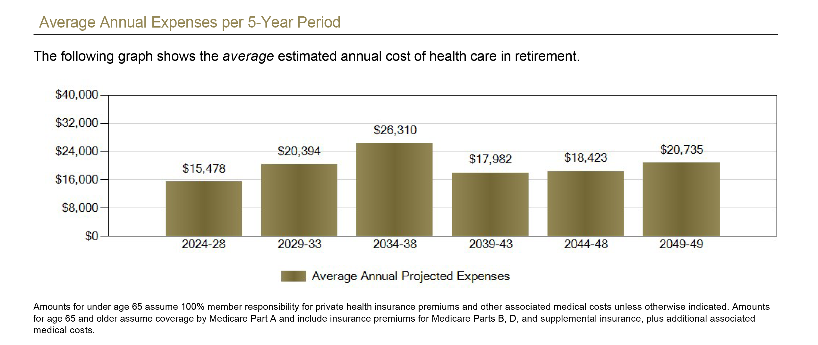
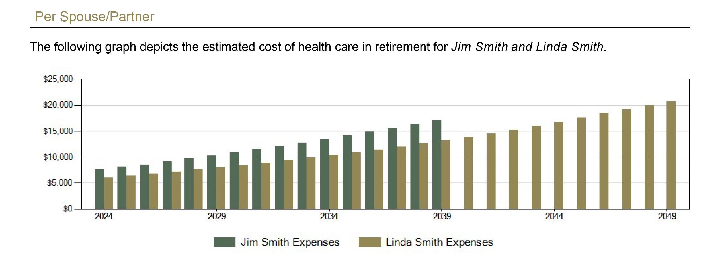
Health Care and LTC Cost Assessment
Health Care and LTC Cost Assessment

Slide 34
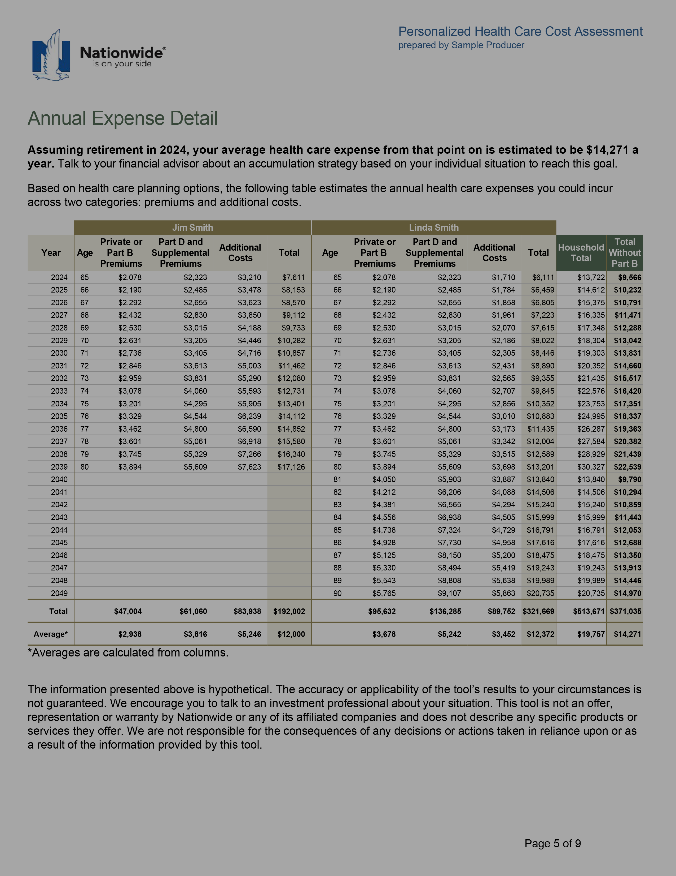
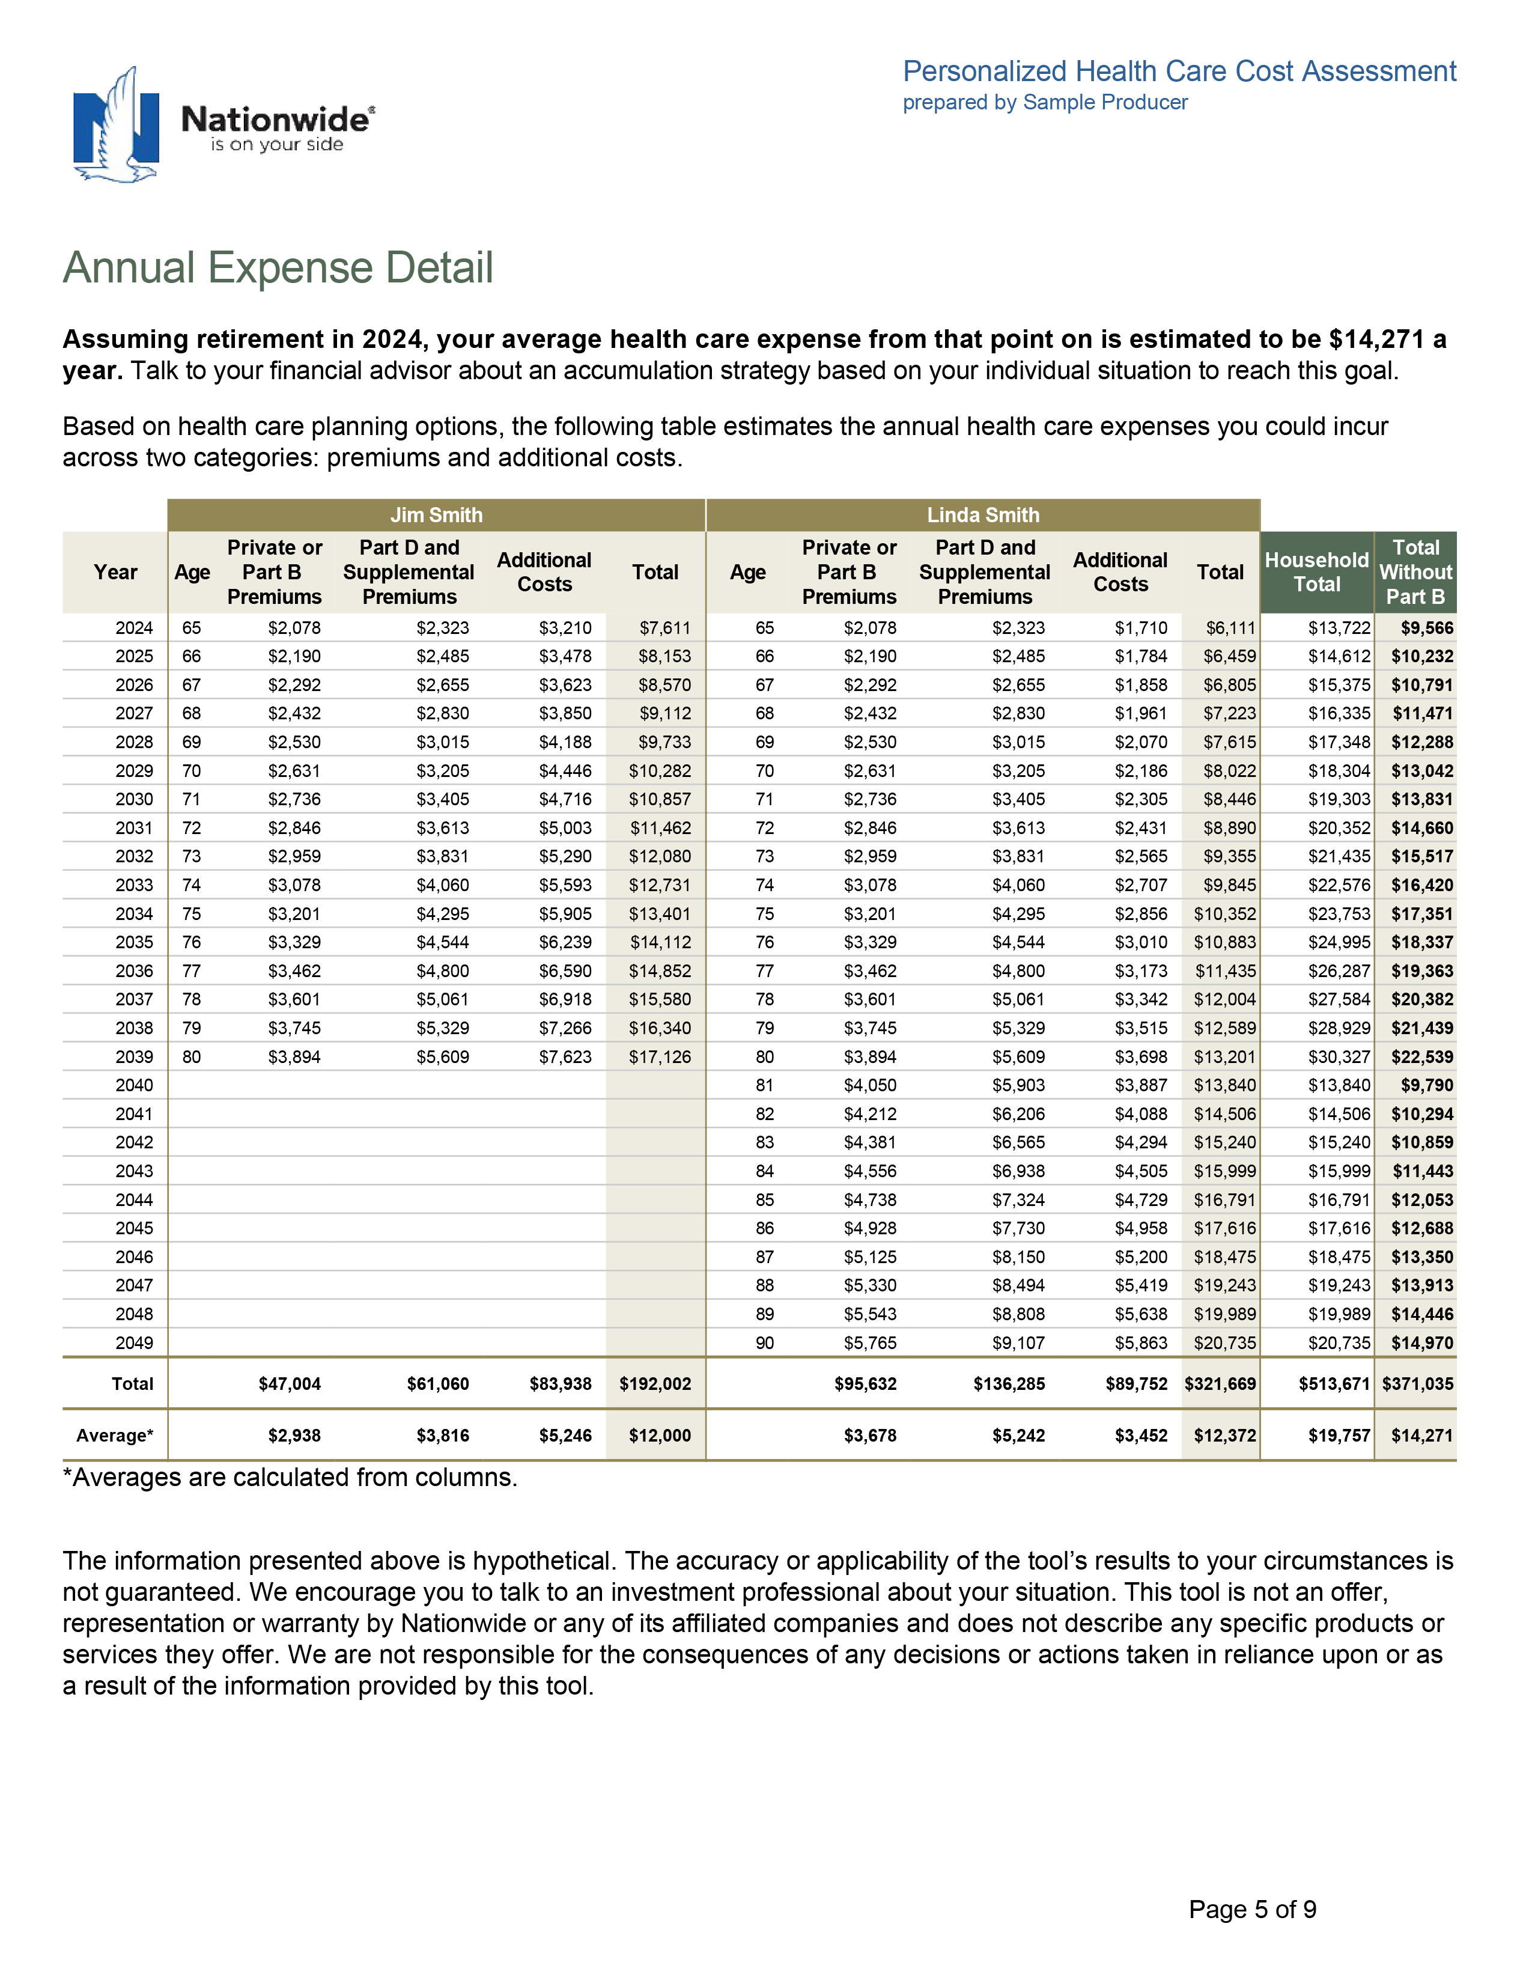
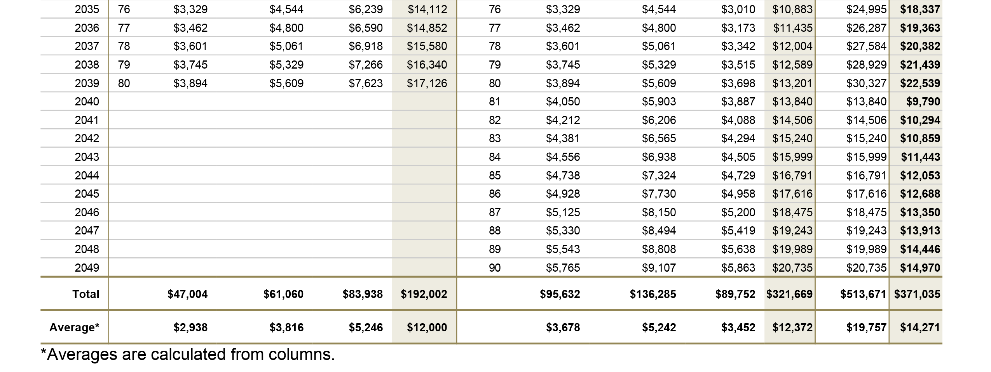
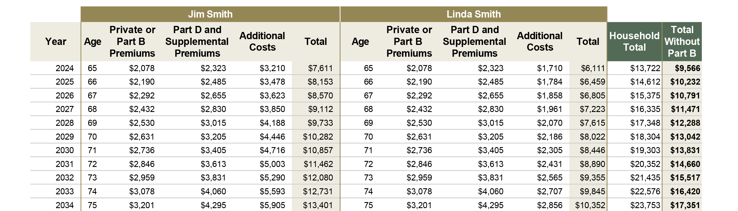
Health Care and LTC Cost Assessment

Slide 35
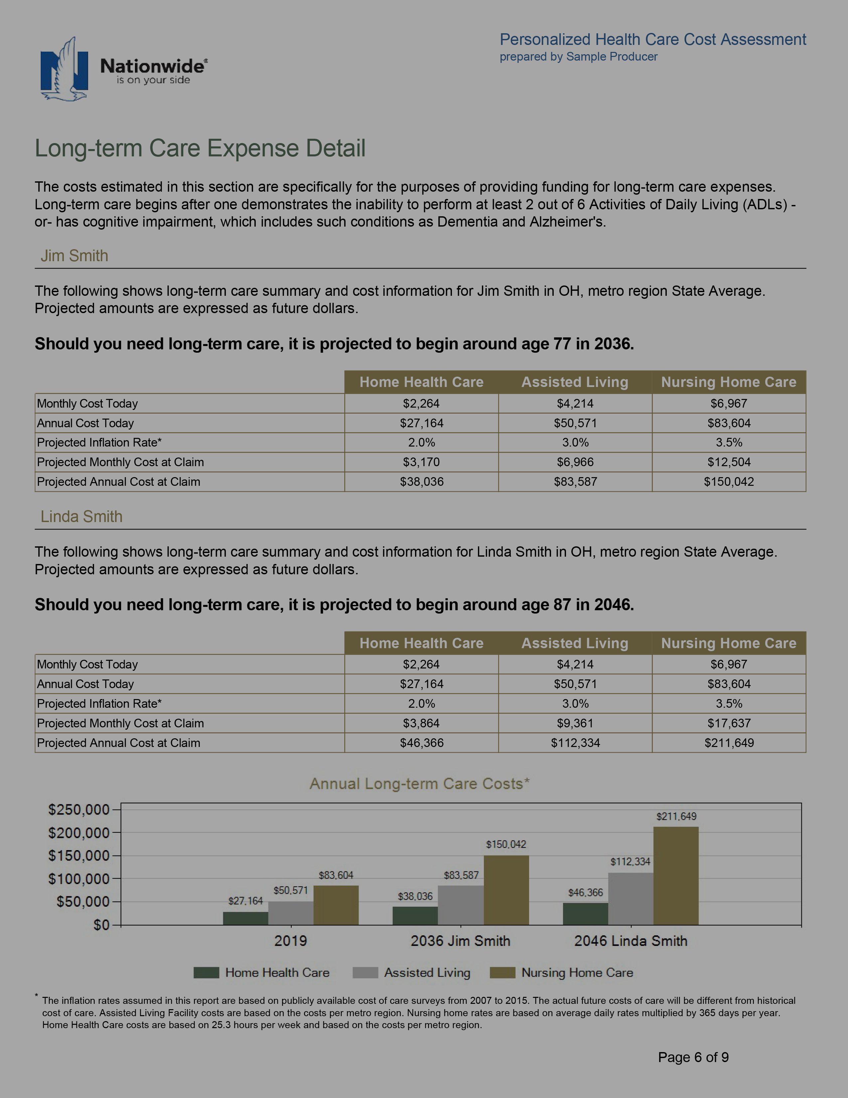
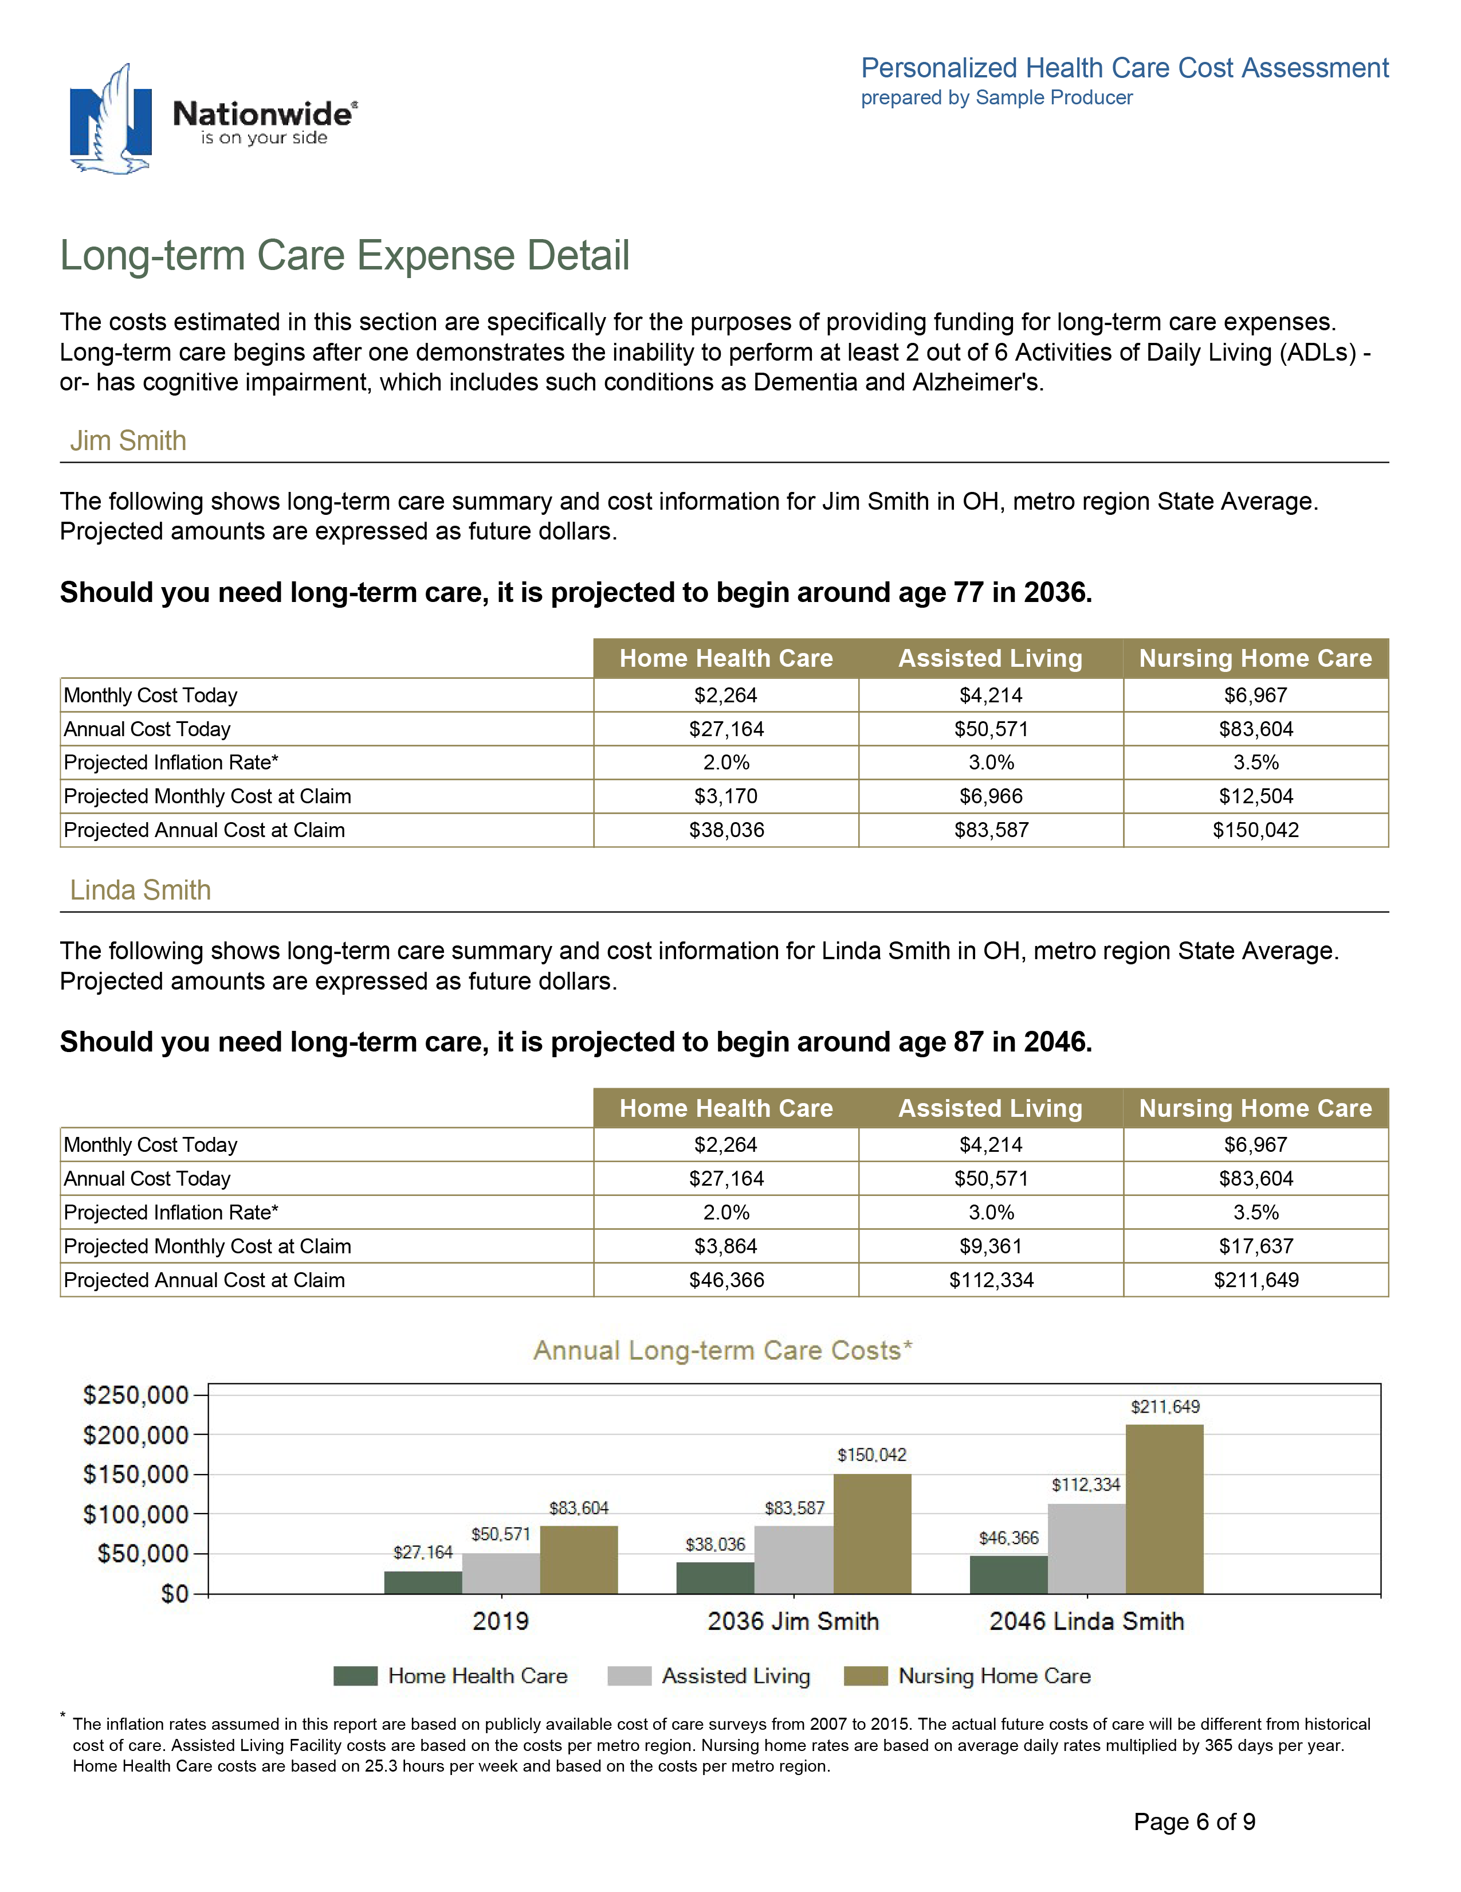
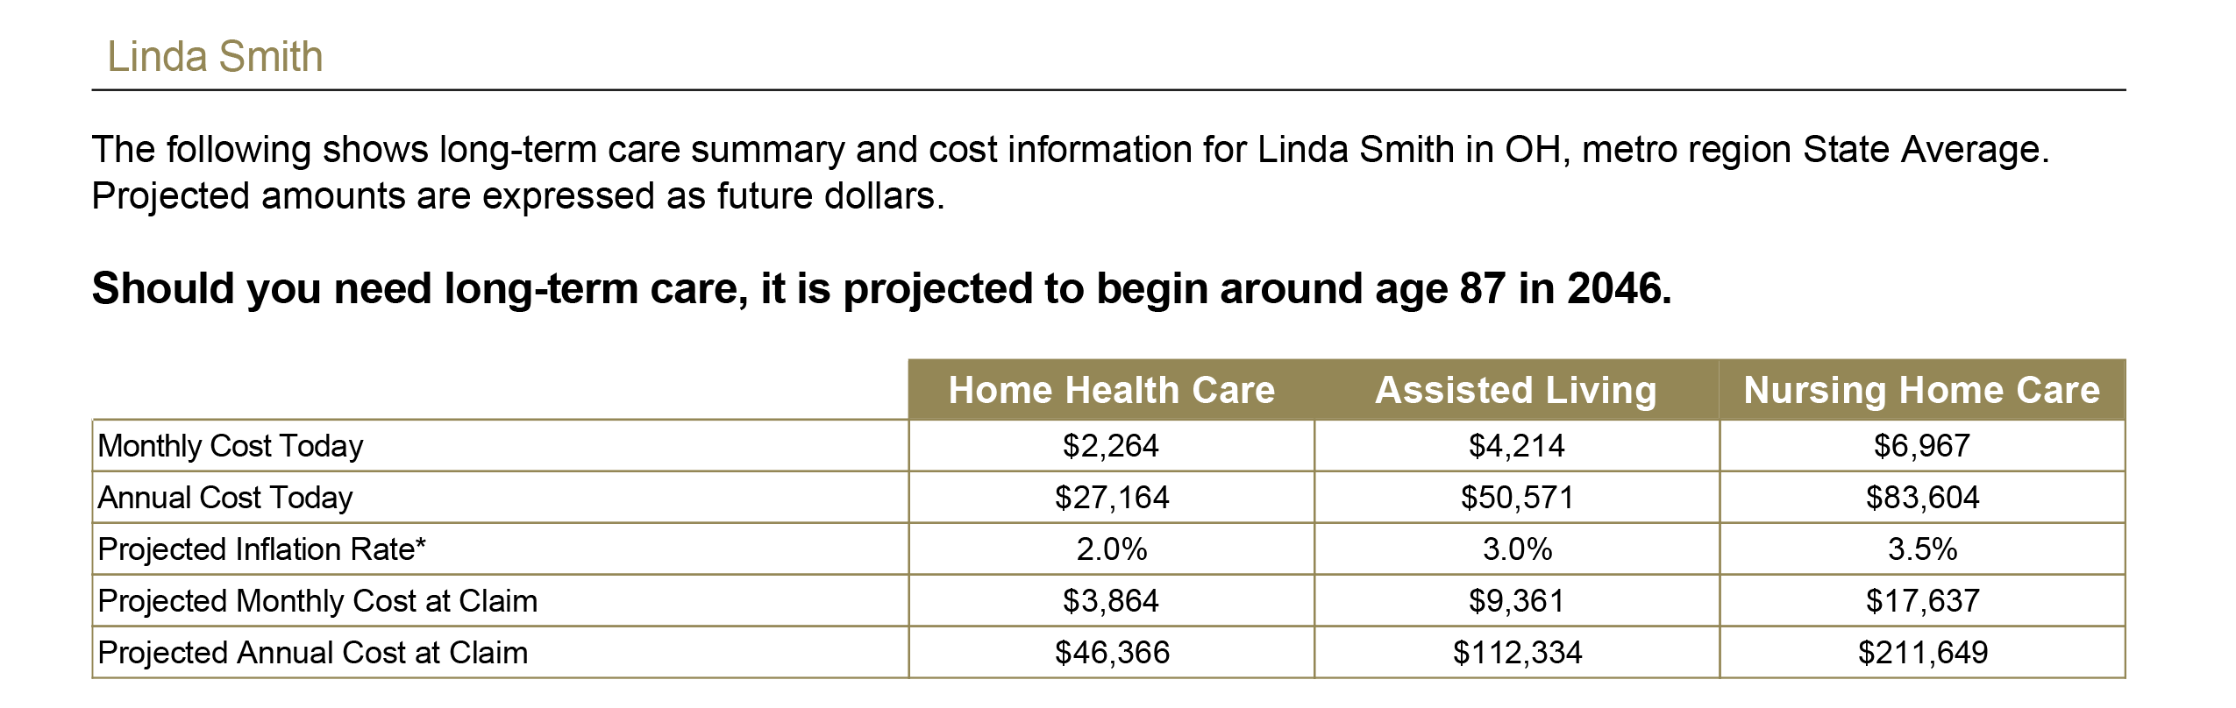

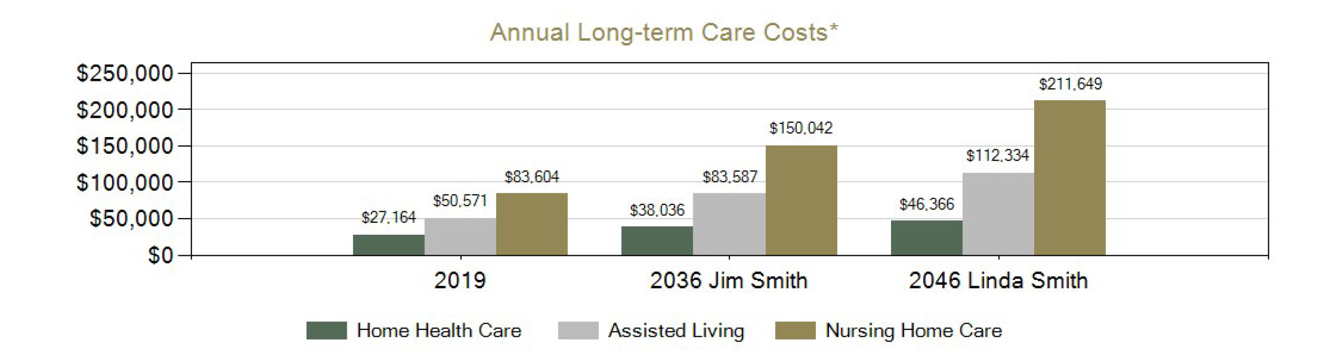
Health Care and LTC Cost Assessment

Slide 36
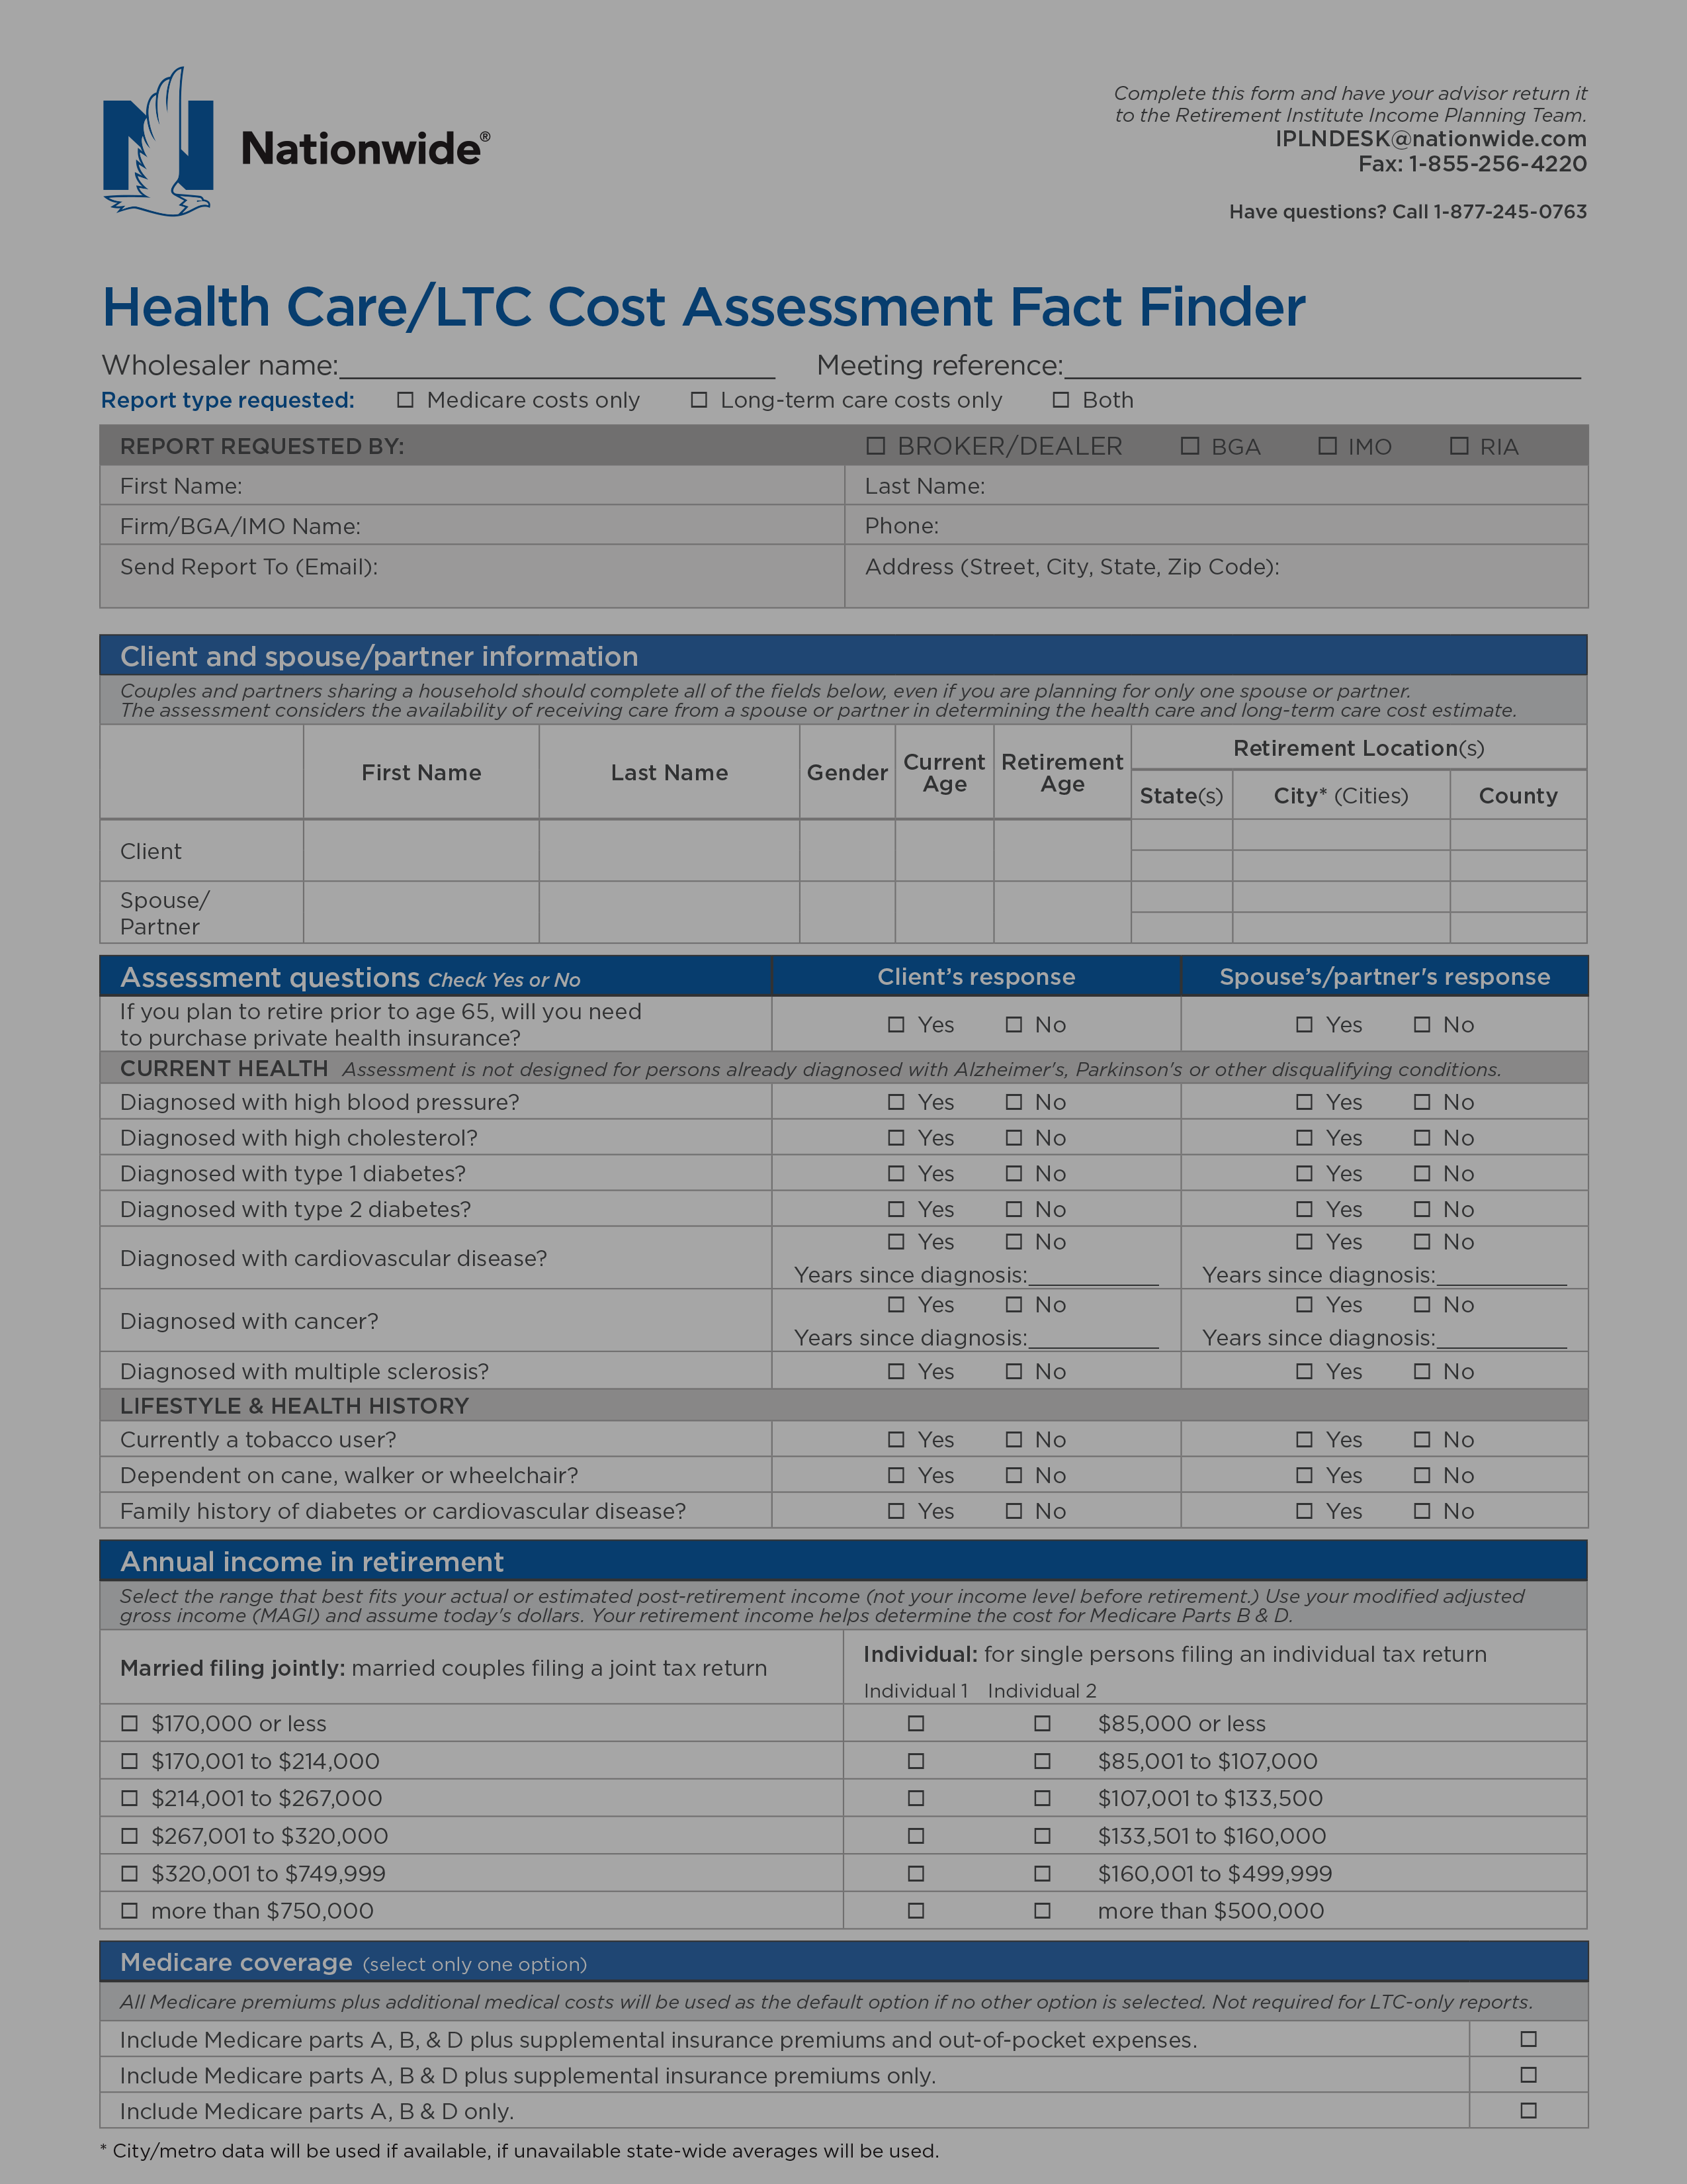
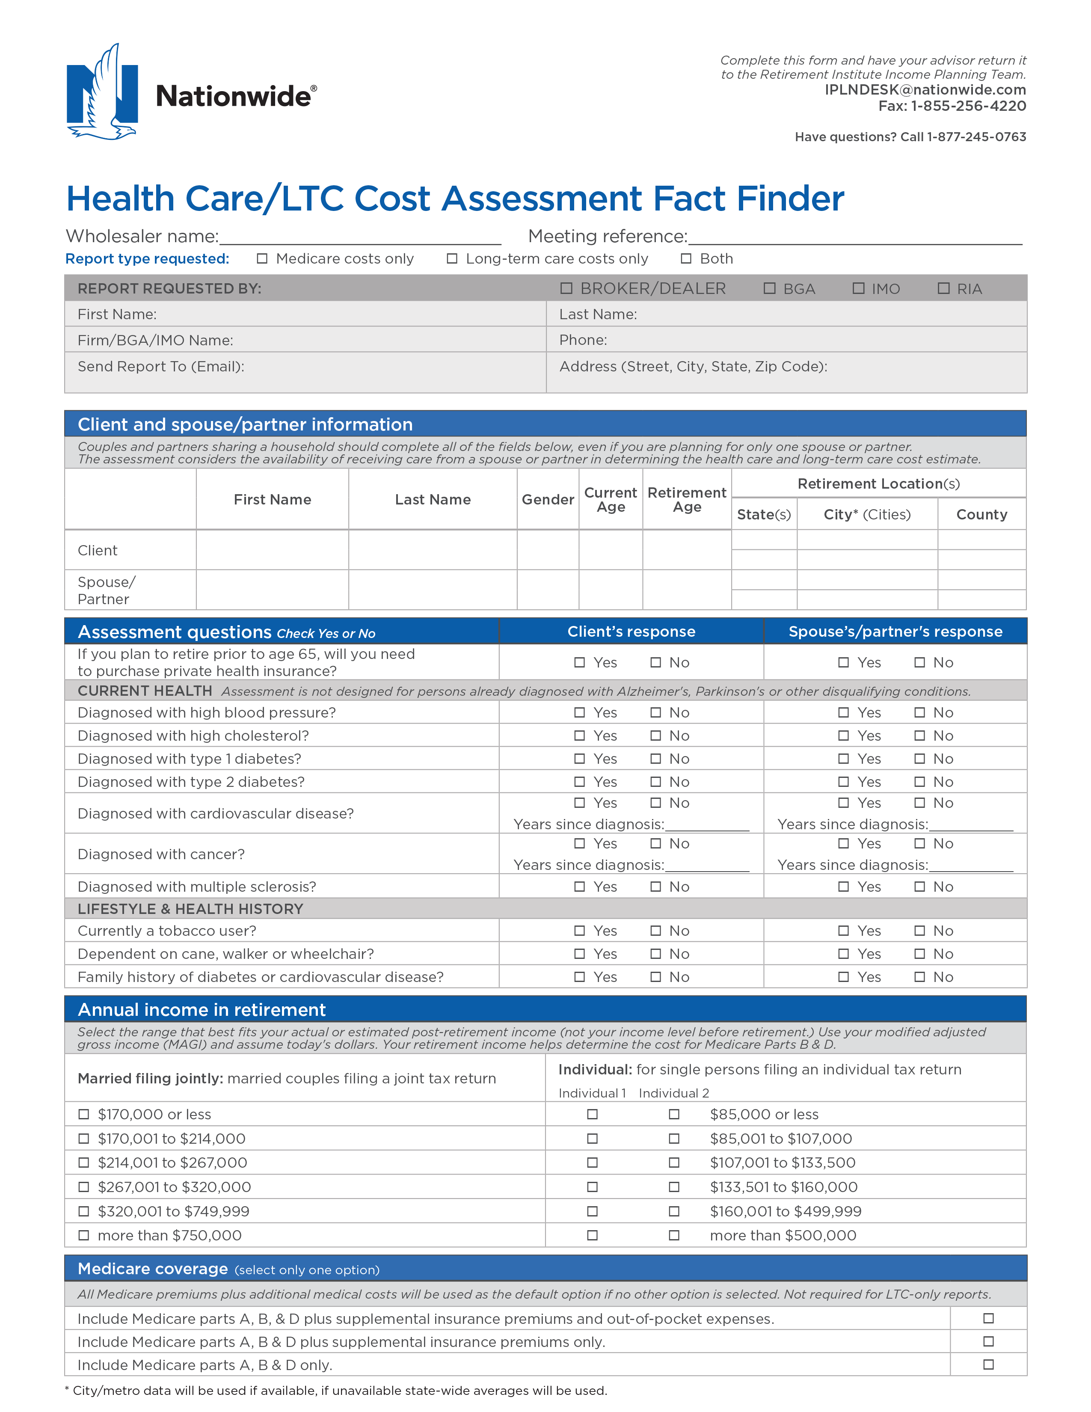
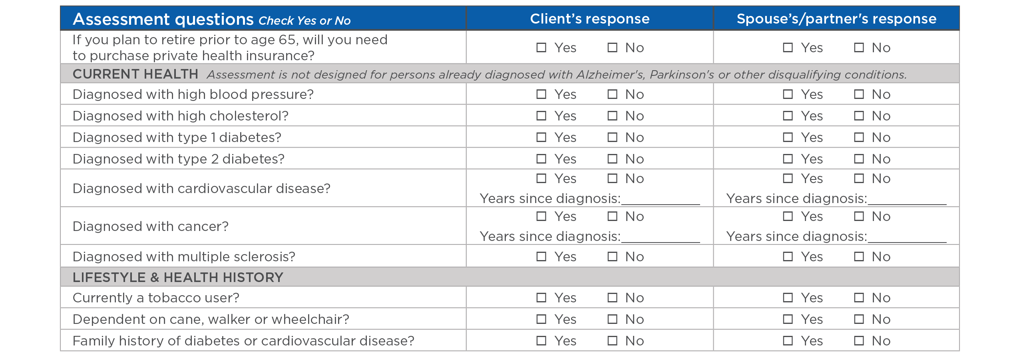

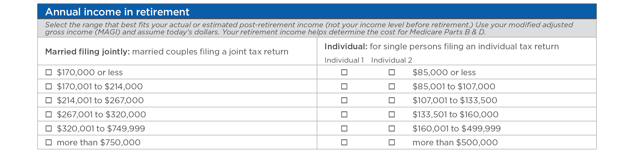
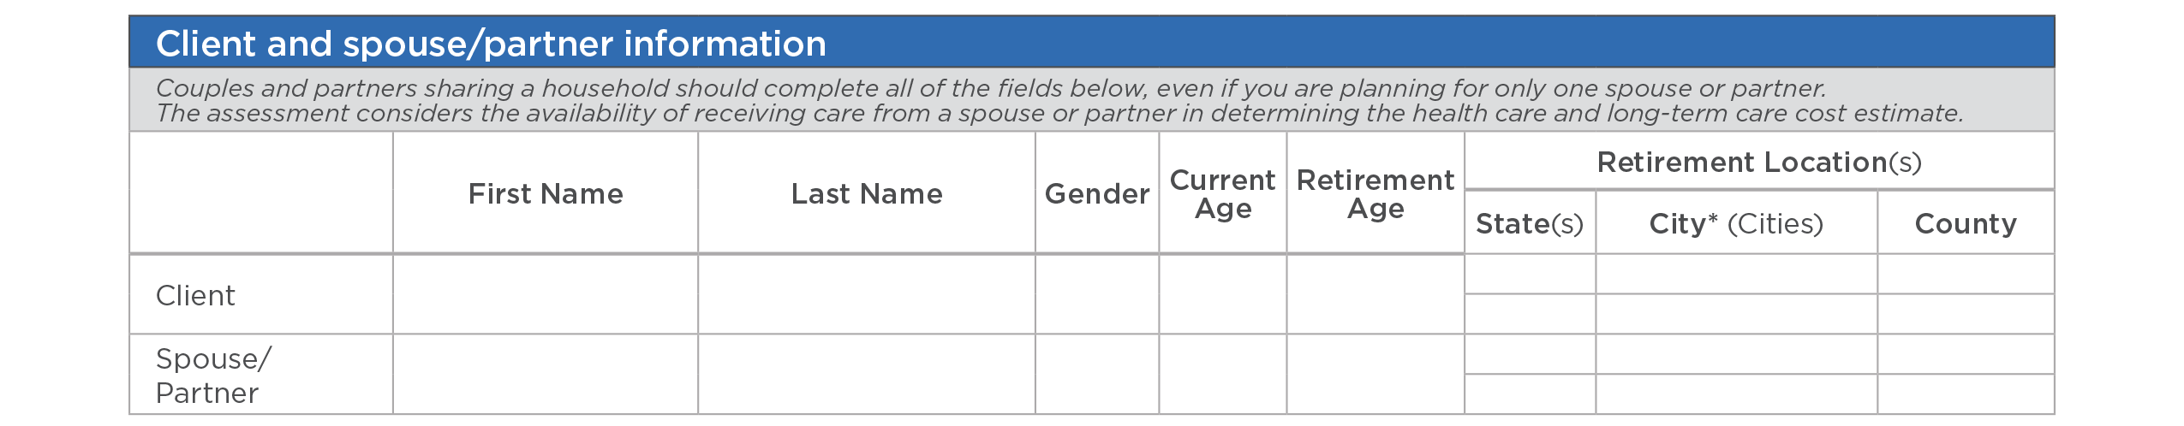
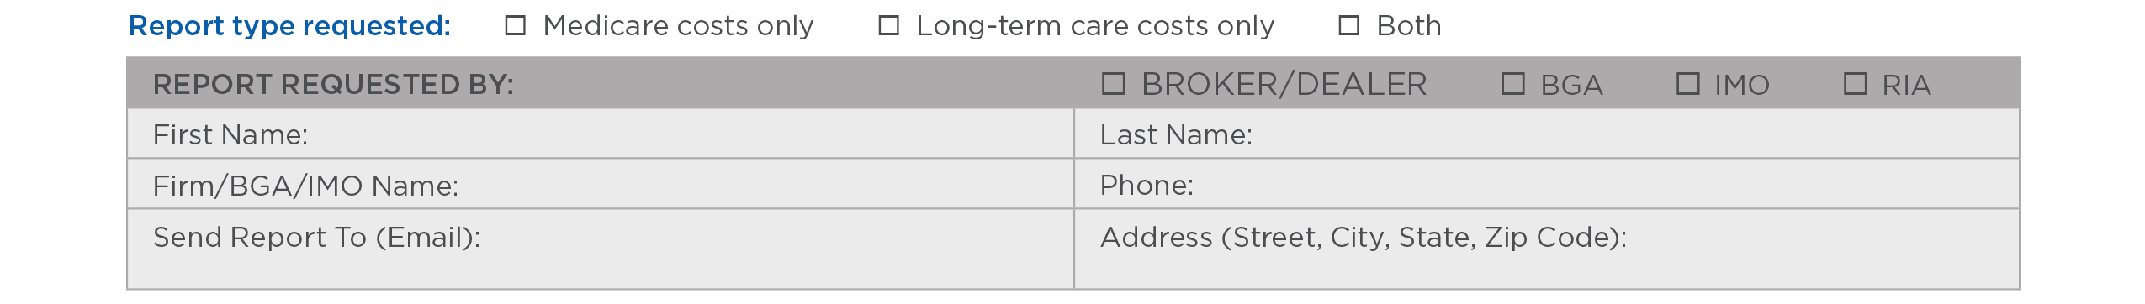
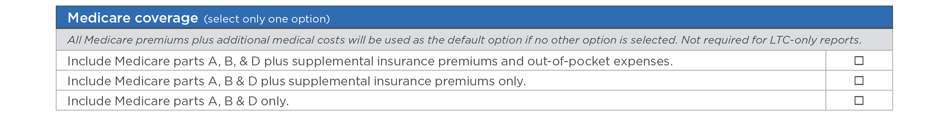
Health Care and LTC Cost Assessment
Notes:
[TALK ABOUT Fact finder]
The information collected on the Health Care Cost Assessment will be kept confidential and used to provide an estimate of your potential health care costs in retirement.
The estimate is based on your specific financial situation and goals, plus your current overall health condition. As your financial situation and health conditions may change over time, these changes may affect future costs. Please keep in mind that the estimates resulting from this fact finder are for hypothetical purposes only and are not guaranteed.

Slide 37
Summary
The retirement income challenge
Understanding health care
Creating a plan to address health care costs
Notes:
Now that we have covered these topics in detail, let’s summarize our discussion:
Retirees face a challenge in creating and managing secure and sustainable income to last throughout retirement
The increasing cost of health care in retirement compounds the retirement income challenge for retirees
To start planning adequately for these likely expenses, it’s important to understand first what Medicare covers and what costs you’re likely to pay in the form of premiums, deductibles and copays
To help you and your advisor plan for retirement health care costs, the Nationwide Personalized Health Care Cost Assessment offers a picture of the costs you’re likely to pay based on your individual health profile and medical history.

