Slide 1



Protecting Your Retirement Income
Transitioning from career earnings to a Lifetime Check by JacksonSM
Jackson® is the marketing name for Jackson National Life Insurance Company® (Home Office: Lansing, Michigan) and Jackson National Life Insurance Company of New York® (Home Office: Purchase, New York).
CMV18767PPT 04/20
Notes:
Welcome. I'm [Presenter Name] with Jackson. Today I want to talk about a topic that seems to be either misunderstood or severely oversimplified among the financial services industry, popular press, and even elite financial professionals—and that is the unique and very real challenge of retirement income planning.

Slide 2
Important Disclosures
Before investing, investors should carefully consider the investment objectives, risks, charges and expenses of the variable annuity and its underlying investment options. The current contract prospectus and underlying fund prospectuses, which are contained in the same document, provide this and other important information. Please contact your financial professional or the Company to obtain the prospectuses. Please read the prospectuses carefully before investing or sending money.
This material was prepared to support the promotion and marketing of Jackson variable annuities. Jackson, its distributors and their respective representatives do not provide tax, accounting or legal advice. Any tax statements contained herein were not intended or written to be used, and cannot be used, for the purpose of avoiding U.S. federal, state or local tax penalties. Please consult your own independent advisor as to any tax, accounting or legal statements made herein.
The latest income date allowed on variable annuity contracts is age 95, which is the required age to annuitize or take a lump sum. Please see the prospectus for important information regarding the annuitization of a contract.
In certain states, we reserve the right to refuse any subsequent premium payments.
Variable annuities are long-term, tax-deferred investments designed for retirement, involve investment risks, and may lose value. Earnings are taxable as ordinary income when distributed and may be subject to a 10% additional tax if withdrawn before age 59½.
Add-on benefits are available for an extra charge in addition to the ongoing fees and expenses of the variable annuity. Only one add-on living benefit and one add-on death benefit may be elected per contract. Once elected, benefits may not be canceled or changed; please see prospectus for specific benefit availability. The long-term advantage of the add-on benefits will vary with the terms of the benefit option, the investment performance of the Variable Investment Options selected, and the length of time the annuity is owned. As a result, in some circumstances the cost of an option may exceed the actual benefit paid under the option.
Guarantees are backed by the claims-paying ability of Jackson National Life Insurance Company or Jackson National Life Insurance Company of New York and do not apply to the principal amount or investment performance of a variable annuity’s separate account or its underlying investments. They are not backed by the broker/dealer from which this annuity contract is purchased, by the insurance agency from which this annuity contract is purchased or any affiliates of those entities, and none makes any representations or guarantees regarding the claims-paying ability of Jackson National Life Insurance Company or Jackson National Life Insurance Company of New York.
Variable Annuities are issued by Jackson National Life Insurance Company (Home Office: Lansing, Michigan) and in New York by Jackson National Life Insurance Company of New York (Home Office: Purchase, New York). Variable annuities are distributed by Jackson National Life Distributors LLC, member FINRA. These contracts have limitations and restrictions. Jackson issues other annuities with similar features, benefits, limitations and charges. Discuss them with your representative or contact Jackson for more information.
Notes:
[Read slide]

Slide 3
Important Disclosures
Morgan Stanley Wealth Management is not affiliated with Jackson National Life Insurance Company.
The views and opinions expressed in this presentation are not necessarily those of Morgan Stanley Wealth Management or any affiliates.
Nothing discussed or suggested in these materials should be construed as permission to supersede or circumvent any Morgan Stanley Wealth Management incorporated policies, procedures, rules, and guidelines. This material should be regarded as educational information and is not intended to provide specific advice. If you have questions regarding your particular situation, you should contact your legal or tax advisors.
Notes:
[Read slide]

Slide 4
Important Disclosures
Investing involves risk including possible loss of principal. Information is current as of the date of this material.
Any opinions expressed herein are from a third party and are given in good faith, are subject to change without notice, and are considered correct as of the stated date of their issue.
Merrill Lynch, Pierce, Fenner & Smith Incorporated is not a tax or legal advisor. Clients should consult a personal tax or legal advisor prior to making any tax or legal related investment decisions.
Bank of America Corporation (“Bank of America”) is a financial holding company that, through its subsidiaries and affiliated companies, provides banking and investment products and other financial services .
Merrill Lynch, Pierce, Fenner & Smith Incorporated (also referred to as “MLPF&S” or “Merrill”) makes available certain investment products sponsored, managed, distributed or provided by companies that are affiliates of Bank of America Corporation (“BofA Corp.”). MLPF&S is a registered broker-dealer, registered investment adviser, Member SIPC and a wholly owned subsidiary of BofA Corp. Merrill Lynch Life Agency Inc. (“MLLA”) is a licensed insurance agency and a wholly owned subsidiary of BofA Corp.
Merrill offers a broad range of brokerage, investment advisory and other services. There are important differences between brokerage and investment advisory services, including the type of advice and assistance provided, the fees charged, and the rights and obligations of the parties. It is important to understand the differences, particularly when determining which service or services to select. The views and opinions expressed in this presentation are not necessarily those of Bank of America Corporation; Merrill Lynch, Pierce, Fenner & Smith Incorporated; or any affiliates. Merrill has not participated in preparing this presentation and accepts no responsibility for the accuracy of the information contained herein. For more information about these services and their differences, speak with your Financial Advisor.
Nothing discussed or suggested in these materials should be construed as permission to supersede or circumvent any Bank of America, Merrill Lynch, Pierce, Fenner & Smith Incorporated policies, procedures, rules, and guidelines. Investment products offered through MLPF&S and insurance and annuity products offered through Merrill Lynch Life Agency Inc.:
Are Not FDIC Insured
May Lose Value
Are Not Bank Guaranteed
Are Not Insured by Any Federal Government Agency
Are Not Deposits
Are Not a Condition to Any Banking Service or Activity
Notes:
[Read slide]

Slide 5
Creating Certainty From Uncertainty
Leaving the guesswork of retirement finances behind and taking a step toward financial freedom
While we can’t predict what the market will do, we can choose how to approach it. There are three key methods for coping with market risk and market loss:
AVOID RISK but eliminate needed potential market gains
REDUCE RISK and reduce potential gains
PROTECT* YOUR INCOME AGAINST RISK while retaining access to market gains
What are variable annuities?
Variable annuities are long-term, tax-deferred investments designed for retirement, involve investment risks, and may lose value. Earnings are taxable as ordinary income when distributed and may be subject to a 10% additional tax if withdrawn before age 59½.
Add-on living benefits are available for an extra charge in addition to the ongoing fees and expenses of the variable annuity and are subject to
conditions and limitations. There is no assurance a variable annuity with an add-on living benefit will provide sufficient supplemental retirement income.
*Guarantees are backed by the claims-paying ability of Jackson National Life Insurance Company or Jackson National Life Insurance Company of New York and do not apply to the principal amount or investment performance of the separate account or its underlying investments.
Notes:
Navigating the pitfalls of retirement planning can be tricky, as the most important factors are also the most difficult for people to predict:
• When will markets fall and when will they grow?
• How long will I live?
We can't predict what the market will do, but we can choose how to approach it.

Slide 6
Creating Certainty From Uncertainty
Leaving the guesswork of retirement finances behind and taking a step toward financial freedom
With Jackson®, you can:
PROTECT your income throughout your retirement. Certainty is possible, regardless of market downturns.
Pursue GROWTH opportunities and invest without fund restrictions.*
*Select up to a maximum of 99 investments and adjust options or allocations up to 25 times each contract year without transfer fees. To prevent abusive trading practices, Jackson restricts the frequency of transfers among Variable Investment Options, including trading out of and back into the same subaccount within a 15-day period.
Notes:
Today, we will focus on the third objective, "Protecting your Income Against Risk" while retaining your access to potential market gains and show you how Jackson can:
(read bullets on slide)

Slide 7
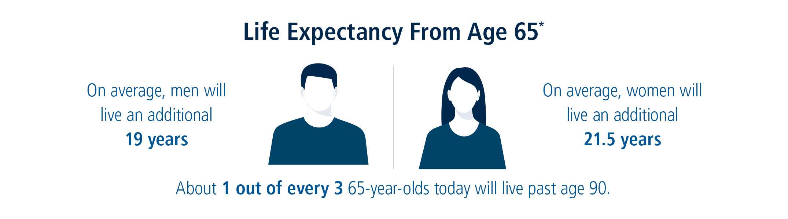
How Long Will You Live?
Thanks to modern medicine, the median life expectancy continues to increase. In fact, there’s a good chance a person will reach age 90.
* Social Security Administration, “Benefits Planner-Life Expectancy,” December 2019.
Notes:
First, let's discuss a few common concerns you may have about retirement. (read slide)

Slide 8
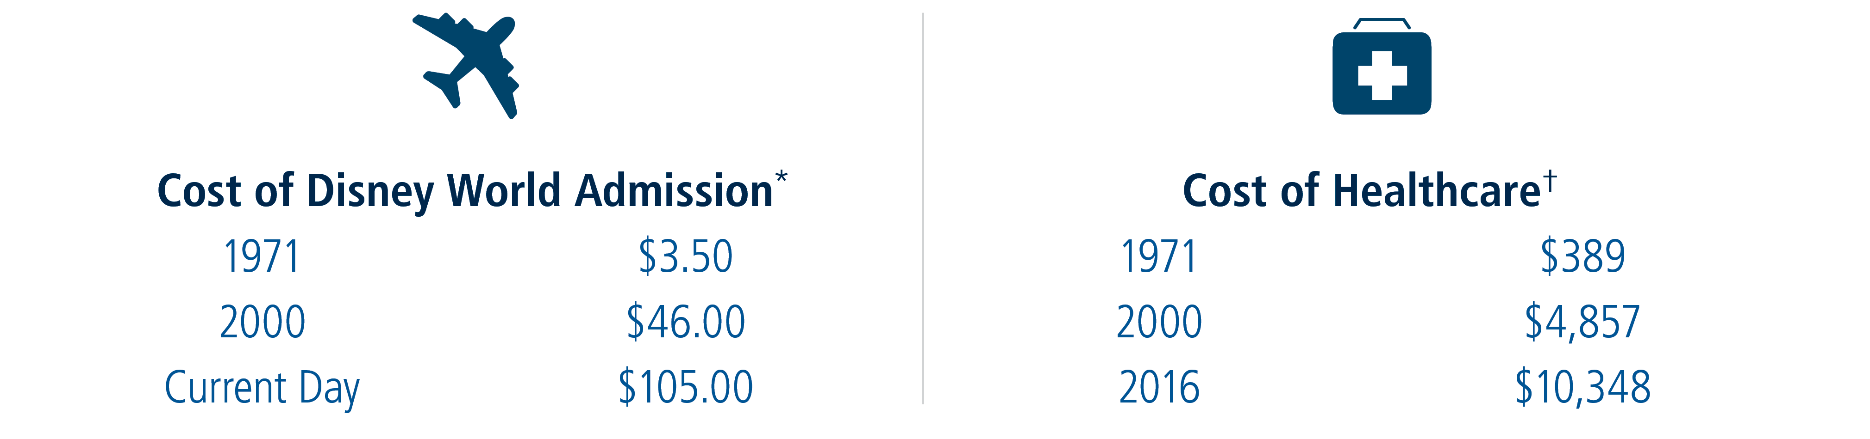
The Cost of Inflation
Living longer presents new challenges
1971
2000
2019
$3.50
$46.00
$125.00
1971
2000
2017
$389
$4,857
$10,739
* Jade Scipioni, CNBC, "How much a Disney World ticket cost the year you were born," August 3, 2019.
† Kimberly Amadeo, The Balance, "The Rising Cost of Health Care by Year and Its Causes," December 7, 2019.
Notes:
Living a long, fulfilling retirement is a goal we all have, but it also presents new challenges. Living longer means retirees may have to deal with the impact of rising costs on activities and expenditures they had originally been counting on, like a trip to Disney World with their grandkids, or paying for healthcare.
Enjoying a longer retirement shouldn’t cause financial hardship. But that could happen. However, together with your financial professional, you can address that.
Let's pause a moment and check in:
What if you could receive a check that would never decrease, could keep pace with inflation and last your entire life, no matter how long you live?

Slide 9
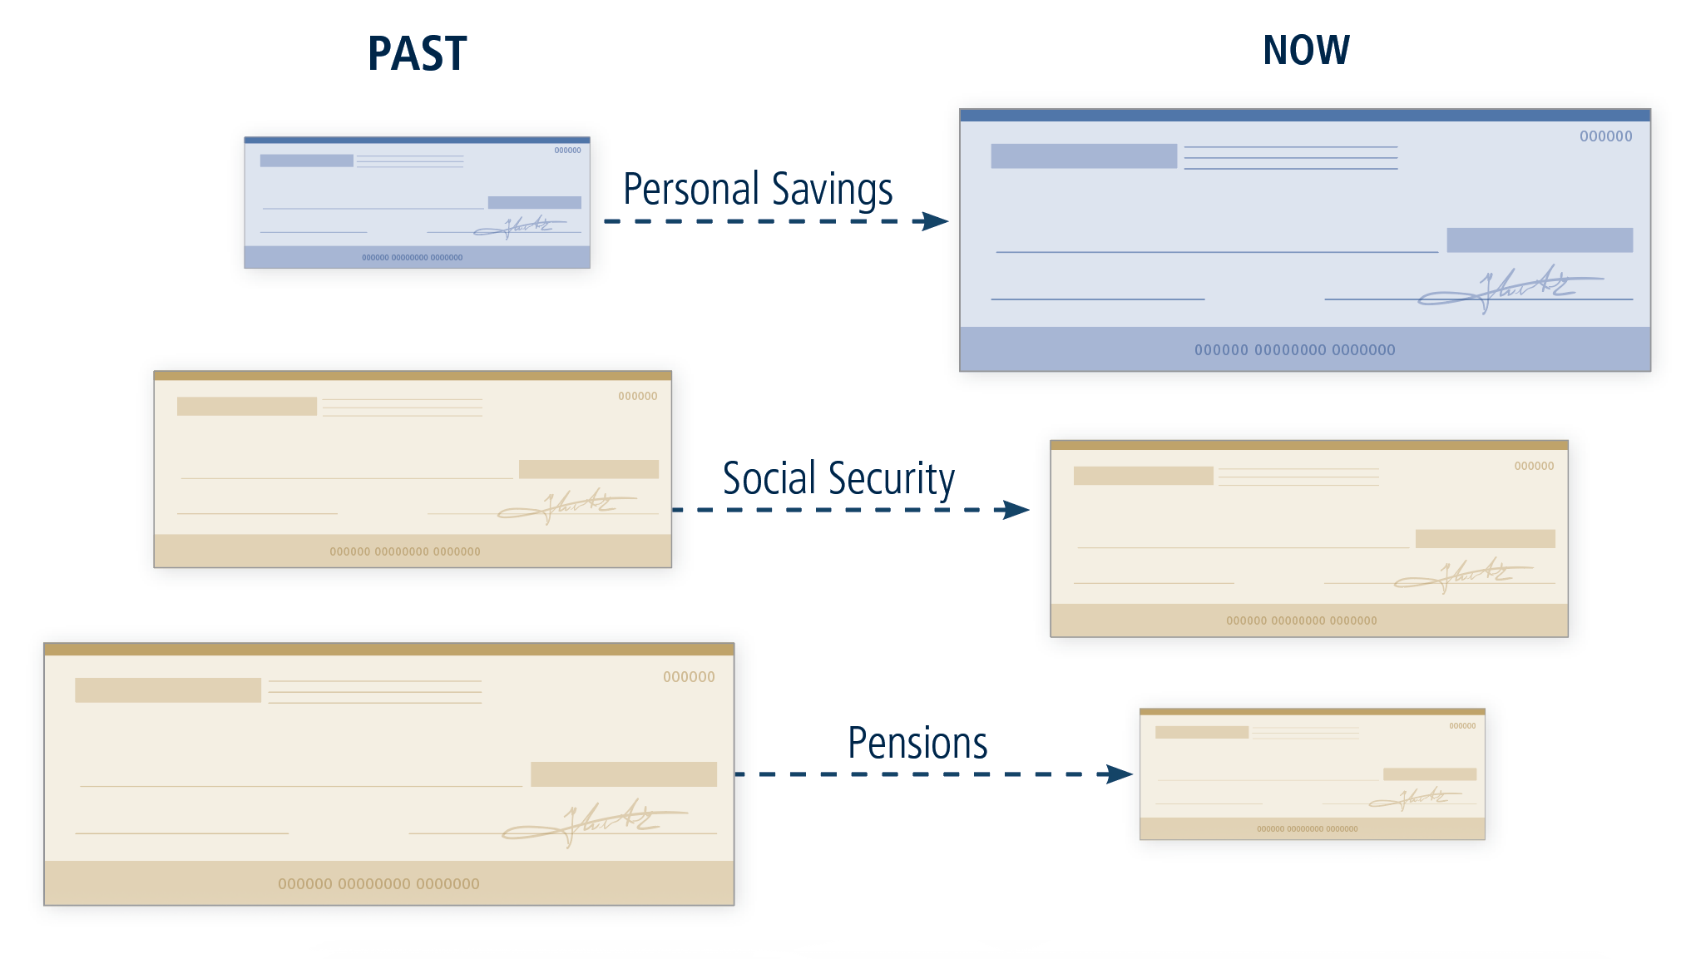
Creating the Retirement You Want
Think of Retirement Income as a Retirement Check
Sources of retirement income that were generally considered protected, such as Social Security* and pensions†, are now disappearing.
*Jeff Reeves, MarketWatch, “Opinion: Collapsing pensions will fuel America’s next financial crisis,” May 17, 2017.
†Kathleen Elkins, CNBC, "A brief history of the 401(k), which changed how Americans retire,” January 4, 2017.
Notes:
When you’re no longer working, you’ll need to rely on different sources of income. Traditional sources include:
Personal Savings
Social Security
Pensions
If you think of retirement income as a retirement check, you can see the past and present are a very different picture. Sources of retirement income that were generally considered protected are now disappearing such as Social Security and pensions.
Do you have a pension? Do you worry that Social Security might not provide enough income for you each month?

Slide 10
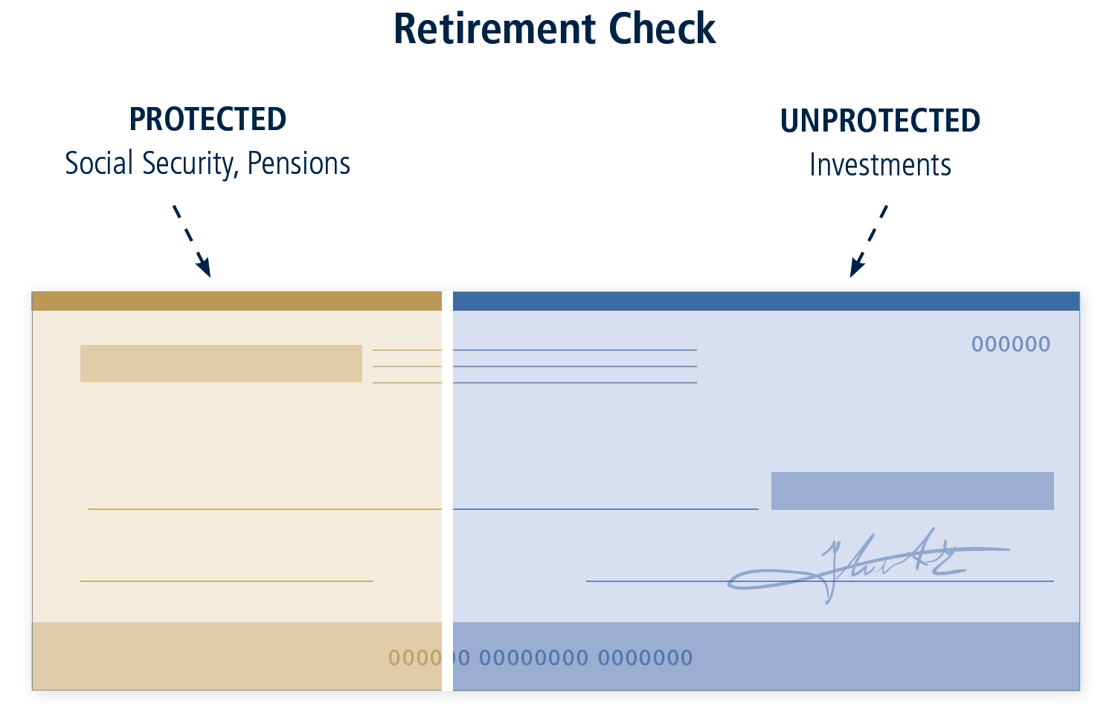
Where Will Your Retirement Check Come From?
Ask yourself:
How much monthly income do I want in retirement?
How much will come from PROTECTED sources?
How much will come from UNPROTECTED investments?
Social Security is estimated to replace only about 40% of the average person’s income.*
*Social Security Administration, "Learn about Social Security Programs," accessed December 2019.
Notes:
With fewer guaranteed sources, a large portion of retirement income will now need to be funded by personal savings.
(read slide)
How much of your projected monthly income in retirement is “protected”? How much would you like to protect?

Slide 11
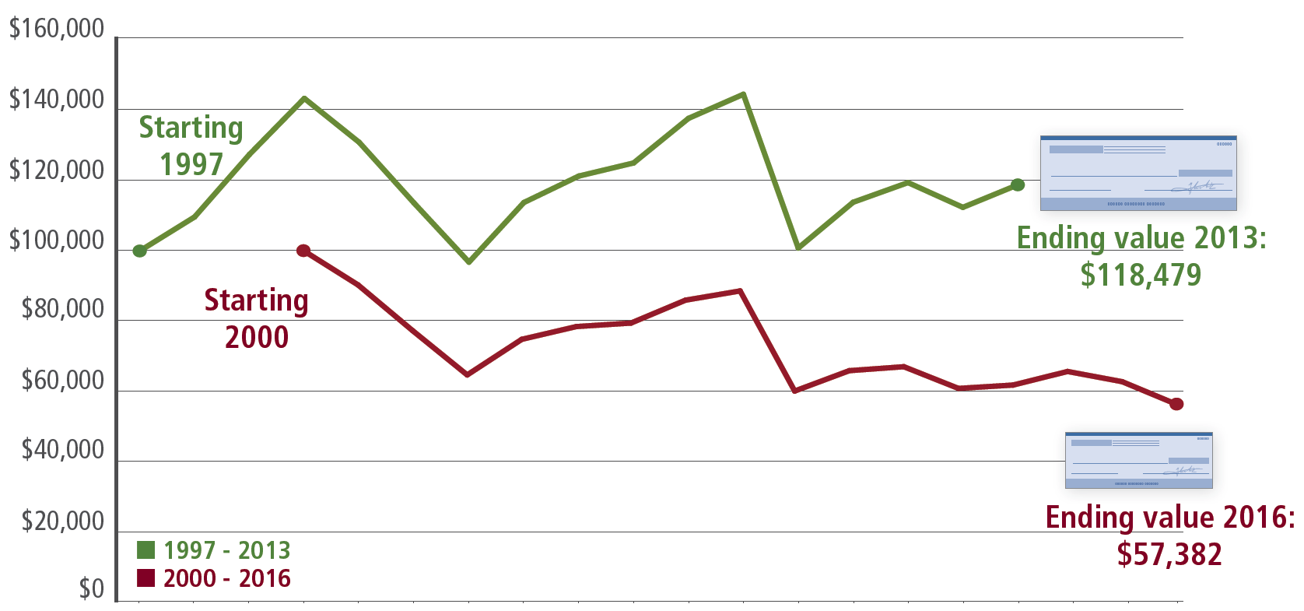
Protecting Income Against Market Losses
Market Cycles Matter
Hypothetical example assumes a 70/30 portfolio with $100,000 starting value and 4% per year withdrawal adjusted for inflation over 15 years.
Source: 70% MSCI World Index, 30% Bank of America Merrill Lynch U.S. Treasury Index. The MSCI World Index is a broad global equity benchmark that represents large and mid-cap equity performance across 23 developed markets countries. The MSCI World Index is unmanaged and not available for direct investment. The Bank of America Merrill Lynch U.S. Treasury Index is an unmanaged index that tracks the performance of the direct sovereign debt of the U.S. Government and is not available for direct investment. This chart is hypothetical, for illustrative purposes only.
This hypothetical is designed to illustrate two investors retiring at different times - one in an up market and one in a down market. It is not representative of the past or future performance of any product. Past performance is no guarantee of future results. An investment cannot be made directly into an index.
Notes:
One of the greatest challenges most retirees face is the possibility of running out of money. Without products such as variable annuities with add-on benefits, retiring at the wrong time can turn this possibility into a reality. Hypothetical example illustrates two investors retiring at different times, one in an up market in 2013 and one three years later in a down market in 2016. The example assumes a 70/30 portfolio with $100,000 starting value and 4% per year withdrawal adjusted for inflation over 15 years.
If you withdraw 4% of your portfolio, it’s potentially less money in a down market than in an up market. What can you do to protect your retirement income in down markets?
Do you know anyone who had to change their plans for retirement because of the stock market crash of September 29, 2008? What if YOU retire at the wrong time?

Slide 12
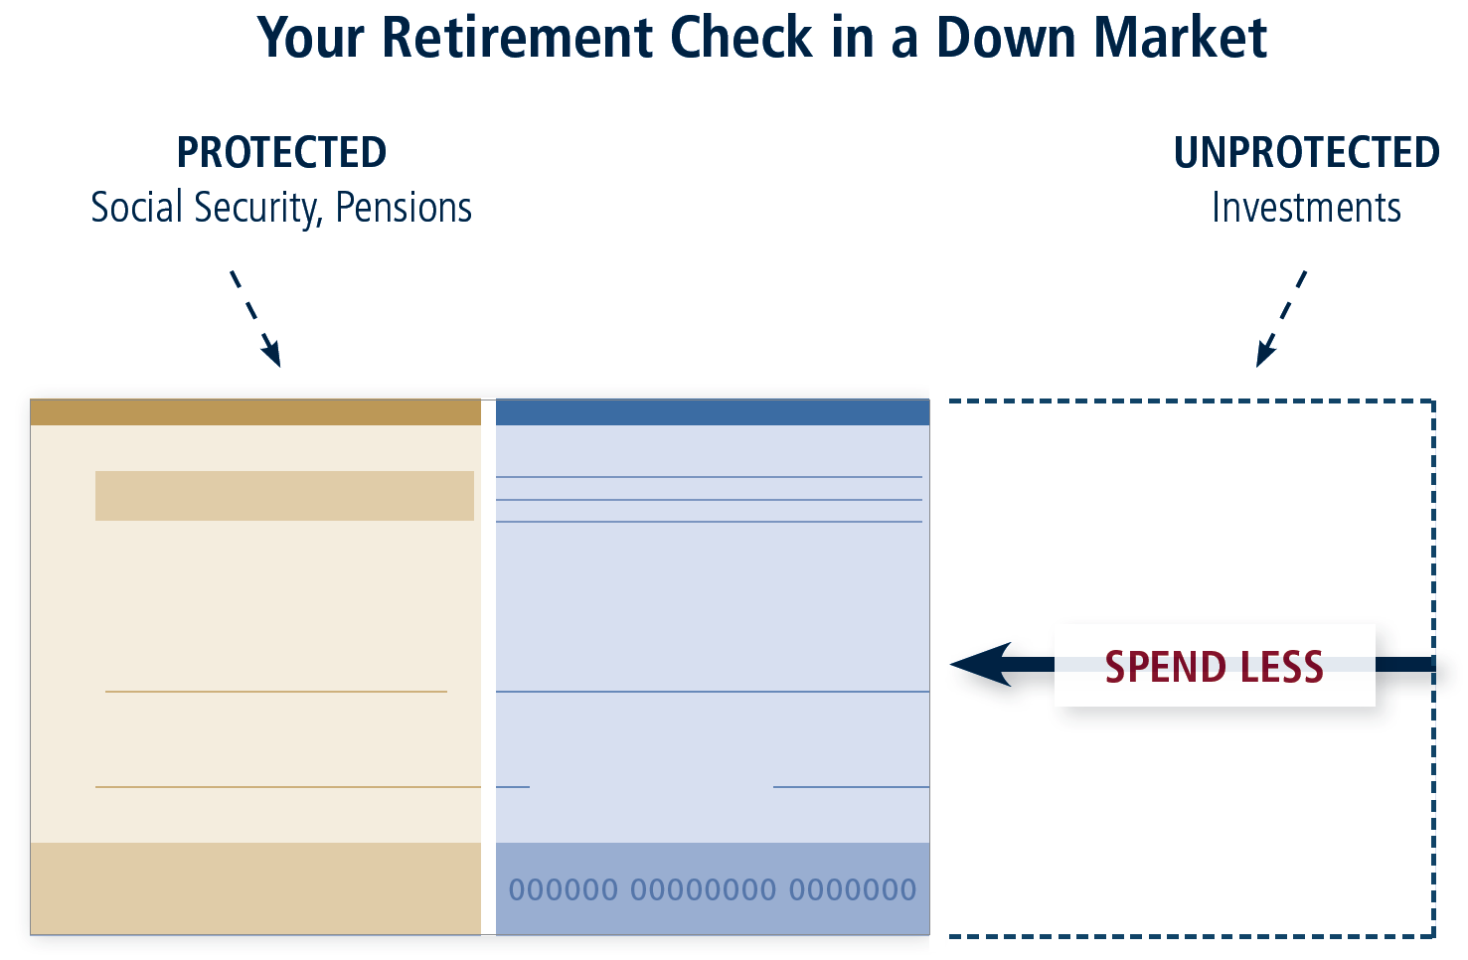
What Are Your Options in Market Downturns?
It could be a difficult choice:
CONTINUE SPENDING at the same rate and increase your risk of running out of money
OR
REDUCE SPENDING and make lifestyle changes
What if you could take a portion of your unprotected investments and turn that into protected income?
Guarantees are backed by the claims-paying ability of Jackson National Life Insurance Company or Jackson National Life Insurance Company of New York and do not apply to the principal amount or investment performance of the separate account or its underlying investments.
Notes:
What happens if you lose money in your investments? Your protected income from a variable annuity with an add-on living benefit won’t be affected. But what about withdrawals from unprotected investments?
It could be a difficult choice:
CONTINUE SPENDING at the same rate and increase your risk of running out of money - or- REDUCE SPENDING and make lifestyle changes?
Your retirement check in a down market could take a portion of your unprotected investments and turn that into protected income. Help overcome one of the greatest challenges. Protecting your retirement check means even if your investment loses value, your income never decreases OR runs out.

Slide 13
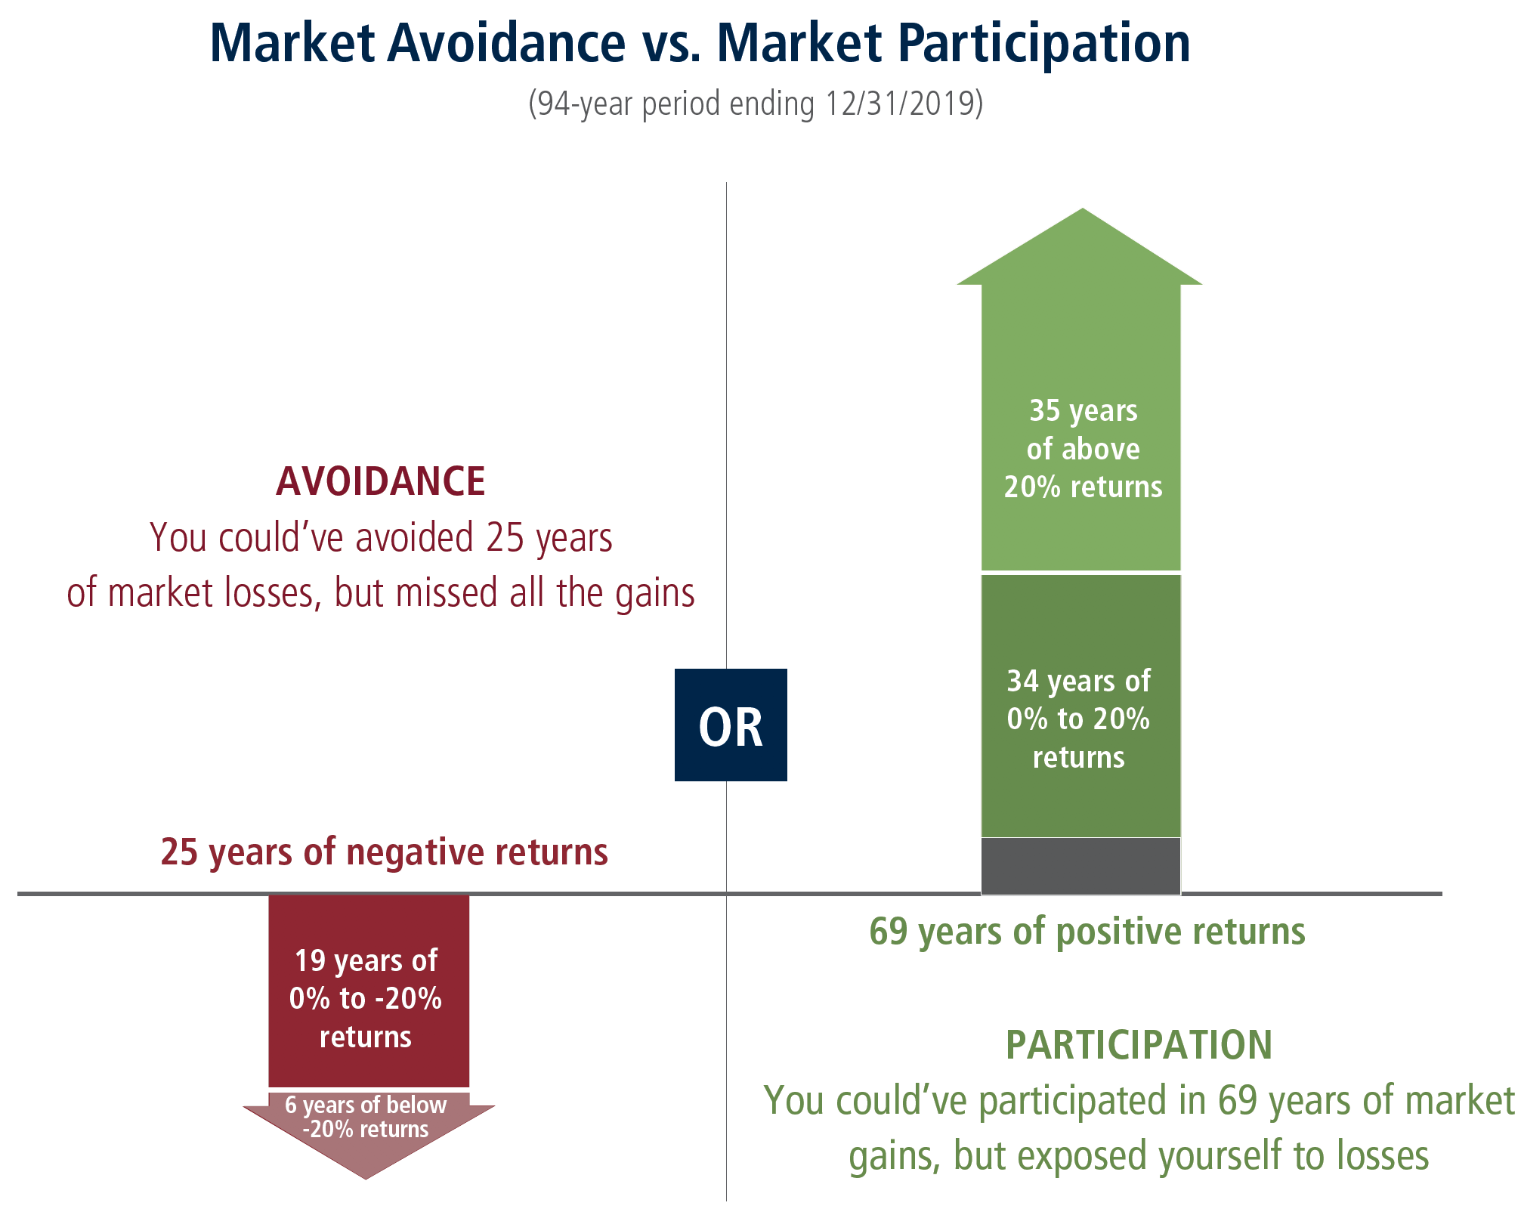
Growing Your Market Potential
Your retirement might last 30 years or more. To keep up with inflation and rising healthcare costs, market growth isn’t a luxury—it’s a necessity.
There’s good news for your long-term investment: History has been on your side.
Past performance is no guarantee of future results.
Source: Ibbotson Associates SBBI Data, Ibbotson SBBI US Large Stock Index for the 94-year period ending 12/31/2019. ©2020 Morningstar, Inc. All rights reserved. Used with permission. Ibbotson Associates, as of January 2020.
Large company stock performance is derived from the Ibbotson SBBI US Large Stock TR and includes the re-investment of dividends with no fees assessed.
Chart is for illustrative purposes only and is not representative of the performance of any particular portfolio, security, or strategy.
An investment cannot be made directly in an index.
Lifetime income of the add-on lifetime benefits becomes effective at issue if the designated life is age 59½ at issue, or upon the contract anniversary following designated life’s 59½ birthday, provided the contract value is greater than zero and has not been annuitized.
Notes:
(read slide)
What if you could invest in a vehicle that allowed potential for market growth and protected your retirement check against market losses?

Slide 14
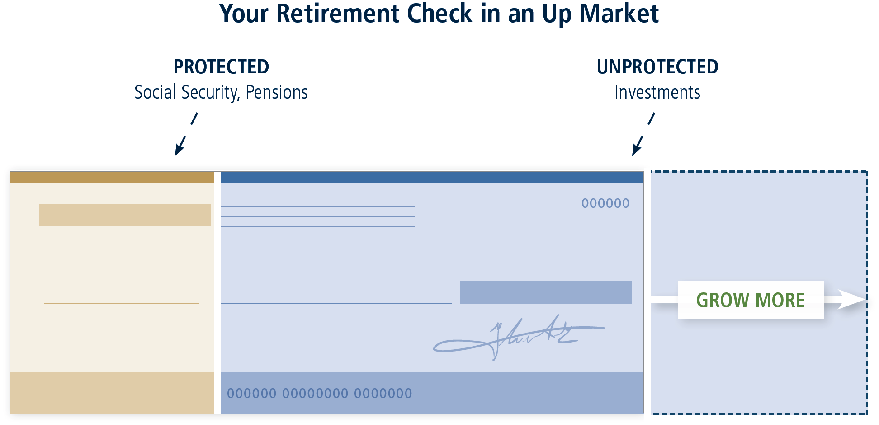
What Can Market Upswings Do for You?
Market growth that increases the value of unprotected investments can mean a potentially bigger retirement check.
Guarantees are backed by the claims-paying ability of Jackson National Life Insurance Company or Jackson National Life Insurance Company of New York and do not apply to the principal amount or investment performance of the separate account or its underlying investments.
Notes:
Market growth can support the common investment goals of increasing retirement income and keeping pace with inflation over time. (read slide)
Some retirement products not only allow the opportunity for market growth but they can lock it in and protect it too. Growth + Protection = More Income Potential.

Slide 15
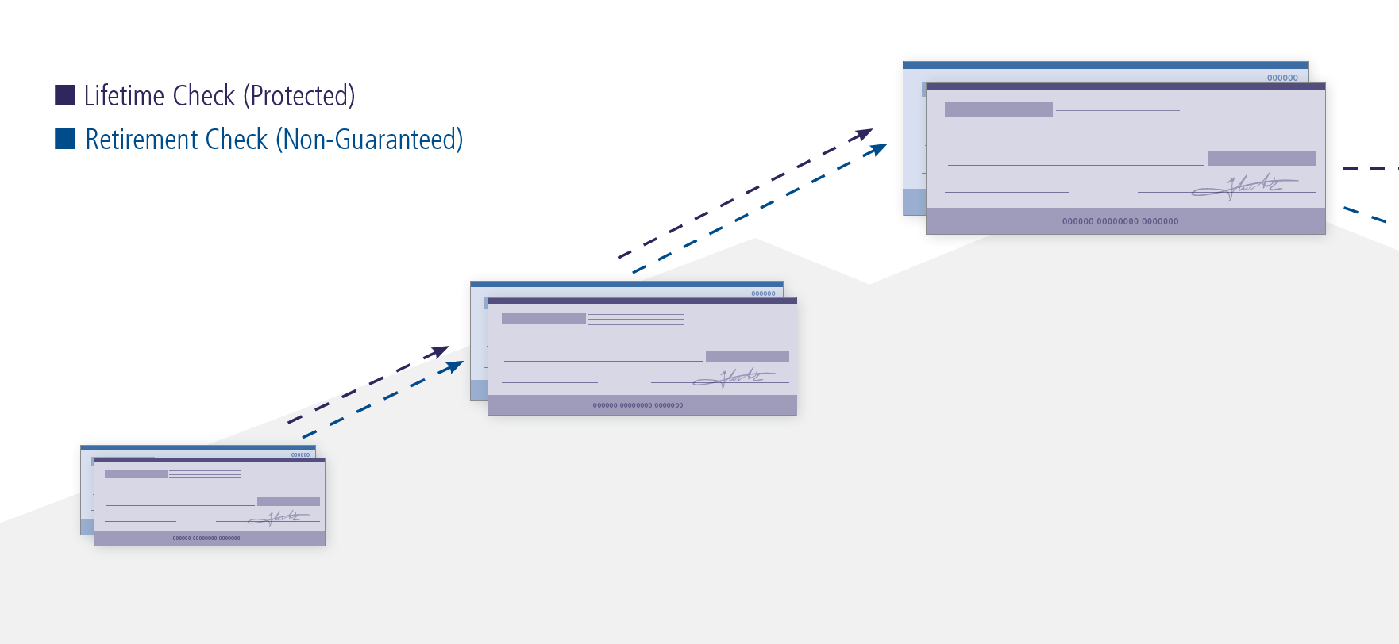
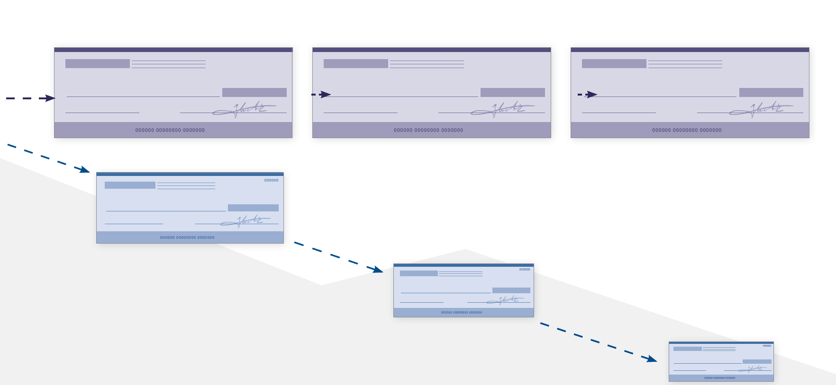
Offering Growth and Protection
How a Lifetime CheckSM compares to a retirement check
When the market grows, both checks participate in market gains.
Growth
Protection
Guarantees are backed by the claims-paying ability of Jackson National Life Insurance Company or Jackson National Life Insurance Company of New York and do not apply to the principal amount or investment performance of the separate account or its underlying investments.
When the market goes down, the Lifetime Check is protected, but the Retirement Check is not.
Lifetime income of the add-on lifetime benefits becomes effective at issue if the designated life is age 59½ at the issue, or upon the contract anniversary following designated life’s 59½ birthday, provided the contract value is greater than zero and has not been annuitized.
Notes:
A variable annuity can offer growth and income protection – growth through investment options and lifetime income protection through add-on living benefits that are available at an additional charge. So, instead of receiving a Retirement Check from non-guaranteed sources of income, you could receive a Lifetime Check by Jackson providing protected income. How important is the opportunity for market growth to you? With a diverse variable annuity investment platform and no investment allocation restrictions, Jackson offers true investment freedom.
Some retirement products not only allow the opportunity for market growth but they can lock it in and protect it too. Growth + Protection = More Income Potential.

Slide 16
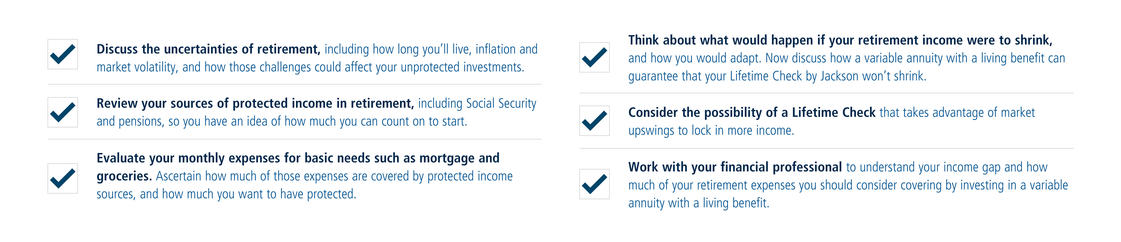
Partnering With Your Financial Professional
Your Checklist Toward Financial Freedom
Notes:
You have questions. Financial professionals have answers. A financial professional can help you make smart, long-term choices and find options you may not even know exist. They can help you create a customized retirement plan, and can also help you stick to that plan. Your financial professional may also be able to help you with tax-efficient investments and planning your legacy. Can you imagine working on your own to navigate all of the potential pitfalls related to retirement planning? A financial professional can help.

Slide 17
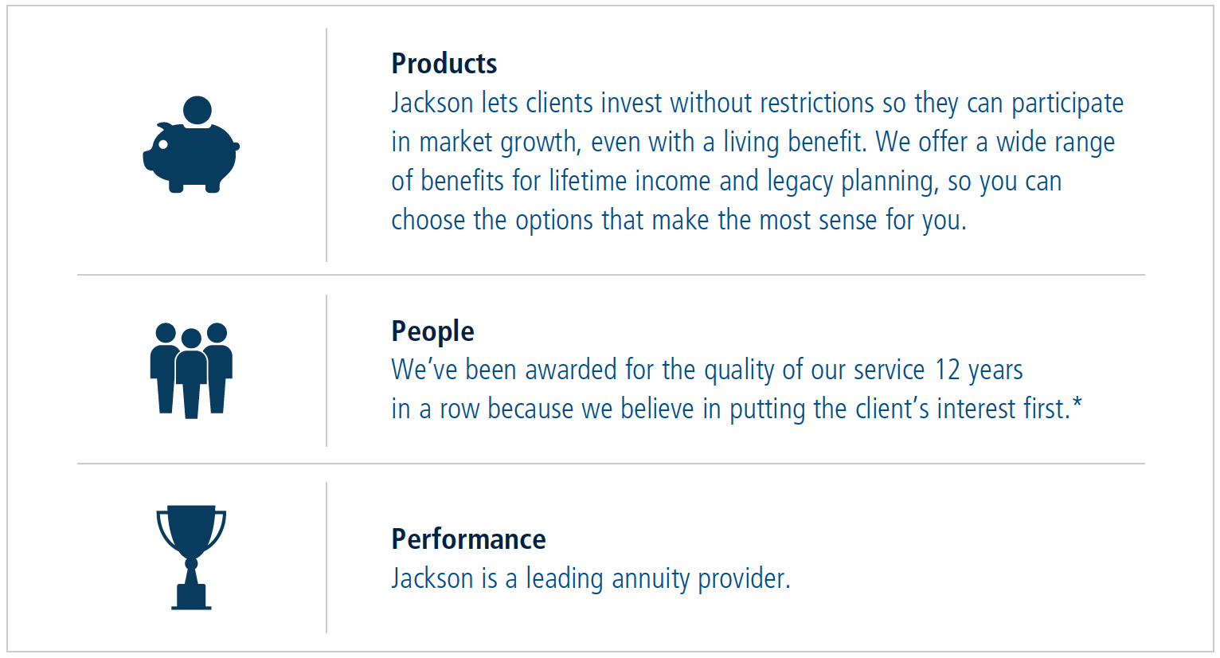
Choosing Jackson as Your Annuity Provider
Products
Jackson lets clients invest without restrictions to allow participation in market growth, even with a living benefit. We offer a wide range of benefits for lifetime income and legacy planning, so you can choose the options that make the most sense to you.
People
We’ve been awarded for the quality of our service 14 years in a row.*
Performance
Jackson is a leading annuity provider.
*Service Quality Measurement (SQM) Group, Call Center Industry Awards Program for 2004 and 2006-2019.
Notes:
At Jackson, we believe everyone deserves the opportunity to live life well, and not outlive their money. Jackson is committed to helping people achieve financial freedom so they can live the lives they want. I will leave you with one last closing thought: Could a variable annuity that allows potential for market growth and income protection benefit you? Both features can exist in the same account.

Slide 18

Go. Enjoy Your Retirement.
A Lifetime Check by Jackson can help you focus on the retirement you’ve earned. Partner with your financial professional to see how a variable annuity can fit into your comprehensive financial plan for today, tomorrow, and what’s next. Thank you.
JACKSON.COM
CMV18767PPT 04/20
Notes:
[Read slide]

