Slide 1

[When presenting in AR, CA, OK, TX or IL, use the phrase “Insurance Sales Presentation.” In CA and AR, add License Number]
Issued by Pruco Life Insurance Company and by Pruco Life Insurance Company of New Jersey.
[Firm Logo(s)]
1003323-00007-00 Ed. 9/2019
Notes:
[REMOVE SLIDE WHEN USING FOR BANK FIRM OR CHASE].
Welcome. My name is _______________. Today we are going to talk about some of the income challenges you might face in retirement. Just know that you are not alone in facing them. Every one of us will face any number of these challenges.

Slide 2
INVESTMENT AND INSURANCE PRODUCTS ARE: NOT FDIC INSURED NOT INSURED BY ANY FEDERAL GOVERNMENT AGENCY NOT A DEPOSIT OR OTHER OBLIGATION OF, OR GUARANTEED BY, THE BANK OR ANY OF ITS AFFILIATES SUBJECT TO INVESTMENT RISKS INCLUDING POSSIBLE LOSS OF THE PRINCIPAL AMOUNT INVESTED
Prudential Annuities®
Meeting Today’s Retirement Income Challenges
[Presenter Name], [Presenter Title]
Issued by Pruco Life Insurance Company and by Pruco Life Insurance Company of New Jersey.
1003323-00003-00 Ed. 3/2019
Notes:
[REQUIRED SLIDE FOR JP MORGAN CHASE AND CITIBANK. REMOVE WHEN USING FOR ALL OTHER FIRMS]
Welcome. My name is _______________. Today we are going to talk about some of the income challenges you might face in retirement. Just know that you are not alone in facing them. Every one of us will face any number of these challenges.

Slide 3
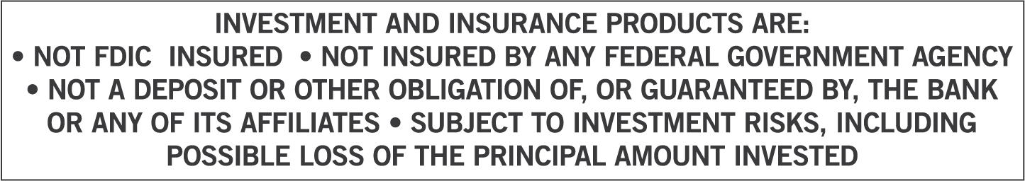
Issued by Pruco Life Insurance Company and by Pruco Life Insurance Company of New Jersey.
[When presenting in AR, CA, OK, TX or IL, use the phrase “Insurance Sales Presentation.” In CA and AR, add License Number]
1003323-00003-00 Ed. 3/2019
Notes:
[REQUIRED SLIDE FOR JP MORGAN CHASE AND CITIBANK. REMOVE WHEN USING FOR ALL OTHER FIRMS]
Welcome. My name is _______________. Today we are going to talk about some of the income challenges you might face in retirement. Just know that you are not alone in facing them. Every one of us will face any number of these challenges.

Slide 4
[Required For Merrill Lynch Events Only]
Investing involves risk including possible loss of principal. Information is current as of the date of this material and subject to change.
Any opinions expressed herein are from a third party and are given in good faith, are subject to change without notice, and are considered correct as of the stated date of their issue.
Merrill Lynch, Pierce, Fenner & Smith Incorporated is not a tax or legal advisor. Clients should consult a personal tax or legal advisor prior to making any tax or legal related investment decisions.
Bank of America Corporation (“Bank of America”) is a financial holding company that, through its subsidiaries and affiliated companies, provides banking and investment products and other financial services .
Merrill Lynch makes available products and services offered by Merrill Lynch, Pierce, Fenner & Smith Incorporated (“MLPF&S”), a registered broker-dealer and member SIPC, and other subsidiaries of Bank of America Corporation (BofA Corp). Merrill Lynch Life Agency is a licensed insurance agency and a wholly owned subsidiary of BofA Corp.
Merrill Lynch offers a broad range of brokerage, investment advisory and other services. There are important differences between brokerage and investment advisory services, including the type of advice and assistance provided, the fees charged, and the rights and obligations of the parties. It is important to understand the differences, particularly when determining which service or services to select. The views and opinions expressed in this presentation are not necessarily those of Bank of America Corporation; Merrill Lynch, Pierce, Fenner & Smith Incorporated; or any affiliates. [For more information about these services and their differences, speak with your Financial Advisor.]
Nothing discussed or suggested in these materials should be construed as permission to supersede or circumvent any Bank of America, Merrill Lynch, Pierce, Fenner & Smith Incorporated policies, procedures, rules, and guidelines.
Investment products offered through MLPF&S and insurance and annuity products offered through Merrill Lynch Life Agency Inc.:
[This material should be regarded as educational information on [health care] [and] [Social Security] and is not intended to provide specific advice. If you have questions regarding your particular situation, you should contact your legal or tax advisors.]
Are Not FDIC Insured | May Lose Value | Are Not Bank Guaranteed
Are Not Insured by Any Federal Government Agency | Are Not Deposits | Are Not a Condition to Any Banking Service or Activity

Slide 5

[When presenting in AR, CA, OK, TX or IL, use the phrase “Insurance Sales Presentation.”]
[In CA and AR, add License Number]
Issued by Pruco Life Insurance Company and by Pruco Life Insurance Company of New Jersey.
Prudential Annuities is providing this workshop for informational or educational purposes only and does not provide investment advice or recommendations about managing or investing your retirement savings.
1003323-00003-00 Ed. 3/2019
Notes:
[OPTIONAL SLIDE]
[REQUIRED SLIDE FOR ALLSTATE PRESENTATIONS ONLY. REMOVE WHEN USING FOR ALL OTHER FIRMS.]

Slide 6
[For Allstate Financial Services only: This slide must be shown prior to the beginning of the customer presentation]
[Hosted/Presented by:] [PFR Name] Personal Financial Representative [Allstate Financial Services, LLC or LSA Securities (in LA & PA)]
Securities offered by Personal Financial Representatives through Allstate Financial Services, LLC (LSA Securities in LA and PA). Registered Broker-Dealer. Member FINRA, SIPC. Main Oﬃce: 2920 South 84th Street, Lincoln, NE 68506. (877) 525-5727. Check the background of this firm on FINRA's BrokerCheck website.
Annuities offered and issued by third party companies not affiliated with Allstate. Each company is solely responsible for the financial obligations accruing under the products it issues. Product guarantees are backed by the financial strength and claims-paying ability of the issuing company.
Notes:
[OPTIONAL SLIDE]
[REQUIRED SLIDE FOR ALLSTATE PRESENTATIONS ONLY. REMOVE WHEN USING FOR ALL OTHER FIRMS.]

Slide 7
[Optional Disclosure Slide]
[Investments are offered through [BROKER DEALER NAME], a registered broker dealer. [Insurance is offered through [AGENCY NAME- if applicable.]]
[BROKER DEALER and AGENCY- if applicable], located at [ADDRESS], [is/are] not affiliated with Prudential Financial.]]
Notes:
[Optional Slide]

Slide 8
[Required Slide For Edward Jones Events Only]
Edward Jones - Important Disclosures: Opinions and positions stated in this publication are those of Prudential and do not represent the opinions or positions of Edward Jones. The information contained in this presentation is for education purposes only. It is not intended, and should not be construed, as a specific recommendation, or legal, tax, or investment advice. The views and opinions expressed in this presentation are not necessarily those of Edward Jones. It is important to work with the Social Security Administration for a full discussion of your available benefits and options. For answers to specific Social Security questions, please contact the Social Security Administration at 800-772-1213 or www.ssa.gov. Before making any decisions, consult with your qualified tax advisor. Edward Jones, its employees and financial advisors are not estate planners and cannot provide tax or legal advice. You should consult your estate-planning professional or qualified tax advisor regarding your situation.

Slide 9
[Required For Morgan Stanley Smith Barney Events Only]
Morgan Stanley Smith Barney is not affiliated with Prudential Annuities.
The views and opinions expressed in this presentation are not necessarily those of Prudential Annuities; or any affiliates. Nothing discussed or suggested in these materials should be construed as permission to supersede or circumvent any Morgan Stanley Smith Barney incorporated policies, procedures, rules, and guidelines. This material should be regarded as educational information on Health Care, Social Security, Taxes and is not intended to provide specific advice. If you have questions regarding your particular situation, you should contact your legal or tax advisors.

Slide 10
What is The Retirement Red Zone®?
Prudential has defined The Retirement Red Zone as the critical time period when you need a strategy for turning your savings into income that can last a lifetime.
Notes:
[Optional Slide]

Slide 11
Understanding Today’s Retirement Income Challenges
Retirement Red Zone Challenges to
Your Income
Managing Your
Red Zone Challenges
Retirement Income:
Yesterday and Today
Prudential Annuities is providing this workshop for informational or educational purposes only and does not provide investment advice or recommendations about managing or investing your retirement savings.
Notes:
11
Let’s review what we will cover today.
[Read slide.]

Slide 12
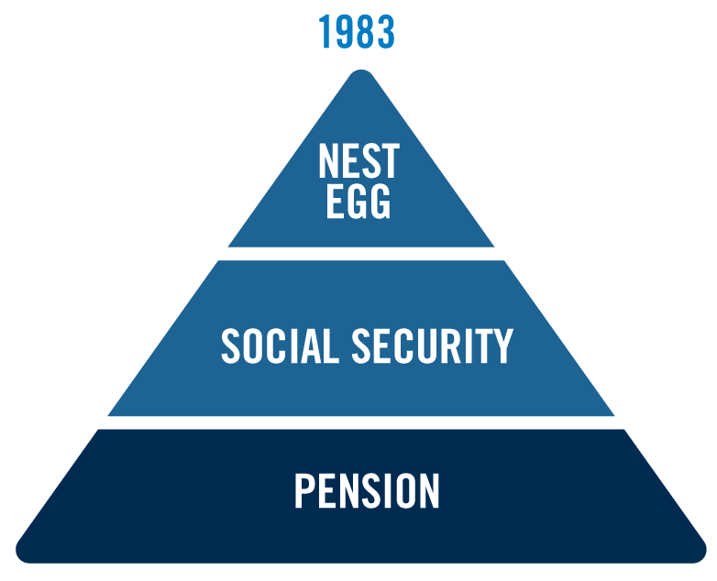
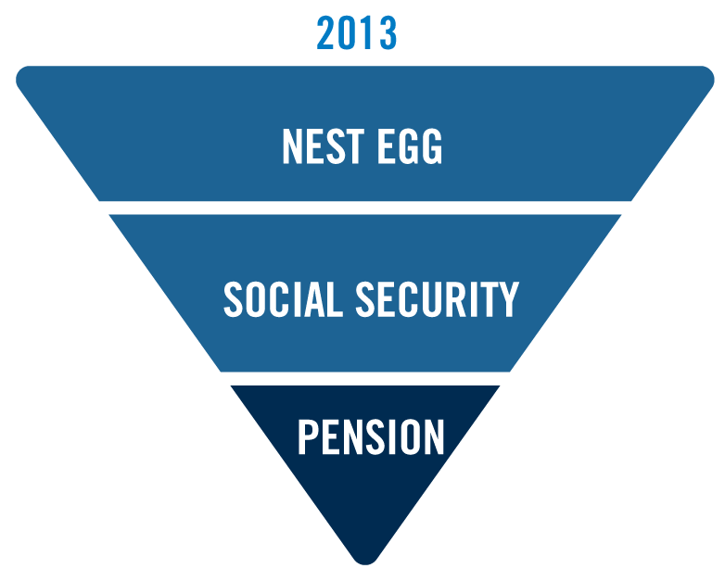
Retirement Income – Yesterday and Today
Yesterday
Today
Notes:
Not all that long ago, American workers could rely on their pensions to help fund their retirement.
But today, pensions are playing a smaller role in the income we’ll have in retirement. The number of traditional employer pension plans has decreased significantly over the last several decades. As a result of this decline, there is a greater emphasis on the need for increased personal saving and investing wisely.
So let me ask you this…
Other than Social Security, do you have a guaranteed source of income for retirement?
How important is it to you to have an additional source of guaranteed income?

Slide 13



The Key Challenges You’ll Face in The Retirement Red Zone
Market volatility
Retiring in a down market
Continued low interest rates
Your reaction to market ups and downs
Inflation
Healthcare costs
Outliving your savings
Determining how much to withdraw each year
Notes:
13
With the decline of pension plans and the uncertain future of Social Security, it’s very likely that you will have the responsibility of creating your own plan for retirement income.
But your plans for retirement income will face challenges that can affect your future. Most likely the challenges to your retirement income will fall into 3 categories:
[Read slide.]
Let’s take a look at each challenge.

Slide 14

Market Trends
Market Trends: One of the most important factors to portfolio longevity
On average, retirees will likely face a bear market every 3.5 years
Since 1945:
There have been 15 separate bear markets
Only 3 of these bear markets produced losses exceeding 40%
The median drop in stocks was 26%
Source: Bloomberg.com, Ben Carlson: Prepare for the Next Bear Market in Stocks, January 10, 2018
Notes:
Market trends are one of the most important factors for your portfolio’s longevity, perhaps second only to the retirement account’s withdrawal rate. Investors typically spend decades saving for retirement. Systematic investing in a fluctuating market, coupled with historically rising trends, has helped many Americans accumulate sizeable retirement accounts.
However, when you retire and stop contributing to and start withdrawing from your retirement accounts, you become much more susceptible to market risks. Chances are most of you will have to live through at least one bear market in retirement. In fact, the average retiree will likely face a bear market every 3.5 years.
[Speaker: Read bullet points on slide.]

Slide 15
Increased Volatility: The New Normal?
S&P 500® Index Volatility: Last 15 years
 | 2003 | 2004 | 2005 | 2006 | 2007 | 2008 | 2009 | 2010 | 2011 | 2012 | 2013 | 2014 | 2015 | 2016 | 2017
S&P EOY Close | 26.4% | 9.0% | 3.0% | 13.6% | 3.5% | -38.5% | 23.5% | 12.6% | 0.0% | 13.3% | 29.6% | 11.5% | -0.7% | 9.5% | 19.4%
0.0%
0.0%
0.0%
S&P High Date | 12/31 | 12/30 | 12/14 | 12/15 | 10/9 | 1/3 | 12/28 | 12/29 | 4/29 | 9/14 | 12/31 | 12/29 | 5/21 | 12/13 | 12/18
S&P Low Date | 3/11 | 8/12 | 4/20 | 6/13 | 3/5 | 11/20 | 3/9 | 7/2 | 10/3 | 1/3 | 1/2 | 2/3 | 8/25 | 2/11 | 1/3
Source: Yahoo Finance, 2018. Market returns represented by S&P 500 Price Return Index. Returns assume no reinvestment of dividends and reflect calendar year returns, not peak to trough. Past performance is not indicative of future returns.
Notes:
In recent history, the U.S. – and the world – have experienced increased volatility in the financial markets. In any given year, the markets can have up periods and down periods. The chart illustrates this intra-year volatility over the last 15 years for the S&P 500. While many investors are concerned the wave of volatility will continue, opportunities do exist to capitalize on pockets of positive performance, as the chart highlights. Let’s look at a few examples
From 2003-2007 the S&P was up nearly 67%. But in 2008 it gave back most of those gains, making the 6-year period from 2003-to 2008 up just 2%.
The S&P hit its 2011 high on April 29th, up 8.4%. This was followed by a 20% decline. The index then climbed 14.4% finishing the year where it began.
2012 was a good year for investors, as the S&P closed up 13.3%. But there were opportunities during the year to capture even higher gains.
But what if you were able to capture those gains, for income purposes, no matter when they occurred?

Slide 16
Retiring in a Down Market
What percentage of gain does it take to recover from a loss?
42.86%
% of Gain Required to Break Even
25%
11.11%
% of Loss
10%
20%
30%
This is a hypothetical example for illustrative purposes only. It does not reflect a specific annuity, an actual account value, or the performance of any investment. Chart assumes no withdrawals are taken that year.
Notes:
The truth is that when you invest, sometimes you will experience a down market. Let’s take a look at the amount of gains it will take to offset a loss and get you back to breaking even.
This chart shows a hypothetical portfolio with no withdrawals taken that year. If you lose 10% of your investment, you have to gain 11.11% to break even for that year.
And you can see that as the percentage of loss increases, you’ll need a larger percentage of gain to break even.
[Read the rest of the chart.]

Slide 17
Retiring in a Down Market
Recovery from losses is even more difficult when you start taking income from your investments.
63%
42%
% of Gain Required over 3 Years
26%
Withdrawal rate
4%
4%
4%
% of Loss
10%
20%
30%
This is a hypothetical example for illustrative purposes only. It does not reflect a specific annuity, an actual account value, or the performance of any investment. Chart assumes a one-year decline from the initial value of an investment.
Notes:
So you just saw that it can be difficult to recover from a stock market loss - and that was when there were no withdrawals being taken. But what happens when you are taking withdrawals from your investments and you suffer a loss? Unfortunately, recovering to breakeven is even more difficult.
This chart assumes a one-year decline from the initial value of an investment. At a 4% withdrawal rate, the percentage of gain required over a 3-year period is now 26%, 42%, and 63%.

Slide 18
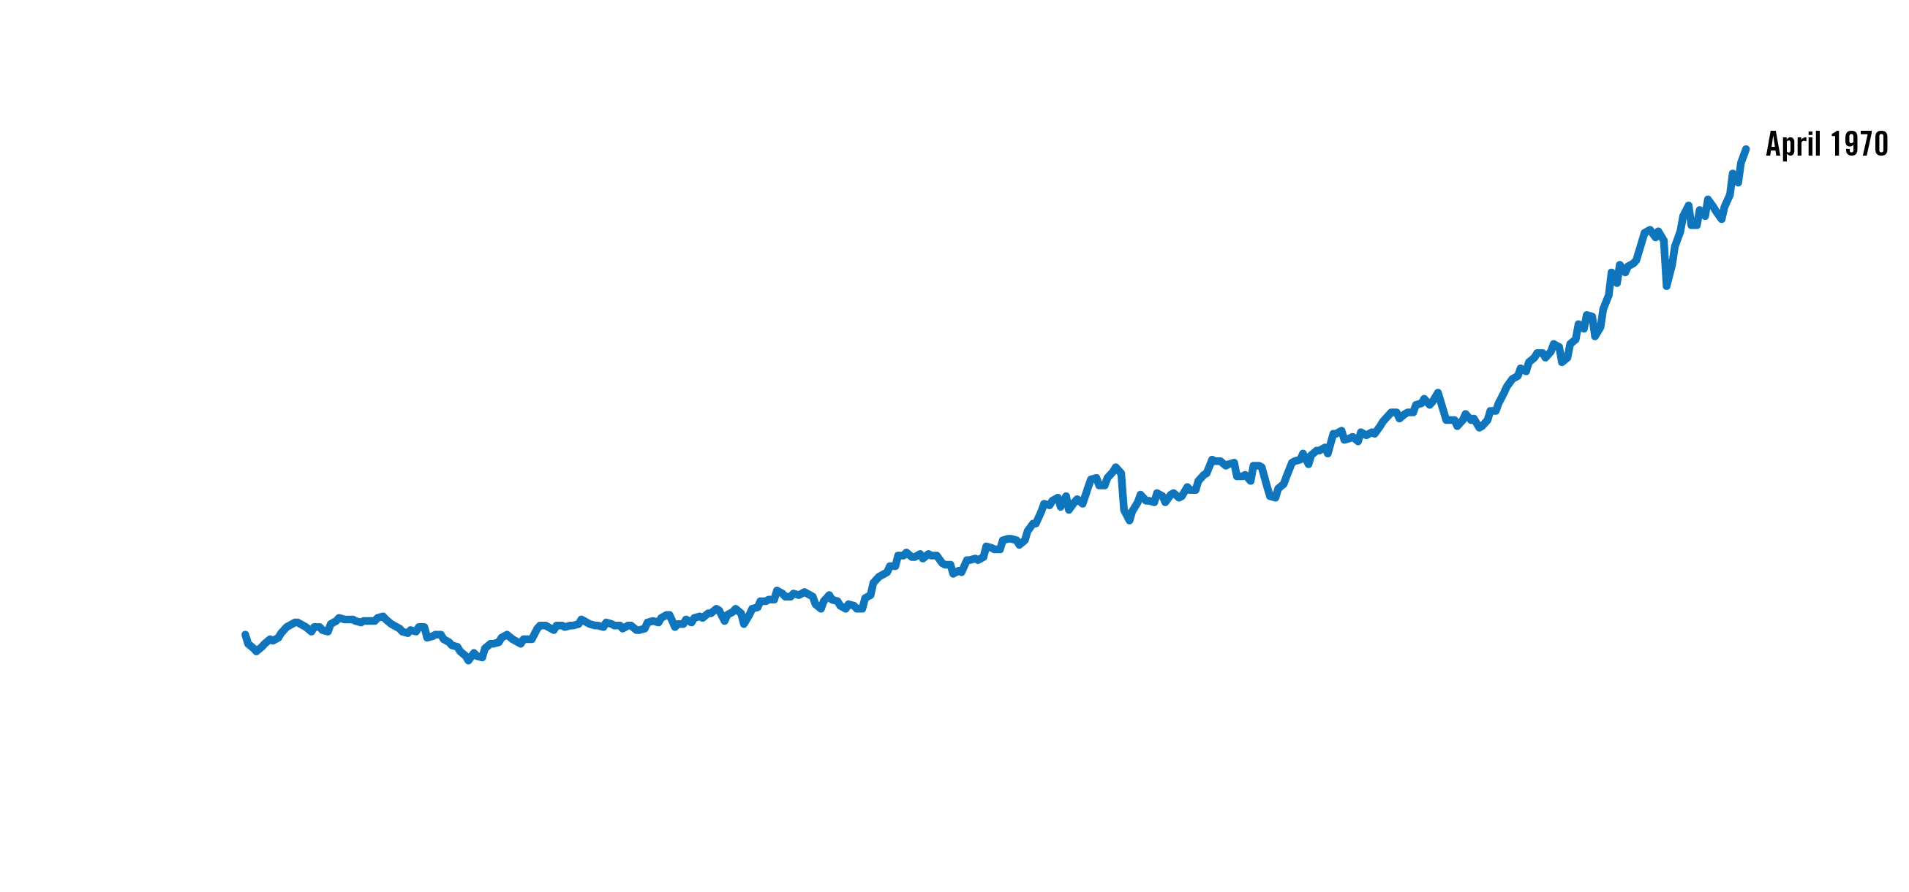
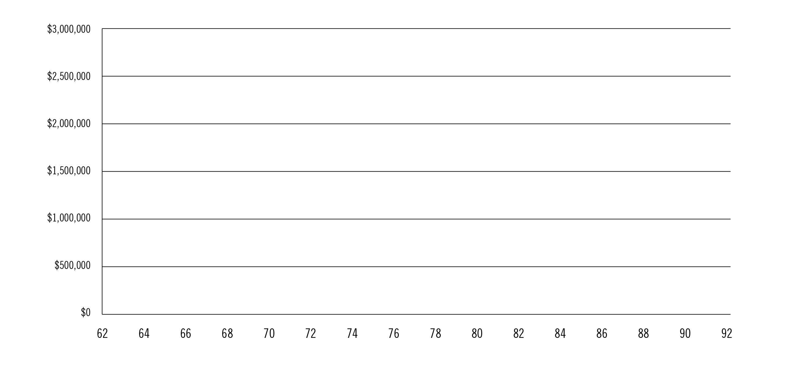
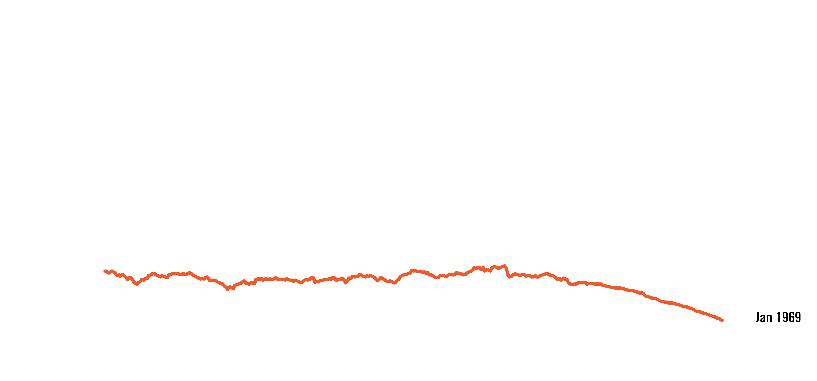
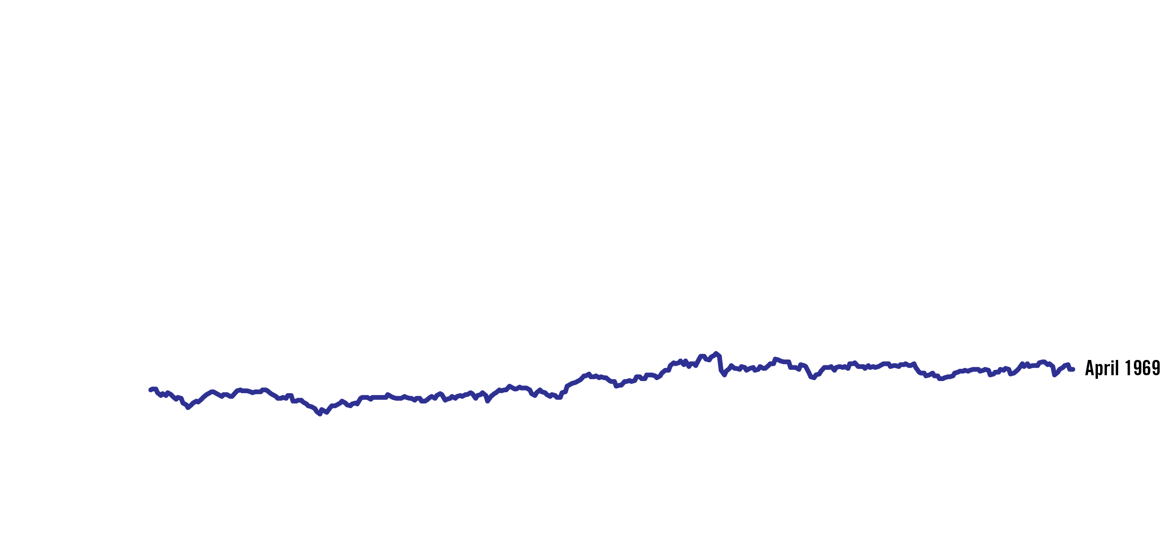
What Market Will You Retire Into?
Timing is important
30 years of retirement
Value of portfolio for those retiring from April 1969 to April 1970
Investor’s Age
Chart assumes retirement at age 62
Source: 2015 LIMRA Retirement Book
Chart assumptions: $500,000 initial investment; 4.05% withdrawal adjusted annually for inflation; 42.5% Large Cap, 17.5% Small Cap, 40% Intermediate Government Bond; rebalanced annually
Notes:
So when you retire (what kind of market you retire into) has a big impact on how long your retirement investments may last.
[Click.] Let’s take a look at a 30-year retirement beginning in or just before 1970.
[Click.] If you retired and began distributions in April 1970, you would have over $1.5 million dollars when you are 86 years old.
[Click.] But if you retired a year earlier, in April 1969, you would have about $600,000.
[Click.] And, if you retired just a few months before, in January 1969, you would run out of money by age 91.
Source: 2015 LIMRA Retirement Book
$500,000 initial investment; 4.05% withdrawal adjusted annually for inflation; 42.5% Large Cap, 17.5% Small Cap, 40% Intermediate Government Bond; rebalanced annually

Slide 19
Generating Income is a Challenge
Annual interest income on $100,000
2000
$5,450
2007
10-year Treasury
5.45%
$4,680
14% Decline
10-year Treasury
4.68%
2017
$2,450
48% Decline
10-year Treasury
2.45%
55% Cumulative Decline
Source: U.S. Department of the Treasury, as of 2017- Rates are as of beginning of the year.
Notes:
And if we turn our attention to yields? Current retirees may not realize how income generation has changed. In just a short period of time, yields and coupons have decreased dramatically. (Walk through numbers on slide).
So what does this mean for investors? Does anyone think these types of coupons are attainable anymore? Well, they essentially have 2 options. The first is to invest 3-4 times the amount of money in order to be able to preserve principal and clip coupons to generate the same level of income as they would have had 15 years ago. However, it is rare that the average investor has 3-4 times the amount of money at their disposal. Which leads us into our second option: To tap into principal. However, even tapping into principal can be a risky proposition.
Does anyone think we’ll see meaningful return from price movement going forward? If investors fail to consider the changes, they may run the risk of seeing significant alterations to their accumulation or distribution plans.

Slide 20
How Do You React to Market Ups and Downs?
Volatility and low interest rates influence behavior
20-Year Annualized Returns by Asset Class (1997-2016)
Sources: BlackRock; Bloomberg; Informa Investment Solutions; Dalbar. Past performance is no guarantee of future results. It is not possible to directly invest in an index. Oil is represented by the change in price of the NYMEX Light Sweet Crude Future contract. Contract size is 1,000 barrels with a contract price quoted in US Dollars and Cents per barrel. Delivery dates take place every month of the year. Gold is represented by the change in the spot price of gold in USD per ounce. Homes are represented by the National Association of Realtors’ (NAR) Existing One Family Home Sales Median Price Index. Stocks are represented by the S&P 500 Index, an unmanaged index that consists of the common stocks of 500 large-capitalization companies, within various industrial sectors, most of which are listed on the New York Stock Exchange. Bonds are represented by the Bloomberg Barclays US Aggregate Bond Index, an unmanaged market-weighted index that consists of investment-grade corporate bonds (rated BBB or better), mortgages and US Treasury and government agency issues with at least 1 year to maturity. International Stocks are represented by the MSCI EAFE Index, a broad-based measure of international stock performance. Inflation is represented by the Consumer Price Index. Average Investor is represented by Dalbar’s average asset allocation investor return, which utilizes the net of aggregate mutual fund sales, redemptions and exchanges each month as a measure of investor behavior. Returns are annualized (and total return where applicable) and represent the 20-year period ending 12/31/16 to match Dalbar’s most recent analysis.
Notes:
DO you react to financial headlines? Or can you tune them out?
The financial research firm DALBAR looked at a period from 1997 to 2016 to see how certain sectors performed, the rate of inflation, and the average investor’s performance. During this time period, stocks, as represented by the S&P 500 Index gained an average of 7.68%.
We see that Stocks beat bonds, gold beat international stocks [and etc….]
And inflation ate away at your purchasing power at 2.11%.
You can also see all the way over to the right of the chart that the average investor returns were less than all the other categories, and not even beating inflation.
All of this may suggest that individual investors can overreact to near-term events rather than rely on the strength of the market to perform over time. They typically buy high in times when the market is up, and they sell low at times when the market is down. And they do this based on human emotion. With today’s quick news cycle and information easily at our fingertips, investors are often doing the wrong thing, at the wrong time, and for the wrong reason.
And there has been no shortage of market events that lead to this type of behavior.
Sources: BlackRock; Bloomberg; Informa Investment Solutions; Dalbar. Past performance is no guarantee of future results. It is not possible to directly invest in an index. Oil is represented by the change in price of the NYMEX Light Sweet Crude Future contract. Contract size is 1,000 barrels with a contract price quoted in US Dollars and Cents per barrel. Delivery dates take place every month of the year. Gold is represented by the change in the spot price of gold in USD per ounce. Homes are represented by the National Association of Realtors’ (NAR) Existing One Family Home Sales Median Price Index. Stocks are represented by the S&P 500 Index, an unmanaged index that consists of the common stocks of 500 large-capitalization companies, within various industrial sectors, most of which are listed on the New York Stock Exchange. Bonds are represented by the Bloomberg Barclays US Aggregate Bond Index, an unmanaged market-weighted index that consists of investment-grade corporate bonds (rated BBB or better), mortgages and US Treasury and government agency issues with at least 1 year to maturity. International Stocks are represented by the MSCI EAFE Index, a broad-based measure of international stock performance. Inflation is represented by the Consumer Price Index. Average Investor is represented by Dalbar’s average asset allocation investor return, which utilizes the net of aggregate mutual fund sales, redemptions and exchanges each month as a measure of investor behavior. Returns are annualized (and total return where applicable) and represent the 20-year period ending 12/31/16 to match Dalbar’s most recent analysis.

Slide 21

Will Rising Costs Affect Your Retirement Income?
Create an increased income demand for the remainder of a retiree’s life
Can be most damaging in later years of retirement
Since 1982:
Average annual 4.9% increase
Average annual 2.9% increase
Average annual 2.6% increase
CPI
CPI-Elderly
Healthcare
1. Source: US BLS; based on CPI-W from 12/1982 through 12/2016; http://data.bls.gov/timeseries/CWUR0000SA0?output_view=pct_1mth
2. Source: US BLS; CPI-E is an experimental index, public and unpublished data; 12/1982 through 12/2016
3. Source: US BLS; based on Medical Care index from 12/1982 through 12/2016: http://data.bls.gov/timeseries/CUUR0000SAM?output_view=pct_1mth
Notes:
INFLATION: WILL YOUR MONEY KEEP UP?
Prices for basic necessities (food, transportation, utilities, etc.) tend to increase over time. But most of us underestimate the cumulative impact inflation can have on our standard of living in retirement.
This chart shows you the Consumer Price Index, or CPI. The CPI measures price changes for major groups of goods and services, including housing, transportation, food, energy, apparel, medical care, recreation and education. But the problem is that even at a relatively modest rate of around 3%, inflation can still seriously erode your purchasing power over time.
The Bureau of Labor Statistics also calculates an experimental CPI for the elderly. As you can see that's a higher rate of inflation, because it takes into account the fact that older Americans devote a substantially larger share of their total budgets to medical care.* And as we know all too well, healthcare costs [Speaker: indicate healthcare on chart] are rising at rates well above inflation.
*Source: Bureau of Labor Statistics: Consumer Price Index for the elderly, www.bls.gov/opub/ted/2012/ted_20120302.htm

Slide 22
Rising Costs: Healthcare
It is estimated that an average,
healthy 65-year-old couple will need
Average Annual Medicare Out-of-Pocket Costs: $5,600 per Person*
$280,000
to pay for medical expenses for the remainder of their lives.
This does not include long-term care costs*
Source: Fidelity Investments Retiree Health Costs Estimate, 2018. Healthcare and nursing home costs may vary by state.
Notes:
The cost of healthcare is arguably one of the biggest financial issues facing Americans today. Rising healthcare costs are a concern when you're entering retirement because it can be a time when health issues are more likely to arise. And since women tend to live longer than men, they can incur even higher healthcare expenses during their lifetime.
[Speaker: Review stats on slide.]

Slide 23

Longevity Risks Your retirement journey could last longer than you think
Expected life span of individuals and couples age 65:
50% are expected to live to age:
25% are expected to live to age:
Men 87
Men 93
Women 90
Women 96
Couples (surviving spouse) 94
Couples (surviving spouse) 98
Source: Society of Actuaries RP-2014 Mortality Table projected with Mortality Improvement Scale MP-2014, 2016.
Notes:
Now let’s touch on our final set of challenges and these are around longer life spans for today’s retirees. We’re living longer and that is good news! But longer lives can bring on the challenge of outliving your money. This is something we should all be aware of when planning for retirement. And even though no one knows how long they will live, we should be prepared for a long life.
On the chart you can see that a 65-year-old married couple has a 50% chance that one member will live to age 94. The challenge is how can you make your money last in retirement for 30 years, or possibly more?
This brings up the need for spousal protection planning. It is very likely that one spouse will outlive the other, and in many instances the surviving spouse's income will most likely be reduced.

Slide 24
Withdrawal Rate Risk What is a Safe and Sustainable Withdrawal Rate?
Answer: The rate one can safely withdraw from their retirement portfolio without prematurely depleting the account
Opinions on Safe Withdrawal Rates have varied over time
Some expert opinions over time:
Bengen (1994)¹: | 4%
Guyton (2004)²: | 3.6% - 5.8%
Milevsky & Huang (2010)³: | 3%
Pfau (2017)⁴: | 2.4%
1. “Determining Withdrawal Rates Using Historical Data”, William Bengen, Journal of Financial Planning, October 1994
2. “Decision Rules and Portfolio Management for Retirees: Is the ‘Safe’ Initial Withdrawal Rate Too Safe?”, Jonathan Guyton; FPA Journal; October 2004
3. “Spending Retirement on Planet Vulcan: The Impact of Longevity Risk Aversion on Optimal Withdrawal Rates”; M.A. Milevsky & H. Huang; Retirement Income Journal, March 2010
4. “Retirement Income Dashboard For a Benchmark Couple Both Turning 65 in April 2017”; Conservative portfolio (25% stock allocation) with 2% spending COLA; Wade Pfau at https://retirementresearcher.com/dashboard/
SL 0092 03/2018
Notes:
Another challenge of living longer is how much money you can safely take out of your retirement investments each year.
How much can you safely withdraw from your portfolio so it lasts for the rest of your life?
In theory, a safe withdrawal rate is the maximum amount of money you can withdraw from a retirement portfolio with zero probability of depleting these savings during your lifetime. This is also referred to as a “Sustainable Withdrawal Rate.”
As you can see, over time, financial experts have had different opinions on what a safe withdrawal rate is, depending on the prevailing market conditions. For example, in the past, a safe withdrawal rate has been viewed as being as high as almost 6%. But in today’s low interest rate environment, the latest estimates are actually lower than 3%.
Bengen = “Determining Withdrawal Rates Using Historical Data”, William Bengen, Journal of Financial Planning, October 1994
Trinity Study = “Retirement Savings: Choosing a Withdrawal Rate that is Sustainable”; Cooley, Hubbard & Walz;; Journal of the American Associatron of Individual Investors; February 1998
Jonathan Guyton = “Decision Rules and Portfolio Management for Retirees: Is the ‘Safe’ Initial Withdrawal Rate Too Safe?”, Jonathan Guyton; FPA Journal; October 2004; range 3.4% to 5.8%
Bengen = “Conserving Client Portfolios During Retirement”; William Bengen; FPA Press, 2006
Kitces = “Resolving the Paradox – Is the Safe Withdrawal Rate Sometimes Too Safe?”; Michael Kitces; The Kitces Report; May 2008; assumes a 60/40 equity fixed income allocation
Milevsky/Huang = “Spending Retirement on Planet Vulcan: The Impact of Longevity Risk Aversion on Optimal Withdrawal Rates”; M.A. Milevsky & H. Huang;; range 3.0% to 7% (highly risk averse to less risk-averse)
Pfau= Retirement: Income dashboard 4/2107

Slide 25
What Can Impact My Safe Withdrawal Rate? Required Minimum Distributions (RMDs) and Sustainable Withdrawals
Age
70½
75
80
85
90
95 100
RMDs Increase Each Year*
3.65%
4.37%
5.35%
6.76%
8.77%
11.63%
15.87%
*If the spouse is the sole beneficiary and is more than 10 years younger, the RMD rate is lower. Source: www.irs.gov, accessed October 2017
Notes:
When thinking about how much money to withdraw from your retirement accounts each year, you have to consider your Required Minimum Distributions or RMDs. RMDs are annual withdrawals that are required by federal law from most retirement accounts starting at age 70 ½.
According to the IRS, you are required to withdraw, at a minimum, 3.65% of the value of your account starting at age 70 ½. And as you can see, the withdrawal rate quickly increases as you age. As we just discussed, the latest estimates for a safe/sustainable withdrawal rate are around 2%, so these increasing RMD percentages could be a challenge for you.
*RMDs must begin by April 1 of the year after you reach age 70 ½ and must continue annually.

Slide 26
Managing Retirement Risk
Managing Risk
Transferring Risk Can Help
Cover Essential Expenses in Retirement
Reduce Withdrawal Rate from Non-Guaranteed Investments
Reduce Pressure on Other Retirement Assets
“Free Up” Other Assets for Longer-Term Investing
A
Avoid
Retain
Transfer
R
T
All references to guarantees, including optional benefits, are backed by the claims-paying ability of the issuing company and do not apply to the underlying investment options.
Notes:
There are different ways to deal with risk.
You can Avoid it. Many do this by simply getting out of equities and investing in money markets, CDs and Treasuries.
You can Retain it. Some may just hope that they retire at the right time and that the market will cooperate with their retirement income needs. However, hope is not a plan.
You can Transfer it. This raises the question of how much of your risk you should consider transferring.

Slide 27
Example: Managing Retirement Income Challenges Through Planning
Guaranteed Sources of Income
(Pension, Social Security, Annuities)
Cover Essentials
Essential Expenses
(Housing, Food, Clothing, Healthcare, Transportation)
Convert Assets into Income
Cover Gap
Other Sources of Income
(Mutual Funds, Stocks, Bonds, CDs, Real Estate)
Discretionary Expenses
(Travel, Restaurants, Entertainment)
Discretionary
Notes:
We talked about a number of challenges to your retirement income, and now it’s time to explore how we can offset the effects of these challenges by planning for them.
As you prepare for your retirement, you and your financial professional can categorize your income sources as well as your expenses. You can decide what income sources you’ll use to cover certain expenses.
[Read slide.]

Slide 28
Example: Covering Essential Expenses
Essential Expenses $46,000
Housing/Food/Clothing/Transportation $35,000
Healthcare $11,000
Guaranteed Income Sources $39,000
Pension $15,000
Social Security $24,000
Income Gap ($7,000)
Hypothetical example for illustrative purposes only.
Notes:
[Optional Slide - speaker please hide if hiding slides 27 and 28.]
So let’s look at an example. Through your planning with your financial professional, you may uncover an income gap. You’ll need a way to fill this shortfall.
[Read slide.]
This is where guaranteed income from a variable annuity may be able to help you.

Slide 29
Example: Covering Essential Expenses Investment needed to generate $7,000 per year at age 65
Non-Guaranteed Investment with 3.3% withdrawal
$210,210
Funding Variable Annuity at age 65
$116,667
45% Less
Funding Variable Annuity at age 60
$100,673
52% Less
59% Less
Funding Variable Annuity at age 55
$85,948
$0 | $50,000 | $100,000 | $150,000 | $200,000
These hypothetical examples assume income percentages of 6.00% at age 65, 5.45% at age 60. 5.0% at age 55, and an income growth rate of 5.00%, and all are for illustrative purposes only. They do not reflect a specific annuity, an actual account value or the performance of any investment. Please refer to the following slide for additional information.
Notes:
[Optional Slide - speaker please hide if hiding slides 26 and 28.]
In our example, we need to cover an annual income gap of $7,000. Let's look at different investments that could potentially generate that $7,000.
[Click.] If you put your retirement savings in a non-guaranteed investment and count on withdrawing 3.33% annually, you would need to invest $210,210. But that's not guaranteed income, and as we discussed earlier, 4% may not be a safe withdrawal rate.
[Click.] But by investing in a variable annuity, you'll be able to do more with less -- at age 65 you'll need to invest $116,667 to generate $7,000/year.
[Click.] If you invest in a variable annuity at age 60, you'll only need a little more than $100,637.
[Click.] And if you invest in a variable annuity at age 55, you'll need just $85,948 to generate an income stream of $7,000/year.

Slide 30
Variable Annuity Performance
Funding an Annuity at Age 55
0% Gross Return Scenario |  | 6% Flat Return
Year | Account Value | Account Value
Initial Investment |  | $85,948
56 | $83,633 | $88,654
57 | $81,378 | $91,446
58 | $79,183 | $94,328
59 | $77,046 | $97,302
60 | $74,966 | $100,372
61 | $72,940 | $103,540
62 | $70,967 | $106,809
63 | $68,554 | $109,397
64 | $66,220 | $112,049
65 | $63,965 | $114,766
These hypothetical examples assume no withdrawals and are for illustrative purposes only. They do not reflect a specific annuity, an actual account value, or the performance of any investment. The hypothetical 10-year scenario illustrates a -3.30% annual net rate of return for the 0% gross return scenario, and a 2.49% annual net rate of return for the 6% flat return scenario. The hypothetical 5-year scenario illustrates a -3.01% annual net rate of return for the 0% gross return scenario, and a 2.67% annual net rate of return for the 6% flat return scenario. All scenarios reflect the following fees: (i) M&E&A fee of 1.10%; (ii) benefit fee of 0.80%; with maximum benefit fee of 1.50% applied after the 7th annuity year on the 10-year scenario (iii) the ASTTM Multi-Sector Fixed Income Portfolio fee of 0.75%, and (iv) for purchase payments of less than $100,000, an annual maintenance fee of the lesser of $50 or 2% of the account value is deducted on each annuity anniversary.
Important Information on the Prudential Defined Income Variable Annuity:
The benefit is part of your annuity and you may not cancel the benefit. However, upon specified events, the benefit may be terminated. Please see the prospectus for more details.
The annuity does not provide a diverse set of investment choices nor does it provide the option to allocate your purchase payments or account value among a variety of investment choices with different investment styles, objectives, strategies and risks. The performance of your account value will depend entirely on the performance of the AST Multi-Sector Fixed Income Portfolio.
Fixed income investments are subject to risk, including credit and interest rate risk. Because of these risks, a subaccount’s share value may fluctuate. If interest rates rise, bond prices usually decline. If interest rates decline, bond prices usually increase.
P-BBND(2/13), P-RID-LI-DB(5/14), or state variation thereof.
Funding an Annuity at Age 60
0% Gross Return Scenario |  | 6% Flat Return
Year | Account Value | Account Value
Initial Investment |  | $100,637
61 | $97,984 | $103,864
62 | $65,402 | $107,194
63 | $62,887 | $110,630
64 | $90,439 | $114,177
65 | $88,055 | $117,838
Notes:
[Optional Slide – speaker please hide if hiding slides 26 and 27.]
Of course, when contemplating an annuity, fees and surrender charges must be considered.

Slide 31
A Variable Annuity with an Income Benefit* Can Provide:
1. A guaranteed income stream for as long as you live
2. Income that is protected from market downturns
3. Guaranteed income growth for those taking income later
*Certain income benefits are optional and available for an additional fee.
Withdrawals in excess of the income amount impact the value of a product or benefit and can also affect the certainty of the income. An excess withdrawal occurs when cumulative Lifetime Withdrawals exceed the income amount in an annuity year. If an excess withdrawal is taken, only the portion of the Lifetime Withdrawal that exceeds the remaining income amount for that year will proportionally and permanently reduce future guaranteed amounts. If an excess withdrawal reduces the account value to zero, no further amount would be payable and the contract terminates.
Notes:
31
[Read slide.]

Slide 32

Understanding Today’s Retirement Red Zone Challenges
Navigating Uncertain Markets
Rising Costs
Longer Life Spans
A variable annuity can help manage these challenges. Talk to your financial professional today!
Notes:
We’ve covered a lot of ground today, but I hope that you have a new awareness of the challenges you’ll face in retirement and realize that with this knowledge you can plan for them.
The good news is that you don’t have to prepare for these challenges alone. [Your financial professional/Name of FP] has years of experience helping people like you.
You may find that a variable annuity might be right for a portion of your portfolio to help you overcome your retirement income challenges.

Slide 33
Disclosures
Investors should consider the features of the contract and the underlying portfolios' investment objectives, policies, management, risks, charges and expenses carefully before investing. This and other important information is contained in the prospectus, which can be obtained from your financial professional. Please read the prospectus carefully before investing.
Issuing companies are located in Newark, NJ (main office). Variable annuities are distributed by Prudential Annuities Distributors, Inc., Shelton, CT. All are Prudential Financial companies and each is solely responsible for its own financial condition and contractual obligations. Prudential Annuities is a business of Prudential Financial, Inc.
This material is being provided for informational or educational purposes only and does not take into account the investment objectives or financial situation of any client or prospective clients. The information is not intended as investment advice and is not a recommendation about managing or investing your retirement savings. Clients seeking information regarding their particular investment needs should contact a financial professional.
Annuity contracts contain exclusions, limitations, reductions of benefits, and terms for keeping them in force. Your licensed financial professional can provide you with complete details.

Slide 34
Disclosures
A variable annuity is a long-term investment designed for retirement purposes. Investment returns and the principal value of an investment will fluctuate so that an investor’s units, when redeemed, may be worth more or less than the original investment. Withdrawals or surrenders may be subject to contingent deferred sales charges. Withdrawals and distributions of taxable amounts are subject to ordinary income tax and, if made prior to age 59½, may be subject to an additional 10% federal income tax penalty, sometimes referred to as an additional income tax. Withdrawals reduce the account value and the living and death benefits.
All references to guarantees, including the benefit payment obligations arising under the annuity contract guarantees, rider guarantees, optional benefits, any fixed account crediting rates or annuity payout rates are backed by the claims-paying ability of Pruco Life Insurance Company and Pruco Life Insurance Company of New Jersey. Those payments and the responsibility to make them are not the obligations of the third party broker/dealer from which this annuity is purchased or any of its affiliates. All guarantees, including optional benefits, do not apply to the underlying investment options.
MSCI EAFE (Europe, Australasia, Far East) is a widely accepted benchmark for international stock performance. It is a free float-adjusted market capitalization index that is designed to measure the equity market performance of 21 developed markets, excluding the U.S. and Canada.
Bloomberg Barclays U.S. Aggregate Bond Index covers the USD-denominated, investment grade, fixed rate, taxable bond market of SEC-registered securities. The index includes bonds from the Treasury, Government-Related, Corporate, Mortgage-Backed Security (MBS), Asset-Backed Security (ABS) and Commercial Mortgage-Backed Security (CMBS) sectors.
S&P 500® Index is a market capitalization-weighted index of the 500 widely held stocks often used as a proxy for the stock market. S&P chooses the member companies for the 500 based on market size, liquidity and industry group representation.

Slide 35
Disclosures
Asset-Backed and/or Mortgage-Backed Securities Risk - Asset-backed and mortgage-backed securities are subject to interest rate risk, liquidity risk, and credit risk, which may be heightened in connection with investments in loans to “subprime” borrowers. Certain asset-backed and mortgage-backed securities are subject to the risk that those obligations will be repaid sooner than expected or later than expected, either of which may result in lower than expected returns. Mortgage-backed securities, because they are backed by mortgage loans, are also subject to risks related to real estate, and securities backed by private-issued mortgages may experience higher rates of default on the underlying mortgages than securities backed by government-issued mortgages.
Derivatives Risk - The use of derivatives is a highly specialized activity that involves a variety of risks in addition to and greater than those associated with investing directly in securities, including the risk that: the party on the other side of a derivative transaction will be unable to honor its financial obligation; leverage created by investing in derivatives may result in losses to the Portfolio; derivatives may be difficult or impossible for the Portfolio to buy or sell at an opportune time or price, and may be difficult to terminate or otherwise offset; derivatives used for hedging may reduce or magnify losses but also may reduce or eliminate gains; and the price of commodity-linked derivatives may be more volatile than the prices of traditional equity and debt securities.
Equity Securities Risk – The value of a particular stock or equity-related security held by a Portfolio could fluctuate, perhaps greatly, in response to a number of factors, such as changes in the issuer’s financial condition or the value of the equity markets or a sector of those markets. Such events may result in losses to the Portfolio.

Slide 36
Disclosures
Fixed Income Securities Risk - Investment in fixed income securities involves a variety of risks, including that: an issuer or guarantor of a security will be unable to pay obligations when due; due to decreases in liquidity, the Portfolio may be unable to sell its securities holdings at the price it values the security or at any price; and the Portfolio’s investment may decrease in value when interest rates rise. Volatility in interest rates and in fixed income markets may increase the risk that the Portfolio’s investment in fixed income securities will go down in value. Risks associated with rising interest rates are currently heightened because interest rates in the US have begun to increase from historically low levels in recent years and may continue to increase in the future with unpredictable effects on the markets and the Portfolio's investments.
High Yield Risk - Investments in fixed income securities rated below investment grade and unrated securities of similar credit quality (i.e., high yield securities or junk bonds) may be more sensitive to interest rate, credit and liquidity risks than investments in investment grade securities, and have predominantly speculative characteristics.
Real Estate Risk – Investments in real estate investment trusts (REITs) and real estate-linked derivative instruments are subject to risks similar to those associated with direct ownership of real estate. Poor performance by the manager of the REIT and adverse changes to or inability to qualify with favorable tax laws will adversely affect the Portfolio. In addition, some REITs have limited diversification because they invest in a limited number of properties, a narrow geographic area, or a single type of property.
© 2019 Prudential Financial, Inc. and its related entities. Prudential Annuities, Prudential, the Prudential logo, the Rock symbol, Bring Your Challenges, and The Retirement Red Zone are service marks of Prudential Financial, Inc. and its related entities, registered in many jurisdictions worldwide.
[REF# 4682181]

Slide 37
Disclosures Securities offered by Personal Financial Representatives through Allstate Financial Services, LLC (LSA Securities in LA and PA). Registered Broker-Dealer. Member FINRA, SIPC. Main Oﬃce: 2920 South 84th Street, Lincoln, NE 68506. (877) 525-5727. Check the background of this firm on FINRA's Broker Check website. Annuities offered and issued by third party companies not affiliated with Allstate. Each company is solely responsible for the financial obligations accruing under the products it issues. Product guarantees are backed by the financial strength and claims-paying ability of the issuing company.
[REF# 7759364]
Notes:
[OPTIONAL SLIDE]
[REQUIRED SLIDE FOR ALLSTATE PRESENTATIONS ONLY. REMOVE WHEN USING FOR ALL OTHER FIRMS.]

