Slide 1
WWW.ADVISORCONTROLS.COM | (309) 650-1125 | SUPPORT@ADVISORCONTROLS.COM
Notes:
The hierarchy of income planning™ is a methodology that mirrors Maslow‘s hierarchy of needs, where portfolio construction begins with the types of investments that provide predictable and probable streams of income to help meet the target income need.
This presentation has been designed to create awareness, as to the various risks we are likely to face in retirement, while also introducing fiduciary-based methods and tools that will help to provide a clear path as to the types of investments that may need to be leveraged in an effort to maximize planning outcomes.

Slide 2




Risks in Retirement
Longevity
RISK
Sequence of Return
RISK
Inflation
RISK
Taxation
RISK
Notes:
Let’s start by introducing various risks he will face in retirement including inflation taxes longevity and sequence of returns.

Slide 3
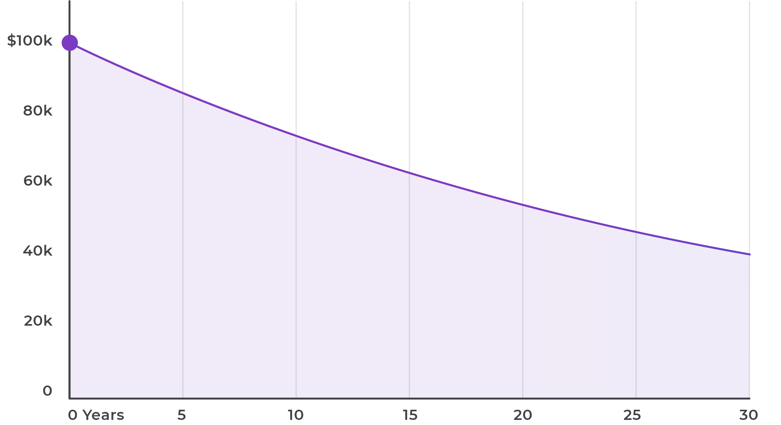
Effect of 3% Inflation on Purchasing Power
Inflation
RISK
Notes:
First, inflation risk is commonly defined as the rise in prices for goods and services over time. The average annual inflation rate since 1926 was around 3%, though currently, inflation is hovering around 2%. Investors often don’t understand the damage inflation can do over long periods of time. This may be because the annual average seems relatively low. Over a long-time horizons such as a 30-year retirement however an annual increase in prices of 3% can have a tremendous impact on investors financial situation. This graph demonstrates that $100,000 of income today will only be worth $85,873 in as little as five years, or roughly 14% less than today. Over the course of a typical 30-year retirement income will be reduced by nearly 60% to $40,101. To make matters worse, medical expenses which can be a considerable factor for retirees, are rising faster than the average inflation rate. A recent estimate from Aloith Foundation suggest that medical care experienced an average inflation rate of 3.38% per year from 2000 to 2019 compared to the overall inflation rate of 2.06 during that same period.

Slide 4



Types of Taxation
Taxation
RISK
Ordinary Income Tax
PAYCHECK
Capital Gains Tax
INVESTMENTS
Estate Tax
INHERITANCE
Notes:
Tax risk is another factor that erodes the dollar. There are three types of taxes we will be reviewing today. First, and most commonly, is ordinary income. This is the rate at which the majority of your income, including salaries, commissions, bonuses and certain interest income, is taxed. Your ordinary income tax rate is determined by a progressive scale where higher earners pay more.
Second, is capital Gaines, which is the rate at that most investment income is taxed. Dividends and the profit from the sale of securities are taxed as capital gains. For securities held for more than 12 months before being sold and for qualified dividends, a preferential rate is applied. Securities sold prior to being held for 12 months and ordinary dividends, are taxed at the ordinary income rate. The preferential rate is based on your income level. For example, some individuals with lower income may pay no tax, where higher income earners may pay as much as 20%. Finally, estate taxes are levied on the assets of a deceased person. This tax is assessed when the deceased persons of state passes to his or her heirs. This typically only applies to large estates that exceed the annual estate tax exemption.

Slide 5
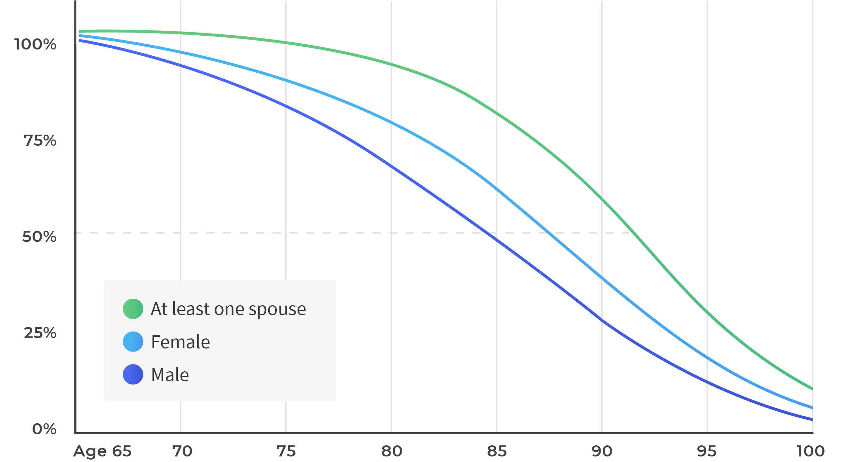
Probability of a 65-Year-Old Living to Various Ages
Longevity
RISK
Source: Annuity 2000 Mortality Tables. © 2012 Morningstar. All Rights Reserved. 3/1/2012
Notes:
Longevity Risk is more common now than ever before due to longer life expectancies. Retirees should Plan for a long retirement.
Longevity risk is more common now than ever before due to longer life expectancy is. Retirees should plan for a long retirement. Longevity risk is the possibility that a person will outlive his or her retirement savings. Chances are, people are going to live longer than they think. Well living longer is a good thing, it compose some challenging financial issues in retirement. Longevity risk is perhaps one of the biggest risks that investors will face, as they enter retirement. Accounting for longevity risk and retirement planning is more important than ever because people today living significantly longer than prior generations due to advances in medicine, diet, and technology. This risk is compounded by medical and healthcare expenses that are rising considerably faster than the rate of inflation, as previously discussed. Most people underestimate how long they are likely to live. Too often, people base their financial planning upon their life expectancy, which is the average age at which someone is expected to die. In the United States, the median life expectancy of a 65-year-old man and woman is 85 and 88, respectively. What people do not always realize is that this is the median. Half of the population will live longer, often much longer than their life expectancy.
The image above illustrates the probabilities of a 65-year-old living to various ages. For example, there is a 25% chance that a 65-year-old man will live most people underestimate how long they are likely to live. Too often, people based their financial planning upon their life expectancy, which is the average age at which someone is expected to die. In the United States, the median life expectancy of a 65-year-old man and woman is 85 and 88, respectively. What people do not always realize is that this is the median. Half of the population will live longer, often much longer than their life expectancy. The image above illustrates the probabilities of a 65-year-old living to various ages. For example, there is a 25% chance that a 65-year-old man will Live to age 91, a 65-year-old woman to age 93, or at least one spouse of a 65-year-old couple to age 96. Retirees should plan for a long retirement, perhaps as long as 30 years. If retirees' financial plans assume, they live only to the median life expectancy, they run a greater risk of depleting the retirement savings. There are a couple additional reasons to use conservative mortality assumptions.

Slide 6
Sequence of Returns Risk
$500k
$2.5 mil
Actual historical return sequence
Reversed historical return sequence
400
2.0
300
1.5
200
1.0
100
0.5
0
1973
1977
1981
1985
1989
1993
Aug 94
1993
1989
1985
1981
1977
1973
Returns
RISK
Past performance is no guarantee of future results. Hypothetical value of $500,000 invested at the beginning of 1973 and August 1994. Assumes inflation-adjusted withdrawal rate of 5%. Portfolio: 50% large-company stocks/50% intermediate-term bonds. This is for illustrative purposes only and not indicative of any investment. An investment cannot be made directly in an index. © 2012 Morningstar. All Rights Reserved. 3/1/2012
Notes:
What if the market doesn’t work out your way. The obvious goal is to have your money live longer than you.
Well… the market’s Sequence of returns can significantly affect your retirement and presents one more layer of risk when it comes to retirement income planning.
Sequence of returns risk addresses the possibility of the market not working out your way while in retirement. The obvious goal is to have your money live longer than you. Well, the markets sequence of returns can significantly affect your retirement and presents one more layer of risk when it comes to income planning. The point in time that a person chooses to retire can affect the ability of his or her portfolio to last throughout retirement.
The image above demonstrates this by showing how the sequence of market returns affects how much a portfolio can grow while sustaining needed with drawls in retirement. Both images look at a hypothetical 50% stock /50% bond portfolio with an initial value of $500,000 and assumes an inflation adjusted annual withdrawal rate of 5%. The image on the left assumes a person retired on January 1, 1973 (right before a bear market) and began making monthly withdrawals in January 1973. The result was that the portfolio ran out of money by August 1994.
The image on the right illustrates a hypothetical case where the historical returns occurred in reverse chronological order. The returns from 1994 occurred before the returns of 1993, etc., with returns from 1973 occurring last. By reversing the sequence of returns, the portfolio experienced higher returns in in the early years and low returns in the later years. As a result, the portfolio increased substantially over time, more than tripling in value, despite the ongoing 5% withdrawals. This hypothetical example highlights that in early years of retirement, portfolio values eroded by a bear market and withdrawals simultaneously, may not be able to rebuild well, even if good returns are experienced in later years. This is relevant because people who retired right before or during the bear market of the early 2000’s experienced large declines in portfolio values early in retirement. The same reasoning applies to the 2007 through 2009 recession. Unfortunately, no one can predict what the market might do in the critical years of their retirement. This is why it is particularly important in early years to manage this risk with technology that can determine the optimal asset allocation and withdrawal rates so your portfolio will last longer than you.
About the data
Stocks in this example are represented by the Standard & Poor’s 90 index from 1926 through February 1957 and the S&P 500® index thereafter, which is an unmanaged group of securities and considered to be representative of the U.S. stock market in general. Bonds are represented by the five-year U.S. government bond and inflation by the Consumer Price Index. Each monthly withdrawal is adjusted for inflation. An investment cannot be made directly in an index.

Slide 7


Match expenses with potential income sources
Variable Annuities
Stocks
Social
Security
Pensions
Cash
Equity Mutual Funds
Fixed Income (Bonds)
Low Risk Assets
Balanced Mutual Funds
REITs
Notes:
The first step in constructing solutions that will help to build reliability in your retirement income plan, is to Match your expenses with potential income sources. Your retirement income and expenses each have unique characteristics. Essential expenses need to be funded by two types on income sources: Protected income sources, such as: Social Security, pensions and guaranteed income annuities and Probable Income sources such as: cash, cash equivalents and fixed income investments.
Finally, discretionary expenses such as hobbies and travel are also impacted by inflation, but you have the flexibility to adjust your spending more easily than you can with your essential living expenses. For this reason, higher risk or longer-term investments such as stocks, alternatives or annuities without guaranteed income riders can be used as the primary funding source, since these expenses aren’t necessary to keep you retired.
Transition: Now that we have learned about the building blocks of a retirement income strategy, let’s look at how we might develop your own strategy.

Slide 8

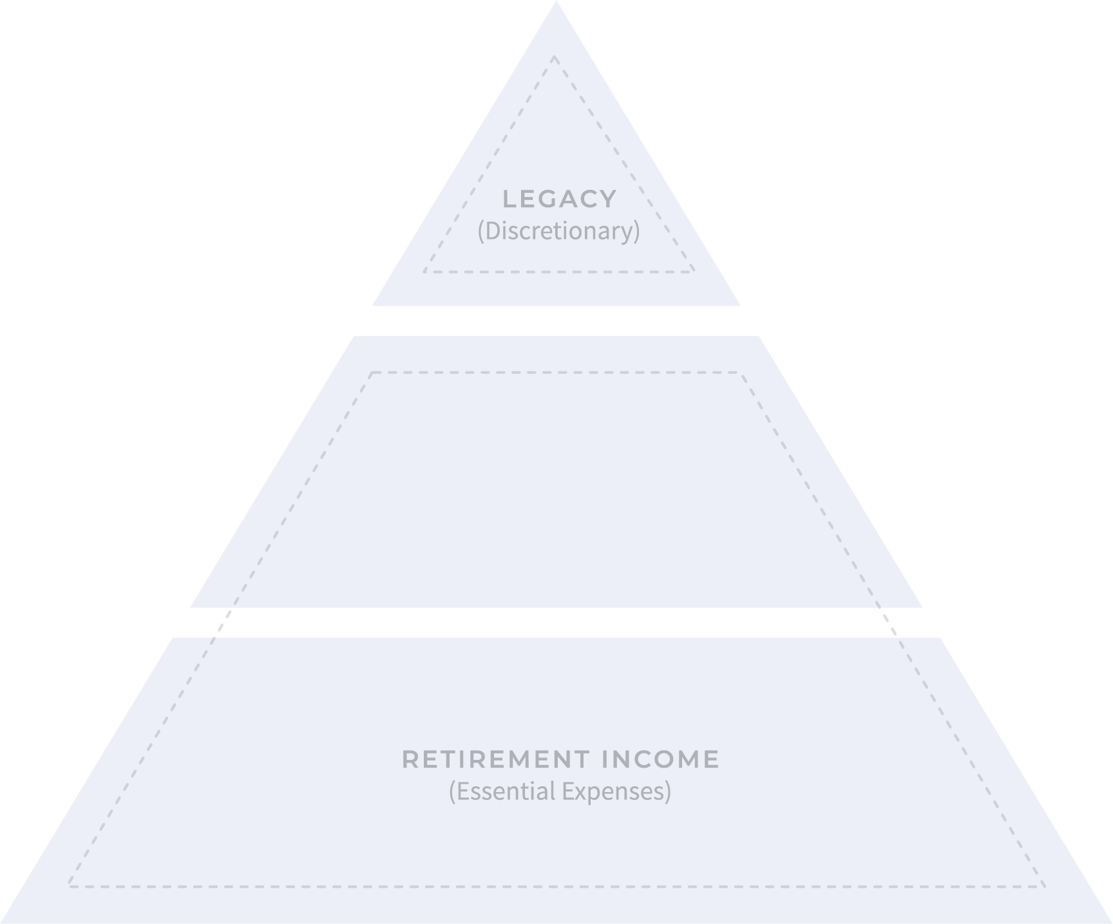


Hierarchy of Income Planning™
Notes:
The hierarchy of income planning™ is a methodology that mirrors Maslow‘s hierarchy of needs, as it addresses the importance of matching protected and probable income sources to fixed and rising expenses essential to keeping your retired.
Using this planning method simplifies and accurately aligns various asset values into three buckets, each of which plays a role in retirement income planning.
As mentioned previously, the lower two buckets cover fixed and rising expenses to meet your needs and wants, to provide for a comfortable retirement, while top bucket will help provide long-term growth.

Slide 9

Hierarchy of Income Planning™
Notes:
The bottom bucket represents low risk/short term investments such as cash, cash equivalents and fixed income investments. We refer to these types of investments as probable income sources, as they carry low to no risk and serve to provide a flexible income solution.
The middle bucket is perhaps the most important income source during retirement, as it represents pensions, Social Security and guaranteed income investments.
With the decrease in pension values historically provided by employers, there is commonly a security gap found in the guaranteed income section of many plans. However, today there are many guaranteed income producing tools that can close that gap, such as annuities that can provide level or rising guaranteed income over your lifetime.
Finally, once the lower two buckets have been fully funded, remaining assets can float to the top bucket that will help provide long-term growth that can be used as an inflation hedge or discretionary spending.
In summary, Investments that provide more stable and or flexible RETIREMENT INCOME are found at the bottom two sections of the pyramid of risk and include investments that provide probable or flexible lifetime income such as: cash, cash alternatives and fixed income, and predictable lifetime income sources such as pensions, Social Security, stable real estate and guaranteed income annuities.
Longer-term/high-risk investments such as: stocks, mutual funds, annuities without income riders and REIT’s are found at the top. Remaining values are then left to your heirs.

Slide 10

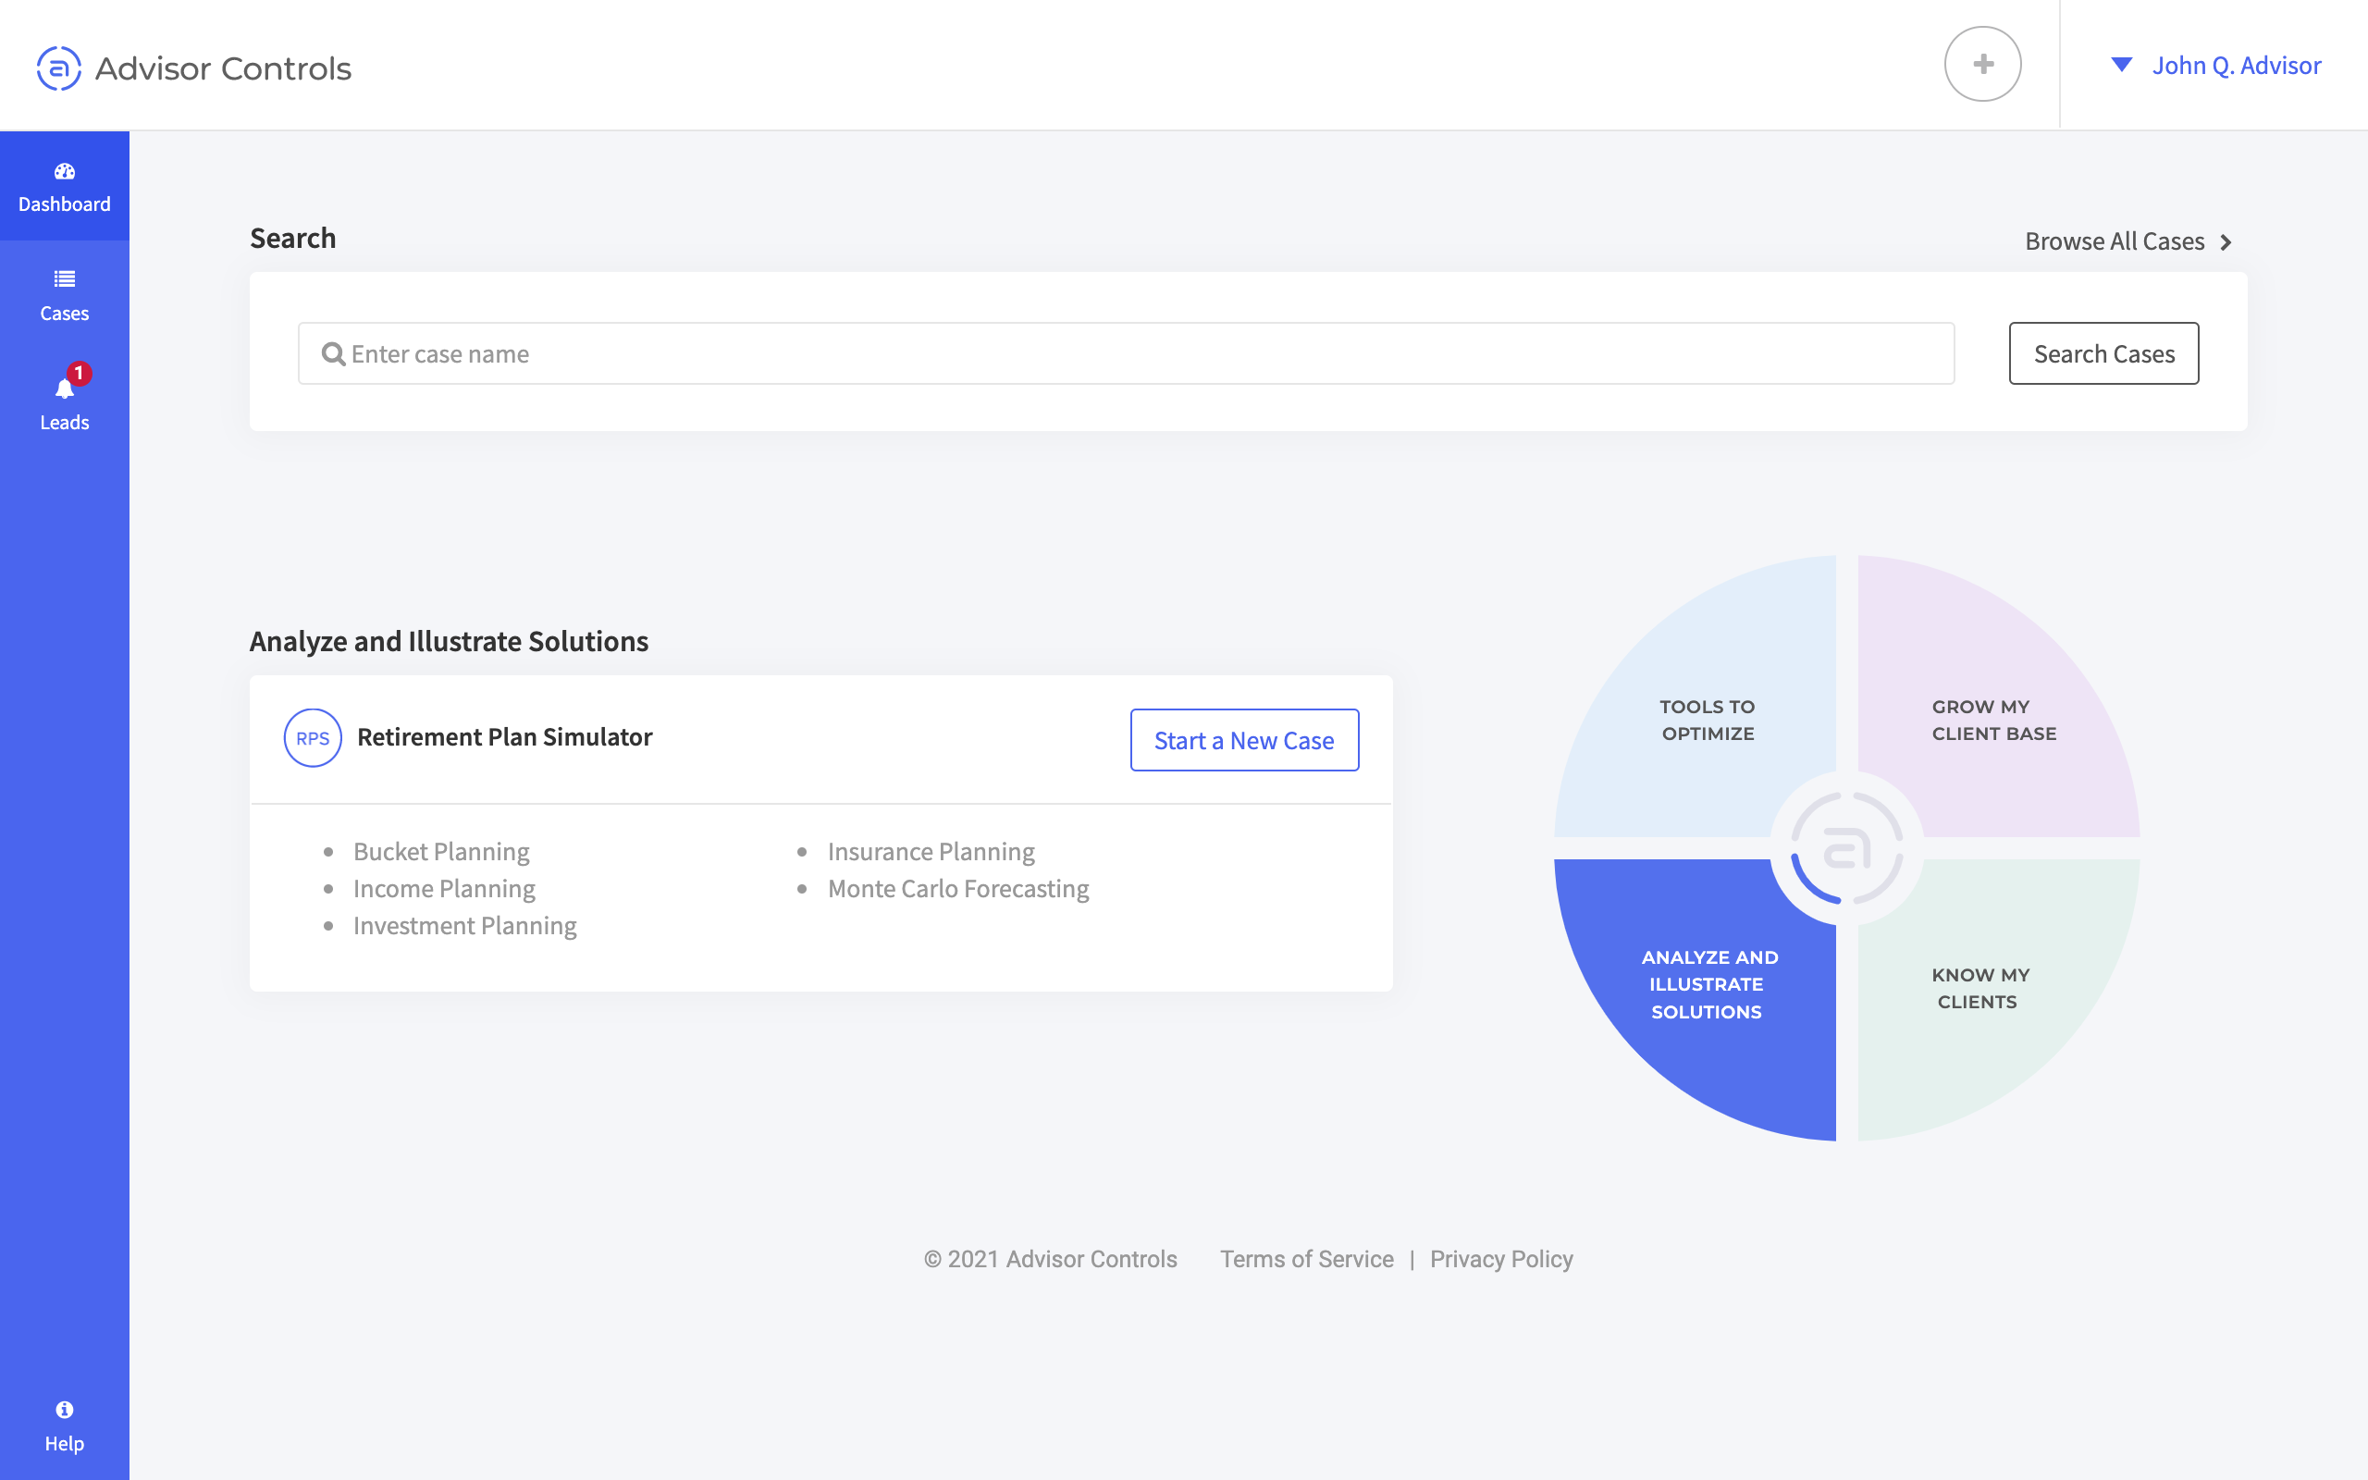
Bring your retirement reality to life
Establish the current plan
Build the proposed plan
Compare side-by-side
Provide easy-to-understand presentations

Slide 11
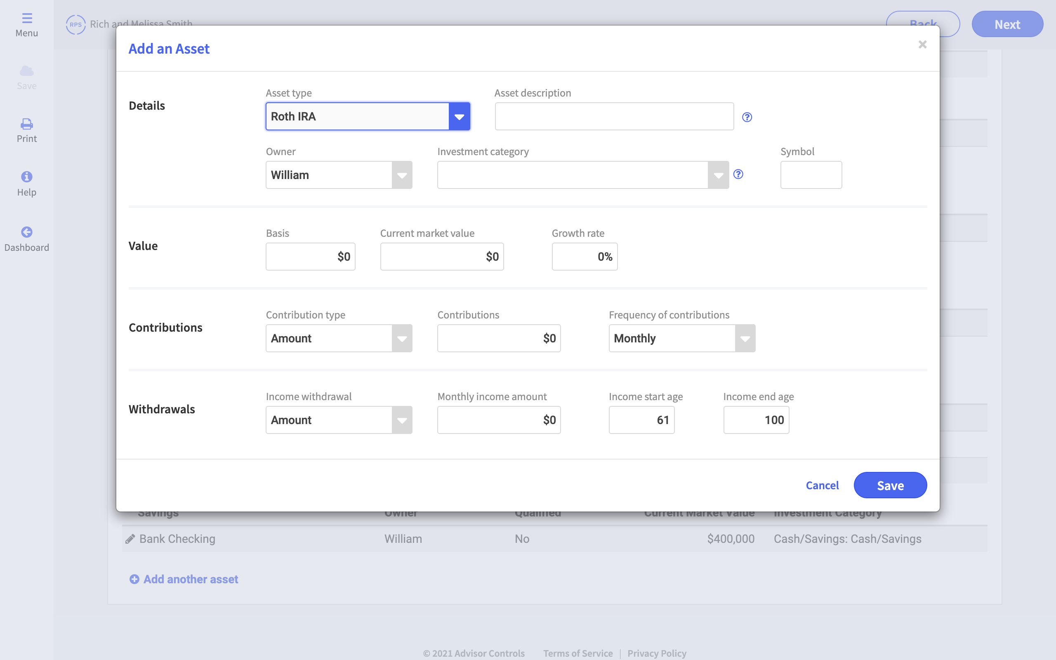
ENTER DATA
Construct a plan in less than 15 minutes
Enter basic information
Income sources
Expenses
Assets

Slide 12
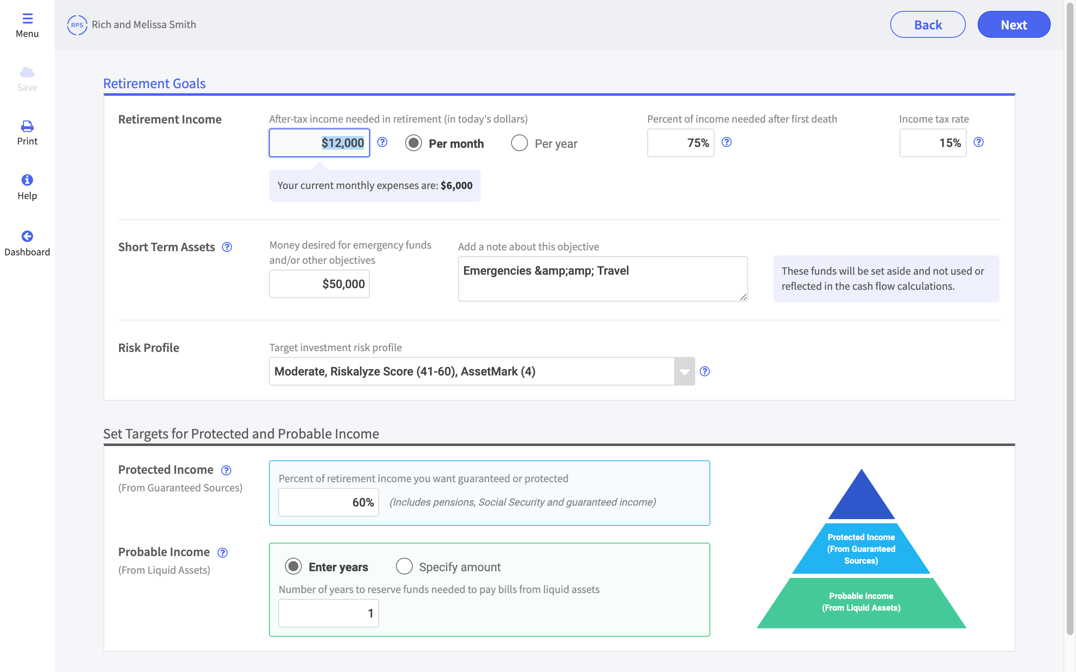
SET GOALS
Set retirement income targets and goals
Retirement income goal
Protected income goal
Probable income goal
Short-term asset goal

Slide 13
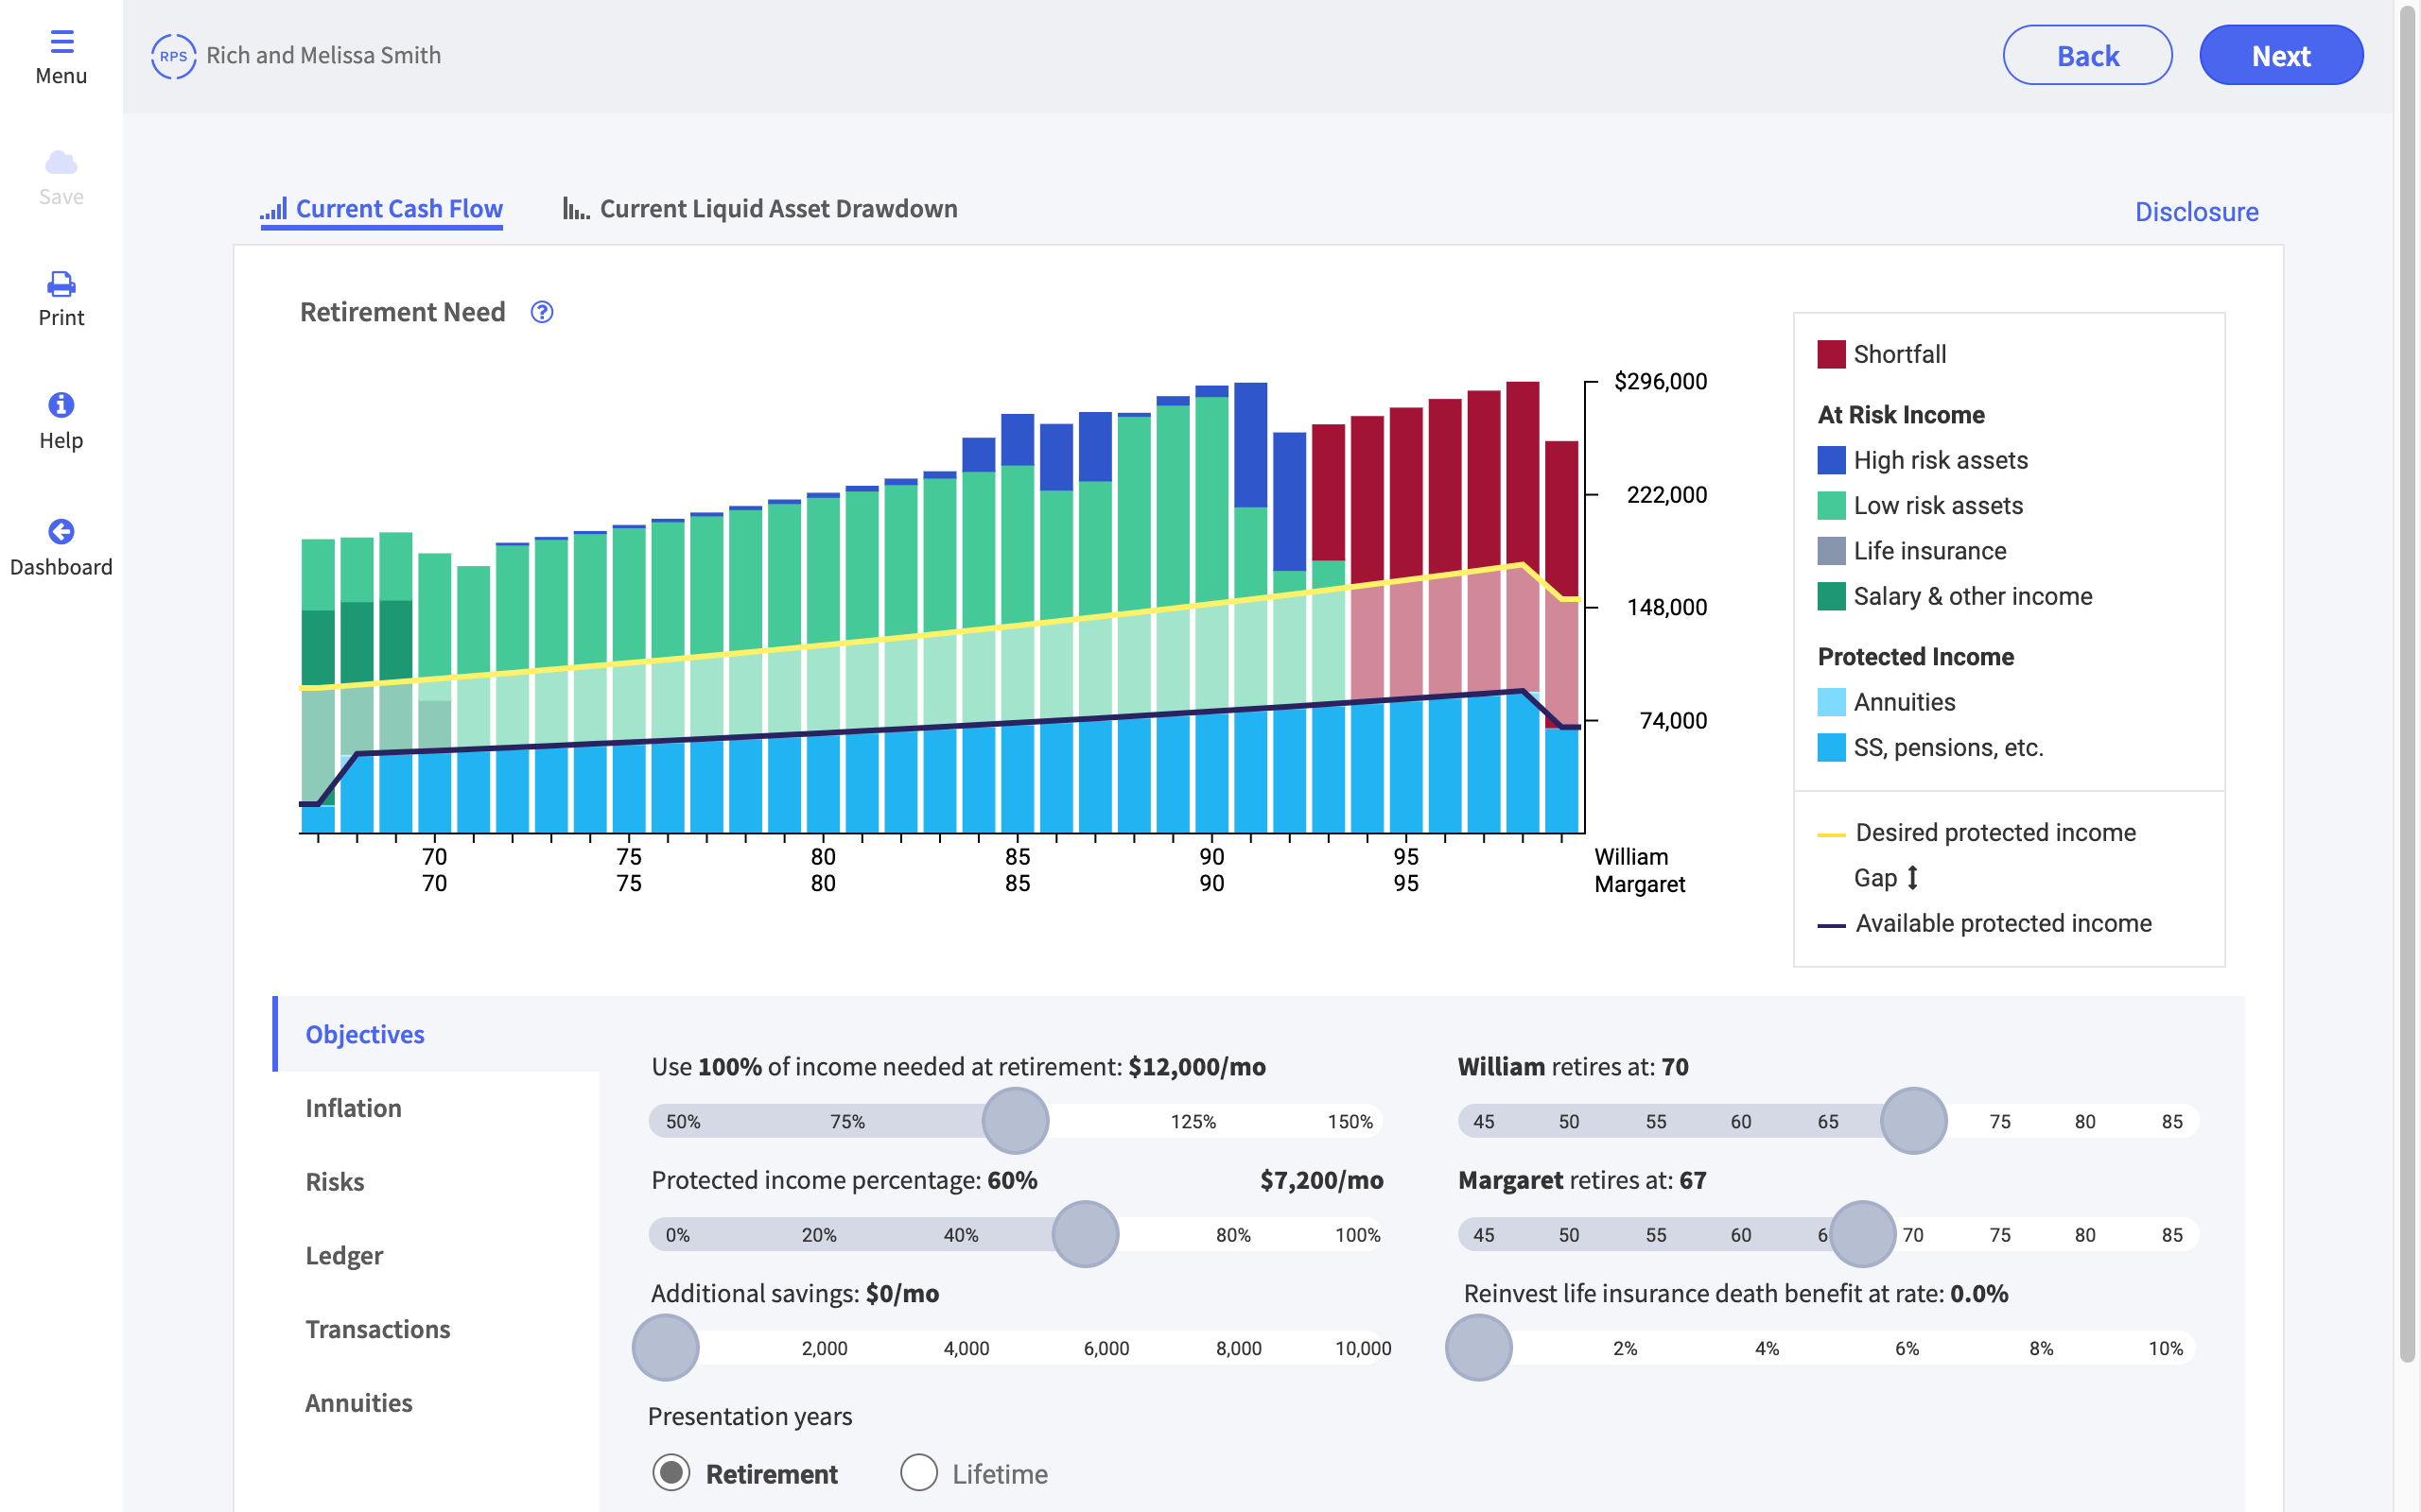
REVIEW
Assess current plan with animated, on-screen graphics
Buckets categorize assets by risk and type
Simulation dials modify targets
Illustrate multiple what-if’s

Slide 14
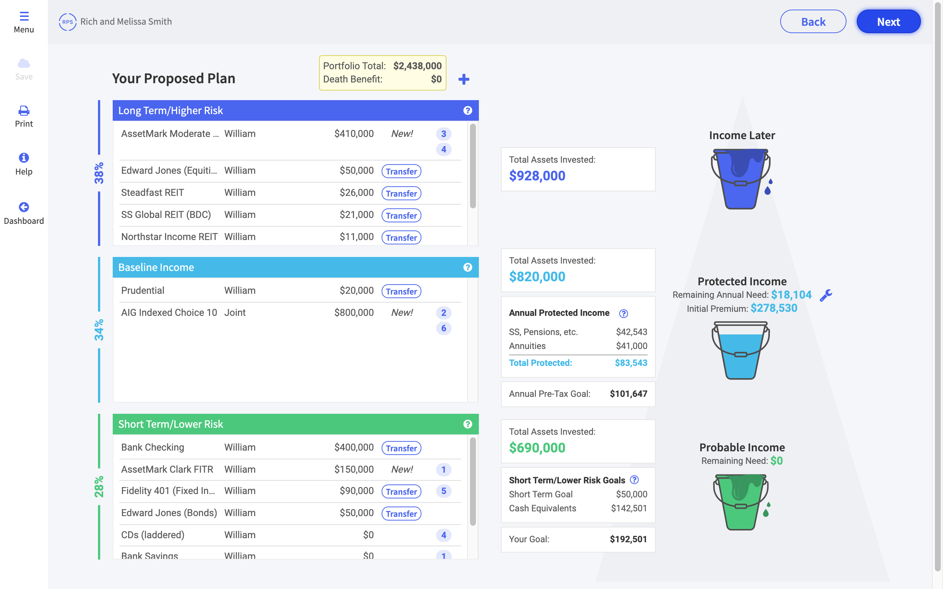
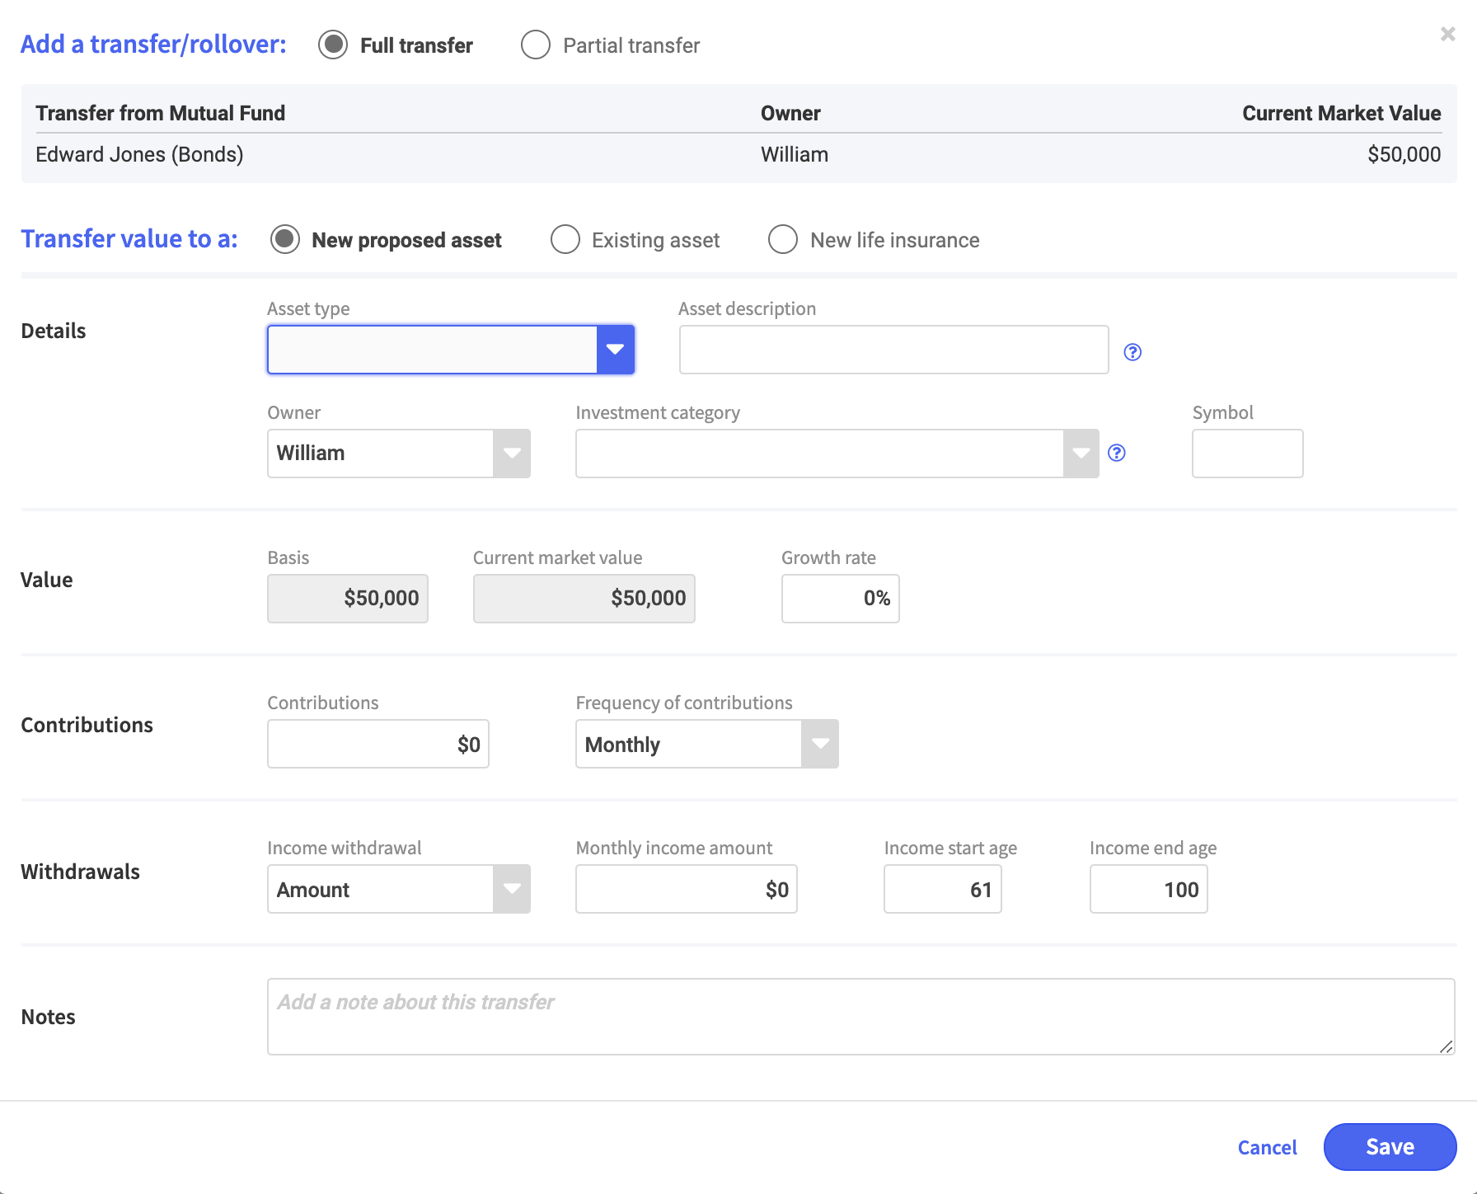
PROPOSE
Propose solutions to maximize retirement income
Transfer buttons easily move assets to recommended buckets
Illustrate full or partial transfers to new or existing assets, annuities, and life insurance

Slide 15
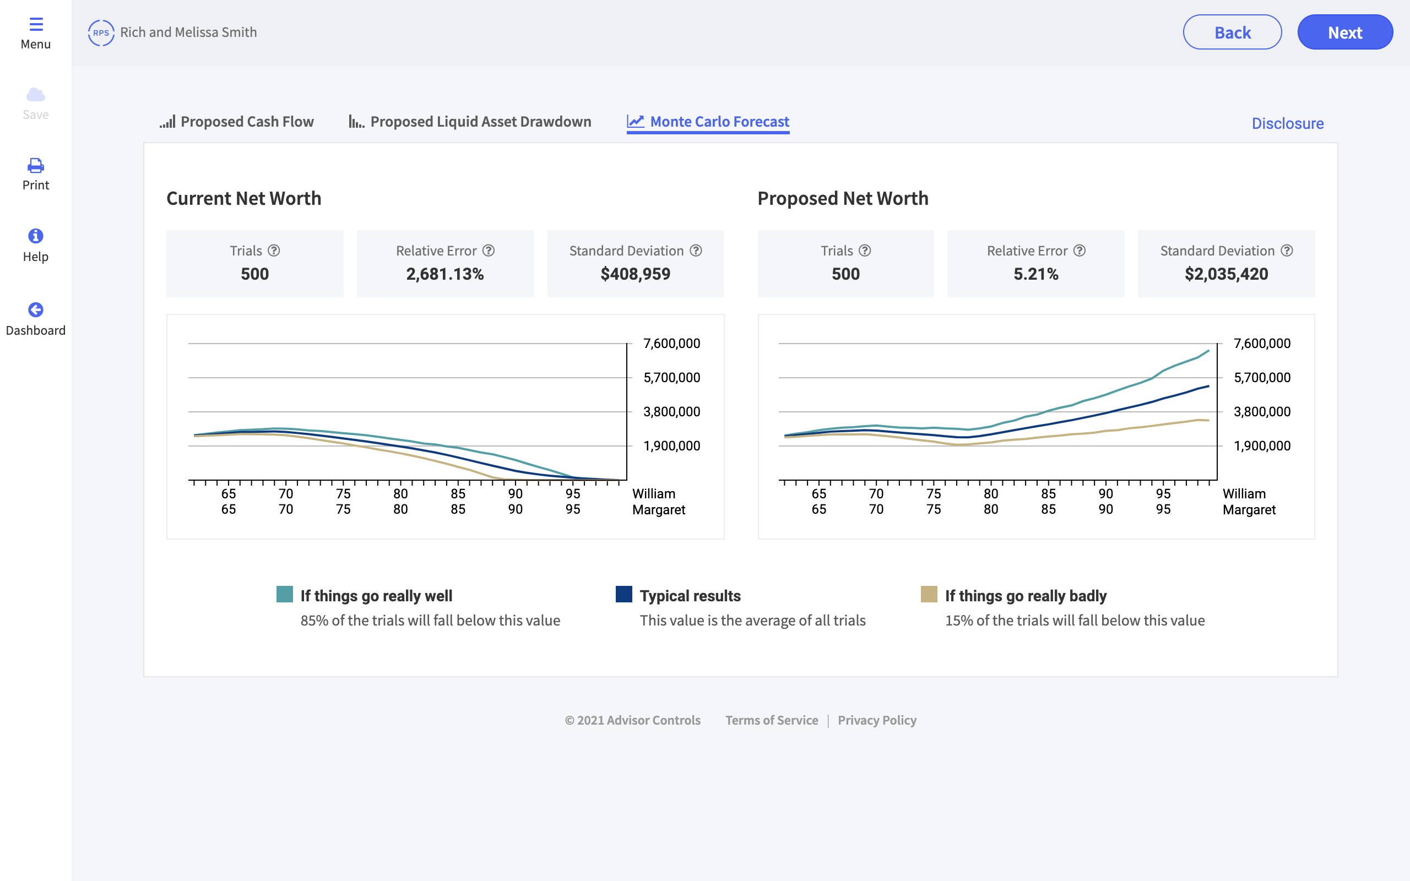
SUPPORT
Compliance friendly features to support Reg-BI requirements
FINRA approved output and screen presentations
Monte Carlo simulations statistically support your recommendations
Include investment rationale notes with recommendations

Slide 16
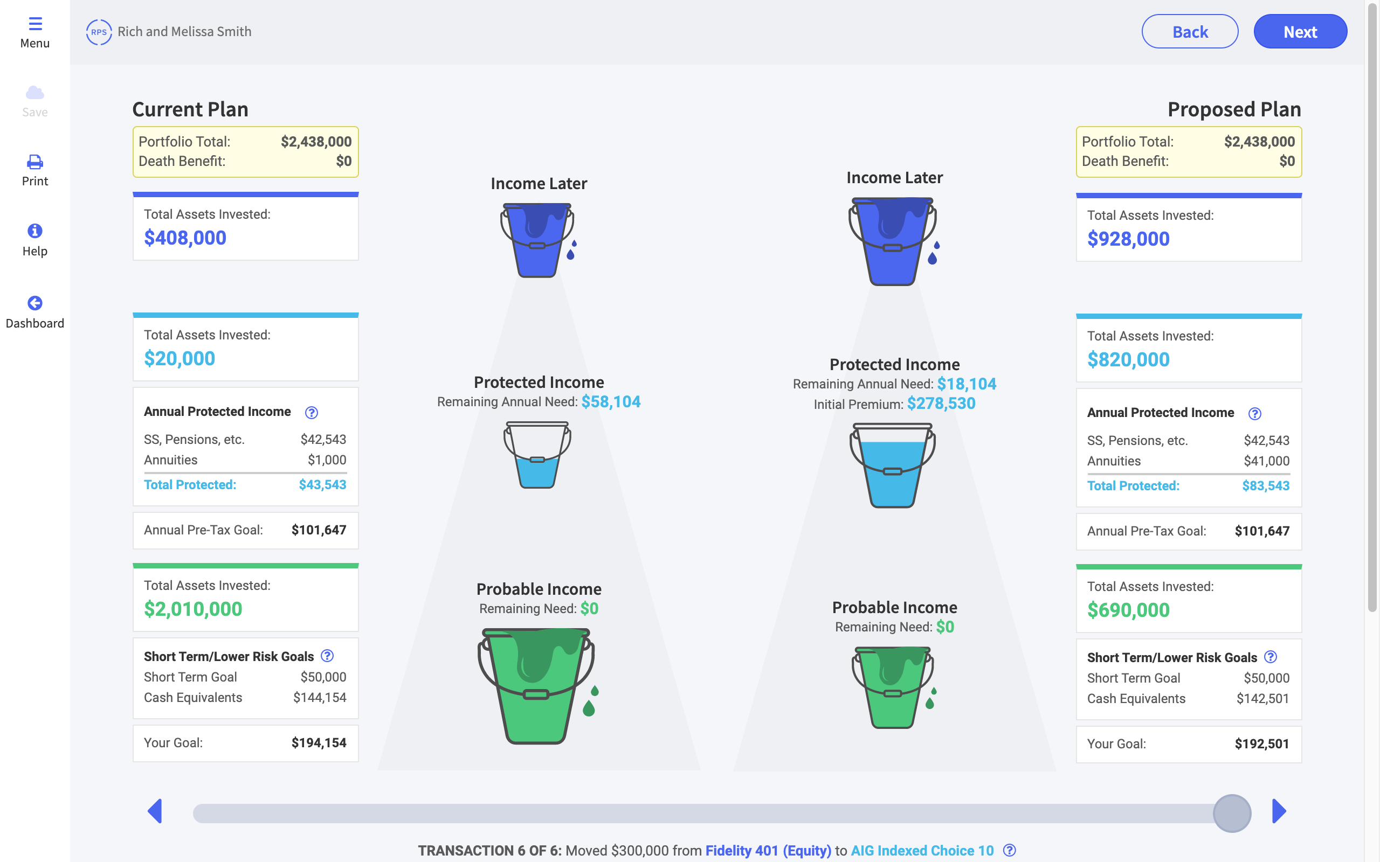
COMPARE
Compare current and proposed plan with
side-by-side summary
Animated, side-by-side visuals
Transfer details and rationale

Slide 17

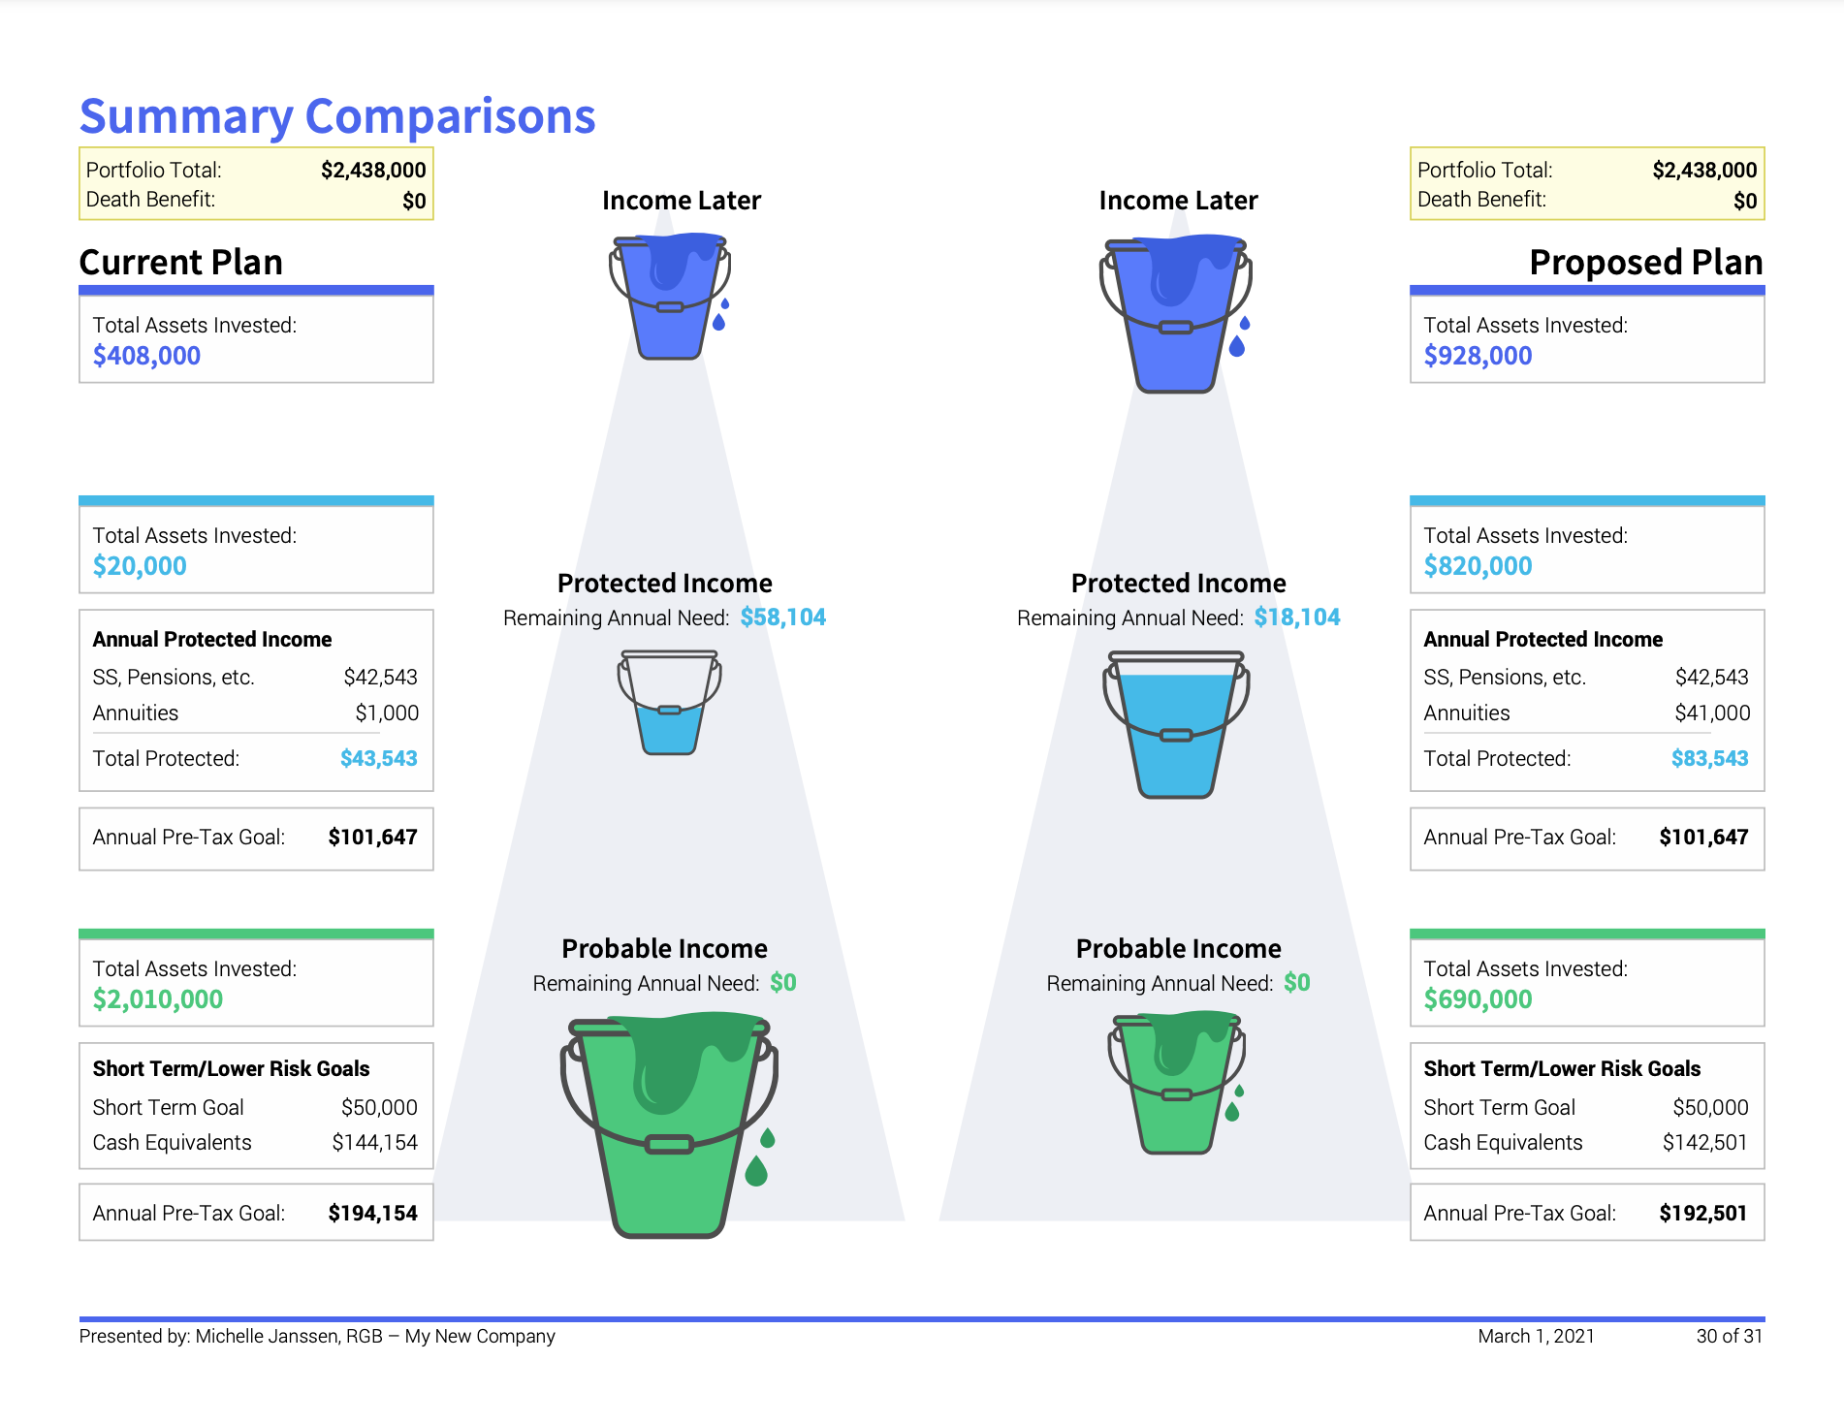
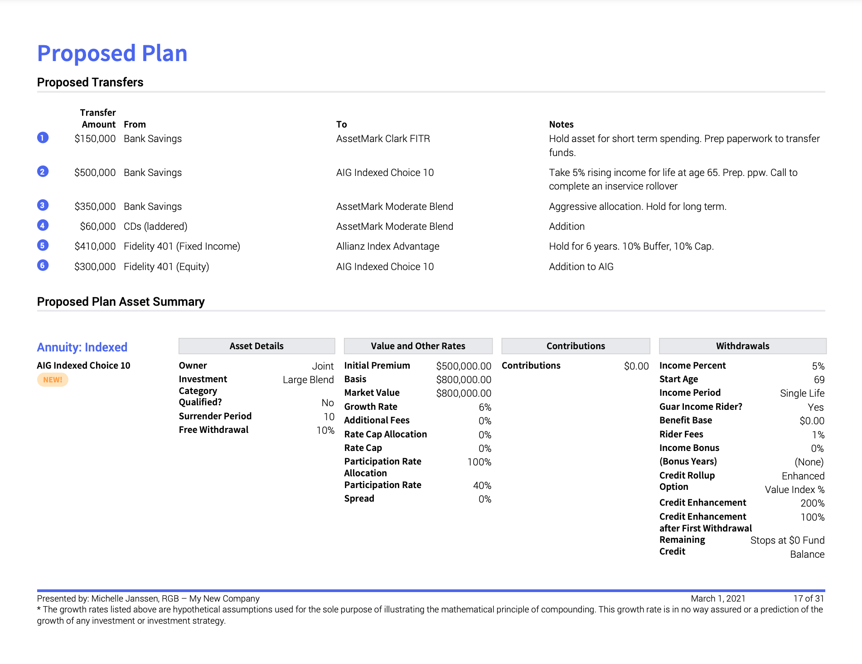
PRESENT
Leave clients with a printed presentation that mirrors the interface
Bullet point recommendations
Investment rationale
Brilliant graphics and simplified data
Custom disclosure information

Slide 18
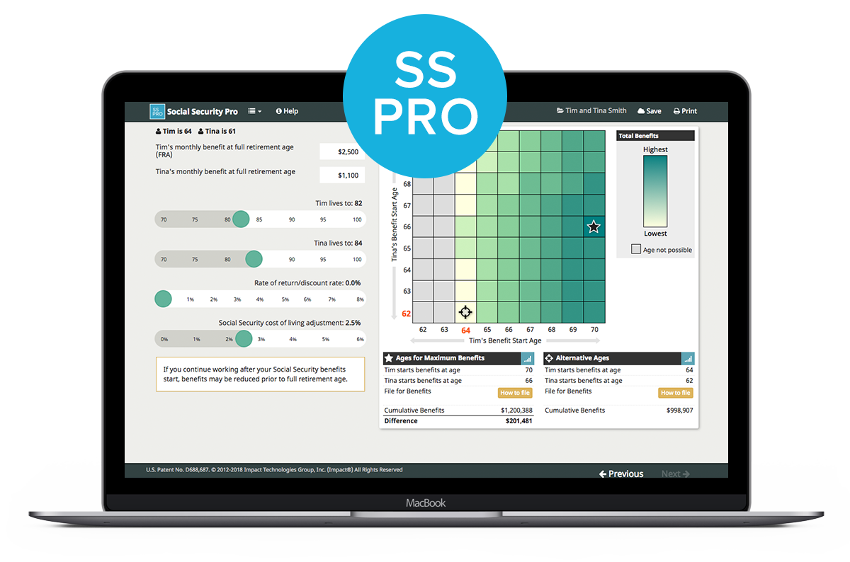



OPTIMIZE
Supporting applications give more planning flexibility
Optimize Social Security
Goal-based fact finding tool
Maximize qualified plan contributions
Estate planning concepts

Slide 19
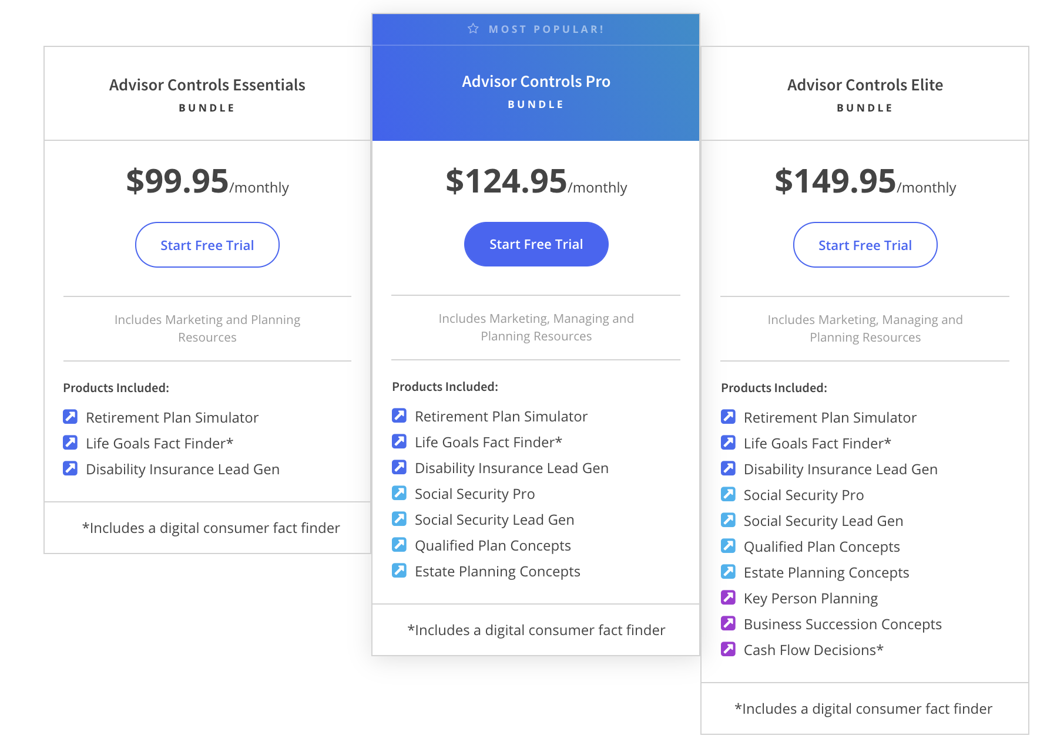
14-DAY FREE TRIAL
Try Advisor Controls Pro risk-free for 14 days

Slide 20
WWW.ADVISORCONTROLS.COM | (309) 650-1125 | SUPPORT@ADVISORCONTROLS.COM
Notes:
The hierarchy of income planning™ is a methodology that mirrors Maslow‘s hierarchy of needs, where portfolio construction begins with the types of investments that provide predictable and probable streams of income to help meet the target income need.
This presentation has been designed to create awareness, as to the various risks we are likely to face in retirement, while also introducing fiduciary-based methods and tools that will help to provide a clear path as to the types of investments that may need to be leveraged in an effort to maximize planning outcomes.

